Slide 1
pCM assembly duration at CAF-MP9 cleanroom
Cleanroom work: September 24, 2015 – January 28, 2016
Cold end couplers - Actual: 8 work days
Cavity string assembly - Actual: 16 days
Explanation:
Quality problems with copper plated beamline components delayed the completion of the string assembly ~4 months.
Short end spool and 1 interconnecting bellows were disassembled from the string after latent copper plating defects were found on the same batch parts. Cav#1 and Cav#2 are the cavities which might be adversely affected due to this issue.

Slide 2
pCM cavities as assembled into the string

Slide 3
Cold End coupler assembly traveler (464176) for pCM
Note that TB9AES028 was tested in HTS, failed the test:
Back to CAF-MP9 cleanroom for FPC cold end disassembly
Cavity is high pressure rinsed
Tested at VTS as dressed cavity
Delivered to CAF-MP9 for cold end coupler assembly (CP3C99) [same cold end FPC used during the first HTS test] and then string assembly

Slide 4
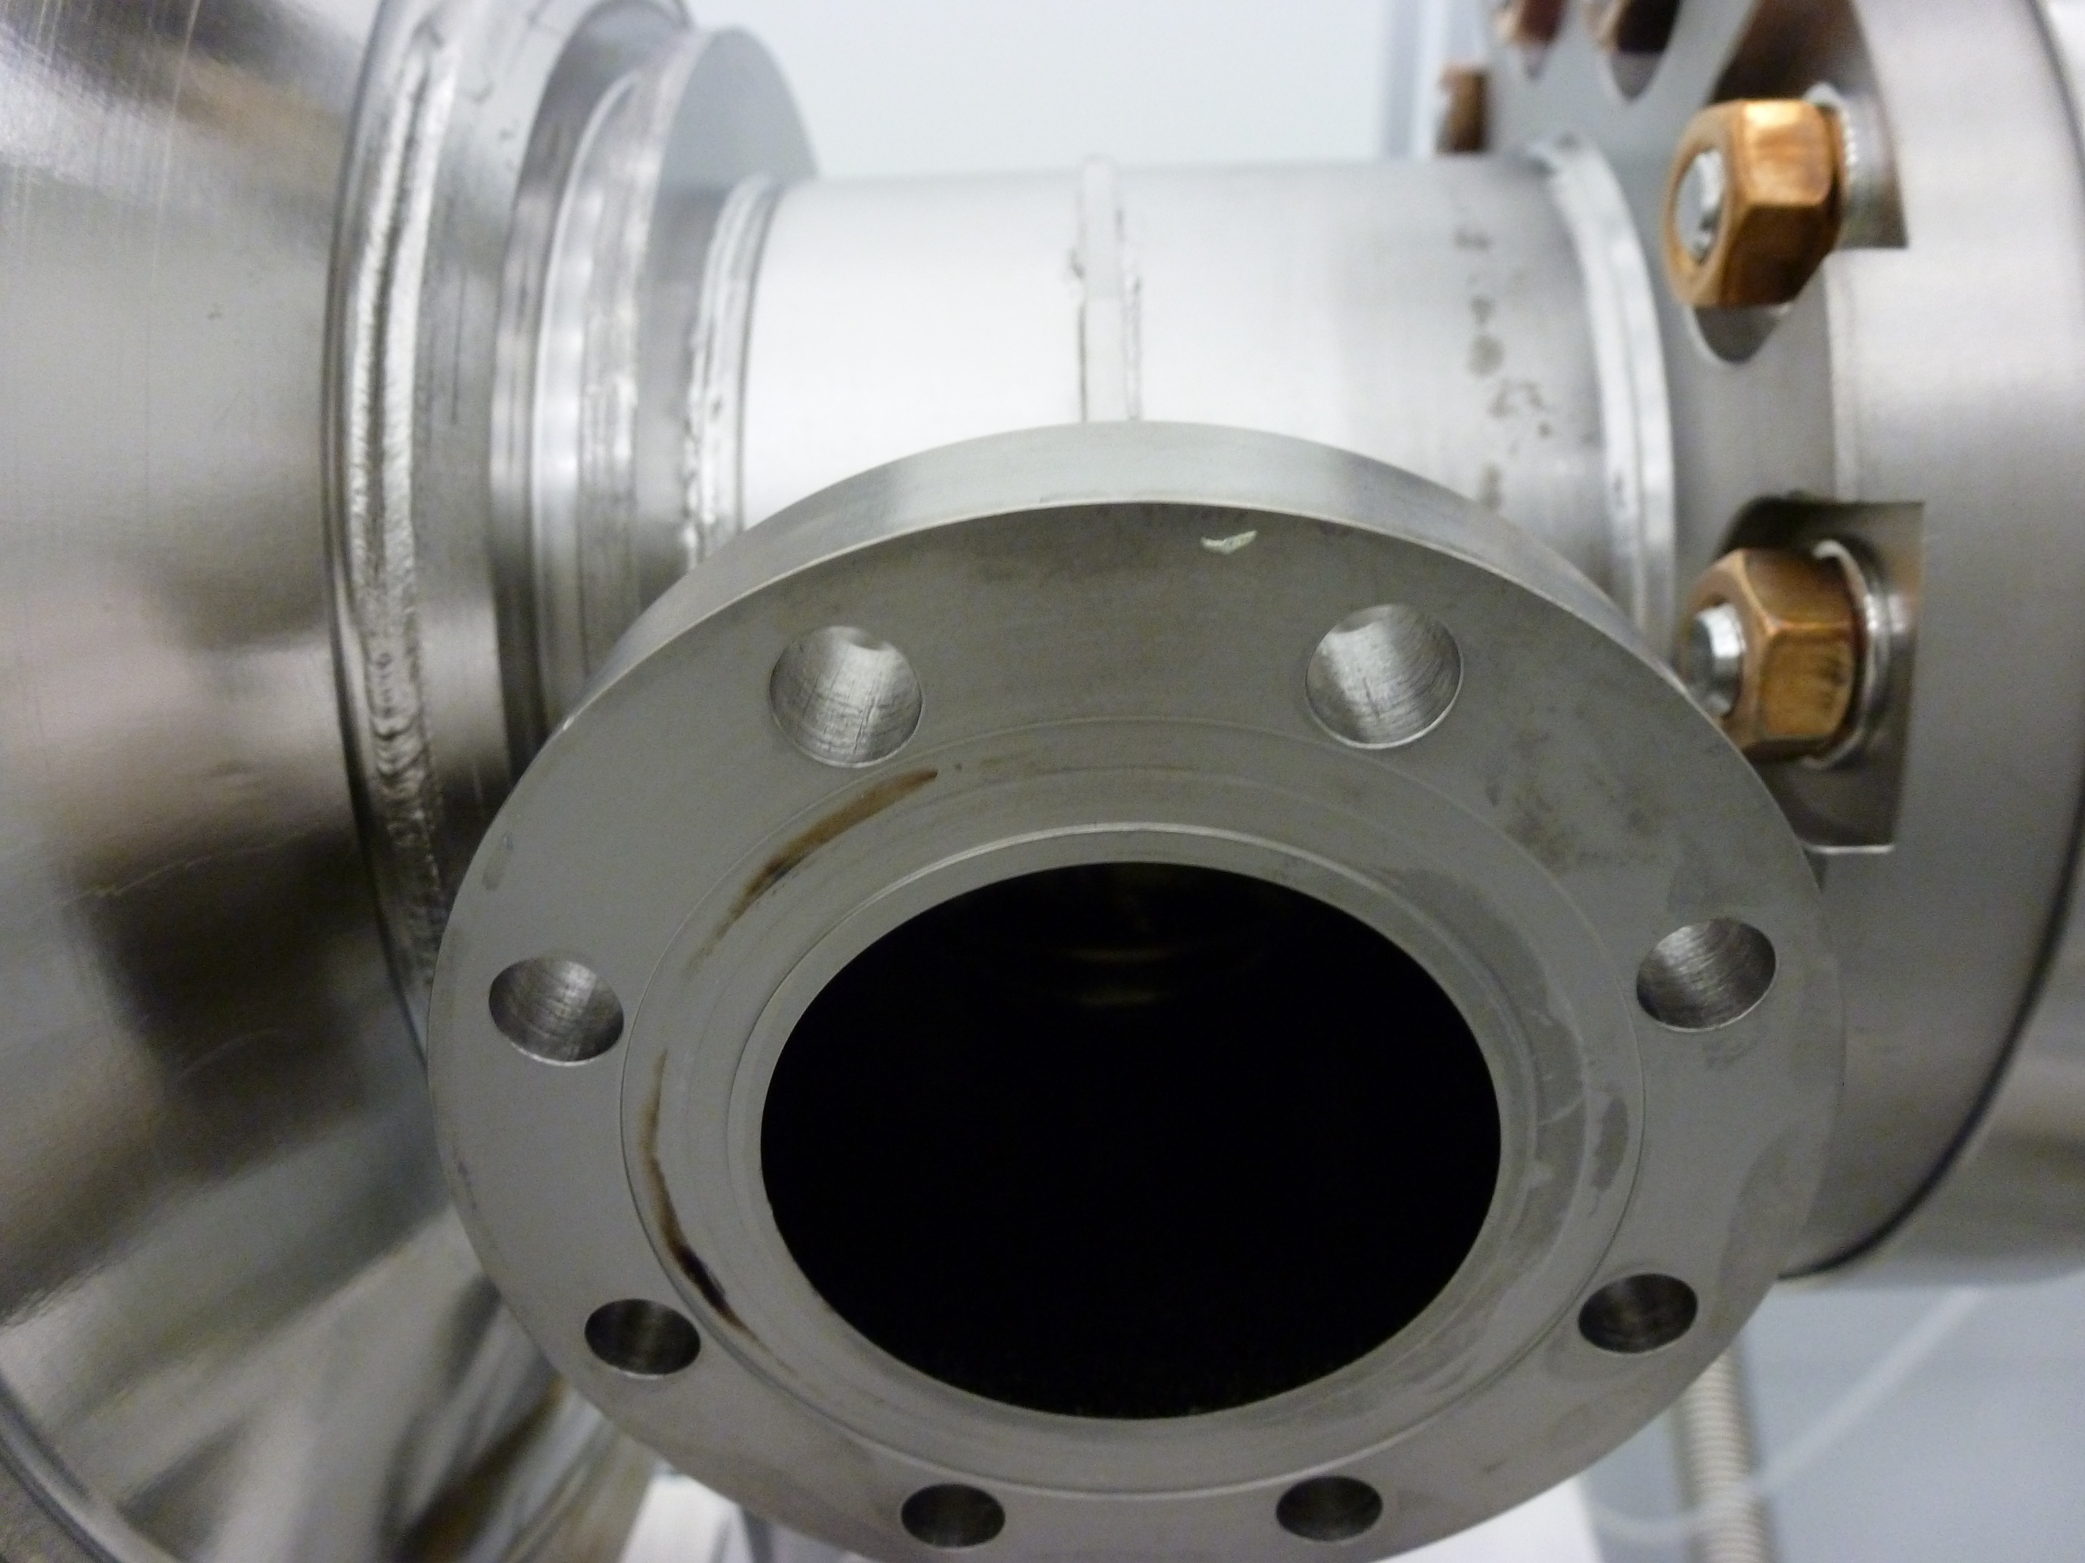
DRs for 464176 for all 8 cavities
Cav#8, TB9AES027: 3 DRs
Cav#6, TB9AES016: 1 DR
Cav#3, TB9AES026: 2 DRs
Cav#2, TB9AES019: 3 DRs
Debris on the flange face
Looking at the DRs, sticky notes, assemblies of 8 cold end FPCs went as expected per the procedures. Minor issues (such as right angle valve on the cavities were installed with not optimized angle etc.) were reported, I do not expect any of these will be the obvious root cause of the FE problem

Slide 5
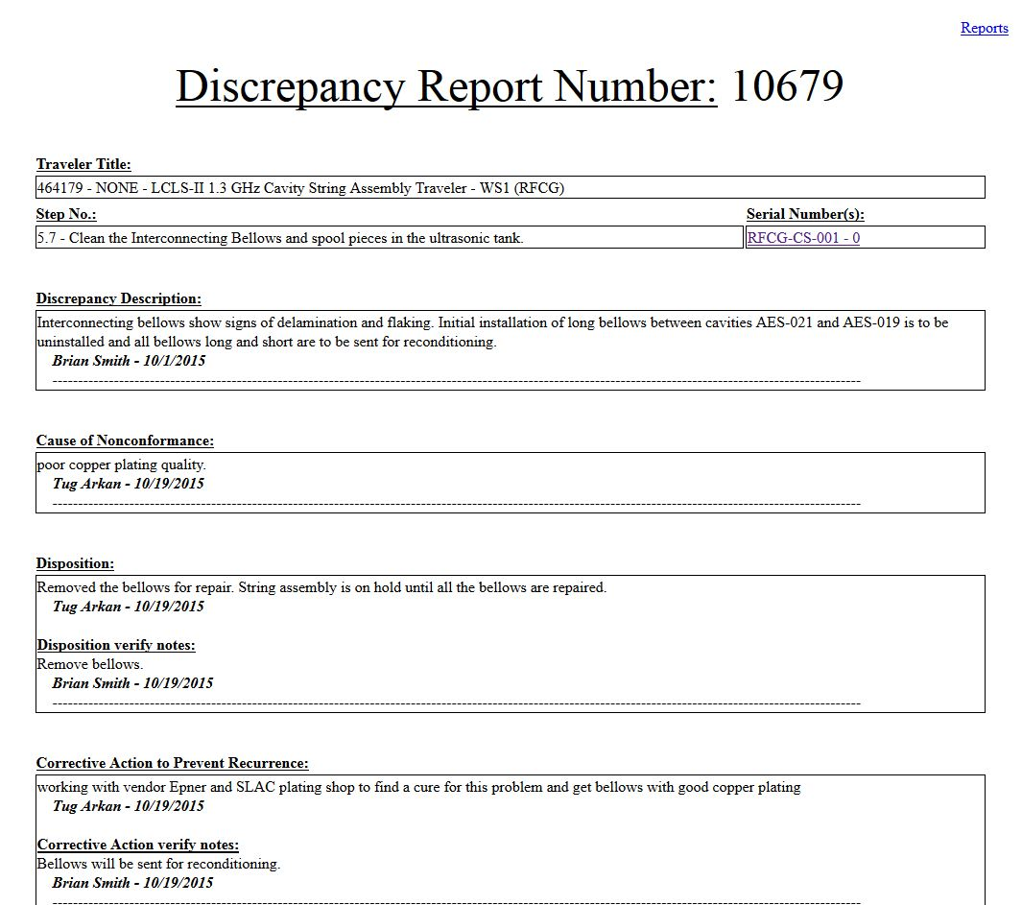
Cavity string assembly traveler (464179) for pCM
Only 1 DR was written which explains the disassembly of the short spool piece between Cav#1 and Gate Valve and also long bellows between Cav#1 and Cav#2.
We did not observe any flaking on the actual copper plated components but same batch deliveries at JLab showed major issues therefore we decided to perform the disassembles
Looking at the DR, sticky notes from the traveler, talking with cleanroom team; string assembly went as expected per the procedures.

