Slide 1
pCM Cleanroom String Preparation
pCM String Assembly Workshop
January 12, 2017

Slide 2
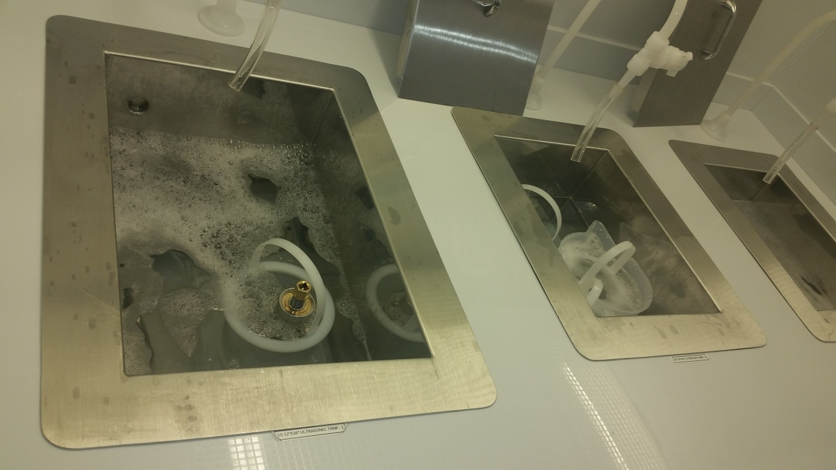
Parts Preparation (UHV Cleaning)
Parts are wiped down with Micro 90 first if needed. Parts are then put in Ultra Sonic tanks with 1% to 2% Micro added for 50 minutes and 130 F. Parts are separated by material.

Slide 3
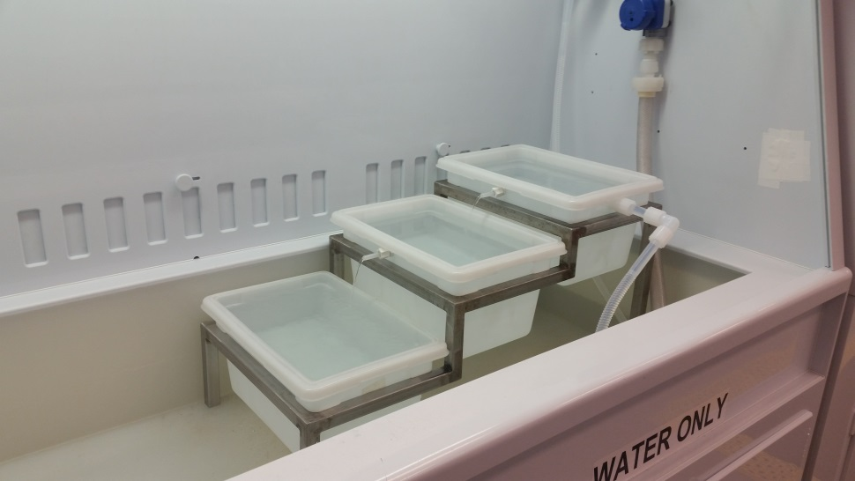
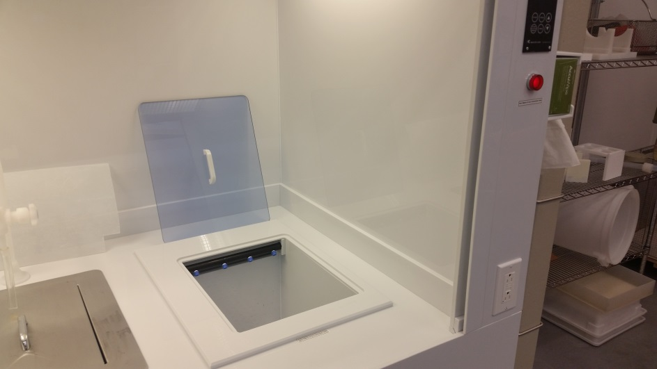
Parts Preparation (UHV Cleaning)
After Ultra Sonic the parts are triple rinsed.
Either in the triple flow or cascading triple rinse.

Slide 4
Parts Preparation (UHV Cleaning)
Parts are then laid out in the laminar flow hood to dry.

Slide 5
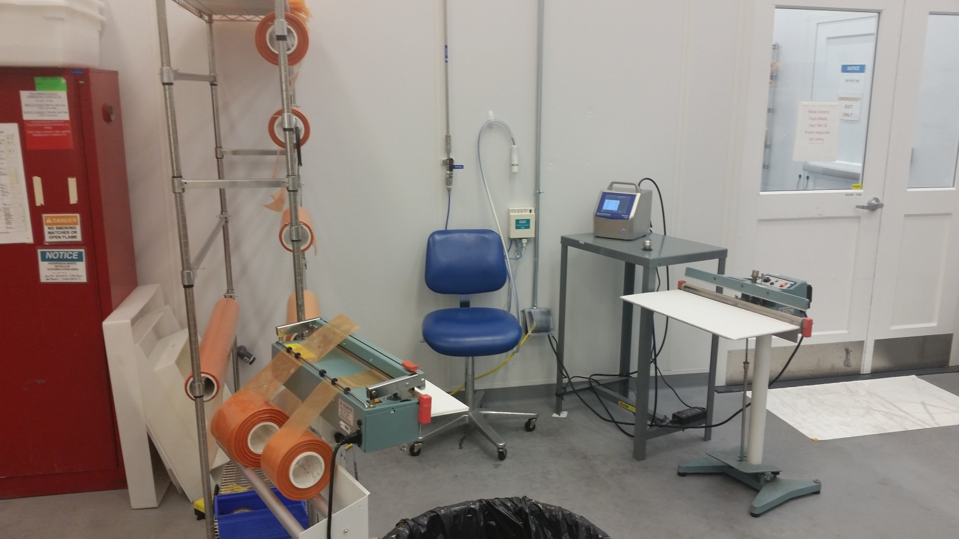
Parts Preparation (UHV Cleaning)
After hardware is dry it is blown off and bagged

Slide 6
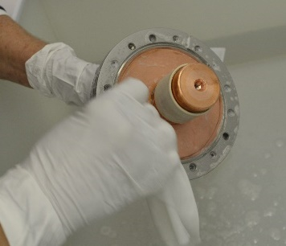
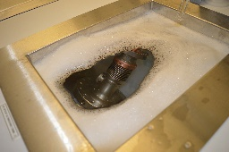
Coupler Prep
The coupler was first wiped down with Micro 90 and an Alpha Clean Room Wipe.
The next step we put the coupler into an ultra-sonic tank with 2% Micro 90, no heat and 20% power on the ultra-sonics. The coupler stayed in the ultra-sonic tank for 15 minutes. The coupler was then removed and thoroughly rinsed with the hose and a water bottle in the water sink. When we saw no more soap bubbles, the coupler was vigorously dipped in the first bin of the triple rinse. If no soap bubbles are visible, the coupler is dipped again in the other two bins, then submerged in a bin filled with clean Acetone.

Slide 7
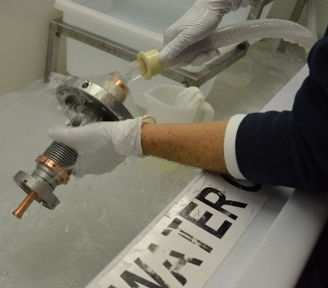
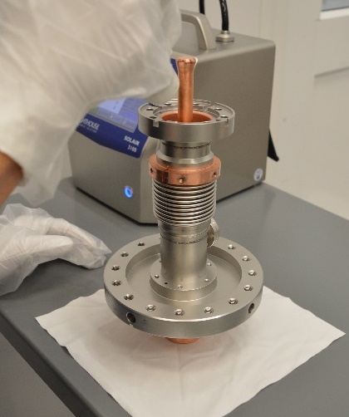
Coupler Prep

Slide 8
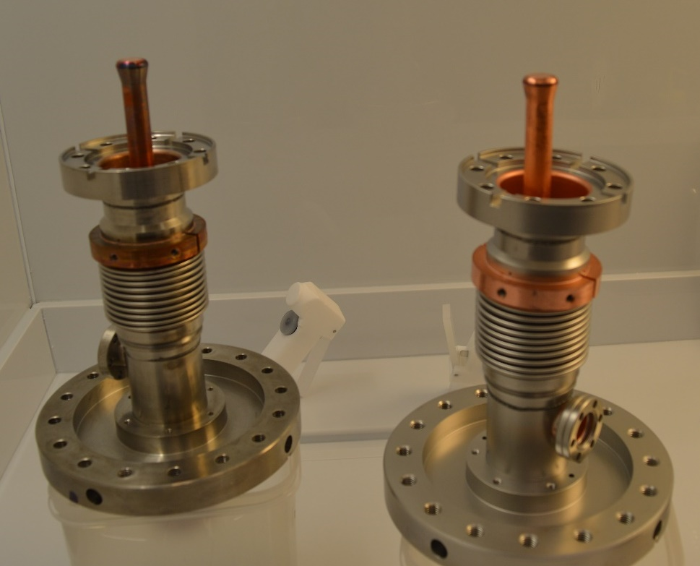
Coupler Prep
Before and after.

