Slide 1
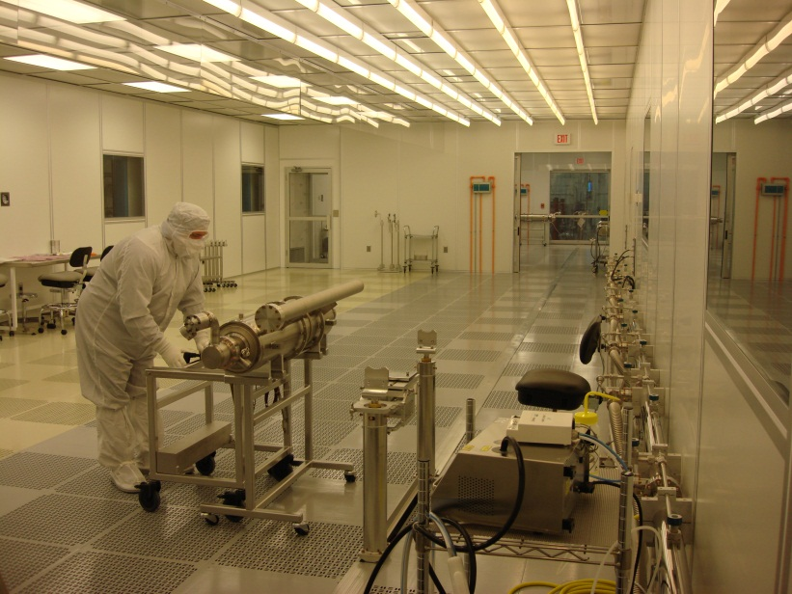
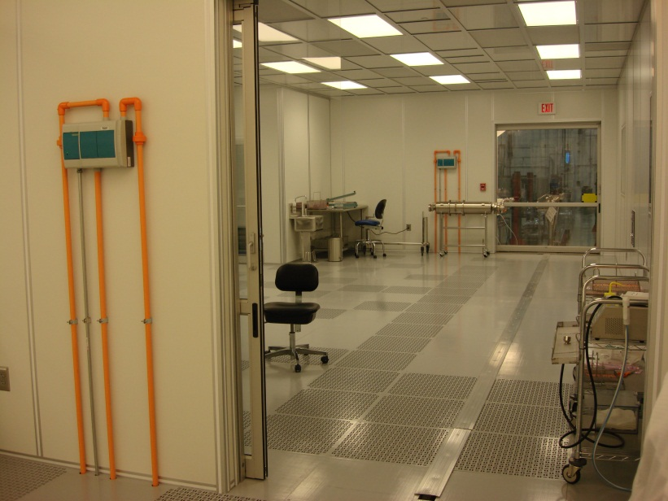
CAF-MP9 Clean Room
Cavity String Assembly Clean Room
A ~2500 square-feet clean room:
Class 1000 (ISO6) ante clean room area (36 ft. x 24 ft.)
Preparation of the dressed cavities for transportation into the assembly clean room.
Class 100 (ISO5) sluice area
Parts and Fixtures final preparation to enter the Class 10 assembly area.
Class 100 (ISO5) area ( 60 ft. x 12 ft.)
Parts and Fixtures preparation for assembly.
Class 10 (ISO4) assembly clean room area (60 ft. x 12 ft.)
Where the cavities vacuum is vented to interconnect them with bellows.
Class 100
Class 10
Class 1000
Rail

Slide 2
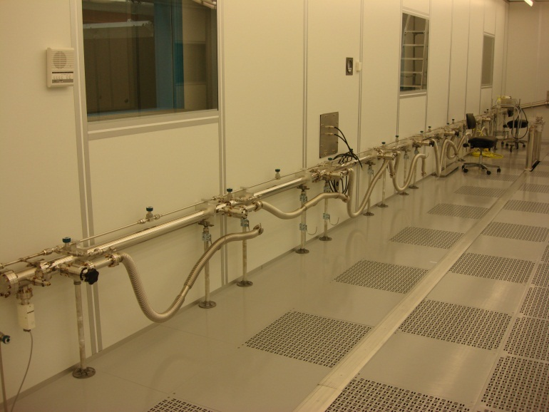
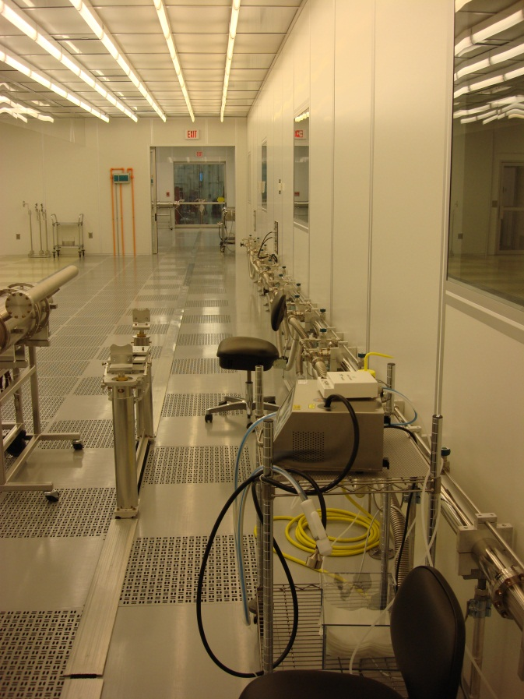
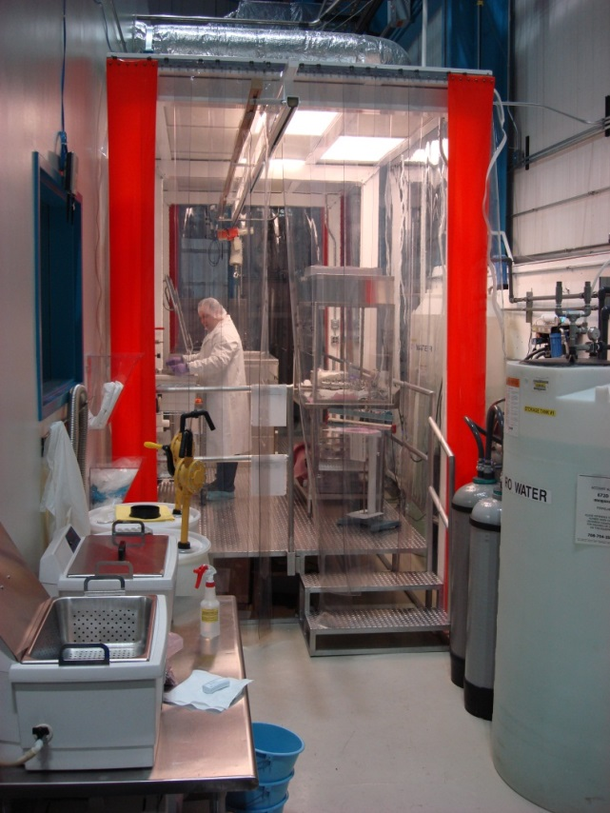
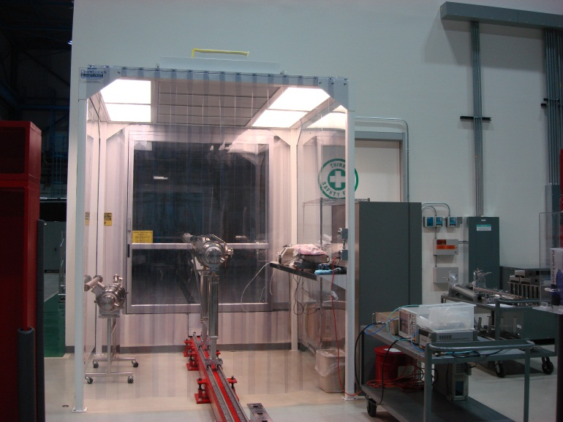
Cleanroom Infrastructure
Vacuum / Gas Manifold
UHV cleaning area
Class 1000 cleanroom for the dressed/qualified cavity preparation to enter the cleanroom

Slide 3
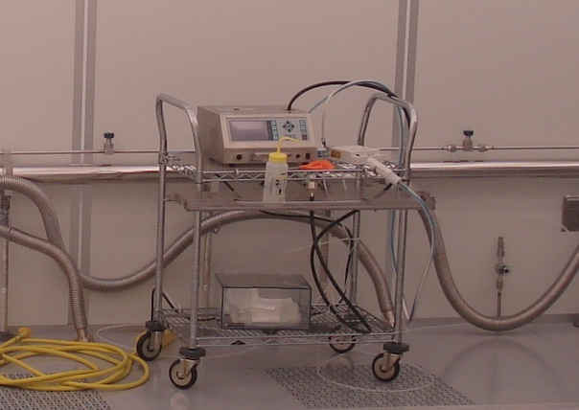
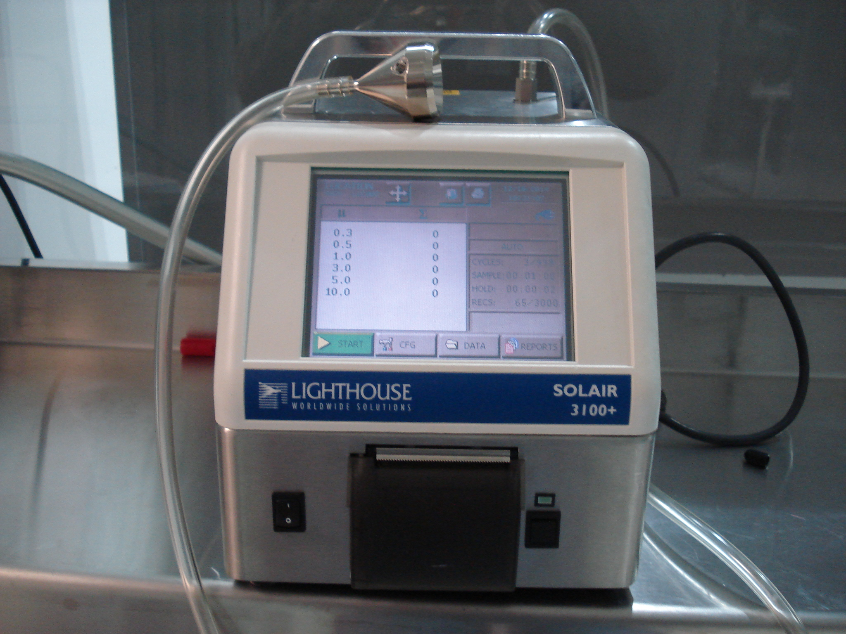
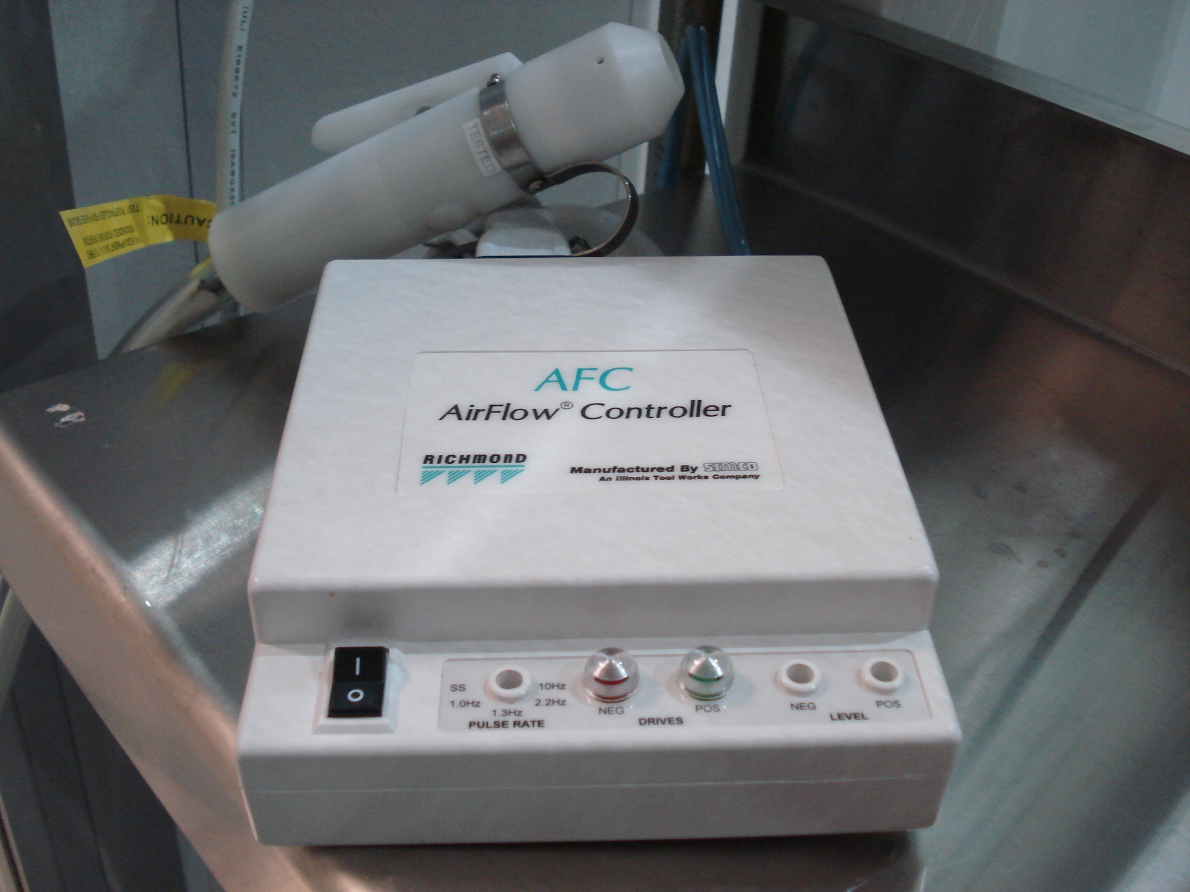
Critical Equipment for Particle Free UHV Assembly
Particle Counters: Met One 3313 (3), 4313 (1), Lighthouse Solair 3100+, calibrated annually (date monitored by TD Process Eng)
Blow guns: Richmond AFC Airflow Controller manufactured by Simco. Change filters as needed

Slide 4
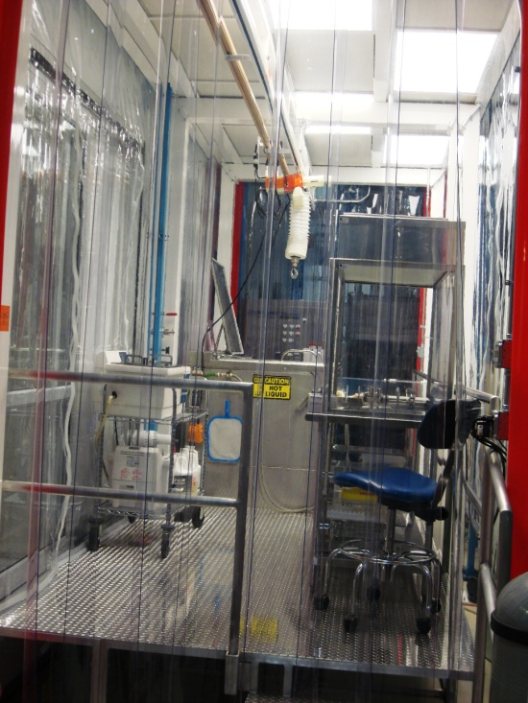
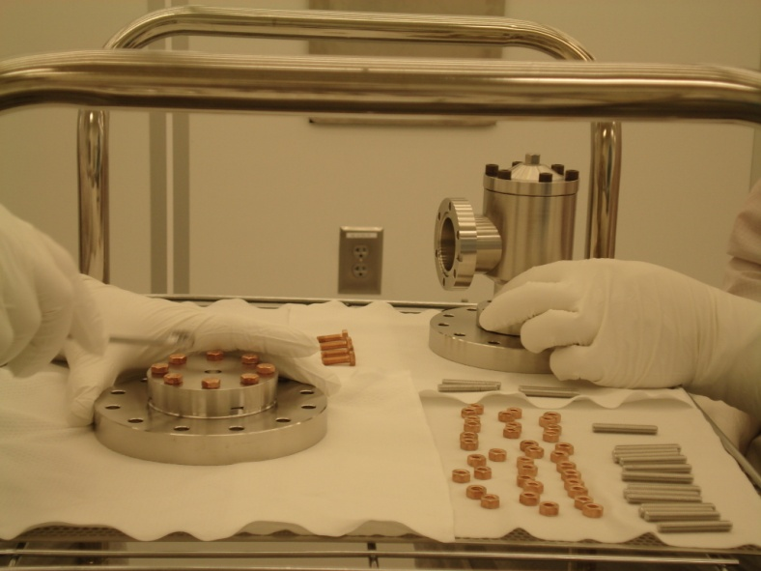
Particle free UHV Cleaning
Cleaning Procedures for stainless steel, titanium, copper and niobium components (not controlled documents, posted in the UHV cleaning area)
Wash/rinse in the ultrasonic baths (1 Stoelting, 3 Branson) with DI water (Crossbow). Operating procedures for ultrasonic baths are not controlled documents and posted on the equipment.
Dry under the Class 10 hood
Transport into the Class 1000 ante clean room
Blow clean with ionized nitrogen while monitoring the particulates count in the Class 100 sluice area
Transport into the Class 10 assembly area
Class 10 Hood
Class 1000 cleanroom
US cleaner

Slide 5
General UHV Cleaning Procedure at CAF
Simple Green, 3% solution, 20 minutes
DI water rinse
Micro90, 2% solution, 15 minutes
DI water rinse
99.9% pure Isopropyl alcohol rinse
Blow dry with boiled off liquid nitrogen gas
Leave under Class 10 cleanroom hood to dry thoroughly

