Slide 1
FNAL pCM Cryogenic System
Jay Theilacker
pCM Testing Review Workshop
January 11, 2017

Slide 2
Operating Modes
The CMTF Cryogenic system has two methods to achieve 2K operation in the cryomodule test stand
Cryoplant Cold Compressors and Warm Vacuum Compressor
(2K Refrigeration Mode, 500W capacity)
Advantages: JT heat exchanger in plant
Disadvantages: Min. CC flow, Less forgiving, Learning curve
Cryoplant in Liquefier Mode with Kinney Vacuum Pump
(Liquefaction Mode)
Advantages: More forgiving/flexible, Better turndown
Disadvantages: No JT HX

Slide 3
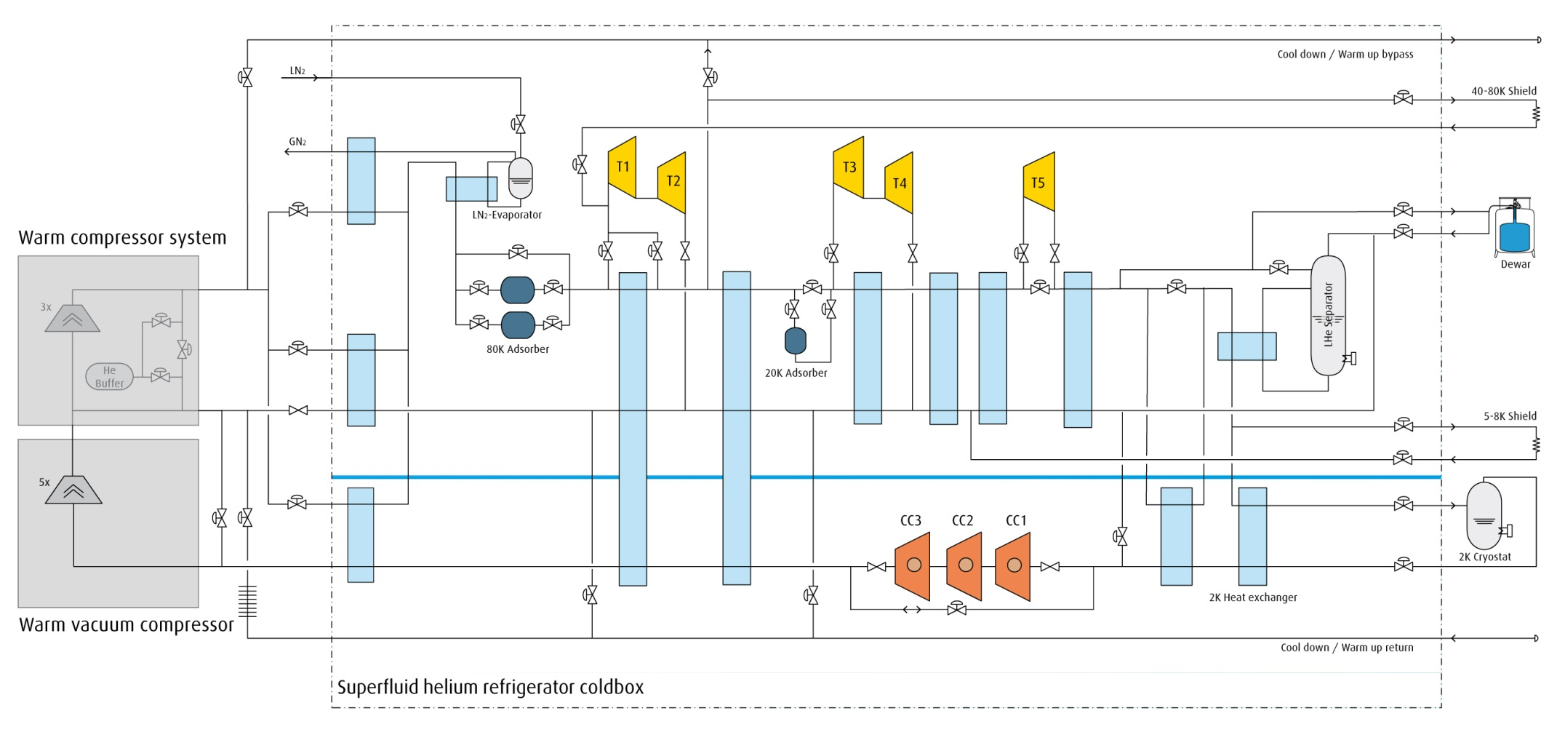
Operating Modes
2K
Load
Kinney Pump

Slide 4
CMTF Layout
Cryo Transferline
CMTS
VB
DB
SCP
Kinney Header

Slide 5
pCM Cryogenic Operating History
2K Plant
Long recovery from CC trips (learning curve)
Anxious for data for CM PRR
4.5K Plant and Kinney Vacuum Pumping
Could only achieve 2.1K due to pressure drop and high flows resulting from the lack of a JT HX
Single cavity tests were performed in this mode
2K Plant
Single cavity tests at 1.93K
Shutdown
Addressed Kinney header ΔP, added LN₂ shield cooling to DB, changed CC drives, changed one control valve, added thermal intercept to CM JT valve, added flow meter to Kinney discharge
4.5K Plant and Kinney Vacuum Pumping
Current mode at 2K

Slide 6
Operational Experiences
Apparent thermoacoustic oscillation (TAO) in CM JT valve
Added thermal intercept, investigating valve stem wiper
High flow rates due to high JT valve inlet temperature (no JT HX and TAO)
Addressing TAO, investigating JT HX possibilities
Liquid level stability in CM was challenging
Four contributors:
incline
Design requirement
high total flow rate
See previous
JT flow injection into two-phase pipe may be disrupting liquid surface
Added baffle to CM2, considering increasing JT line size
apparent flow regime in two-phase pipe not as expected in CMTS
Researching

Slide 7
Baffle at JT Injection

Slide 8
Design for Increased JT Line Size

Slide 9
Operational Experiences
Liquid level can heaters impact level measurement
Limit wattage, primarily use cavity heaters
Microphonics
Tests are in progress to identify sources (Yuriy Pischalnikov talk)

Slide 10
Backup

Slide 11
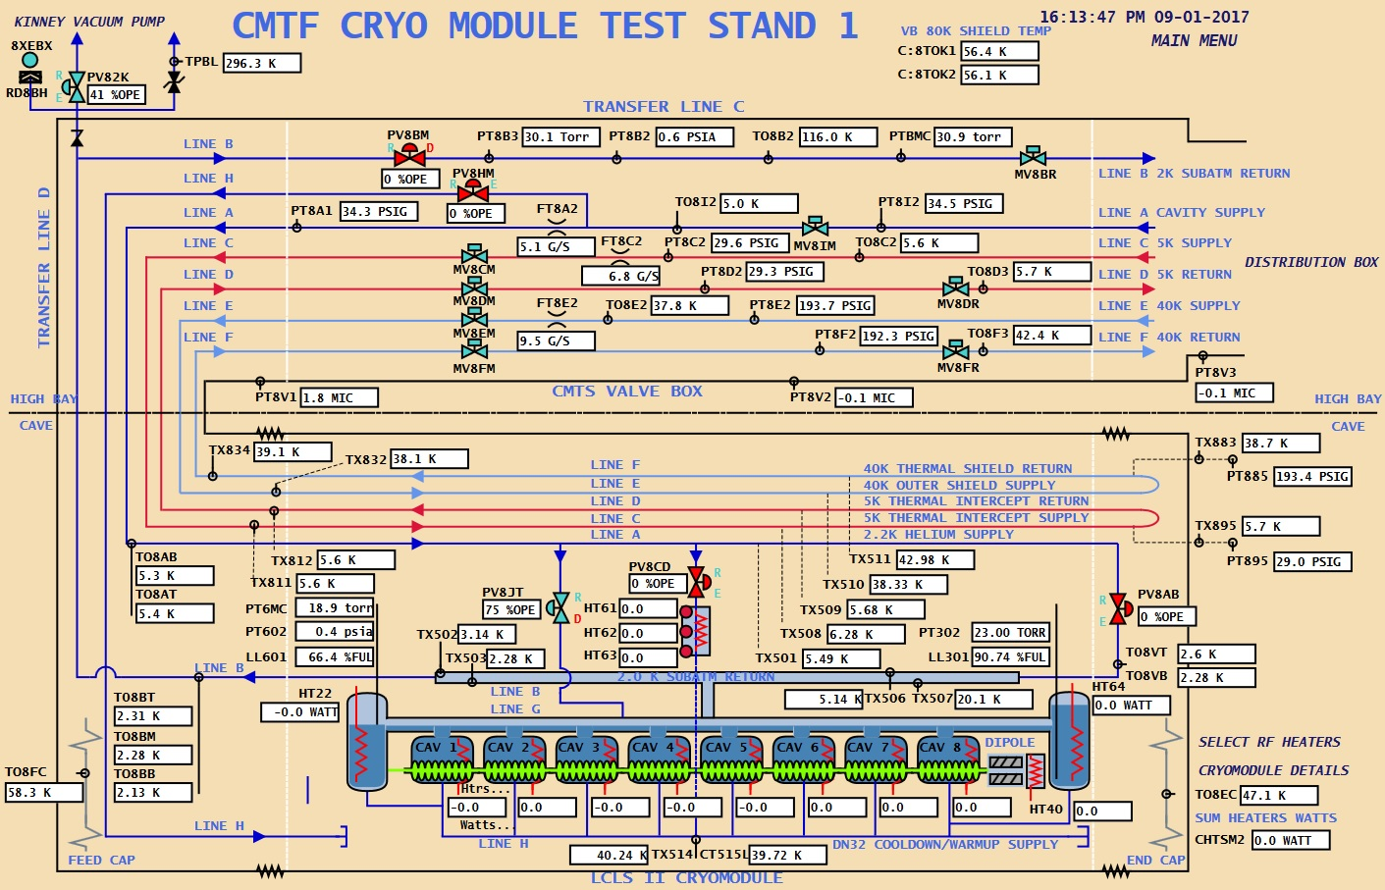
Operational Experiences

Slide 12
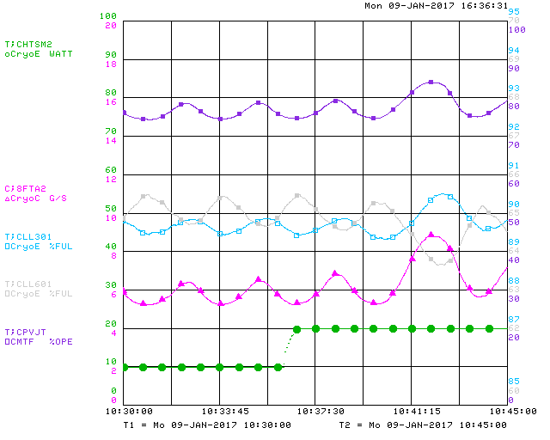
Liquid Level Instability

