Slide 1
JT Valve Outlet Line
Jay Theilacker
pCM Testing Review Workshop
January 11, 2017

Slide 2
JT Valve Addition to Cryomodule
Heat load of CW operation required a JT valve per cryomodule
Tunnel incline required the two-phase pipe to be increased to the largest practical size that would fit in the cryomodule without a 5K shield
A flat liquid surface takes up 60% of the two-phase pipe cross section
This leaves less than ±20% for operational regulation
Based on LHC R&D, it was thought that the liquid surface would be “still” under design conditions
The outlet of the JT valve was routed upstream before injection into the top of the two-phase pipe in order to avoid possible entrained liquid from leaving through the Line B riser

Slide 3
JT Valve Line and Two-Phase Line Observations
Top of JT valve ices up
Thought to be thermoacoustic oscillations
The pCM JT valve did not have a thermal intercept
pCM operation at CMTS has lower liquid quality due to the lack of a JT heat exchanger
Higher vapor flow in the JT valve line
Higher vapor flow in the two-phase pipe between JT valve injection and the Line B riser
Vapor velocity in 0.5” JT line
LCLS-II - 19 m/s (25% of the speed of sound)
CMTS - >57 m/s (>70% of the speed of sound)
JT injection into two-phase pipe may be disrupting the liquid surface
Vapor flow appears to be dragging liquid surface down stream on its way to the Line B riser

Slide 4
Line A, B and G Configuration

Slide 5
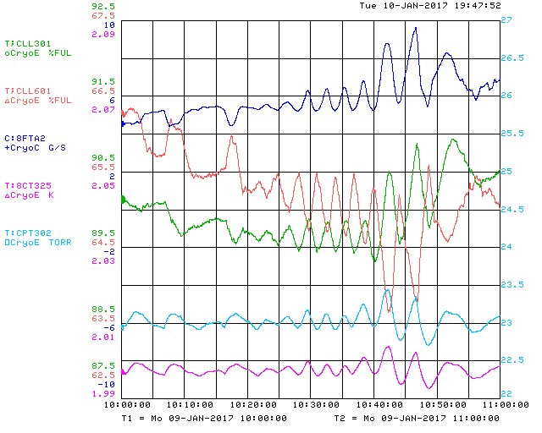
Apparent Liquid Sloshing

Slide 6
Possible Improvements
Apparent thermoacoustic oscillation (TAO) in CM JT valve
Added thermal intercept (didn’t help)
Investigating valve stem wiper with valve vendor
Turn valve around
Liquid level stability in cryomodule
JT flow injection into two-phase pipe impeding liquid surface
Adding baffle
Prevents injection flow from impinging the liquid surface
CFD analysis has been performed
Increase JT line size
Reduces velocity in tube and injection point
Should reduce potential for vibration in JT line
Space constraints make it difficult to increase line beyond 1”
LCLS-II conditions – 4% of the speed of sound
Need to further investigate flow regime throughout two-phase pipe
Revisit LHC research

Slide 7
Baffle at JT Injection

Slide 8
Design for Increased JT Line Size

Slide 9
Possible Problems
Increasing JT line size
Will lower velocities result in liquid/vapor separation in the tube?
Separation in the tube could be a problem since the tube is going uphill
Duplicating LCLS-II vapor velocity in two-phase pipe
Verify that “lifting” liquid surface does not occur at LCLS-II conditions
Need data from Jlab with JT heat exchanger
Consider adding JT HX to CMTS

Slide 10
Backup

Slide 11
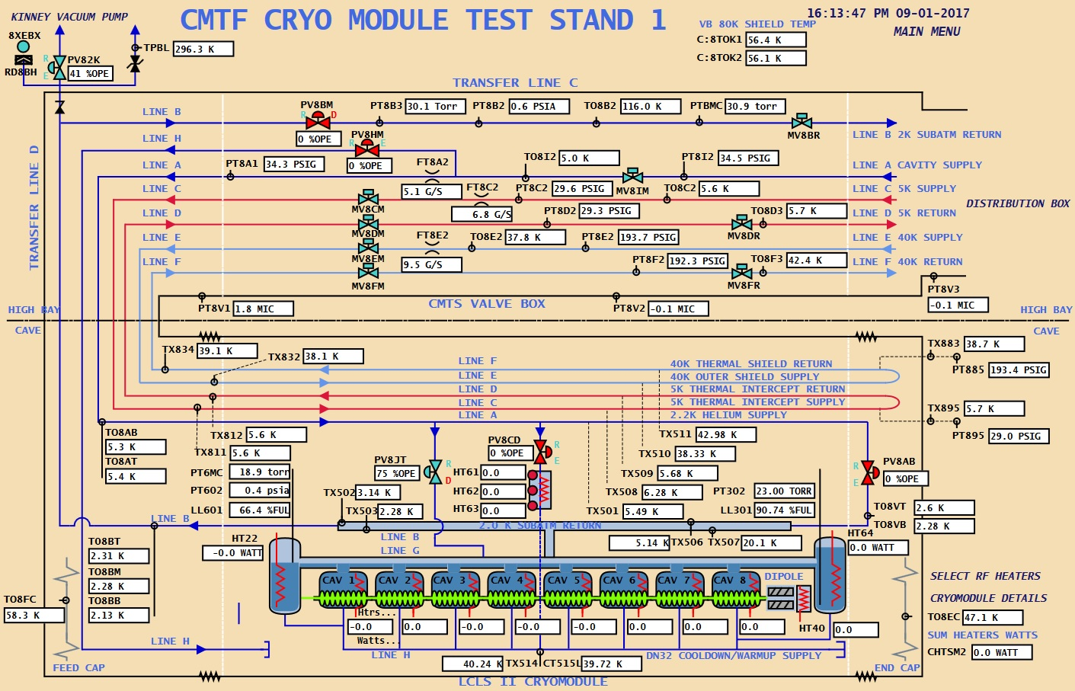
Operational Experiences

Slide 12
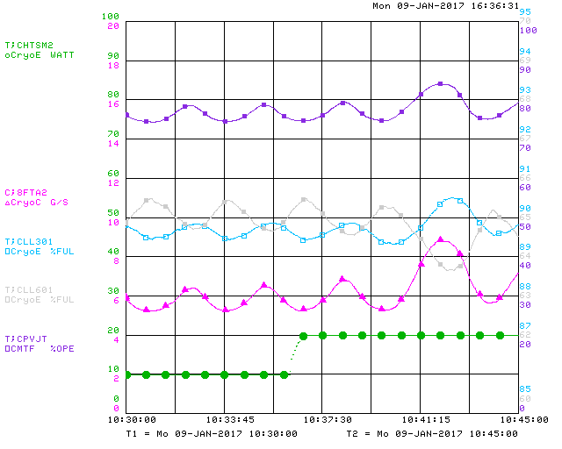
Liquid Level Instability

