Slide 1
C100 Operational Performance From A LLRF Perspective
Curt Hovater
Discussing input from
Trent Allison, Rama Bachimanchi, Ed Daly,
K. Davis, M. Drury, George Lahti, Bob Legg
Clyde Mounts, Rick Nelson,
Tomasz Plawski and Tom Powers

Slide 2
C100 Performance Limitations
Faults | Definition | Outcome/Issues/Comments
Cryogenic Cavity Detuning | He pressure and or cavity boiling causes cavity to detune and fault | Trip and recovery time, availability
Microphonic Detuning | A sudden increase in microphonics (thunder, Cat D7) causes cavity to detune and fault | Trip and recovery time, availability
Anomalous Quench | Real quench that causes the cavity to trip. | Not well known. Is there a cavity damage issue
Vacuum Faults | Vacuum faults caused by field emission | Cryomodule recovery
Gradient Performance | Definition | Outcome/Issues/Comments
Field Emission/Radiation | Gradient reduced to decrease the radiation loading | Reduced gradient, vacuum faults, radiation damage to cables and nearby components,
RF Bath Heating/cryo issues | Gradient reduced because of boiling and or cryo issues | Reduced gradient, He pressure and level not stable
Microphonic Detuning | Gradient reduced to keep cavity with in the klystron power when detuned. | Most noticed on pre-tuner plate modification and specifically on cavities 4 and 5.
Quench/Field Emitter/Boiling/Arc/Window | Original SRF commissioning limitation. | Inflated gradient performance. Cavities commissioned at max gradient in SEL have to be recalibrated in GDR. Most cavities were beyond 19 MV/m so small effect.

Slide 3
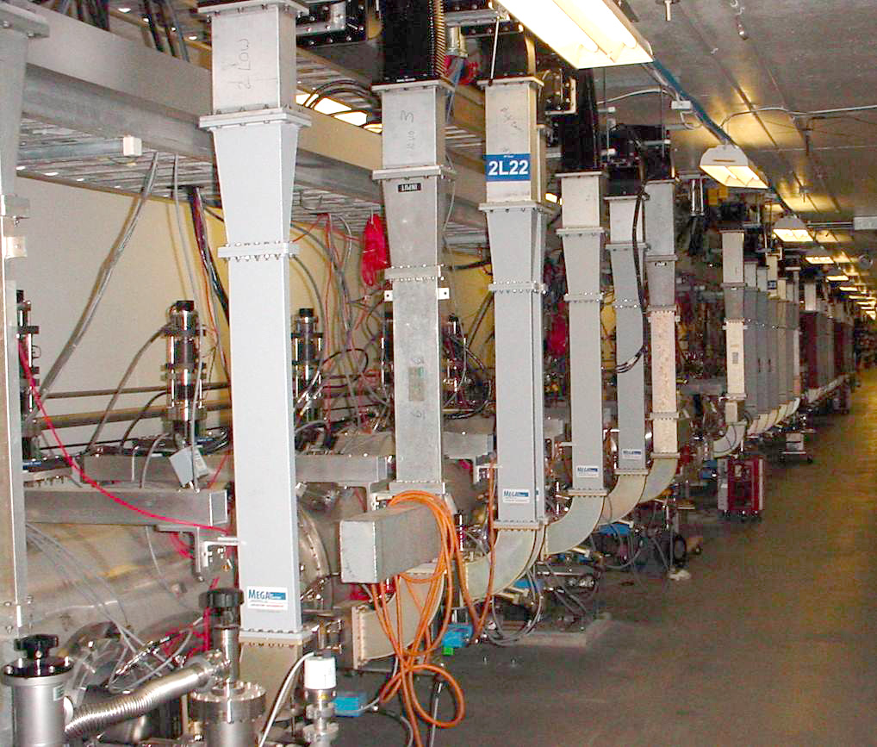
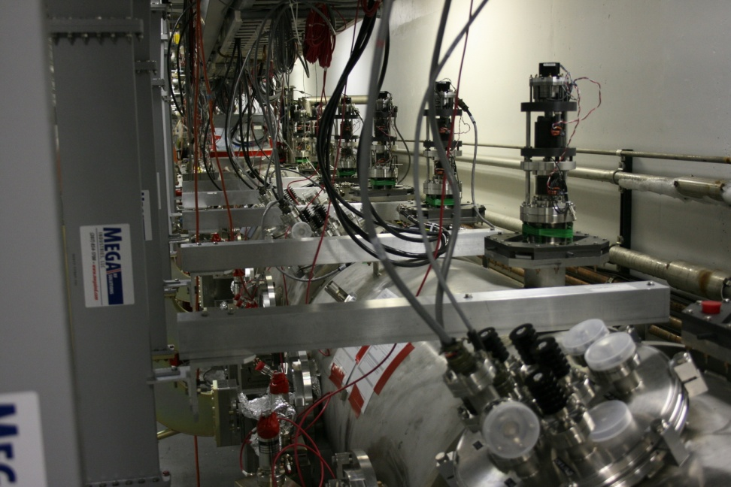
C100 Cryomodule Microphonic Issues
Tuner mechanism (*stepper and piezo)
acts as an acoustic antenna for microphonic ground motion
Waveguides and other mechanical couplings channel
acoustic noise (thunderstorms, cooling tower fans etc.)
onto the cavities
Cavities detune beyond a controllable point (RF power)
and the RF system faults

Slide 4
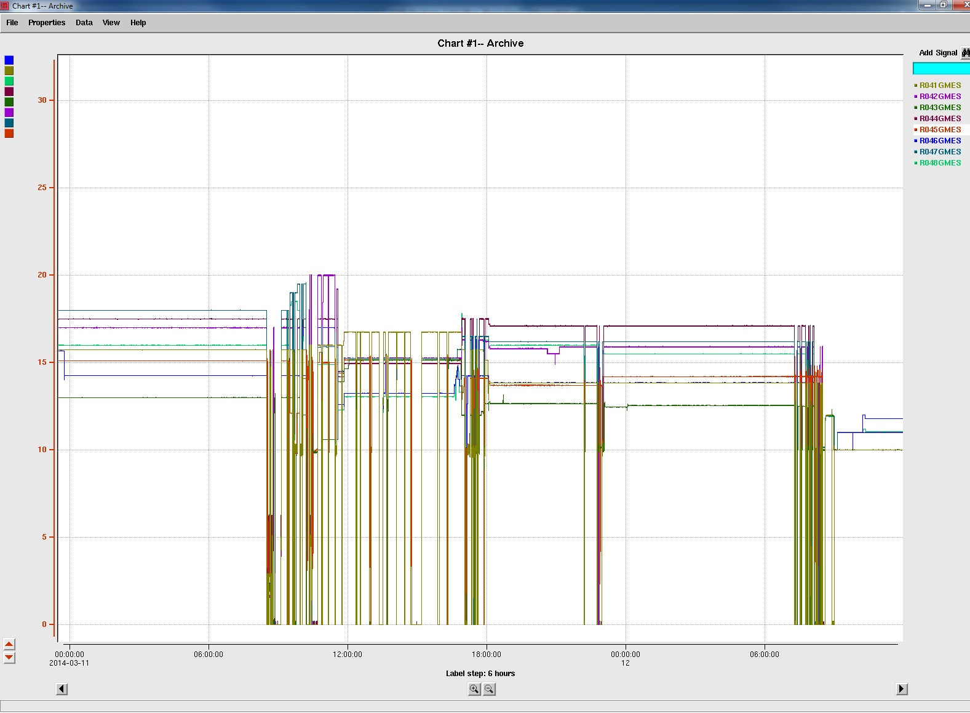
C100 Susceptibility to Construction, Truck Traffic, LCW Cooling Fans, Lawnmowers, Thunder ...
C100 Cavity gradients
The drops show the cavity faulting during the day due to construction and truck traffic really any low frequency acoustic noise.
ESH&Q Building construction halted
Reason: RF Power could not compensate for the rapid detuning
C100 - 0 Cavity Gradients

Slide 5
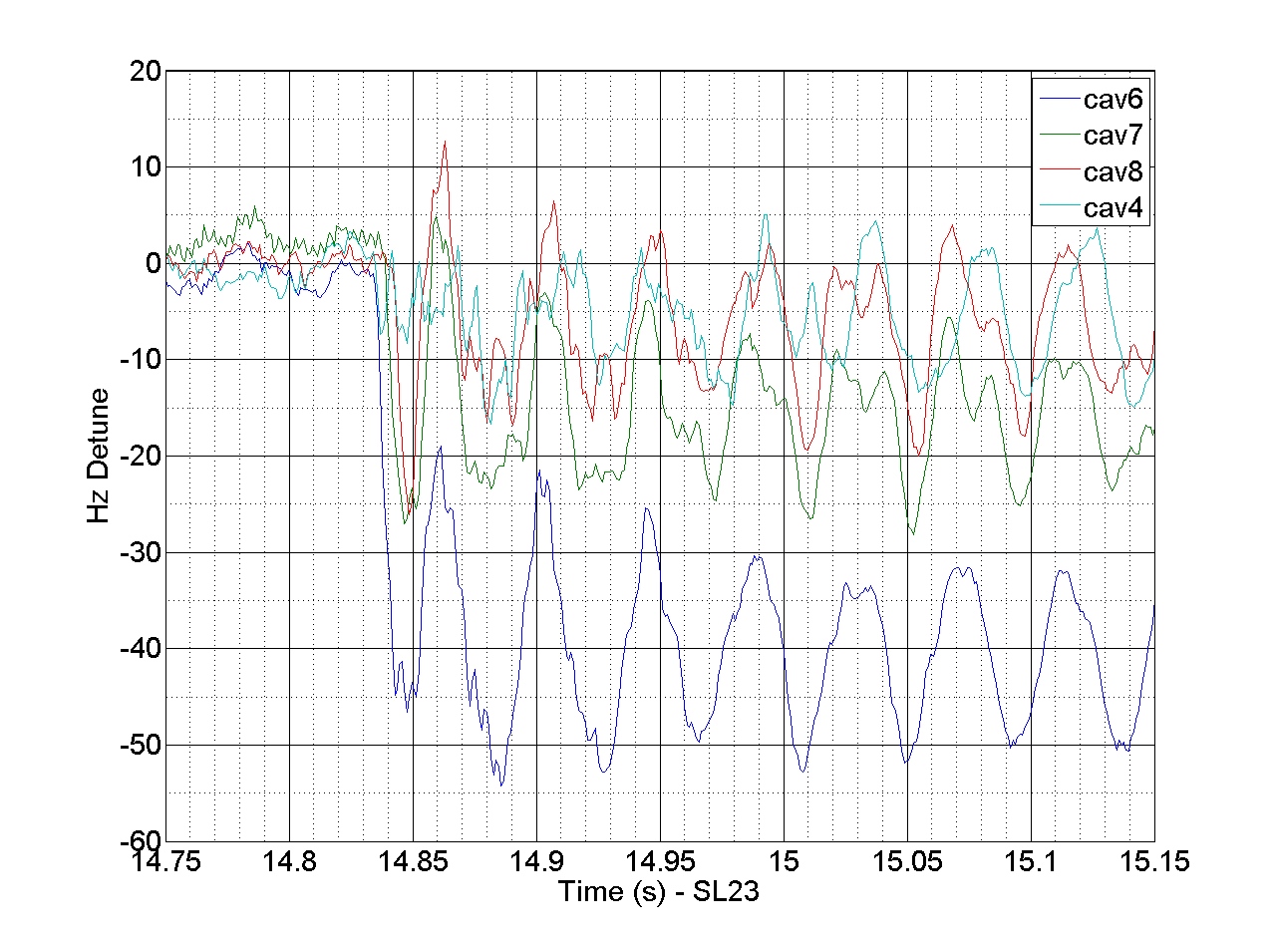
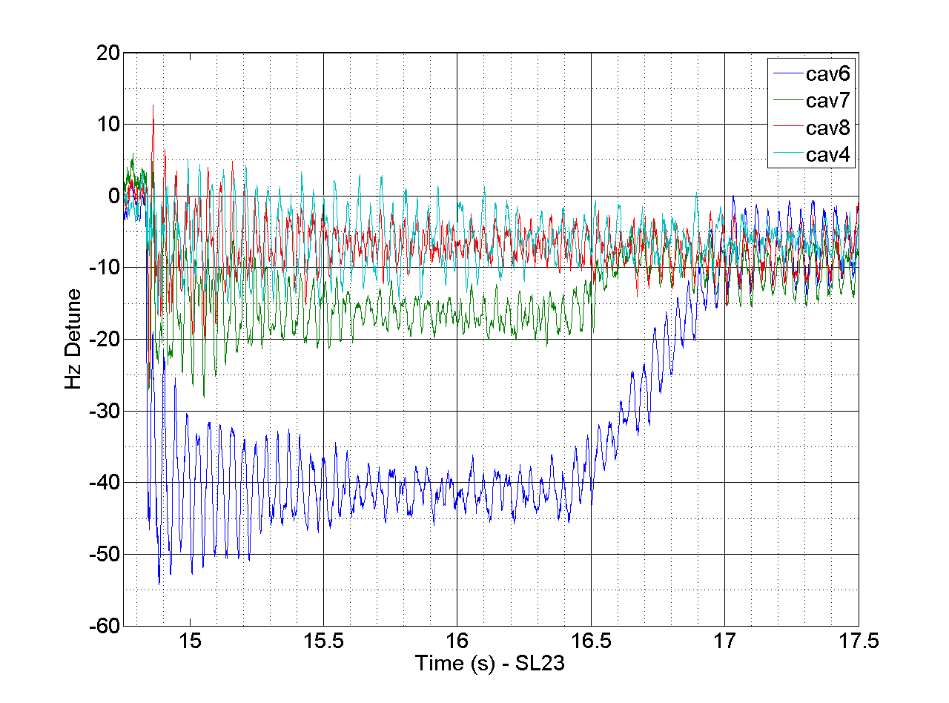
Coupled Cavities
C100-4 Cavities 4, 6, 7, 8 responding to an applied PZT step voltage change from 4 to 3 volts in cavity 5
Cavity 5 PZT
moved 460 Hz
Adjacent Cavity
coupling is ~ 10%
between 1-4 and
5-8 cavities
Cavities 4 and 5
have a “quasi”
mechanical
support between
them.
Ringing is the
21 Hz mechanical
Mode
Cavity Gradients
10 MV/m
Locked in GDR Mode
Klystron had the
overhead to keep
cavities locked
Stepper Motor
kicks in to tune
the cavities

Slide 6
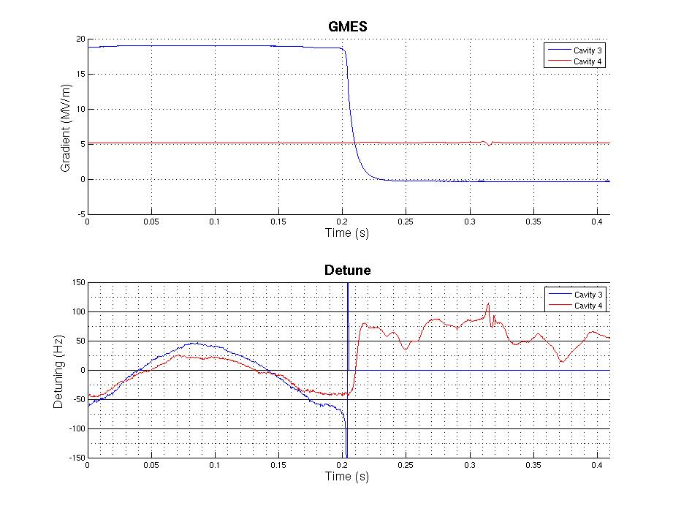
Cavity Fratricide
Cavity Fratricide occurs when one cavity faults (typically microphonic detuning from He instability or ground motion) and the Lorentz force detuning of the faulted cavity detunes the adjacent cavities resulting in the cavity faulting too.
Adjacent cavity has a 10% coupling to its brother/sister!
Adjacent cavity was operating at 5 MV/m so the klystron had the overhead to absorb the detuning

Slide 7
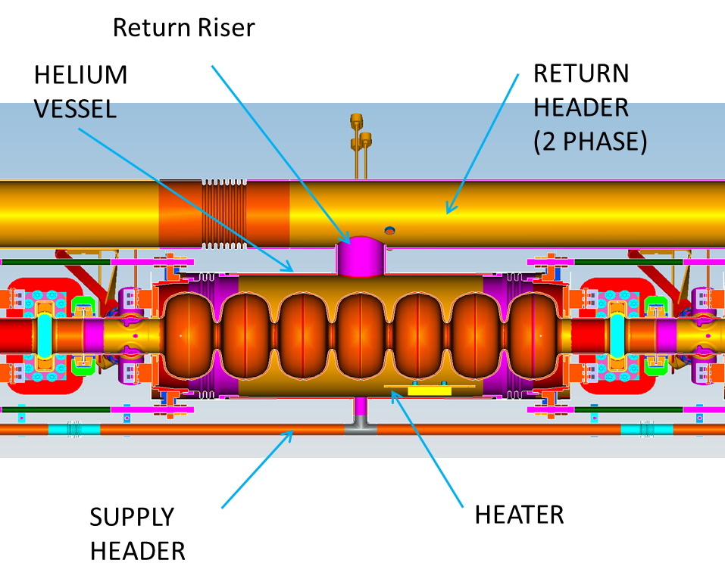
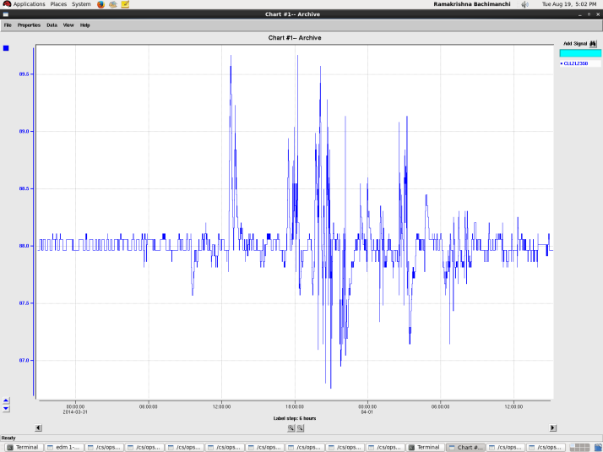
Cryomodule Heaters
Increased microphonics were observed when heaters were on. The cryostat riser is a choke point when additional heat is applied.
Out of the eight installed, only the even heaters (4) were initially used. When an odd cavity would turn off, additional heat would be supplied to the even cavities to compensate ..then
Presently we are implementing an eight heater system on one of the C100s.
He Liquid Level in a cryomodule as
heat was applied.

Slide 8
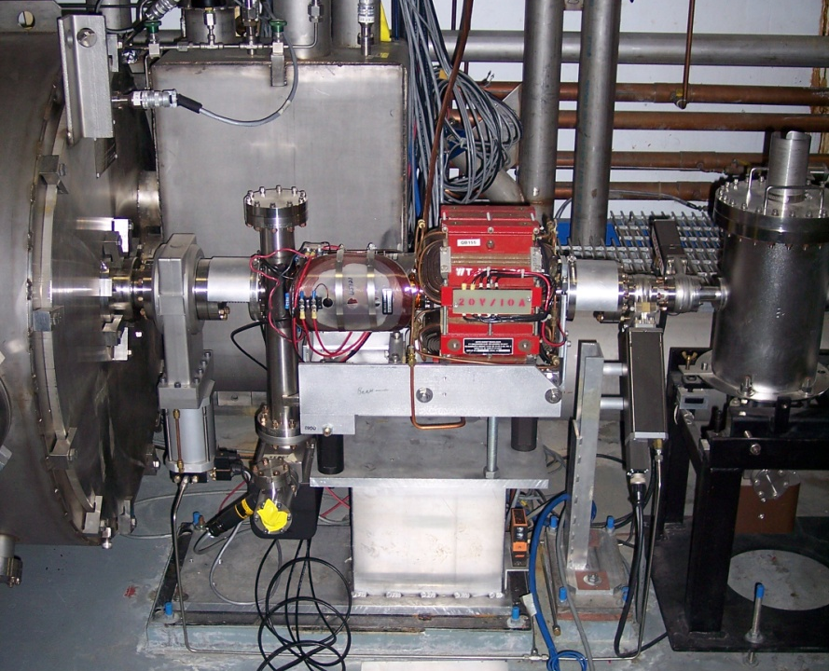
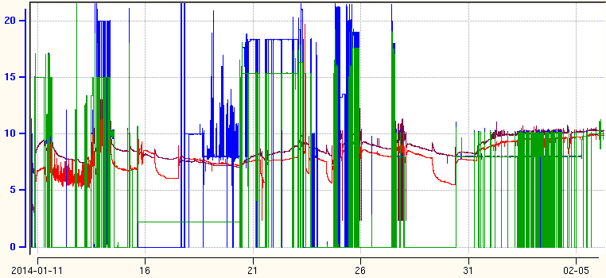
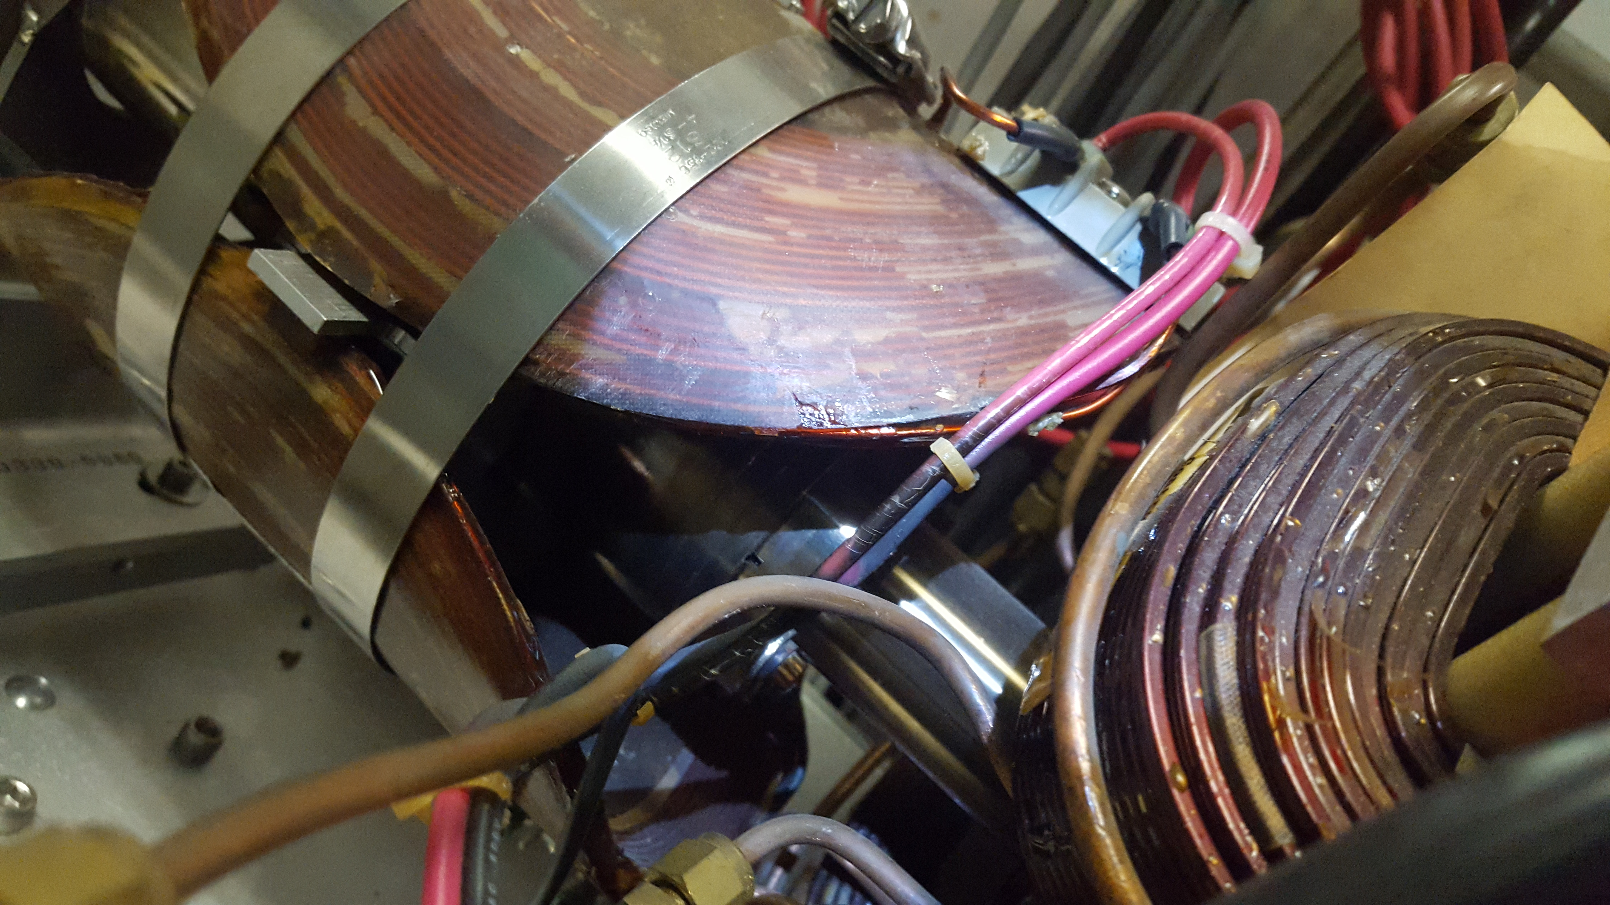
Operational Experience - Field Emission
H&V nested Air Core correctors over BPM
Field emission heats beamline
Vacuum pump faults
Vacuum interlock drops cryomodule out of RF
Viewer & pump drop cross
Quad
End of Cryomodule
Cavity Gradients impacting Beamline Vacuum activity
BEAMLINE VACUUM
C100-10 Cav 6
C100-10 Cav 7
GMES
MV/m
Radiation Damage

Slide 9
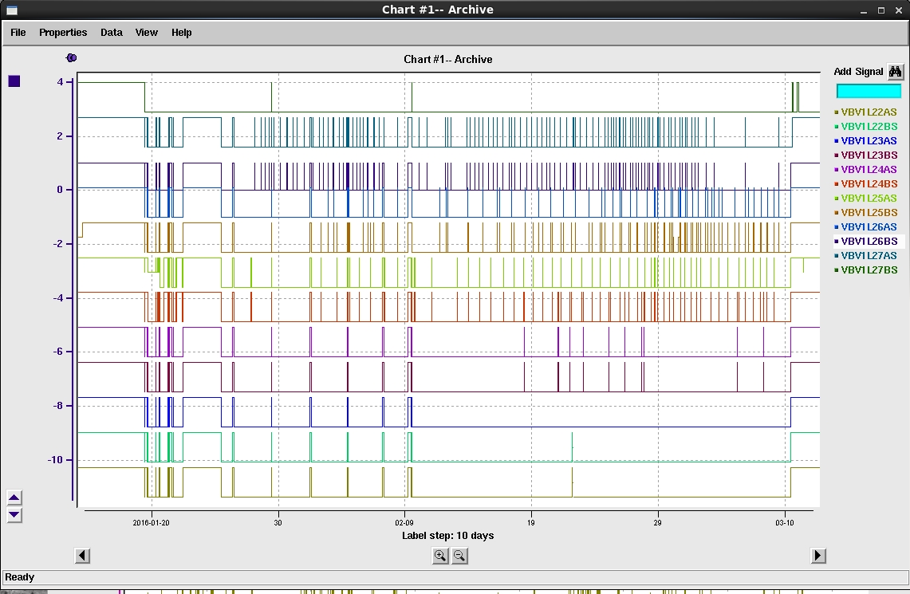
NL C100 FE Vacuum Trips Feb/Mar 2016

Slide 10
RF Firmware/Software Focus
Firmware focus has been, since the first commissioned C100s, on mitigating C100 performance issues
Faults/Detuning
Identifying troubled cavities quickly and softening the blow to the rest of the cryomodule
Microphonic Detuning
Improved algorithm for absorbing periodic microphonic excursions
Cavities switch to SEL when detuning angle is > 60º
Recovery
Single Cavity
Whole Cryomodule

Slide 11
C100 Cavity Fault & Recovery Solution
C100s will never be fully immune from microphonic detunings
Algorithm
Identify cavity and switch to Self Excited Loop (SEL) at gradient
Pull FSD
Once microphonic has passed (driven by, stopped digging what ever…), automatically switch back to locked condition
Alert operator and resume beam operations.
Benefits
C100s automatically recover, operations does not have to assist the C100 RF system.
Potential for automated beam recovery too….
.

Slide 12
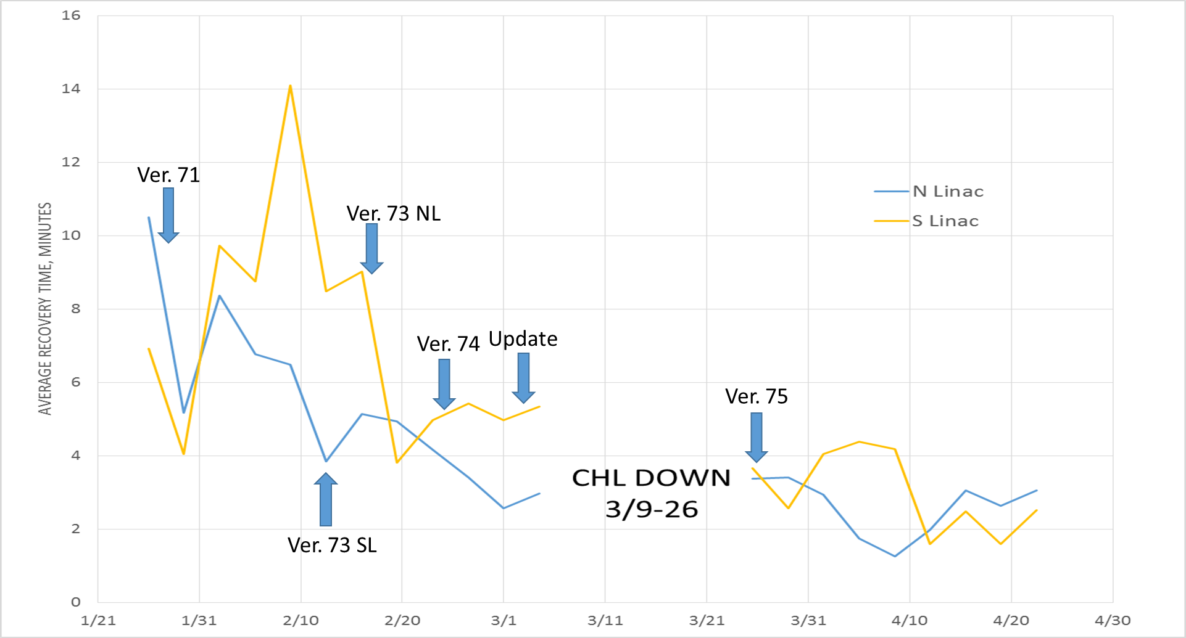
C100 Recovery Time vs Time
Courtesy Bob Legg

Slide 13
Summary
2016
LLRF group and a focused “Gradient Team” have been investigating many C100 Issues.
Recovery times have steadily improved from 2012 to now
RF Issues (HPA, Algorithmic etc.) have been fixed and are improving
SRF Department (Tom et al) are taking a closer look at C100 microphonic and cryogenic heating issues
New Heater implementation

Slide 14
Back Up Slides

Slide 15
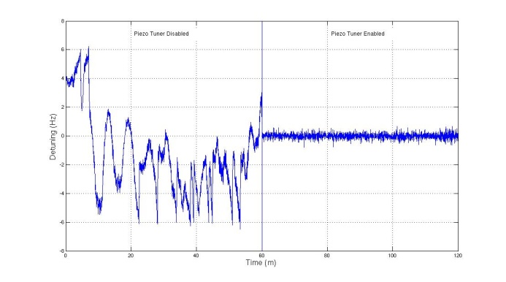
Piezo Tuner
JLAB cavity operating at ~ 15 MV/m with the PZT off and then on.
Substantial improvement for slow detuning ( helium pressure drift or slow microphonics)
Control bandwidths above 2 Hz cause oscillations
Operated 2L25 for two months with Piezos.
Piezo study has been a slow process
Engineer left who was leading the investigation
Competing projects have slowed this down
PZT Off PZT On
Slow tuner turns
On to re-center
The cavity
PZT bandwidth was limited to 2 Hz
Suggest to implement piezo tuners on “non stiffened” tuner C100s ….with possibility of full implementation

Slide 16
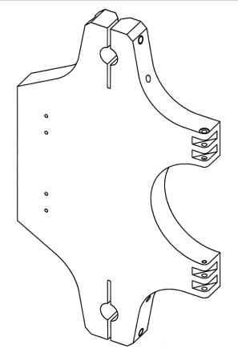
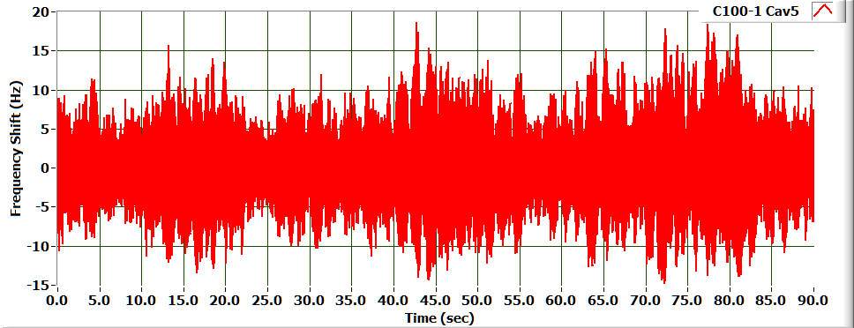
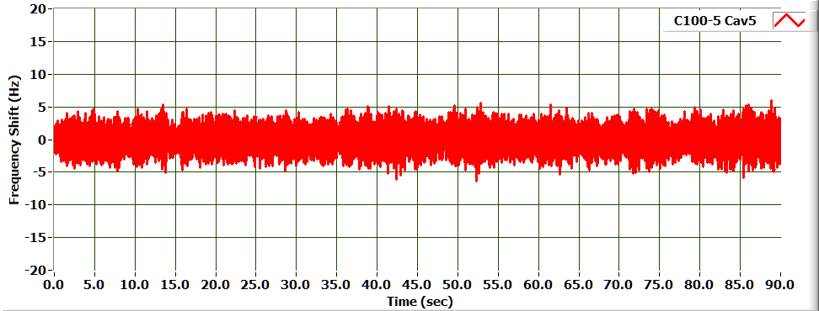
Mechanical Tuner Modification
Design allows for 25 Hz Peak Detuning
Microphonic Detuning* | C100-1 | C100-4
RMS (Hz) | 2.985 | 1.524
6σ(Hz) | 17.91 | 9.14
Actual peak detuning (21 Hz) was higher than expected in first cryomodules
A detailed vibration study was initiating which led to the following design change.
Cavity C100-1-5
A minor change to the tuner pivot plate substantially improved the microphonics for the CEBAF C100 Cryomodules.
While both designs meet the overall system requirements the improved design results in a larger RF power margin
Cavity C100-5-5

Slide 17
C100 Performance Limitations Cont.
Recovery | Definition | Outcome/Issues/Comments | Recovery Time*
Cavity Turn On | Speed to recover a single cavity | Availability | 27.6 seconds
Cryomodule Turn On | Speed to recover a cryomodule | Availability | 55 sec
(Both gradient dependent due to ramping)
*Best time …actual recovery times maybe slower …..

