Slide 1
Coupler Performance at FNAL pCM
Nikolay Solyak (on behalf LCLS-II team)
Nikolay Solyak (on behalf of LCLS-II team)
LCLS-II pCM Test Review Workshop
JLAB, January 11-13, 2017

Slide 2
Outline
Power requirements
Coupler diagnostics in pCM
Coupler tests results at 3.5 and 3.2 kW
FPC static and dynamic heat load
Lessons learned
Changes in production CMs

Slide 3
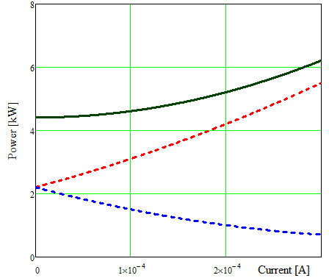
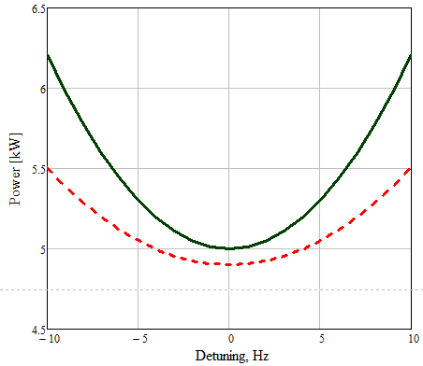
LCLS-II Power requirements for main coupler
RF Power vs. Beam current: 16MV/m; Q_{L}=4e7; ΔF_{pk}=10 Hz
Total
Total Power in coupler (QL=4e7, ΔF_{pk}=10 Hz)
Forward
 | $P_{total}$ (peak / avrg)
 | 0.1 mA | 0.3 mA
16MV/m | 4.6 | 6.4 / 5.7
Reflected
E= 16 MV/m; 0.3mA; QL=4e7
Dissipation in coupler ~ P_{tot.} Max Temp depends on reflection phase.
In pCM coupler power increased to P_{t} =7 kW and 6.4kW (2·P_{f}) by tuning QL ~1.e7
In HTS coupler tested up to P_{t} = 8kW
$P_{t_pk}$ =6.4kW
Average $P_{total}$ =5.7kW
Q_{L}=4.e7; detuning ΔF=10Hz

Slide 4
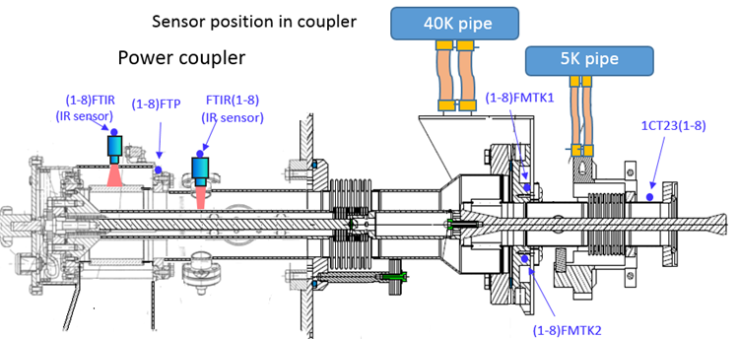
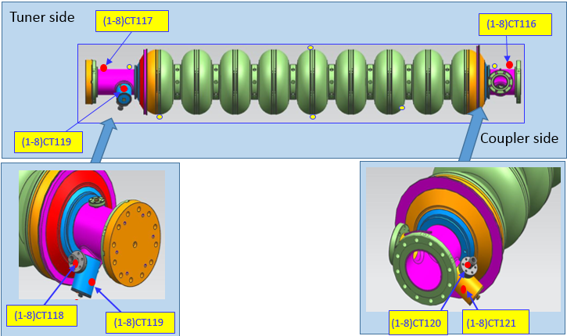
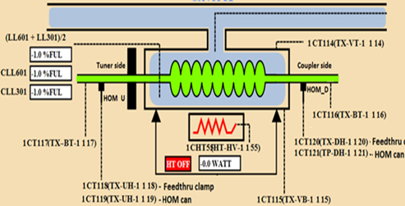
Coupler and cavity end-group diagnostics
(2,4,6,8)

Slide 5
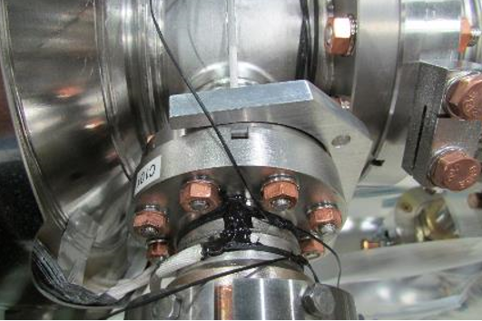
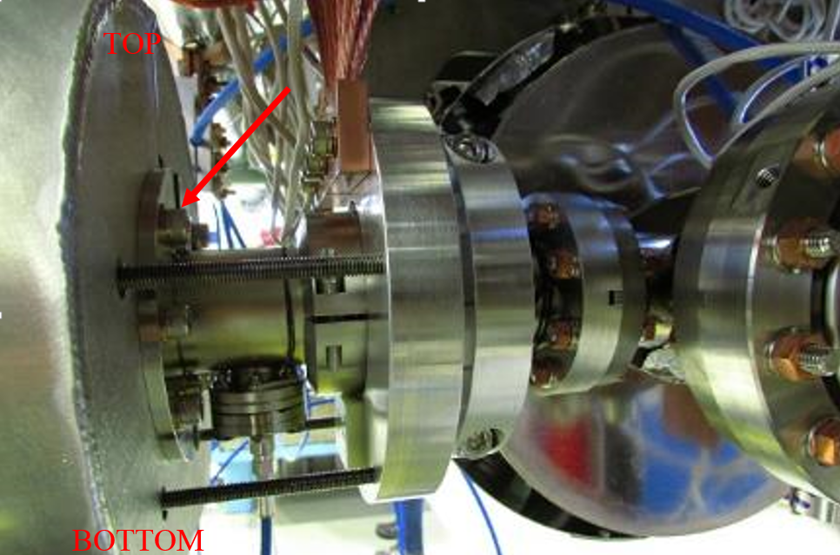
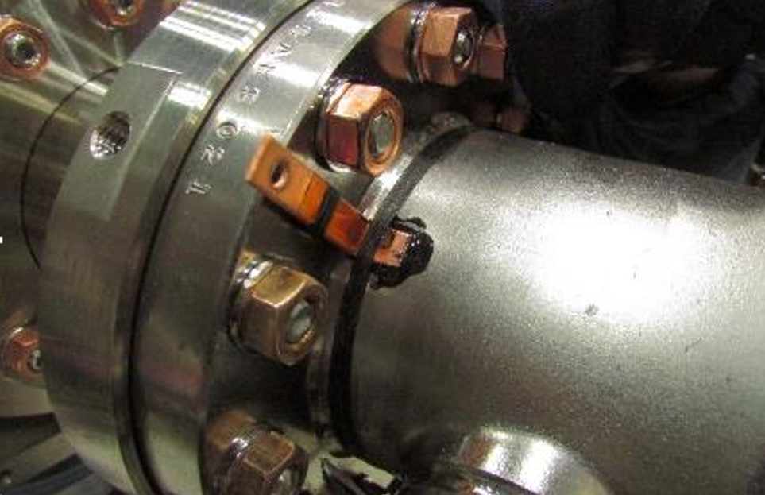
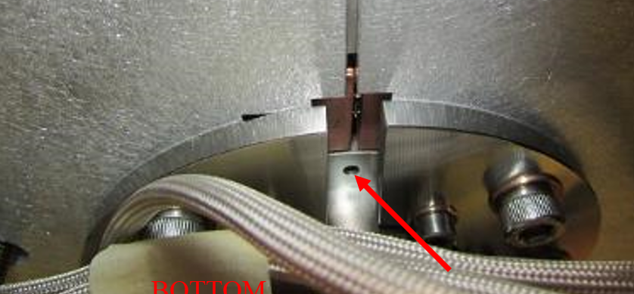
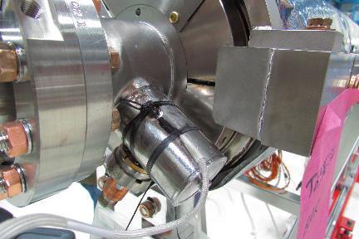
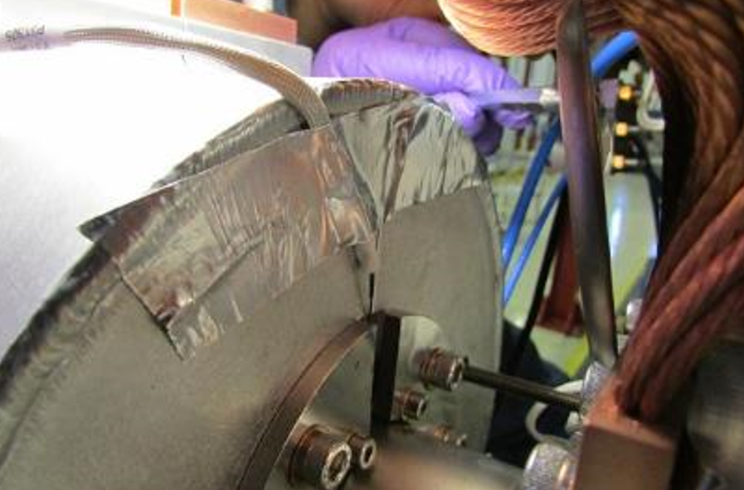
Location of T-sensors
Cernox on FPC 5K tube
PT100 on CF100 flange (50K)
Cernox on cavity beampipe
RTD stycasted to the HOM.

Slide 6
Main coupler tests in pCM
Room temp. power processing (couplers #1 thru #7): 2.5 to 4 kW
Coupler #8 was processed at 4kW with cavity OFF-resonance (2.1K)
All couplers are tested at cold, P= 3.5 kW & 3.2 kW (~12-20 hrs)
QL =1.e7 (tuned to low Q_{ext} for low cavity gradient )
Cavity gradient 10-12 MV/m
All couplers in pCM are TTF3 modified (different from production)
Coupler #4 was retested at 2K (13hrs). From other couplers data are taken from cavity Q0 measurement runs (0.9 kW and 1.6kW)
Test result summary:
Max temperature at 50K/5K intercept ~200K/20K at 3.5 kW.
No overheating of cavity beampipe → small effect on Q0
Improved design will be tested at JLAB pCM (production version)

Slide 7
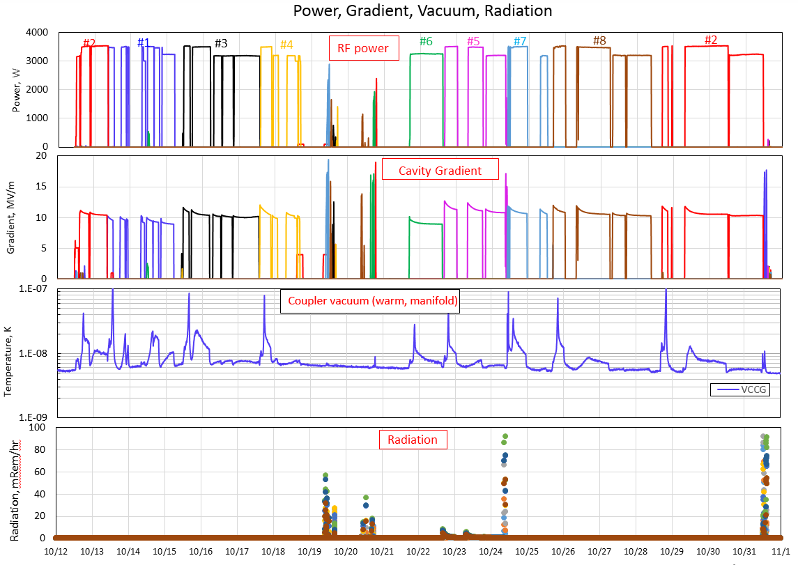
High field operation

Slide 8
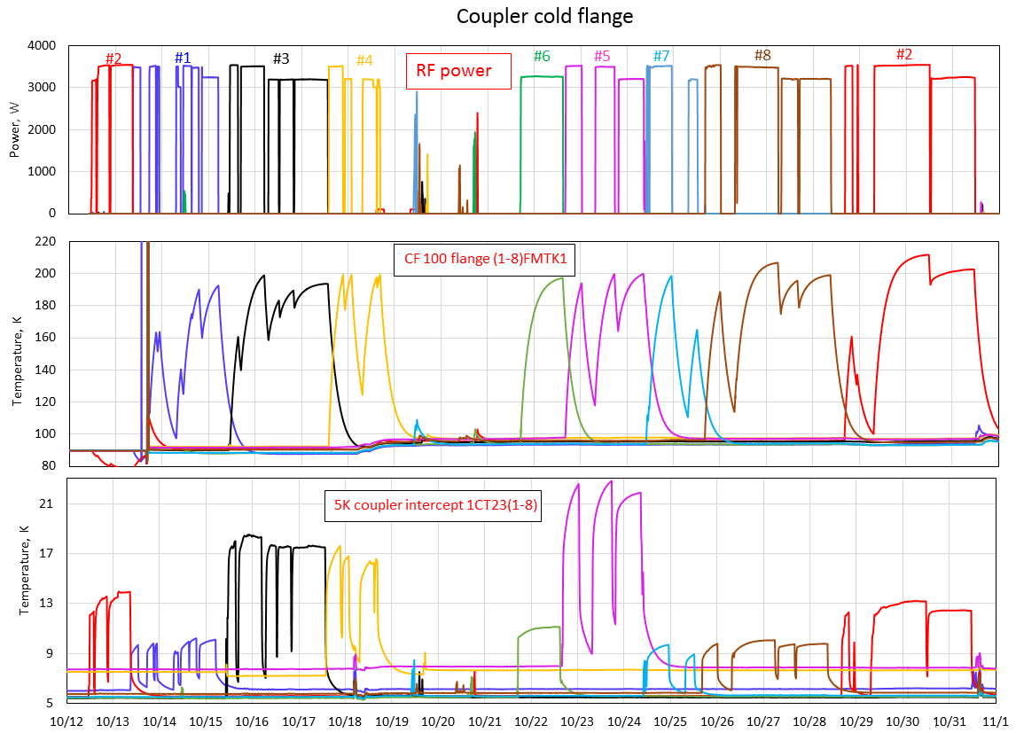
Interlock=200K
Interlock=250K

Slide 9
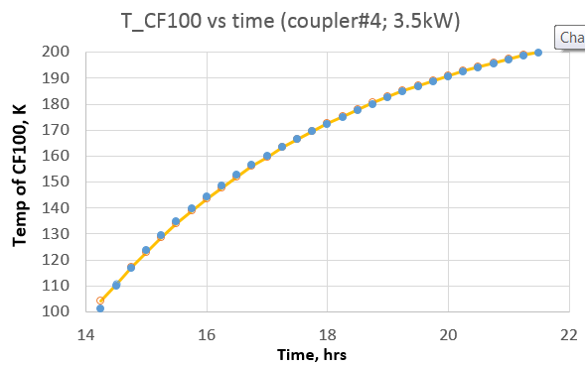
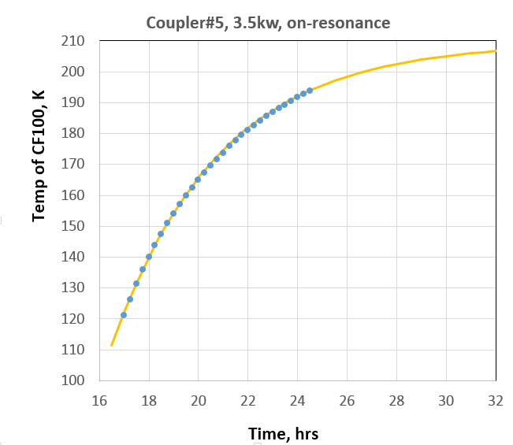
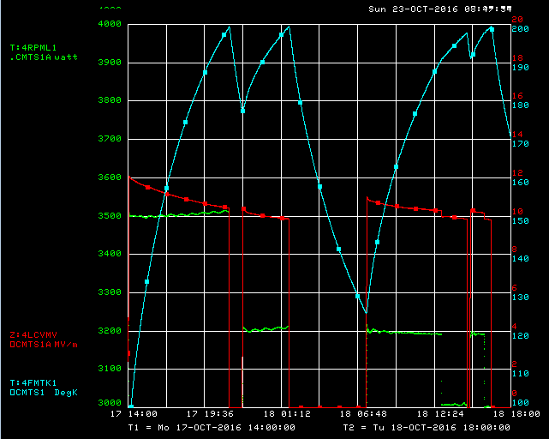
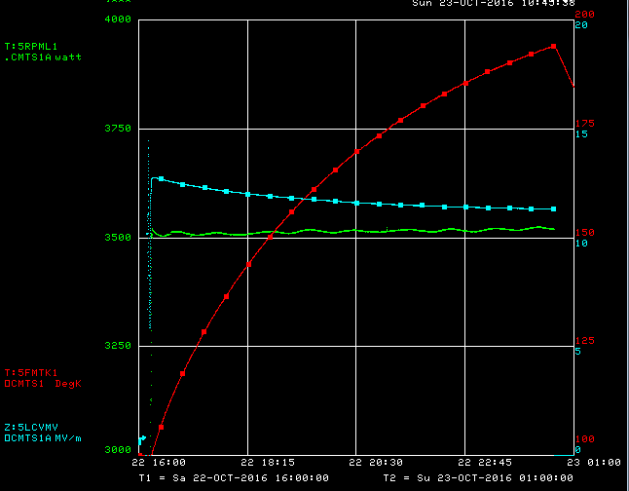
Coupler #4: Power = 3.5 kW
Coupler #5: Power = 3.5kW
Interpolation to equilibrium:
$T\left(t\right)=T_{max}∙(1−\exp\left(− (t−11.5)/τ\right))$
T_{max}=222 K
T_{max}=209 K
$T\left(t\right)=222∙(1−\exp\left(−0.23∙(t−11.5)\right))$
$$T\left(t\right)=209∙(1−\exp\left(−0.23∙(t−13.2)\right))$$

Slide 10
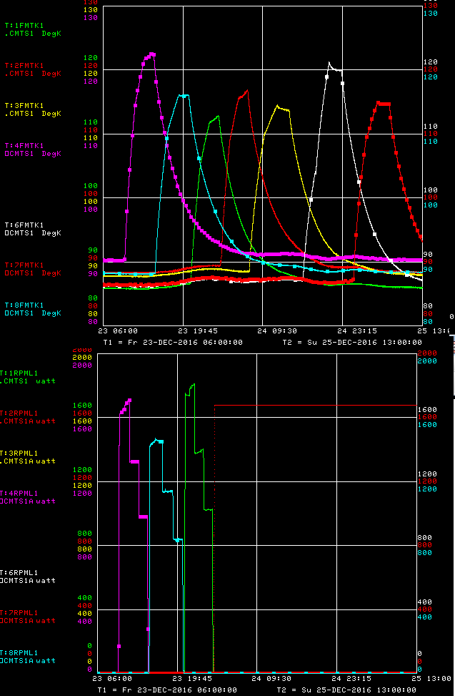
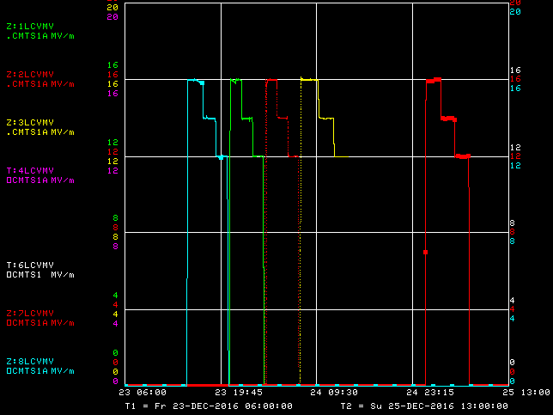
Extended tests at 2K
Temp of CF100
#4; #6; #1; #2; #3; #6; #7
CF100 flange
T_{max} = 115-128 K (at ~0.9 kW)
Gradient MV/m
Cavity Gradient
steps = 16/14/12 MV/m
RF power:
1.65 /1.25/0.9 kW
(variation < 10%)

Slide 11
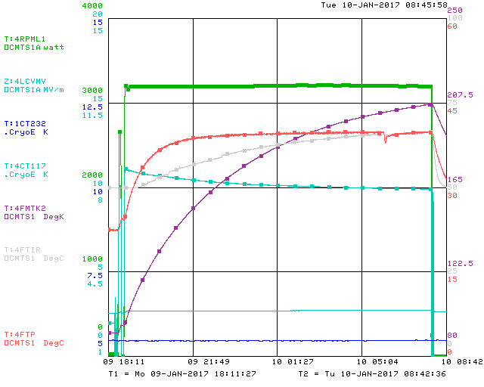
Extended test of the main coupler #4 (2K)
RF power =3.2kW
Power 3.2kW
Duration ~13hrs
T_{CT100} = 208 K
Consistent with 2.1K result
T_{CT100}
Gradient=11.5→10 MV/m

Slide 12
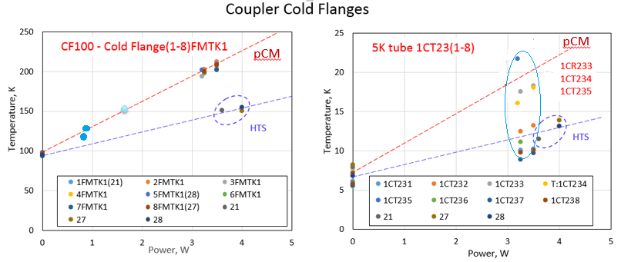
Summary of coupler heating
50K
5K
Coupler#4
Different thermal intercept configuration in HTS

Slide 13
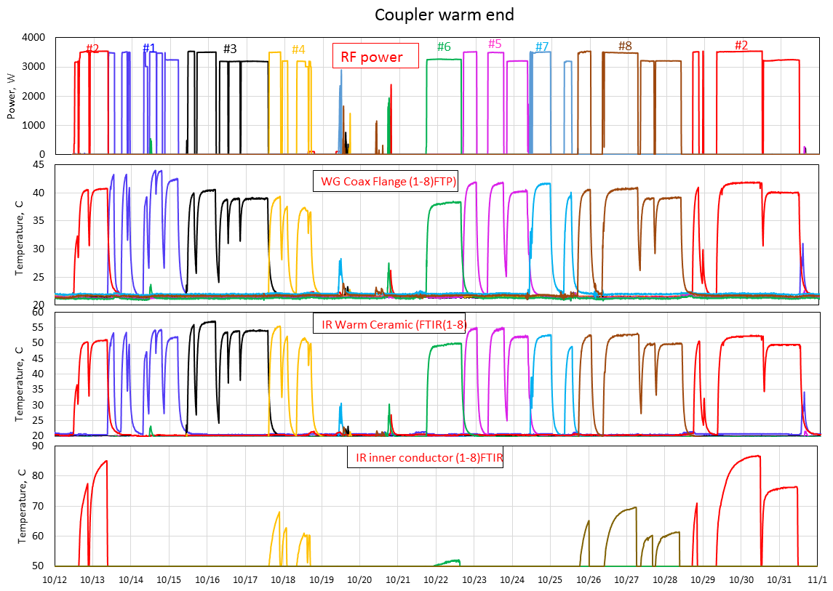

Slide 14
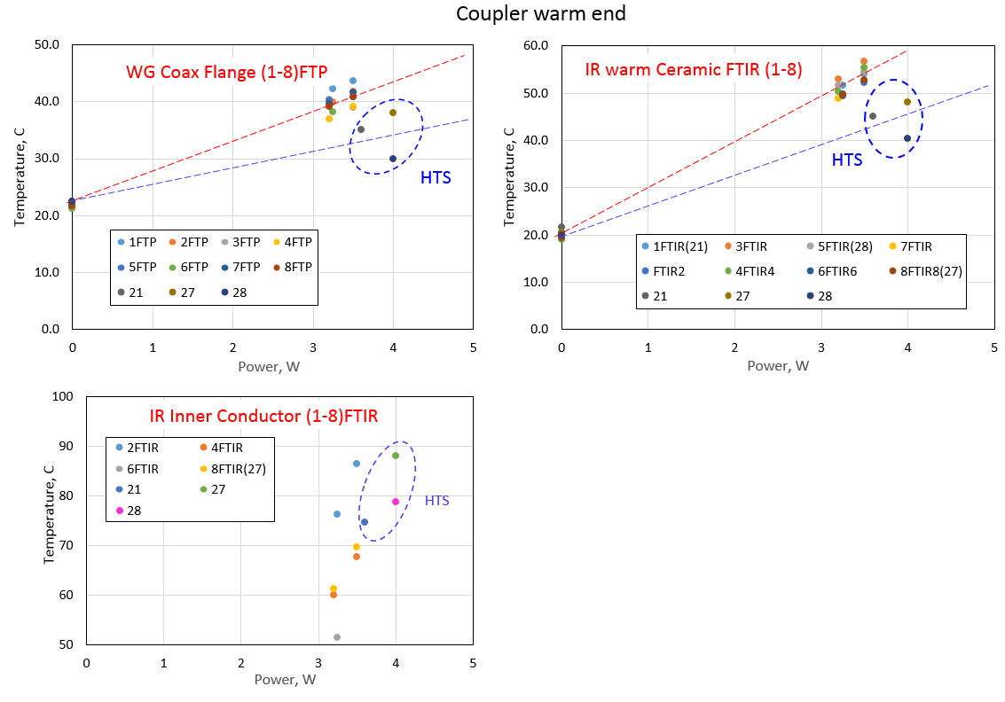
pCM
pCM
Waveguide/RT flange cooling condition
No air cooling in pCM
Dry nitrogen cooling in HTS
pCM

Slide 15
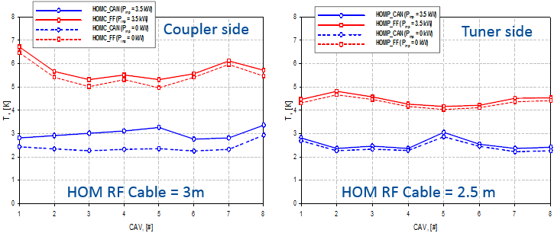
HOM coupler: static and dynamic heating
Conclusion from pCM measurements and simulation:
Static heat load to 2K < 0.15 W
FPC ~ 50mW
HOM+FP cables < 100mW
Dynamic heatload (2K) < 1.2 W
bellow < 150mW @16MV/m
FPC @3.5kW < 1W
HOM-feedthru
HOM-feedthru
HOM-can
HOM-can
Static temperatures (no RF power)
Acnet name | Location | cavity |  |  |  |  |  |  |  | Note
 |  | #1 | #2 | #3 | #4 | #5 | #6 | #7 | #8
CT116 | Cav BeamTube (coupler) | 2.51 | 2.38 | 2.29 | 2.38 | 2.63 | 2.32 | 2.38 | 2.81
CT121 | HOM can (coupler) | 2.41 | 2.34 | 2.26 | 2.31 | 2.30 | 2.25 | 2.31 | 2.87
CT120 | HOM feedthru (coupler) | 6.43 | 5.35 | 5.02 | 5.29 | 4.97 | 5.28 | 5.90 | 5.30 | Heated by 2.5m cable
CT117 | Cav BeamTube (tuner) | 5.01 | 5.47 | 2.85 | 2.84 | 10.73 | 4.64 | 2.71 | 2.35
CT119 | HOM can (tuner) | 2.68 | 2.24 | 2.31 | 2.24 | 2.83 | 2.38 | 2.20 | 2.22
CT118 | HOM feedthru (Tuner) | 4.30 | 4.59 | 4.43 | 4.05 | 3.96 | 4.04 | 4.26 | 4.35 | Heated by 3m cable

Slide 16
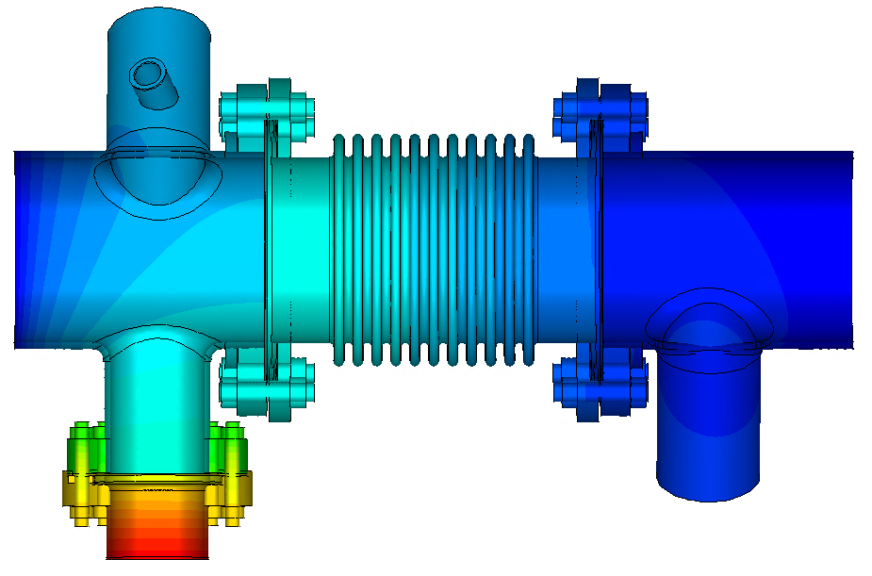
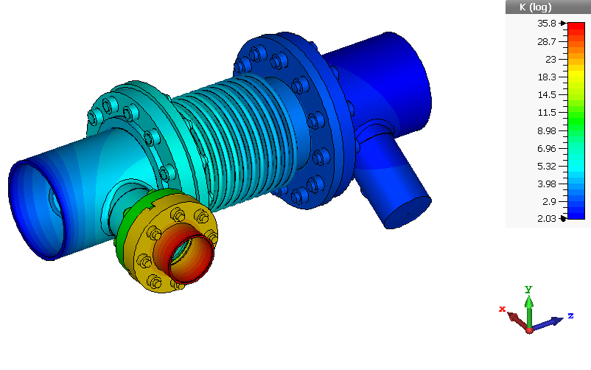
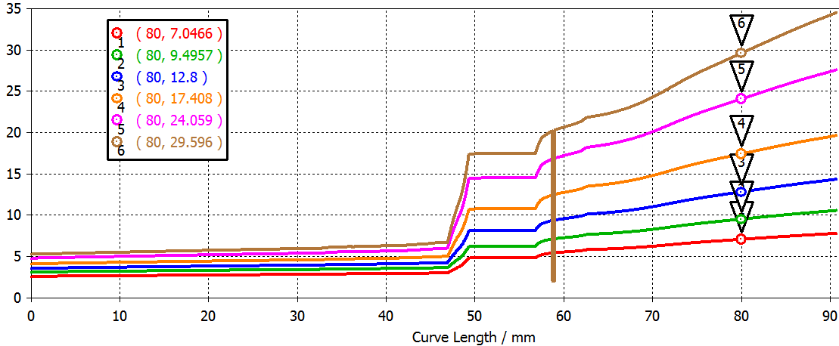
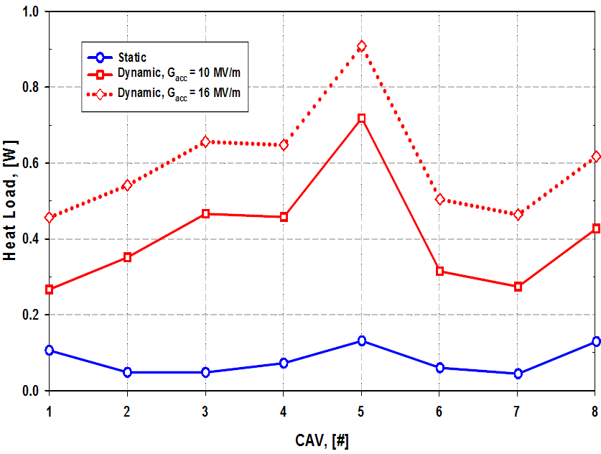
FPC&HOM Couplers 2K Heat Load (CTS/COMSOL analysis of pCM)
P=55 mW @10MV/m
T-map (Q_{FPC} = 1.2 W)
A.Lunin
Total 2K Heat Loads from FPC & HOM Couplers in the LCLS-II pCM (based on T-meas: FPC/HOM/BP)
Temperature Profile along the 5K Tube
Q_{FPC} = 1.2 W
Dynamic heat load
Q_{FPC} = 0.8 W
Q_{FPC} = 0.4 W
Q_{FPC} = 0.2 W
Q_{FPC} = 0.1 W
Q_{FPC} = 0.05 W
Static heat load

Slide 17
HOM and FP performance at FNAL pCM
Tuner side
Coupler side
Cavity | HOM1 Qext | HOM2 Qext | Field Probe Qext | HOM1 Power @16MV/m (W) | HOM2 Power @16MV/m (W)
TB9AES021 | 1.6e13 | 5.0e13 | 2.04e12 | 0.017 | 0.005
TB9AES019 | 3.8e13 | 1.1e12 | 8.26e11 | 0.007 | 0.248
TB9AES026 | 3.0e12 | 6.5e12 | 7.48e11 | 0.091 | 0.042
TB9AES024 | 4.5e13 | 2.7e12 | 7.40e11 | 0.006 | 0.101
TB9AES028 | 5.0e11 | 2.4e12 | 4.61e11 | 0.545 | 0.114
TB9AES016 | 8.1e11 | 2.6e12 | 1.07e12 | 0.336 | 0.105
TB9AES022 | 1.8e13 | 1.3e12 | 5.48e11 | 0.015 | 0.210
TB9AES027 | 6.8e11 | 1.4e12 | 1.60e12 | 0.401 | 0.195
Specification: HOM Qext > 2.7e11 and 1 W maximum
All have < 1W @ 16MV/m
At 20 MV/m, P_HOM ~ 1.56 W specification.

Slide 18
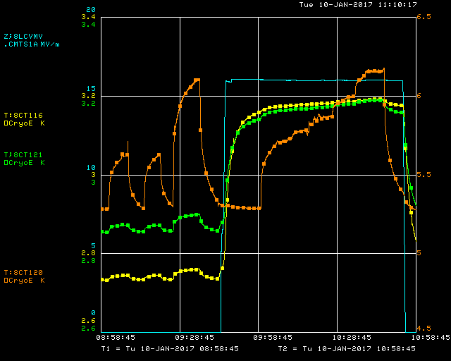
HOM performance: Effect of RF losses in HOM cable
HOM power heat cable → heating of HOM antenna & FT → antenna quench
Expected HOM power from 0.3mA beam < 5W, system designed for 10 W.
Cav#8 HOM1 cable (coupler side) powered at 2GHz up to 5W, full reflection→ P_{tot}=10W
Test Summary
No antenna/FT overheating
FT static T=5.3K (<50mW from cable)
RF power in cable 5.1W; ΔT_{FT}< 0.9K. - Same ΔT_{FT} for 16MV/m
Temp of HOM can & beampipe is not sensitive to cable heating; ΔT<0.04K
At 16MV/m: ΔT_{HOMcan}~0.3K; ΔT_{beampipe}~ 0.4K (FPC power & E_{acc})
HOM FT
Gradient 16MV/m
HOM1 can
Beam tube

Slide 19
Lessons Learned
Coupler warm conditioning may causes cavity surface contamination → MP
Coupler has acceptable 2K heat load (<1W @ 3.5kW), even at relatively high temperature of the 50K/5K intercepts (~200K/20K). → small Q0 degradation due to FPM heating.
FPC thermal intercept design is improved in production CMs, incl. JLAB pCM. (next slide)
Antenna heating changes QL ~10% (16MV/m) at ~10 hrs timescale
HOM coupler performance meet specification
Power leak < 1W at 16MV/m
Small static heat load from HOM cable
Cable can handle up to 10W of HOM power w/o overheating antenna

Slide 20
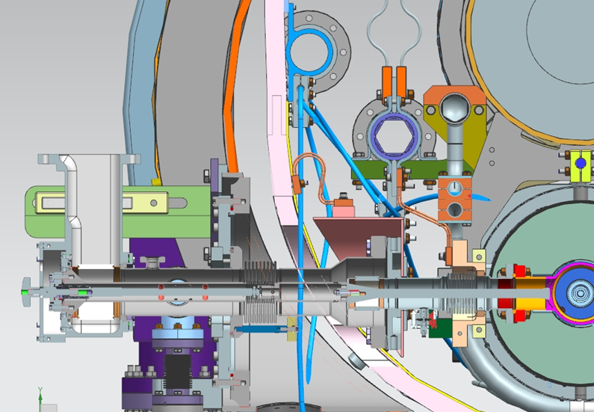
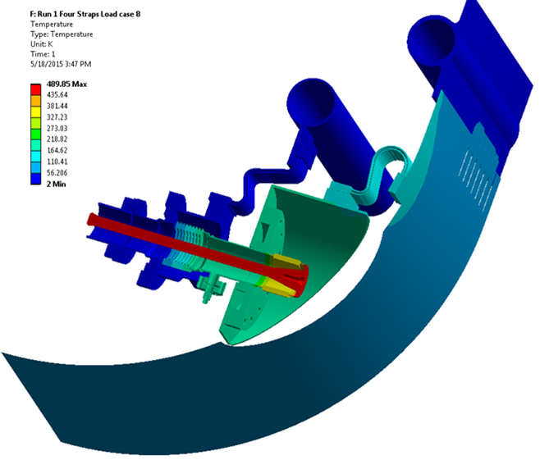
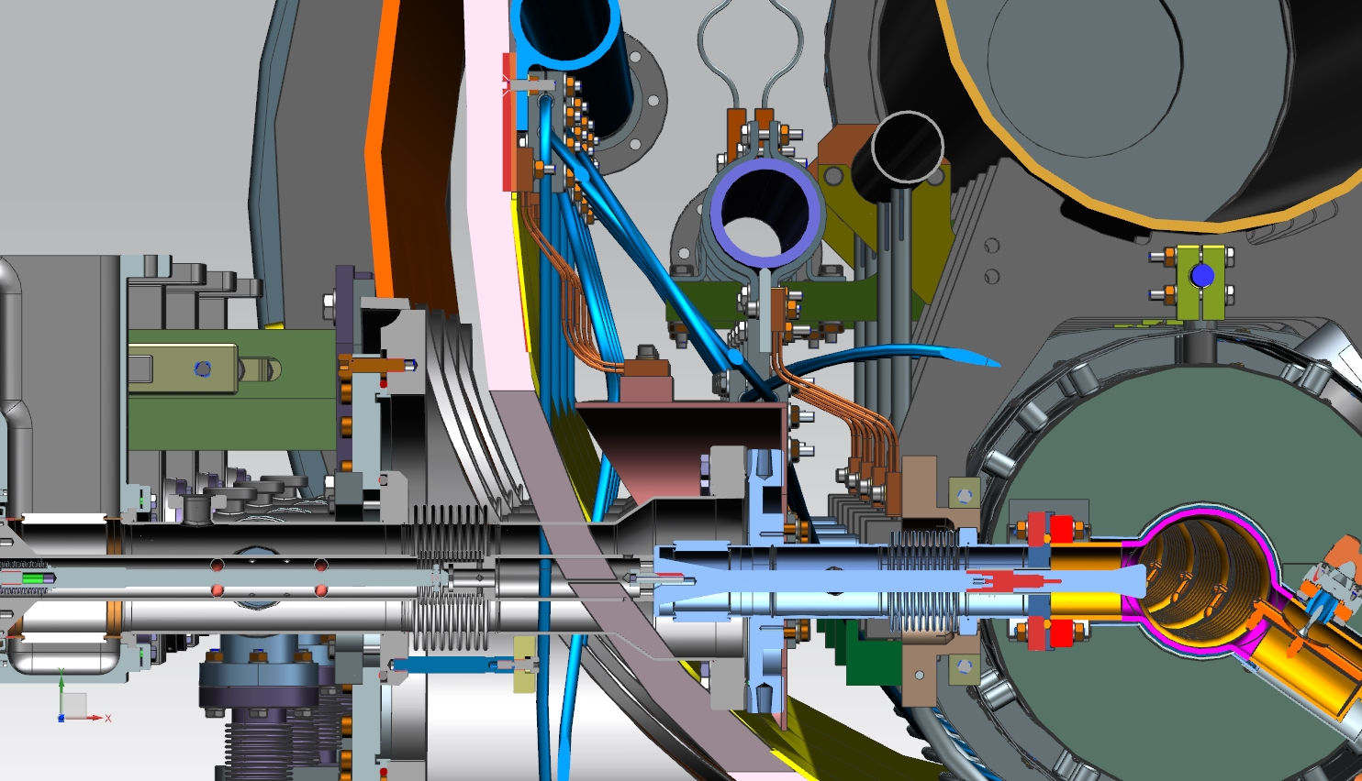
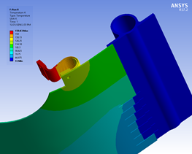
Thermal intercept improvements in production CM (vs. pCM)
Use XFEL FPC design (vs.TTF3 in pCM). Better AL can -flange thermal contact
Thermal strap is connected close to 50K pipe (vs. 50K shield-see thermal analysis)
Better thermal contact between braid and copper extension (flat surfaces)
JLAB pCM already has this feature
pCM
50K thermal
intercept
zoom
Production CM
5K thermal
Intercept
150K
55K
110K
120K
pCM: Thermal analysis – R.Fischer/ANL

Slide 21
Summary
No multipactoring, trips at FPC upto 4kW cw
See overheating on 50K and 5K flange at 3.5kW.
- Max Temp 220 (50K) and 20K at 5K
Effect of overheating on cavity Q0 looks small (<10%), simulations and T-map predicts power to 2K ~0.3-0.8 W
Thermal intercept improved for in production CM (and JLAB pCM)
HOM performance meet specs. Cable heating up to 10W not limit HOM performance

Slide 22
Back-Up slides

Slide 23
Simulations
Pin=3.5kW, 10um on outer, 150um on inner, roughness 10%, ε=9.8, tan=3e-4
320 K
220 K
15 K
320 K
320 K
T_{max} ~ 430 K
T_{IR} ~ 390 K

Slide 24
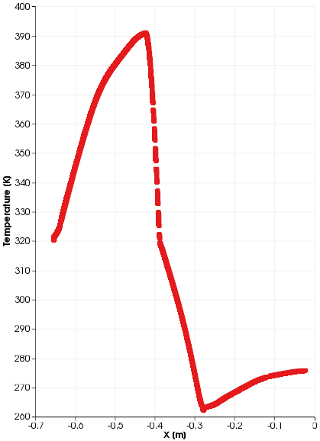
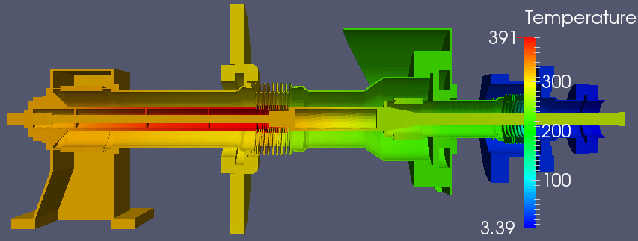
SLAC -3D simulations; 3.5kW pCM conditions
T_{max}=391K
T_{IR}=370K
WG flange float

Slide 25
Total Heat Load Results @ Qin=1e7 w/o Radiative Cooling in Cold Section
Pin=3.5kW | Temps (K) | Power (W)
Cavity Beam Pipe | 3.4 | 0.13
5K Copper ring | 22 | 1.21
CF100 Al plate | 220 | 15.2
300 K flange | 300 | 1.71
WG flange | 300 | 5.24
Max. T | 384 | Total: 23.49
FNAL pCM case.
Pin=3.5kW | Temps (K) | Power (W)
Cavity Beam Pipe | 2 | 0.025
5K Copper ring | 10 | 0.754
CF100 Al plate | 100 | 14.35
300 K flange | 300 | 1.0
WG flange | 300 | 4.66
Max. T | 339 | Total: 20.79
Ideal case As Ref.

Slide 26
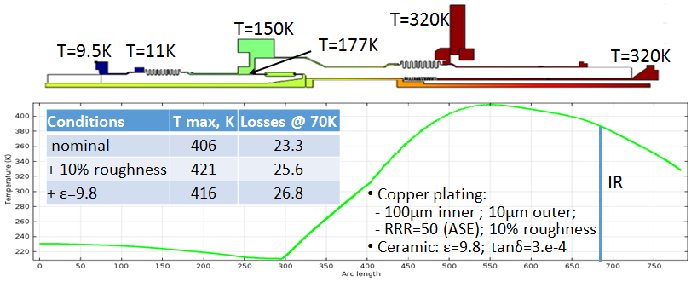
Simulation results for HTS condition: 4kW, cavity ON-resonance
Test result
Simulation of 4kW cavity on-resonance with the last set of parameters from table. Nominal parameters are: 10/100um copper plating, no roughness, e=9; tan=3.e-4; RRR=50 (ASE included RRR=35).

