Slide 1
Data from Tomasz

Slide 2
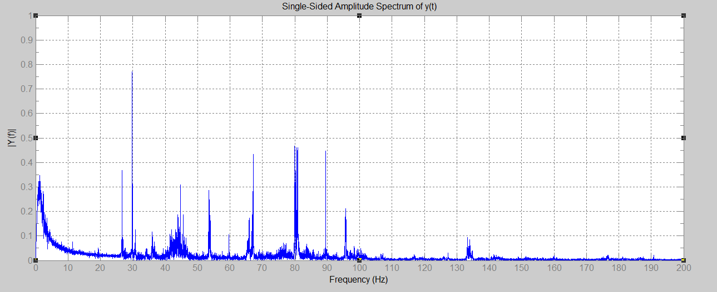

Slide 3
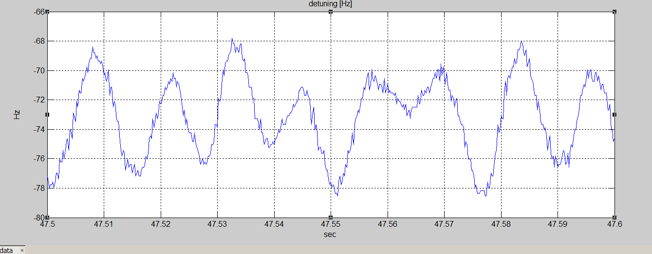

Slide 4
