Slide 1
JLAB pCM Cooldown
Ed Daly representing the JLAB CMTF Team
pCM Workshop
11 January, 2017

Slide 2
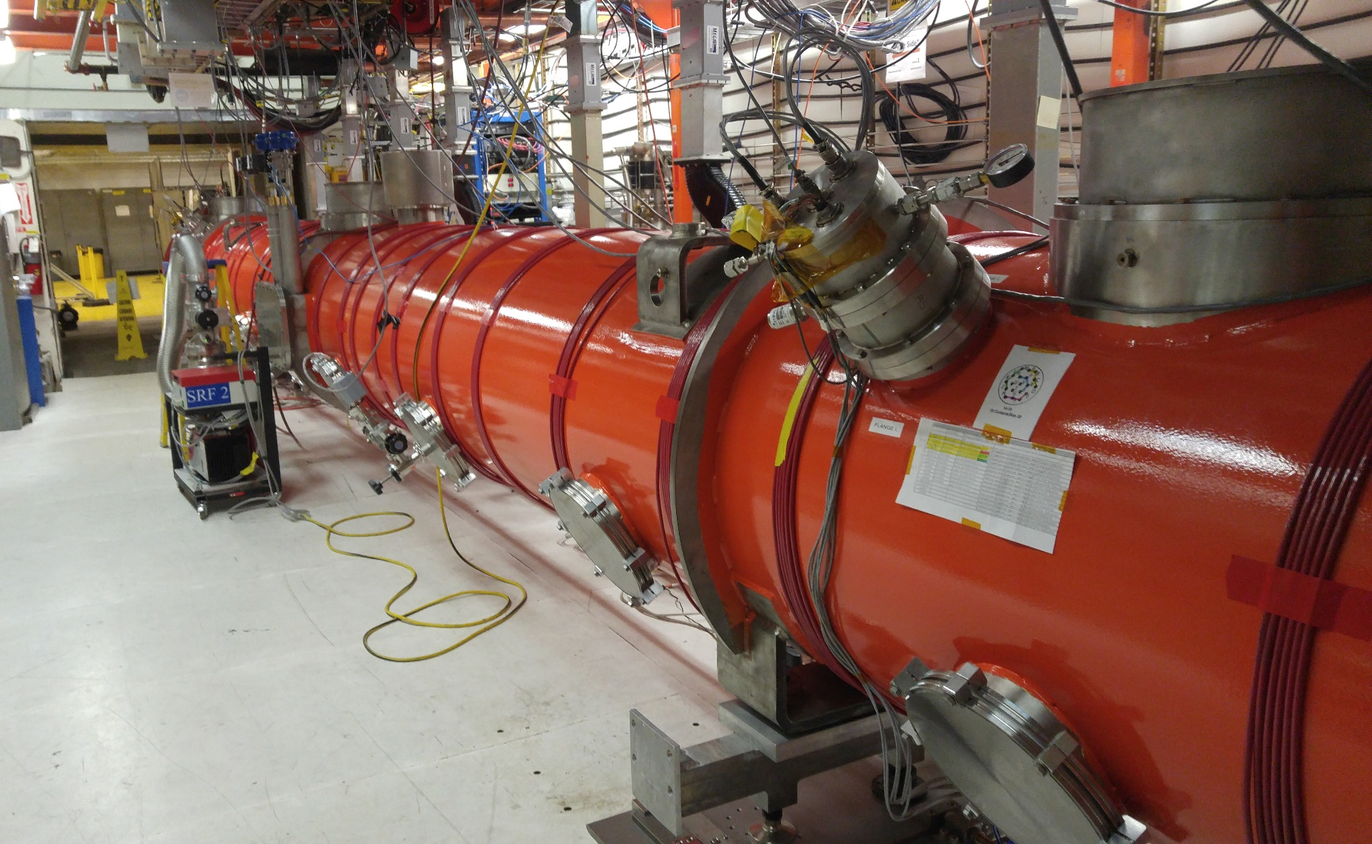
CMTF – pCM Testing in Progress

Slide 3
CM Cooldown (Saga)
15-DEC Cooldown started
Monitored temperatures, pressures and vacuum levels
Maintained limits on GHRP and thermal shields - Temp differences - <15 K vertical, < 50K axial
Proceeded slower than expected due to unexpected pressure drops (1 – 2 K/hr !)
Bypass valve in HX was suspected (Cv – 0.35)
Qo valve in return u-tube was checked and initially ruled out
26-DEC Collected liquid at ~ 0.055 atm (above lambda, unstable)
Re-checked installation of Qo valve actuator installation procedure recommended by mfgr.
Valve was partially closed - once fully opened, return pressure improved
Vacuum levels – 1E-11 torr (beamline), 1E-09 torr (coupler), 1E-06 torr (InsVac)
Note: vacuums have remained stable at these levels throughout testing
28-DEC Collected liquid and controlled at ~0.048 atm (at lambda, stable)
Stable liquid level control over several days
Return pressure improved but capacity was still limited
Debugged faulty liquid level readbacks
03-JAN Achieved stable liquid level control at pressure ~0.035 atm
Kinney pump control settings modified to improve return pressure
04-JAN Began debugging interlocks in advance of cavity testing

Slide 4
CM Cooldown - Observations
Maintained limits on GHRP and thermal shield
Need to verify mixed gas cooldown capability
Cavity cooldown rates from 40K through Tc ranged up to 2K/min
Magnetic field levels at cavities are very good
~ 1 mG average, 4.5 mG peak at one location
LL readbacks are intermittent at times
Possible interaction between CD & JT valves and LL behavior
Rapid filling in upstream end before downstream end when refilling
As at FNAL, observed high heat load on JT valve
Cooldown rate will proceed more quickly (Target is 10K/hr)
Unexpected pressure drops were eliminated
Plan to use warm gas mixing during next cooldown from 300K

Slide 5
Frosty JT Valve (courtesy of J. Nelson)
Revised design based on FNAL guidance
Flow dependent heat load
TAO?
Ice covers brass portion at times (high flow)
Covers only top of pant leg at times (low flow)
Mitigate with fan for this round of testing

Slide 6
Liquid Level % vs Liters (Level)
Some interesting points
0% - 36 L; 100% - 305 L
Control at 80% for level CM
Plan to control at downstream end with sloped CM at ~90%

Slide 7
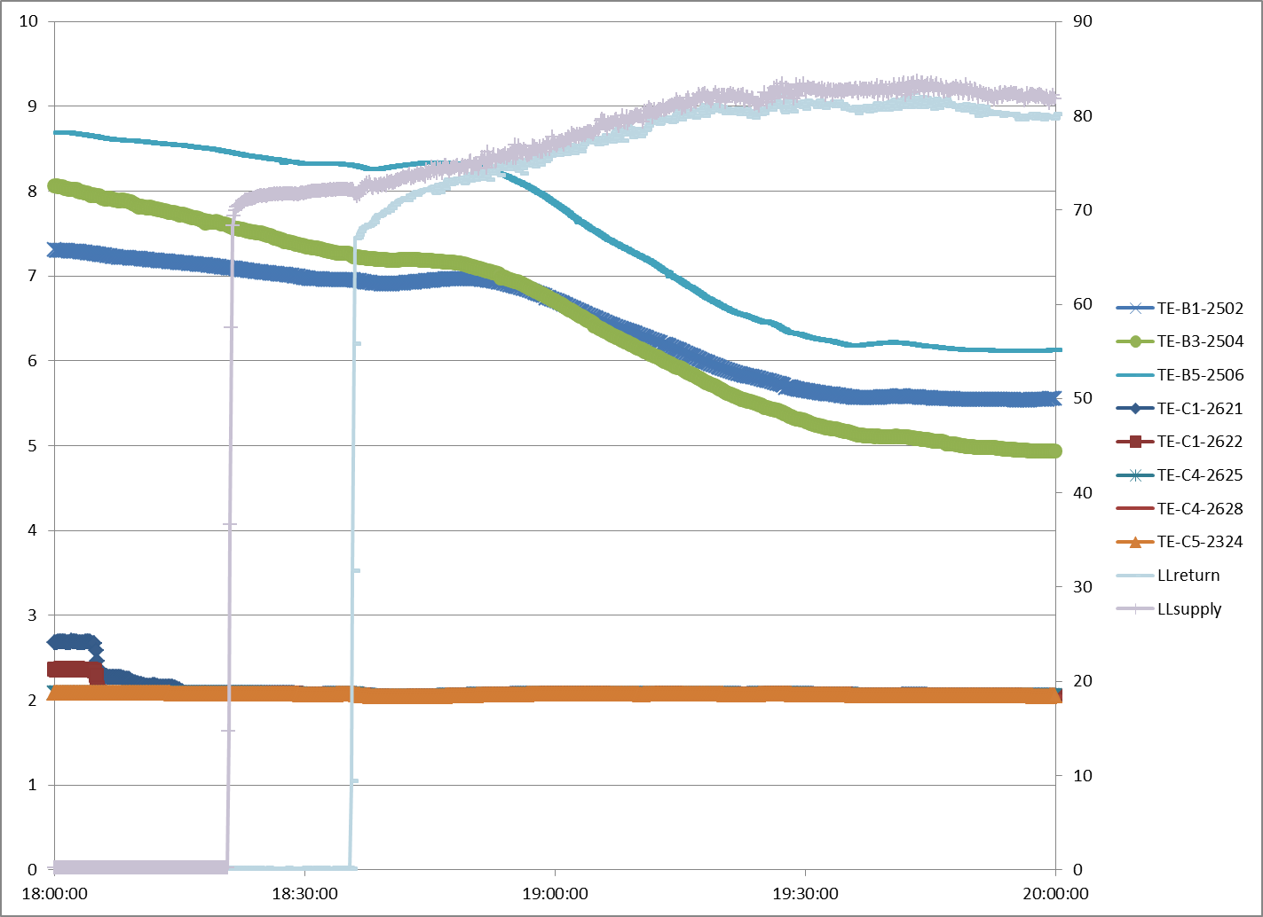
Liquid Level Response – Cooldown from ~50K
GHRP
Cav Temps
LL

Slide 8
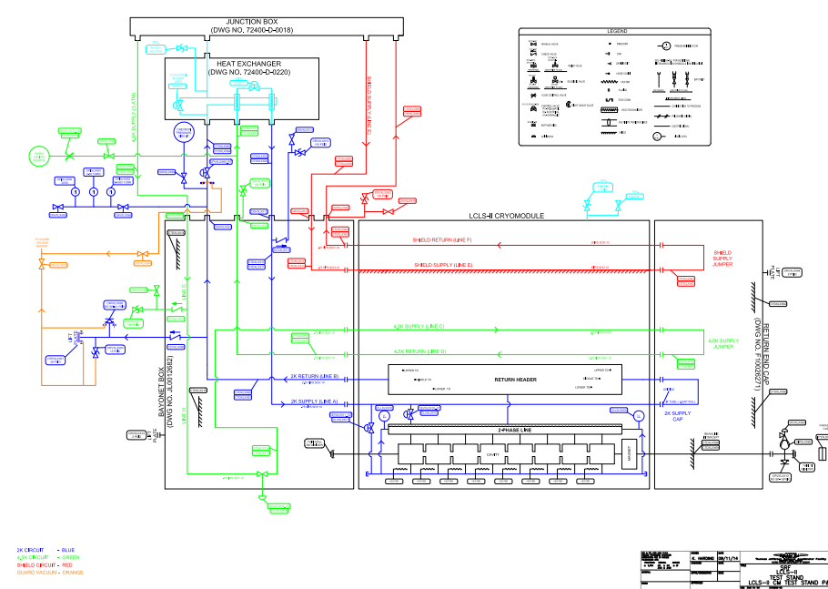
JLab CMTF Bayonet Box & End Cap
4K – 2K HX (CD to AB)
Qo Valve in U-tube
Orifice between line A & B in end cap
CD valve in Bayonet Box

Slide 9
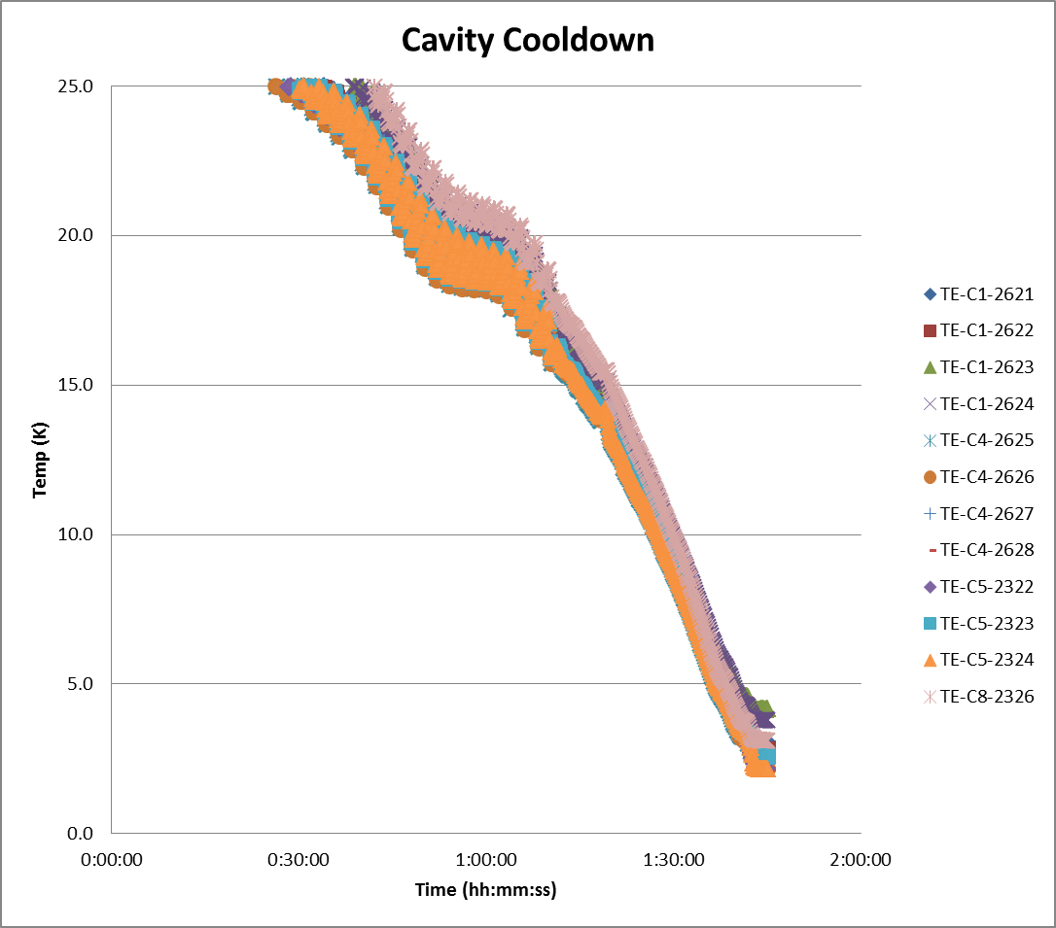
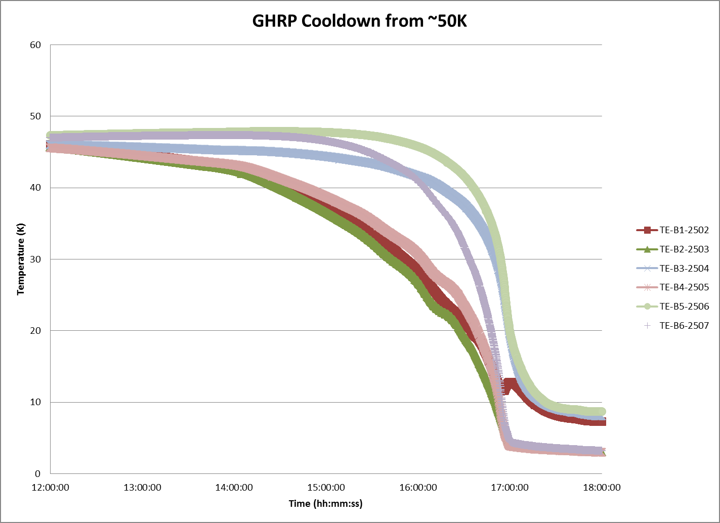
Cooling from 40K
Need to have fast cooldown thru Tc
pCM cooled in about 6 hours from 40K to collecting liquid at 2K
Cavities thru Tc – rates are good to expel flux
Cavity temp. response GHRP cooldown temps
0.5 K/min

Slide 10
Summary
pCM is cold and controlling at level and acceptable pressure range
Expect cooldown to proceed in 3 – 4 days
With proper Qo valve setting
Revised bypass valve sizing (changed in new HX)
Plan to set slope of pCM to 0.5% and check LL response

