Slide 1
Microphonics study at FNAL (pCM)
T.Arkan, B. Chase, J.Einstein-Curtis, B.Hansen, J.Holzbauer, E. Harms, J.Kaluzny, A. Klebaner, M. Mcgee, Yu. Pischalnikov, W. Schappert, R.Stanek, J. Theilacker, R.Wang.
LCLS II CM Test Workshop
January 11, 2017

Slide 2
Status of the Microphonics works (1)
Level of microphonics that measured during first cool-down cycle was in 10-20 time large than LCLS II specs (10Hz peak)
FNAL management put together strong multidisciplinary team (LLRF, mech. engineers, cryo-engineers, resonance control experts, etc.) to address problems with microphonics with FNAL pCM.
In this short talk we will show tests that done so far & preliminary results
Incoming/proposed tests will be presented/testing program can be changed on-going analysis
Our short list of warm tests on CM2 to help (maybe) reduce the microphonics

Slide 3
Status of the Microphonics works (2)
Starting from December, 2016 concentration of the efforts shifted from analysis of just vibration measurements from geophones mounted on the different components of CM (with goals to find external source(s) of vibration penetrated inside CM) to studies the correlation between cavity microphonics & cryo-system operational parameters.
External (outside CM) sources of vibration are not fully excluded yet. Contributions from cryo-flow are dominant… but we can’t conclude at this point that contribution from external sources are non-significant ( below LCLS II spec (10Hz)… )
So far at this stage of studies we think that major sources of the cavities microphonics are cryo-flow induced vibration inside the cryomodule (we are looking forward to the JLAB results as this should give some clear indication of the differentiation of cryo system effects vs. cryomodule effects)
Objectives of this talk to present results of the several tests to measure microphonics on FNAL pCM .. the LCLS II CM cryo-system design and possible impact on microphonics will be presented in Jay Theilaker talk.

Slide 4
Microphonics tests with pCM (during December/ January, 2016/17)
Measurements of the cavities transfer functions (Piezo-to-RF). Objective was to confirm that cavity/tuner system has no low frequency (below 100Hz) resonances. Cavity/tuner TF did not changed from HTS studies.
One shift (8 hours) test at T=2K (recorded microphonics on one cavity at a time)/ during 2 hour test JT valve was fully closed for 5 min…
½ shift ( 4 hours) test at T=2K (recorded microphonics on all 8 cavities simultaneously)
One shift (8 hours) test at T=4K (when cryo-system recovering after Kinney pump trip) – Microphonics at 4K was so large/ data has no value. At the same shift done some efforts to mitigate large (near cavity #1) bellow vibration (analyzing data from geophones)
One shift (8 hours) test at 2K. Stable operation with JT control by AD cryo-control system (2 hours)/fixed position of JT valve/ closed flow to 5K shield / supply He through CD valve…
One shift (8 hours) test at 2K… Regulate Liquid Level into 2-phase pipe through 300mm pipe (Valve PV8AB the AB turn around)

Slide 5
FNAL pCM Vibration Levels
RMS vibration levels are up
to 100 Hz or more
Operating spec calls for 10Hz PEAK
(~2 Hz RMS)

Slide 6
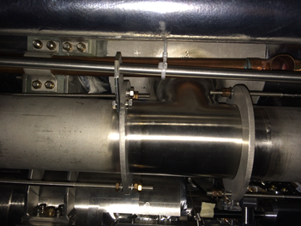
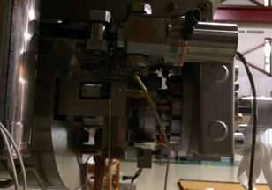
Microphonics Variation
Vibration levels show significant variation in time, amplitude, frequency and space
Two-phase pipe clamped near cavities 1, 4/5 and 8
Cavity 1 attached rigidly to heavy gate valve
Narrow helium supply line from JT valve connects to 2-phase pipe between cavities 3 and 4
TAO at JT valve (near cavity 5)
FNAL Microphonics Team| Microphonics at FNAL pCM

Slide 7
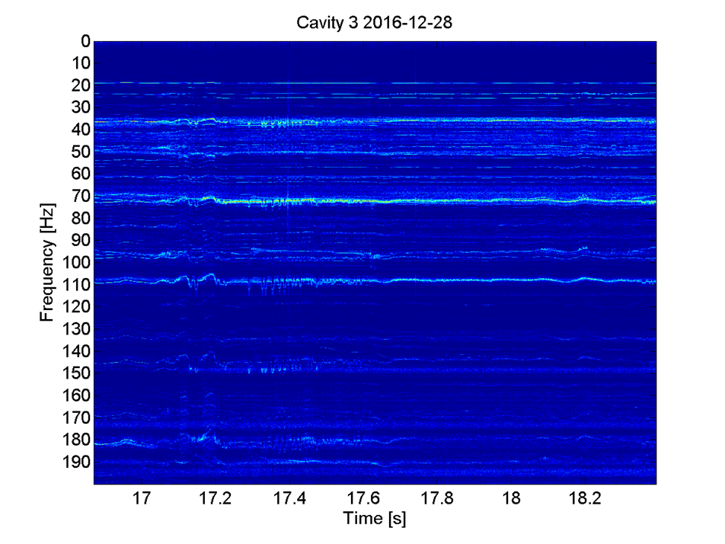
Microphonics Variation
Spectra show dominant vibration frequencies are time dependent

Slide 8
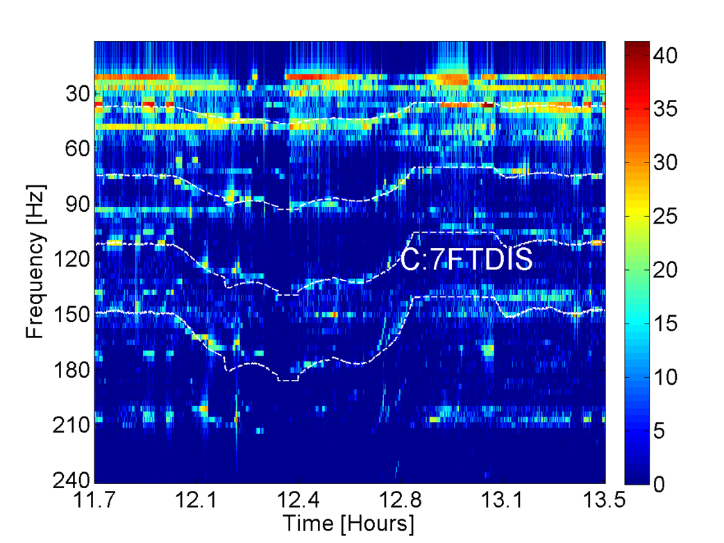
Candidate Vibration Sources
Spectra show dominant vibration frequencies are time dependent
Some frequency lines correlate well with output mass-flow
Cryogenic noise is most likely candidate

Slide 9
Planned pCM Microphonics Studies
The goal of this testing is to identify specific components of the cryomodule that are microphonics sources.
Modulate/perturb existing cryo configuration
JT valve to change flow rate (flow noise)
Change liquid level (2-phase pipe configuration)
Reroute flow within cryomodule to isolate components/flow paths
Flow through fast cooldown circuit to change thermal distribution
Run with bypass valve open to provide phase separation in 300 mm pipe and reduce flow through 2 K valve/supply pipe
FNAL Microphonics Team| Microphonics at FNAL pCM

Slide 10
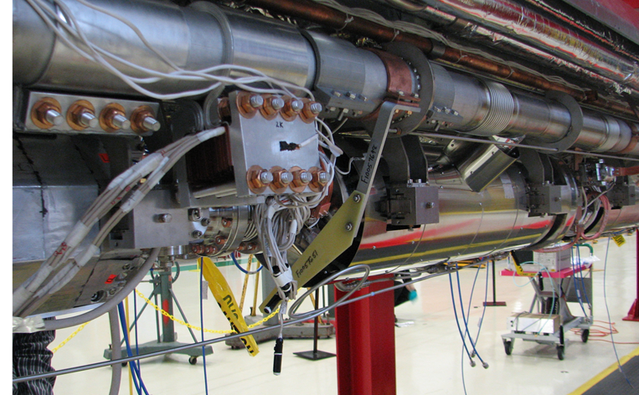
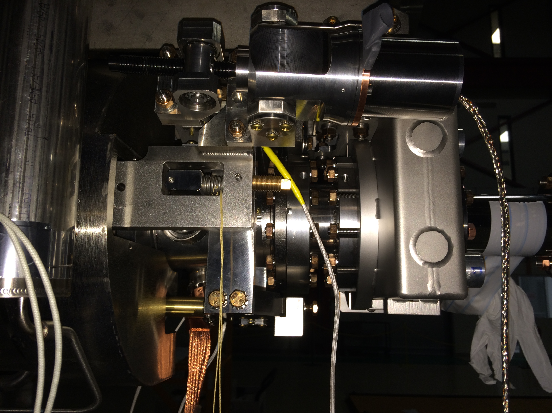
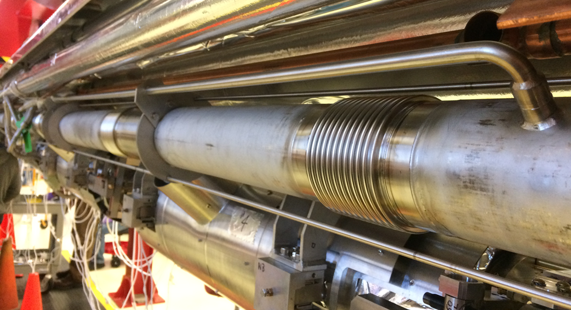
Proposed plan for passive microphonics mitigation at CM2 (FNAL)
Support the capillary line from upstream end liquid level probe to cavity#1 & #8
Measure with Tuner (piezo-as a sensor) vibration of the 2-phase pipe invar rods clamps. If we will find it important to G-10 supports around the 2-phase for these long invar rods.
Evaluate (measure) transfer function of the cavity #1 (Cavity 1 attached rigidly to heavy gate valve)
Repeat warm/ impulse response of the cavities on the string (using piezo-as-a-sensors) … review results … before weld lower shield on the CM02
Larger diameter JT fill line? (Will be discussed in Jay’s talk)

Slide 11
Current Focus/Summary
Current focus is on
Vibrations of 2-phase supply line (Jay Theilacker)
Helium gas supply temperature at JT valve input (Jay Theilacker)
TAO in JT valve (ice on the top & correlation of JT valve vibration with cavity detuning)
Gate valve rigidly attached to Cavity 1
End cap bellows vibrations
Suppressing microphonics to required levels will need a concerted effort on the part of EVERY group involved in the design and operation of the machine
Too early to draw any firm conclusions
Important that FNAL put together strong team with expertise in all aspects (cryo; mech; control; tuners; analysis)
We collected significant amount of the data/ have detail program for studies/analyzing data & modifying test plan as we go..
Based on results from microphonics level at FNAL’s pCM assumption that resonance control of SRF cavities in LCLS II linac can be done without active piezo-control looks quite questionable.
FNAL Microphonics Team| Microphonics at FNAL pCM

Slide 12
Additional Slides

Slide 13
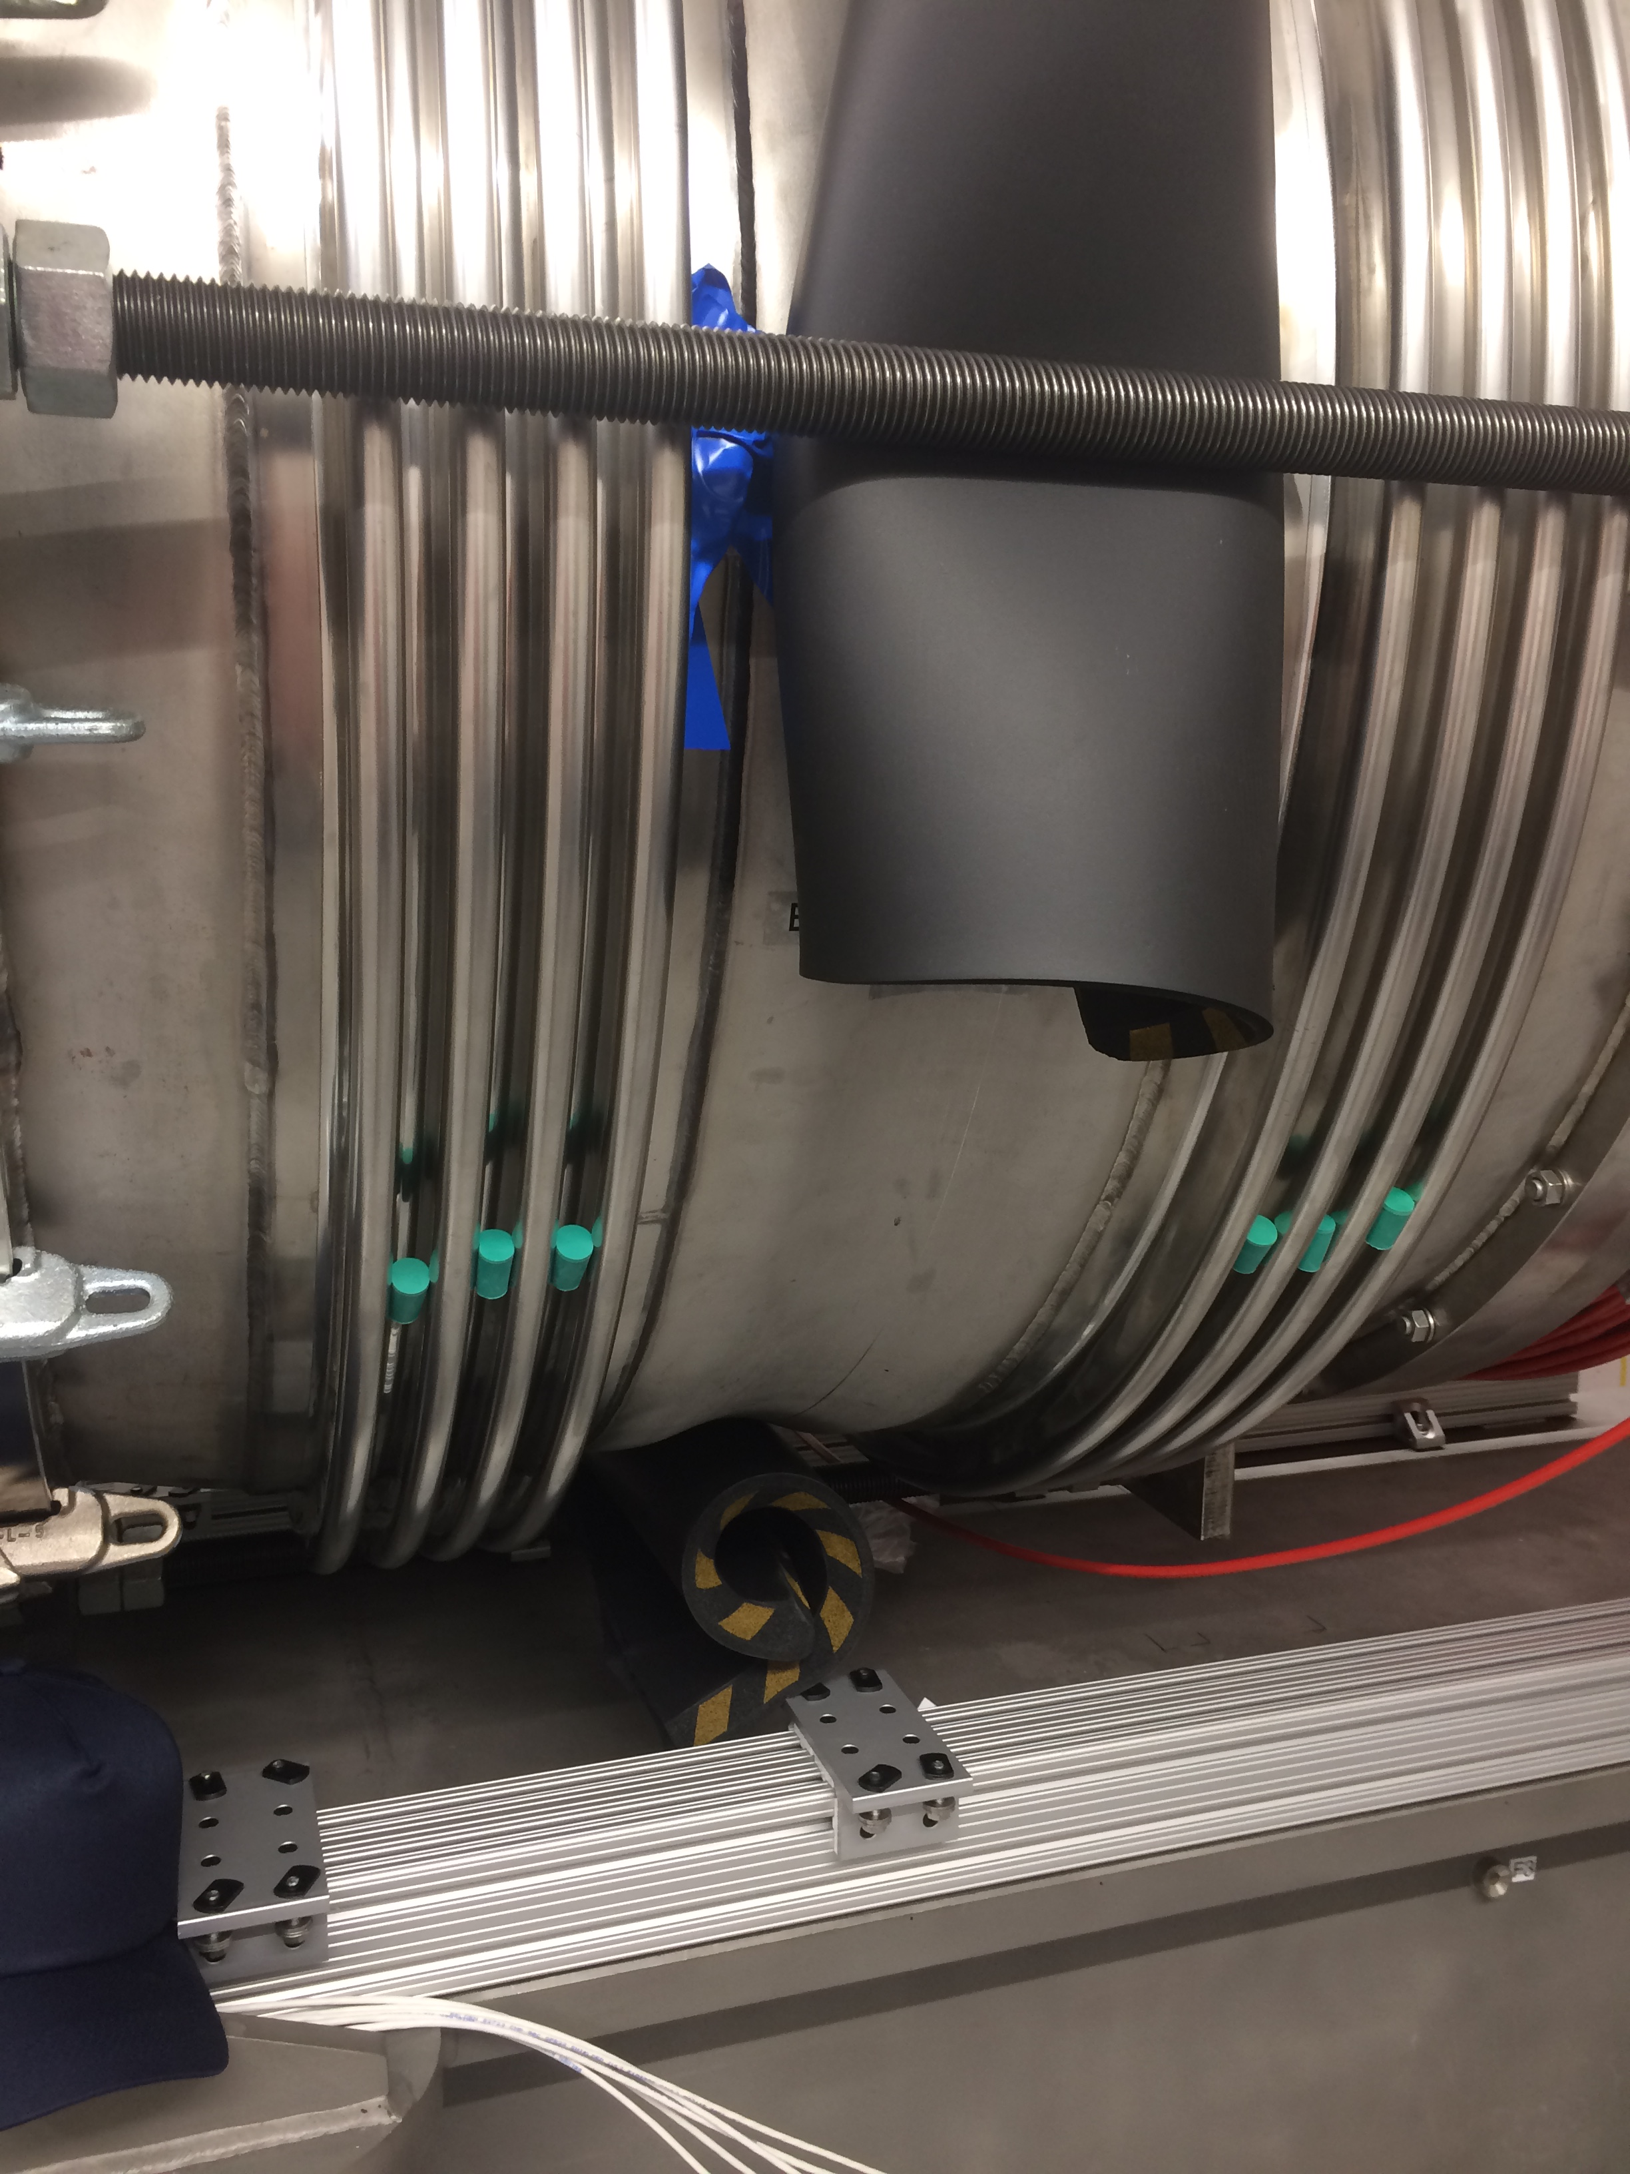
Upstream Cryomodule Bellows Modification
19Hz line
Spectrum while bellows unconstrained
Spectrum while bellows constrained with rubber padding on collar and in convolutions.

Slide 14
Correlation between geophones mounted in different locations outside CM and cavities (recording signals from geophones and piezo-cavity vibration sensor)
Strong correlation between cavity detuning from RF and signals from piezo
Study correlation geophones (external vibrations) and cavities microphonics is under way

Slide 15
