Slide 1
Agenda for assembly in cleanroom session
Is a beamline purge system necessary during assembly?
  What beamline purge system is being used and how does this compare to XFEL?
  Should a study of the beamline purge use be carried out to understand the correct flow to be used and particle migration?
Differences in assembly techniques for string assembly at FNAL and JLab and possible correlations to CM performance
Issues identified during pCM assembly that need to be improved –path forward, lessons learned
Hardware cleaning techniques at each lab
Copper plated beamline components

Slide 2
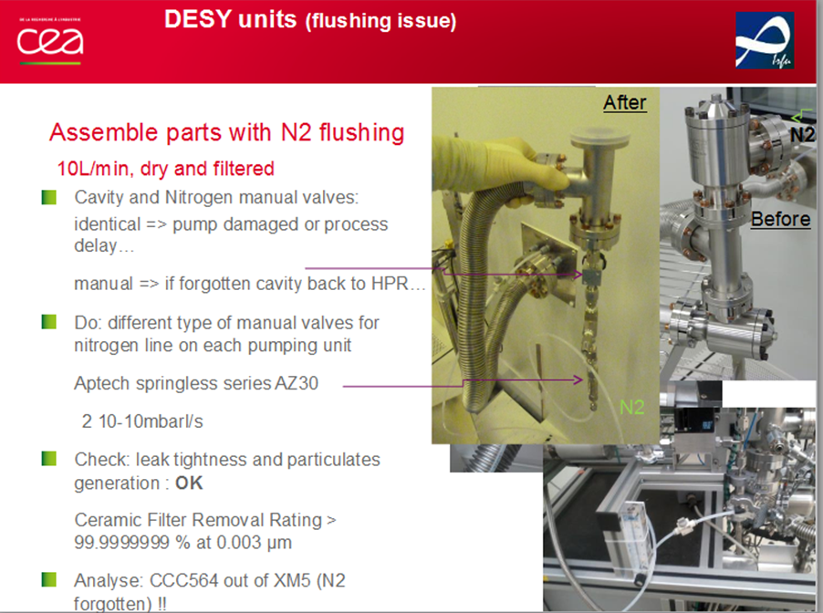
Beamline purge
The maximum venting flow is based on data (Zapfe SRF2007): 3L/min for N2
The purging flow is based on DESY experience: 10L/min (depending on cavity port aperture)
Videos from the DESY cleanroom showed that with this purging flow rate, cavities are protected from particles, metallic fibers to migrate/fall into the beamline during assembly
At Saclay for the XFEL CMs assembly in the cleanroom, 10 liter / minute dry, filtered nitrogen flow was used. Backfill to atmospheric pressure was done through the corrugated flex hose with 3 liter / minute flow. Purge was done through a flexible line which is connected with a tee to the right angle valve of a cavity
TTC topical clean room assembly 2014: https://indico.in2p3.fr/event/10347/timetable/#20141113.detailed

Slide 3
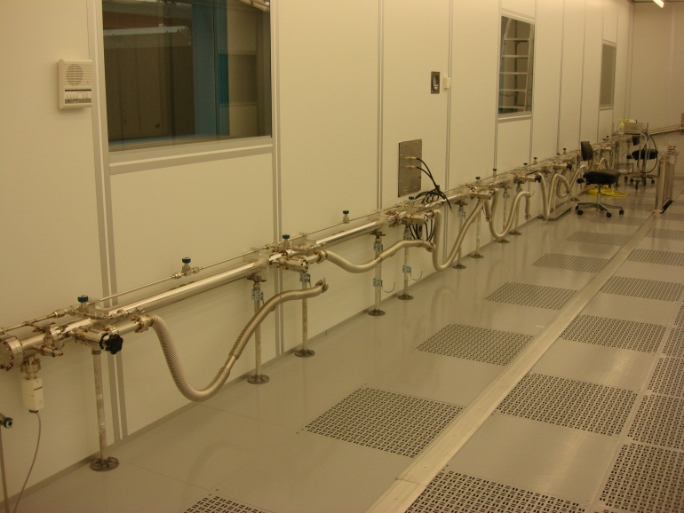
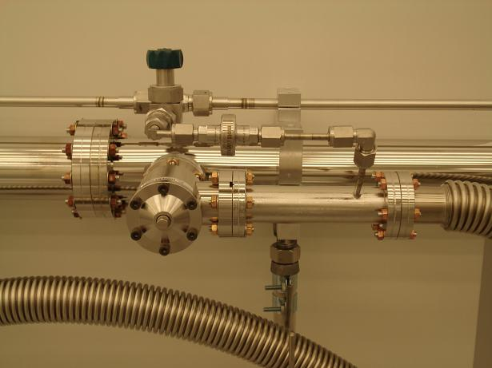
Fermilab CAF cleanroom Vacuum / Purge / Backfill Manifold
3 inches diameter 304 electro-polished SS vacuum header
1/2 inches diameter 304 electro-polished SS backfill/purge line which also goes under the raised floor
8 pump/purge points to assemble 8 cavities string + magnet/BPM package with LN2 boiled-off gas cross flow during assembly (1 liter/min)
Vacuum gauge and calibrated leak
Nitrogen in-line and point of use filters: Mott Defender series sintered all metal (0.03 micron)

Slide 4
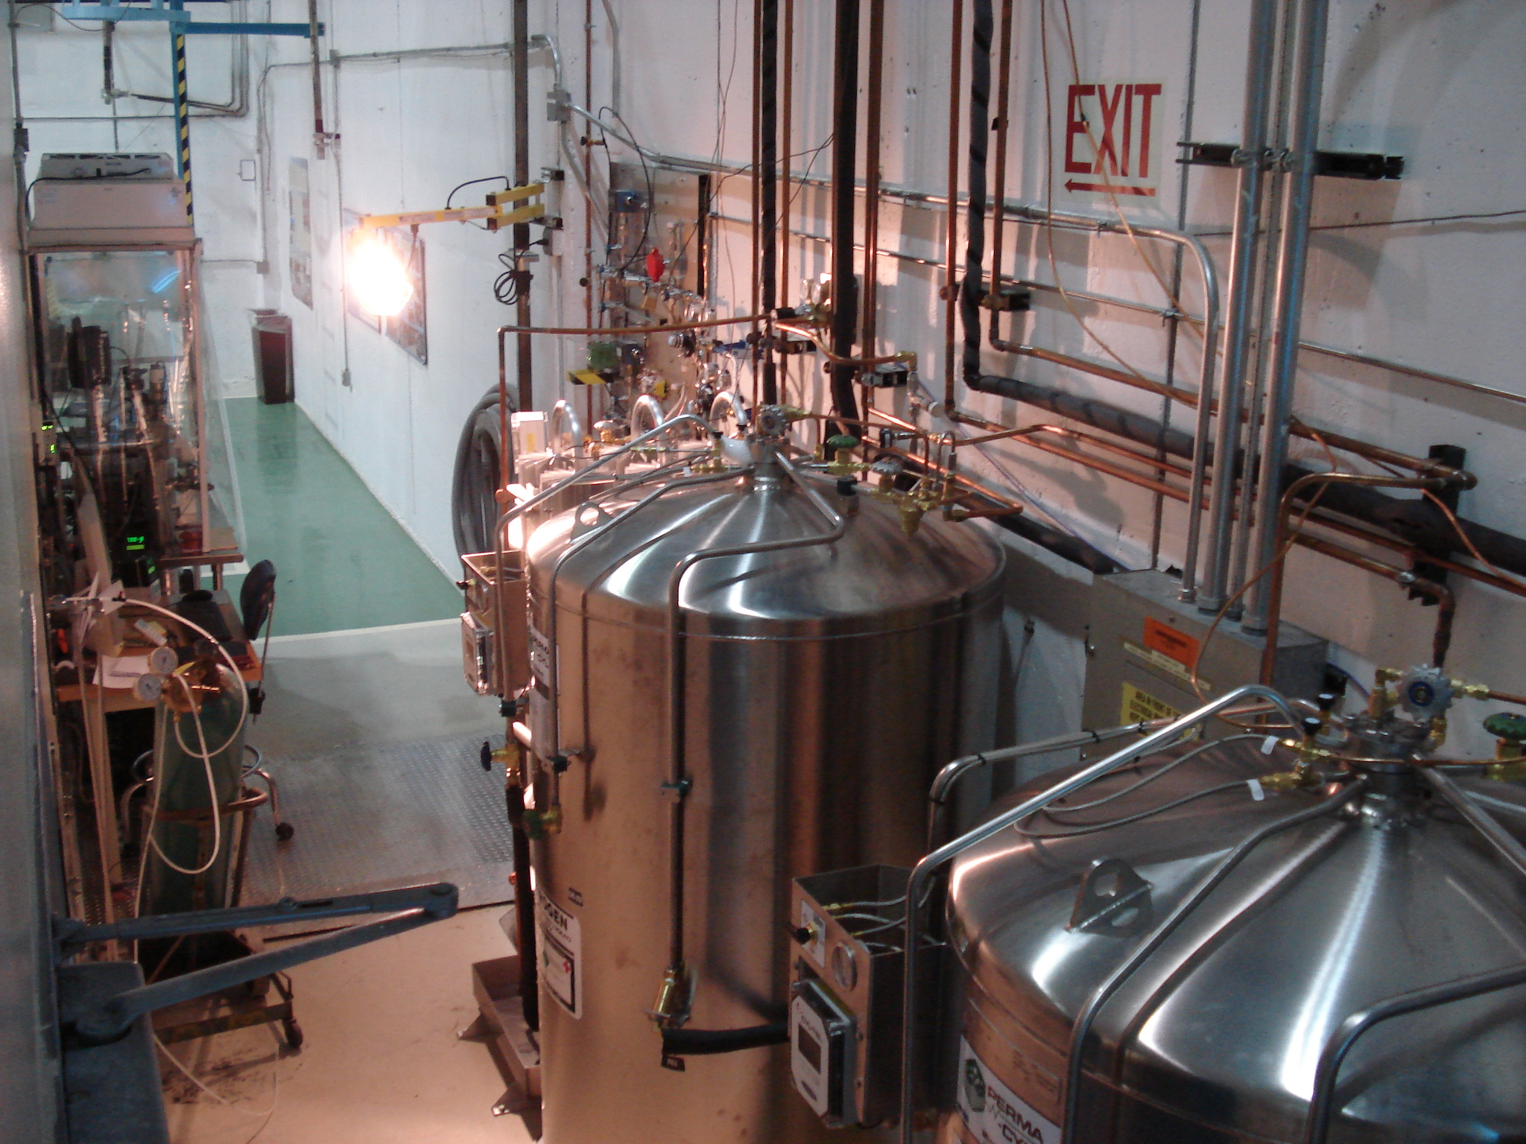
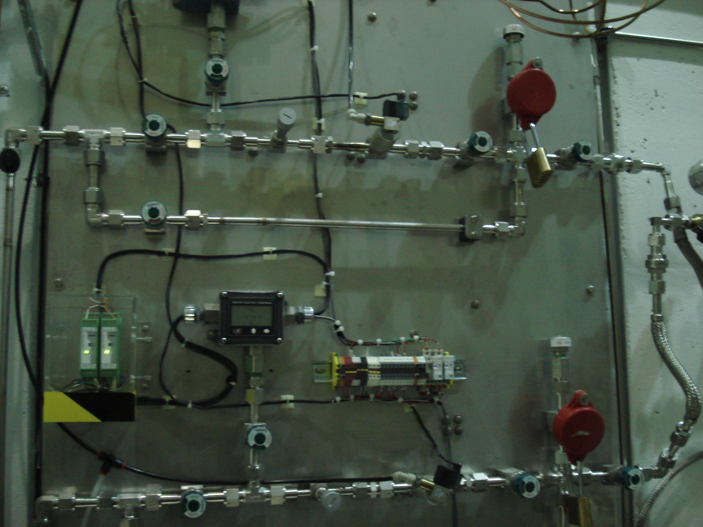
CAF Boiled-off Gas Dewars and Manifold
Upgraded dewars for the anticipated LCLS-II throughput:
300 liters LN2 dewar for cavity backfill and purge
1000 liters LN2 dewar with volumizer for Class 10 WS1 and Sluice area blow guns
1000 liters LN2 dewar with volumizer for Class 10/100 WS0 and UHV cleaning area blow guns
Gas manifold for the cavity backfill and purge operations:
Filter, relief valve, solenoid valve, needle valve, pressure transducer
Set values: Backfill the cavity beamline to 1050 mbar abs pressure with 1 liter / minute flow rate. Purge will start immediately when the pressure transducer senses less than 50 mbar gauge and will stop when it reaches to 50 mbar gauge slightly above atmospheric pressure.
Recommendation noted about flow rate variability from a fixed orifice needle valve depending to the inlet pressure

Slide 5
JLab cleanroom
Slow venting of the qualified cavity beamline before cavity beampipe and FPC flange blank peripherals disassembly and HPR
If needed, slow venting of the cavity string after a leak check to repair leaks
No purge is setup and used in the cleanroom

Slide 6
String Assembly Differences
Cavities receive HPR at JLAB after high power test and prior to string assembly
FPC bodies at JLAB are not installed and leak checked prior to installing cavity on lollipop system
JLAB does not use a purging system during string assembly.
After string completion cavity string is pumped down and leak checked. The goal is to pump the string only this one time during the entire cryomodule assembly.
Sub-assemblies and bellows are completed using different procedures (slides to follow)

Slide 7
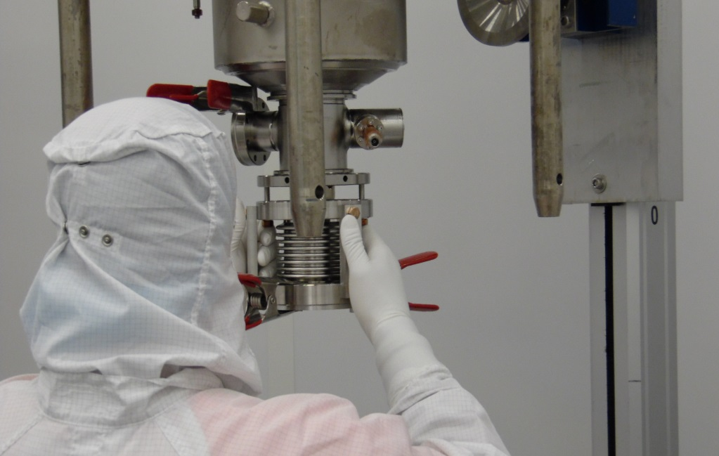
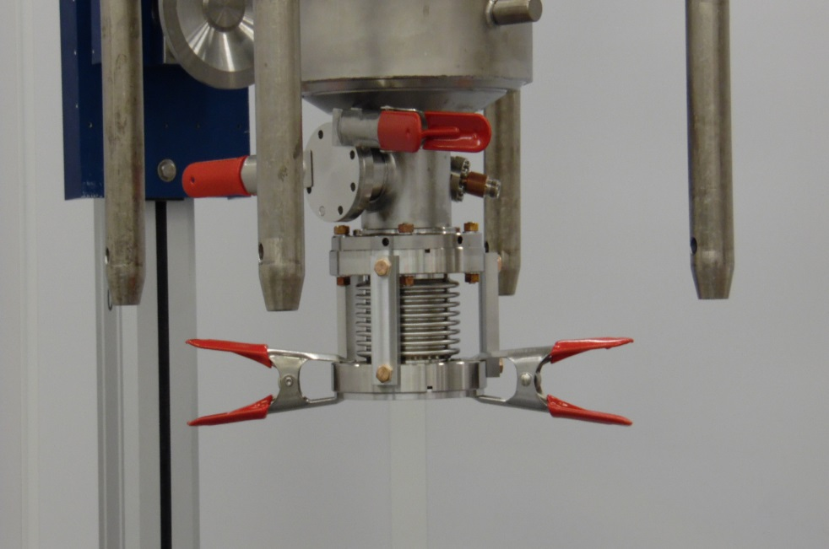
String Assembly Differences (cont.)
Bellows are attached to upstream cavity in a vertical position prior to placing cavities on the lollipop system
Bellows alignment fixtures are different at the two labs. JLAB uses a stiffener system that is placed on bellows prior to attachment on upstream cavity
Extensive studies were done to choose the plate, gasket and spring clamp for the minimum particle generation

Slide 8
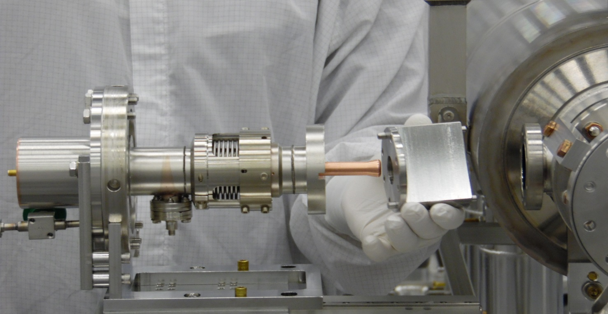
String Assembly Differences (cont.)
Although the FPC alignment tooling is similar, the procedures for aligning FPC to cavity flange are different
Alignment blanks are installed on cavity and FPC prior to installation in tooling. The alignment is performed, blanks removed, gasket inserted and finally assembled
Recommendation noted to clean this tooling after each string assembly
Better process control and quality assurance checks to eliminate the alignment problems encountered during assembly of pCM

Slide 9
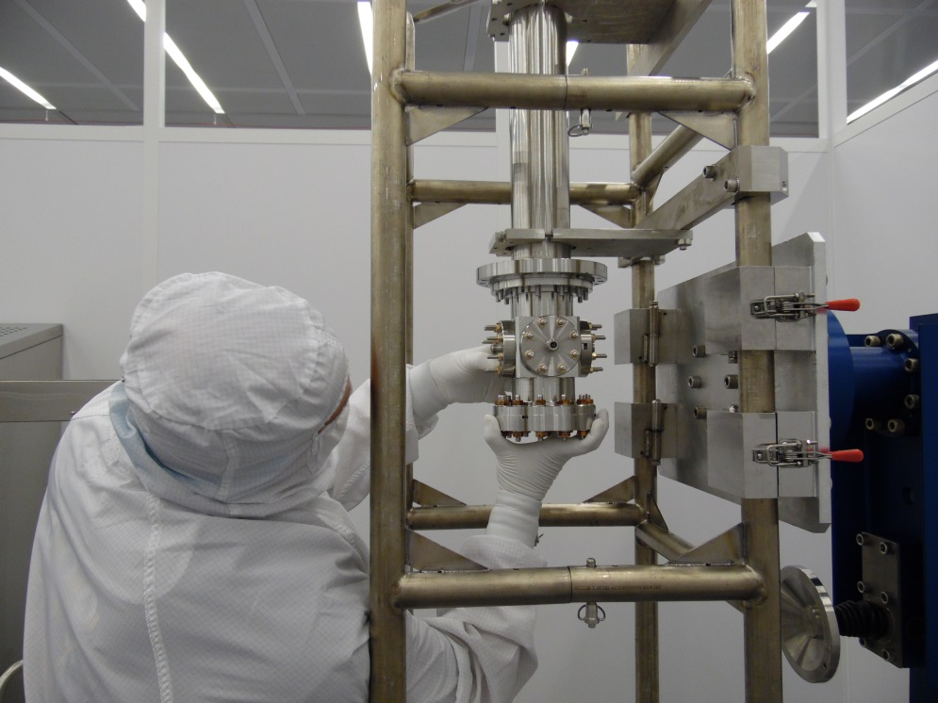
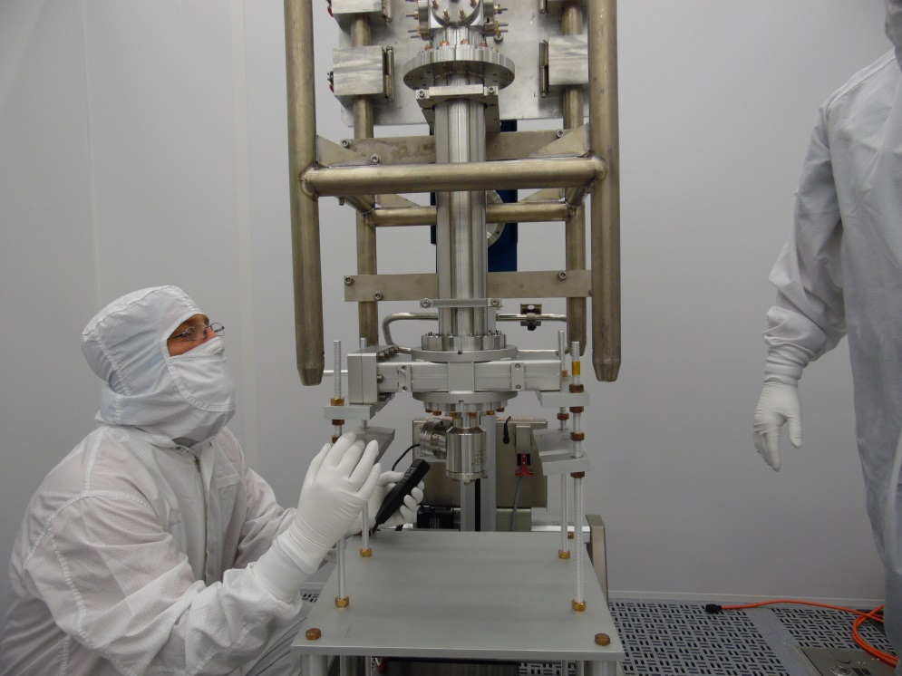
String Assembly Differences (cont.)
BPM sub-assembly at JLAB is completed vertically prior to placement on lollipop system
Leak check performed on sub-assembly and it remains under vacuum until ready for attachment to cavity #8
Modified for ProdCM string assembly, it will be done in horizontal configuration

Slide 10
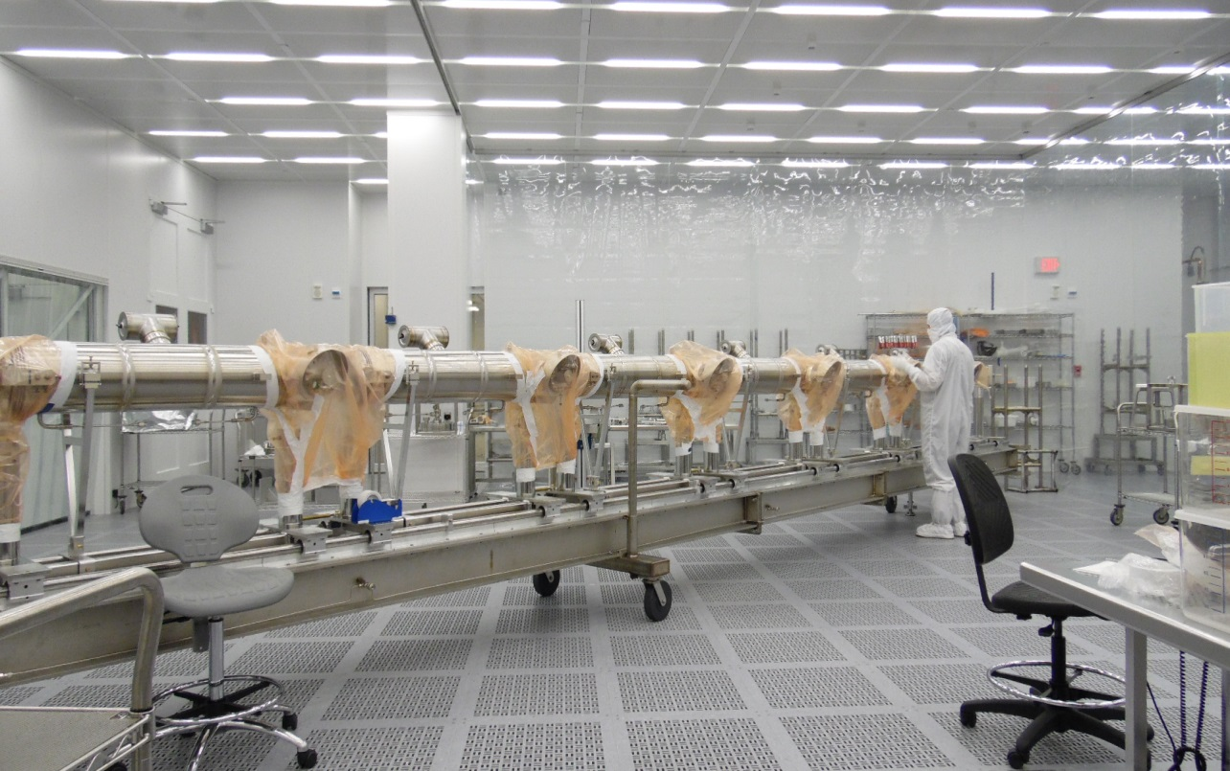
String Assembly Differences (cont.)
Leak checks are similar with differences in the type of detectors being used.
JLAB uses Residual Gas Analyzers with calibrated leaks to calculate MDL. FNAL use leak detection system with automatic MDL calculation.
Recommendation noted for use of torque wrenches for LCLS-II strings assembly in the cleanroom
Over-torqueing of the fasteners to fix a leak is noted. DESY recommendation shall be reviewed further

Slide 11
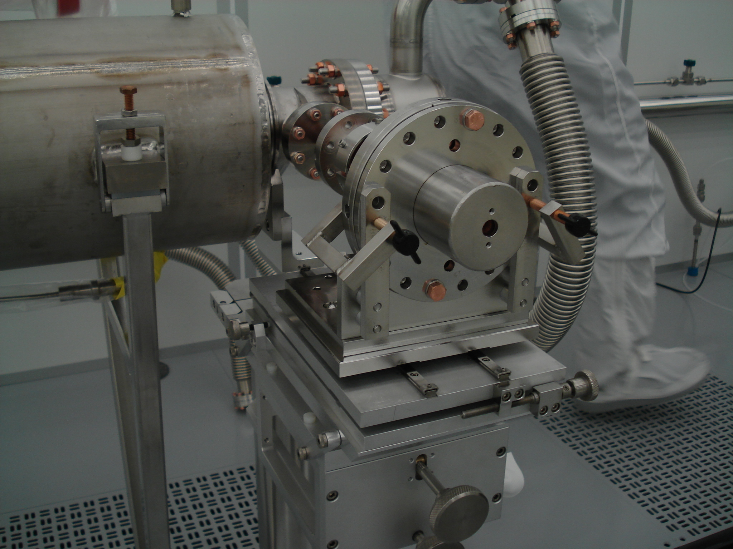
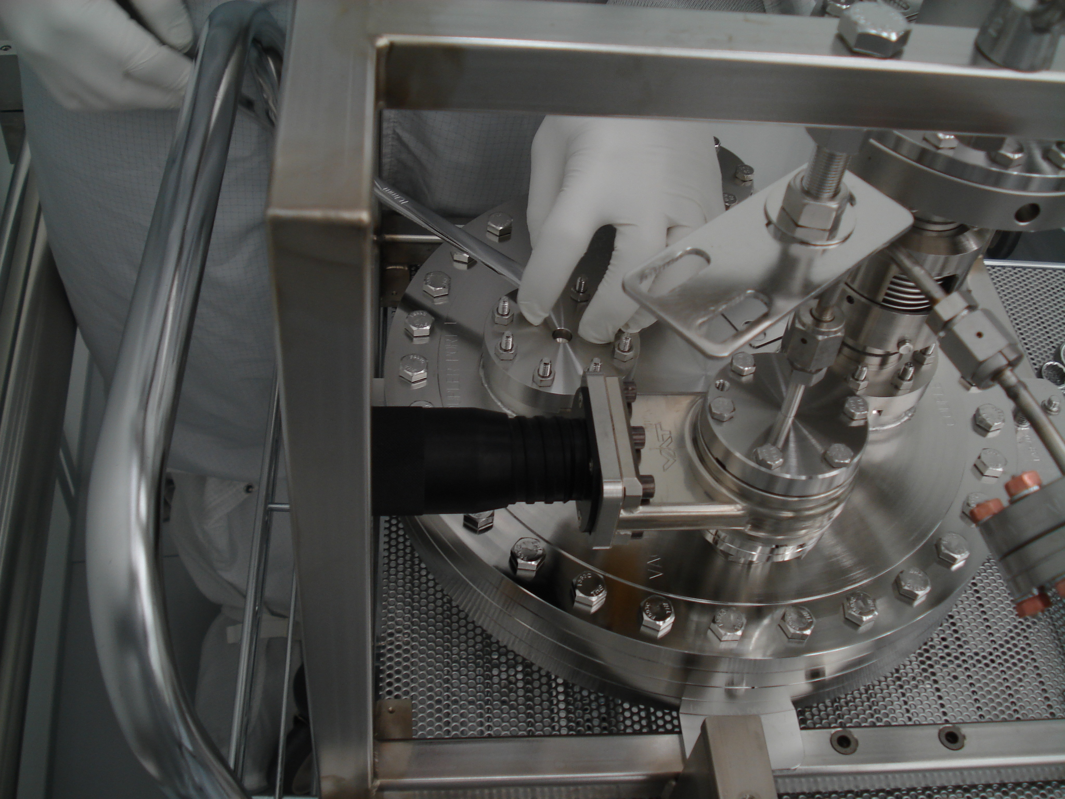
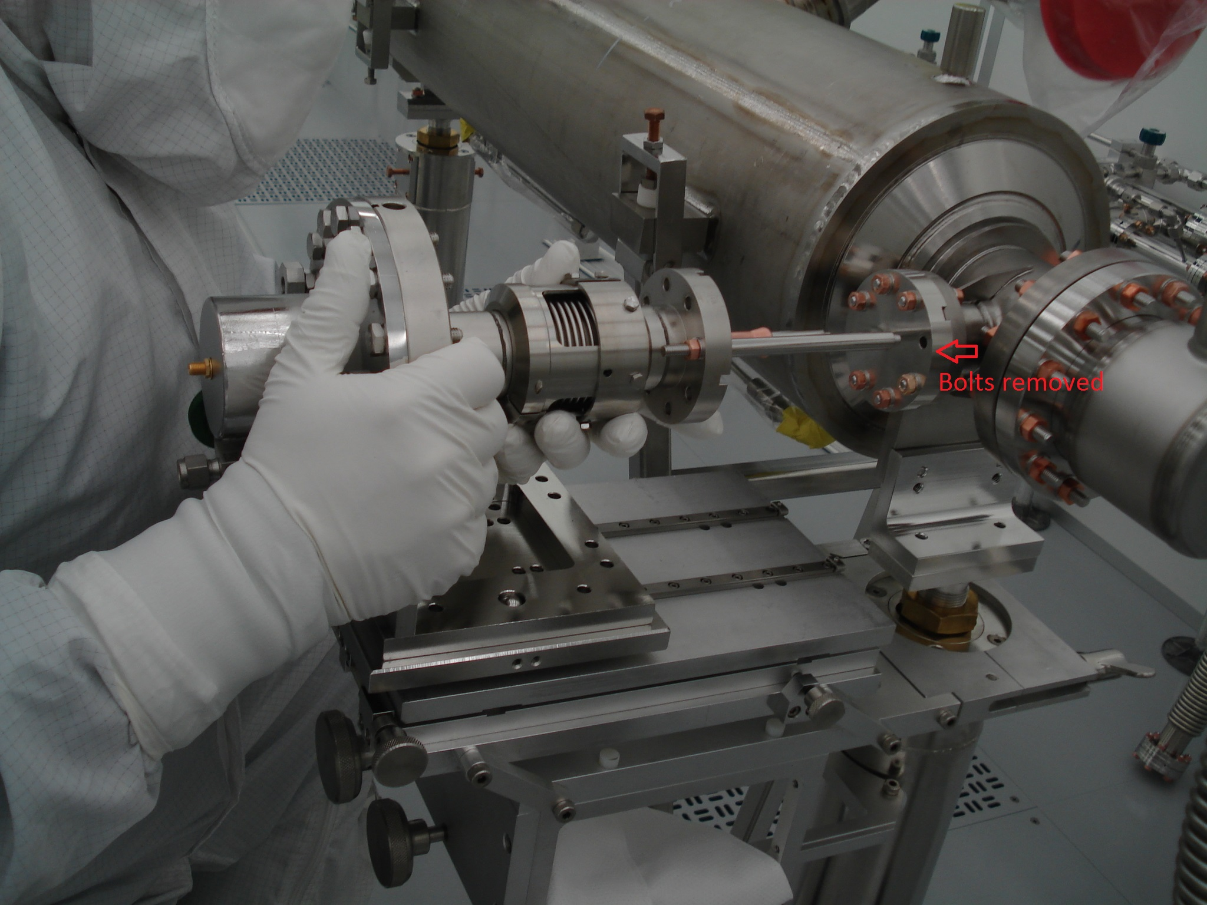
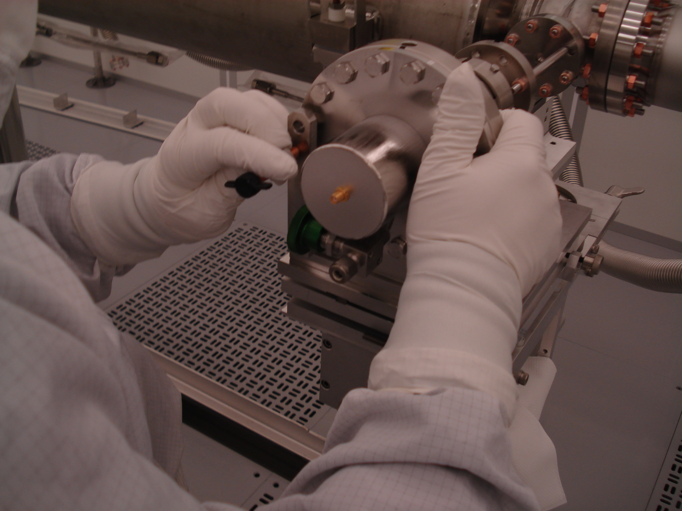
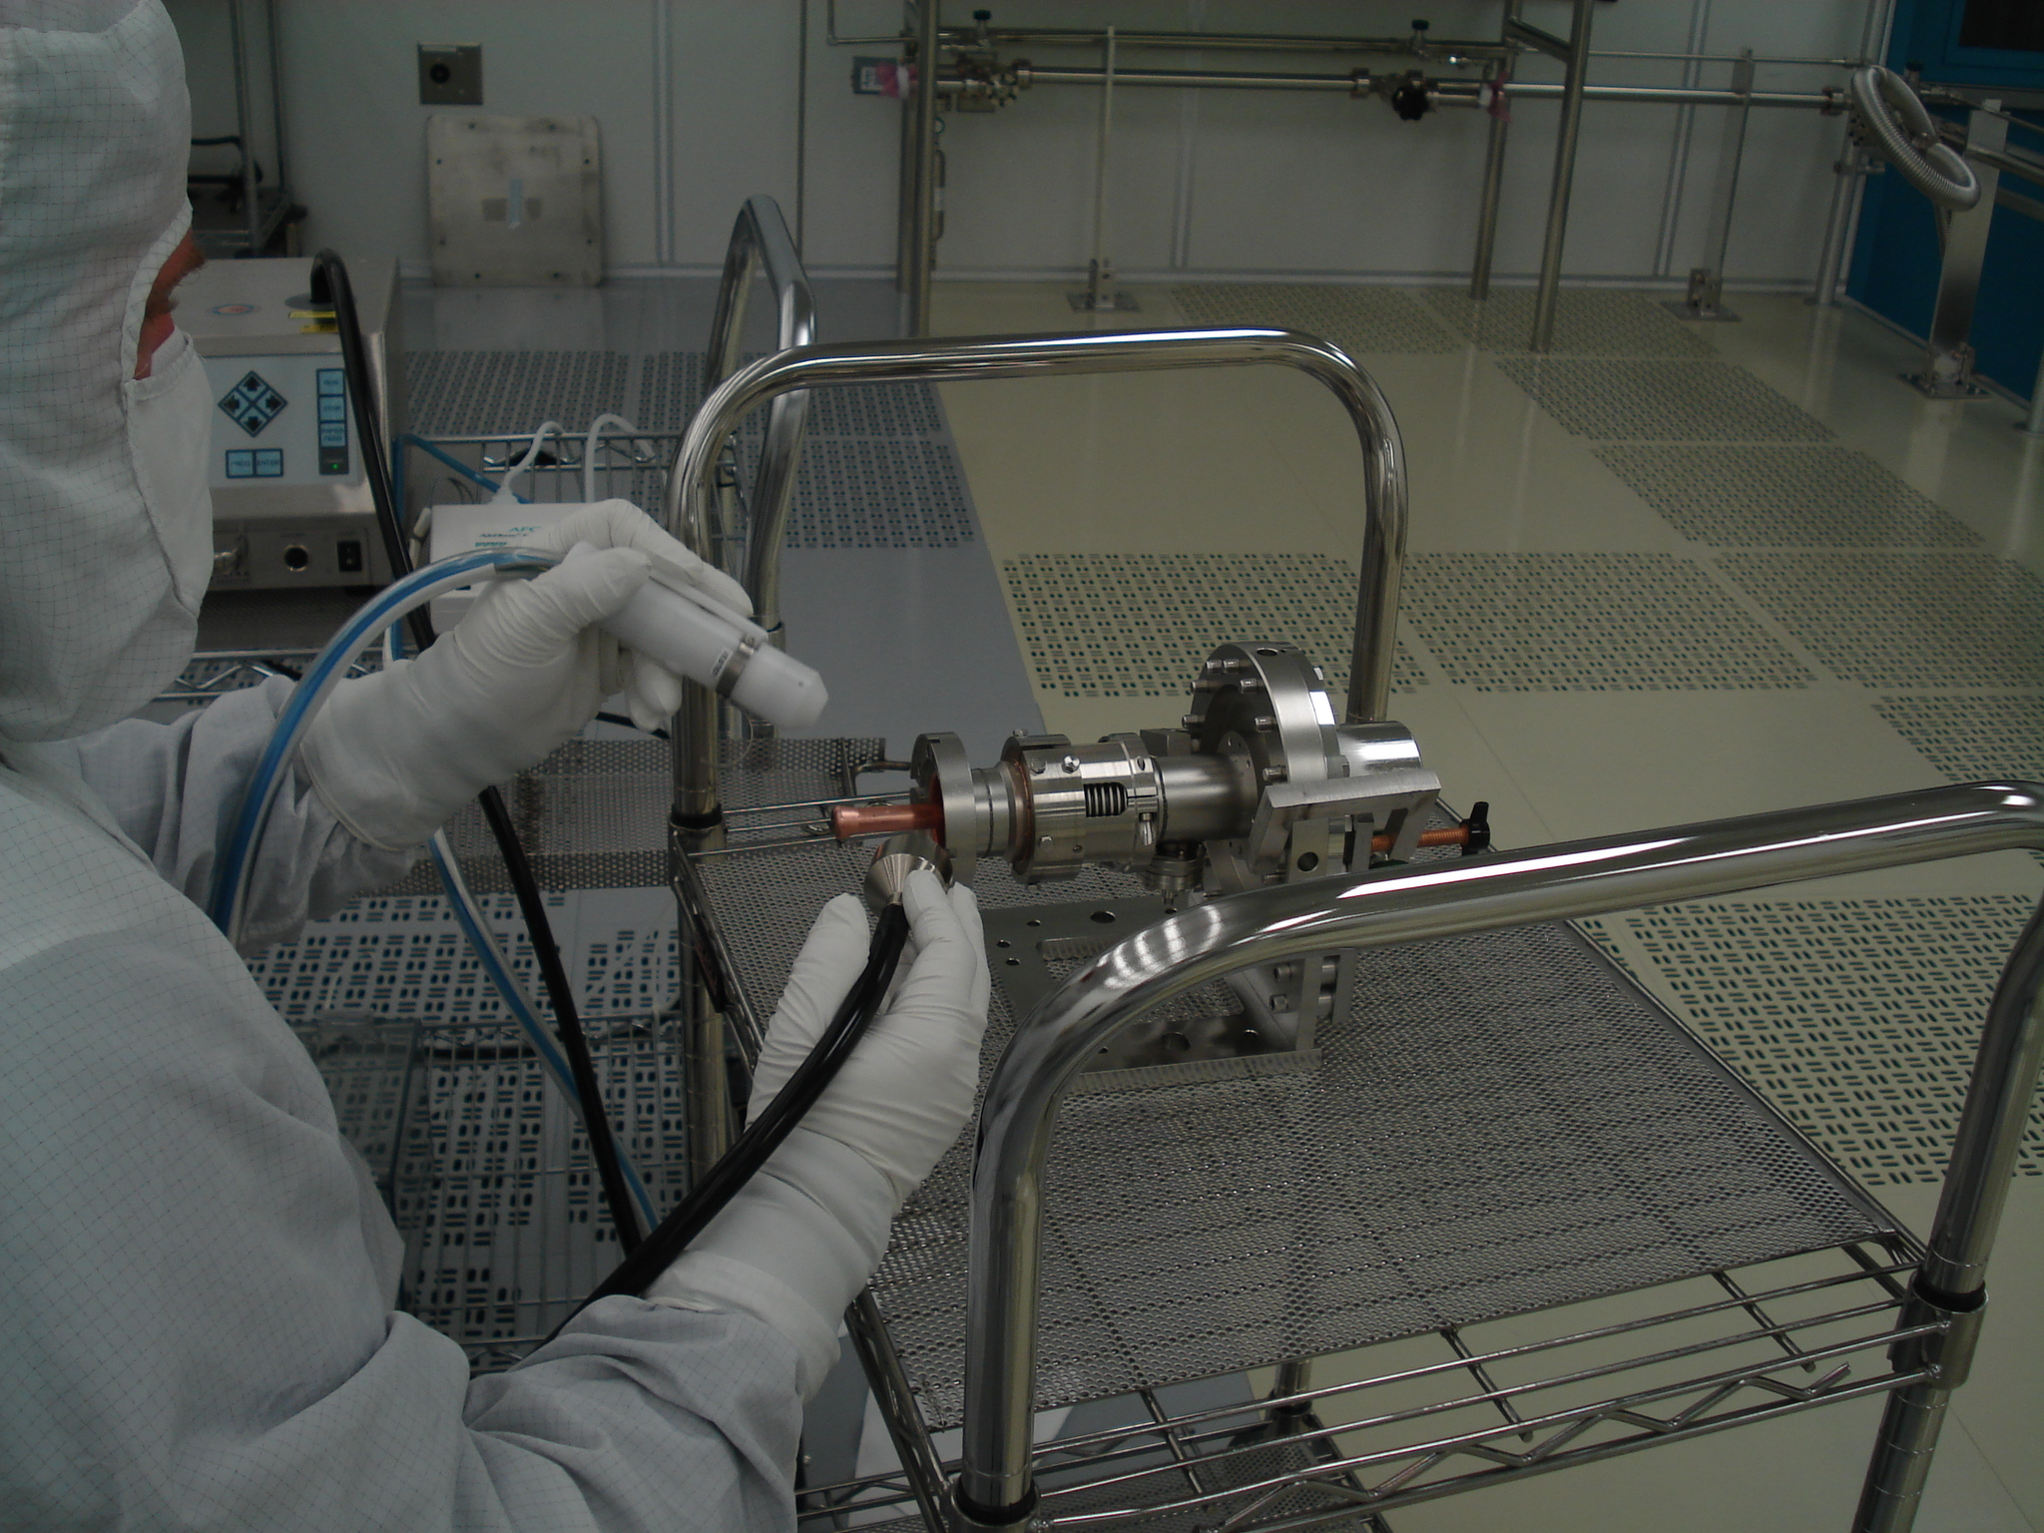
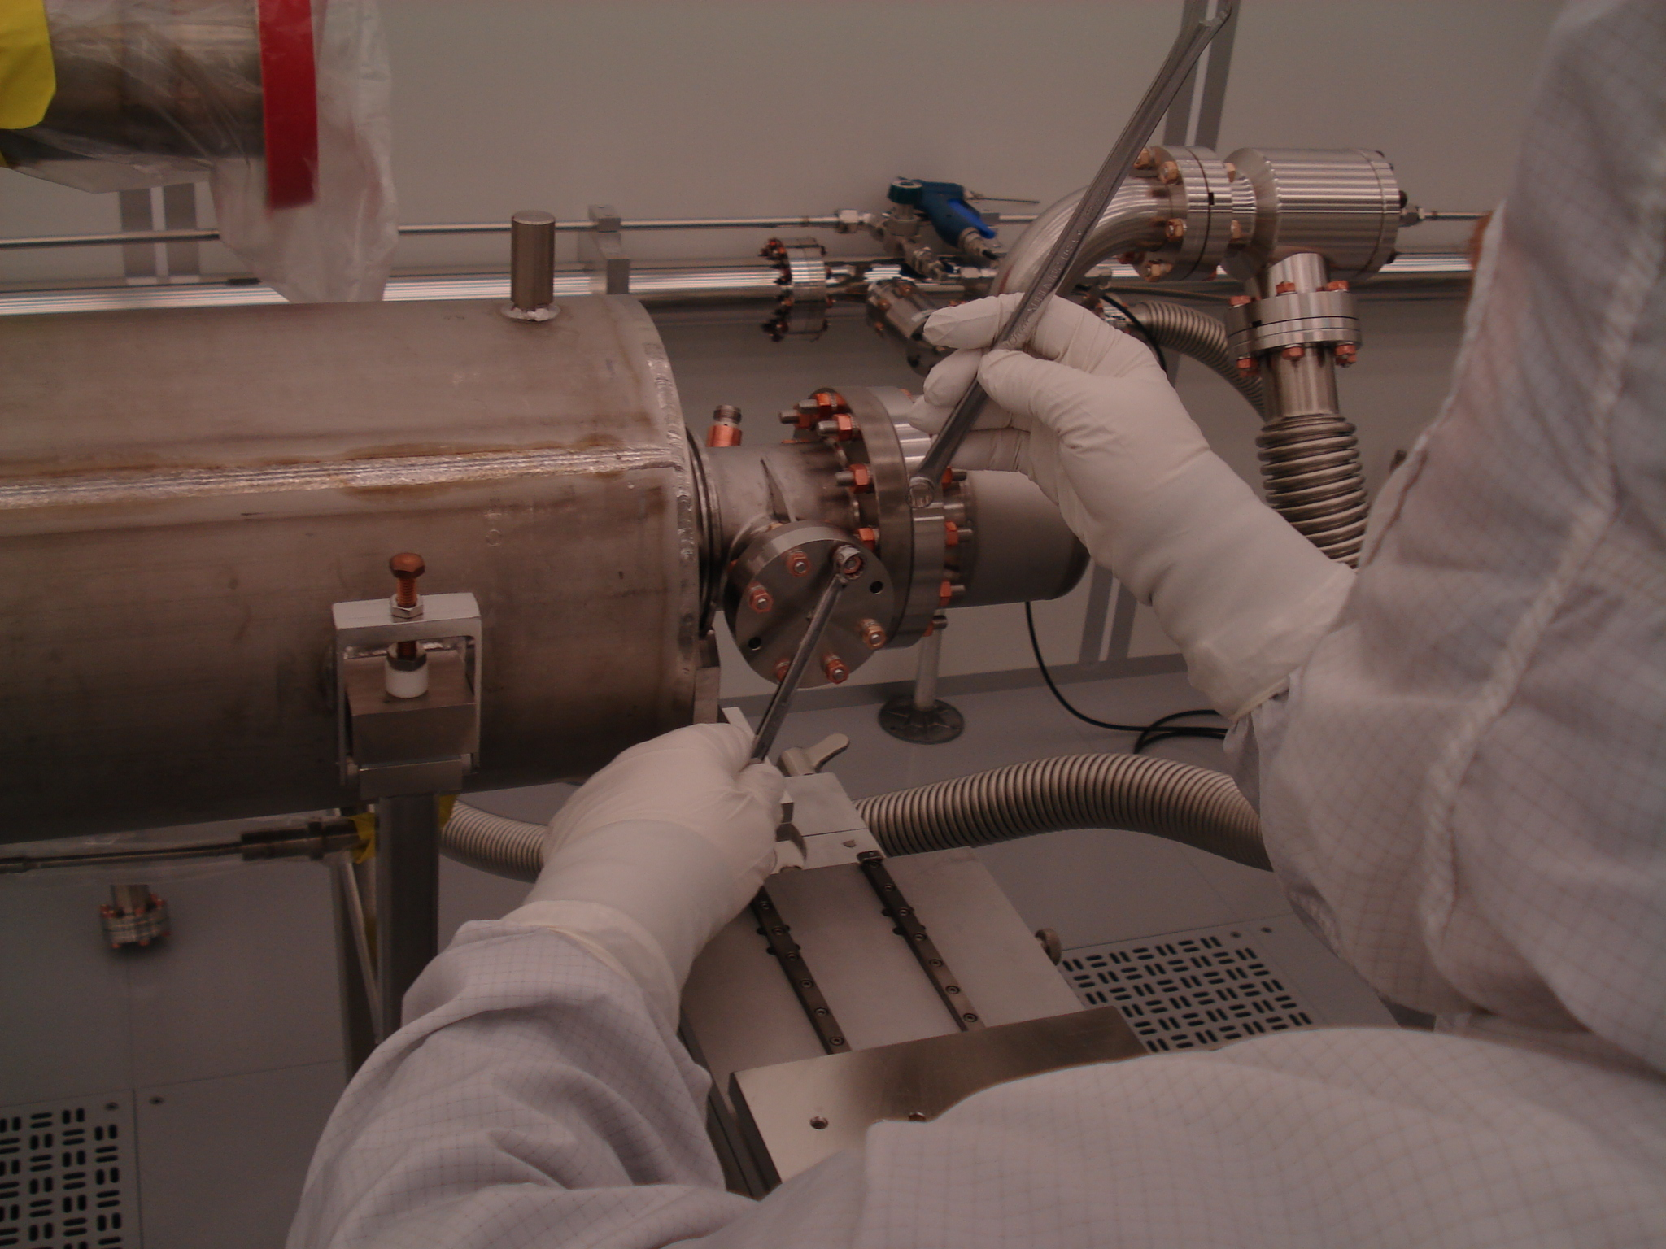
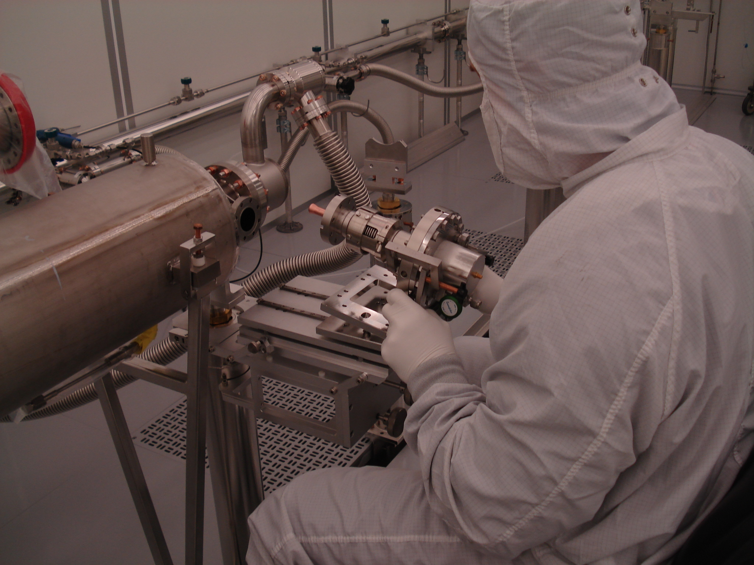
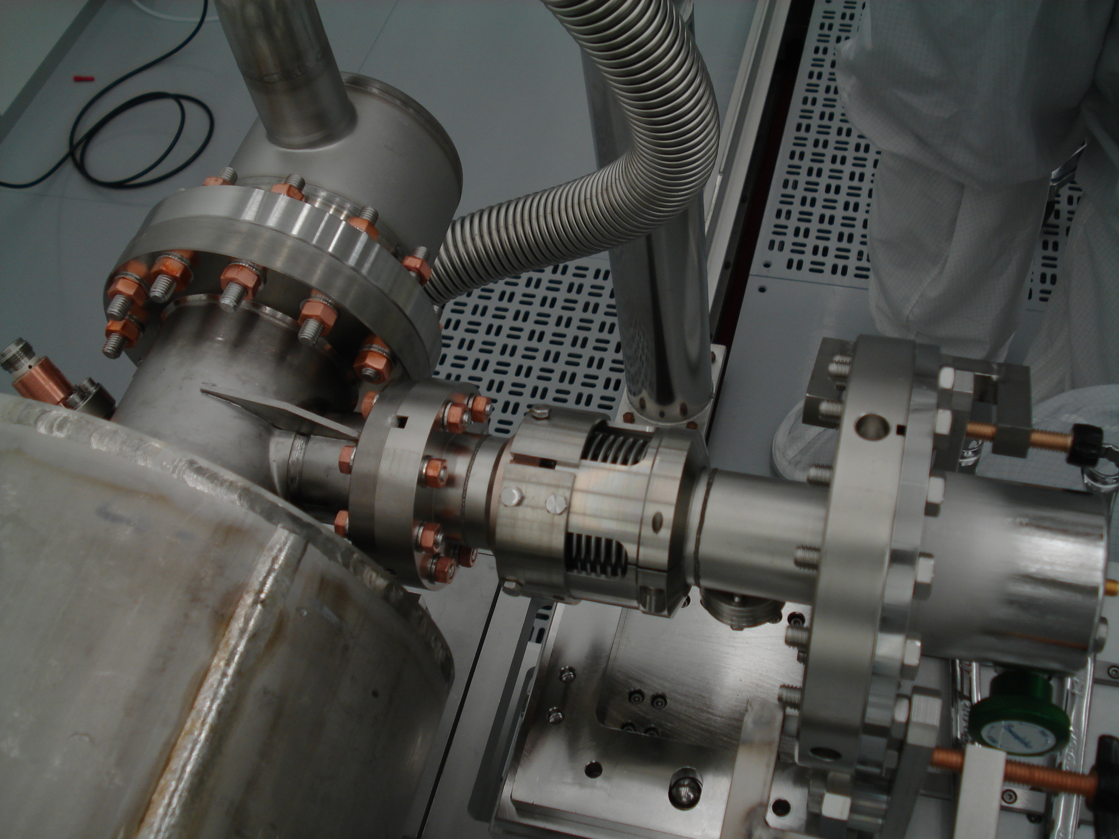
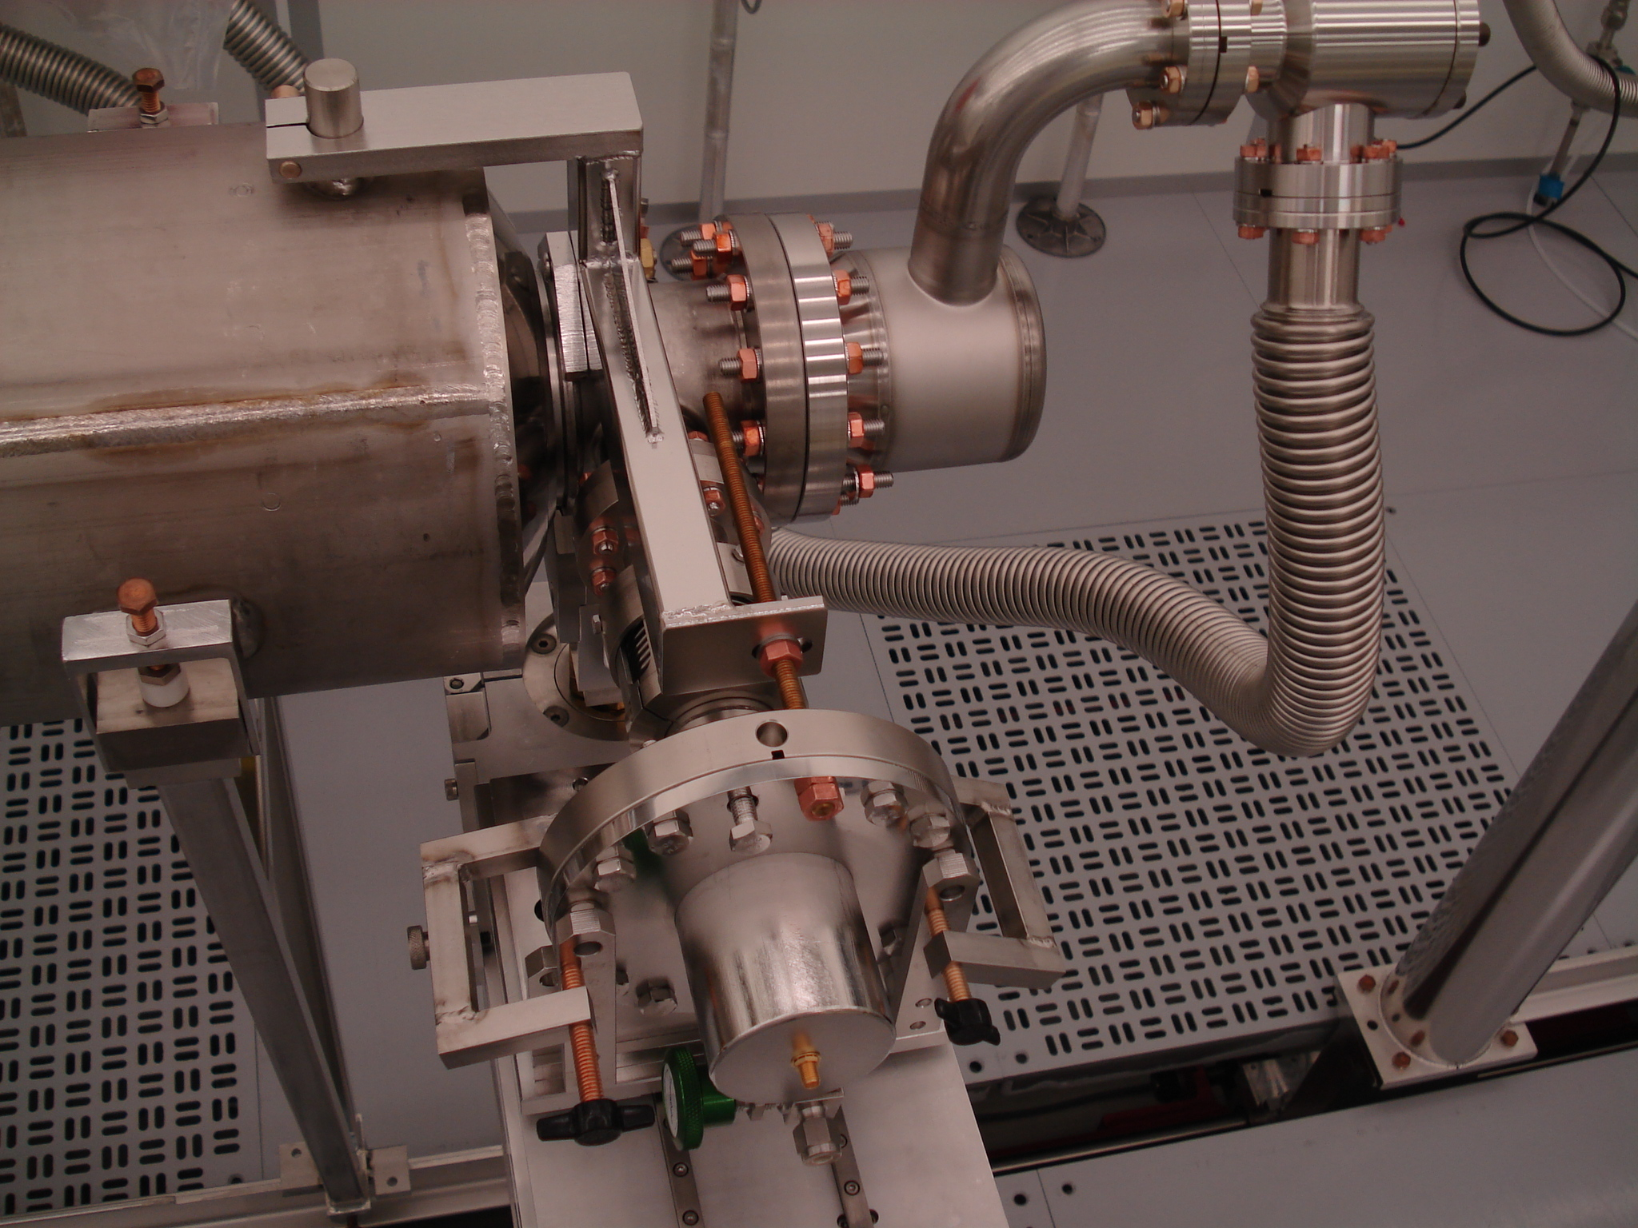
pCM at WS0
Recommendation noted to use the JLab design Delrin clip to hold the gasket

Slide 12
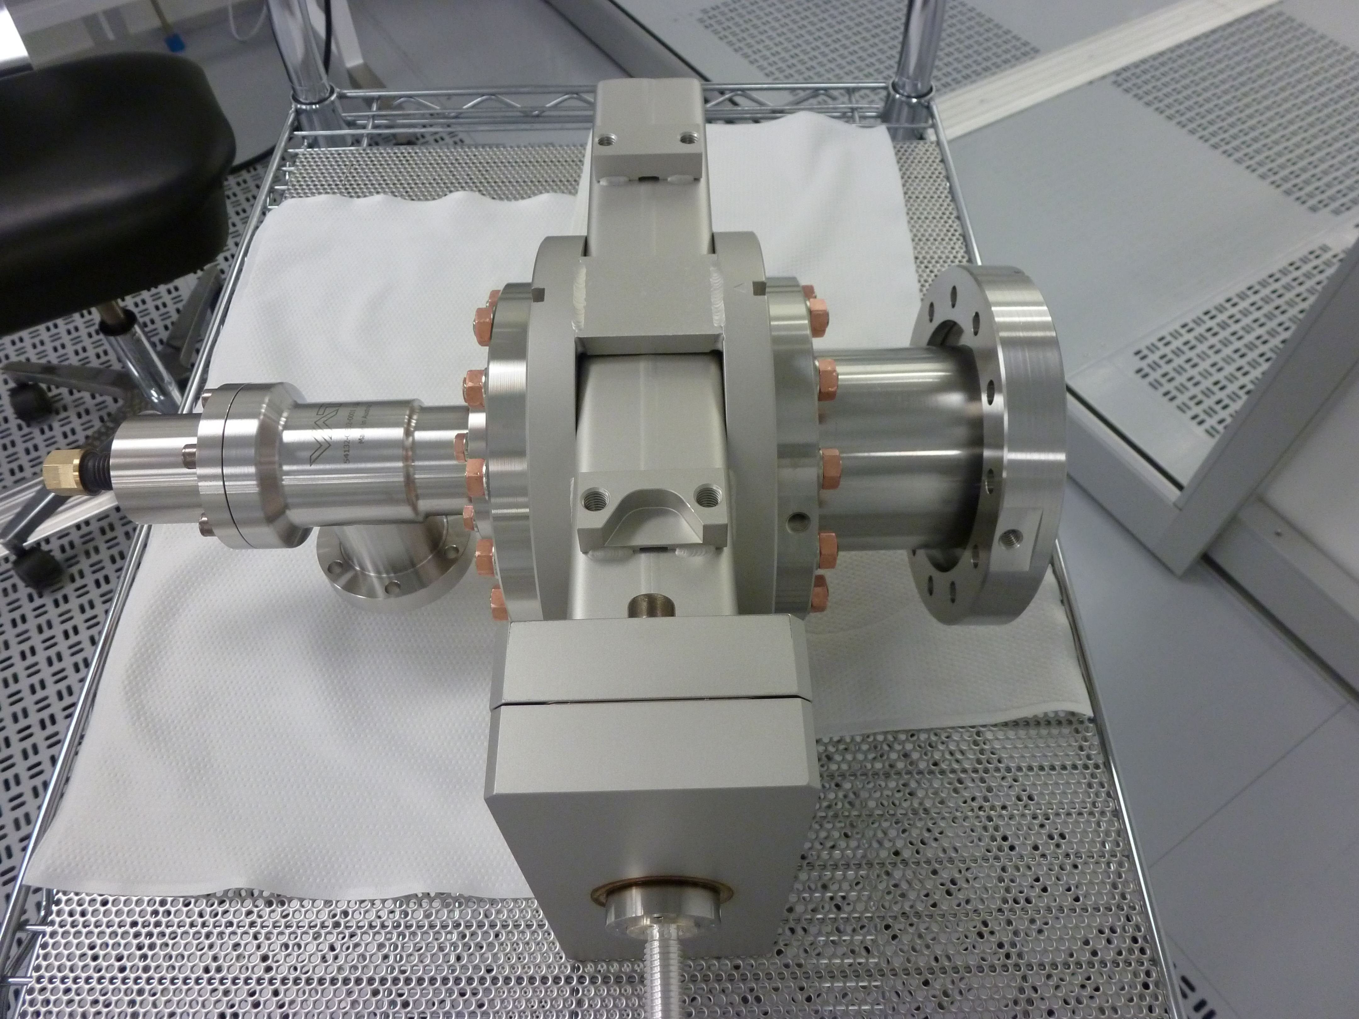
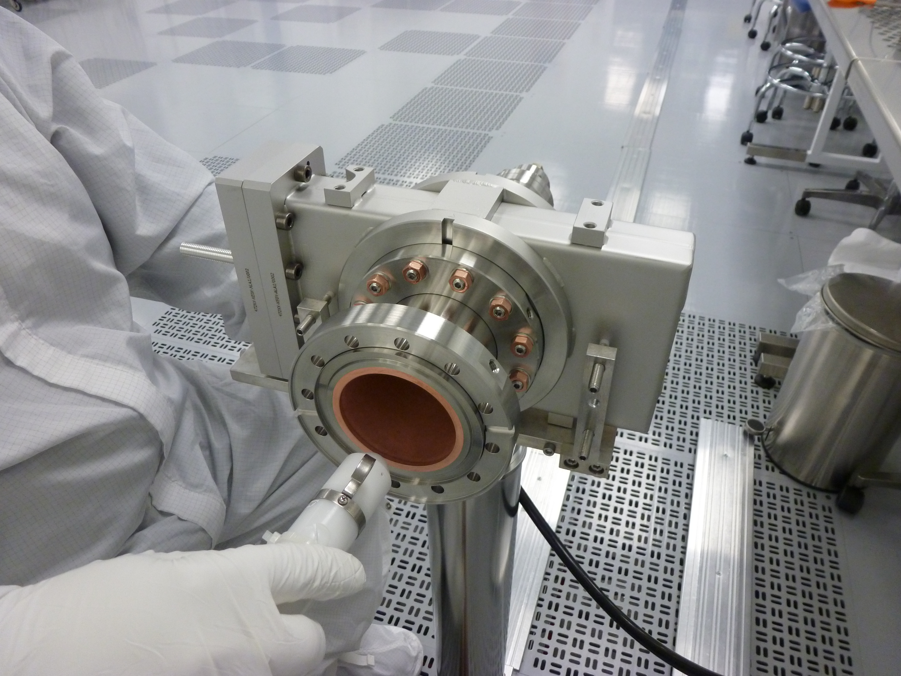
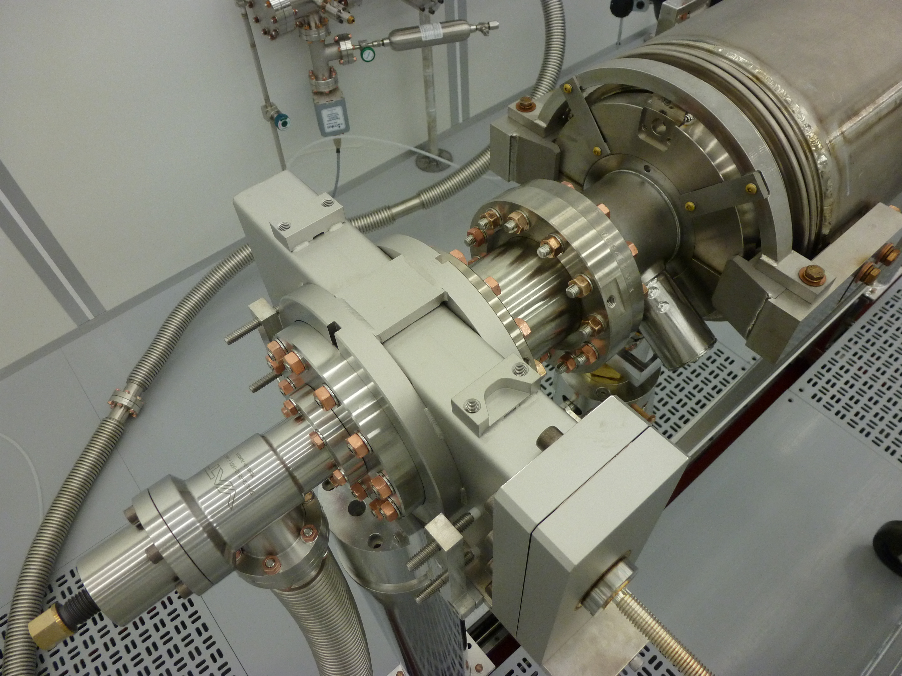
String Assembly-I (WS1)
Align 8 cavities for string assembly
Gate Valve (GV1) to Cavity #1 Assembly:
  Check the particle free cleanliness of the GV and clean as needed
  Sub-assembly of the GV peripherals
  Installation to the cleanroom post and flex hose assembly
  Alignment to the cavity beam line flange
  Assemble the gate valve to the cavity
Recommendation noted that gate valve is opened and closed several times at JLab during particle free cleaning with ionized nitrogen

Slide 13
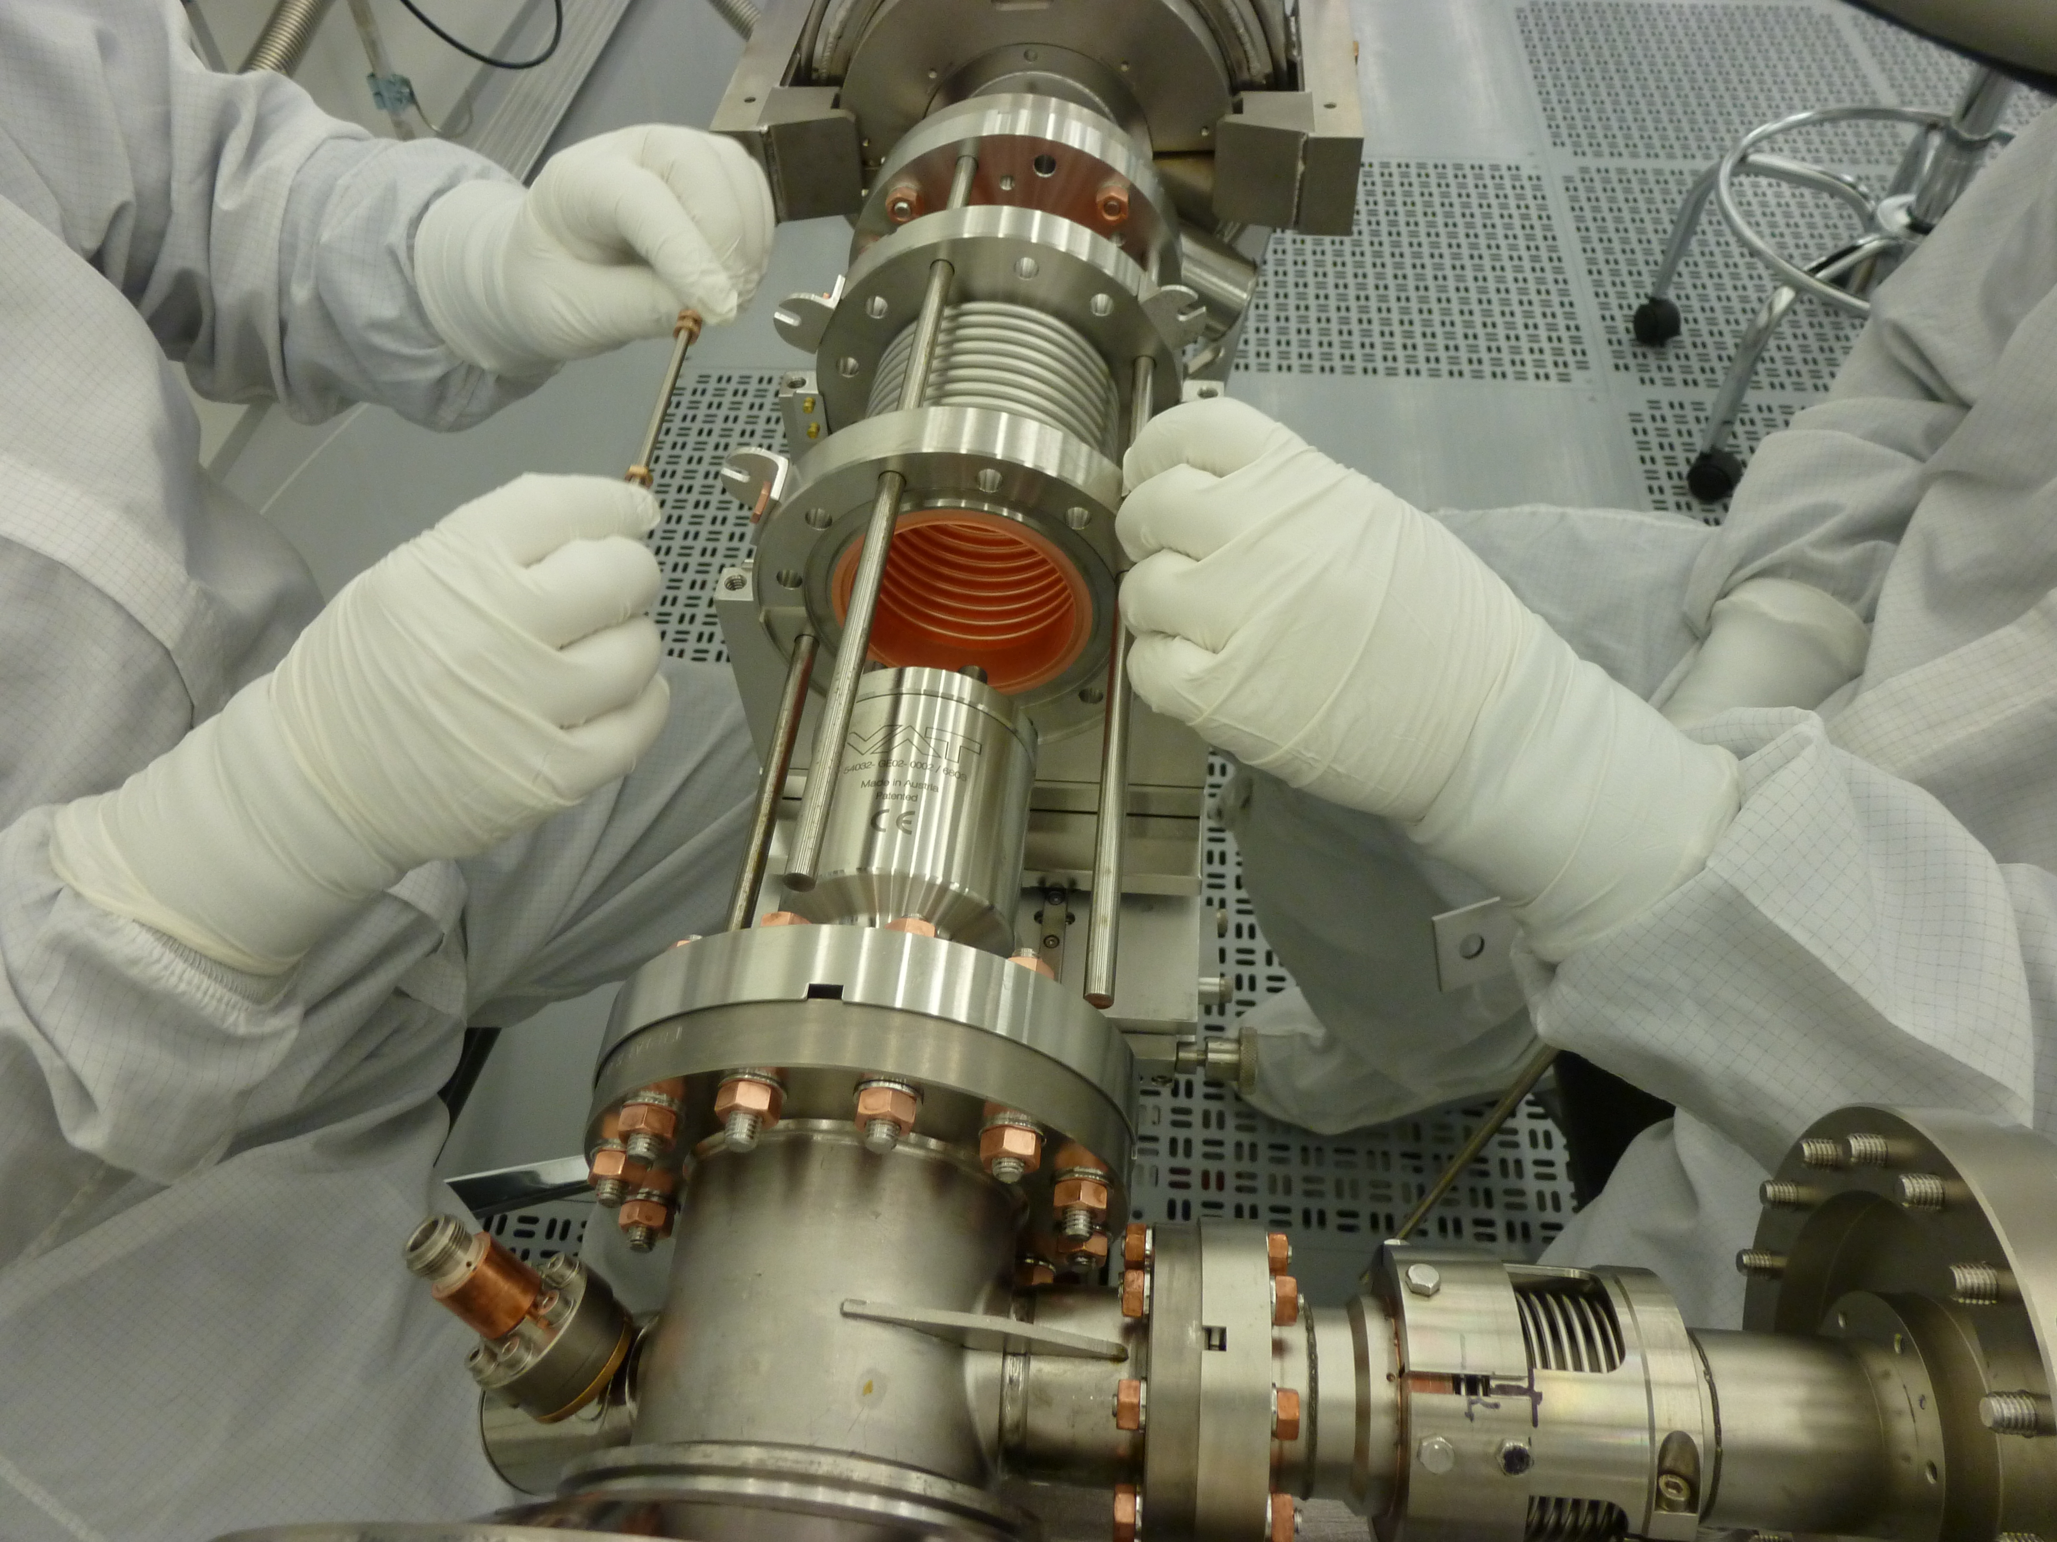
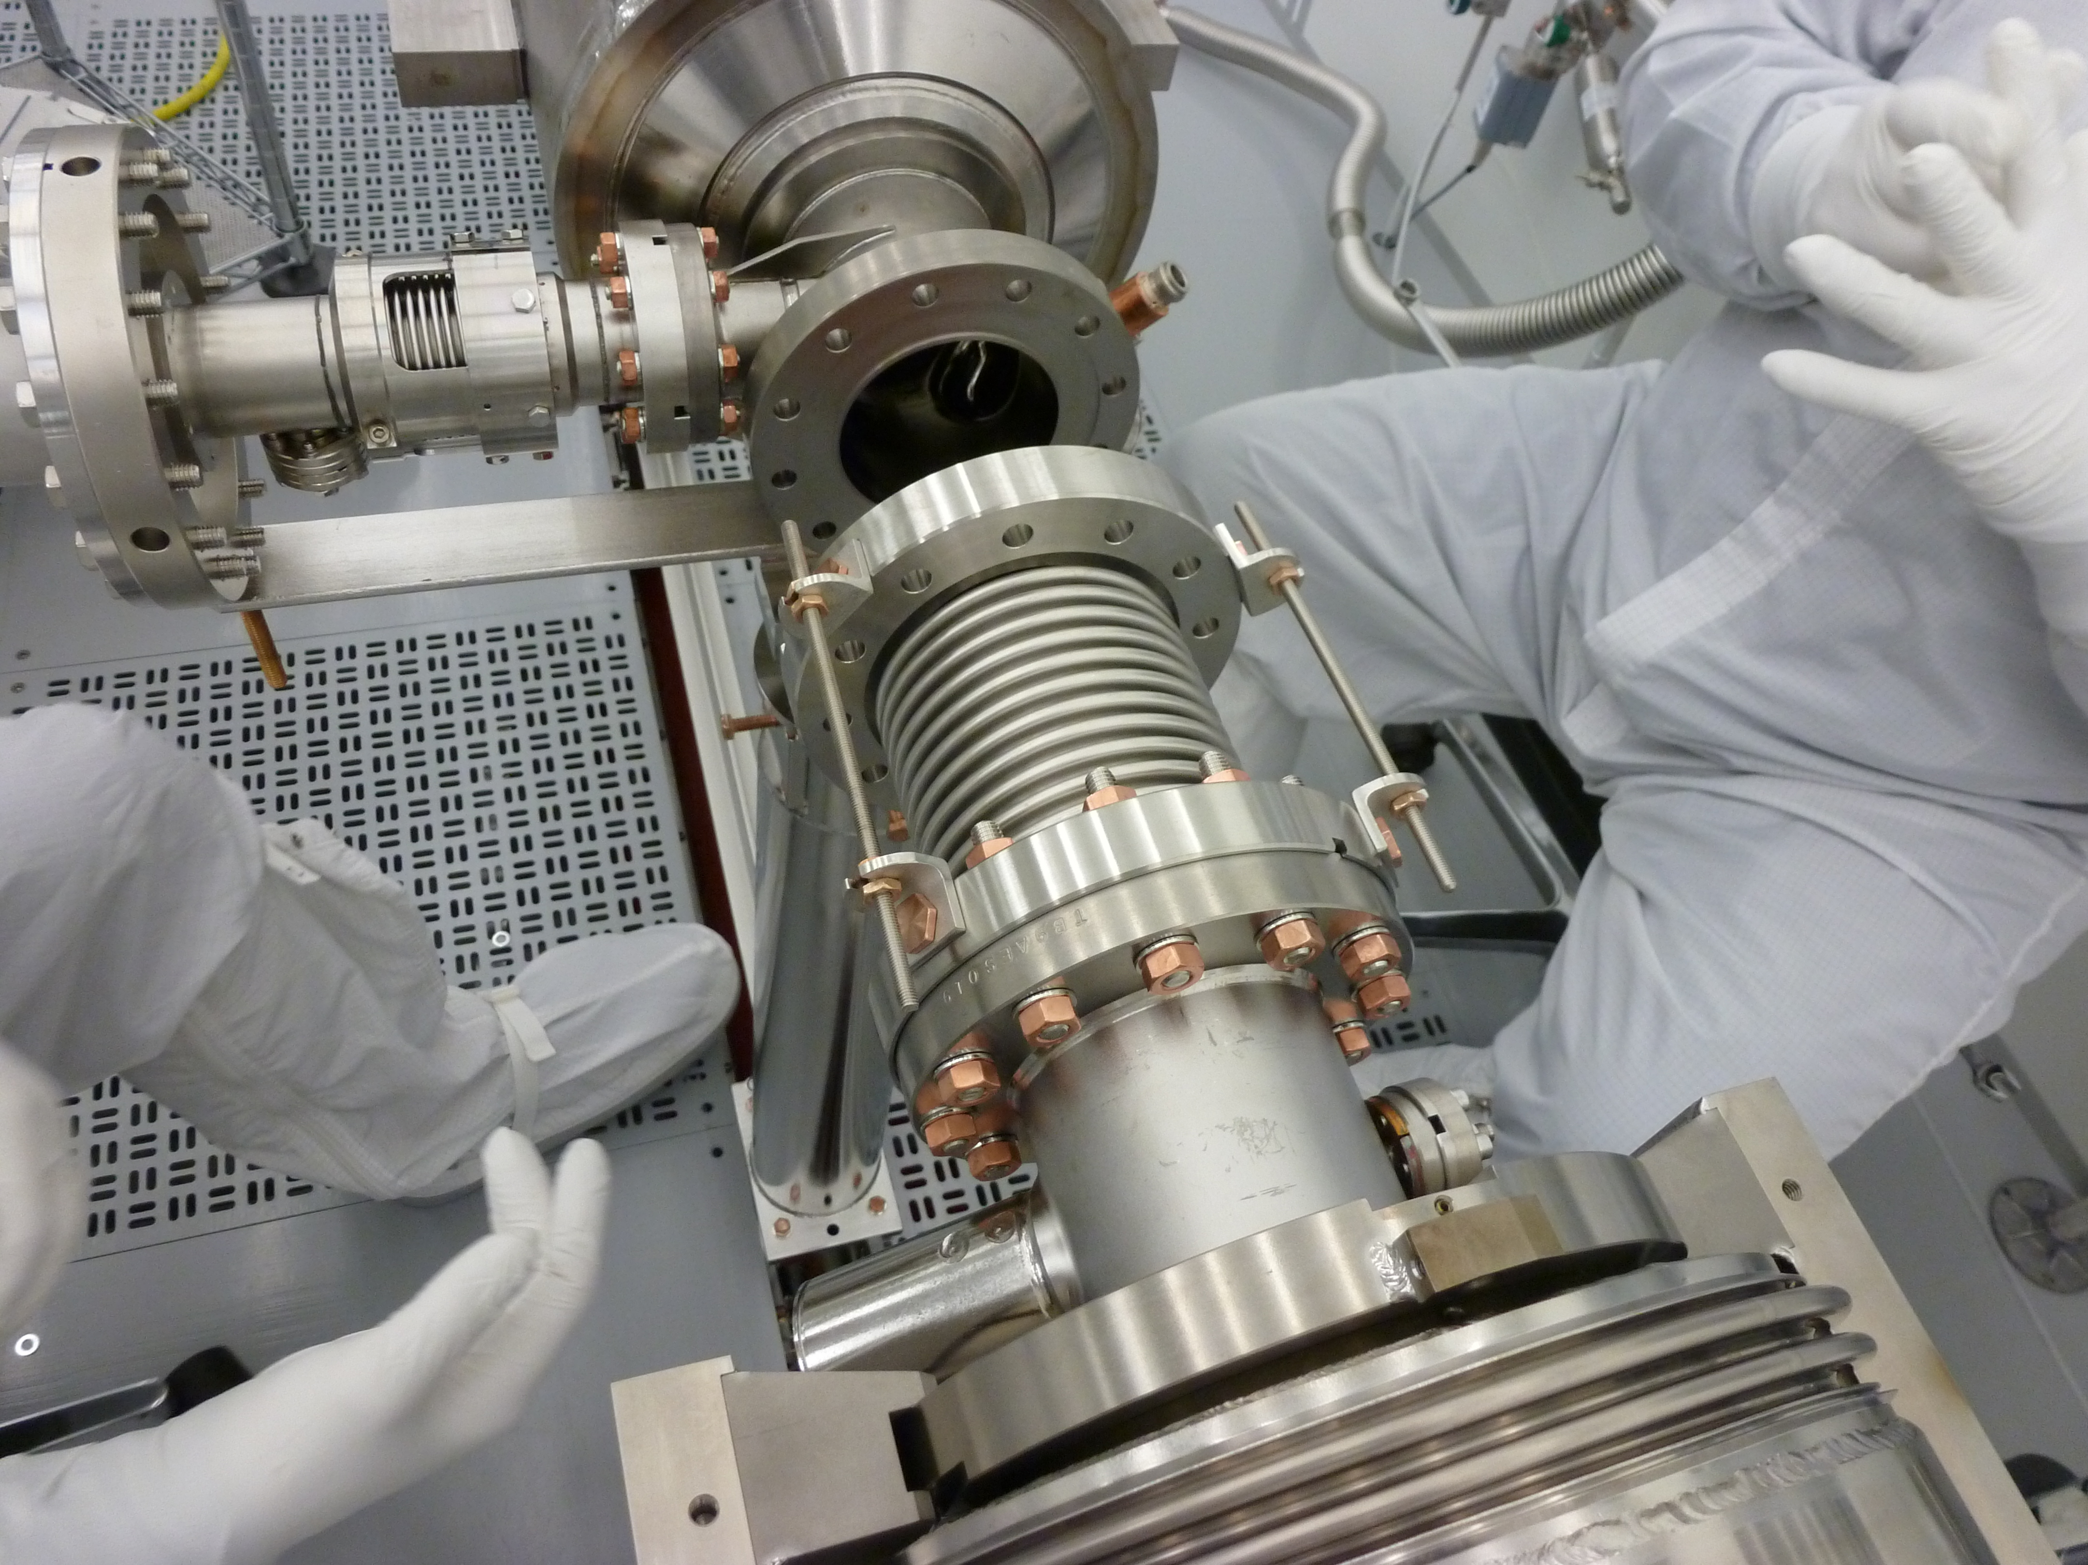
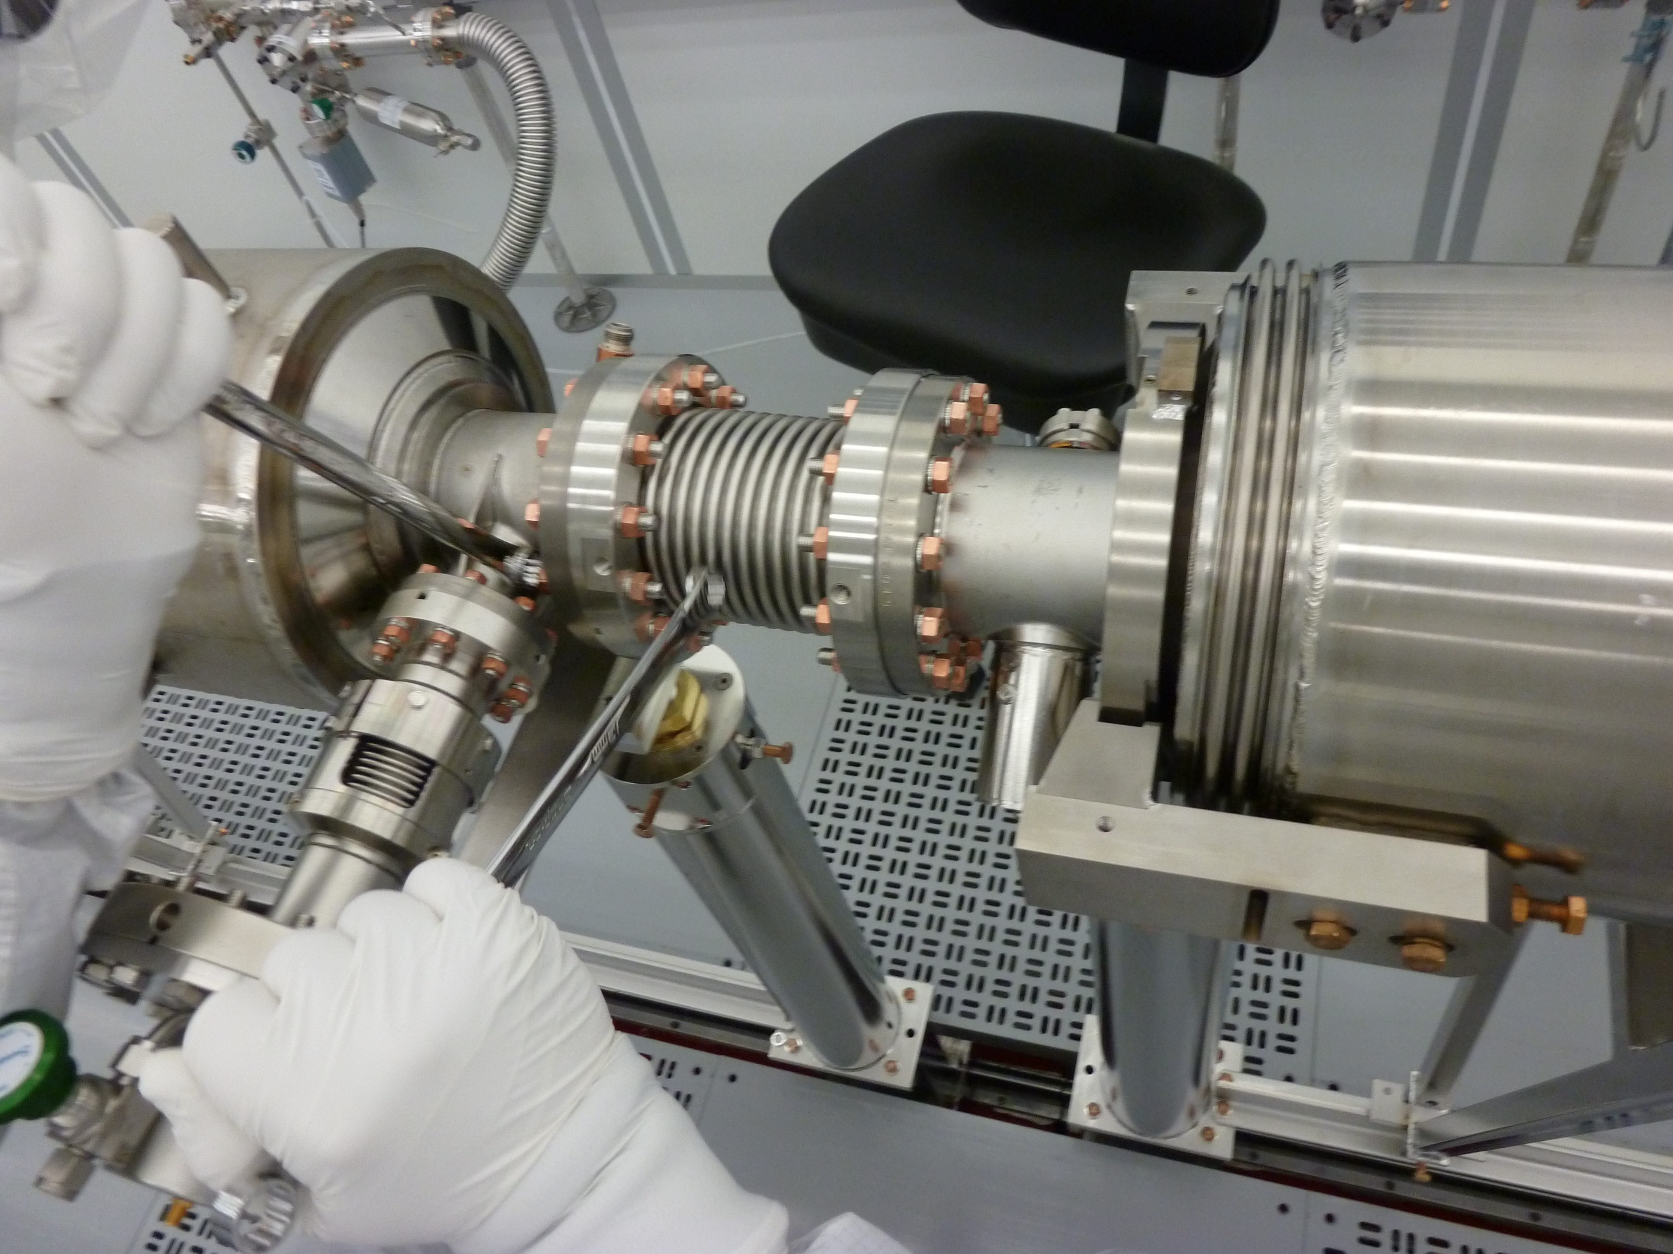
String Assembly-II (WS1)
Cavity to Cavity Assembly with the interconnect bellows:
  Assemble flex hose to the cavity Pump down and Leak check
  Backfill
  Align the interconnect bellows to the cavity field probe end beampipe flange
  Assemble with PFFA
  Align the bellows to the cavity coupler end beampipe flange
  Assemble with PFFA

Slide 14
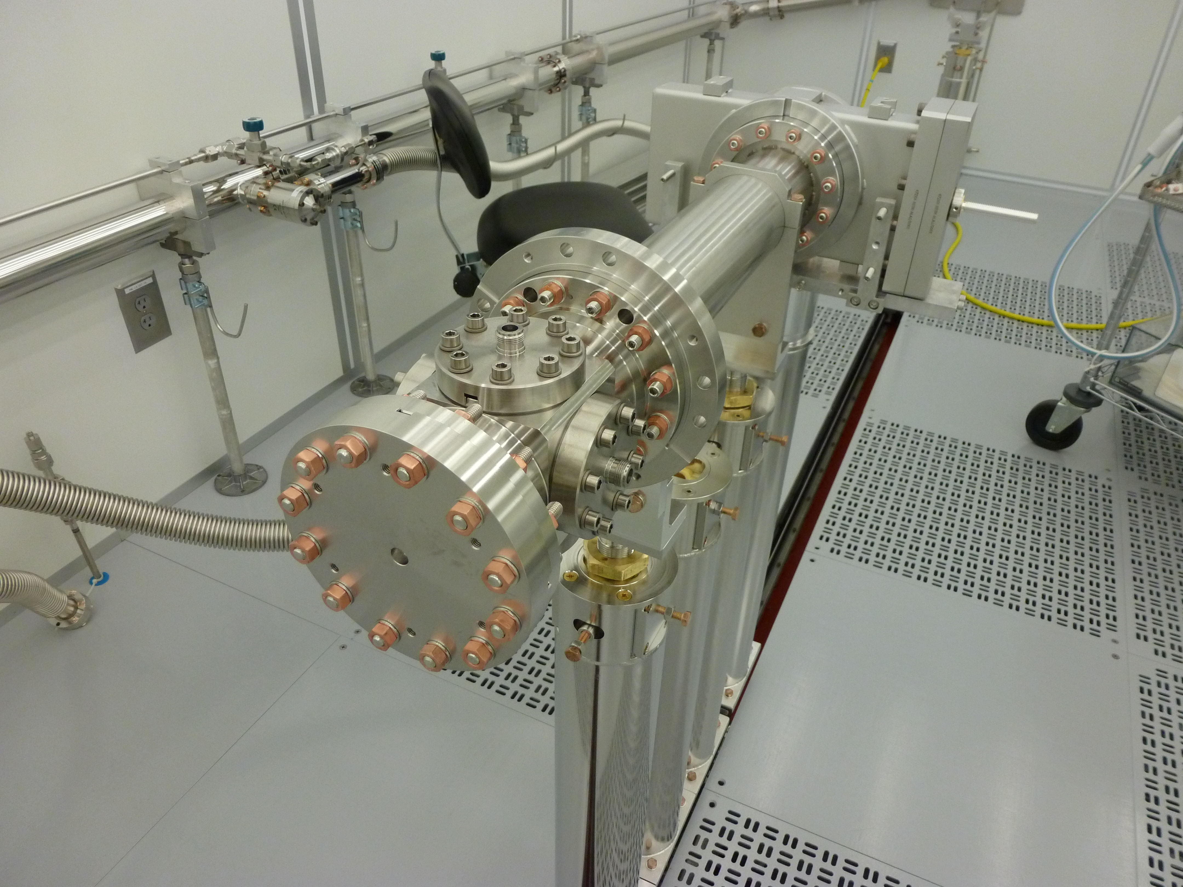
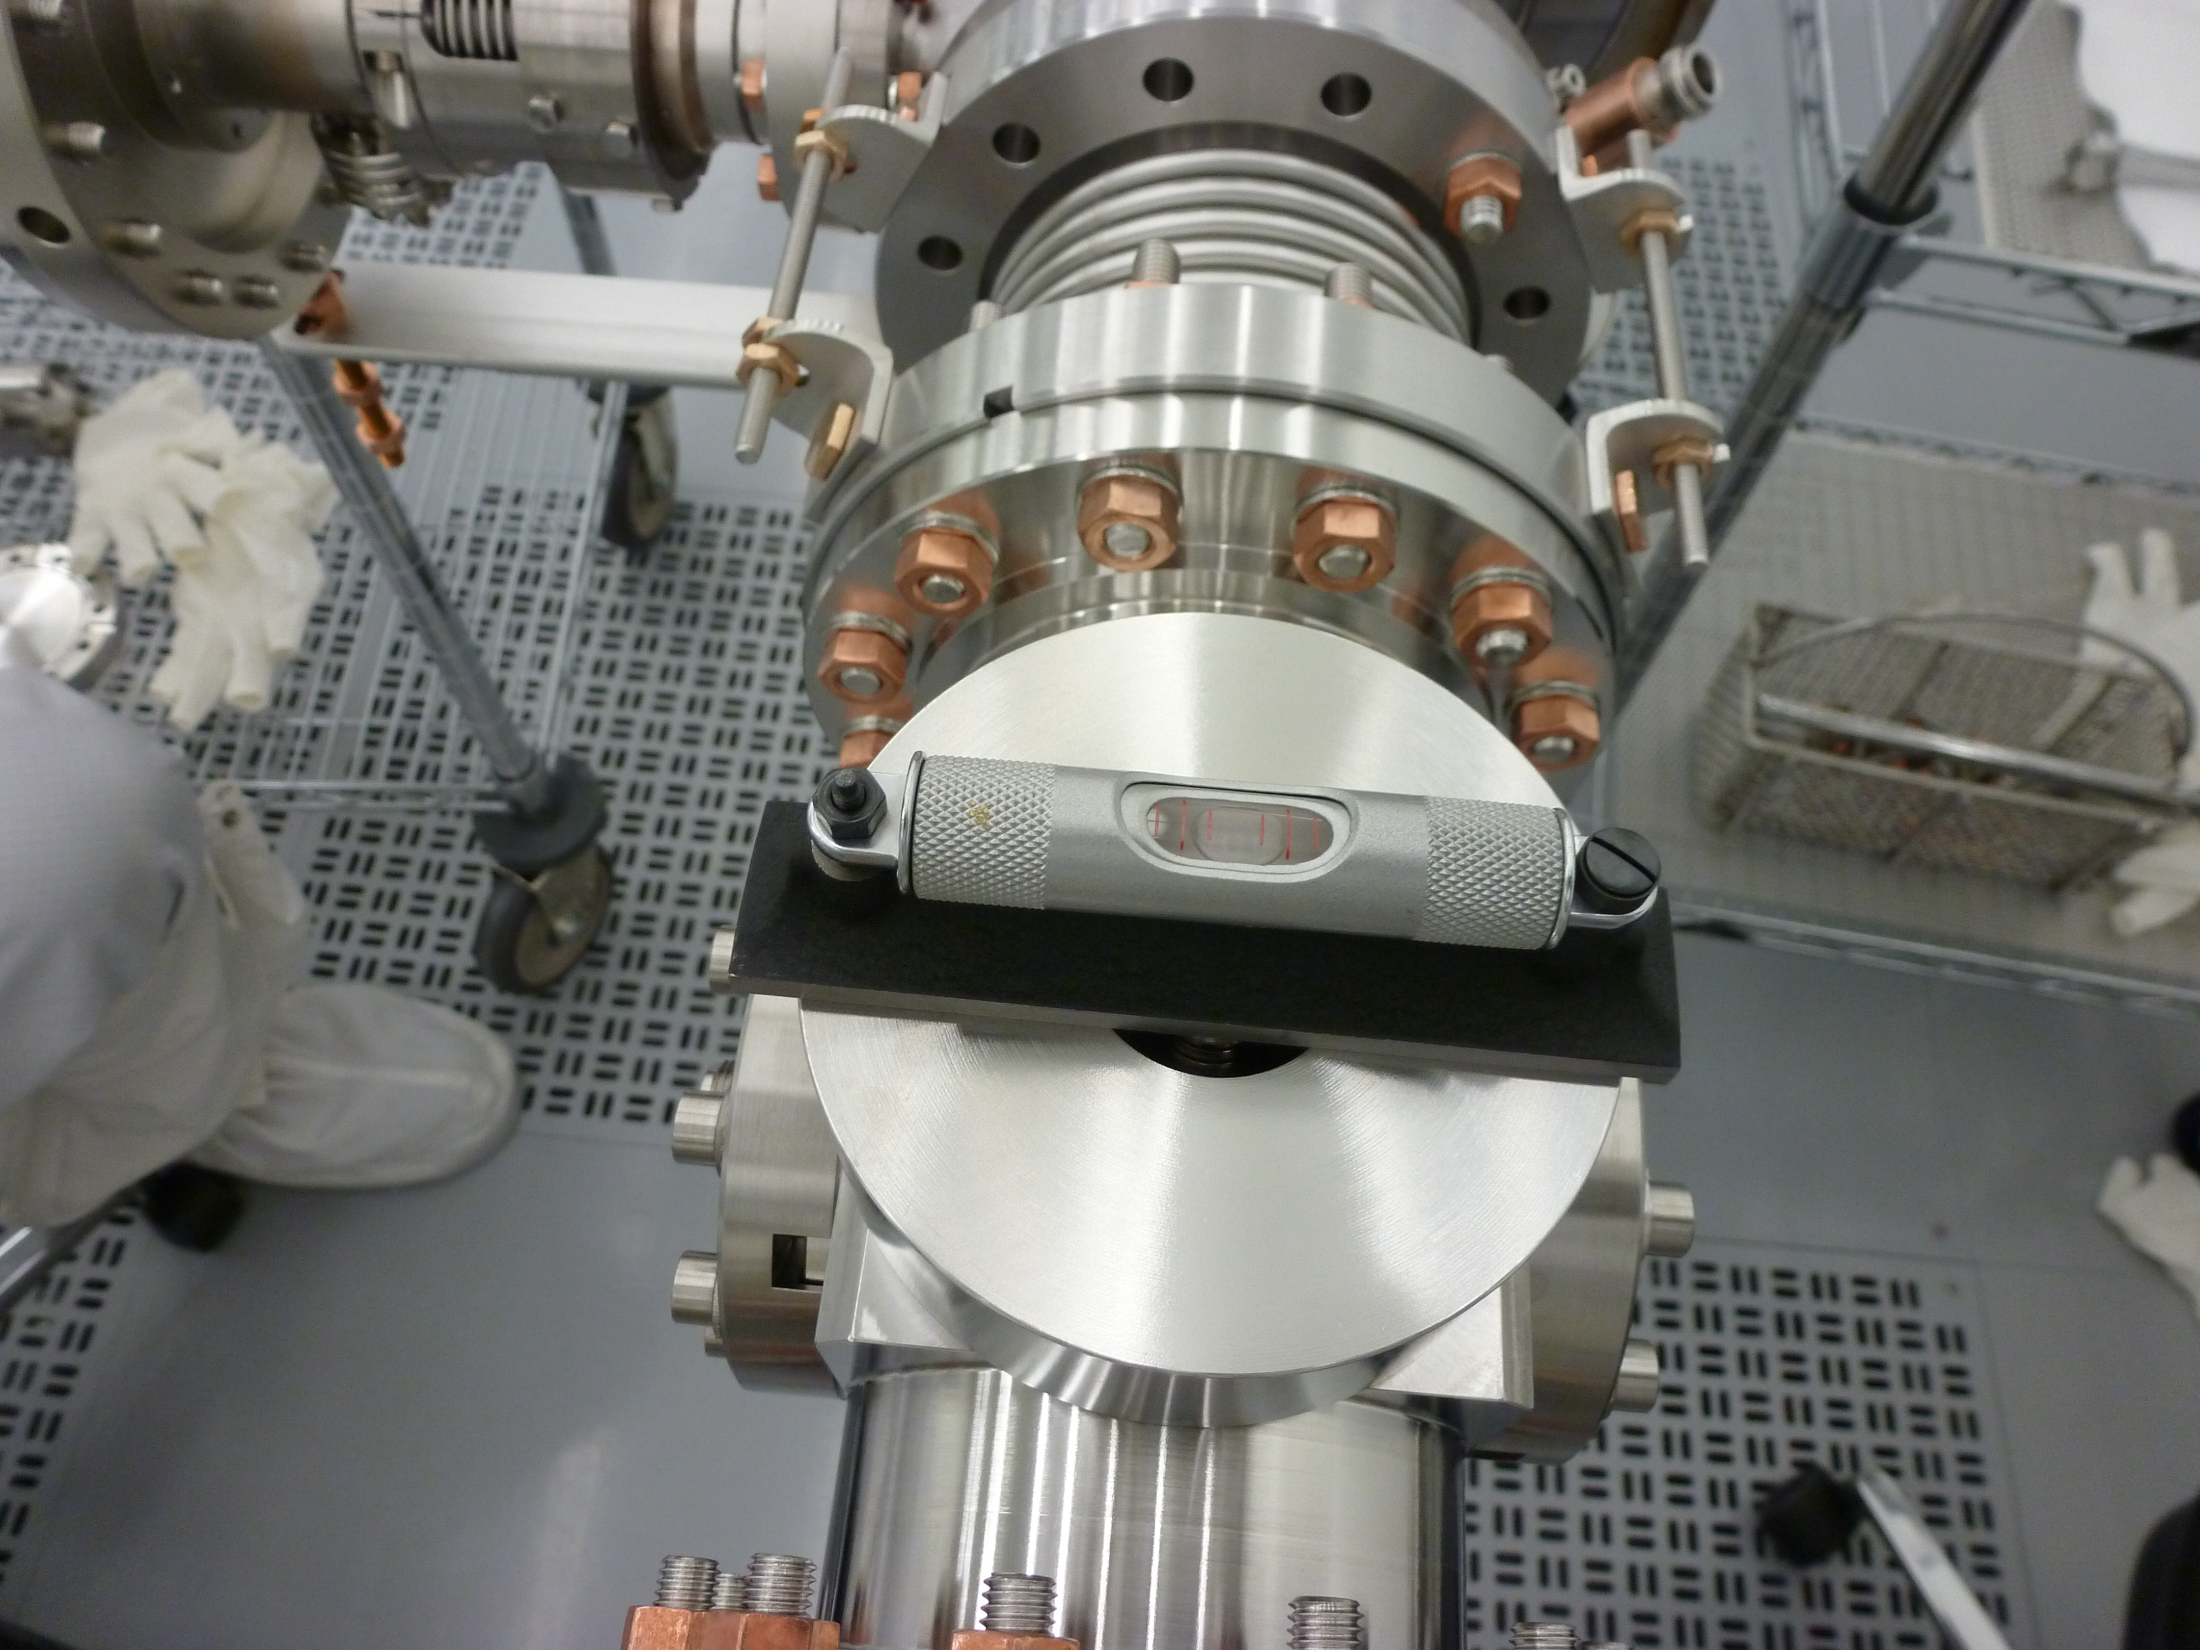
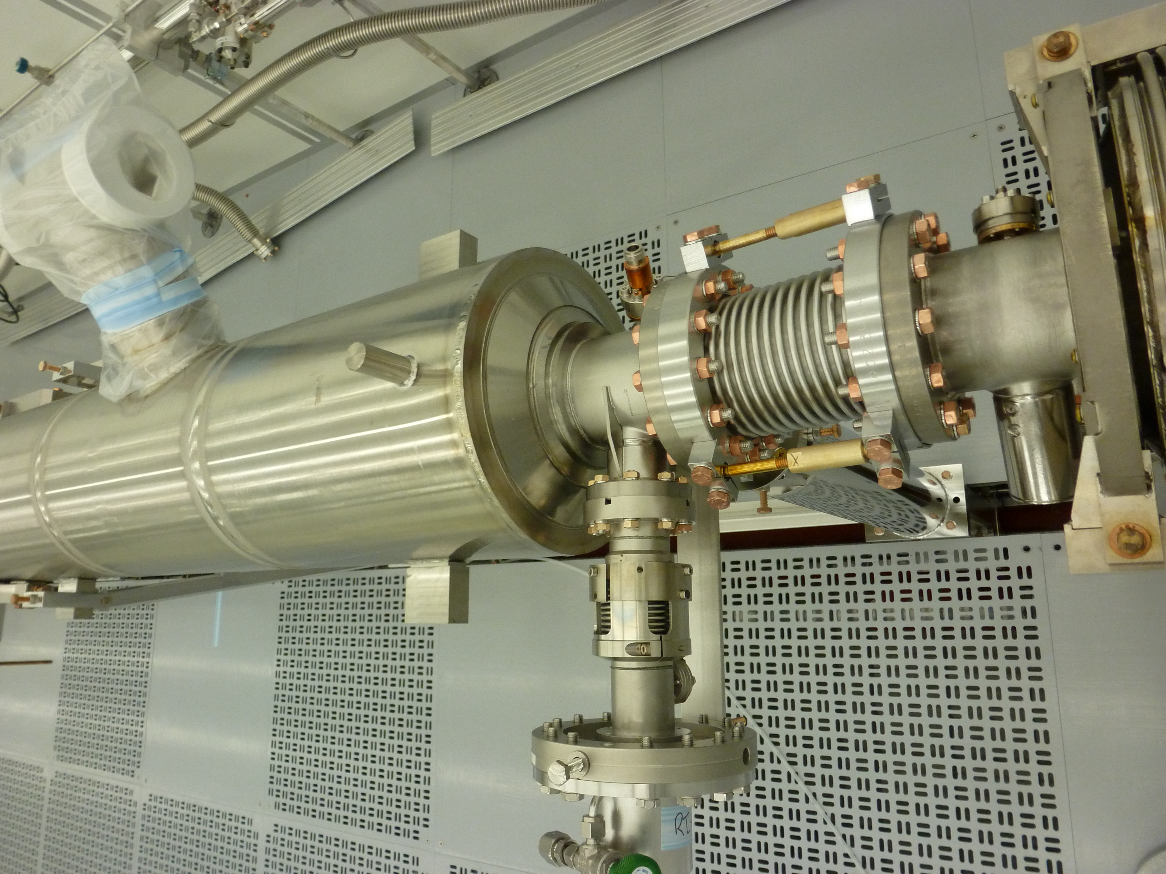
String Assembly-III (WS1)
BPM+Magnet Spool Tube+GV2 assembly and leak check
BPM/Magnet package subassembly to the 8 cavities string
Pump down the fully assembled cavity string, bag the bellows, leak check. Backfill
Roll out of the cleanroom to WS2
Alignment pins currently are not used at neither labs

Slide 15
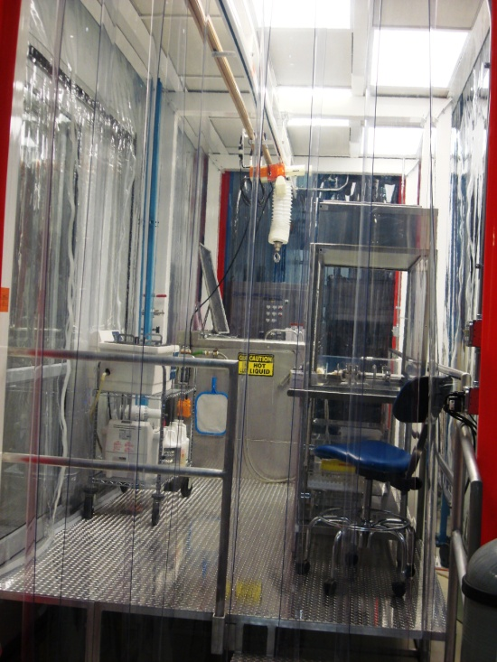
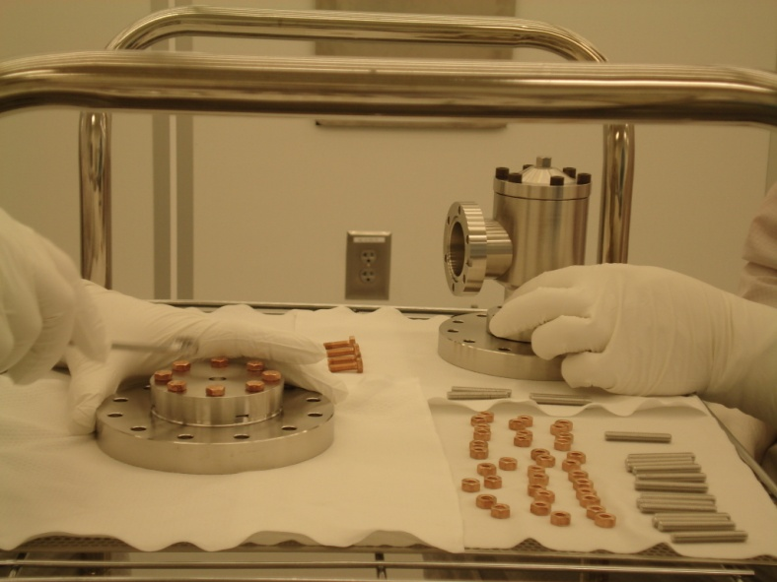
Particle free UHV Cleaning at CAF, Fermilab
  Cleaning Procedures for stainless steel, titanium, copper and niobium components
  Wash/rinse in the ultrasonic baths (1 Stoelting, 3 Branson) with DI water (Crossbow).
  Dry under the Class 10 hood
  Transport into the Class 1000 ante clean room
  Blow clean with ionized nitrogen while monitoring the particulates count in the Class 100 sluice area
  Transport into the Class 10 assembly area
Class 10 Hood
Class 1000 cleanroom
US cleaner

Slide 16
General UHV Cleaning Procedure at CAF
Simple Green, 3% solution, 20 minutes
DI water rinse
Micro90, 2% solution, 15 minutes
DI water rinse
99.9% pure Isopropyl alcohol rinse
Blow dry with boiled off liquid nitrogen gas
Leave under Class 10 cleanroom hood to dry thoroughly

Slide 17
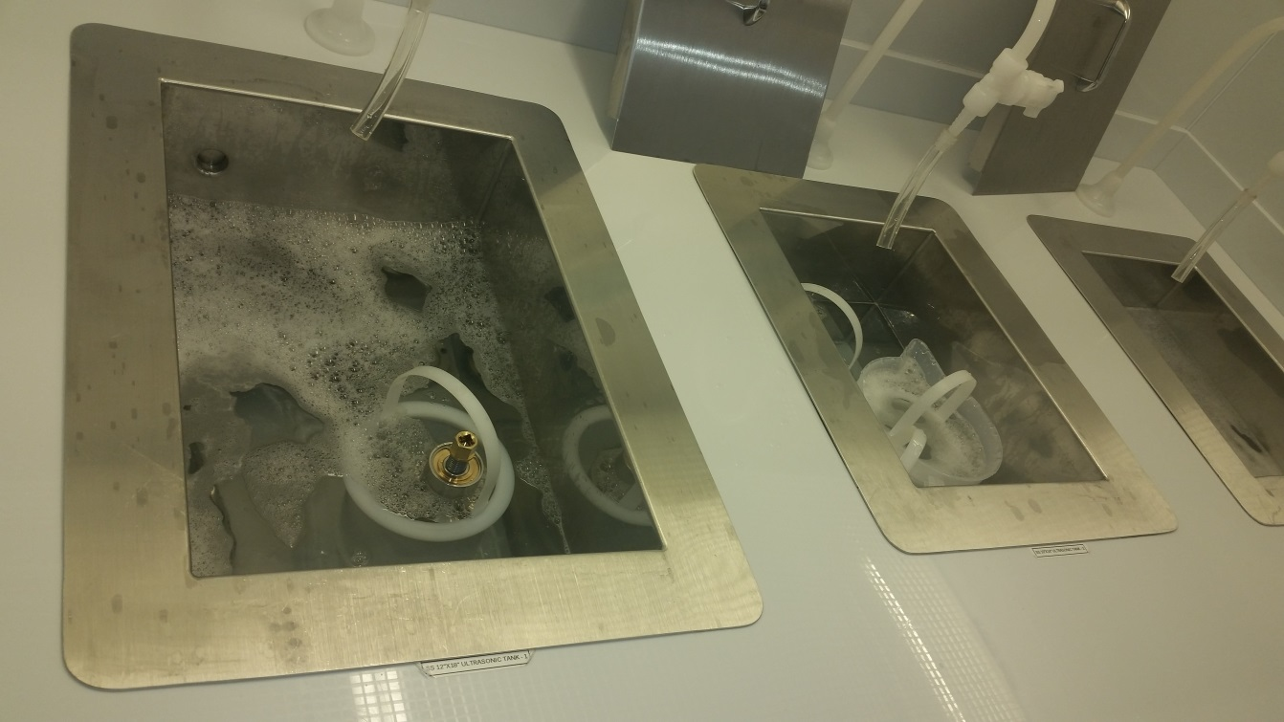
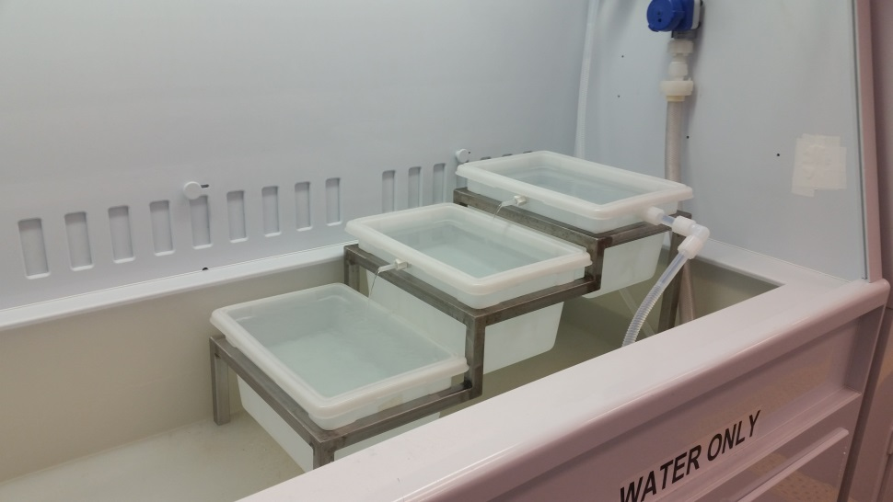
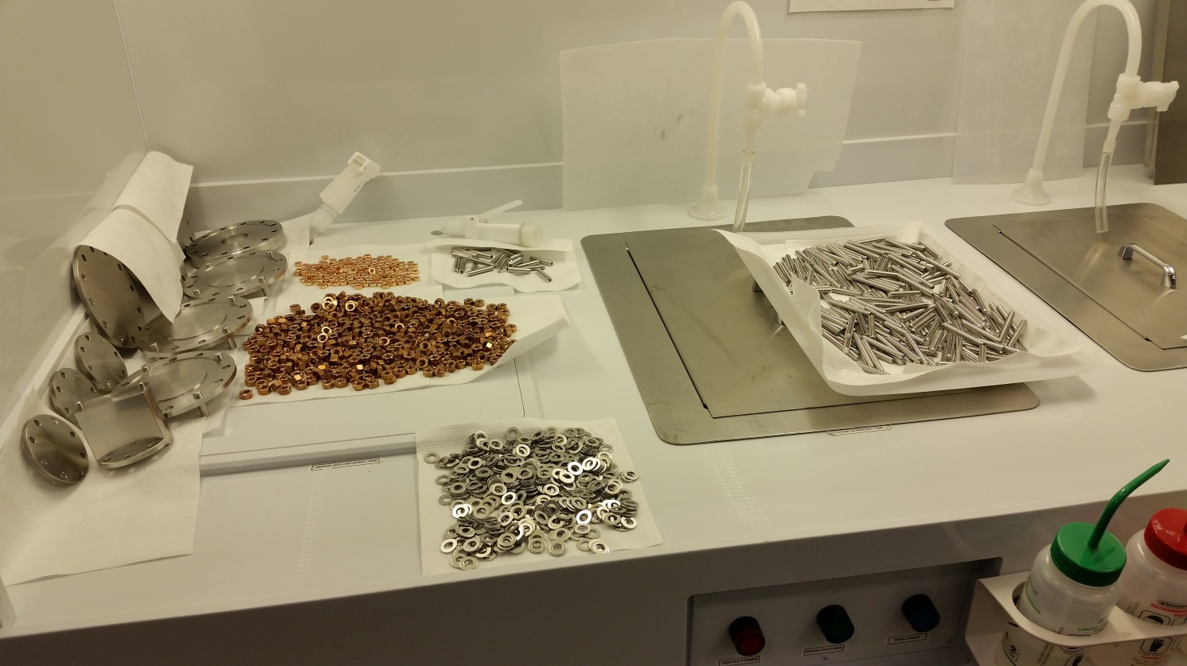
UHV cleaning procedure at JLab
Parts are wiped down with Micro 90 first if needed.
Parts are then put in Ultra Sonic tanks with 1% to 2% Micro added for 50 minutes and 130 F.
Parts are separated by material.
After Ultra Sonic the parts are triple rinsed.
Parts are then laid out in the laminar flow hood to dry
After hardware is dry it is blown off and bagged in Class 1000 cleanroom

Slide 18
Hardware Cleaning Techniques in Cleanroom (Class 10)
Air Force ionized nitrogen guns for spraying parts
Lighthouse particle counters at all stations
No use of the ionized nitrogen spray anywhere near an open cavity
All sub-assemblies sprayed before assembly onto a cavity or string
All parts, fasteners, blanks, valves and sub-assemblies sprayed with ionized nitrogen IAW CP-L2PRO-CST-CHEM-CLN-ION
  Spec 1-particle counts zero on all scales except 0.3µ can be 0 or 1
  Spec 2-particle counts ≤ 1/s on the 1µ scale
Noted that only the deemed critical fasteners are blown cleaned to Spec 1. Remainder of the fasteners are blown cleaned in Class 1000 cleanroom by the chemical group

Slide 19
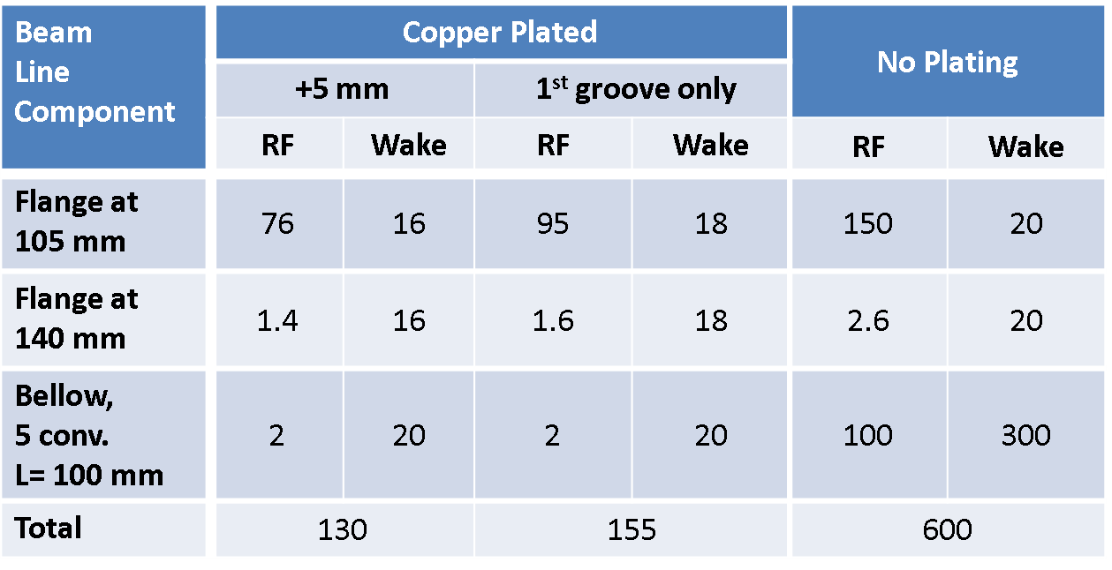
Copper plated Beamline Components QA Goals
Noted that project needs to develop standardized acceptance criteria for the plating imperfections to reduce the subjectivity
No outgassing! No flaking!
Analysis by Andrei Lunin:
Heat Loads Per Cavity*, [mW]
*Accelerating gradient: 16.5 MV/m

Slide 20
Workflow
Lesker fabricates the beamline components
JLab performs leak check and surface roughness measurements (only on flanges)
Nomura Plating performs copper plating and conducts post plating QC steps
Components deemed to be accepted by Nomura are shipped to partner labs
Partner labs perform incoming QC:
  Visual QC
  Fix the flange surfaces scratches
  Leak check
  Copper plating visual check pre and post cleaning

