Slide 1
Accelerator Division Status
Daniel Johnson
All Experimenters’ Meeting/Lab Status Meeting
23 January 2017

Slide 2
Content Slide [22pt Bold]
Bullet points are optional. If preferred, only first level bullets can be used or bullets can be set to “NONE.” [18pt Regular]
First level bullet [18pt Regular]
Second level bullet [16pt Regular]
Third level bullet [15pt Regular]
Fourth level bullet [14pt Regular]
Fifth level bullet [14pt Regular]

Slide 3
Accelerator Operations Summary
From: January 09, 2017 (0000 hours)
To: January 16, 2017 (0000 hours)
Calendar Week # 02
NuMI Weekly Integrated Intensity 1.17 E19 protons
Beam Hours To NuMI 116.6 hours
BNB Weekly Integrated Intensity 8.39 E18 protons
Beam Hours To BNB 142.0 hours
NMuon Weekly Integrated Intensity 1.18 E16 protons
Beam Hours To NMuon 41.2 hours
MTest Weekly Integrated Intensity 1.63 E13 protons
Beam Hours To MTest 21.9 hours
MCenter Weekly Integrated Intensity 0.00 E12 protons
Beam Hours To MCenter 0.0 hours

Slide 4
Accelerator Operations Summary
From: January 16, 2017 (0000 hours)
To: January 23, 2017 (0000 hours)
Calendar Week # 03
NuMI Weekly Integrated Intensity 1.48 E19 protons
Beam Hours To NuMI 134.9 hours
BNB Weekly Integrated Intensity 7.01 E18 protons
Beam Hours To BNB 148.1 hours
NMuon Weekly Integrated Intensity 9.71 E15 protons
Beam Hours To NMuon 77.8 hours
MTest Weekly Integrated Intensity 6.12 E13 protons
Beam Hours To MTest 25.2 hours
MCenter Weekly Integrated Intensity 4.80 E11 protons
Beam Hours To MCenter 1.7 hours

Slide 5
NuMI Operation

Slide 6
BNB Operation

Slide 7
Content and Caption Slide [22pt Bold]
Click to add caption text [13pt Bold]
First level bullet [18pt Reg]
Second level bullet [16pt]
Third level bullet [15pt]
Fourth level bullet [14pt]
Fifth level bullet [14pt]

Slide 8
Complex Status
LINAC
Running well
Testing Marx modulator on LRF5
Booster
Running well
New shielding assessment
MI/RR
Slipstacking 6+6
Tuning
NuMI
Running at ~630 kW with Switchyard
Ran at ~690 kW without Switchyard
Booster Neutrino Beamline (BNB)
Running well
Switchyard
MCenter, MTest, and SeaQuest
Beam available
General
No Downtime Planned
Next Downtime in late February or early March
Coordinating downtime with MSS commissioning

Slide 9
MI-12 Communication Duct
Summary
Emergency Repair Plan In Place
Need 2 hour notification
Vendor has cable
New Communications Duct Plan
Communications duct installation
New duct installed
New fiber cable has been delivered
Electricians notified
Installation pending
Hope to move to new cable in March
Coordinate downtime with Master SubStation outages
Damaged on 10/24/16
Protected from further damage
Provides timing/date to Neutrino Experiments
Experiments running fine

Slide 10
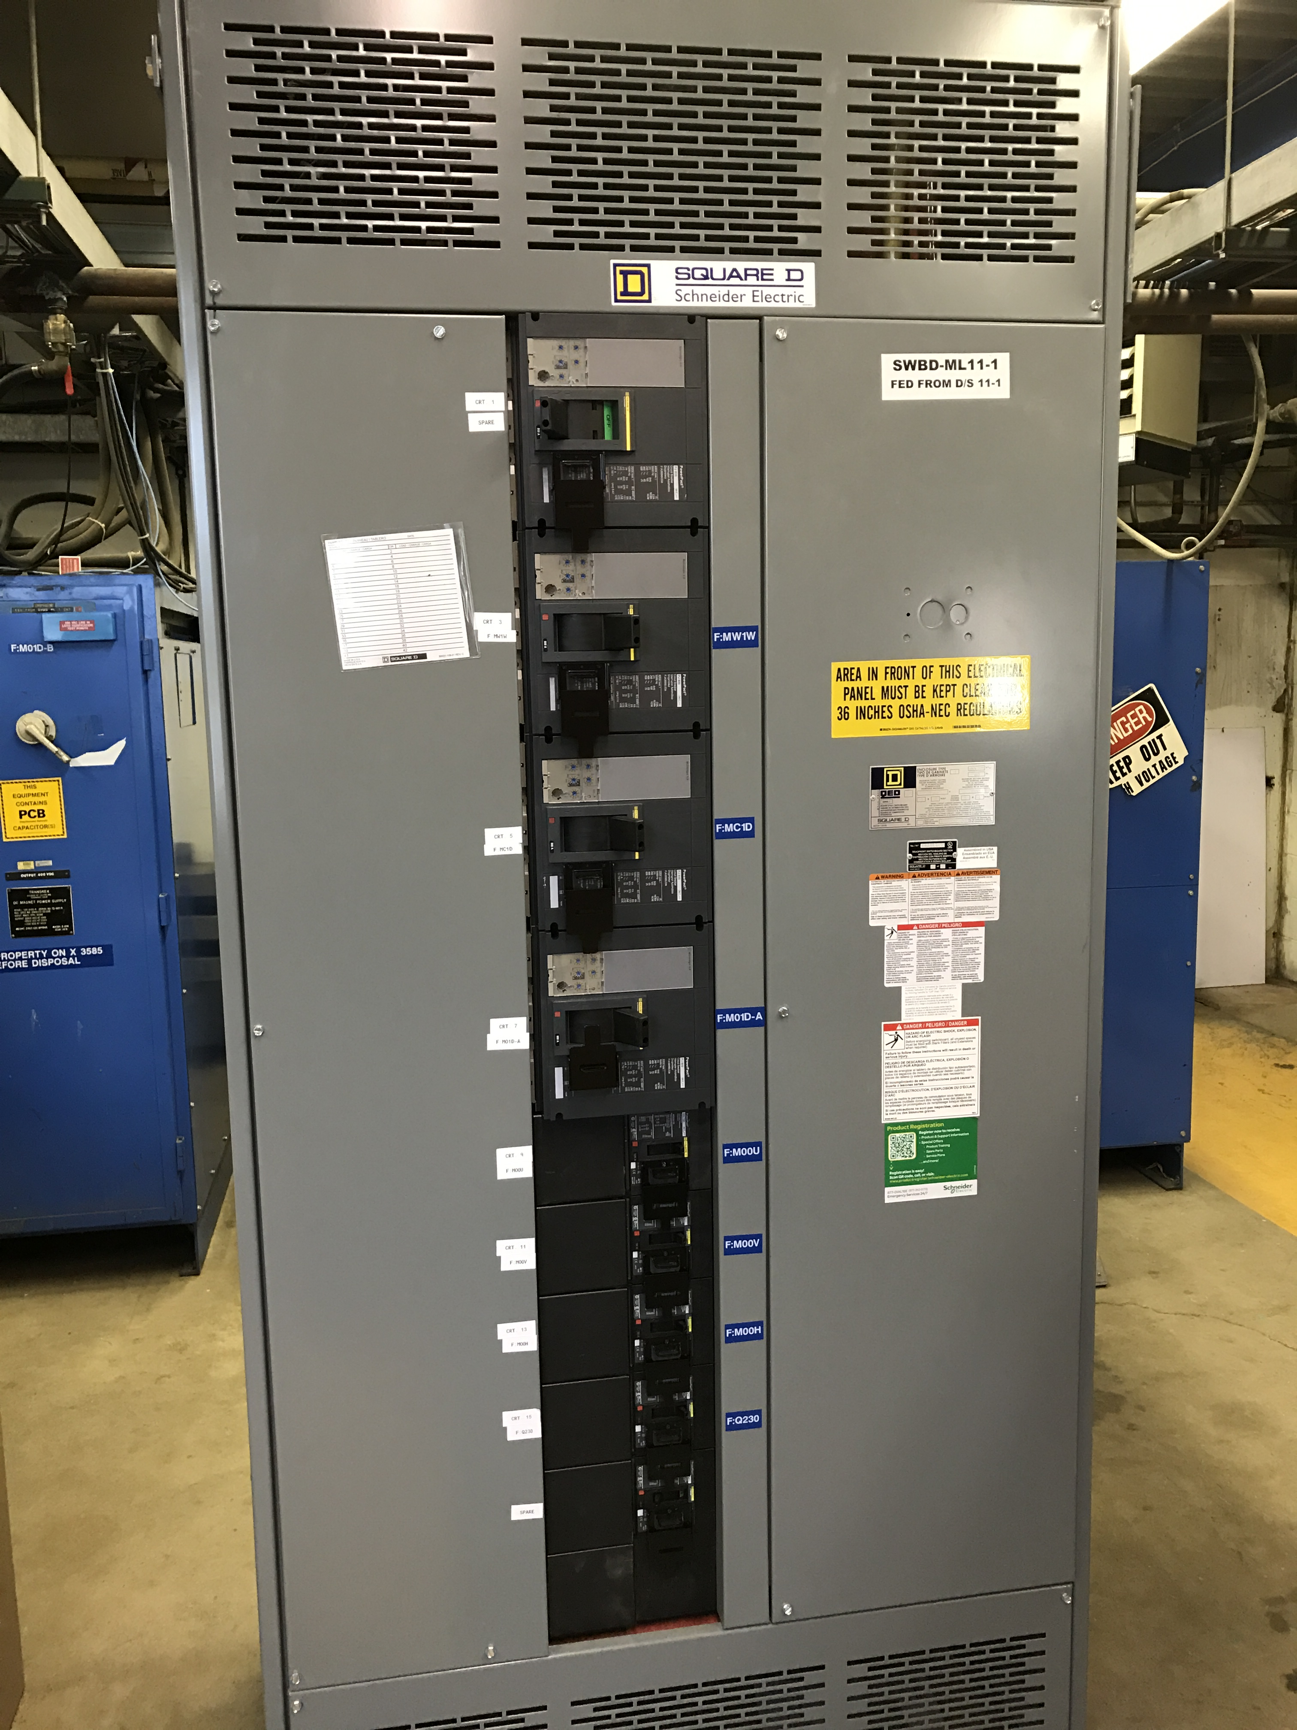
MS1 Bus Failure
All power supplies cabled into breaker panel
Work completed

Slide 11
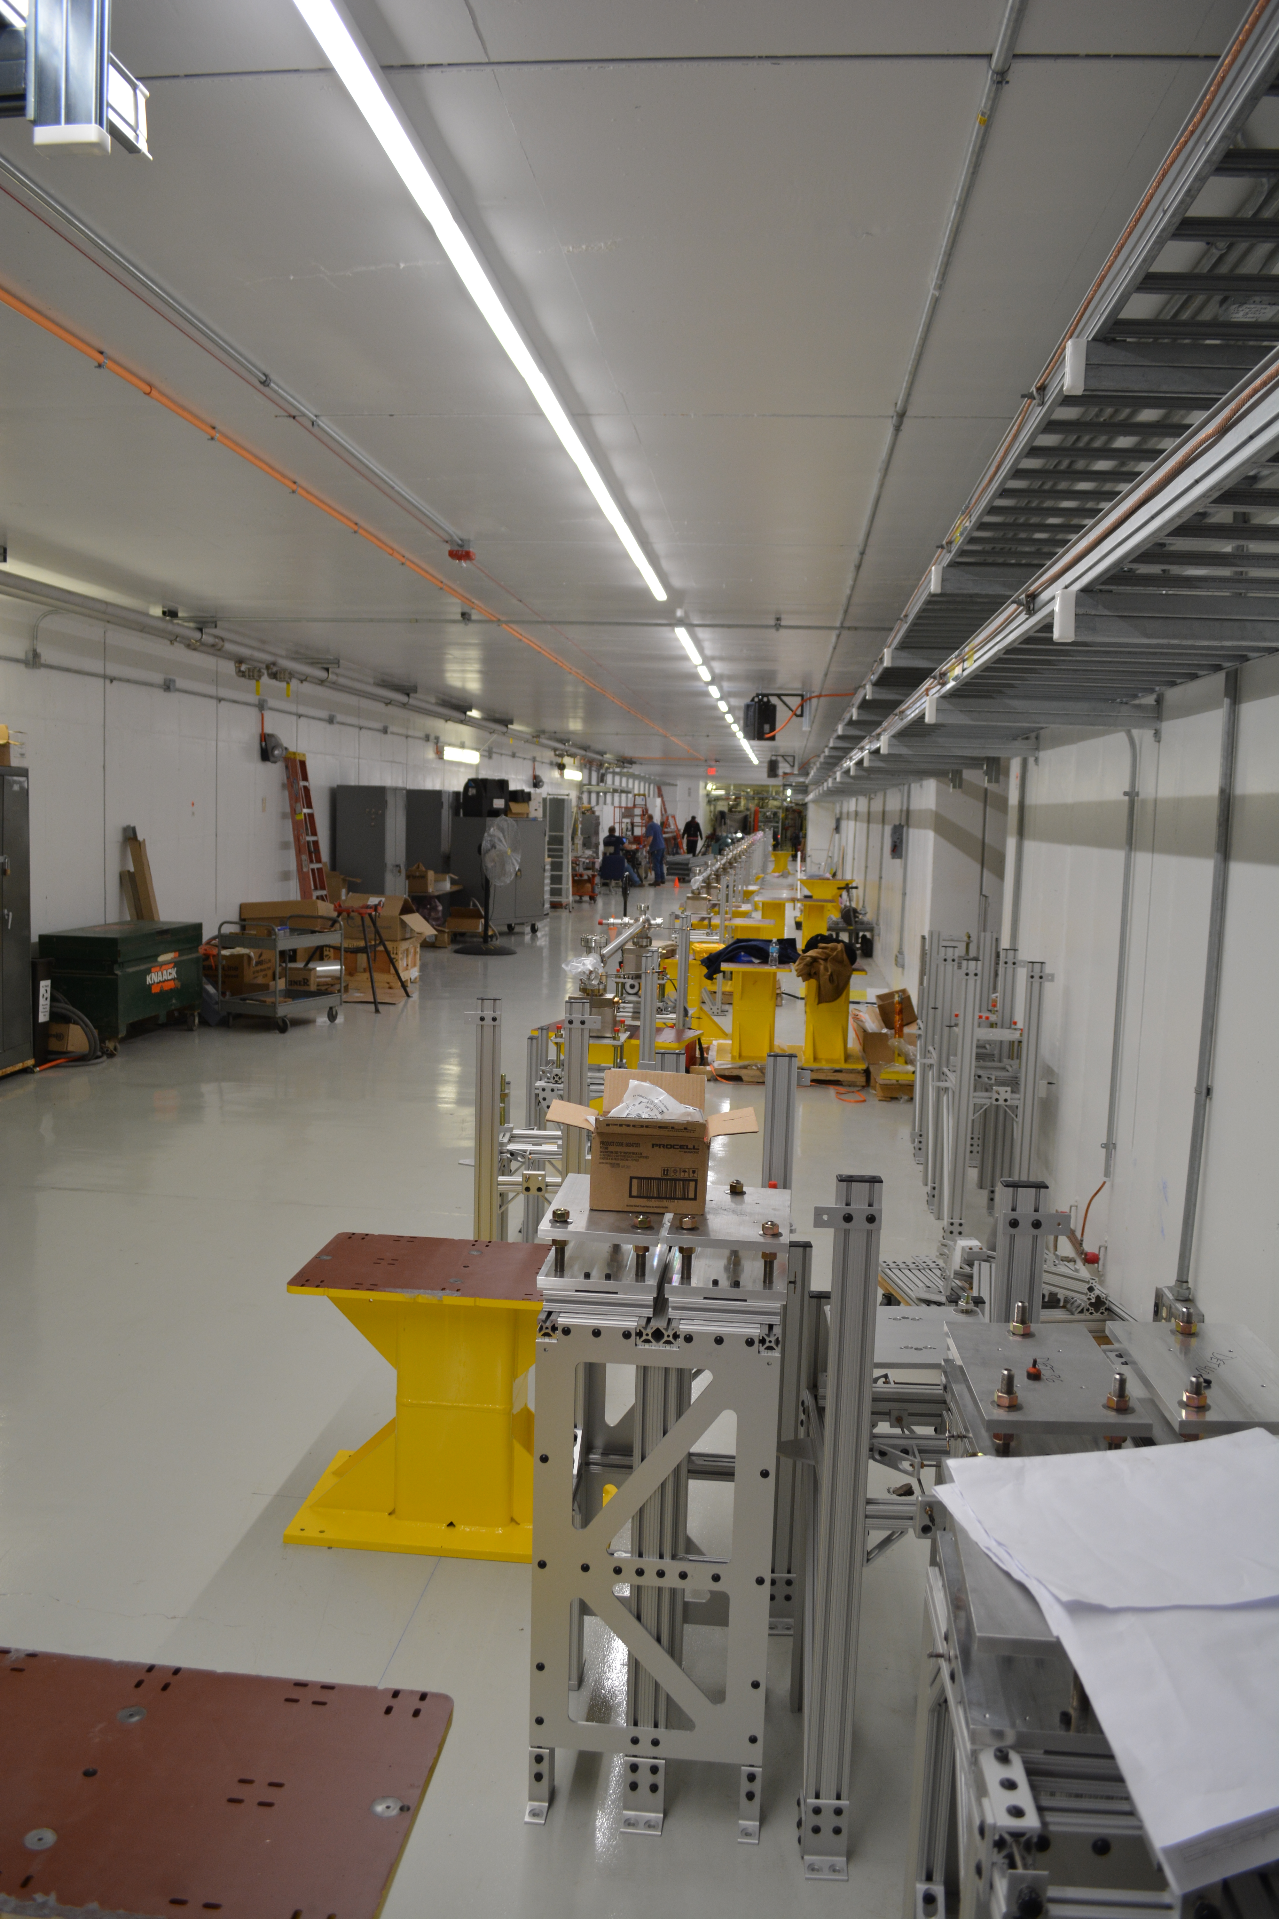
PIP-II Injector Test & FAST Status
PIP-II Injector Test
RFQ operation
Emittance measurements with new scanner look good
Shutdown to install 30 degree bend magnet in Low Energy Beam Transport (LEBT)
Down for ~4-5 weeks
Performed maintenance
Plans for the week
Shutdown for magnet installation
FAST
No gun operation
Drive laser aligned in laser lab
Shutdown for 300 MeV upgrade
Toroids arrived and being cleaned for leak check
Magnet and stand installation
Stands installed and aligned
Magnet supports being added
Magnets to follow

Slide 12
CMTS1 Status
LCLSII Prototype Cryo Module
Cryo
Operation at 2K restored
Accomplishments
On Friday, January 13th all 8 cavities of pCM and magnet were powered to nominal gradient.
Achieved voltage of 129 MV (128MV specification)
Completed Q0 measurements
Gathering lots of microphonics data
Plan for the week
Slow cooldown in progress
Power all 8 cavities of pCM and magnet for endurance test (>10 hours)
Microphonics as needed
Turn off February 17th for ICW work

Slide 13
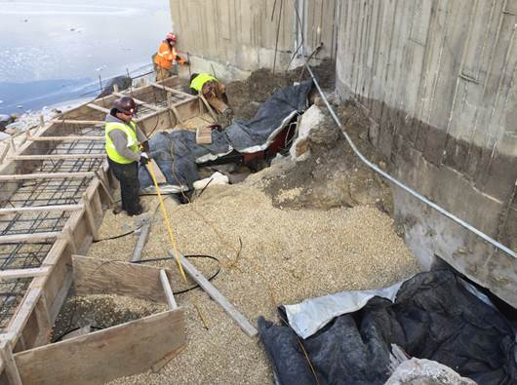
ICW Reduction
Flow reduction began Thursday, December 29th (Complete)
Flow rates reduced < 4300 GPM
Contingency week was needed
Weather added to the challenge
Flow reduction ended Friday, January 20th
Running on one 400 hp pump with
addition pumps ready as needed
Stakeholders impacted
AD, TD, PPD, CD, FESS
Thank You!

Slide 14
February 2017

Slide 15
March 2017

Slide 16
February 15th

Slide 17
February 27th

Slide 18
February 28th

Slide 19
March 1st

Slide 20
March 2nd

Slide 21
Schedules and Links
Schedule can be accessed from the Operations Department Home Page
Schedules -> Operations Schedule
Direct link to schedule
http://www-ad.fnal.gov/ops/schedule.html

Slide 22
Collaborations / Partnerships / Members [22pt Bold]

