Slide 1
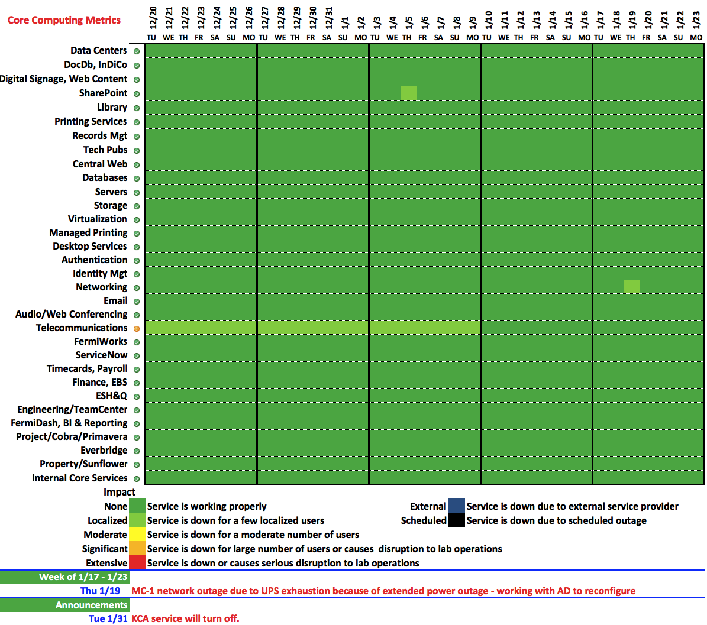

Slide 2
ReadyTalk -> Zoom Transition
Zoom will be replacing ReadyTalk as the new audio, web, and videoconferencing tool for the lab on February 1st.
Rollout Schedule:
End of Jan - Notice to RT users that they will automatically get Zoom accounts and list of training dates
February 2 - SNOW form goes live to request Zoom accounts (for new users only)
March 7 - ReadyTalk accounts for Zoom Pilot Users will be turned off
March 15 - ReadyTalk accounts for remaining ReadyTalk users will be turned off

Slide 3
Scheduled training dates for February
Mon Feb. 6, 2 to 3 pm FCC1W
Wed Feb. 8, 1:30 to 2:30 pm WH8X (Hornets' Nest)
Fri Feb. 10 10 to 11 am WH8X (Hornets' Nest)
Tue Feb. 14 2 to 3 pm WH8X (Hornets' Nest)
Wed Feb. 15 10 to 11 am WH8X (Hornets' Nest)
Fri Feb. 17 10 to 11 am FCC1W
In addition to these instructor-led hands-on training courses,
KB articles (KB0012309),
on-line instructions (http://fnal.zoom.us) and
on-line videos (http://support.zoom.us)
are available.

