Slide 1
Friday 9:00
2017-01-13

Slide 2
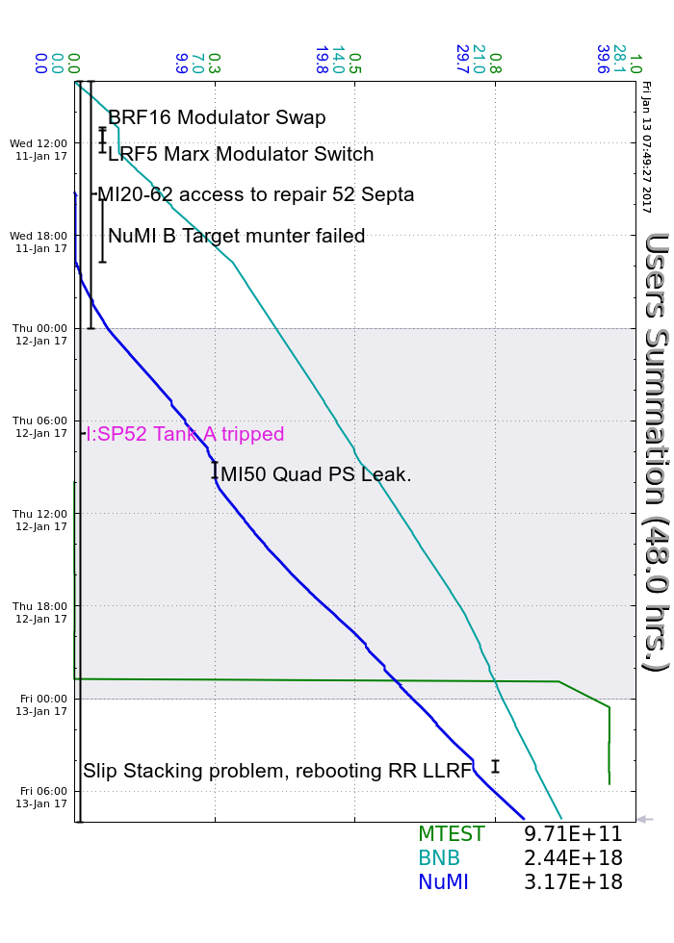
Wednesday
Shutdown Day
BRF16 Modulator Swapped
LRF5 changed back to switch-tube modulator
NuMI Target Chase Dehumidifier failed again, accessed to repair
MI52 Septa at 20kV overnight
Established beam to NuMI
MI Air pressure issues affecting beam stops and cavity shorts
Thursday
MI-50 Quad Power supply leak, experts change module
Septa Commissioning Continued, achieved beam to SY dump
False G2 BBM violation traced to failed SEM
Friday Morning
RR stopped slipstacking, Rebooted RR LLRF, rephased dampers
Current Conditions
Beam to NuMI and BNB

