Slide 1
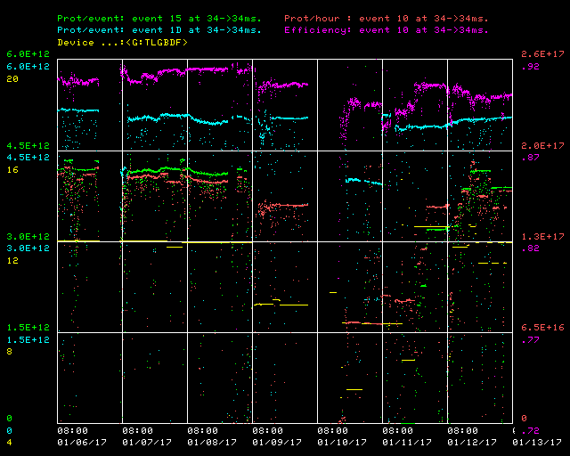
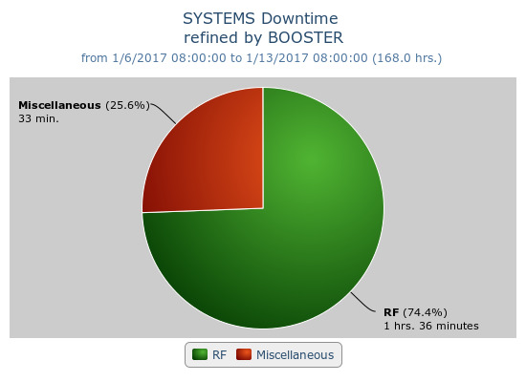
Booster Operations 01/06/17 – 01/13/17
F
T
F
F
Sa
Su
Su
M
F
F
F
W
F
Sa
W
F
Sa
F
F
F
F
F
Sa
Su
Su
M
Tu
F
F
F
M
M
Su
M
M
W
W
Sa
W
Th
F
Sa
Sa
F
F
Su
M
F
M
Th
Su
M
Tu
Sa
Su
F
Sa
F
Tu
F
W
Su
W
F
Sa
M
W
Th
Sa
Su
Tu
W
Th
F
F
Su
W
F
Sa
Su
M
Tu
Sa
Su
M
M
W
Th
F
Sa
Su
M
W
Capture/Transition Issues
Access to replace BRF16 Cavity
BRF8 Cable Fault
DOGL3 Flow Switch
MKS06 Cable Termi
Collimator Studies
Downtime:
Total 2 hours 8 minutes
Mostly various RF trips –
Misc - Cogging code update
This week:
Beam to BnB, NuMI
$1D @ ~5.0E12 89-90%, $15 @ 4.0E12 @ 91%d
TLGBDF back to ~12.05Hz
Orbit correction studies, one shot early injection studies
May want to apply orbit correction changes today
Looking for opportunity to test BRF16 today (~ 10 min)
Access on Tuesday during the MI52 Septa Replacement
PA’s replaced on BRF1, BRF17
Modulator work on BRF 12, 16
Modulator BRF16 replaced
New LLRF frequency source brought online
New cogging code loaded to support laser notching alignment with chop pulse

