Slide 1
Radiation Safety
Paul Derwent
PIP-II Machine Advisory Committee
10-12 April, 2017

Slide 2
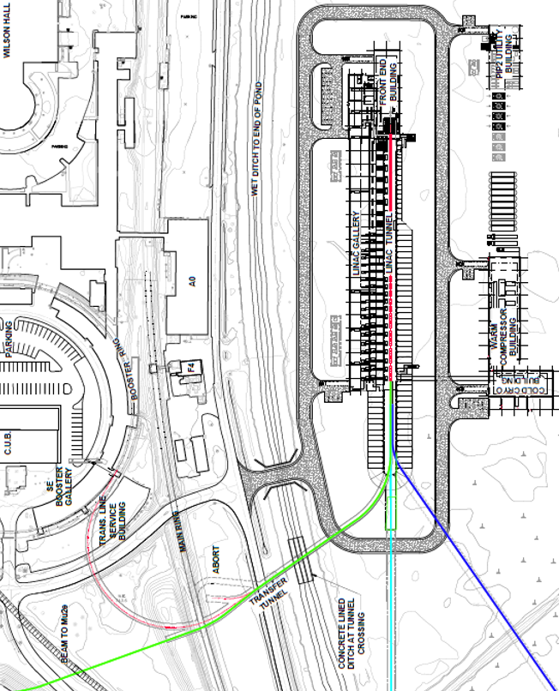
Outline
PIP-II shielding requirements
  800 MeV SC Linac
  Transfer Line
  Booster
  MI8 Line
  Main Injector
Summary

Slide 3

Shielding Development and Review Process (FRCM)
X
We are here

Slide 4
FRCM defines Project and Laboratory Organization elements required for Shielding Development Process
Project Manager
Division Head
Division/Section personnel
FESS
RCO liaison
SARP
Assigned RSO(s)

Slide 5
800 MeV SC Linac Design Goal
The global dose rate limit adopted for the 800 MeV SC Linac is <0.05 mrem/hr
  Normal and accident conditions
  Outdoor spaces including shielding berms and parking lots
  All indoor service building galleries, offices, and corridors
The FRCM prefers passive shielding but allows for radiation interlocked detectors
For high power accelerators and beam lines, passive shielding is impractical and cost prohibitive
  Civil construction
  Utility and waveguide penetrations
  RF power requirements and efficiency
For low beam energy regions, reliance upon passive shielding remains a reasonable means
Where interlocked radiation detectors are employed, the upper limit of dose rate permitted must be considered the normal condition
The accident condition is limited to the level of the normal condition because dose rate limits are held at the time weighted average limit
Notes:
Can you remind me what the “Sullivan method” is? I have heard it used but do not know any details on the method. A summary in the notes field would be enough.
“A Guide to Radiation and Radioactivity Levels Near High Energy Particle Accelerators”: A. H. Sullivan, Nuclear Technology Publishing, (1992)
Application of the method is described in the Project X Preliminary Shielding Assessment 1051-v2, section 5.1.

Slide 6
SC Linac Shielding
SRSO designated shield design is for 10 watt single point loss

Slide 7
800 MeV SC Linac Shielding
The difference between the shield design beam loss and actual beam power is quite significant
  17,000 watts total power vs. 10 watts
The shielding assessment must bridge this gap
Total Loss Monitors (a credited safety control) can be used to eliminate the gap
  By setting the trip level to limit dose rate to 0.05 mrem/hr outside shielding surfaces, the gap is eliminated without reliance on machine protection systems
Groundwater, surface water and air activation for this new facility will be quite limited due to the very low tolerance for beam loss
Notes:
Slide somewhere on activation: which is expected to be minimal ?

Slide 8
800 MeV Beam Transport line shielding
Shielding design for the Transport line is determined similarly
      Beam loss through the transfer line is estimated to be 1 part in 10,000 for the entire transfer line (V. Lebedev)
      10 watt single point loss is shield design basis established by SRSO
This requires up to 18.5’ earth equivalent shield for the beam transport line
The crossover shielding requirement can be met with inclusion of steel to make the equivalent density-thickness
  The steel must be following by at least 2’ of earth equivalent shielding for this technique to be effective
One caution:
  where beam collimation and scraping systems are required, those systems must be well shielded
  The dynamic range of TLM systems is rather small
  Significant beam losses are not tolerable where TLM systems are used

Slide 9
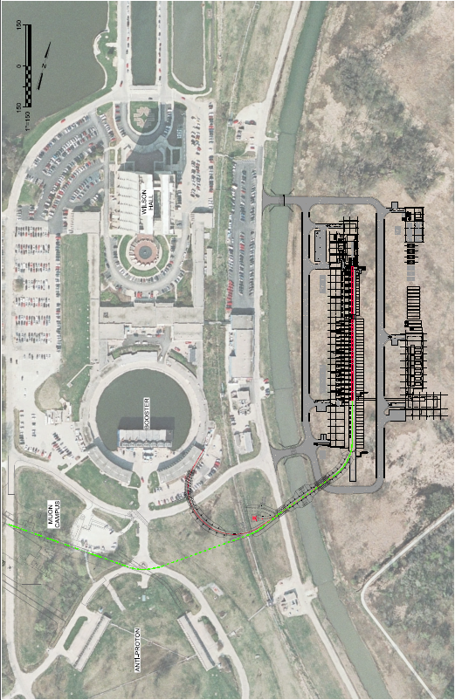
Transport line beam absorber shielding design
Beam Power (50 kW)
  Drives beam dump mass for control of:
    Prompt dose rate on berm surface (< 0.05 mrem/hr)
    Groundwater activation
    Surface water activation
    Air activation
    Residual activation
    personnel access control near absorber

Slide 10
Shielding at Booster/Transfer Line injection region
Booster East Tower presently in place over the proposed injection region
Beam power loss at injection needs to be defined and will drive
  shield design at the new injection region
  Booster East Tower occupancy limitations
  Provisions for control of Groundwater, surface water, air activation, and residual dose rates will be required
The shielding design must specify not only shielding thickness but density of shielding materials

Slide 11
Booster shielding
The Booster is now approved to operate at 96 kW, 8 GeV protons
  Booster shielding is nominally 13.5 feet
  This operation is possible because beam loss, especially for energy above 400 MeV, is very small
8 TLM systems (200 foot detectors) cover the entire Booster
  The response of 6 of 8 of the systems is well below the nominal trip level (~10%)
  2 systems run at about 50 to 70% of the allowed trip limit
  If the beam power losses are controlled/limited, higher power operation should be feasible
  TLM detectors can be sub-divided to reduce response
    Trip levels are based upon single point accident losses
The ESH&Q Section is evaluating the feasibility of higher beam power operation at Booster

Slide 12
MI8 Line and Main Injector Shielding
Shielding for these regions is a minimum of 24.5 feet
Shielding Assessment would be required to evaluate higher beam power
The ESH&Q Section has been asked to study the possibility of operating the MI8 line at 160 kW
The ESH&Q Section has also been asked to study the possibility of operating the MI at >1 MW
TLM systems could be useful in expanding present beam power limitations of the MI8 Line and the MI
Notes:
TLM approval has been granted, so what updates should be put on this slide?

Slide 13
Summary
We are in the process of defining beam power and shield requirements for new facilities
  SC linac
  Transfer line
  Transfer line beam dump
  Booster injection region
The Booster, MI8 Line and MI are being evaluated for higher power operation
A layered approach using shielding and an active protection system (TLM) will minimize project costs while meeting the requirements of the FRCM
A preliminary shielding assessment will be developed following receipt of CD-1 approval
Notes:
Is there a scale that could go with the second bullet?
e.g., TLM utilization in the linac tunnel could mean 13’ instead of 18’?

