Slide 1
Machine Protection System
Arden Warner
PIP-II Machine Advisory Committee
10- 12 April, 2017

Slide 2
Outline
MPS Scope – PIP2IT to PIP-II
System Design and Configuration
Technical Concerns
MPS test and development at PIP2IT
Summary

Slide 3
Main Goals of the MPS
The main goals of the MPS is to protect the machines from beam induced damage; thereby inhibiting the beam in case of excessive beam loss, equipment failures, or operator request. In achieving that objective, the system will also provide the following features:
Manage beam intensity and permit limits of MPS designated devices while providing post mortem data to the control system,
Provide a comprehensive overview of the machine state and readiness status to subsystems and the broader complex,
Provide a global synchronization trigger for beam related system fault-analysis,
Provide Linac beam status to the accelerator complex control system,
Provide high availability and fail safe operation where possible,
Manage and display MPS alarms.
The MPS is not a personnel safety system, however it is required to operate in a fail-safe manner.
Arden Warner | 2017 P2MAC

Slide 4
MPS Design
The PIP2IT / PIP-II MPS comprise of a logic system that takes in signals from various subsystems and drives permits to beam enabling devices. These devices are divided into two (Primary and Secondary) categories based on criticality for mitigating beam damage
Primary Devices :
main actuators for beam and should guarantee that, when they function properly, no dramatic damage can be caused by the beam even if protection through secondary devices fail (includes sensing and beam inhibiting devices).
  Are located in the Ion Source and the LEBT section and include:
    LEBT Chopper
    LEBT Dipole
    Ion Source Modulator
    Ion source Bias Power Supply
Primary devices are not mask during normal operation
Possible to mask during MPS commissioning
Other Primary devices:
  Special Instrumentation and diagnostics specifically developed for MPS use such as beam transmission loss system and permit signals from users indicating readiness for beam from the Linac
Arden Warner | 2017 P2MAC

Slide 5
MPS Design
Secondary Beam Inhibiting Devices are those whose malfunction will not create dramatic damage; either because the effects can be detected and mitigated by primary devices or because the device is included in the MPS for self protection
Secondary Devices :
  Insertion devices – scrapers etc.
Secondary devices further decrease the likelihood of damage and possible irradiation of components. The list includes:
  The System providing the beam request sequence from the complex
  Status signals from Linac subsystems such as
    RF amplifiers, Magnet power supplies, LCW
    Quench detection system and Cryogenic system
    Control System
    Malfunctioning subsystems which can affect beam delivery and therefore drop the Linac beam permit (i.e. RF amplifiers)
Other beam inhibiting secondary devices:
Beam loss indication devices such as radiation monitors, current signals from scrapers, vacuum gauges, valves and position insertion devices
MEBT Chopper is also a beam inhibiting device.

Slide 6
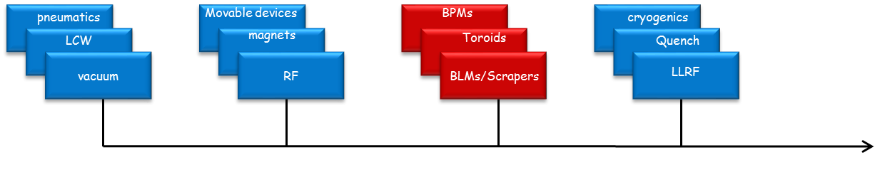
MPS Configuration
The MPS is collection of all subsystems involved in the monitoring and safe delivery of beam to the dumps or designated user and not limited to any particular subsystem or diagnostic device. It has connections to several external devices and sub-systems
The MPS interacts with several subsystems with different times scales of interest. It also has to be integrated with the complex.

Slide 7
Simplified MPS Design Overview
Three functional layers to the system:
Signal interface
Main Logic layer (permit system) includes slot ‘0’ interface
Primary and Secondary Actuators for beam inhibit
3
1
2
Transmission Loss diagnostics (RPU)
LEBT Chopper
Chopper/ Kicker Monitors
Ion Source Modulator
Movable device Interface, Vacuum, Magnets….etc.
FPGA Based Permit System
Slot ‘0’ controller…etc.
MPS comprises a logic system that takes in low level signals from various beam instruments and interlock systems and drives permits to low energy beam enable devices.
LEBT Dipole
LLRF, RF, QP, Temps,
Flow….etc.
Ion Source Bias Supply
MPS dedicated Instru. RPU, Scrapers, BPMs, torroids
Machine Timing
Reset
Beam Mode
Arden Warner | 2017 P2MAC

Slide 8
PIP2IT LEBT/MEBT-3 Test Bed
PIP2IT is being developed in stages. Each configuration requires that the MPS expand to accommodate new diagnostics, machine hardware and higher damage potentials. This has driven the MPS development somewhat.
Lesson learned and techniques developed in PIP2IT system are directly transferable to PIP-II MPS design.
Beam Damage Potential - PIP2IT
Machine Damage Potential:
  The maximum beam power that PI-Test front-end can generate is 21 kW CW (10 mA x 2.1 MeV).
  FY17 operations will be limited to pulsed mode with maximum power of 2.1 kW (5 ms x 20 Hz x 10 mA x 2.1 MeV).
  Standard Long-pulse mode for FY17 for Booster injection scenario 105 W (0.5 ms x 20 Hz x 5 mA x 2.1 MeV
Enough potential to damage invasive hardware, vacuum system and components.
Arden Warner | 2017 P2MAC

Slide 9
Protecting of the Warm Frontend
Detection of beam losses in PIPII warm frontend is mainly done by secondary devices i.e.
  Scraping system
It’s impractical to designate a small set of devices to be responsible for beam loss detection due complicated beam dynamics but:
Warm front end characteristics reduces the potential for critical beam induced damage:
  Lower beam power density
  Negligible residual radiation
  Lower sensitivity of the warm elements to beam loss
  Lower cost
  Redundancy in secondary devices

Slide 10
Technical Concerns / Requirements
CW Beam:
  Losses develop continuously; need to distinguish steady-state losses from those that can cause damage to machine.
  MPS must allow pulsed, diagnostic beam operation when CW losses inhibit normal operation. Transitions from pulse beam to near CW beam requires special diagnostics.
MEBT Chopper:
  Kicks out individual bunches to reduce average current of beam from 5mA to 1mA. Diagnostics needed to insure SRF is not overloaded. Protecting kicker can be challenging but important
LEBT Chopper:
  Requires close monitoring as a primary beam inhibit
Low Energy SRF Transition:
  Most loss monitors are ineffective at low energies.
  Reduced penetration depth of beam energy impacting niobium.
  Need a way to detect losses before cavities quench.
Arden Warner | 2017 P2MAC

Slide 11
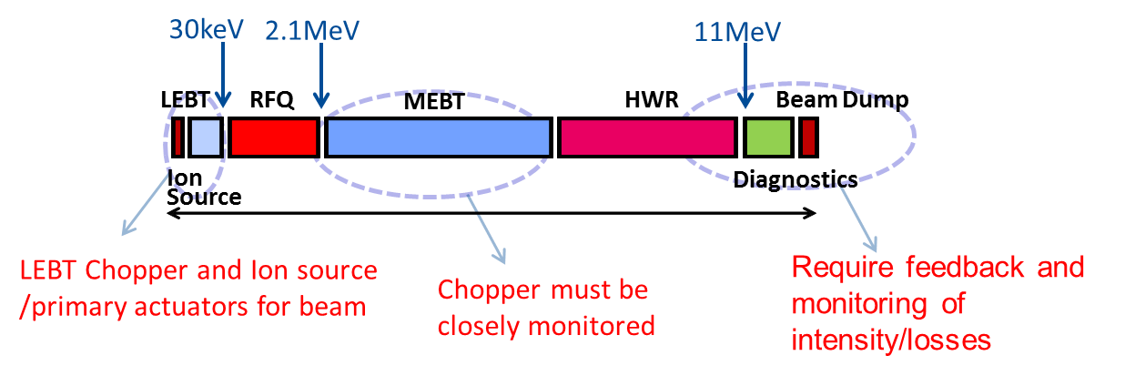
Some Specifications For MPS Primary Systems
Actuators for beam: Primary beam inhibit devices
  LEBT chopper (150 ns delay + 110 ns rise time + propagation).
    turn off with chopper (~ 10 µs scale) after MPS interruption signal
  Specific times scales relevant to interfacing to the global accelerator complex will be based on the mitigating damage potentials at downstream machine location, specific hardware limitation and signal time-of-flight issues.
  Transmission Loss system
    Will monitor for beam loss > 500 µA averaged over 1 µs sliding time window
    And > 5 µA averaged over one power line period (1/60s) for CW operations
    Also monitors beam pattern deviations to 20% level
MPS point of view: Extended source
Arden Warner | 2017 P2MAC

Slide 12
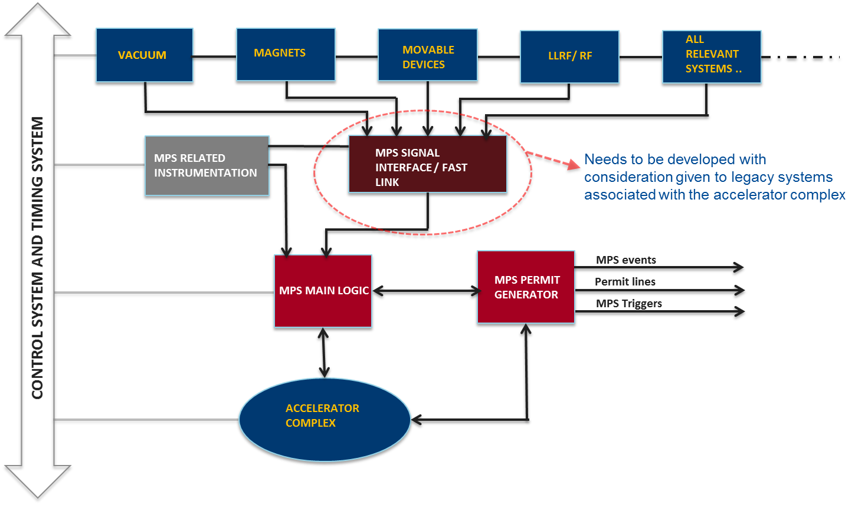
MPS Integration Diagram
The entire protection system interfaces with the accelerator control system and machine timing
system for configuration management, timing and post mortem analysis.
The operational modes, operational logic, reaction time and complexity of inputs will differ based
on the machine configuration and damage potential at various stages of the accelerator complex.

Slide 13
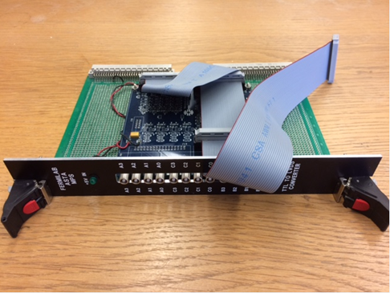
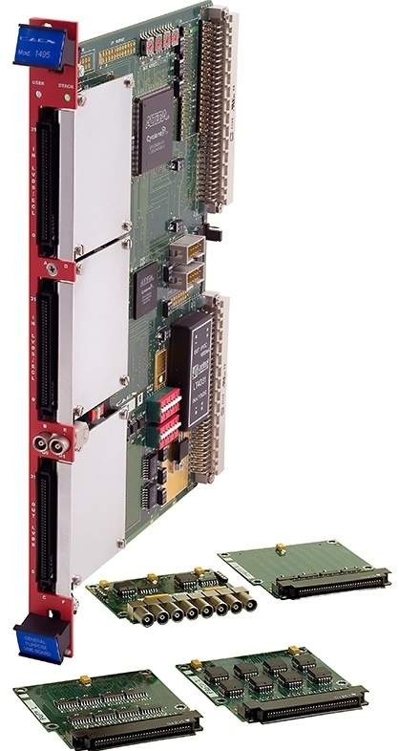
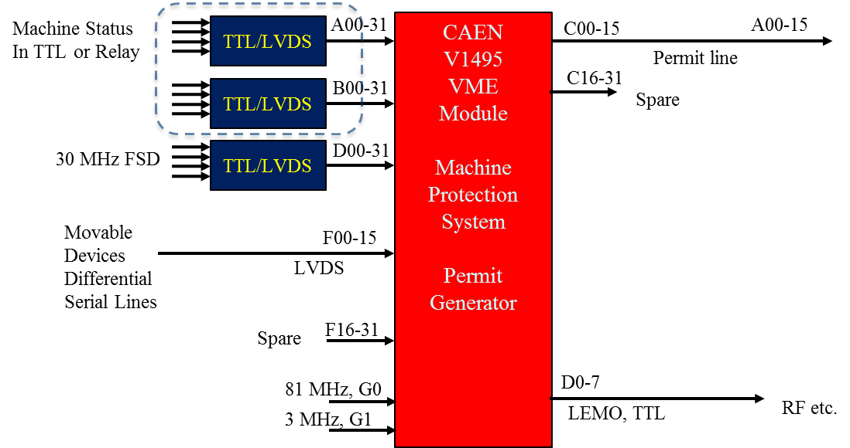
FPGA Configuration at PIP2IT
General purpose FPGA Board
  User customizable FPGA Unit
  LVDS/ECL/PECL inputs (differential)
  64 inputs expandable to 162 (with 32 outputs
  32 outputs expandable to 130 (with 64 inputs)
  405 MHz max for registered logic
  I/O delay smaller than 15 ns
  Programmable 3-color LED
TTL to LVDS converter cards 5V or 3.3V TTL/CMOS logic level is OK (provides noise immunity, signal integrity and verification)
Arden Warner | 2017 P2MAC

Slide 14
MPS related Instrumentation and Requirements
PIP2IT requires some dedicated instrumentation to protect the machine components. The system must monitor the chopped beam intensity, monitor/protect kickers, protect invasive diagnostics from over exposure to beam.
MPS dependent Instrumentation
  Ring pick-ups
    Transmission loss, intensity monitoring, pulse width monitoring, chopper monitoring
  Scrapers
  Kicker electrodes
  Loss monitors (exploring methods for monitoring low energy losses at 2.1 MeV)
Arden Warner | 2017 P2MAC

Slide 15
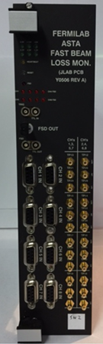
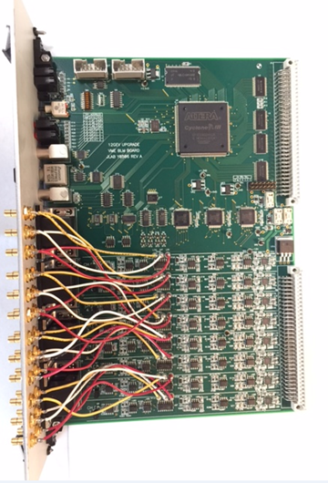
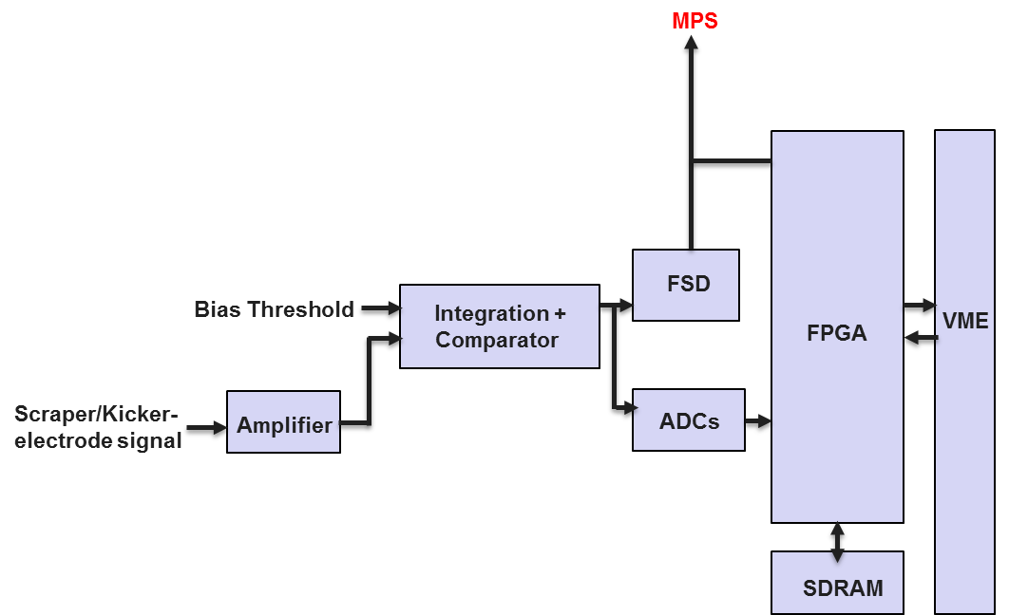
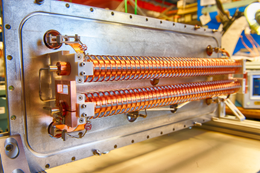
Scheme for protecting Diagnostic Scrapers and kickers
Scrapers and kicker electrodes can be exposed to excessing beam power. A method and a criterion for beam interruption in the MPS is required. (PIP2IT)
  Two proposed Schemes
    Analog integration electronics
    Digital processing
Criterion: Based on some characteristic time constant and integral
i.e. interrupt if integral > (5 mA) * (10 µs)
T << characteristic time (5 mA)
T >> characteristic time (5 µA)
Arden Warner | 2017 P2MAC

Slide 16
Summary
MPS Development work at PIP2T is focus on the main technical challenges for protecting the warm front-end.
Will learn how to monitor and understand the complicated loss structure expected
Techniques transferable to PIP-II
Above 200 MeV the PIP-II MPS hardware design and placement can be modeled after the SNS system.
Protection system R&D aimed to
  Understand and verify acceptable loss rates in the room temperature sections,
  Develop a strategy to monitor chopped beam from the MEBT,
  Estimate the particle shielding effects of superconducting cavities and cryomodules,
  Develop effective algorithms for the FPGA based logic system,
  Demonstrate effective integration with controls/instrumentation and all subsystems,
  Understand dark current effects as it relates to protection issues.

Slide 17
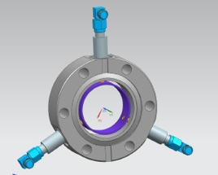
(Back up) - Intensity and Pulse Width Monitoring for MPS
RPU monitors beam pulse width, intensity and chopper performance based on beam threshold comparisons
Arden Warner | Status of Machine Protection System for PIP2IT

Slide 18
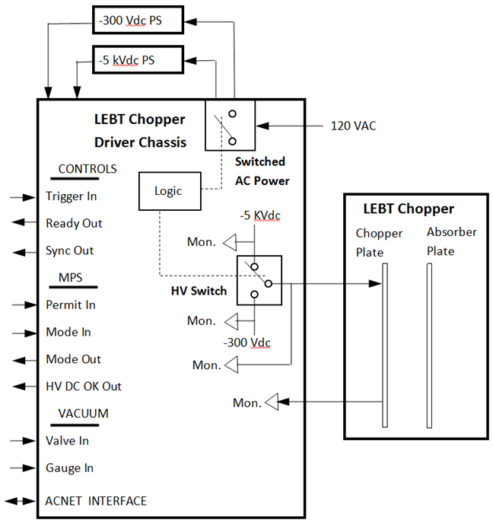
LEBT Chopper / MPS connection Development at PIP2IT
Four signals between driver and MPS
Parameter | Description / Comments |  | Signal Type
Mode (Input) |  | Mode setting command received from the MPS | TTL 50 Ohm term., TTL Serial
Mode (Output) |  | Acknowledgement signal sent back to the MPS | TTL, 50 Ohm drive, TTL Serial
Permit (input) |  | Logic level high enables & low level disables beam transmission | TTL,50 Ohm term, 5 MHz AC
HV_DC_OK (output) |  | Indicates high voltage integrity. Indication that -5 kV DC PS is greater than -5 kV, rear panel. | TTL, 50 Ohm driver, 5 MHz AC
G. Saewert
Code (one byte) | Mode No.
0x41 | 1
0x42 | 2
0x44 | 3
0x48 | 4
MPS INTERFACE
MPS mode value is a single byte TTL protocol -9600 baud
Arden Warner | Status of Machine Protection System for PIP2IT

Slide 19
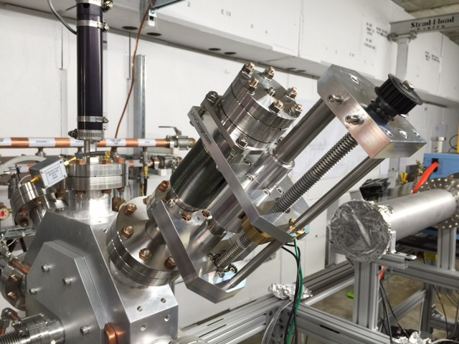
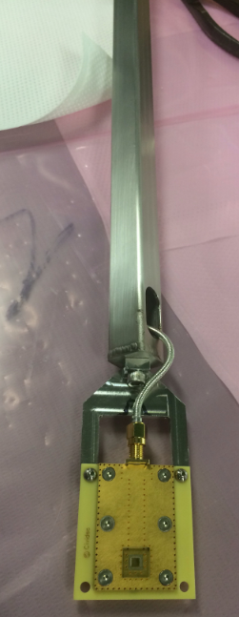
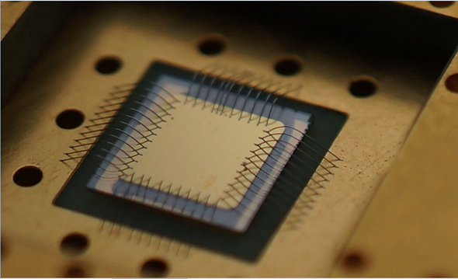
(Back-up) Loss monitor development for MPS at low energy
Test device parameters:
  150 µm
  5 x 5 mm
Charge pileup unavoidable in this setup. Penetration depth for 3MeV protons is 48 µm and charge deposition is 35.3 fC
Would need 5.6 MeV to traverse detector. The plan is to use 25 µm detector on larger substrate for 2.1 MeV.
Detector open front window & RF protection: Polarity such that surface forms a faraday cage with bond wires ands ground layer of readout structure.
Arden Warner | Status of Machine Protection System for PIP2IT

Slide 20
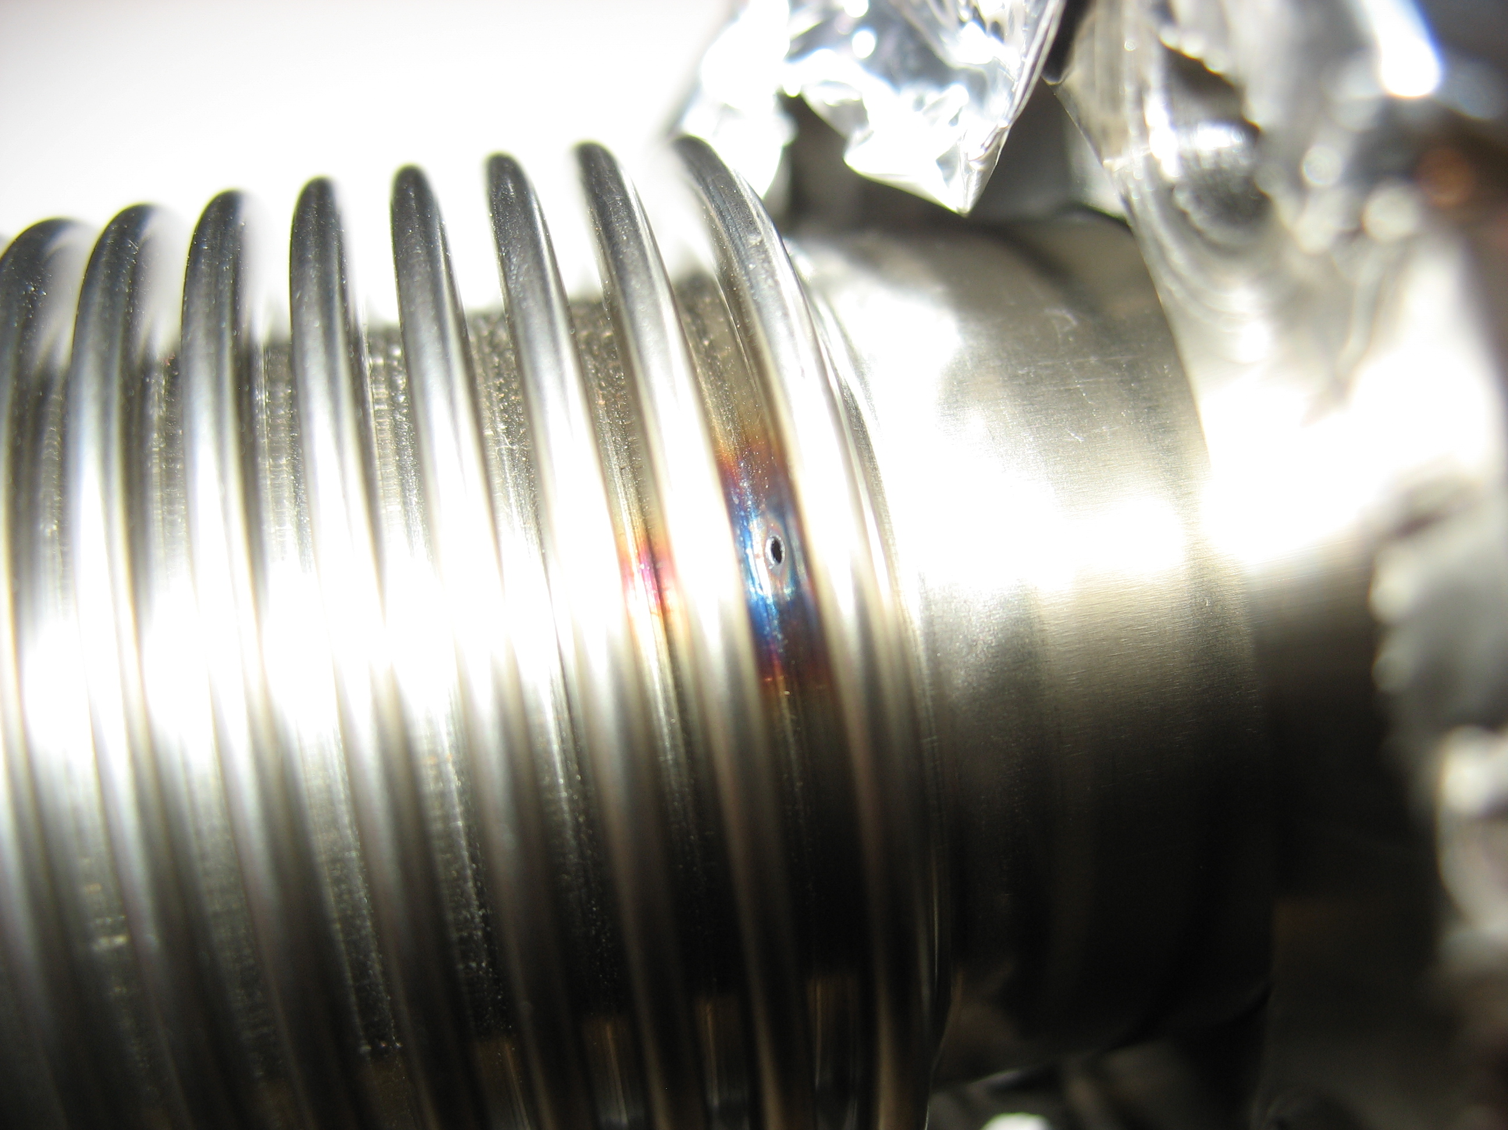
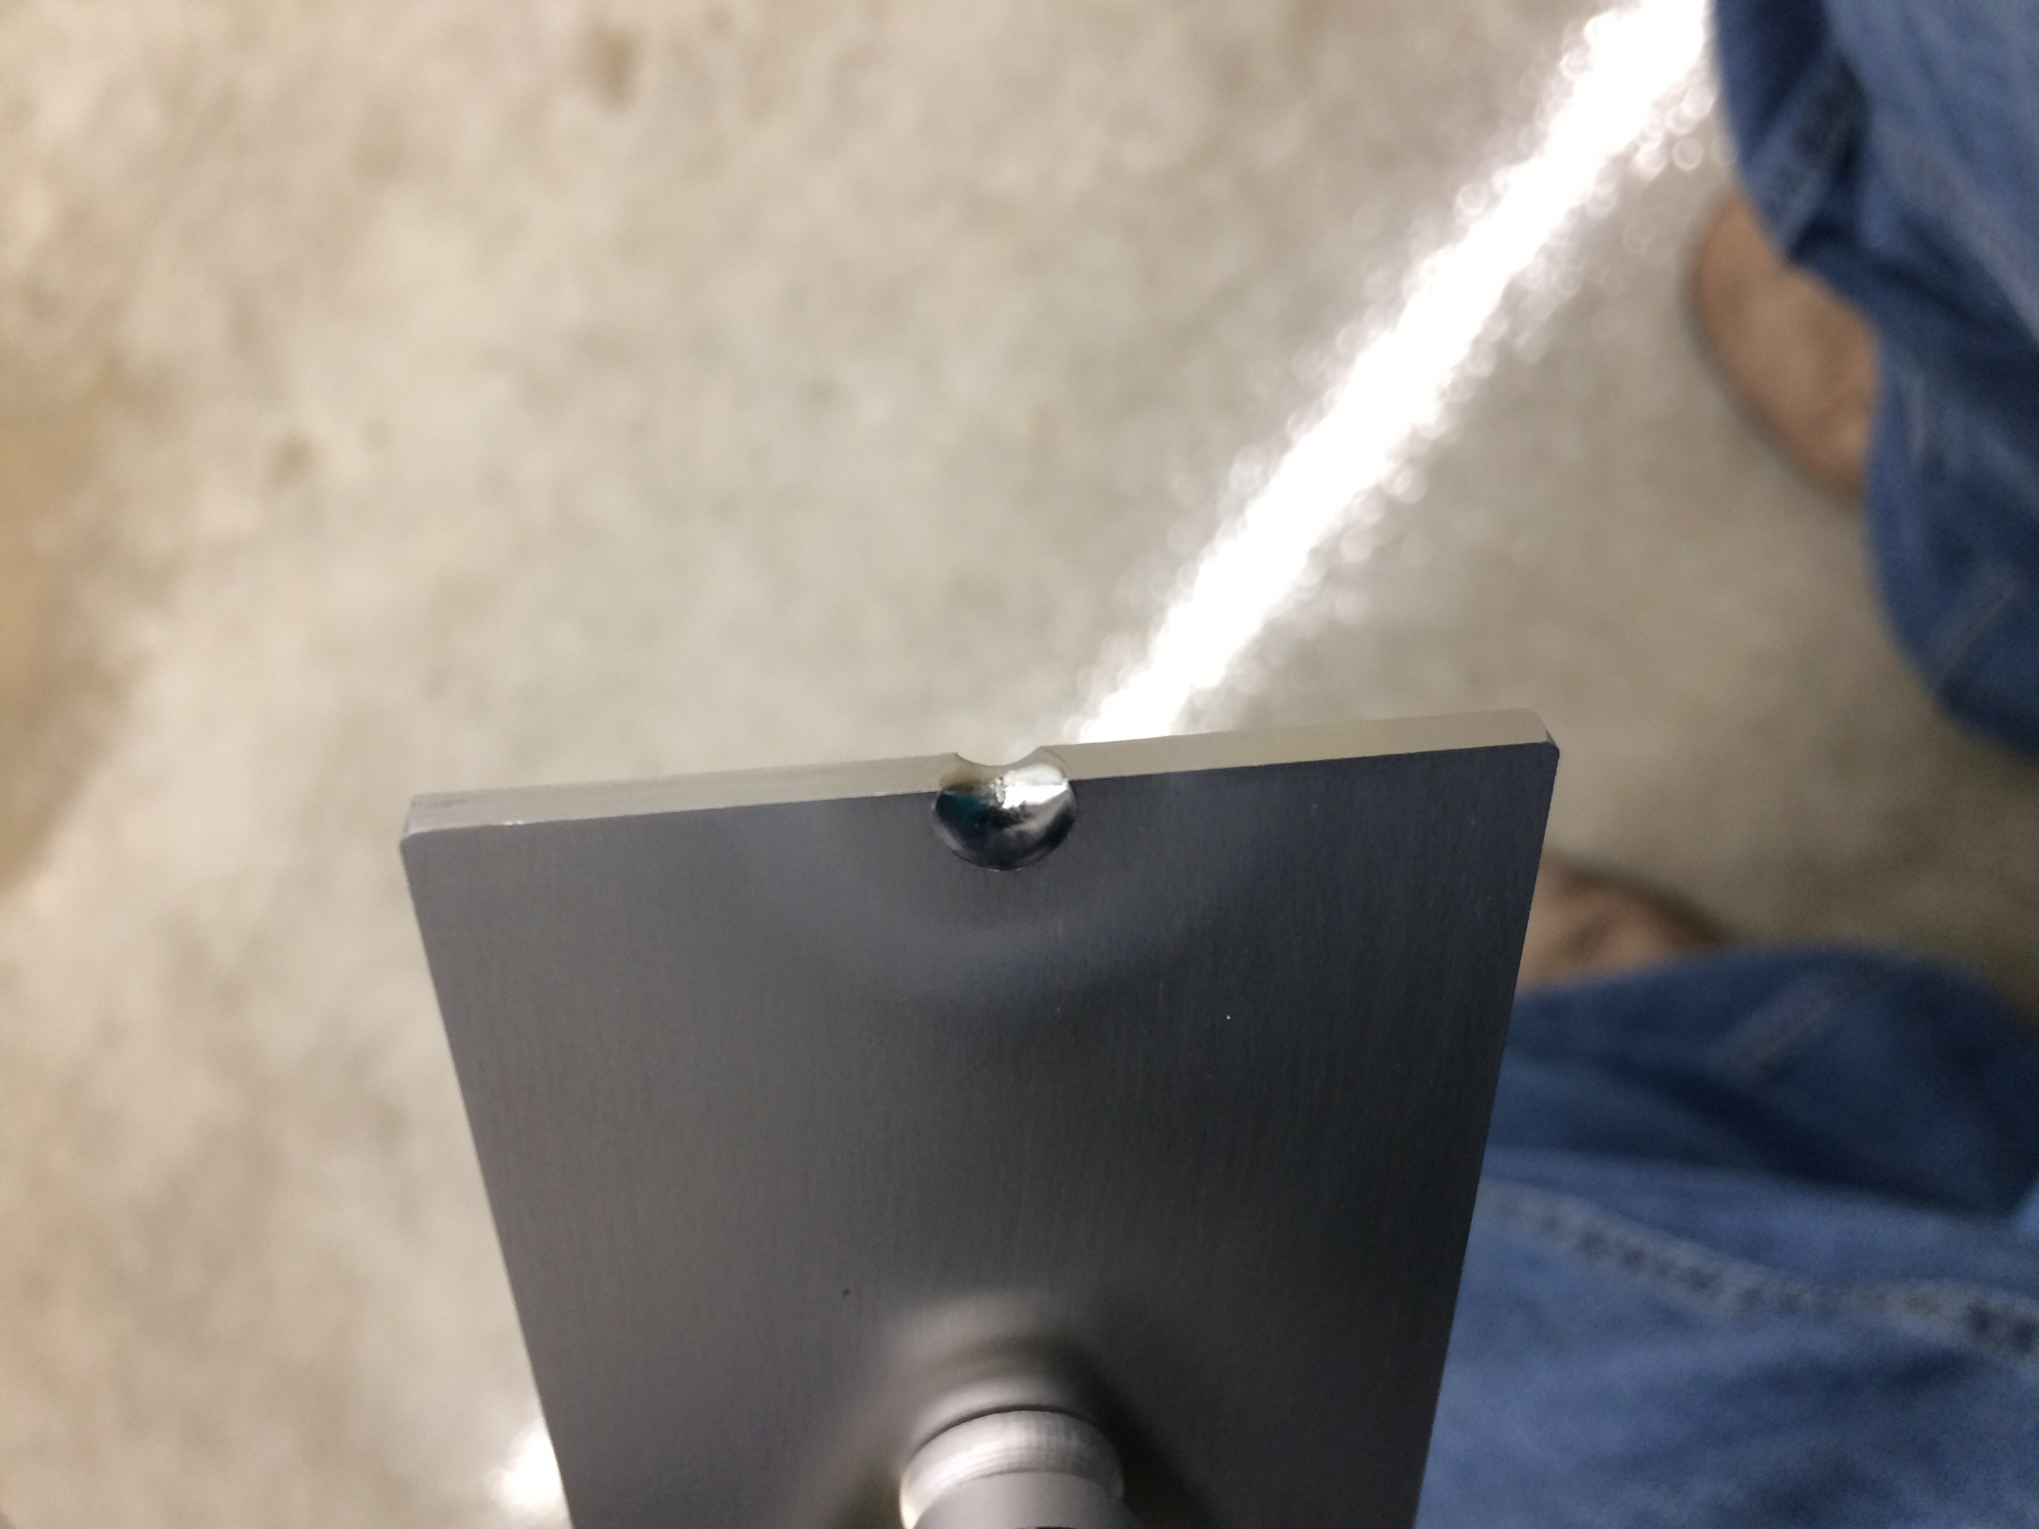
(Back-up) Beam Damage Potential - PIP2IT
Machine Damage Potential:
  The maximum beam power that PI-Test front-end can generate is 21 KW CW (10 mA x 2.1 MeV).
  FY17 operations will be limited to pulsed mode with maximum power of 2.1 KW (5 ms x 20 Hz x 10 mA x 2.1 MeV).
  Standard Long-pulse mode for FY17 for Booster injection scenario 105 W (0.5 ms x 20 Hz x 5 mA x 2.1 MeV
Enough potential to damage invasive hardware, vacuum system and components.

Slide 21
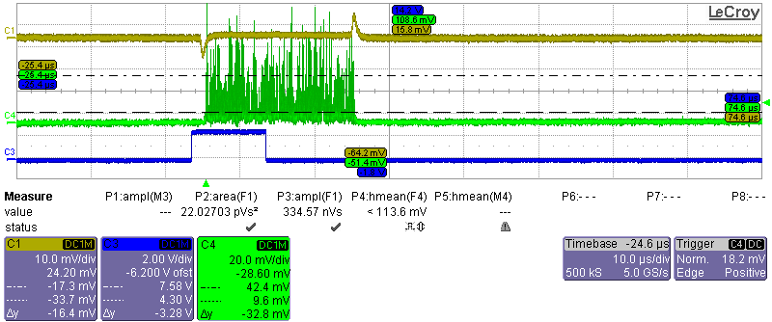
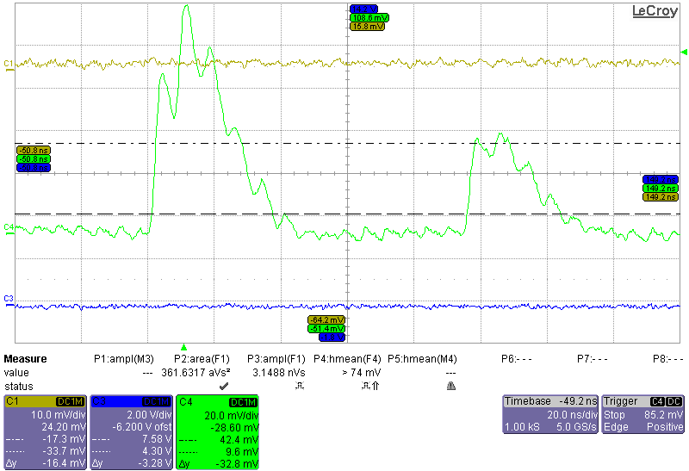
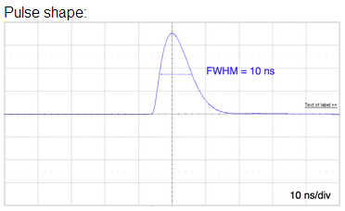


(Back-up) sCVD Diamond Crystal Loss Monitor
Clear beam loss signal that scales with loss current.
Individual particle interactions seen.
Cable capacitance effects.
There are two subsequent events within 100 ns: two protons in the first and one proton in the second pulse.
Fast Charge Amplifier: 100 MHz, 40 dB, 4 mV/fC,
Arden Warner | Status of Machine Protection System for PIP2IT

Slide 22
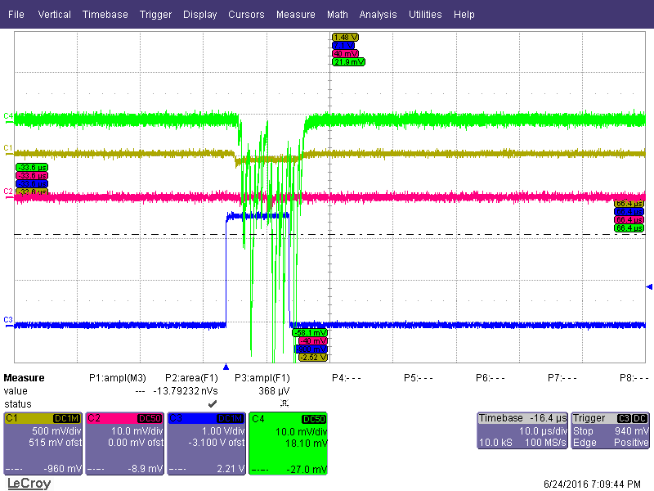
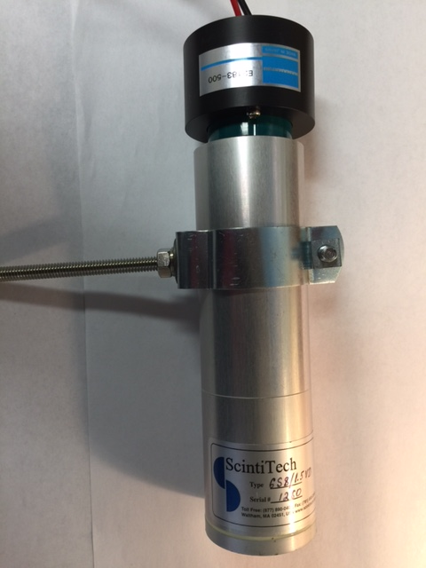
(Back-up) NaI Crystal
Sodium Iodide detector with PMT:
Detectable gammas downstream of RFQ
Arden Warner | Status of Machine Protection System for PIP2IT

