Slide 1
RF couplers for PIP-II
Sergey Kazakov
PIP-II Machine Advisory Committee Meeting
11 April 2017

Slide 2
PIP-II includes:
Room temperature cavities:
RFQ room temperature cavity.
Bunching cavity x 4.
5 types of SC cavities:
HWR x 8,
SSR1 x 16,
SSR2 x 35,
LB 650 x 33,
HB 650 x 24 elliptical cavities.
Each cavity requires a coupler.
Total number of couplers: 122 (RFQ uses 2 couplers).

Slide 3
Operating parameters of cavities determine the requirements to couplers:
(Requirements meets parameters of upgrade version of PIP-II with 5 mA current.)
RFQ coupler:
Frequency 162.5 MHz
Power 75 kW, CW
Buncher coupler:
Frequency 162.5 MHz
Power 3 kW, CW
HWR coupler:
Frequency 162.5 MHz
Power 10 kW, CW
SSR1 & SSR2 coupler:
Frequency 325 MHz
Power 30 kW, CW
LB & HB 650 coupler:
Frequency 650 MHz
Power 110 kW, CW
All couplers were designed and some prototypes were built and tested.

Slide 4
Principles of design:
Simplicity of vacuum part of coupler:
no moving parts, no bellows.
simple configuration – more reliable, easy to clean, less expansive.
Air cooling of antennas (no water) – Not so severe consequences in case of leak.
Ability to apply high voltage bias to suppress a multipactor.
Avoid a copper coating of stainless steel.
Based on this principles the RFQ, SSR1 & SSR2, LB & HB 650 couplers were design.
RFQ and SSR1 & SSR2 couplers were built and tested.

Slide 5
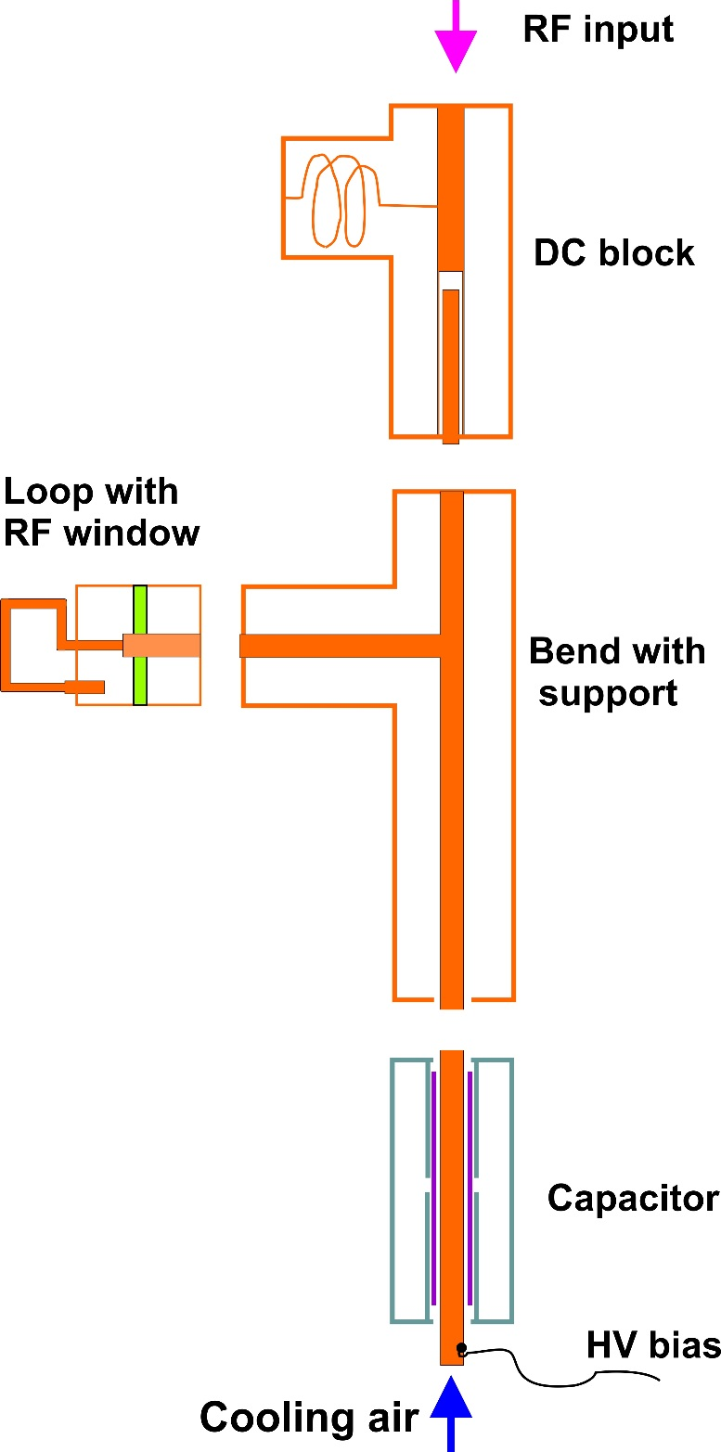
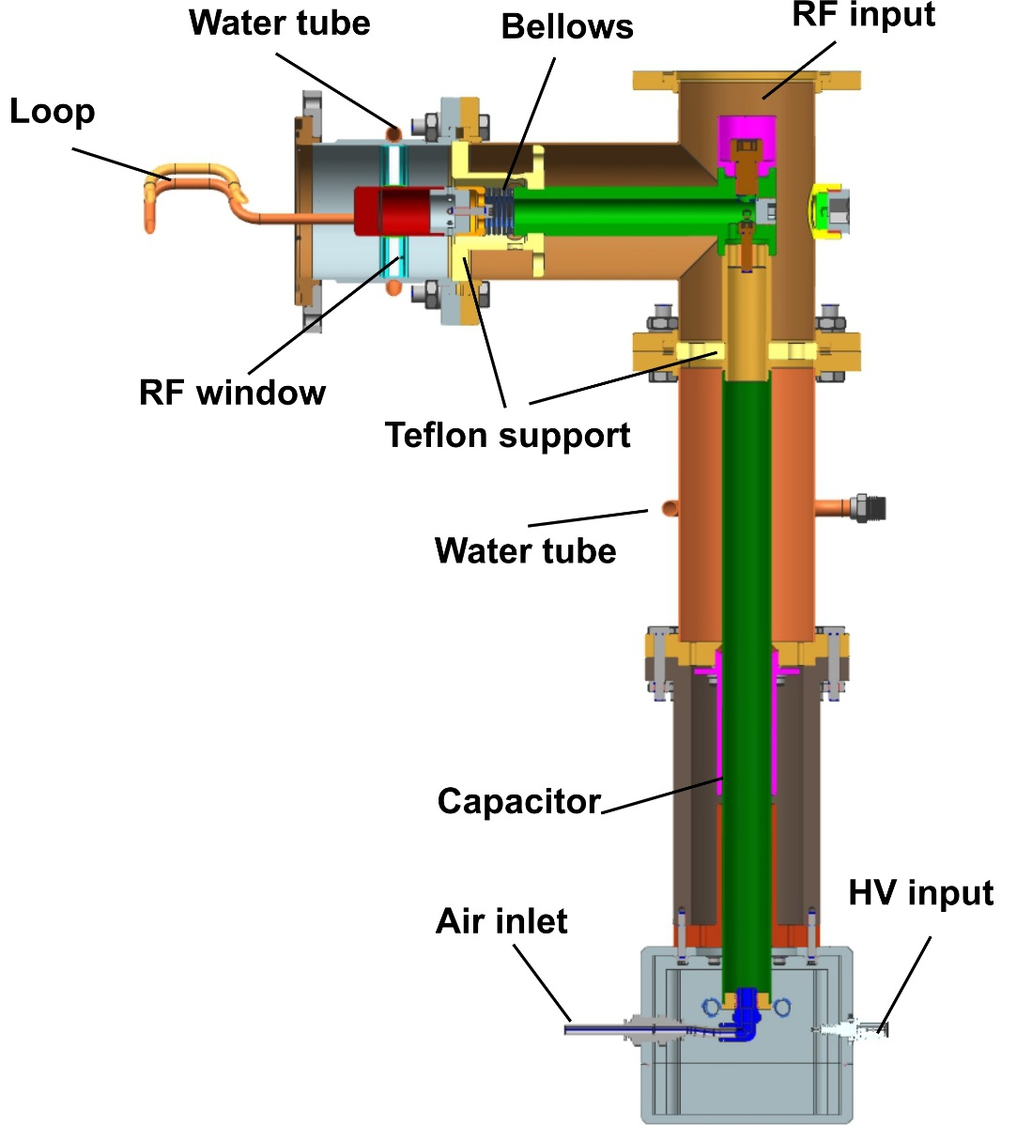
RFQ coupler:
RFQ coupler structure:
RFQ coupler cut-view:
Main features:
Not grounded loop
Rotatable loop
Air cooling of loop
HV bias
DC block protects RF
source against HV of bias.

Slide 6
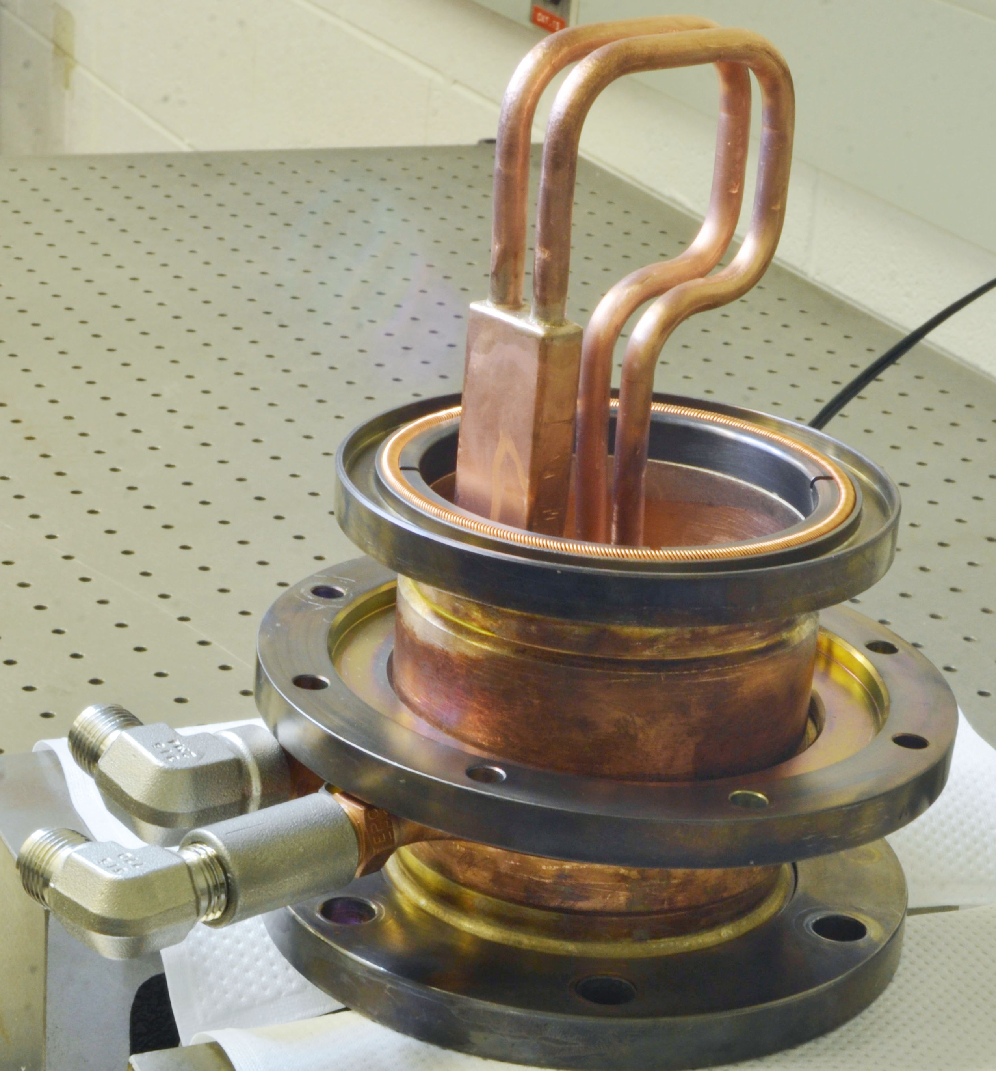
Ceramic window assembly:
Custom Rotatable
Flange SS316
3 1/8 Fixed coaxial flange
Viton O-ring
RF seal
Beryllium Copper C175 Alloy 10
(Bal Seal Spring )
Al2O3 ceramic disc
Copper sleeves
Copper 101 Tube OD .25”

Slide 7
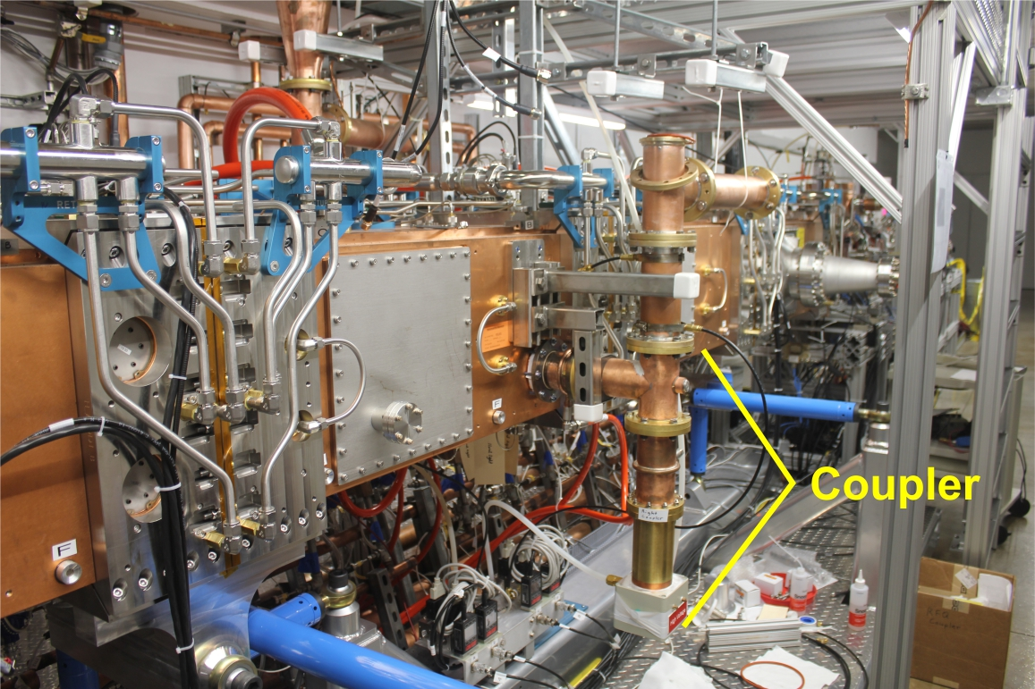
RFQ coupler connected to RFQ cavity:
DC block

Slide 8
Results of testing:
Two couplers with four ceramic window units were produced.
Couplers were tested at RFQ cavity up to 65 kW in pulse and CW modes.
CW mode integrated time was ~ 500 hours.
Two windows were broken. The reason is not clear enough.
The most probable reasons are not enough air cooling or/and
low quality of window brazing.
Remaining two windows are installed to RFQ cavity and operating in pulse mode now.

Slide 9
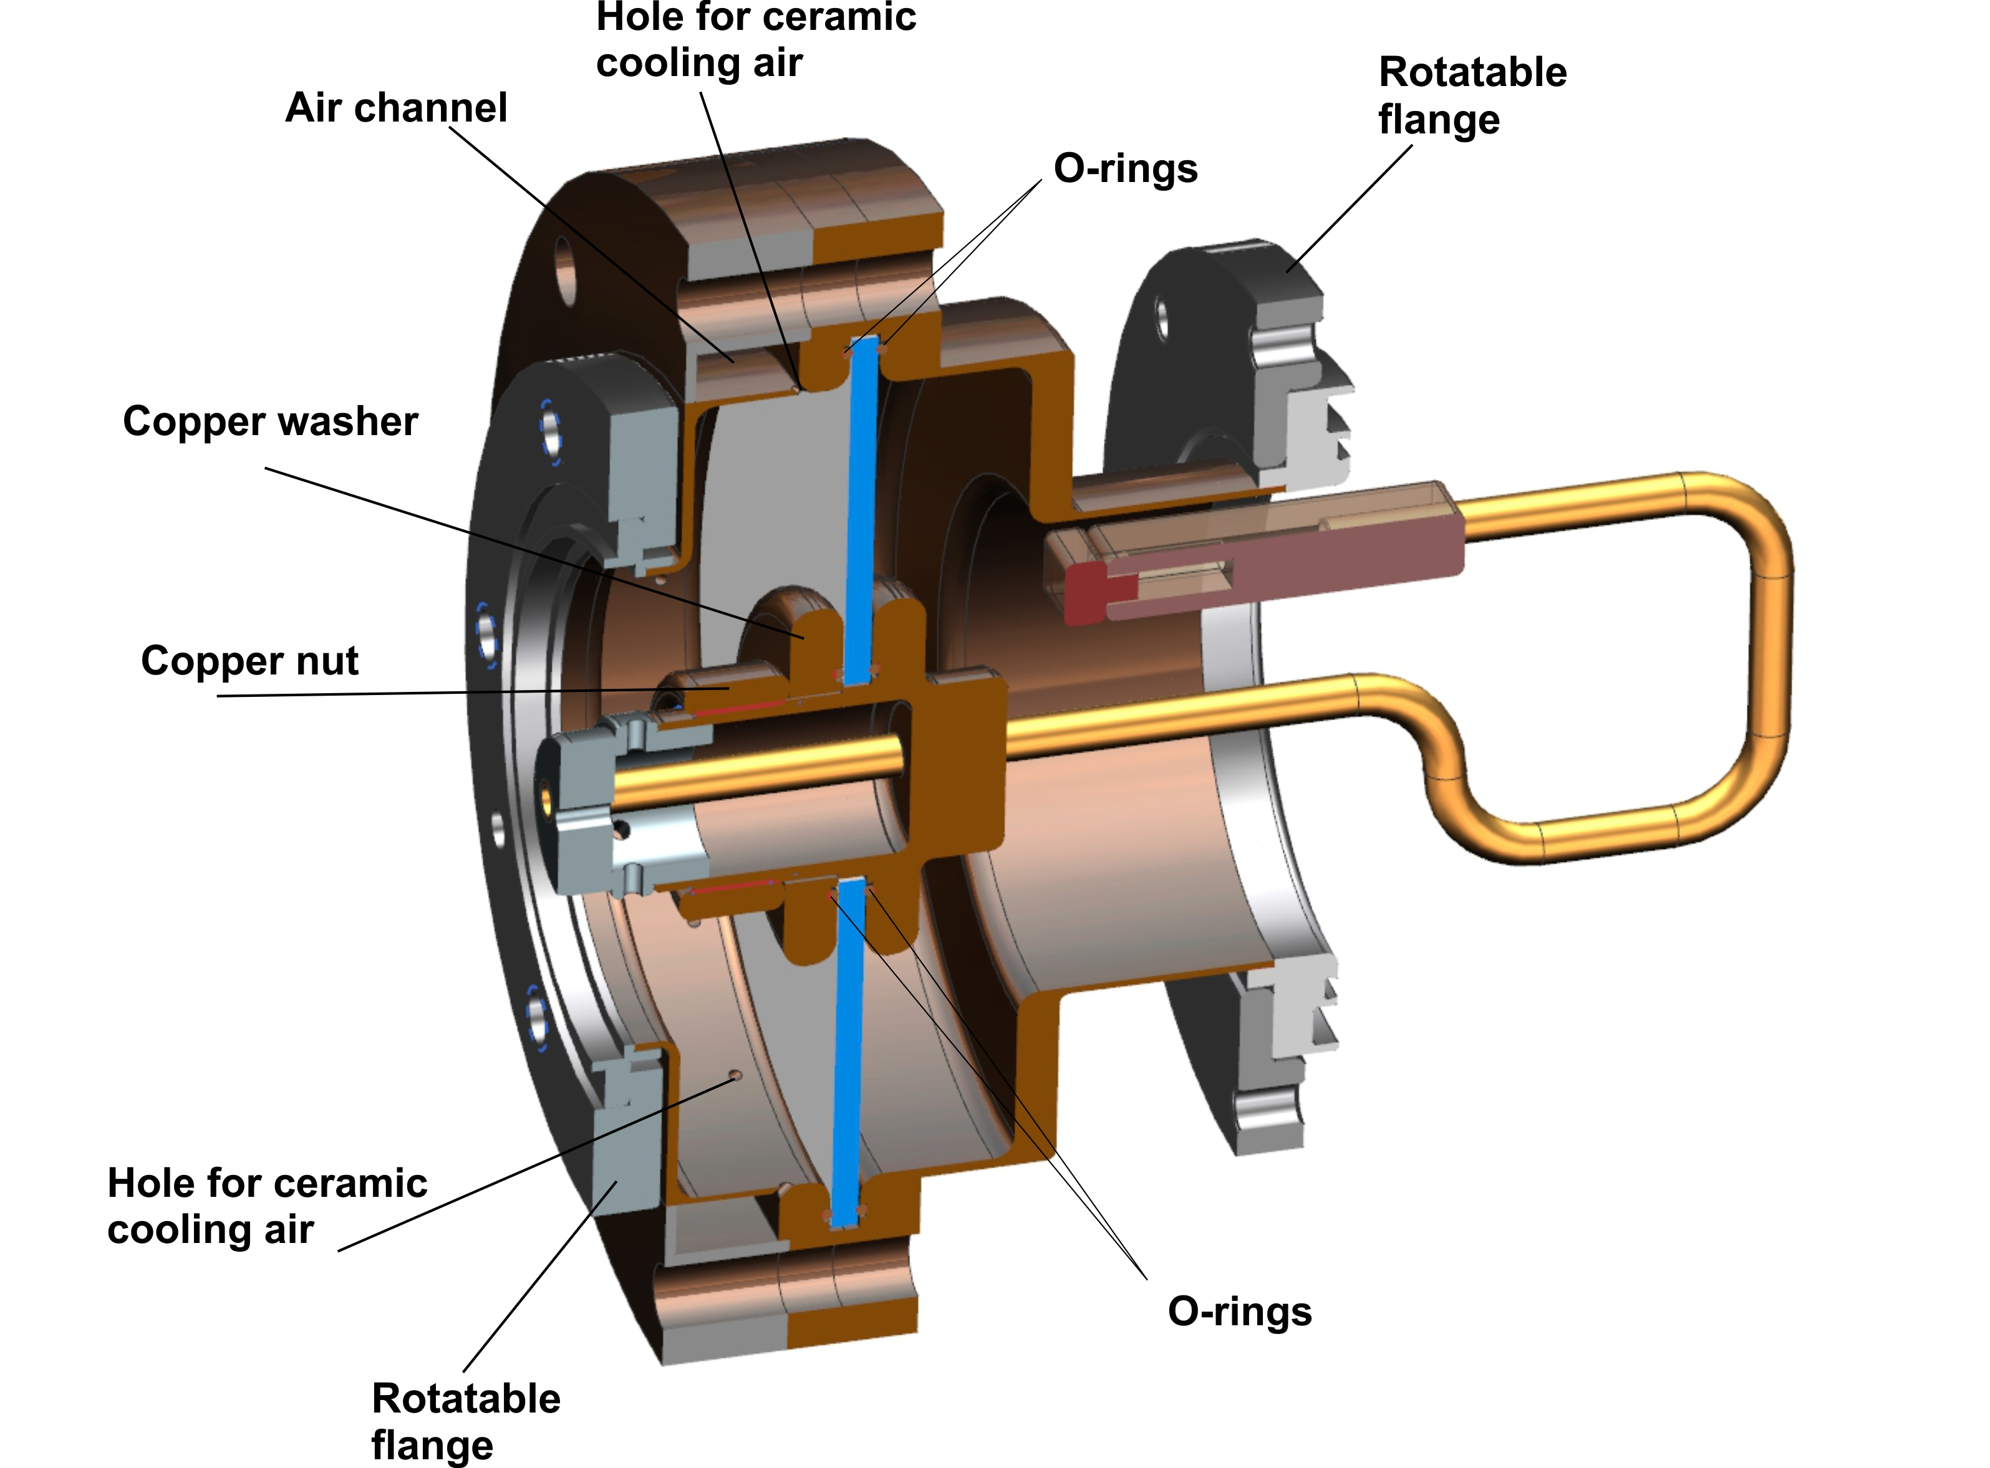
Backup RF windows:
We decided to design and build “backup” ceramic windows units with bigger and replaceable ceramics. Ceramic disk will be vacuum sealed by Viton rings or aluminum diamond seals. We expect that new window will be powerful enough. In case of broken window the ceramic disk can be change easily for new one.
Ceramic diameter 6’’ (was 3’’)
Ceramic thickness 4 mm (0.16’’)

Slide 10
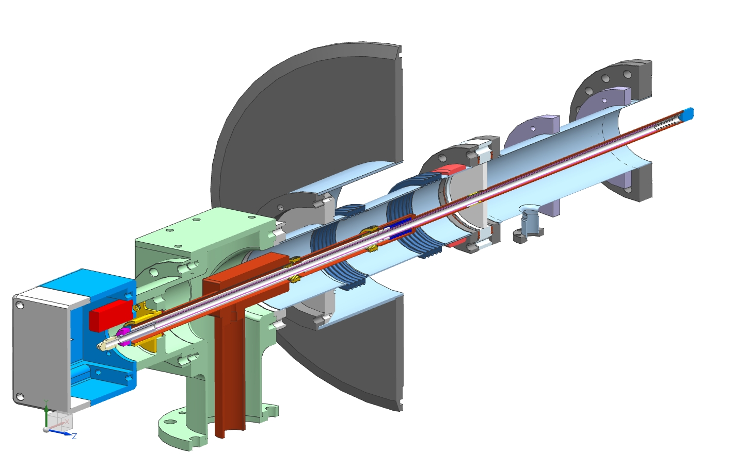
SSR1 & SSR2, 325 MHz coupler:
Design power:
30 kW, CW, full reflection
Antenna:
Copper 0.5’’, air cooled, HV bias.
RF Window:
Single, room temperature, alumina, OD 73mm (2.87’’),
ID 12.7mm (0.5’’), thick. 6mm (.236’’)
Outer conductor:
SS, ID 73mm (2.78’’), 0.4mm wall thickness, not Cu coated.
Cryomodule flange
Spring to compensate
thermal expansion
“5K” intercept
“80K” intercept
Ceramic window
Thermal properties of coupler:
Antenna
P, kW | “2K “, W | “5K”, W | “70K”, W
0 | 0.06 | 0.58 | 2.02
3 | 0.10 | 0.81 | 2.35
6 | 0.15 | 1.03 | 2.68
20 | 0.35 | 2.07 | 4.25
30 | 0.50 | 2.82 | 5.36
Matching bump
Arc detector
Cold flange
e-pickup port
Ni-Cu bellows
3’’x 0.0158’’
stainless steel tube
Heater
Air inlet
3-1/8’’ coaxial input

Slide 11
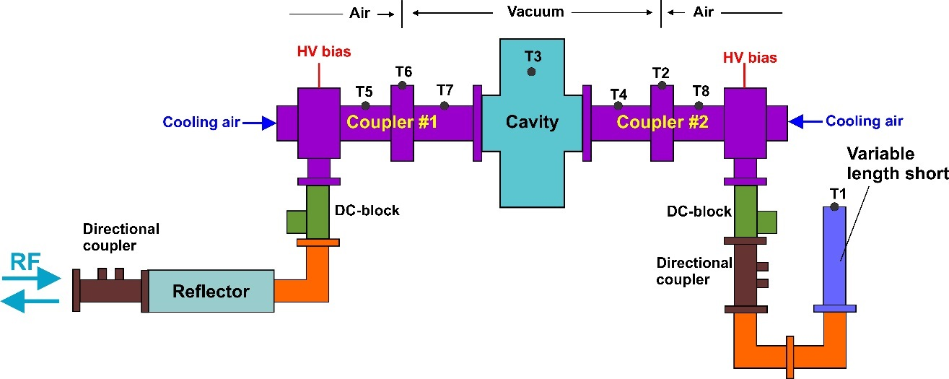
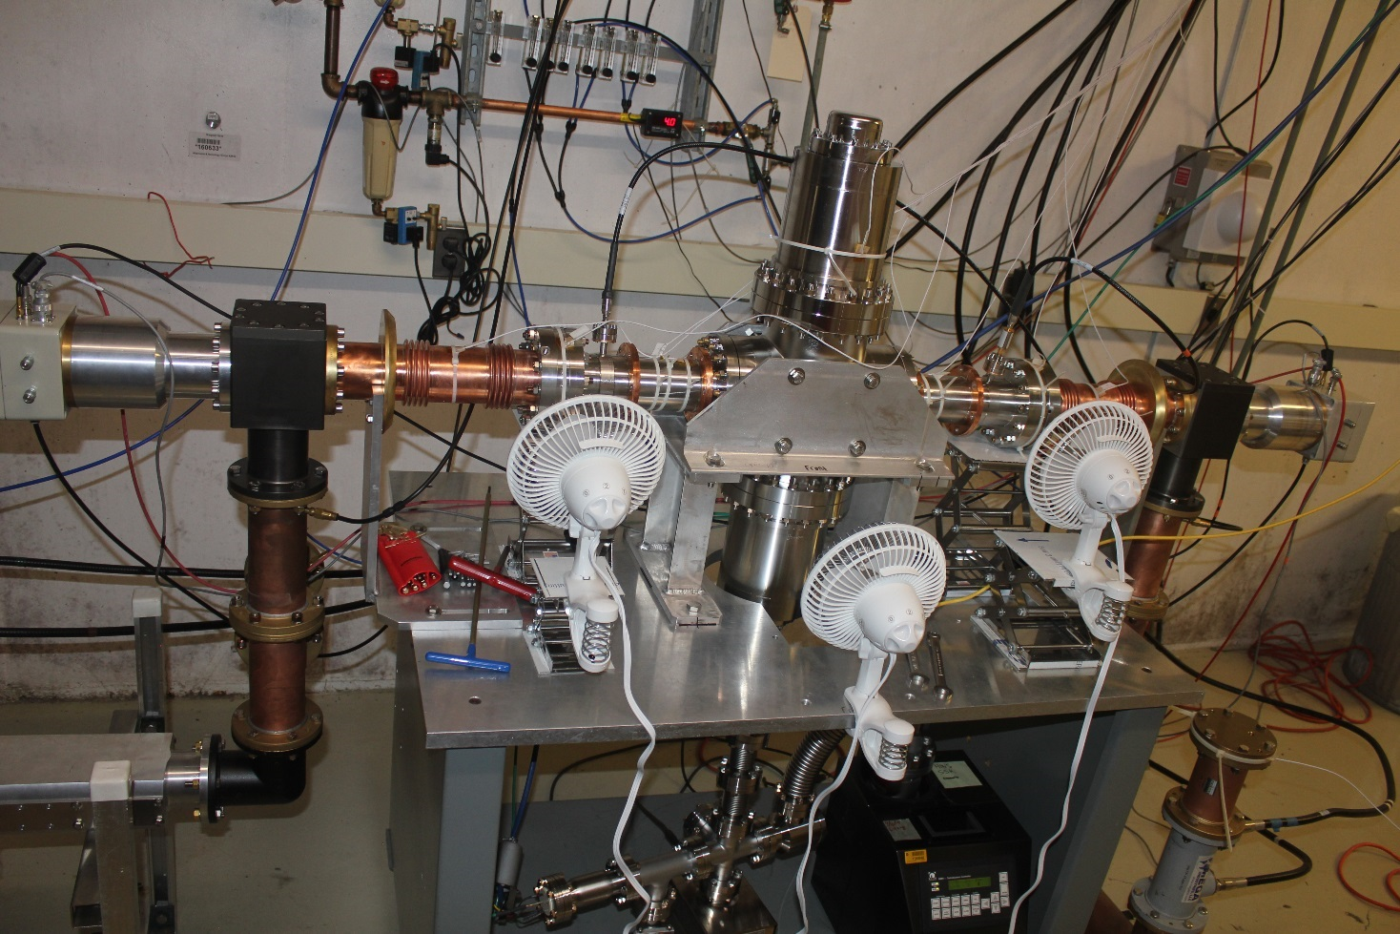
Results of testing, 325 MHz couplers:
Three prototypes were produced and tested in test stand at room temperature.
Pair of couplers were successfully tested up to 30 kW, CW, full reflection, 90 dgr. step reflection phase.
Then couplers were tested up to failure. Window was destroyed at 47 KW, CW, full reflection.
One prototype was successfully tested with SSR1 SC cavity in cryomodule up to 10 kW, CW. Coupler demonstrated designed thermal parameters.
10 couplers are under production.
Test stand of 325 MHz couplers

Slide 12
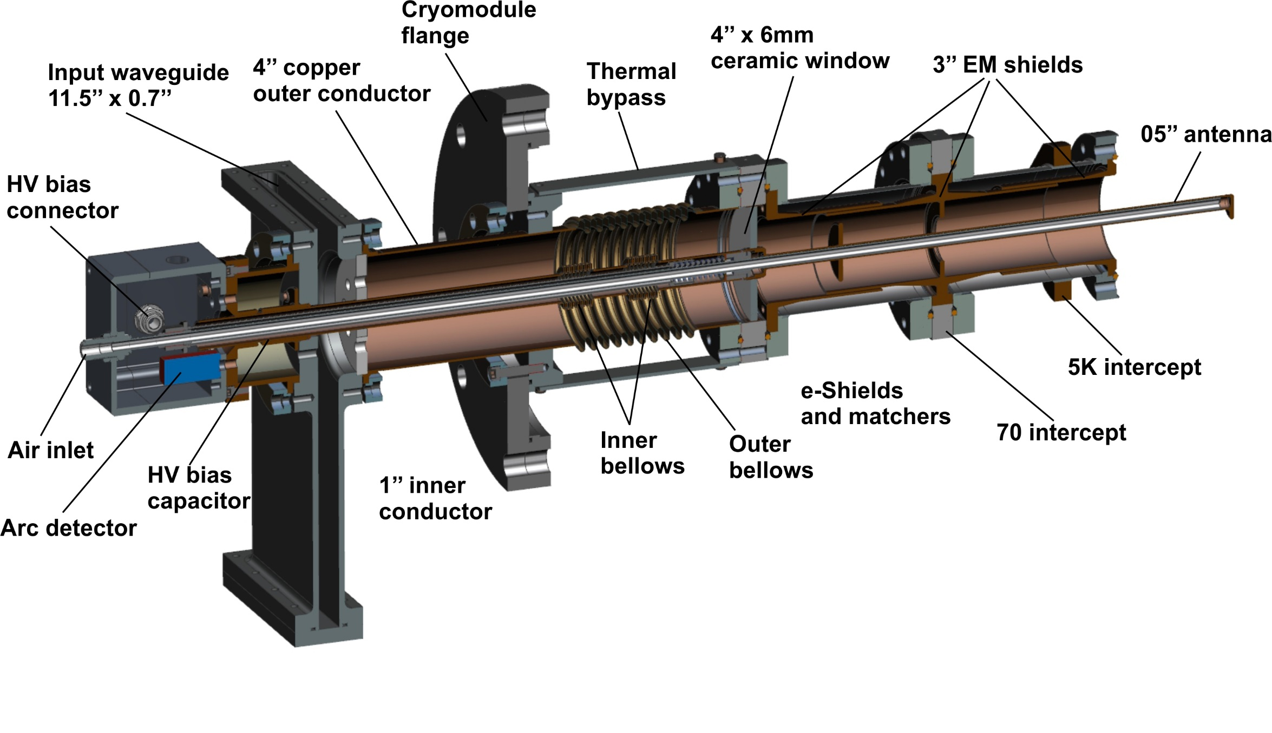
LB & HB, 650 MHz coupler, new design

Slide 13
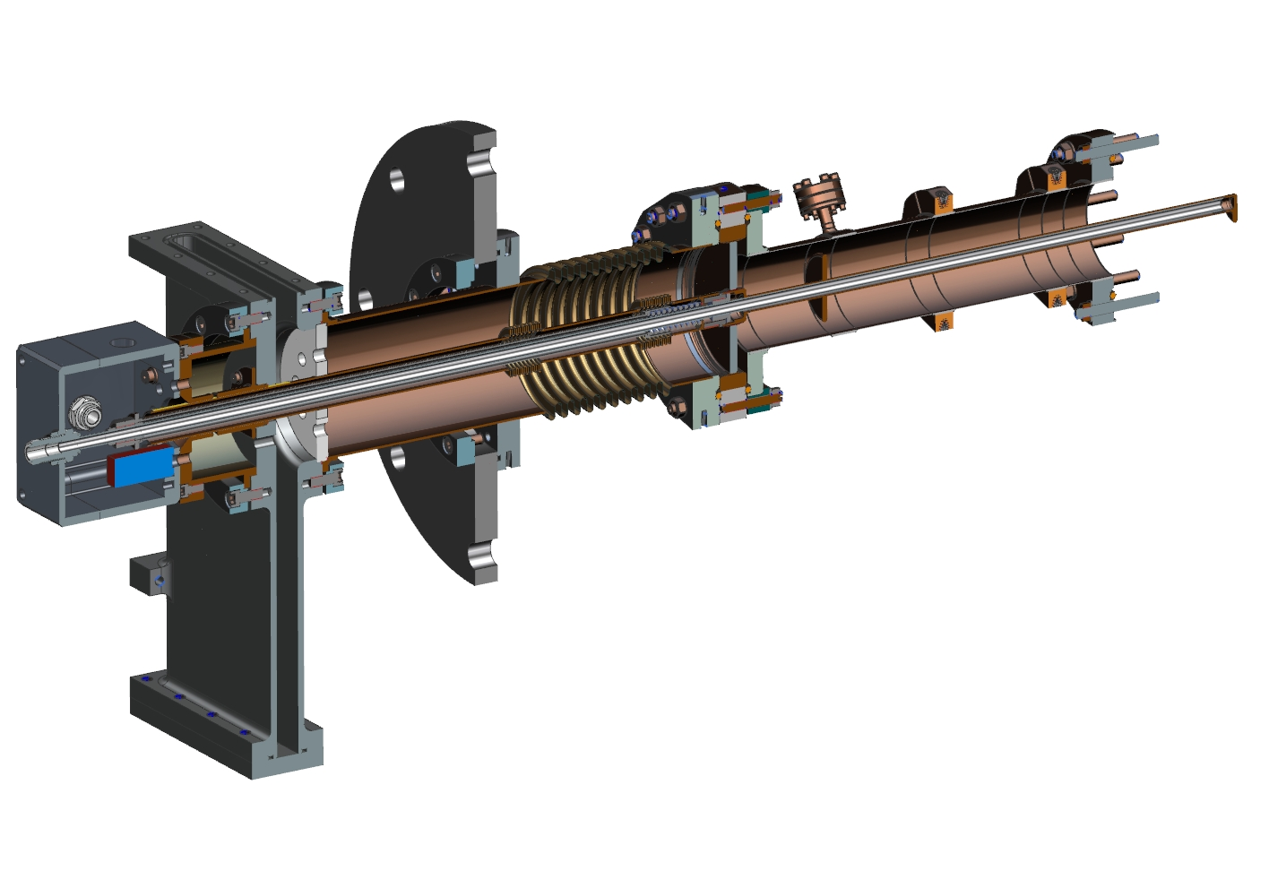
LB & HB, 650 MHz coupler, backup design

Slide 14
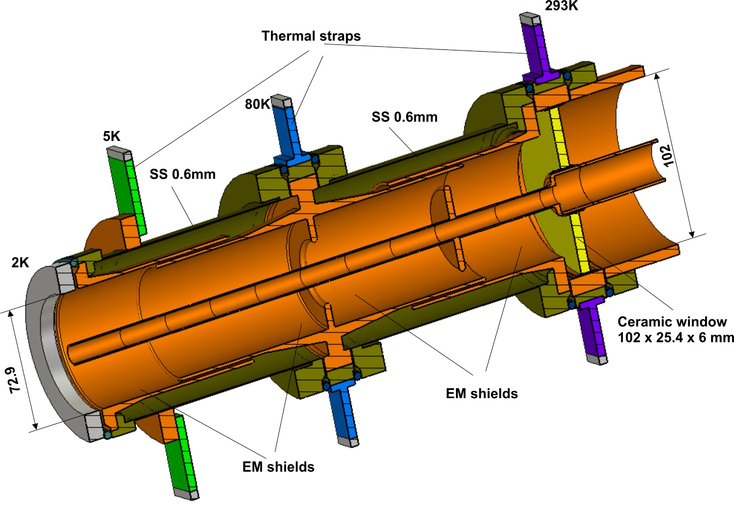
Vacuum part of 650 MHz coupler, new design

Slide 15
Thermal properties of 650 MHz couplers
 | 2K, W | 5K, W | 70K, W | 293K, W | Tw, max, K | Tw, min, K | Grad, max, K/mm
New, 0 kW | 0.15 | 0.6 | 3.3 | -2.7 | 288 | 288 | 0
New, 100 kW | 0.55 | 0.93 | 6.2 | 21 | 347 | 334 | 0.47
New, 300 kW | 1.52 | 1.6 | 11.5 | 48 | 398 | 386 | 0.40
Bckp, 0 kW | 0.41 | 1.46 | 3.0 | -3.1 | 288 | 288 | 0
Bckp, 100 kW | 0.97 | 4.1 | 11.4 | 20 | 344 | 331 | 0.47
Bckp, 300 kW | 2.19 | 9.4 | 27 | 50 | 408 | 389 | 0.58
100 kW:
New = 0.55*960 + 0.93*220 + 6.2*20 = 857 W of cryo-plant
Bckp = 0.97*960 + 4.1*220 + 11.4*20 = 2061 W of cryo-plant
New design requires ~ 2.4 times less power of cryo-plant.
Two prototypes of 650 MHz couplers will be ordered soon.

Slide 16
Summary:
RFQ coupler
Two RF windows broken after 500 h of CW.
New RF windows are under design.
SSR coupler
Design – OK
Five coupler were produced. Couplers satisfy the requirements.
There are issues with production - not experienced vendor.
10 couplers will be produced with more experienced vendor.
650 MHz coupler.
Design is completed.
Two prototypes will be produced this year.

