Slide 1
PIP-II Design Overview
Valeri Lebedev
PIP-II Machine Advisory Committee
10-12 April, 2017

Slide 2
Outline
PIP-II Performance Goals
Design Concept and Design Choices
  Linac
  Transfer line
  Booster
  Recycler and MI
Summary

Slide 3
PIP-II Performance Goals
Increase MI power from 700 kW (NOvA) to >1 MW (LBNF) in the energy range 60 – 120 GeV
Increase Booster power from 80 to 160 kW
  8 GeV program: SBNE, …
Future upgrades
  Mu2e at 0.8 GeV and ~100 kW CW beam
    Writing of letter of intent for Mu2e-II was recently initiated
  Beam power to LBNF to >2 MW
  Provide a platform supporting a high duty factor/CW operation for future intensity frontier experiments getting beam simultaneously

Slide 4
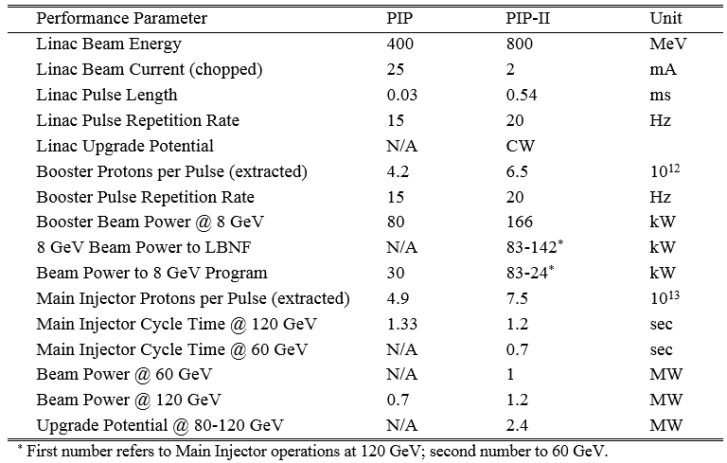
PIP-II High Level Performance Goals

Slide 5
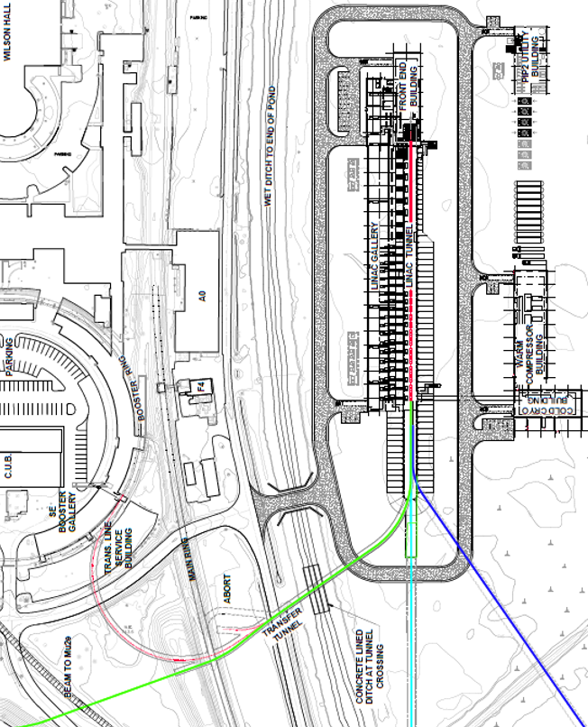
PIP-II Components
New 0.8 GeV linac (L≈222 m)
  Includes 4 empty slots at the
  linac end (L≈46 m)
    Time-of-flight energy meas.
    Possible energy upgrade
    to 1.2 GeV
  Space for a possible energy
  upgrade to 2 GeV
Linac-to-Booster transfer line
  3-way beam split to: (1) Beam
  dump, (2) Booster & (3) Mu2e-II
Upgraded Booster
  20 Hz, 800 MeV injection
    New injection girder
    RF system upgrade
Upgraded Recycler & MI
  RF and collimation

Slide 6
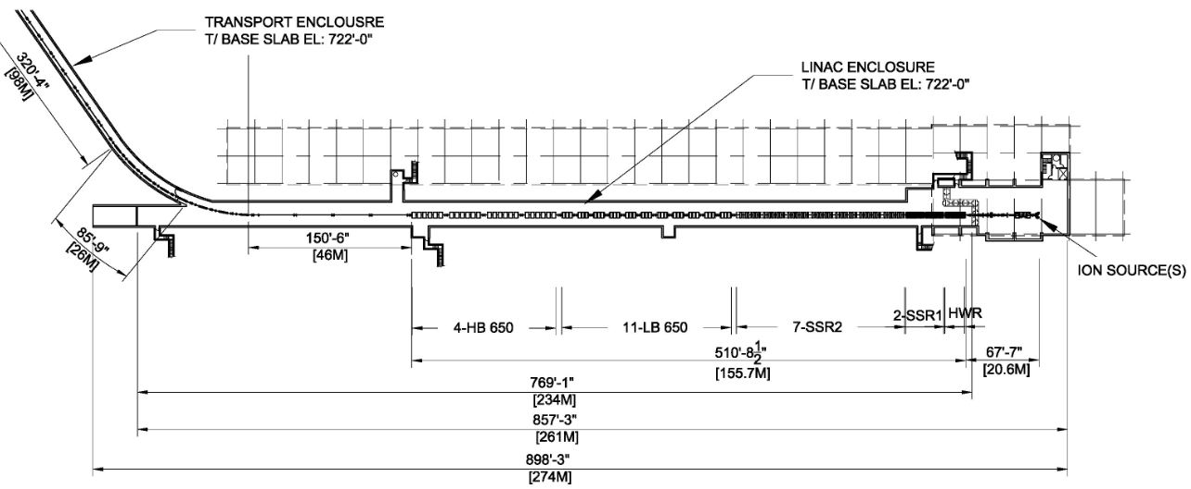
Linac layout
Warm frontend, shielding wall, SC linac, 4 empty slots
Five types of SC cavities: HWR, SSR1, SSR2, LB650 & HB650

Slide 7
Approach to the PIP-II Accelerator Physics Design
New SC Linac
  Design compatible with both Pulsed and CW operations
  MEBT bunch-by-bunch chopper
    For the beam sent to Booster: chops out bunches at boundaries of Booster RF buckets and from the extraction gap
  Energy stability of ~10⁻⁴ to support longitudinal painting
  Emittance less than 0.3 mm mrad (rms, norm)
    to minimize injection loss, and to support tailless transverse painting
Booster upgrade
  Rep. rate: 15 -> 20 Hz (delivers more power at 8 GeV)
  Injection energy: 400 -> 800 MeV => intensity×1.5, reduction ΔQ_{SC}
  Transverse and longitudinal painting: small I_{beam} helps (300 inj. Turns)
    Reduces (1) tails, (2) uncontrolled injection loss and (3) ΔQ_{SC}
Recycler
  Rep. rate increase
  => larger momentum separation in slip-stacking => smaller loss
Main Injector: >1 MW power in 60-120 GeV energy range

Slide 8
SC Linac &
Transfer Line
to Booster

Slide 9
Challenges of SC Linac R&D
Reliable operation of warm frontend
  Bunch-by-bunch chopper
Design of SC cryomodules
  Suppression of microphonics and LFD
    Interaction with cryo-system
      Development and testing LCLS-II cryomodules is greatly helpful
  RF couplers
    long-term reliability
Cryogenic system
  Minimization of microphonics
Energy stabilization
  LLRF
    Beam based stabilization if required

Slide 10
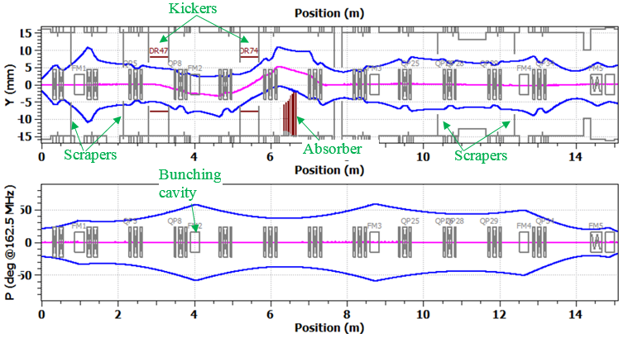
Warm Frontend
Ion source, LEBT, RFQ and short version of MEBT were tested in the pulsed regime
Full MEBT test is planned this fall
  Bunch-by-bunch chopper
CW operation will follow later (lower priority for now)

Slide 11
General Approach to the Design of Cryomodules
All the CMs are based on SSR1-type concept
  They should contain as much identical parts as possible
SSR1 and SSR2 should be as much similar as possible
  The same concept of the He vessel with small df/dP
  The same high power couplers
  Similar tuners. The goal is to use identical tuners
  Similar designs of solenoids
LB650 and HB650 should be as much similar as possible
  The same concept of He vessel with small df/dP
  The same high power couplers
  Similar tuners. The goal is to use identical tuners
  no magnets inside
  Similar magnetic screens
Requirement of pulsed operation results in better designs of cryomodules
  (1) Suppression of LFD, (2) more reliable fast tuners

Slide 12
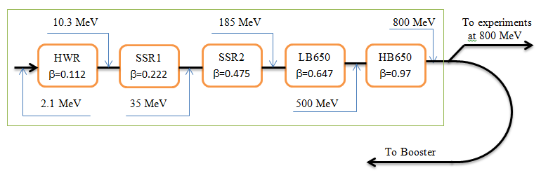
Status of SC Cryomodules
HWR design complete. CM is in production
  Interface document is complete
Designs of SSR1 & HB650 are more advanced than SSR2 & LB650
  SSR1 design is almost complete, production started
    Interface document is getting to be ready for review
  HB650 design is advancing well

Slide 13
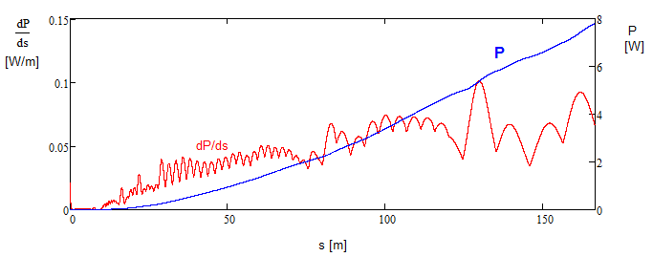
Beam Loss and Linac Activation
Intrabeam stripping is expected to be the major mechanism of beam loss
  0.1 W/m corresponds to 15 mrem/hour @30 cm residual radiation for E>1 GeV
5 mA RFQ, 2 mA CW

Slide 14
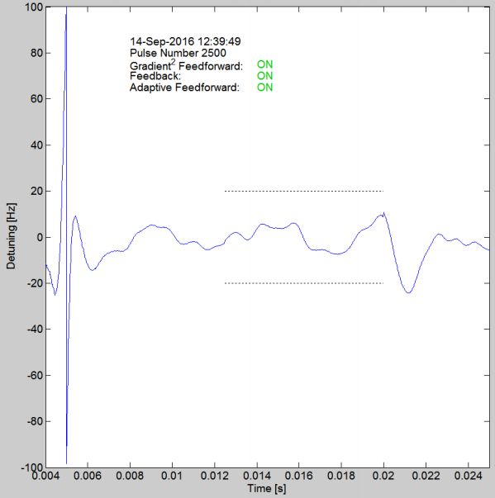
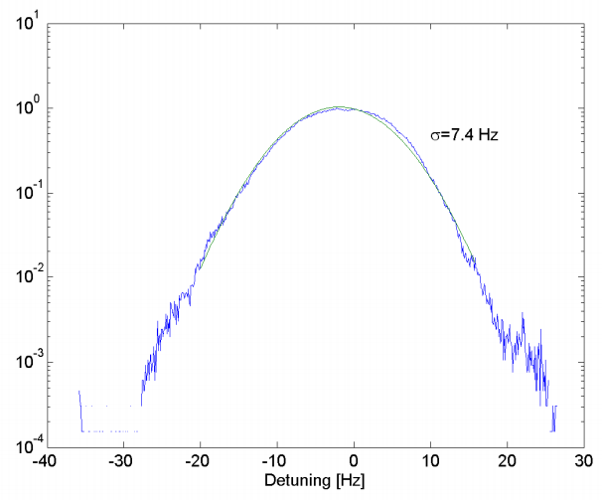
Suppression of Microphonics and LFD
The great challenge
  Requirements to LFD is significantly increased in PIP-II: ~3 times compared to XFEL (LFD/Δf : 4(XFEL) →11(HB))
    Well above the state of the art
Maximum detuning < 20 Hz (σ<3 Hz)
Passive means
  Minimize df/dP
  Minimize LFD
  Minimize noise at 5-to-2 K conversion
Active means
  Adaptive LFD Control Algorithm
  initially developed at NML /CM1
  The dressed SSR1 cavity has been
  used for R&D: σ=7.4 Hz - achieved
    Will be better with volt. stabilization (LLRF)
  Close attention to reliability of fast tuner

Slide 15
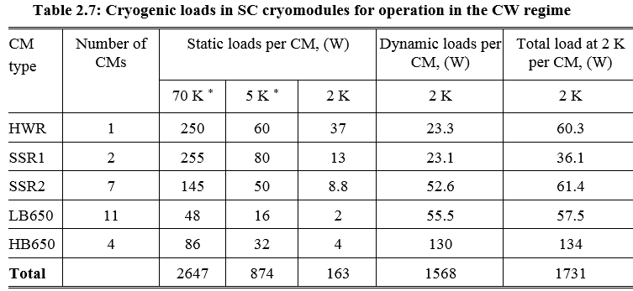
Requirements to Cryogenics
Requirements to cryo-plant are set by operation in CW
  Operation in pulsed regime reduces cryo-load at 2 K
  from 2000 W to ~600 W
Cryo-plant power has sufficient operating margins at 70 and 5 K
  No margin for 2 K in CW
RMS pressure fluctuations have to be <0.1 mbar
  Passive microphonics
  suppression
Heat loads in the cry-distribution
70 K 5 K 2 K
680 W 140 W 250 W
Projected parameters of cryo-plant
 | 70 K | 5 K | 2 K
Maximum cooling power [W] | ≥9,100 | ≥1,500 | ≥2,000

Slide 16
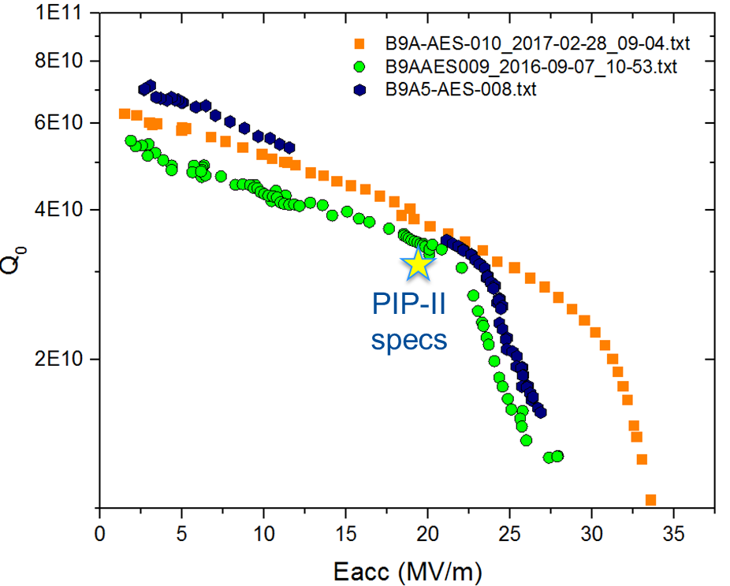
R&D in SRF
High Q0:
  N-doping evolved from discovery
  to proven technology for LCLS-II
  Technology is transferred to PIP-II
  Tests at 650 MHz show that an
  additional N-doping optimization is
  desirable (relative to doping
  developed for 1.3 GHz)
Fast cooling
  Suppresses magnetic flux
  penetration to SC cavity
    Reduces requirements to the residual magnetic field
    However
      2 layer magnetic screen
      + Active suppression of longitudinal magnetic field.
    Similar to LCLS-II
Vertical test results for 5-cell HB cavity

Slide 17
Booster

Slide 18
Booster Status and Main Challenges
Status: at present intensity
  Beam loss at injection is acceptable. A reduction is desirable.
  Longitudinal emittance growth due to transition crossing is above desirable value
    results ~5% beam loss due to slip-stacking (Recycler / MI)
PIP-II will address the beam loss at injection for 1.5 higher intensity by an increase of injection energy
  reduced space charge effects
PIP-II challenges
  Transition crossing with 1.5 times larger beam current
  Injection at 800 MeV
    Radiation shielding of injection related beam loss is a challenge
    Final choice of the scheme is not finalized:
      Tightly located elements of the injection straight
      Versus new short dipoles adjacent to injection straight

Slide 19
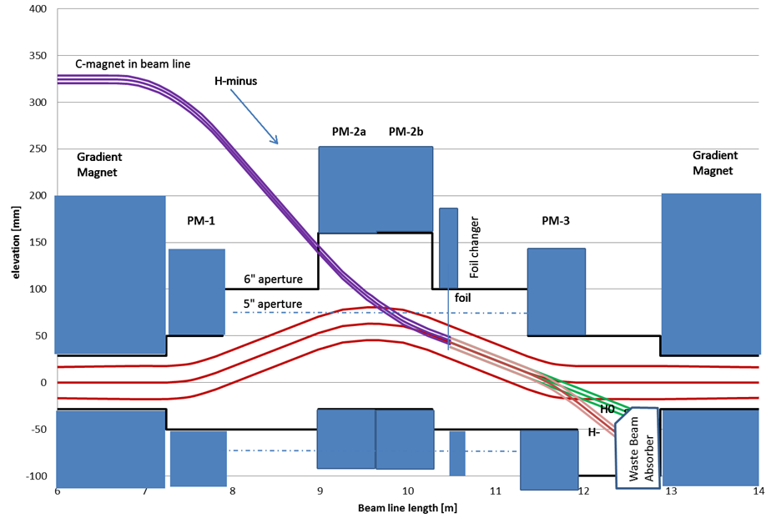
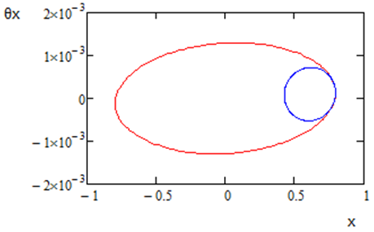
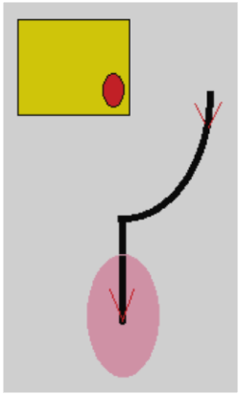
Booster Injection
H⁻ strip injection occurs through vertical dogleg
Painting in X&Y planes
  Vertical painting is done by changing dogleg dipoles
    fast correctors in the
    beam line correct V. angle
  Horizontal painting is done with Booster correctors
  linac beam stays at the same point of the foil
Foil – 600 μg/cm²
Reduced beta-functions
for linac beam to reduce secondary hits of the
stripping foil (both planes)

Slide 20
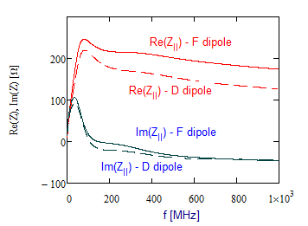
Acceleration in Booster
Beam aperture in the Booster is formed by poles of laminated combined function dipoles
  That greatly amplifies Booster impedance
  Theoretical model yields results close to the wire measurements
  Parameters of the impedance model are adjusted to match beam based measurements
Transition from 15 to 20 Hz rep. rate and 1.5 times intensity increase require quite large RF voltage (~1.2 MV)
  Beam deceleration due to RW impedance
    Peak voltage achieves ~250 kV shortly after transition for PIP-II parameters
  Large acc. voltage helps to reduce the quadrupole oscillations after transition

Slide 21
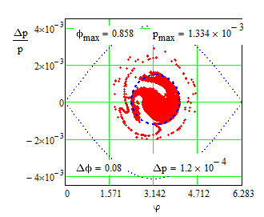
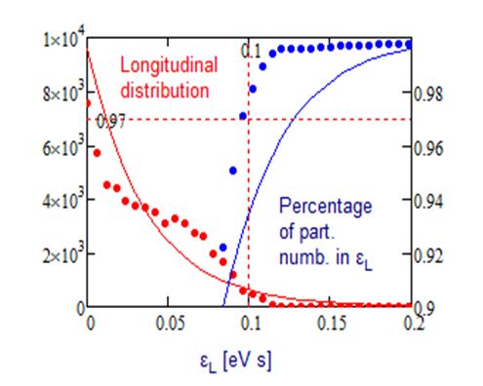
Beam Emittance Growth due to Transition Crossing
Simulation have been benchmarked by measurements of beam acceleration in Booster
Simulation show that required longitudinal emittance (97% of particles in 0.1 eV∙s can be achieved at PIP-II intensity
  Trim quadrupoles are used for soft Q-jump
  Sextupoles control second order slip-factor

Slide 22
Recycler and
Main Injector

Slide 23
Slip Stacking in the Recycler
Slip stacking with 50% more beam
  It requires an increase of slip stacking efficiency: 95% → 97%
    Increased rep. rate (15→20 Hz) increases bucket separation ⇒ helps
    But there are still severe limit on the tails of Booster beam L. distr.
For a while we considered an insertion of octupoles or electron lens for more effective damping of ⊥ oscillations at slip-stacking
Theoretical study of ⊥ instability at slip-stacking showed that the Σ-mode is much more dangerous than the π-mode
  Damper electronics was modified to make the damper effective for the Σ-mode suppression
    That allowed a reduction of Recycler chromaticity
    => reduced beam loss during slip-staking
Scrubbing is used to suppress ep-instability at present intensity
  We need better understanding of performance for PIP-II intensity
Operation at 60 GeV will increase the repetition rate in the RR and will require a replacement of 53 MHz RF cavities used for slip-stacking

Slide 24
Acceleration in MI
More powerful RF system in MI
  Present system can accelerate up to 6.2•10¹³
  PIP-II requires 7.5•10¹³
A design of γ_{t} jump system for the Main Injector was completed as part of the Project X Reference design
  Transition crossing simulations for the PIP II intensities have confirmed that the γ_{t} jump system is needed for loss-free transition crossing
Electron cloud simulations indicate that SEY smaller than 1.4 is sufficient to suppress the e-cloud in both MI and Recycler.
We have a capability to coat both the MI and the Recycler beam pipe.
  The MI beam coating has to be done in situ.
  The Recycler beam pipe can be replaced.

Slide 25
From RDR to CDR (June 2015 – March 2017)
All sections were extended / corrected
Significant progress in the following sections (supported by actual design work)
  Design of SC cryomodules
  Fault scenarios (loss of elements in SC linac)
  Transition crossing in Booster
  Cryogenics
  Instrumentation
  Civil construction
New chapters
  Discussion of alternatives (choice is approved by DOE)
  Vacuum
  Magnets
  Alignment and optics correction
  Transport to Mu2e

Slide 26
Summary
Charge Item: #1
The PIP-II design concept is mature and is likely to meet the specified technical performance requirements.
  Areas of technical risk have been identified and provide R&D focus.
  The design concept is solid and has not changed in any significant way since June 2015
The CDR represents an expansion of the RDR developed for the June 2015 IPR, and a draft is now available
In the course of last year a considerable progress has been achieved in
  Design of SRF cavities
  Microphonics and LFD suppression
  Understanding of transition crossing in Booster
  Suppression of transverse instabilities during slip-stacking
  Understanding of ep-instability in Recycler and ways of its suppression
This meeting is devoted to the review of the CDR draft with its subsequent completion before CD-1 review (November 2017).

Slide 27
Backup Slides

Slide 28
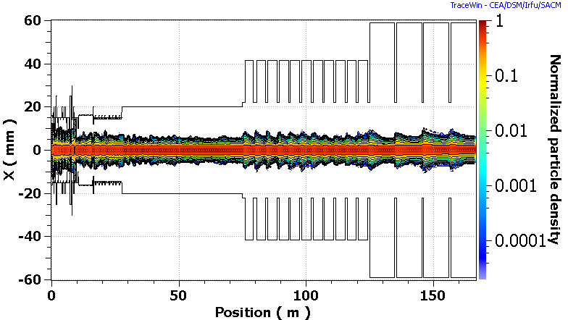
Apertures in SC linac
Simulations do not show loss in SC linac for chosen apertures
Aperture in SSR1&2 LB&HB650 is limited by collimators/quads installed between cryomodules

Slide 29
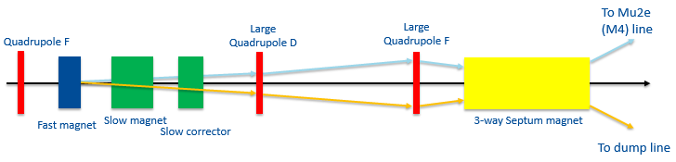
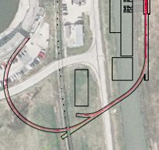
SC Linac-to-Booster Transfer Line
Major design features
  Bending radius is chosen to prevent Lorentz stripping up to 1 GeV
  Simple FODO optics, minimum number of power supplies
  2 arcs, zero dispersion straight (between arcs) with beam switch
  Beam based energy stabilization with energy measured by 1st arc BPMs
    Or by Time-Of-Flight in 46 m line after
  Switching time from beam dump to Booster is determined by the voltage rate changes for SC cavities
      ≈20 μs ⇒ still manageable voltage on the fast corrector
  Crossing Tevatron tunnel
    Tevatron tunnel is used for beam delivery to BSY
    Line to Booster is lifted to allow free passing through to BSY

Slide 30
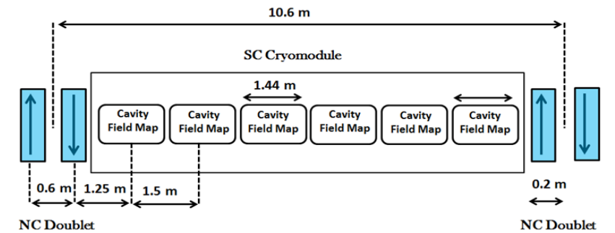
Warm Sections of SC linac
Straight sections between LB&HB650 cryomodules include 2 warm quads (Q) +1 dipole corrector (D) (X&Y), and strip-line BPM
Configurations are:
  Low Beta : (QDQ) (CCC) (QDQ) ………. : 11 CM
  High Beta :(QDQ) (CCCCCC) (QDQ) ….. : 4 CM

Slide 31
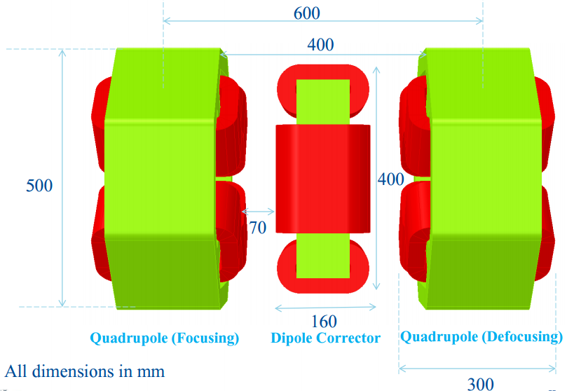
Magnets & BPMs
Quads
GdL (T) | 3
G (T/m) | 13.5
2*a [mm] | 48
Dipoles
BdL (mT m) | 10
2*a [mm] | >48
BPMs
Button-type
4 electrodes
Located between quads

Slide 32
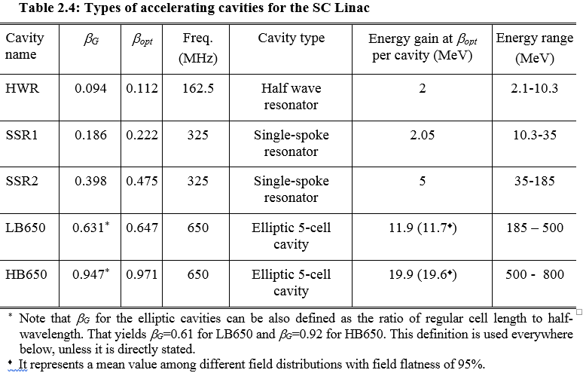
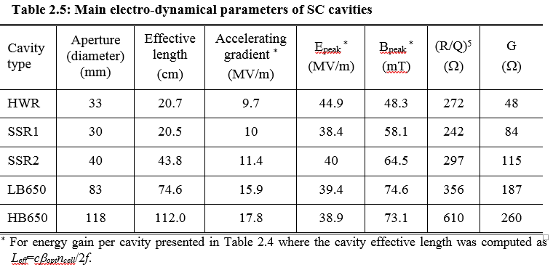

Slide 33
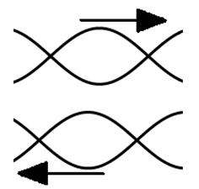
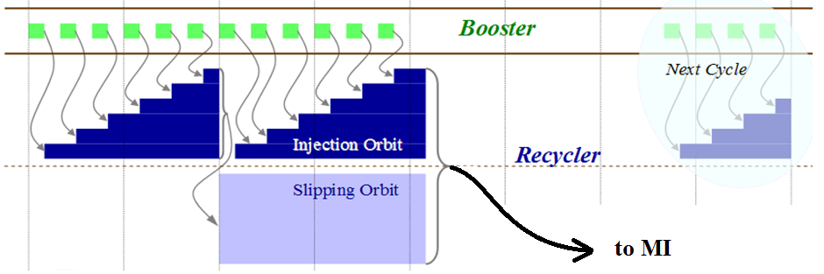
Slip Stacking in Recycler
Twelve Booster batches are slip-stacked in Recycler
An increase of Booster rep. rate from 15 to 20 Hz requires faster slipping
=> larger momentum separation
=> larger RF bucket size
=> smaller loss at slip stacking

Slide 34
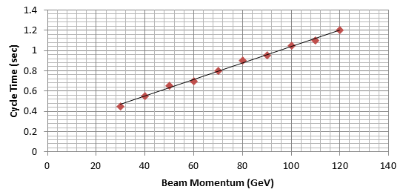
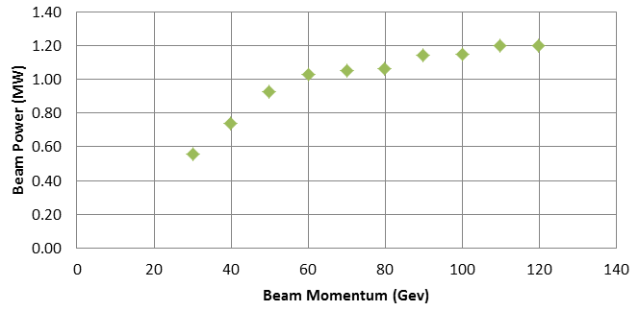
Beam Acceleration in MI
The accelerating rate in MI is determined by maximum slue rate of magnetic field and RF voltage
  That determines the dependences of
  (1) cycle time duration
  and (2) beam power
  on the final beam energy
MI RF power upgrade is required to support the beam intensity increase

Slide 35
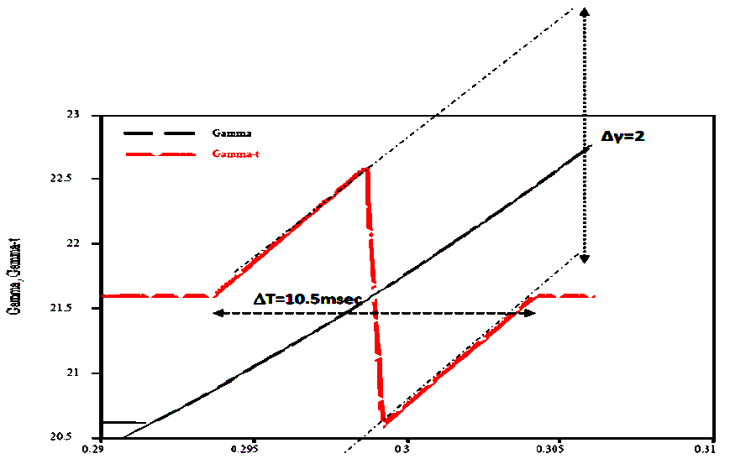
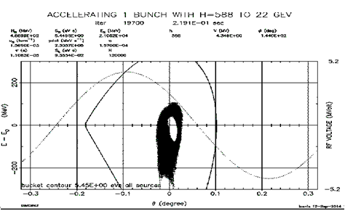
MI Transition Crossing
Increased beam intensity and larger longitudinal emittance complicate transition crossing
γ_{t} jump is preferred method for transition crossing in MI
ESME simulations do not show significant increase of L. emittance and longitudinal tails
Additional hardware for fast tune change is required
Phase space distribution after transition in MI. The hole in the center is a result of slip stacking

