Slide 1
Electro-dynamical Design of SC Cavities
Paolo Berrutti
PIP-II Machine Advisory Committee Meeting
4/10/2017

Slide 2
LINAC technology map
β_{opt}=0.11
β_{opt}=0.22
β_{opt}=0.47
β_{g}=0.61
β_{g}=0.92
The SRF part of the PIP-II LINAC is composed by:
- HWR at 162.5 MHz, β=0.11
- SSR1 and SSR2, single-spoke at 325 MHz, β=0.22 and β=0.47
- LB 650 MHz, elliptical 5-cell at 650 MHz β=0.61
- HB 650 MHz, elliptical 5-cell at 650 MHz β=0.92
Particle energy goes from 2.1 MeV (end of RT section) to 800 MeV

Slide 3
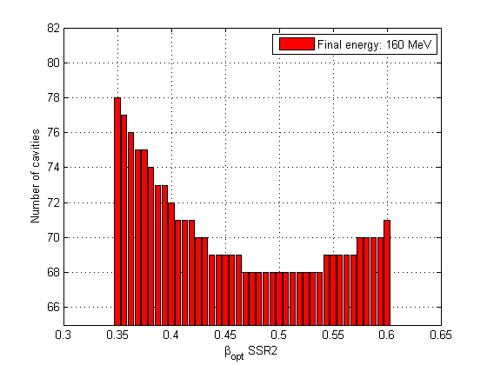
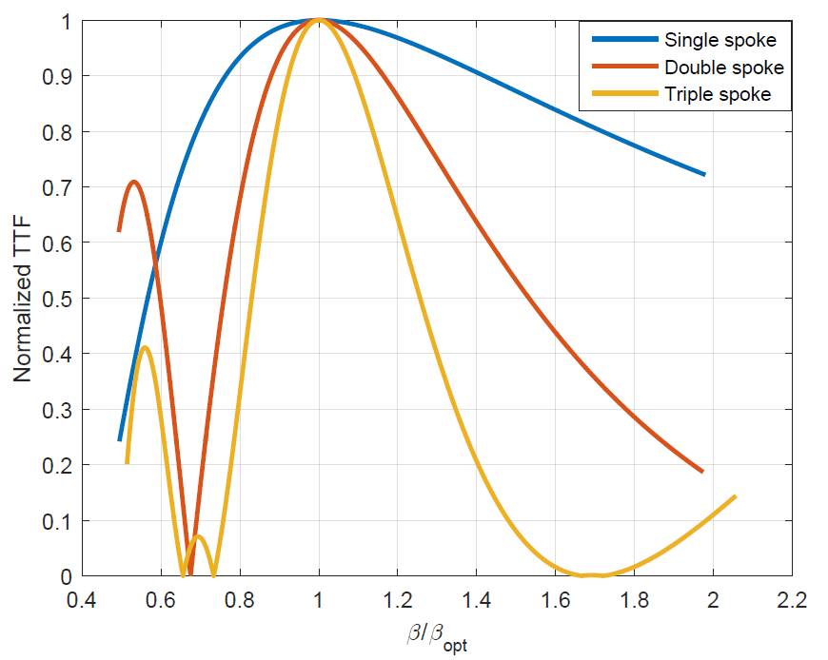
Choice of beta and number of gaps
The values of optimal β and the number of gaps are crucial in order to maximize the acceleration efficiency for each cavity type.
Increasing the number of gaps increases the energy gain per cavity, reducing the energy range in which the cavity accelerates particles efficiently.
TTF vs β/β_{opt} for single, double and triple spoke cavities.
Beta optimization example number of cavities vs β_{opt}

Slide 4
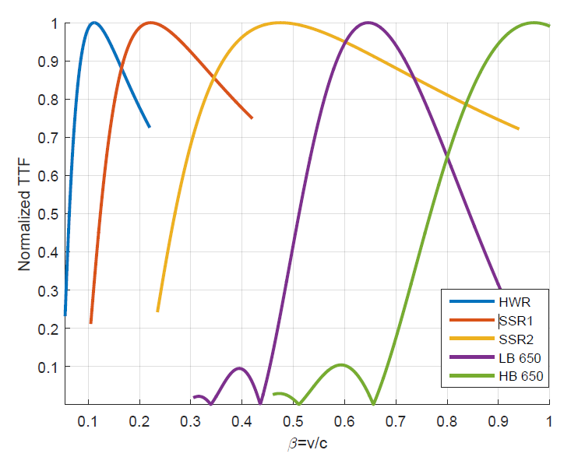
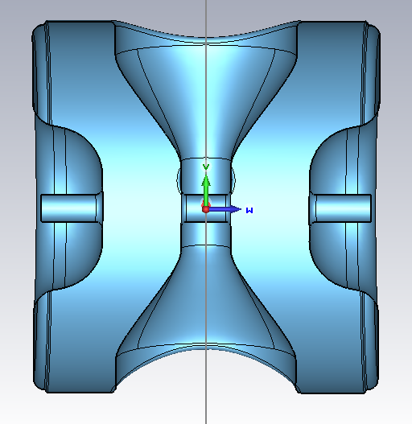
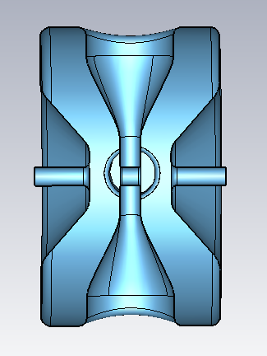
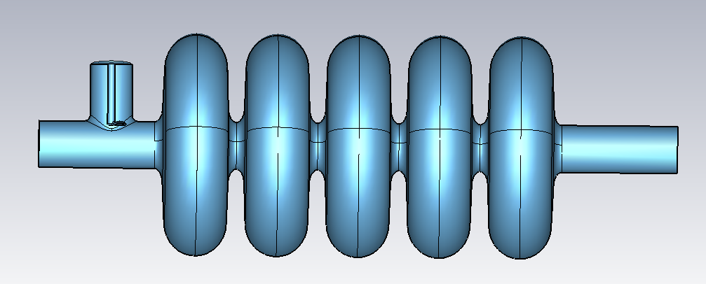
Normalized TTF along the LINAC
The optimization of beta and number of gaps define the optimal TTF for acceleration efficiency.
HWR: 2.1-10.3 MeV
SSR2: 35-185 MeV
HB 650 MHz: 500-800 MeV
SSR1: 10.3-35 MeV
LB 650 MHz: 185-500 MeV

Slide 5
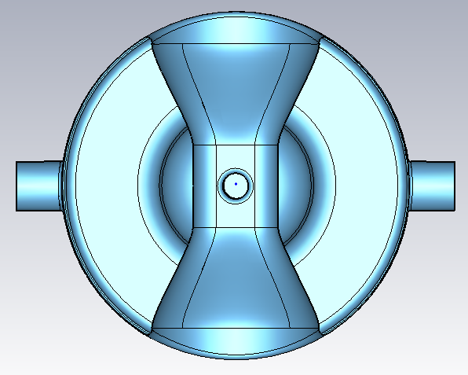
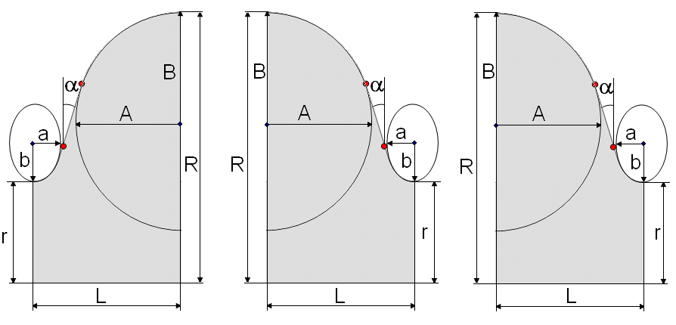
EM design parameters
Once the choice of optimal beta and cavity type is done, the EM parameters of each cavity design should be optimized to improve cavity performances:
E_{peak}/E_{acc} as low as possible
B_{peak}/E_{acc} as low as possible
R/Q should be maximized to improve acceleration efficiency
G factor as high as possible to decrease cryogenic cost
R_spoke
L_cav
R_cav
Gap_to_gap
D_aperture
CP_to_center
R_cav
H_spoke

Slide 6
HWR EM design (ANL)
Robust design, lowest frequency in the SRF LINAC→ more gain per cavity achievable, less focusing/defocusing effects.
Parameter
Frequency (MHz) | 162.5
Aperture (mm) | 33
Effective Length (cm) | 20.7
β_{opt} | 0.112
E_{pk}/E_{acc} | 4.68
B_{pk}/E_{acc} (mT/(MV/m)) | 5.02
Max En. Gain (Mev) | 1.75
G (Ω) | 48
R/Q (Ω) | 272
HWR 3D Electric field
HWR 3D Magnetic field

Slide 7
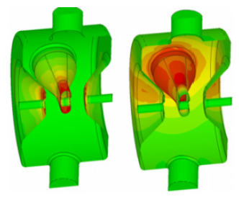
SSR1 EM design
First single spoke cavity at 325 MHz, successfully built and tested at FNAL
Parameter
Frequency (MHz) | 325
Aperture (mm) | 30
Effective Length (cm) | 20.5
β_{opt} | 0.22
E_{pk}/E_{acc} | 3.84
B_{pk}/E_{acc} (mT/(MV/m)) | 5.81
Max En. Gain (Mev) | 2.1
G (Ω) | 84
R/Q (Ω) | 242
SSR1 3D Electric and Magnetic field

Slide 8
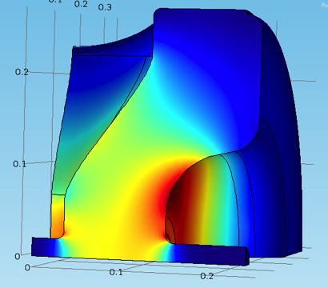
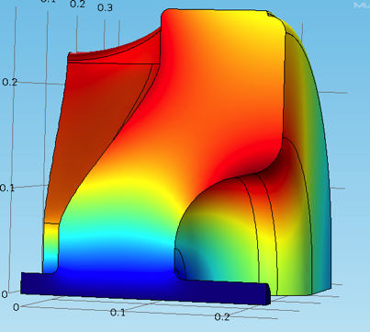
SSR2 EM design
EM design completed (mutual effort between FNAL and BARC), mechanical design undergoing at BARC.
Parameter
Frequency (MHz) | 325
Aperture (mm) | 40
Effective Length (cm) | 43.8
β_{opt} | 0.47
E_{pk}/E_{acc} | 3.69
B_{pk}/E_{acc} (mT/(MV/m)) | 5.95
Max En. Gain (Mev) | 5.2
G (Ω) | 115
R/Q (Ω) | 242
SSR2 3D Electric (top) and Magnetic (bottom) field

Slide 9
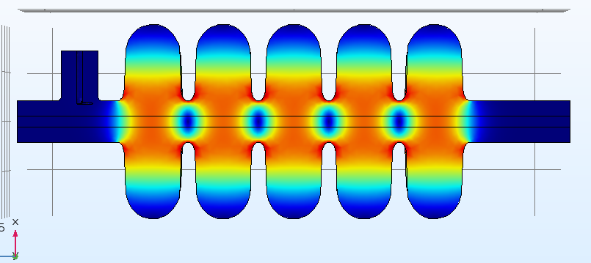
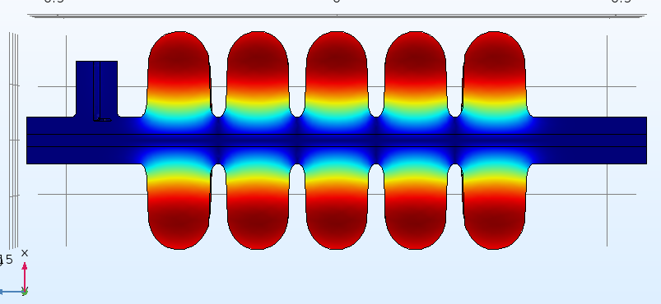
LB 650 MHz EM parameters
Design undergoing through IIFC collaboration (VECC), RF and mechanical design close to completion.
Parameter
Frequency (MHz) | 650
Aperture (mm) | 83
Effective Length (cm) | 74.6
β_{opt} | 0.65
β_{g} | 0.61
E_{pk}/E_{acc} | 2.48
B_{pk}/E_{acc} (mT/(MV/m)) | 4.69
Max En. Gain (Mev) | 11.8
G (Ω) | 187
R/Q (Ω) | 356
Electric (top) and Magnetic (bottom) field

Slide 10
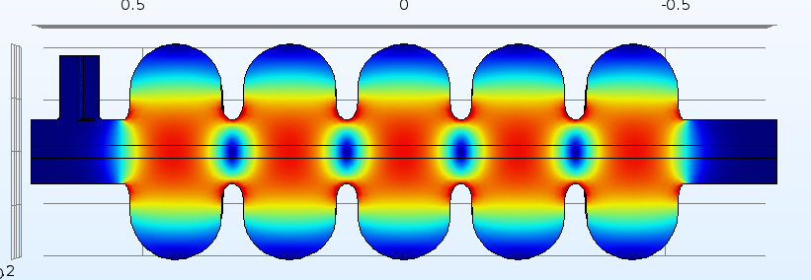
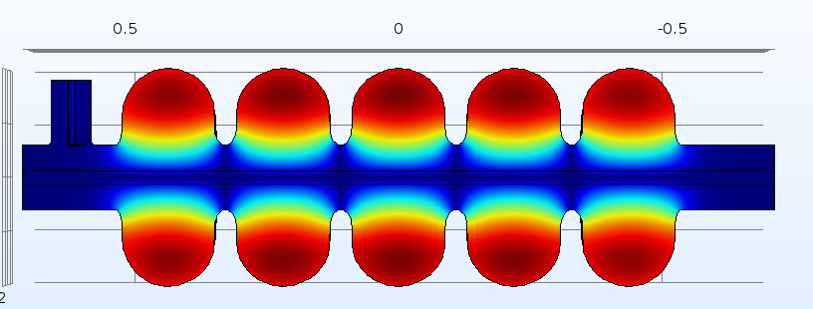
HB 650 MHz EM parameters
HB 650 MHz cavities have been fabricated and tested at FNAL, β=0.92 has improved HOMs damping and it is suitable for high current.
Parameter
Frequency (MHz) | 650
Aperture (mm) | 118
Effective Length (cm) | 112
β_{opt} | 0.97
β_{g} | 0.92
E_{pk}/E_{acc} | 2.1
B_{pk}/E_{acc} (mT/(MV/m)) | 3.9
Max En. Gain (Mev) | 19.9
G (Ω) | 260
R/Q (Ω) | 610
Electric (top) and Magnetic (bottom) field

Slide 11
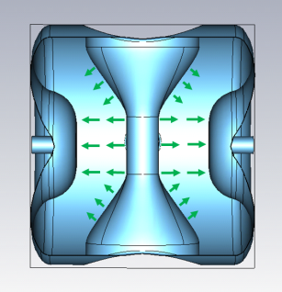
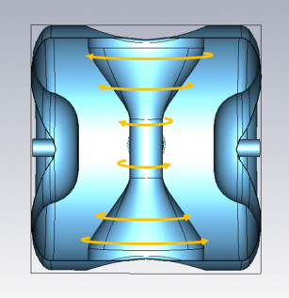
Transverse EM fields
Coaxial resonators are not symmetric: inner electrode breaks azimuthal symmetry→ quadrupole field perturbation!
Elliptical cavities have a coupler port → dipole perturbation to the field!
Electric and Magnetic field sketch for coax resonators
650 MHz coupler port is highlighted (green)
$$Δp_{x}\left(r,α\right)c=\int_{z_{i}}^{z_{f}}{\left(\frac{E_{x\left(r,α\right)}}{β}−Z_{0}iH_{y}\left(r,α\right)\right)}e^{i\frac{kz}{β}}dz$$
$$Q=\frac{Δp_{x}\left(r,0\right)c−Δp_{y}\left(r,π/2\right)c}{\left(Δp_{x}\left(r,0\right)c+Δp_{y}\left(r,π/2\right)c)/2\right.}$$
$$Δp_{y}\left(r,α\right)c=\int_{z_{i}}^{z_{f}}{\left(\frac{E_{y}\left(r,α\right)}{β}+Z_{0}{iH}_{x}\left(r,α\right)\right)}e^{i\frac{kz}{β}}dz$$

Slide 12
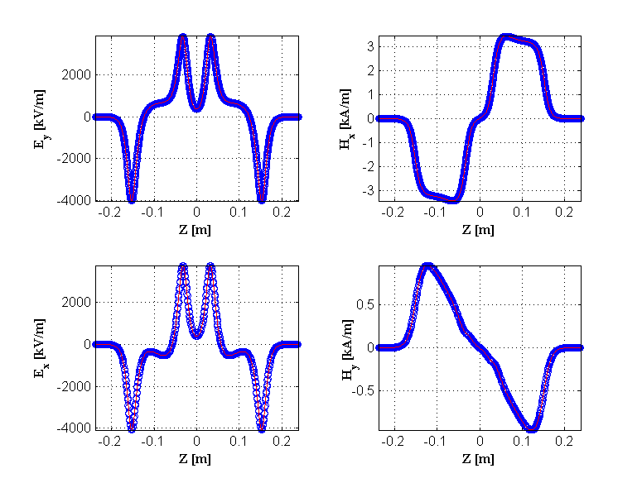
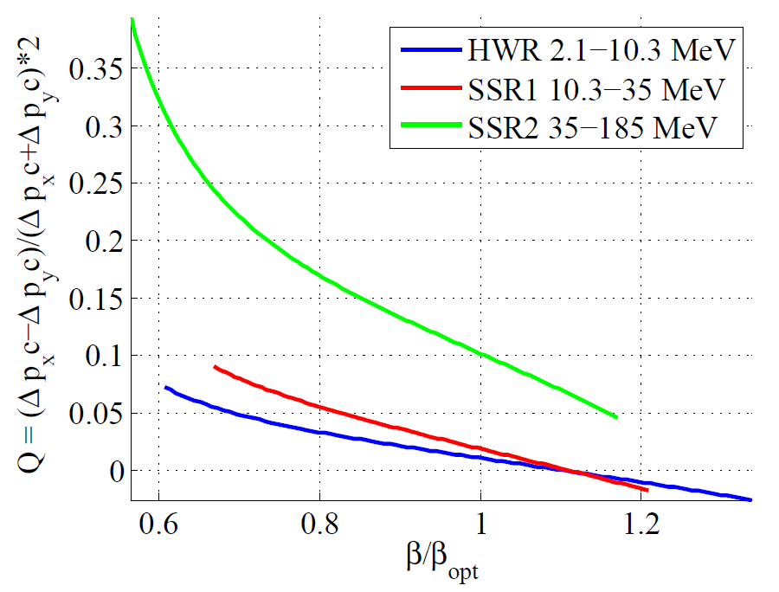
Transverse EM fields: coax resonators
The asymmetry parameter Q is ratio of the quadrupole amplitude over the monopole (average transverse kick).
Transverse EM fields of SSR2 cavity (r=10mm).
Summary Q plot for PIP-II coax resonators.
Impossible to compensate for quadrupole components over a wide beta range with simple cavity design changes.
To correct for quadrupole asymmetry each solenoid will have a corrector.

Slide 13
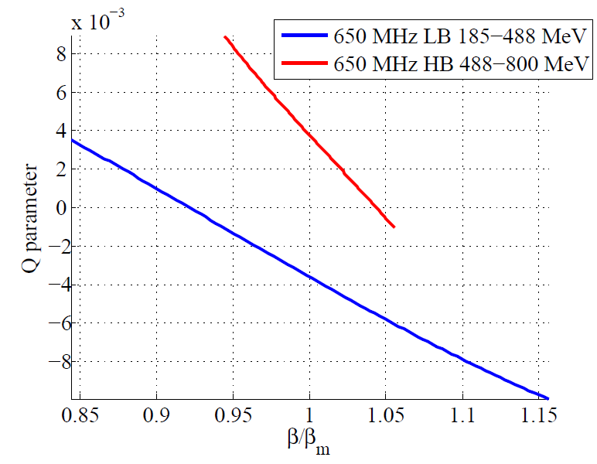
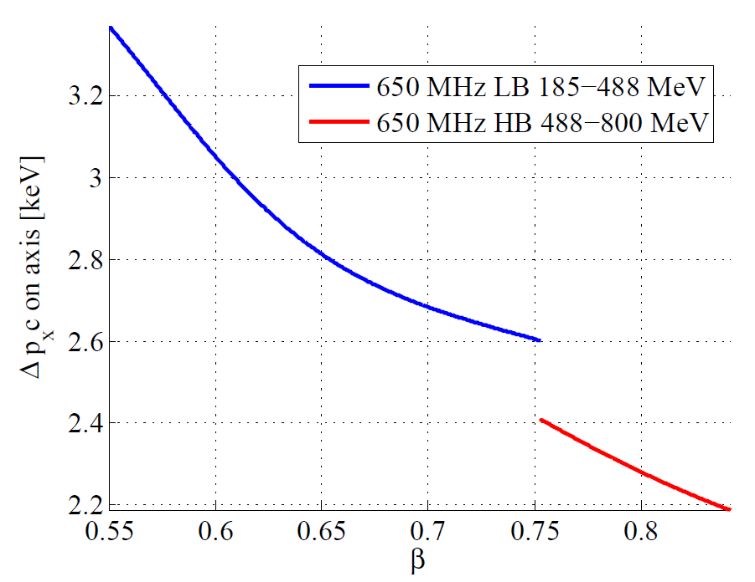
Transverse EM fields: elliptical cavities
The geometry is intrinsically symmetric, the only symmetry breaking element is the coupler port → no quadrupoles and high order multipoles.
Summary Q plot for PIP-II elliptical cavities.
Dipole kick due to coupler port in PIP-II elliptical cavities.
Dipole and quadrupole kick both very small.

Slide 14
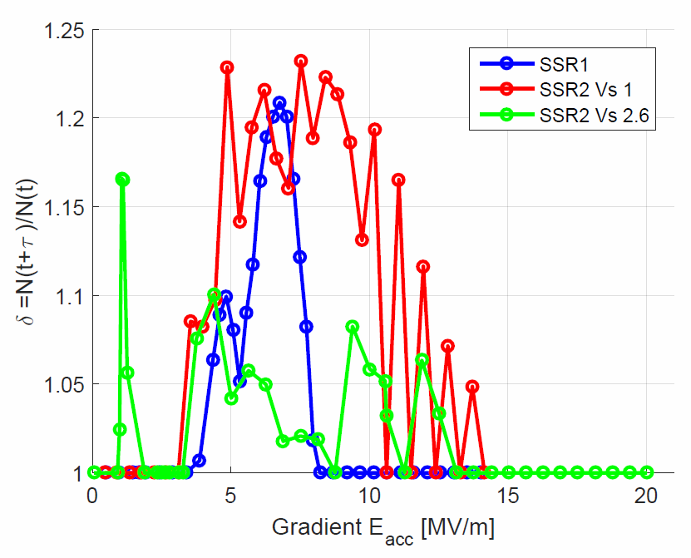
Multipacting for PIP-II cavities
Extensive studies have been done on PIP-II cavities: HWR at ANL, SSR1 at FNAL, SSR2 initially at FNAL now at BARC, LB 650 currently being optimized at VECC and HB 650 at FNAL.
SSR2 initial design had a potential risk of high MP level → the design has been modified at FNAL, undergoing final optimization at BARC, MP level lower than SSR1 (already built and tested).
New SSR2 geometry: ripple added to mitigate MP.
MP comparison: SSR1, SSR2 old and new design.

Slide 15
Summary
PIP-II cavity types have been chosen upon an optimization of the number of gaps and β_{opt}.
Cavity designs are either done (HWR, SSR1, HB 650) or undergoing the final stages of optimization (SSR2 and LB650).
All cavities provide needed performance in terms of particle acceleration.
Field asymmetry has been studied and it does not represent an issue for all cavity types.
Multipacting studies have been carried out and all cavities will have reasonably low MP levels.

Slide 16
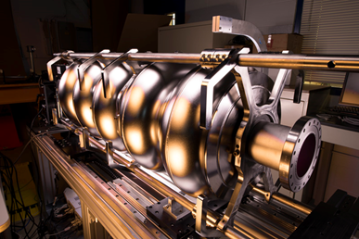
Thank
You!
Notes:
You should note who the vendor is on this.

