Slide 1
Mechanical Design of SC Cavities
Ivan Gonin
PIP-II Machine Advisory Committee Meeting
10-12 April 2017

Slide 2
PIP-II Layout
Section | Freq | Energy (MeV) | Cav/mag/CM | Type
RFQ | 162.5 | 0.03-2.1
HWR (β_{opt}=0.11) | 162.5 | 2.1-10.3 | 8/8/1 | HWR, solenoid
SSR1 (β_{opt}=0.22) | 325 | 10.3-35 | 16/8/ 2 | SSR, solenoid
SSR2 (β_{opt}=0.47) | 325 | 35-185 | 35/21/7 | SSR, solenoid
LB 650 (β_{g}=0.61) | 650 | 185-500 | 33/22/11 | 5-cell elliptical, doublet
HB 650 (β_{g}=0.92) | 650 | 500-800 | 24/8/4 | 5-cell elliptical, doublet
2

Slide 3
SC Cavities
HWR β=0.11 RF and Mechanical design are developed at ANL
SSR1 β=0.22 RF and Mechanical design developed at Fermilab
SSR2 β=0.47 RF Fermilab design, Mechanical design is under development at BARC, India
LB 650 MHz β=0.61 cavities VECC/Fermilab collaboration – RF bare and dressed cavity mechanical design and fabrication. April 21, Cavity Preliminary design review
HB 650 MHz β=0.9 cavities:
CW operation. Priority dF/dP minimization
Beam current 1 mA
HB 650 MHz β=0.92 cavities :
Pulsed operation. Priority LFD minimization
Beam current 2 mA

Slide 4
The Scope of EM-Mechanical Design Issues
Minimize a sensitivity to microphonics due to He pressure fluctuations (df/dP) and mechanical vibrations
Minimize a Lorentz Force Detuning (LFD) coefficient
To keep the stiffness and tuning sensitivity at suitable level to allow for tuning.
Keep provision for slow and fast tuner integration.
Dressed cavity has to be qualified in 5 different load conditions by stress analysis
Warm Pressurization
Cold operation at maximum pressure
Cool down and tuner extension
Cold operation at maximum pressure and LHe weight
Upset condition – Insulating and beam vacuum failure

Slide 5
Material Properties
The Dressed SRF Cavity is constructed of three materials:
Pure niobium (RRR 300),
Ti-45Nb alloy, and Grade 2 Titanium.
The material properties and allowable stresses are defined in Fermilab Technical Division Technical Note TD-09-005.
Stress analysis is intended to demonstrate that the PIP-II SRF cavities conform to the ASME Boiler and Pressure Vessel Code (the Code), Section VIII, Div. 1, to the greatest extent possible.

Slide 6
Allowable Stresses (MPa)
 | Allowable Stress (S) for materials |  | Allowable Stress (0.6xS) for weld joints
Material | 2 K | 293 K | 2 K | 293 K
Nb | 171 | 25 | 102.6 | 15
Ti-45Nb | 156 | 156 | 93.6 | 93.6
Gr. 2Ti | 319 | 99 | 191.4 | 59.4
Material | Stress Category
 | Pm |  | P_{L} |  | P_{m} ( or P_{L} ) + P_{b} |  | P_{m} ( or P_{L} ) + P_{b} + Q
 | 2 K | 293K | 2 K | 293K | 2 K | 293K | 2 K | 293K
Nb | 171 | 25 | 256.5 | 37.5 | 256.5 | 37.5 | 513 | 75
Ti-45Nb | 156 | 156 | 234 | 234 | 234 | 234 | 468 | 468
Gr. 2Ti | 319 | 99 | 478.5 | 148.5 | 478.5 | 148.5 | 957 | 297
Nb Welds | 102.6 | 15 | 154 | 22.5 | 154 | 22.5 | 308 | 45
Ti-45Nb Welds | 93.6 | 93.6 | 140.4 | 140.4 | 140.4 | 140.4 | 280.8 | 280.8
Gr. 2Ti Welds | 191.4 | 59.4 | 287 | 89 | 287 | 89 | 574 | 574
Pm = primary membrane stress; P _{L}= primary local membrane stress P_{b} = primary bending stress Q = secondary stress
Technical Division Technical Note TD-09-005.

Slide 7
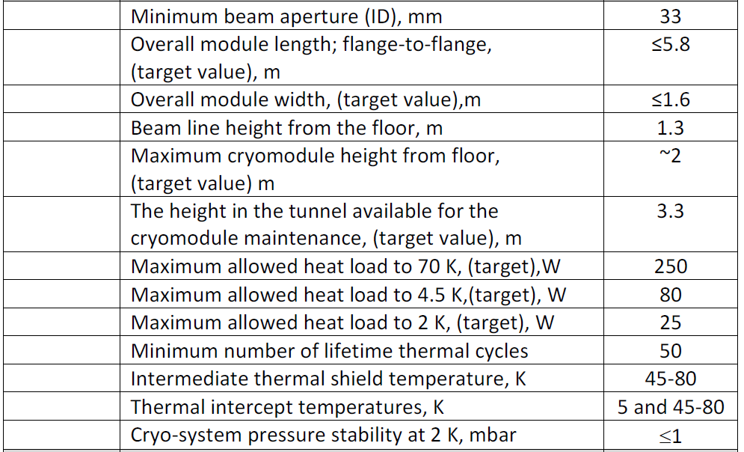
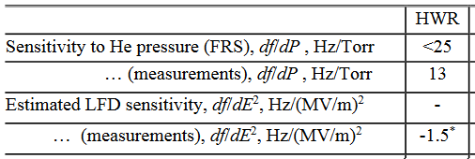
HWR Cavities FRS

Slide 8
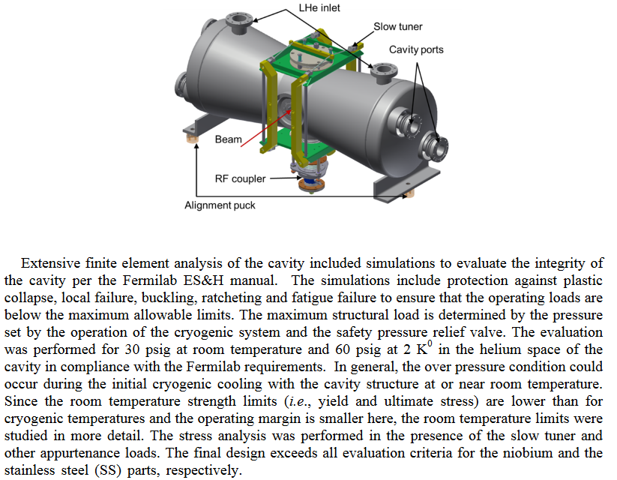
HWR Cavities Stress analysis

Slide 9
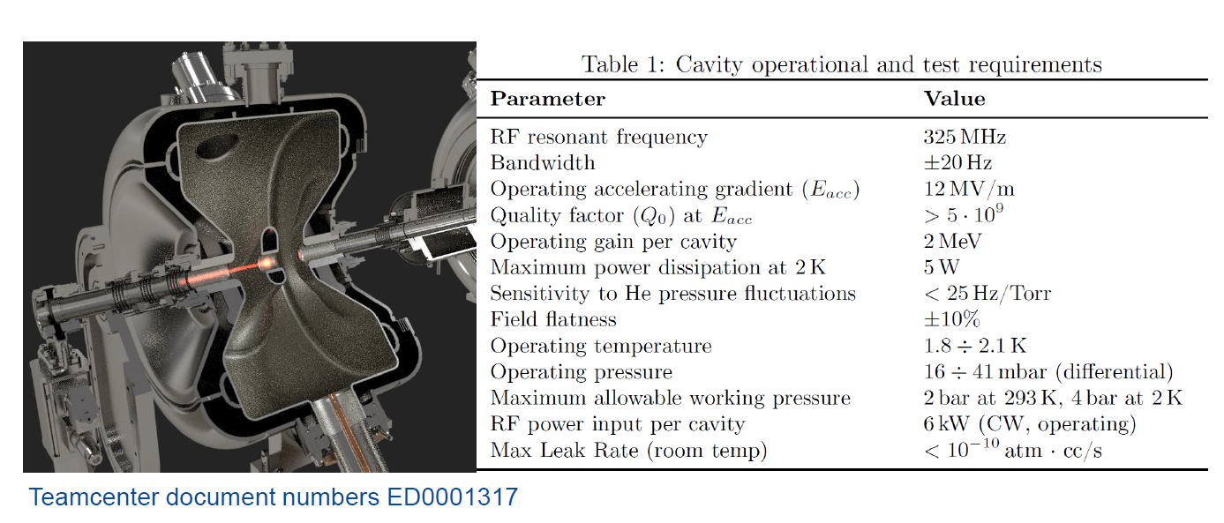
SSR1 Cavities FRS

Slide 10
SSR1 Cavities: Pressure sensitivity

Slide 11
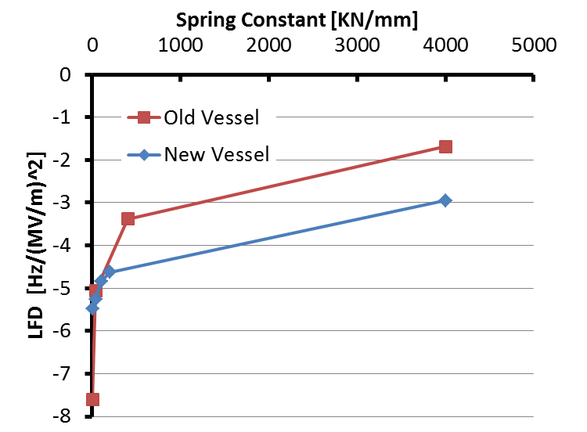
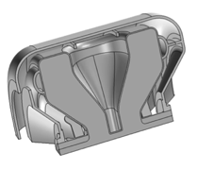
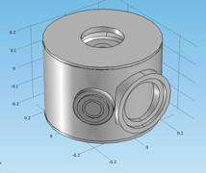
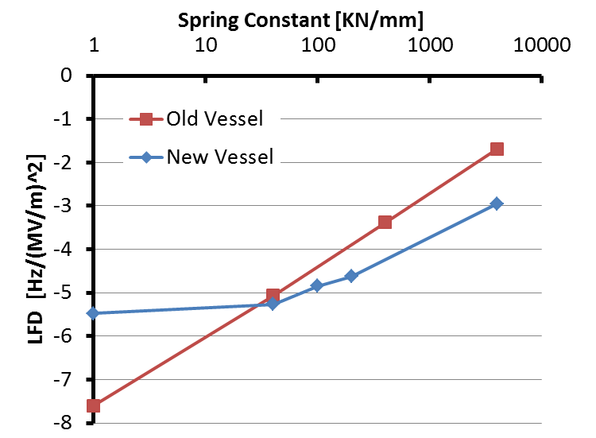
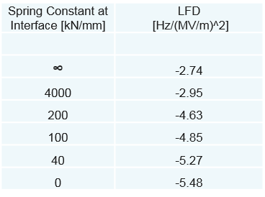
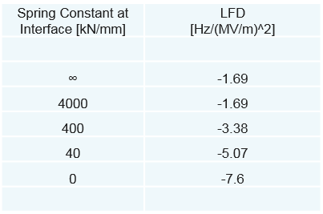
SSR1 Cavities: LFD
The design of Helium Vessel was optimized to keep LFD within specifications.
A spring constant of ~ 30 kN/mm is expected at the interface

Slide 12
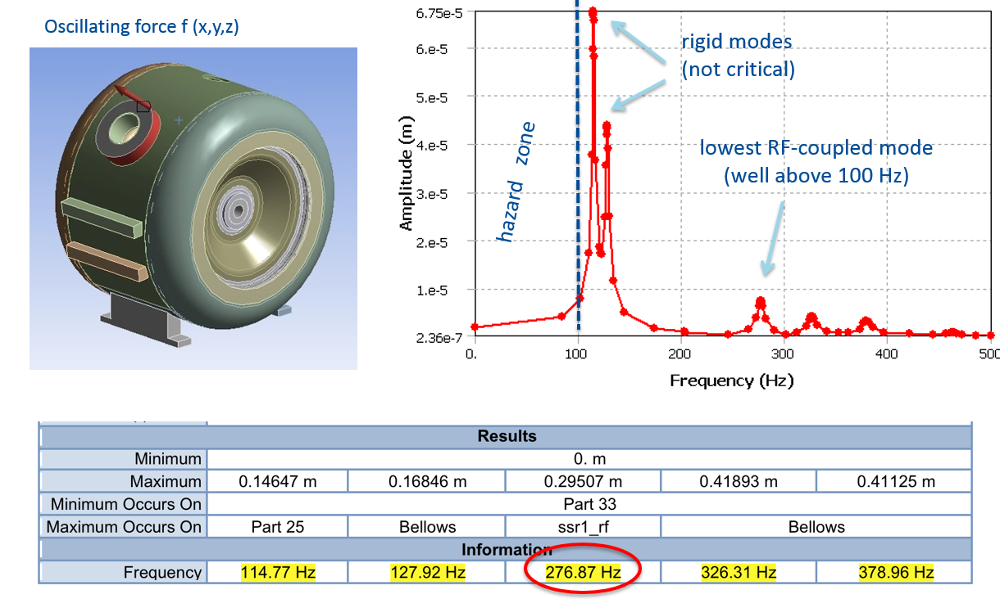
SSR1 Cavities: Mechanical Resonances

Slide 13
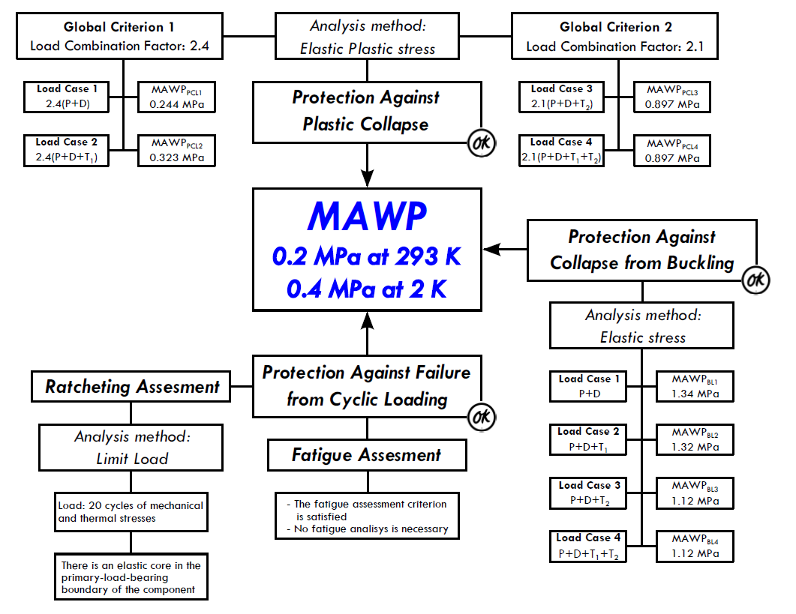
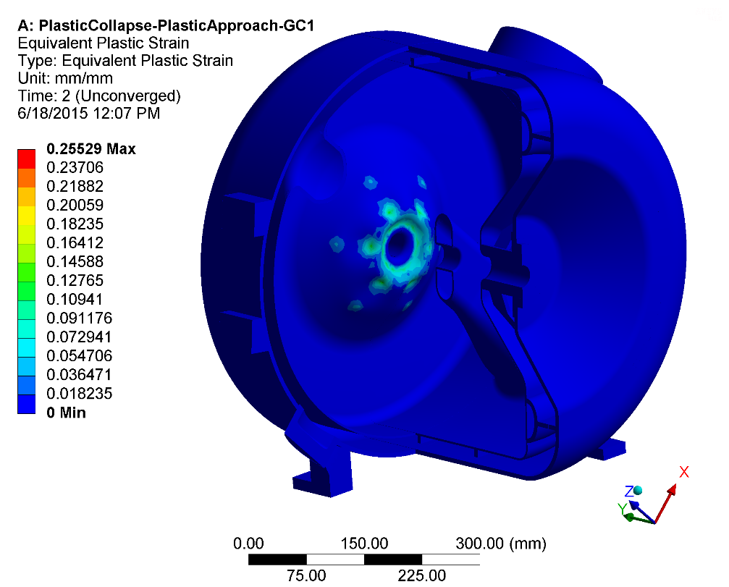
SSR1 Cavities: MAWP Requirements
Jacketed SSR1 cavities meet the requirements of maximum allowable working pressures according to Fermilab ES&H Manual chapter 5031.6. The assembly represents a sound mechanical structure that poses no hazard to personnel or equipment.
D. Passarelli

Slide 14
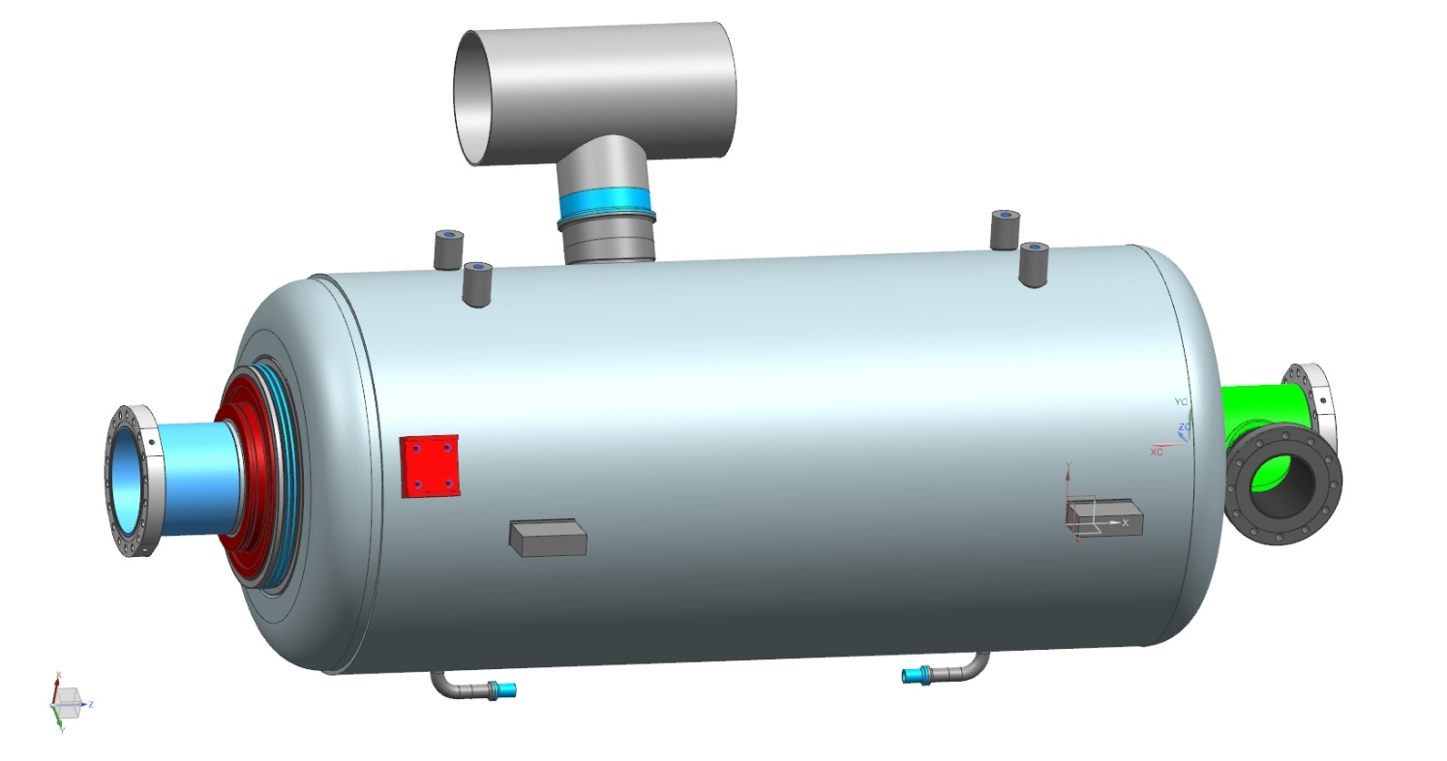
HB 650 MHz Cavity Helium Vessel
components:
Long Cylinder
Transition ring MC end
Transition ring FP end
Bellow assembly
Support lugs
Lifting lugs
Helium inlet
2-phase pipe assembly
Tuner mounting lugs
Bellow restrains
Magnetic shielding (external)
2-phase pipe assembly
Transition ring MC end
Transition ring FP end
Lifting lugs
Long Cylinder
Support lugs
Bellow assembly
Helium inlet
Tuner Support

Slide 15
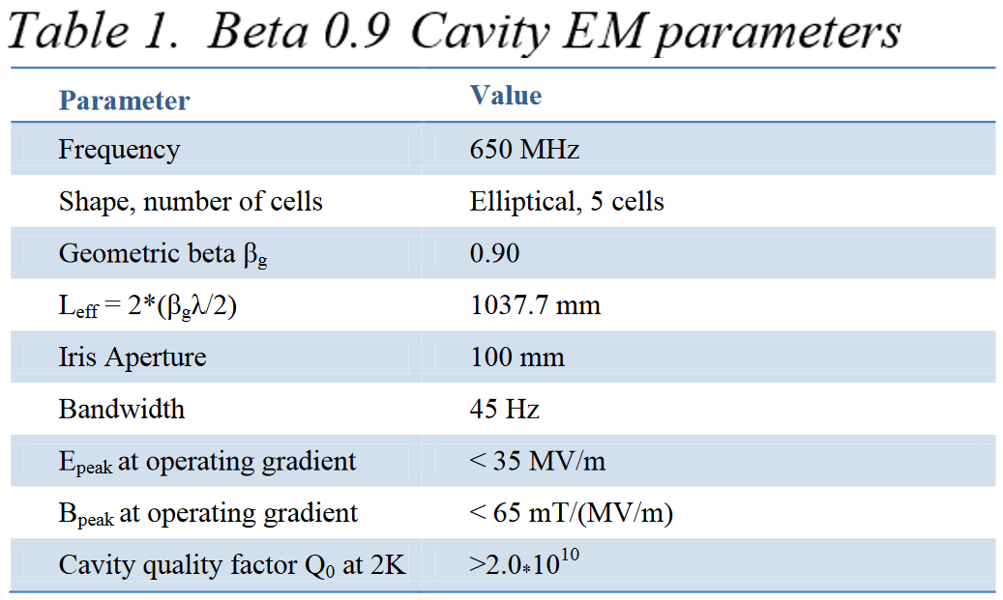
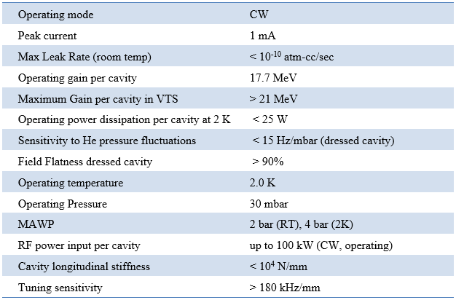
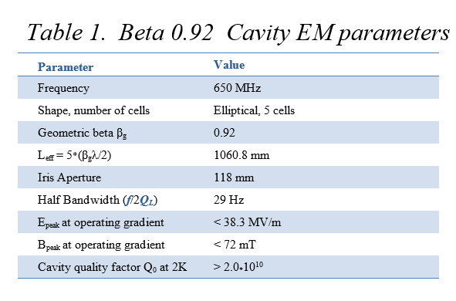
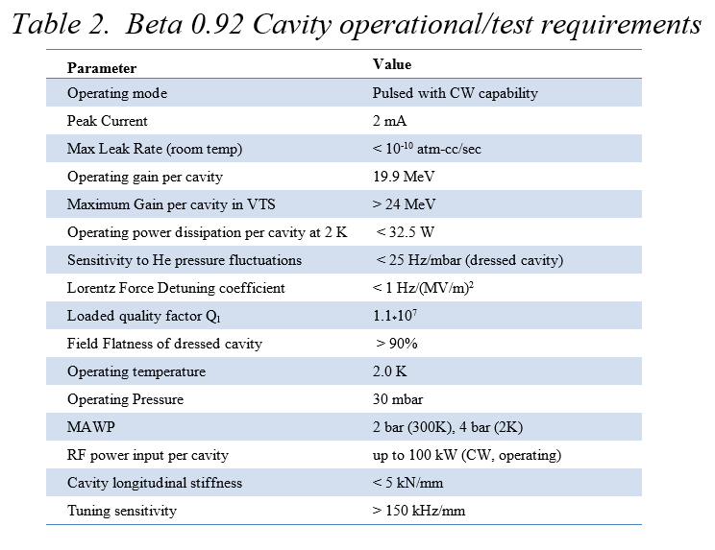
Performance parameters for beta=0.9&0.92 cavity

Slide 16
HB 650 MHz Cavity Helium Vessel
β = 0.9
β = 0.92
Similarities
Diameter is same
Same supporting lug gap
Same tuner lug location
Same Helium inlet stubs
Similar Magnetic shielding
Differences
Length for β = 0.92 is more
Cavity stiffness is different
Bellow position nominal dia is different
End groups are different

Slide 17
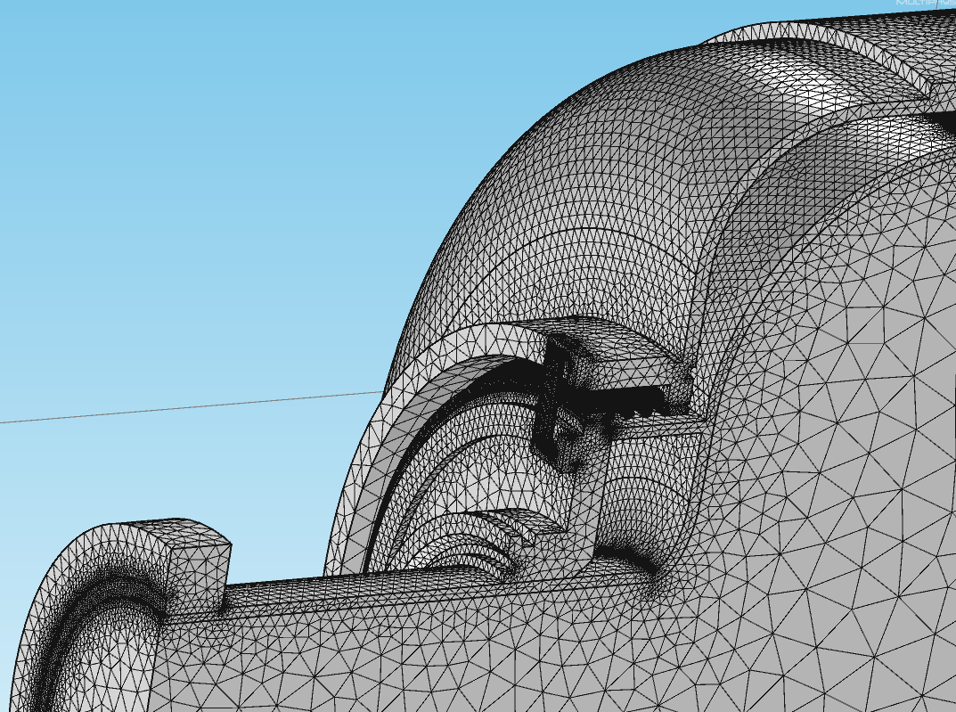
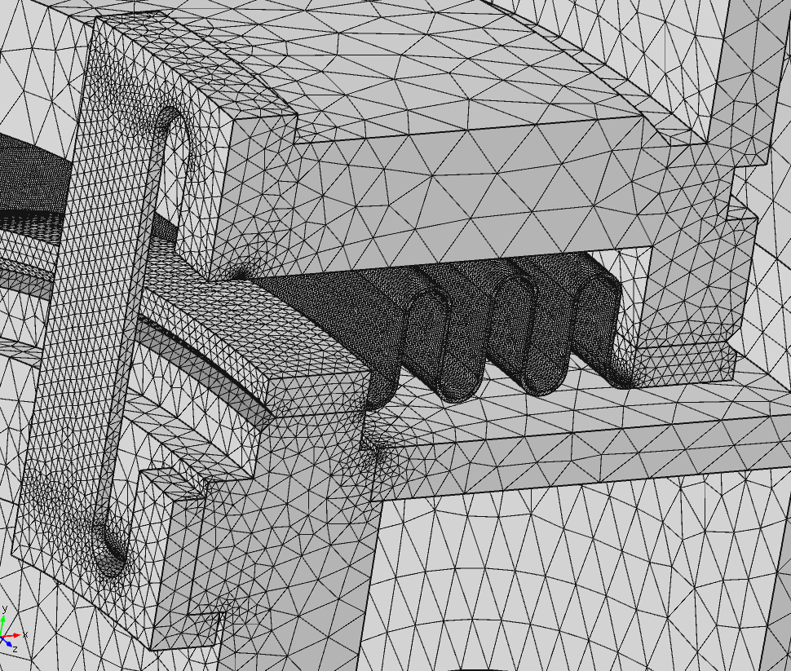
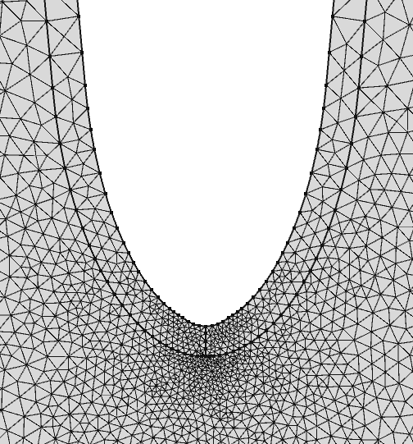
FE mesh
Figures below shows the typical 3D and 2D FE meshes used in COMSOL analysis. 1.2 Million of 2-nd order 10-nodes tetrahedral elements was used in 3D analysis and ~70K 2-nd order 6-nodes triangular elements in 2D analysis. To increase the accuracy, mesh has been dense in critical areas like bellow, irises, axis line etc.

Slide 18
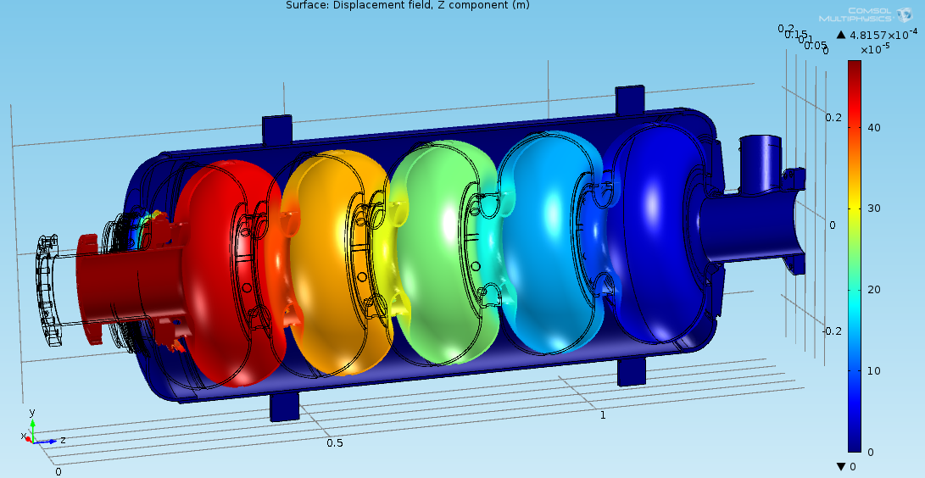
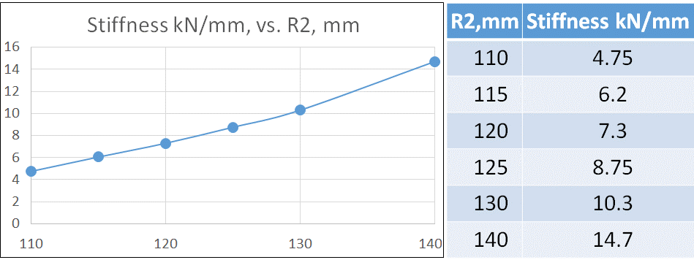
Cavity stiffness, wall thickness 3.75 mm
F
R2
x2
x1
F, N | 1000
x1, mm | 0.295
x2, mm | 0.016
VM σ bellow, MPa | 52
VM σ cavity, MPa | 10

Slide 19
LFD and dF/dP simulations algorithm
LFD ~ -1.33 Hz/(MV/m)^2
dL~0.418μm
dL~2.01μm
CAVITY SENSITIVITY ~ 160 Hz/μm

Slide 20
LFD and dF/dP simulations algorithm
COMSOL Multiphysics algorithm to evaluate LFD, dF/dP consists from 5 following steps.
Running RF analysis of 2D CAD model in RF domain to calculate the initial fundamental frequency
Running Solid Model analysis with boundary conditions showing on Fig. 2, normalized Lorentz forces applied to cavity surface according to EM field from step 1 and applied tuner stiffness or apply He pressure.
Running Moving mesh COMSOL module to update initial mesh according to wall displacements from step 2
Running again RF analysis of 2D CAD model in updated RF domain to calculate a new fundamental frequency
Calculate LFD, dF/dP coefficient based on the difference of frequencies from steps 1 and 4

Slide 21
LFD
FRS

Slide 22
dF/dP
FRS

Slide 23
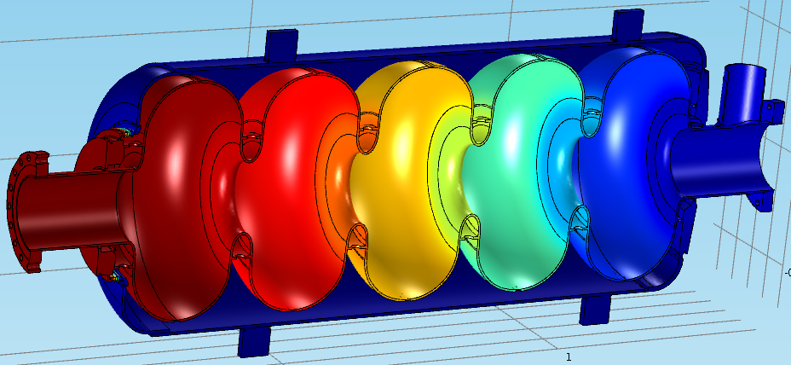
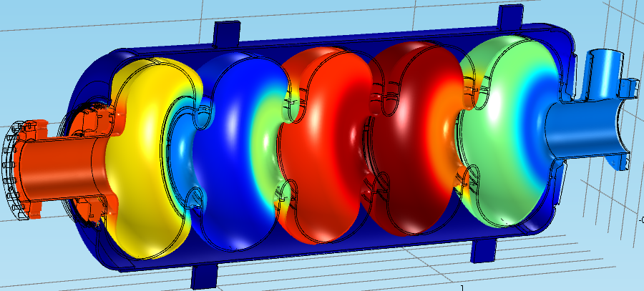
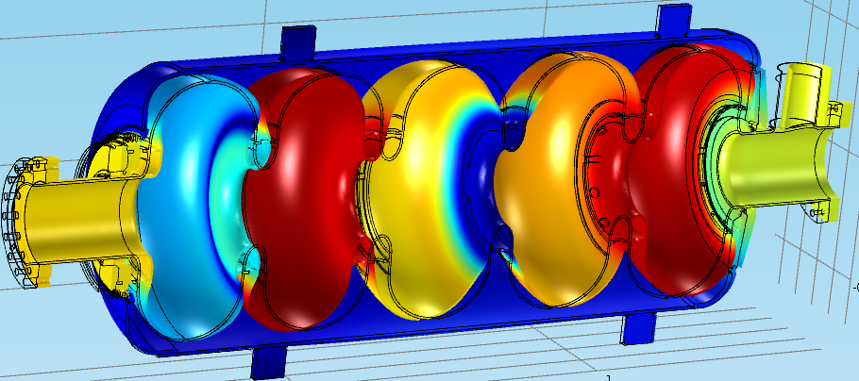
Modal analysis
Frequencies of 3 lowest Longitudinal Modes vs. Stiffness of the beta=0.92, tuner stiffness 0 kN/mm, thickness =3.75 mm

Slide 24
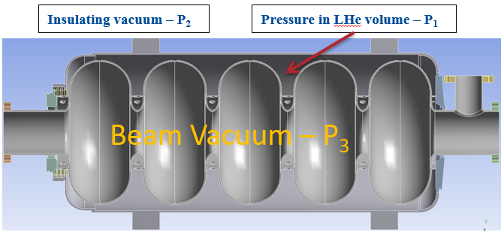
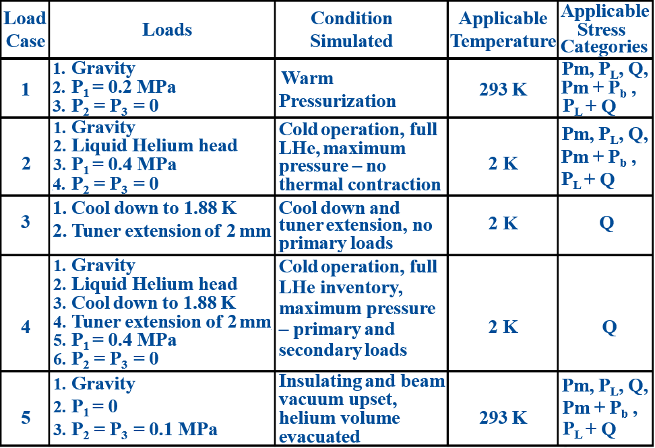
Stress analysis. 5 Load cases

Slide 25
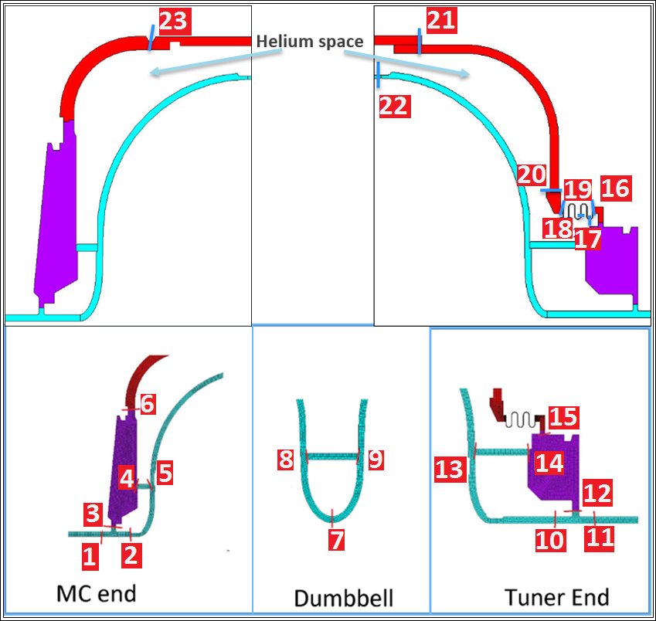
Load cases and results
Different loads applicable to cavity
Gravity
Liquid helium pressure head
P1 = 2 bar at room temp. p2=p3=0
Cool-down shrinkage to 2K
P1 = 4 bar at 2K, p2=p3=0
Tuner extension and
Cavity vacuum failure loads p3=1bar
SCLs

Slide 26
Load Case 1
Material | SCL | Pm | Sa | Ratio
NbTi-Ti | 6 | 4.32 | 93.6 | 0.05
NbTi-Ti | 15 | 1.11 | 93.6 | 0.01
Ti | 16 | 1.46 | 59.4 | 0.02
Ti | 17 | 31.6 | 99 | 0.32
Ti | 18 | 19.95 | 99 | 0.20
Ti | 19 | 51.98 | 59.4 | 0.88
Ti | 20 | 18.93 | 59.4 | 0.32
Ti | 21 | 5.41 | 59.4 | 0.09
Ti | 22 | 2.62 | 59.4 | 0.04
Material | SCL | Pm+Pb | Sa | Ratio
NbTi-Ti | 6 | 6.88 | 140.4 | 0.05
NbTi-Ti | 15 | 5.26 | 140.4 | 0.04
Ti | 16 | 17.05 | 89 | 0.19
Ti | 17 | 43.11 | 148.5 | 0.29
Ti | 18 | 141.1 | 148.5 | 0.95
Ti | 19 | 82.9 | 89 | 0.93
Ti | 20 | 37.30 | 89 | 0.42
Ti | 21 | 6.28 | 89 | 0.07
Ti | 22 | 5.13 | 89 | 0.06
5 load cases with different combination were qualified.
All applicable stress categories have been evaluated at the stress classification lines.
It was found that in all cases the stresses are below the allowable values.

Slide 27
Summary
HWR cryomodule is under development in ANL. Completion ~ end of 2018
SSR1. The design status of the cryomodule completion ~ March 2019.
SSR2. RF design is done in FNAL. Mechanical design is under development in BARC, India
LB 650 MHz cavities
RF and Mechanical design will provide by VECC, India
HB 650 MHz cavities RF and mechanical design has been done
Stiffening ring, end group, HV are optimized to satisfy LFD FRS
dF/dP, natural modes are satisfied to FRS
All load cases are examined and found to be satisfactory

