Slide 1
PIP II Booster
Kiyomi Seiya
PIP-II Machine Advisory Committee
10-12 April, 2017
Notes:
Wrong date: 9-11 March 2015

Slide 2
Outline
Present status
Requirements for PIP-II
Injection
  Injection girder, Phase space painting
Beam capture
  Bucket to bucket transfer, Early injection
Transition crossing, Acceleration
  Measurements and simulations, Q-jump
20 Hz operation
  GMPS Power Supply

Slide 3
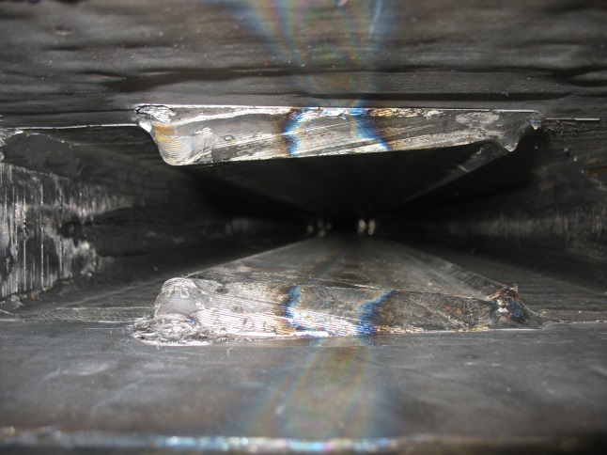
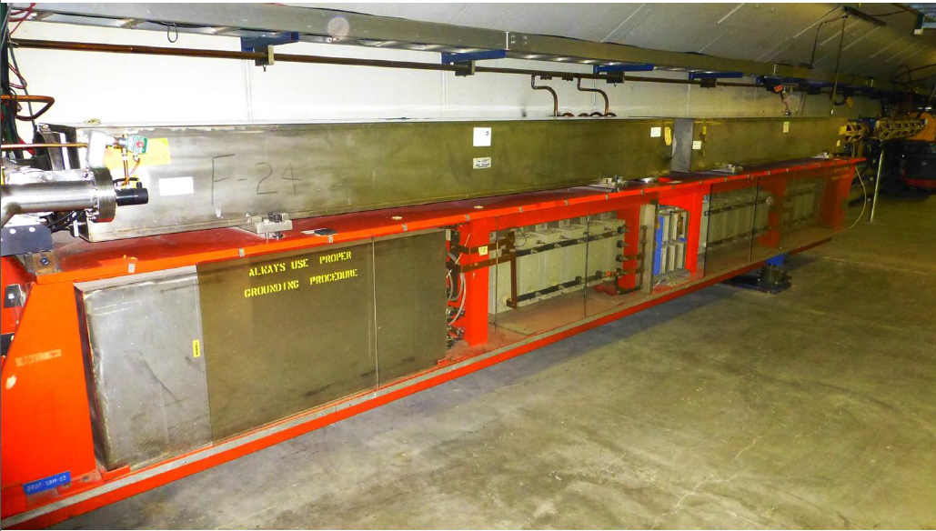
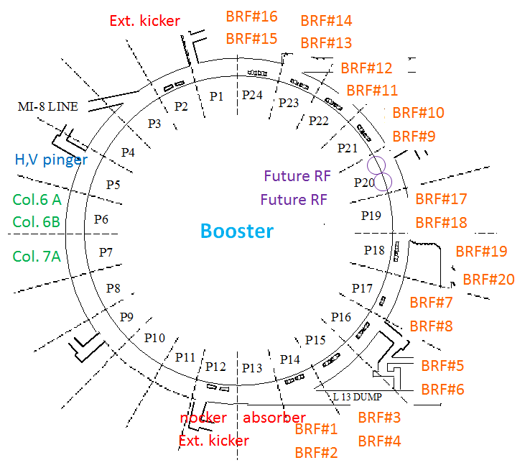
Booster: 15 Hz Resonant Circuit Synchrotron
D-Magnet
F-Magnet
Resonant Capacitor
Choke
Proton Kinetic Energy
@ Injection → @ Extraction
400MeV 8GeV in 33.33msec

Slide 4
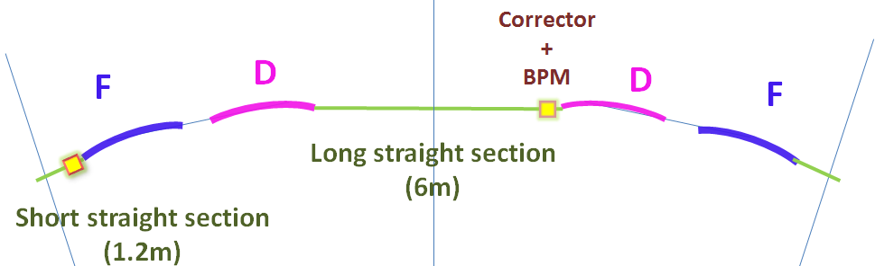
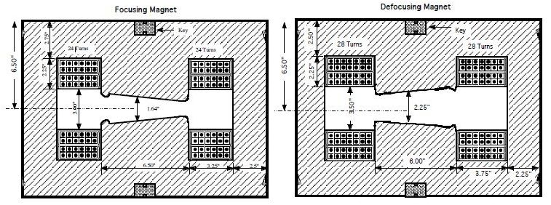
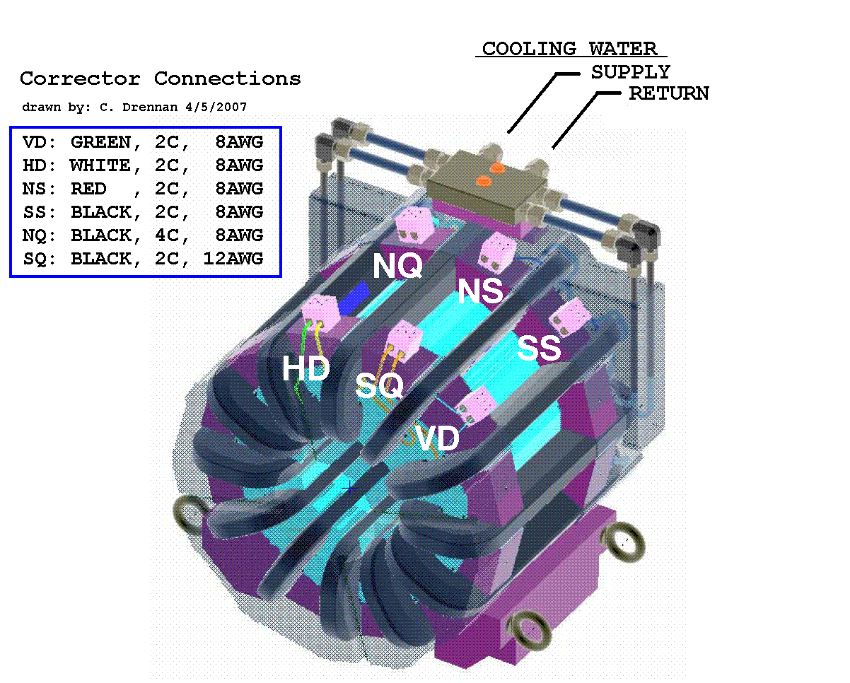
Booster: FDOODF lattice
F Magnet
D Magnet
Combined function magnets: F, D
FDOODF x 24 periods
Corrector packages at short and long
Corrector package (12 poles) includes
H & V dipoles, quad, skew quad, sextupole, skew sextupole
and H & V BPMs.
Corrector Package

Slide 5
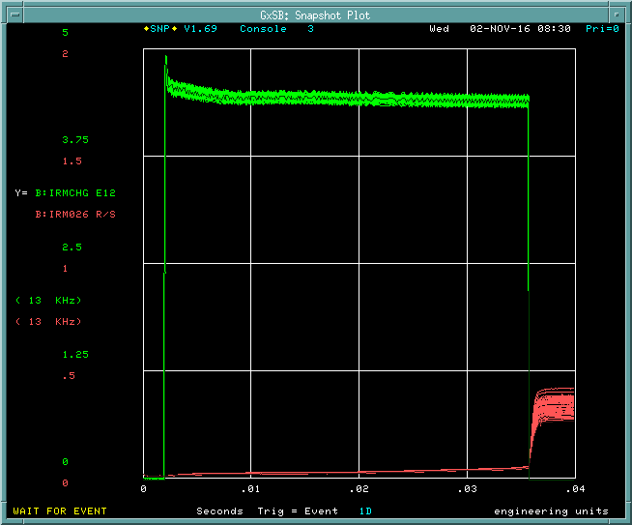
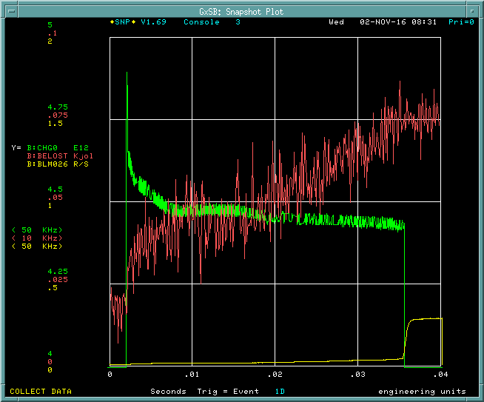
Booster: Intensity and Beam Loss
Beam Energy Loss
Notch creation
Transition
Extraction
Intensity
Int. at Injection: 4.8E12 ppp
Int. at Extraction: 4.4E12 ppp
Efficiency: 92%
Slow loss
Slow loss
This loss will not present under PIP-II
Beam energy loss/cycle = 0.055 kJ

Slide 6
Booster: Emittance
PIP-II Goal
Intensity @4.4E12 ppp
H_emittance: 12pi mm-mrad
V_emittance: 13pi mm-mrad
L_emittance: 0.1 eV-sec

Slide 7
PIP-II Booster parameter table
 | Present operation | PIP Goal | PIP-II
Injection Energy | 400 MeV | 400 MeV | 800 MeV
Extraction Energy | 8 GeV | 8 GeV | 8 GeV
Protons per pulse | 4.3 - 5.0E12 | 4.3E12 | 6.5E12
Repetition Rate | 15Hz | 15Hz | 20Hz
RF Frequency | 37.8 – 52.8 MHz | 37.8 – 52.8 MHz | 44.7 – 52.8 MHz
RF Voltage | 1MV | 1.2MV | 1.2MV
Cycle efficiency | 92% | 95% | 97%
Injection time | 40 μsec | 40 μsec | 550 μsec
H & V emittance | 12π mm-mrad | 13π mm-mrad | 16π mm-mrad
L emittance | 0.1 eV-sec | 0.1 eV-sec (95%) | 0.1 eV-sec (97%)

Slide 8
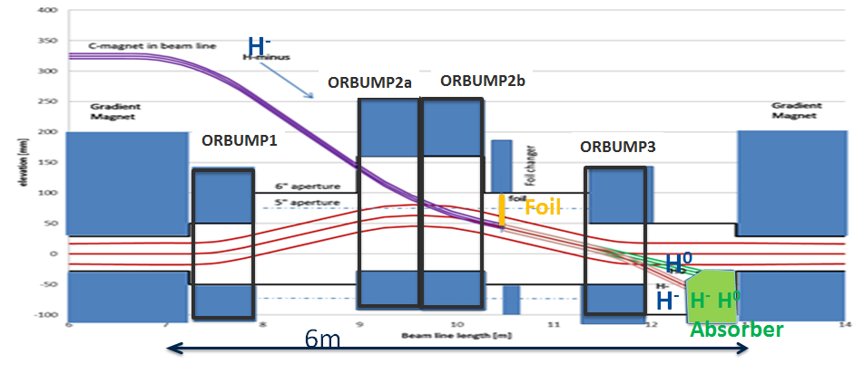
Injection: New injection girder at L11
Injection energy: 400MeV → 800MeV
-Beam enters vertically
-New 4 bump system (ORBUMP)
Conceptual Design – optimizing
Beam absorber for H⁰ and H⁻
Space for corrector package

Slide 9
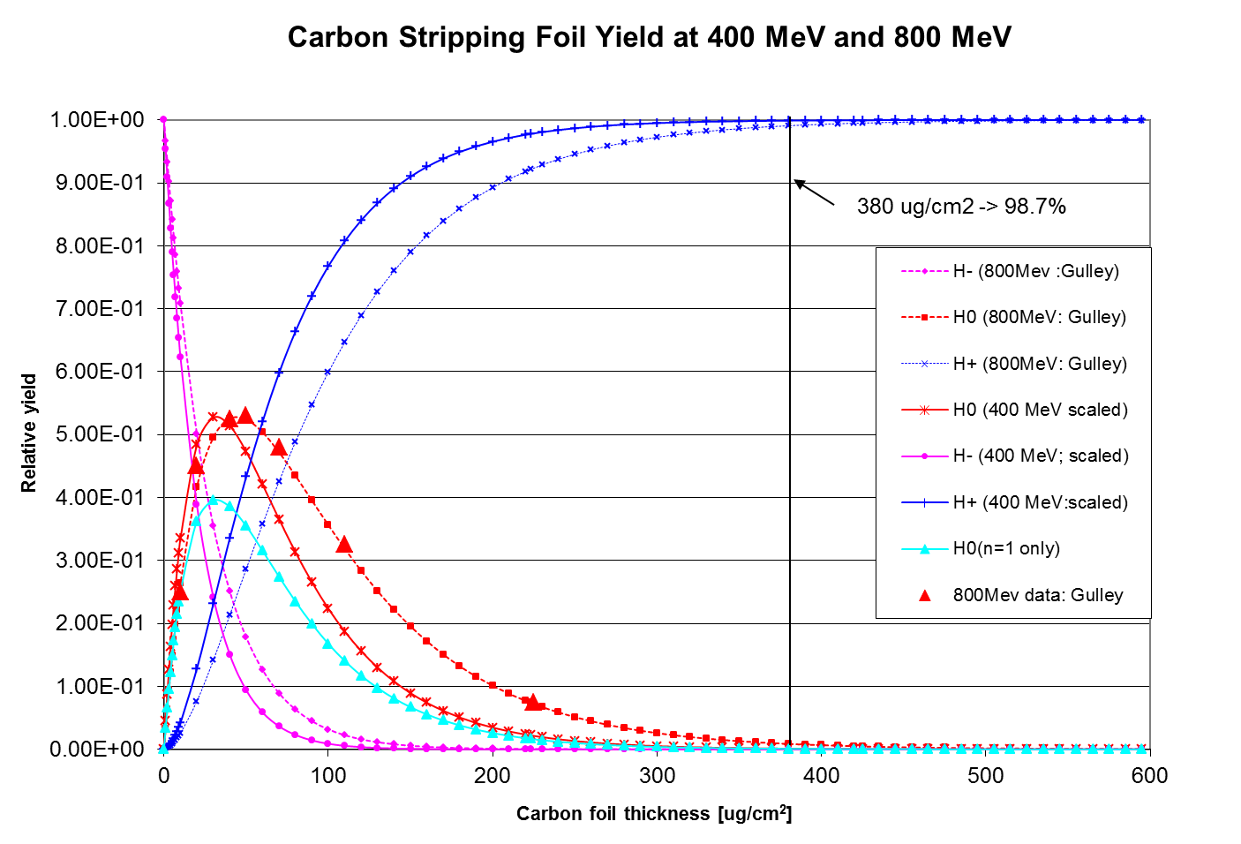
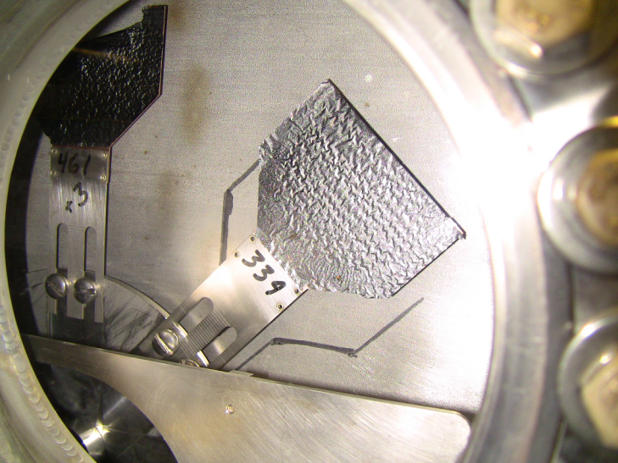
Injection: Foil stripping
Carbon foil yield at 400MeV and 800MeV
H⁺
380 ug/cm²
With foil thickness 380 ug/cm²
Efficiency to protons @ 400 MeV: 99.9% Efficiency to protons @ 800 MeV: 99.1%
H⁻
Relative yield
present foil holder
present foil
H⁰
Carbon foil thickness [ug/cm²]
- To match 400 MeV efficiency at 800 MeV foil thickness needs to increase to ~ 600 ug/cm²
Injection power increases to ~ 18 kW at 800 MeV with 6.7E12 injected at 20 Hz
Power loss is 18 Watts on downstream gradient magnet for a 0.1% loss
Life time will be reduced
- Need to provide injection absorber

Slide 10
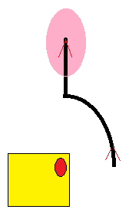
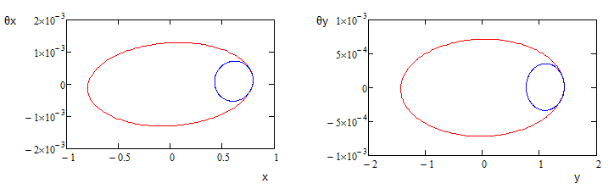
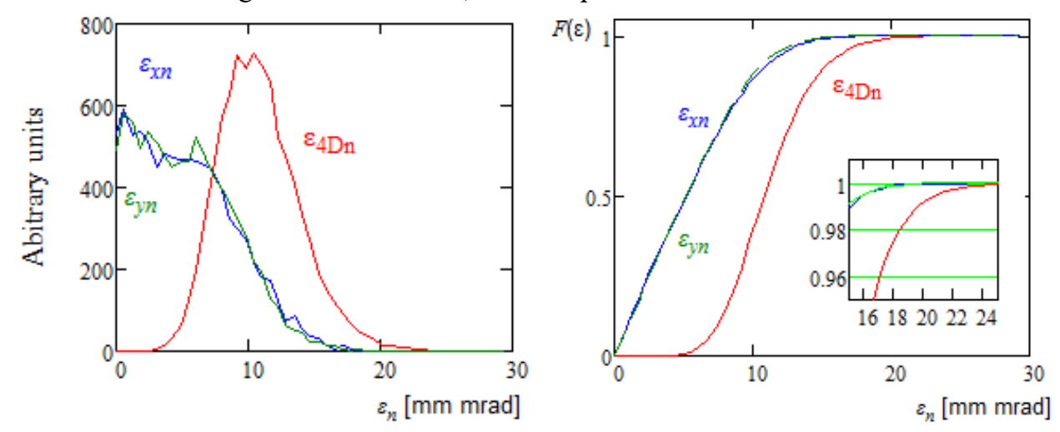
Injection: Painting for Space Charge Mitigation
Move beam vertically using the ORBUMPs
Move beam horizontally with 5 bumps using existing dipole correctors.
Carbon foil for stripping (presently 15 turns vs 315 turns for PIPII)
y
Foil
Boundaries for :
Beam from LINAC (1.8pi mm-mrad)
After painting (16pi mm-mrad)
x
Simulation results of the carbon foil strip injection
εx, εy (95%) < 16π mm-mrad

Slide 11
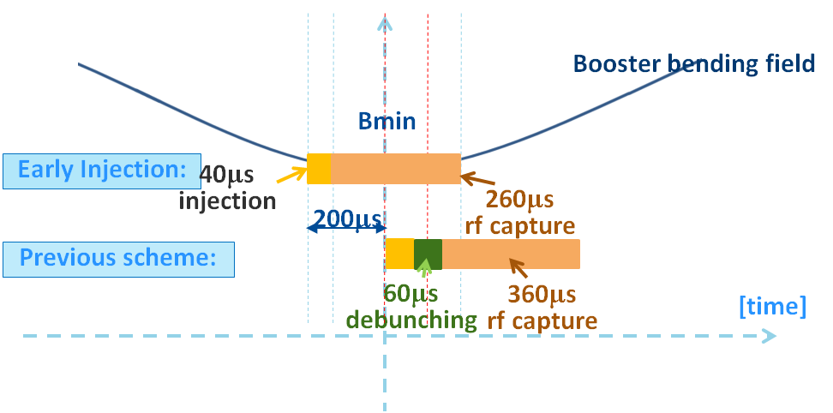
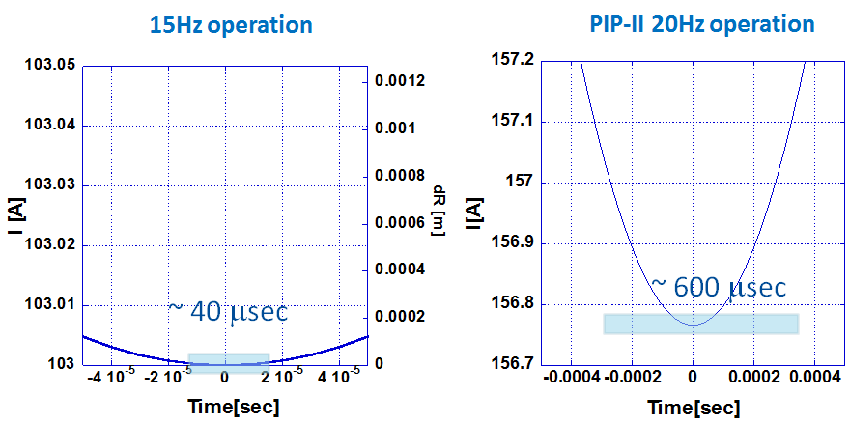
Injection Capture: Bucket to Bucket Transfer
LINAC 2 mA beam current for 0.6 ms provides 6.7E12 particles
Testing early injection scheme to improve capture efficiency.
Developing a new VXI board for the GMPS (Gradient Magnet Power Supply) feedback in order to reduce current and timing error
    I_err < +/- 0.02 [A], T_err < 20 msec
Using LINAC energy control vs. Booster ramp control needs to be studied
Flattened front porch for injection will be made with hor. corrector ramp

Slide 12
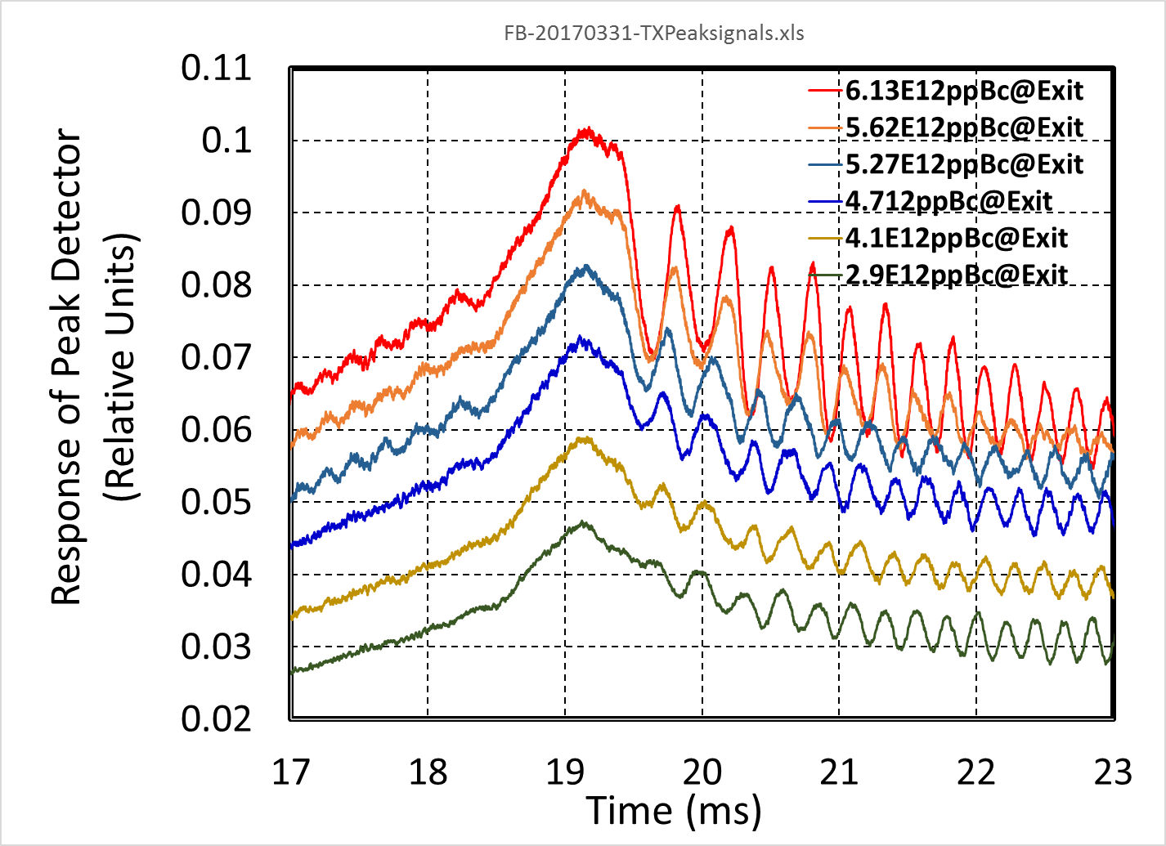
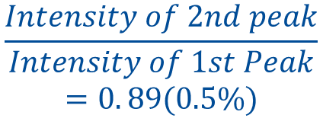
Transition: Measurements of the Emittance Blow up After Transition
Peak detector signal at transition
$$\frac{Intensity of 2nd peak}{Intensity of 1st Peak}$$
$$=0. 89(0.5\%)$$
Simulation with space charge:
8BT ≈ 3E12p/81 bunch
16BT ≈ 6E12p/81 bunch
Transition jump was based on time and is now based on frequency.
Simulation and measurements show that the quad peak ratio does not change with beam intensity.
No blowup due to the space charge effect at the intensity of 6E12 ppp.

Slide 13
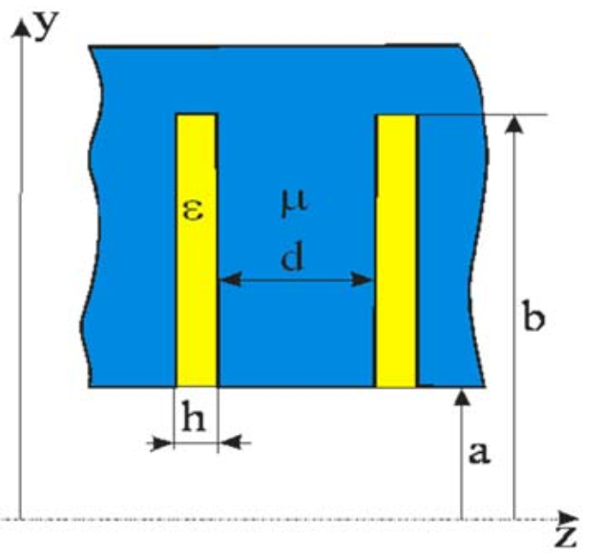
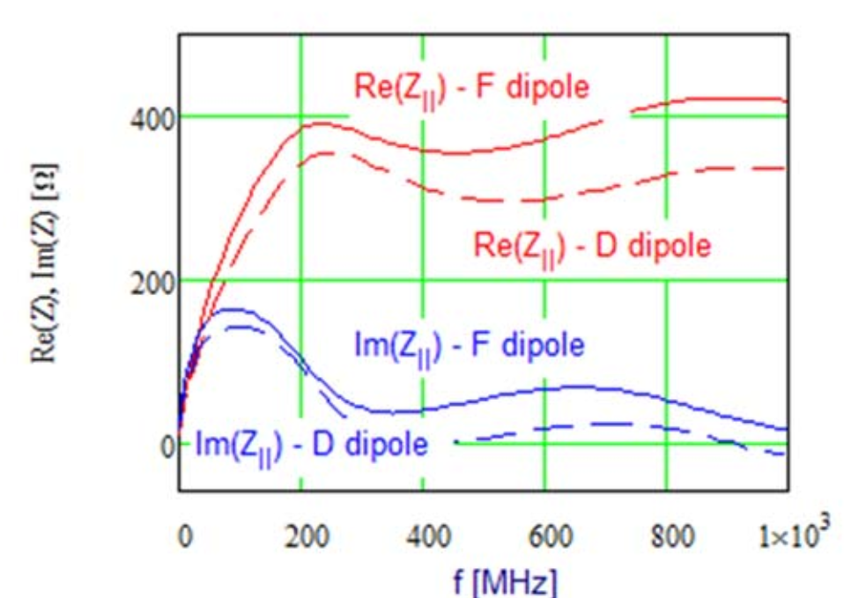
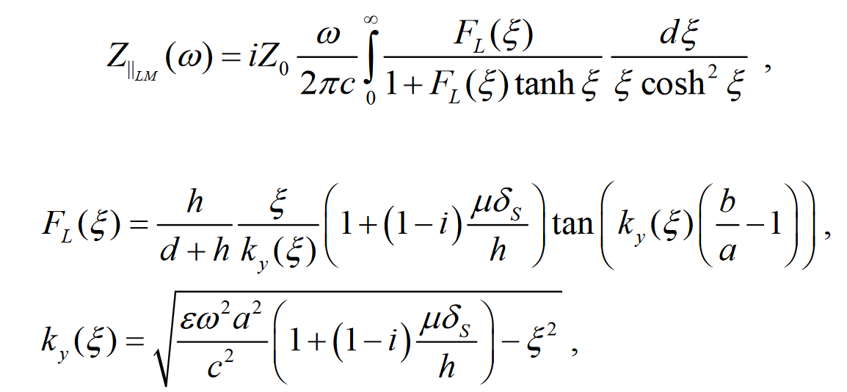
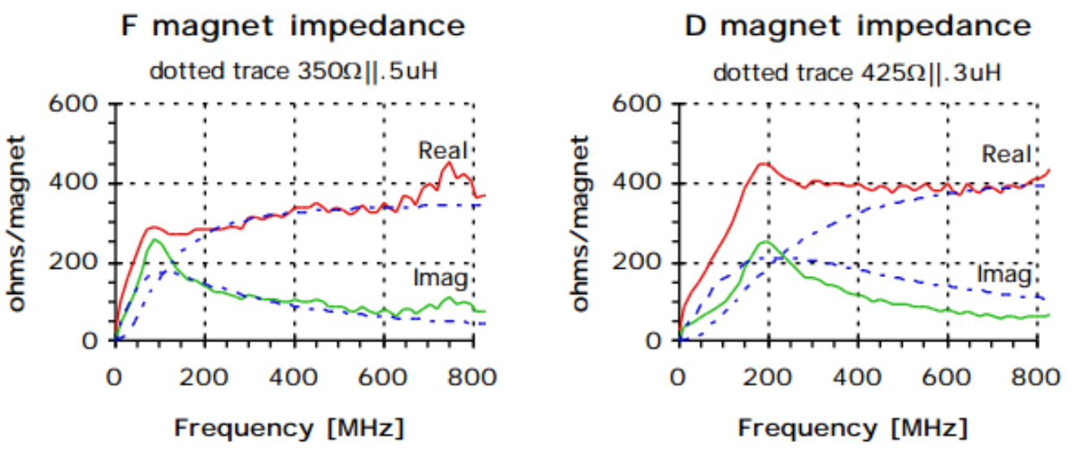
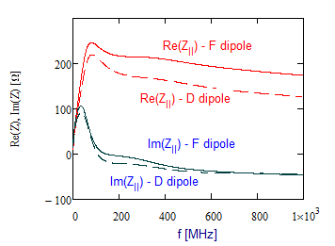
Acceleration: Impedance modeling and simulation (1)
Impedance modeling for the laminated combined function magnet
Calculated impedance for F and D magnets
Measured impedance for F and D magnets
Modified impedance for F and D magnets
based on the measurement
  Theoretical model yields results close to the wire measurements
  Parameters of the impedance model are adjusted to match beam based measurements

Slide 14
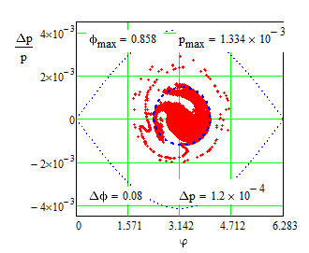
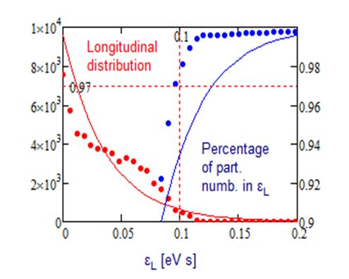
Acceleration: Impedance modeling and simulation (2)
Simulation for the beam acceleration in Booster
Longitudinal emittance at extraction was 0.1 eV∙s with 97% particles
May need
  Q-jump with correction quadrupoles
  Sextupoles to control second order slip-factor
The simulation efforts continue and results will be compared with the measurements

Slide 15
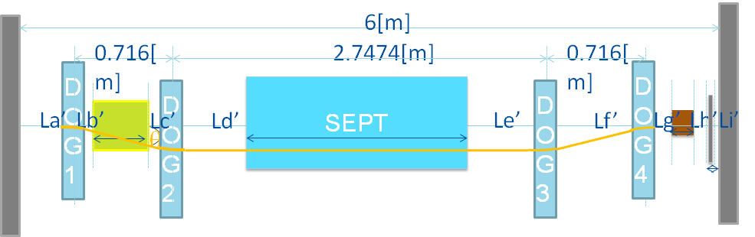
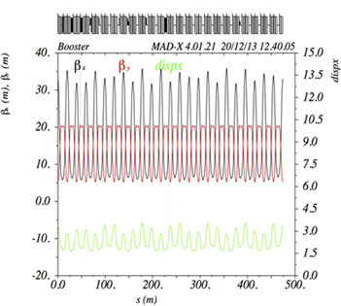
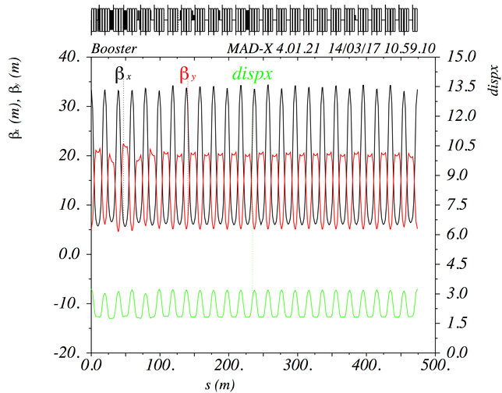
Acceleration: Transverse Beam Emittance (1)
DOGLEG bump at Long3
(To avoid the septum at injection)
Beta beating with DOGLEG
corrected lattice
Beta beating can be corrected with correction quads around the ring.

Slide 16
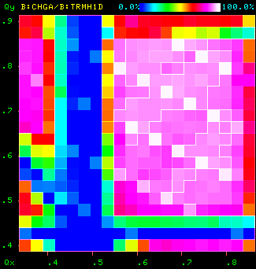
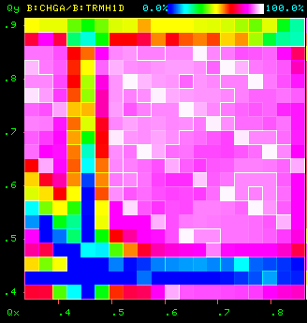
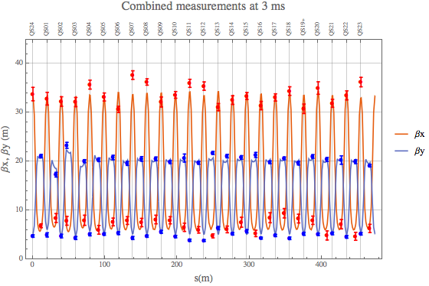


Acceleration: Transverse Beam Emittance (2)
Beta function
Measurements: points
Simulation: solid lines
$$v_{V}$$
Operational lattice
Corrected lattice
0.5
0.5
$$v_{H}$$
0.5
Performing lattice measurements and comparing with the model on MADX
Improving beam envelope periodicity at injection and reduce transverse emittance

Slide 17
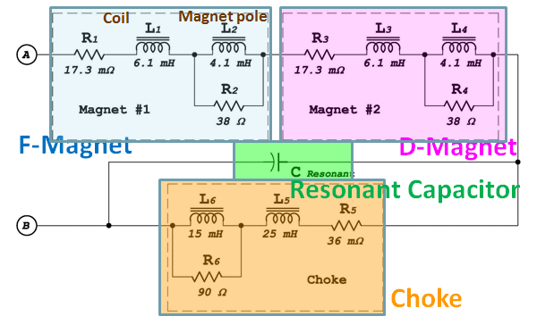
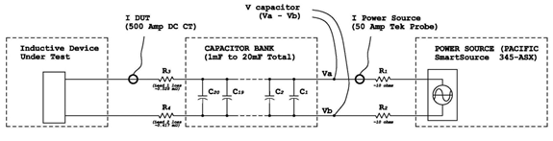
20Hz Operation:
Magnet Power Supply Loss Measurements(1)
F-Magnet
D-Magnet
Resonant Capacitor
Choke
I
V
11/9/2015

Slide 18
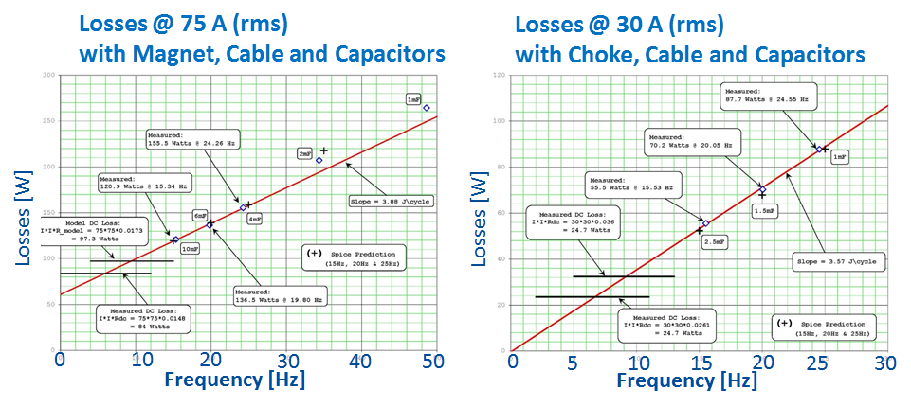
20Hz Operation:
Magnet Power Supply Loss Measurements(2)
Require about 3.9% more power.
Resonant capacitor at each “Girder” must decrease from ~8.33 mF to 4.69 mF.
Capacitor voltage will increase by about 32%
RMS current per µF will also increase as well.
Require same measurements at high current ~500A(rms)

Slide 19
Conclusion
We have solid conceptual design for Booster operations under PIP II.
Presently, beam studies and upgrades are progressing under the PIP project. The work has resulted in significant improvement in particle flux.
These efforts directly impact PIP II plans and will help clarify additional work/studies as we transition from PIP to PIP II.
We will continue to identify issues and test solutions at PIP II intensities as operational limits allow.

