Slide 1
Design of SC Cryomodules
Vincent Roger
PIP-II Machine Advisory Committee Meeting
10 April 2017

Slide 2
Outline
Introduction
Design strategy
Cryomodule design - PIP II
Definition of the way to support the cavities
P&I Diagram
Pipe sizing
Vibration
Assembly process
Cryomodule status - PIP II
Summary

Slide 3
1. Introduction
In addition to the HWR cryomodule, 4 SC cryomodules need to be designed at 325 MHz and 650 MHz to complete the Proton Improvement Plan-II (PIP-II) at Fermilab.
HWR Cryomodule
SSR1 Cryomodule
SSR2 Cryomodule
LB650 Cryomodule
HB650 Cryomodule

Slide 4
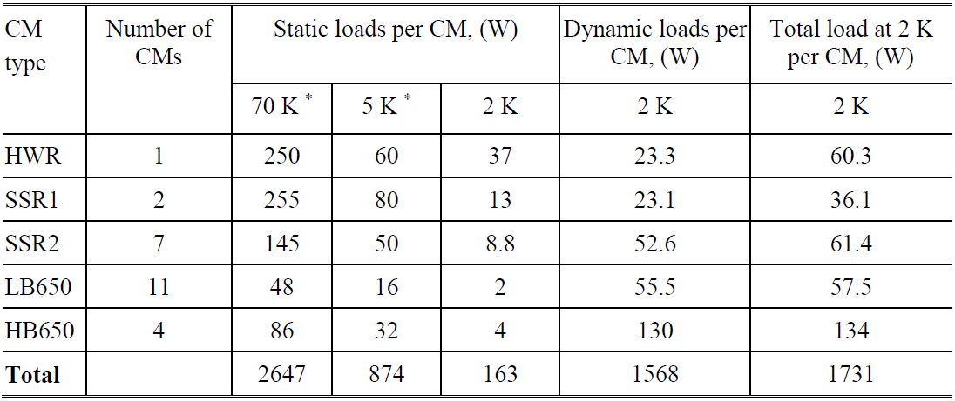
1. Introduction
General parameters of SC cryomodules
Cryogenic loads in SC cryomodules for operation in the CW regime

Slide 5
2. Design strategy
Define the way to support the string assembly
Alignment
Tooling
Design of the string assembly
Cavity spacing
Length of the cryomodule
Write down the P&I Diagram of the cryomodule
Estimation of the heat-loads
1 or 2 thermal shields
Exchanger inside or outside the cryomodule
Calculate the needed diameter for each cryogenic lines
Relief valve calculation and code compliance
Small df/dP
Design the cold-mass around the string assembly
Design of the vacuum vessel with the interfaces
Design tooling

Slide 6
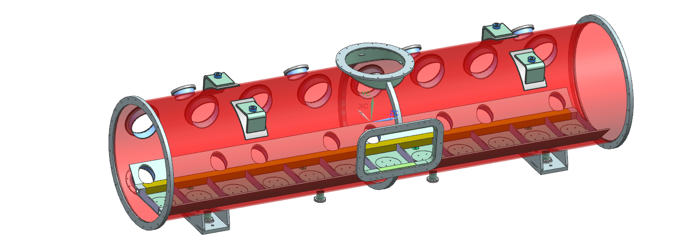
3. Cryomodule design - PIP II
3.1 Definition of the way to support the cavities
Choice: A strong-back at room temperature supporting the cavities
The alignment of the cavities will be done on the strong-back outside the vacuum vessel. To keep the alignment, the strong-back needs to be supported in the exact same way when it will be inside the vessel.

Slide 7
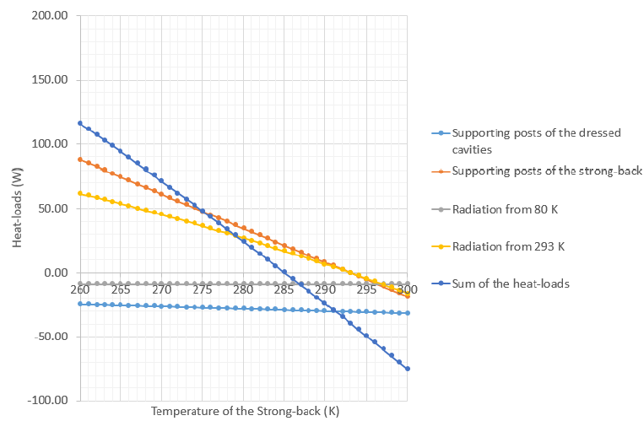
3. Cryomodule design - PIP II
3.1 Definition of the way to support the cavities
The strong-back at room temperature will support the cold-mass. To validate this strategy, thermal analysis have been in order to be sure that the temperature of the strong-back will not change significantly during the operation.
For SSR1, a strong-back temperature of 285K has been estimated during the operation.

Slide 8
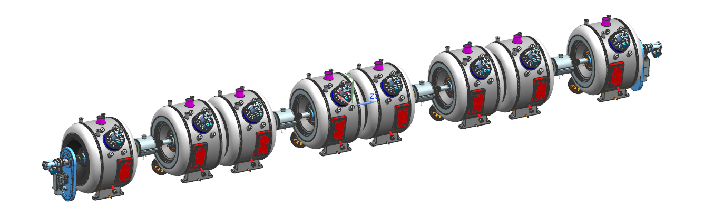
3. Cryomodule design - PIP II
3.2 Design of string assembly
The displacement during the cool down need to be estimated.
The bellows need to be calculated (allowable displacement & forces applied).
All the assembly process and tooling need to be developed “particle-free”.
HB650
string assembly
SSR1
string assembly

Slide 9
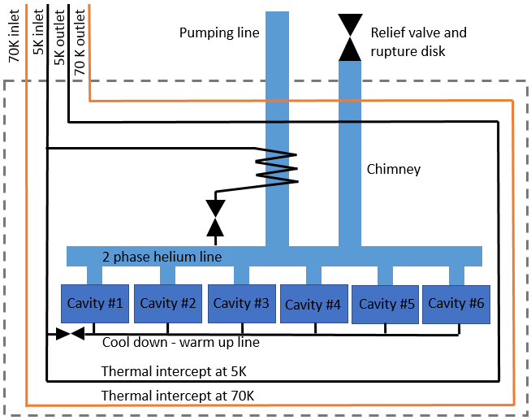
3. Cryomodule design - PIP II
3.3 P&I Diagram
SSR1, SSR2, LB650 and HB650 cryomodules share a similar P&I Diagram according to the number of cavities and solenoids.
One single thermal shield
An exchanger inside the cryomodule
A 2 phase helium pipe sized in order to get a small df/dp
A cool-down warm up line sized to reduce the transition time (resistive / supra)

Slide 10
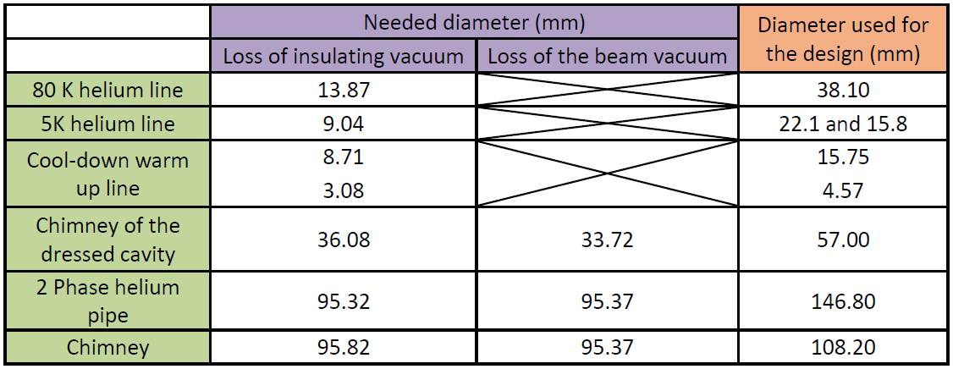
3. Cryomodule design - PIP II
3.4 Pipe sizing
All the lines meet the requirements according to the pressure relief consideration. The diameter of the two phase helium pipe has been oversized on purpose to order to help during the operation and reduce df/dp.
Pipe sizing - SSR1

Slide 11
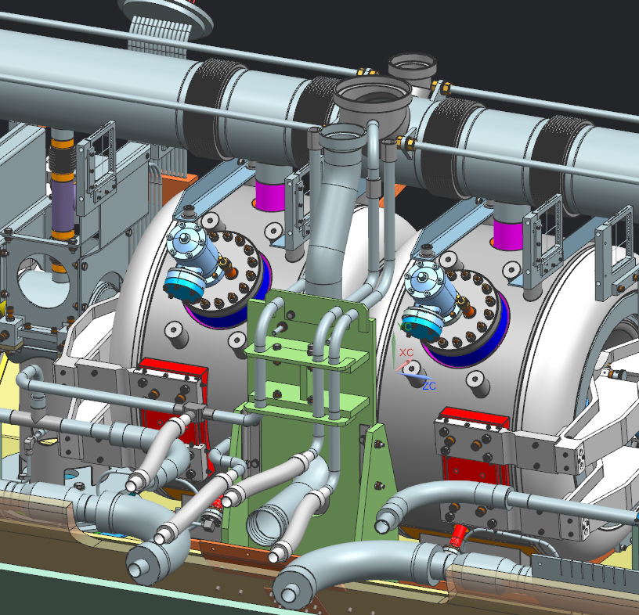
3. Cryomodule design - PIP II
3.5 Vibration
Take advantage of LCLS II experience.
Helium lines have been design in order to reduce the movement and vibration on the 2 phase helium pipe.
Investigation on LCLS II cryomodule are still on progress in order to reduce vibration and optimize the cryogenic process.
Based on these results some design modifications will be done on the side opening of the PIP II cryomodules.

Slide 12
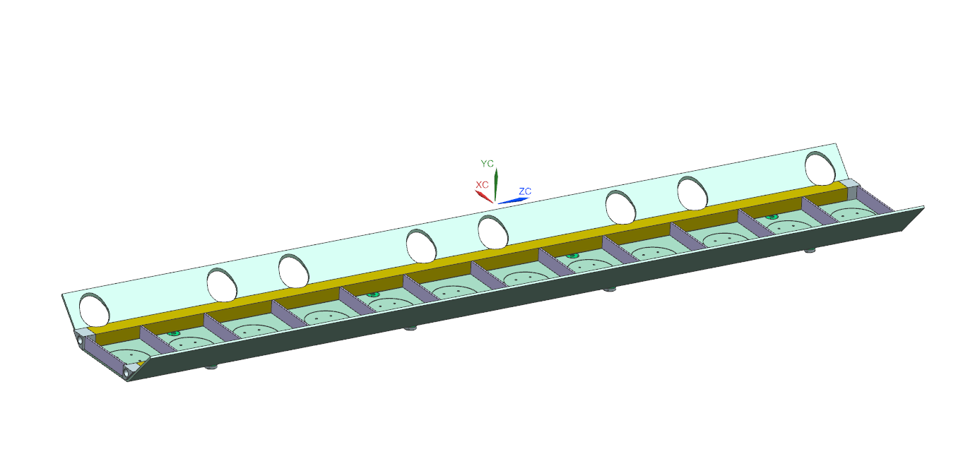
3. Cryomodule design - PIP II
3.6 Assembly process - SSR1 cryomodule
First the string assembly will be assembled inside the clean-room.
Then, the cold-mass starting with the strong-back will be assembled outside.

Slide 13
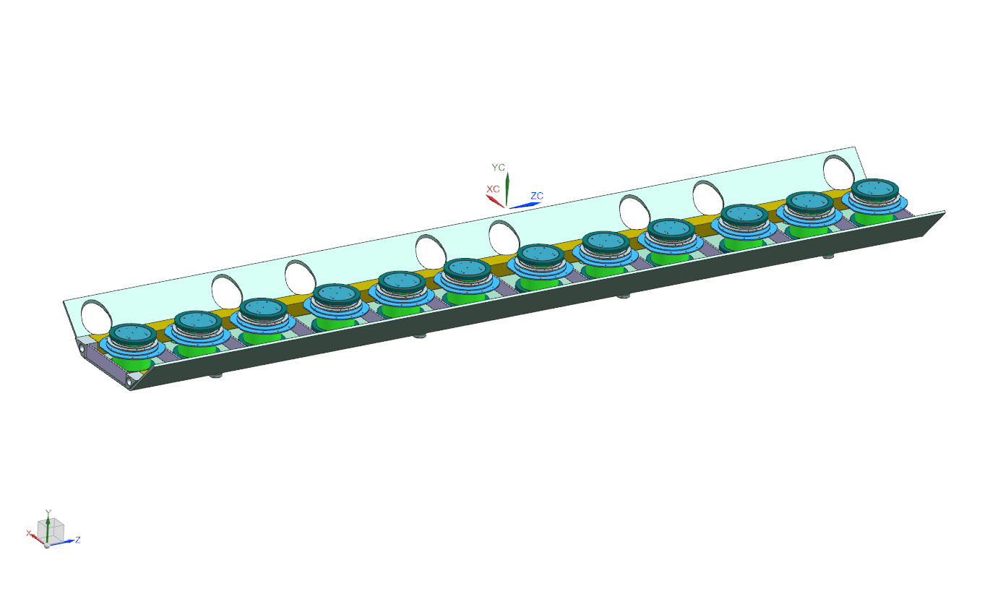
3. Cryomodule design - PIP II
3.6 Assembly process - SSR1 cryomodule
The G10 support posts will isolate the strong back at room temperature from the components at cold temperature.

Slide 14
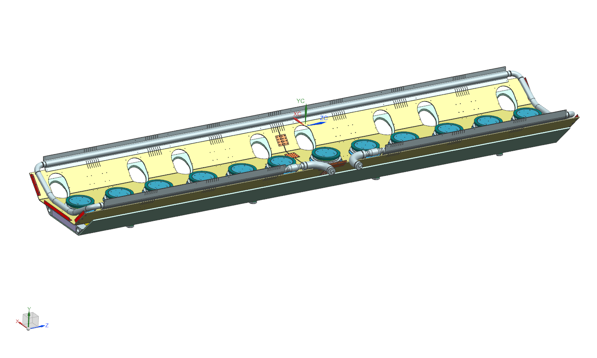
3. Cryomodule design - PIP II
3.6 Assembly process - SSR1 cryomodule
The bottom part of the thermal shield will be set up on the G10 support posts.

Slide 15
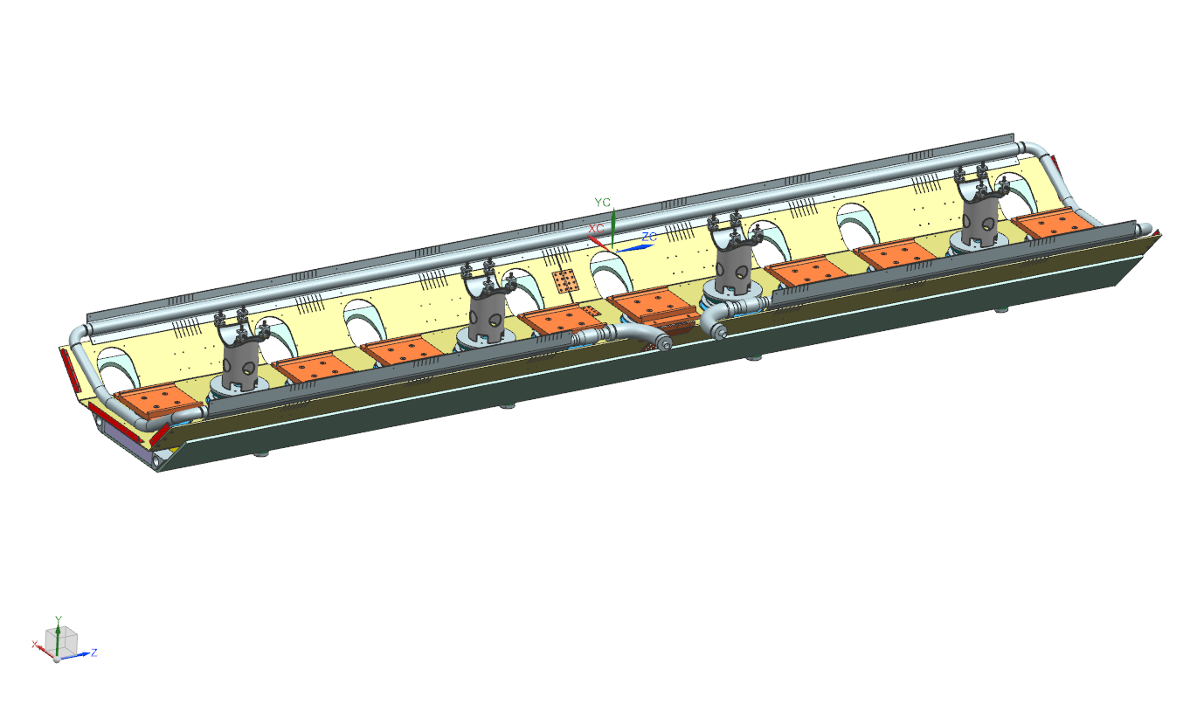
3. Cryomodule design - PIP II
3.6 Assembly process - SSR1 cryomodule
The support posts of the cavities and solenoids will be installed on the G10 posts.

Slide 16
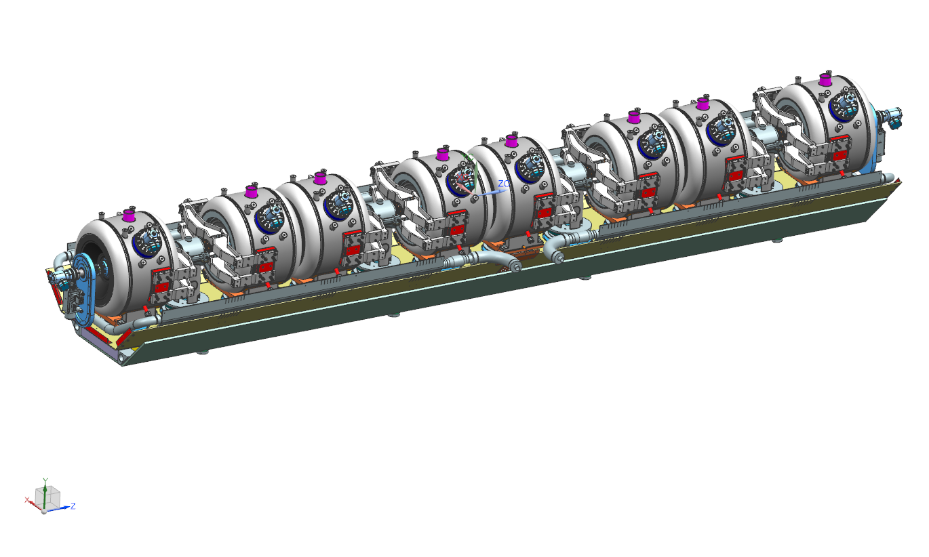
3. Cryomodule design - PIP II
3.6 Assembly process - SSR1 cryomodule
With a supporting fixture, the assembly string will be put in place on its posts.

Slide 17
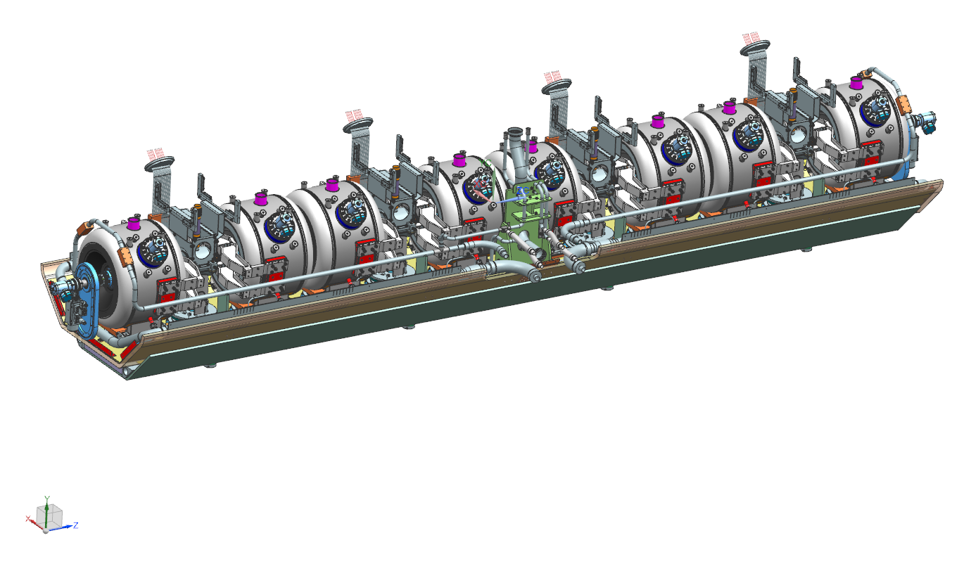
3. Cryomodule design - PIP II
3.6 Assembly process - SSR1 cryomodule
The current leads of the solenoids will be set up.

Slide 18
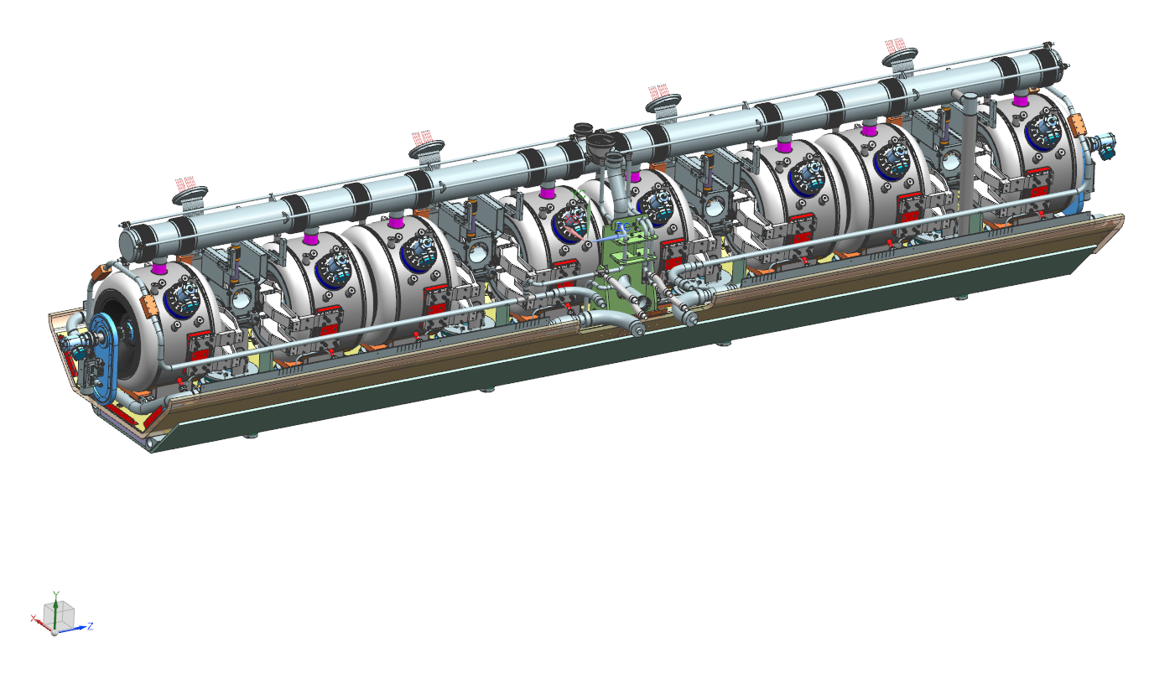
3. Cryomodule design - PIP II
3.6 Assembly process - SSR1 cryomodule
The two phase helium pipe will be welded on the top of the cavities and solenoids.

Slide 19
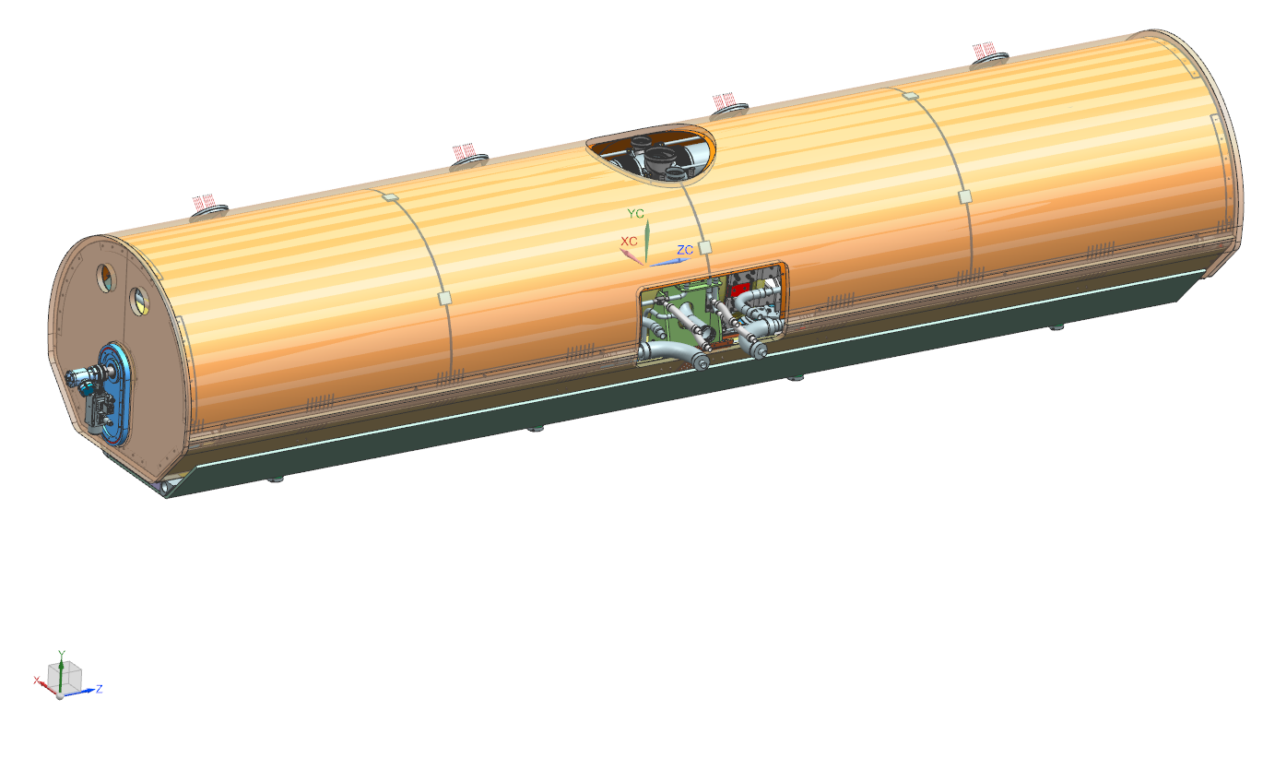
3. Cryomodule design - PIP II
3.6 Assembly process - SSR1 cryomodule
Finally the top part of thermal shield with MLI all around will be placed all around the cold-mass.

Slide 20
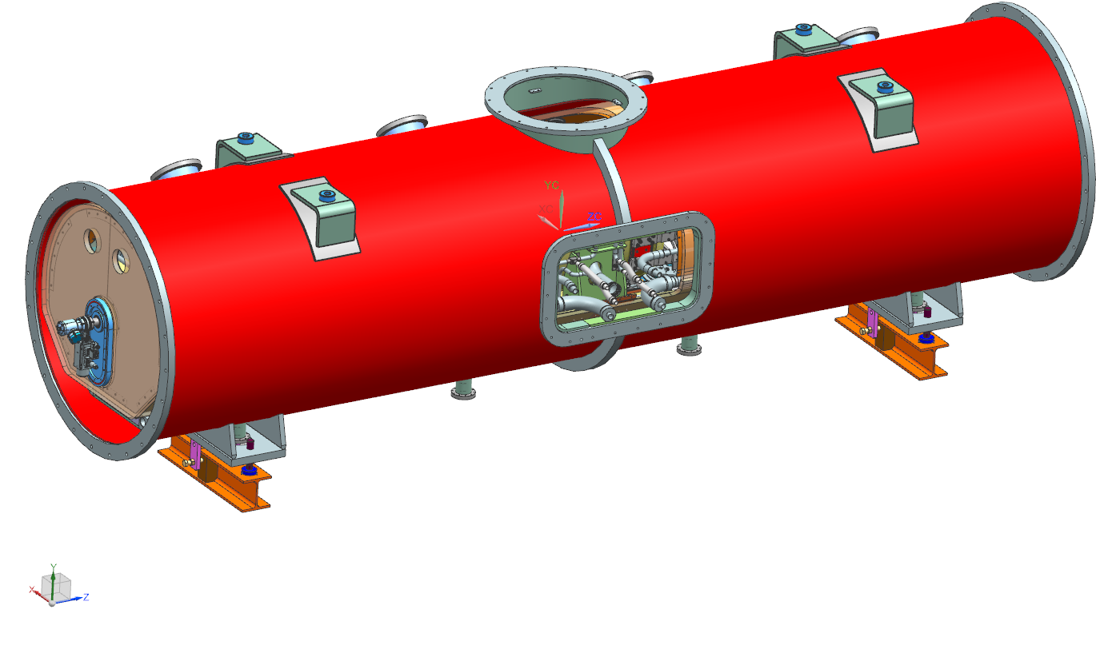
3. Cryomodule design - PIP II
3.6 Assembly process - SSR1 cryomodule
Then, the cold-mass will be inserted inside the vacuum vessel.
For this dedicated tooling will be designed.

Slide 21
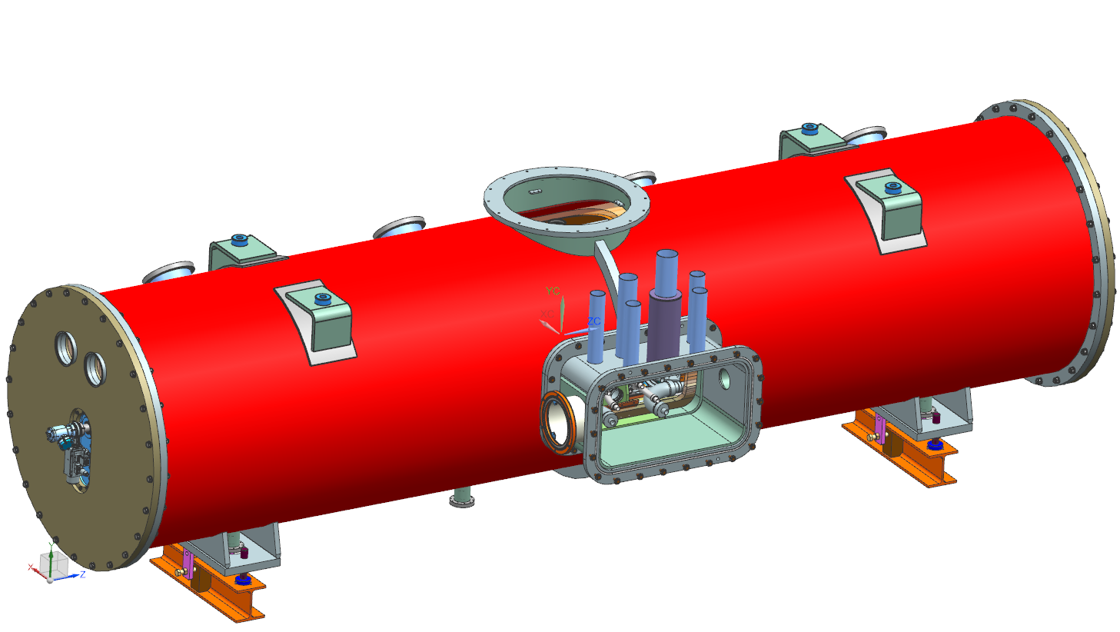
3. Cryomodule design - PIP II
3.6 Assembly process - SSR1 cryomodule
The vacuum vessel will be close and side opening will be set up.
For this dedicated tooling will be designed.

Slide 22
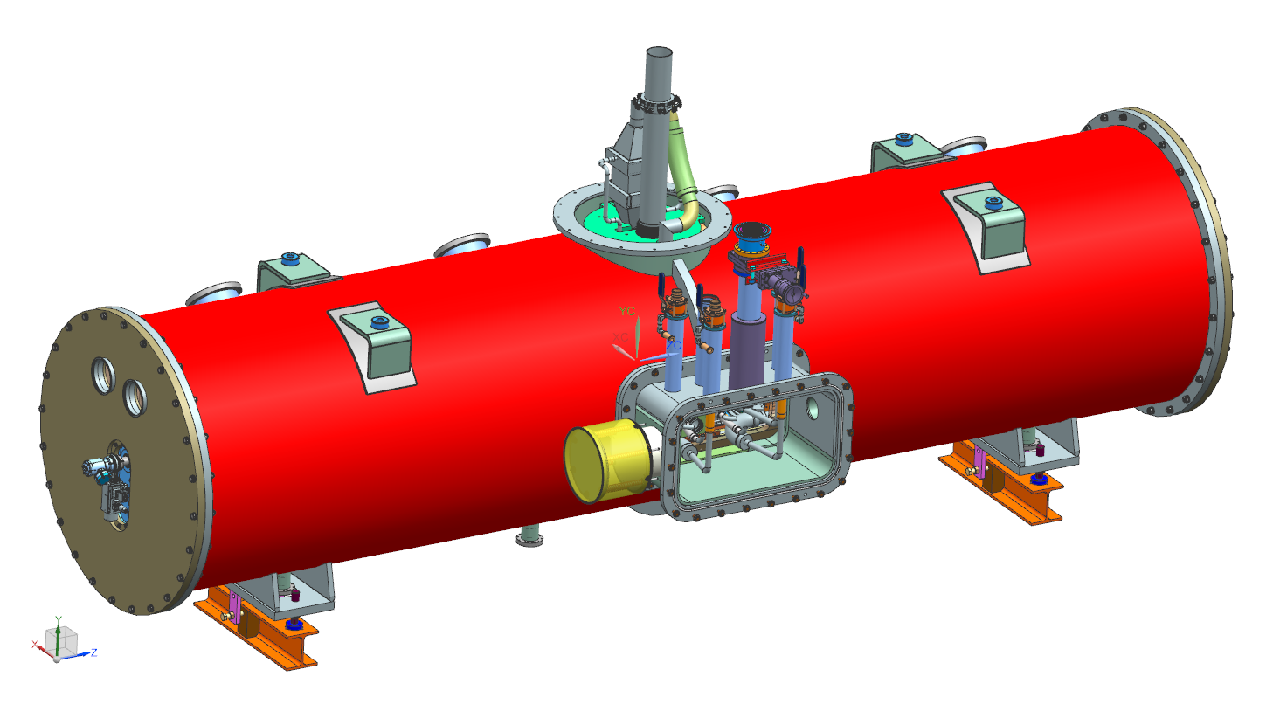
3. Cryomodule design - PIP II
3.6 Assembly process - SSR1 cryomodule
Cryogenic lines will be welded to the valves, bayonets, exchanger and chimney.

Slide 23
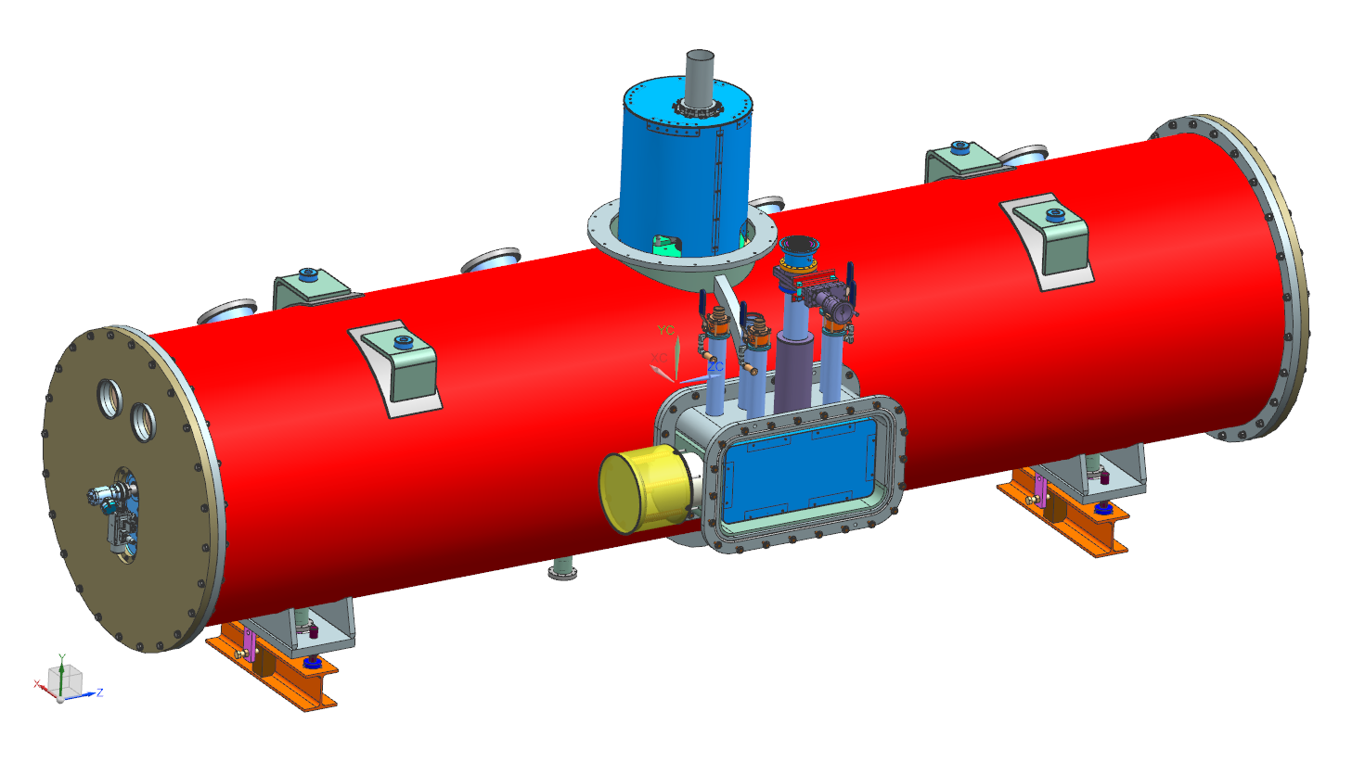
3. Cryomodule design - PIP II
3.6 Assembly process - SSR1 cryomodule
The thermal shield will be set on the top and side openings.

Slide 24
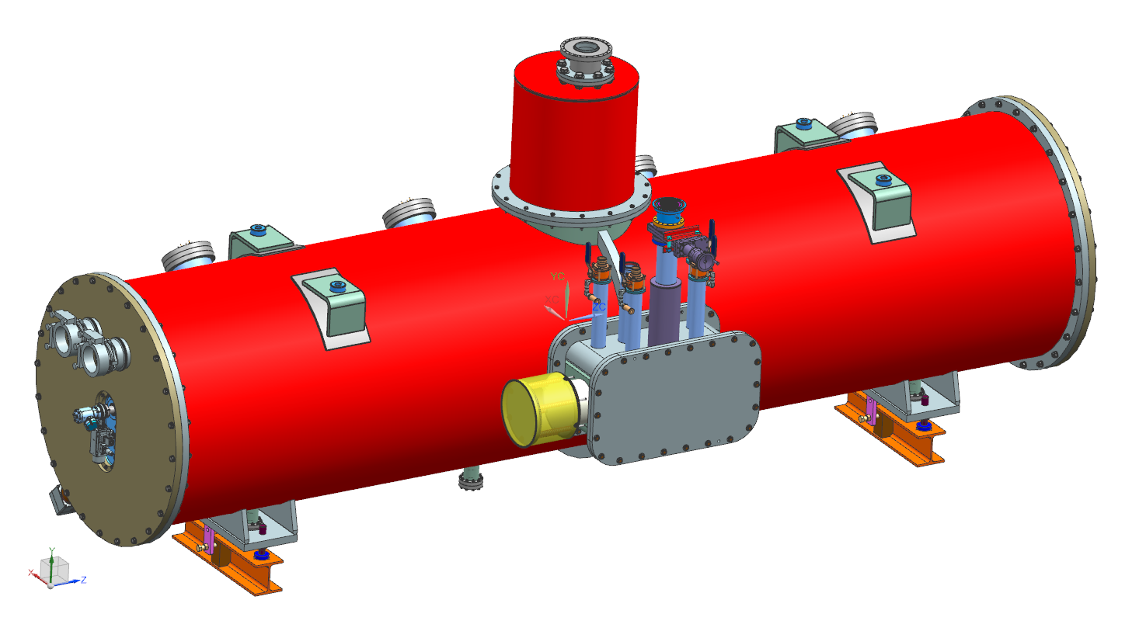
3. Cryomodule design - PIP II
3.6 Assembly process - SSR1 cryomodule

Slide 25
4. Cryomodule status - PIP II
4.1 SSR1 Cryomodule
The cold-mass review is expected by June 2017. Work packages and lead engineers are clearly identified to complete this cryomodule.
SSR1 string assembly
Final design: 100% completed
Procurement: 100% completed
Assembly completed by 1st half 2018
SSR1 cryomodule - Top assembly
Conceptual design: completed
Final design: ~90% completed
First CM delivered by 1st half 2019
4.2 SSR2 Cryomodule
The design of SSR2 Cryomodule didn’t start, but it should be similar to SSR1 cryomodule. CM delivery is expected by 2023.
Notes:
The vessel extension is 30” long
The extension of the thermal shield is cooled with new 80K lines
2 support posts will be used to support HB650 cavity
The 2 phase helium line has been modify to fit HB650 cavity

Slide 26
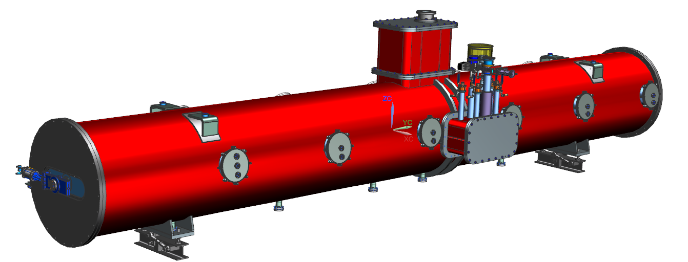
4. Cryomodule status - PIP II
4.3 HB650 Cryomodule
The preliminary design is done. The strategy is now, first, to have the review of SSR1 cold-mass before completing HB650 cryomodule.
First CM delivered by 1st half 2021
4.4 LB650 Cryomodule
The design of the LB650 CM will be similar to the HB650 CM. RRCAT is in charge of the design.
First CM delivered by 2nd half 2022
Notes:
The vessel extension is 30” long
The extension of the thermal shield is cooled with new 80K lines
2 support posts will be used to support HB650 cavity
The 2 phase helium line has been modify to fit HB650 cavity

Slide 27
5. Summary
A common design strategy has been defined for SSR1, SSR2, LB650 and HB650 cryomodules.
The design of the SSR1 Cryomodule is advanced and this experience will be used to complete the design of the other cryomodules.
The technical team is formed by engineers, scientists and technicians with previous experience in SRF. Work packages and lead engineers are clearly identified.
To respect the planning of these CM, particular attention need to be taken considering cavity, tuner, and coupler manufacturing and the availability of the test station to qualify these elements.
Notes:
The vessel extension is 30” long
The extension of the thermal shield is cooled with new 80K lines
2 support posts will be used to support HB650 cavity
The 2 phase helium line has been modify to fit HB650 cavity

