Slide 1
Orbit and Optics Measurement and Correction
Vyaghri L S Sista
PIP-II Machine Advisory Committee
10-12 April, 2017

Slide 2
Outline
Orbit and optics measurements: goals and requirements
Focusing and Instrumentation in SC Linac
Orbit and optics measurement and correction
Summary

Slide 3
Orbit and Optics Measurements: Goals and Requirements
Reliable and low loss machine operation requires optimal beam steering and optimal beam envelope matching
Accurate optics model is required to support both objectives
The model will be based on the beam-based measurements and will be built with off-line analysis.
This model will be used for both the beam steering and the on-line calculation of the beam focusing settings
The latter is required for machine retuning in the case of hardware problems (loss of cavity or a limitation on its accelerating gradient)
Optics measurements will be based on the differential orbits measurements (i.e. orbit response) and will be supplemented by the beam profile measurements
Differential orbit measurement measure properties of lattice focusing. They are not sensitive to the beam space charge which plays very significant role in the beam focusing
Beam profile dynamics is affected by the space charge

Slide 4
Orbit and Optics Measurements (continue)
Differential orbit measurements use ~130 BPMs
69 in the Linac, 57 in the transport line
Matching of beam envelopes done with profile measurements
20 profile monitors (6 - MEBT, 10 - SC Linac, 4 - transport line)
Profile monitors have to be capable to measure bunch sizes in all 3 dimensions
Automation of optics measurements and analysis greatly simplify and accelerate this work
Profile monitors are not effective in x-y coupling measurements
Coupling will be measured with differential orbits
Requirements to accuracy of BPM measurements
In normal operation (CW & pulsed) ≤ 0.5 mm (absolute)
Quad centering can help with calibration
Solenoid centering cannot
In optics measurements the relative BPM accuracy ≤30 μm and the differential non-linearity less ~1% for Δr≤5 mm

Slide 5
Focusing in the SC Linac
SC Solenoids are used for focusing in the LEBT and the first three SC sections (HWR, SSR1 and SSR2)
Solenoids rotate the plane of betatron oscillations => X-Y coupling
Quadrupole doublets and triplets are used in the rest of the machine
SC cavities have considerable transverse defocusing depending on their accelerating phases
X-Y coupling is corrected by skew-quads in SSR1&2 and at the linac end
Longitudinal focusing is supported by off-crest beam acceleration
Each focusing element (solenoid, doublet, or triplet) has nearby 3-plane BPM (x,y, arrival time)

Slide 6
FRS for Alignment of Focusing Elements and Corrector Strengths
 | HWR | SSR1 | SSR2
Alignment (rms, um) | 500 | 500 | 500
Angular Alignment (rms, mrad) | 1 | 0.5 | 0.5
Note that the relative quad location on girders between LB & HB 650 cryomodules should be set with accuracy better than 150 um rms
Strengths of dipole correctors are determined by expected accuracy of misalignment and requirements of optics measurements

Slide 7
Orbit Correction
Automatic orbit correction will use an optics model built on the base of beam measurements
Greatly accelerates convergence
Orbit correction application has to be developed.
There is a number of well developed algorithms
The choice of algorithm will be done later
It will be based on reliability, convergence speed and will take into account Fermilab specific limitations
A prototype software will be built for PIP2IT
Java platform looks as most appropriate for development of this software
It is well supported in Fermilab AD

Slide 8
Differential Orbit Measurements
Java based application has been developed for Differential orbit measurements in PIP2IT
Its functionality is determined by configuration files
Software has a few preset measurements (normally corresponding to a measurement in a transfer line, like LEBT, MEBT, SC linac …)
Additional measurement(s) can be added at any time
Response & delay times are incorporated in the configuration file
Sequence of measurements
Acquire the Reference Orbit
Change the first actuator, acquire data and return actuator back
Repeat measurements for other 5 actuators (2 for each plane)
Acquire the reference orbit again
Compute results and save data
Data are written in a format compatible with reading to OptiM
GUI allows easy control of data quality
OptiM will be used for data off-line analysis

Slide 9
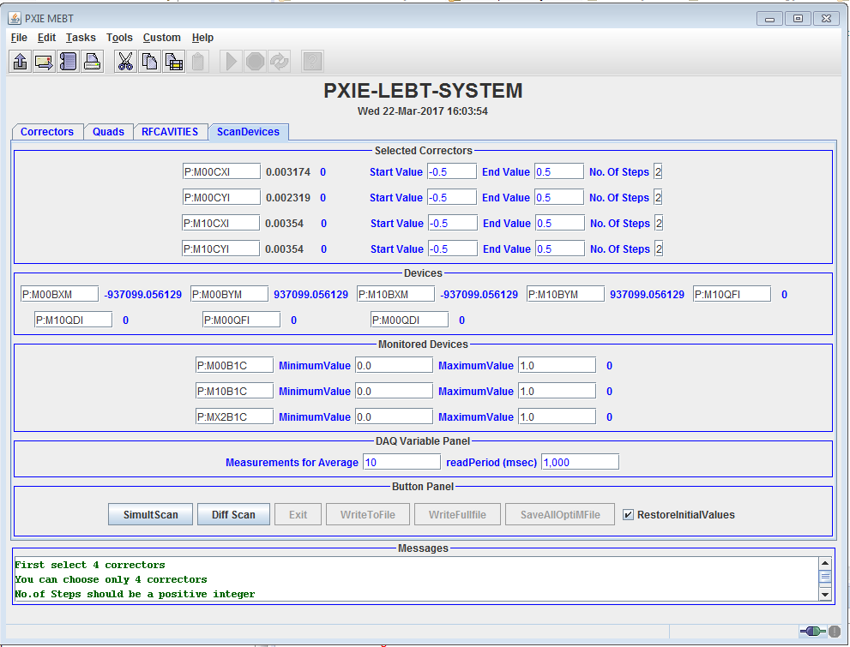
Typical screen shot of Java applications:

Slide 10
Summary
The goal of optics measurements is to develop a reliable optics model of the Linac
Software for orbit and optics measurements and correction will be tested at PIP2IT
A prototype of optics measurement software was already used in PIP2IT optics measurements
Orbit correction will follow
It is not required now and in near future => low priority
TraceWin and OptiM will be the main tools for optics calculations and data analyses
OptiM was initially written for Windows. Recently it was ported to other major platforms (Linux, Apple …)

