Slide 1
Recycler/Main Injector Upgrades
Ioanis Kourbanis
PIP-II MAC
10 April 2017

Slide 2
Outline
MI/RR in PIP II.
Slip stacking
MI RF Upgrades.
RR Cavities
MI Transition Crossing
Loss Control
Electron Cloud
Conclusions.

Slide 3
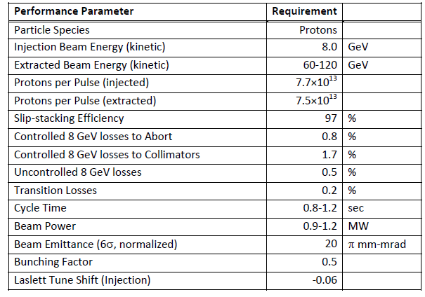
MI/RR Performance Requirements
Slip stack and accelerate 50% more intensity.
Run MI at lower energies.

Slide 4
MI/RR Accelerator Issues
Can we slip stack and accelerate 50% more intensity.
Power loss from slip stacking (8 GeV)
RF Power (Acceleration)
Running Recycler 53 MHz Cavities CW (Running at 60 GeV)
Transition crossing.
Electron cloud.
Beam loss control/mitigation.

Slide 5
Slip Stacking in the Recycler
We need to maintain the same power loss from slip stacking with 50% more intensity per bunch (120 GeV operation).
Increase slip stacking efficiency from 95% to 97%.
Limits on longitudinal emittance and bunch height from Booster beam are not much different than the NOvA ones due to the higher frequency separation and RF voltage.
For MI operation at energies lower than 120 GeV the power loss will increase up to 50% in both MI and RR.
Have no un-controlled losses (Collimators).
Collimators should be able to handle the extra loss.

Slide 6
Injected beam requirements for 97% efficiency.
97% of particles inside 0.1 eV-sec matched to 140 KV Recycler Bucket
8.0 MeV
4.2 nsec
Particles on initial matching contours in an 140KV bucket after 300 msec of slip stacking with 1,680 Hz separation.

Slide 7
Recycler Operation Update
Recycler Collimators were installed during the summer shutdown and are now operational.
New Recycler “frequency” Damper was commissioned allowing us to damp the resistive wall instability during slip stacking.
Maintaining low chromaticity through slip stacking.
Have demonstrated ~720 KW to the NuMI target.
We are currently consistently at 650 KW with SY120.
Record hourly power with SY120 is 694 KW corresponding to equivalent beam power of 763 KW.

Slide 8
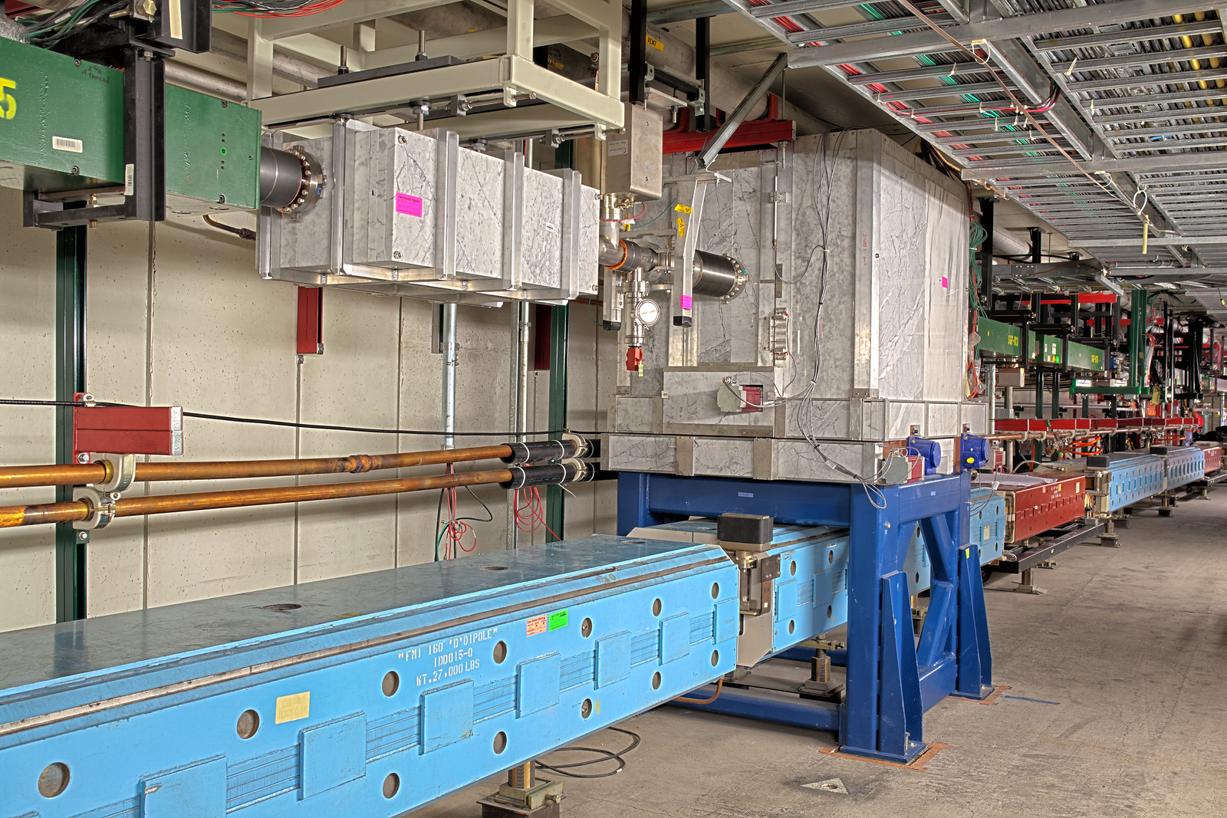
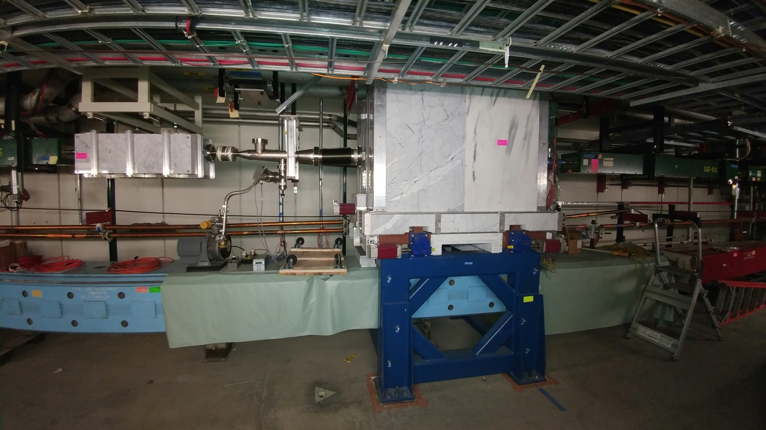
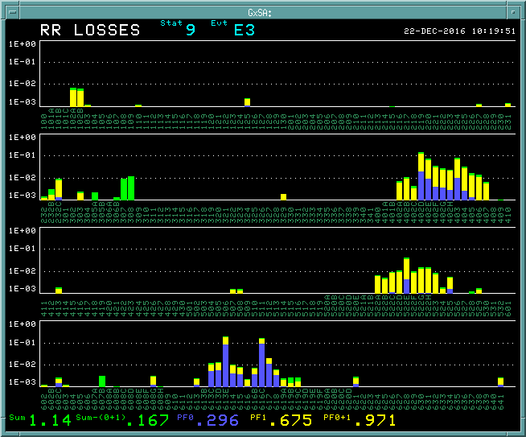
Effect of Recycler Collimators on Losses
Abort
Collimators
Collimators eliminated the Ring losses in all the vertical locations.
No effect on the losses on horizontal locations.

Slide 9
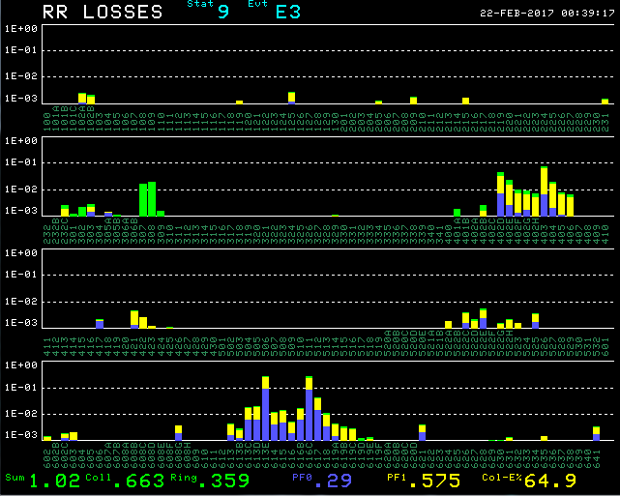
Effect of the “frequency” damper on losses
Abort
Collimators
We are now able to run with constant low chromaticity during slip stacking.

Slide 10
MI Beam Power since Nov. 20th 2016
NEW DAMPER
NO SY120
NPWR1H Average power for 1 Hr.
PWR2A Average Power per supercycle(60 sec).
636KW to NuMI target with SY120 is equivalent to 700KW with NuMI only.

Slide 11
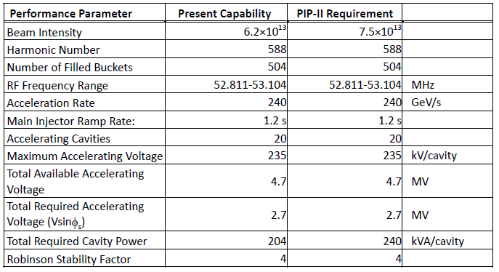
Present and Required MI RF Capabilities
*
* Maximum Beam Intensity capable with current RF system. It is 27% higher than the required Beam Intensity for PIP I (4.9E13).
Present RF System does not have the power to accelerate the PIP-II Beam intensities

Slide 12
MI RF Options for higher power
Operate the current RF cavities with two power tubes instead of one in a push-pull configuration.
Need to double the number of modulators and solid state drivers.
Use a new more powerful power tube (EIMAC 4CW250,000B).
New mounting configuration (much longer tube).
New modulators and upgraded PA cooling.
Test and evaluate both options.
We estimate ~2 years to evaluate both options.

Slide 13
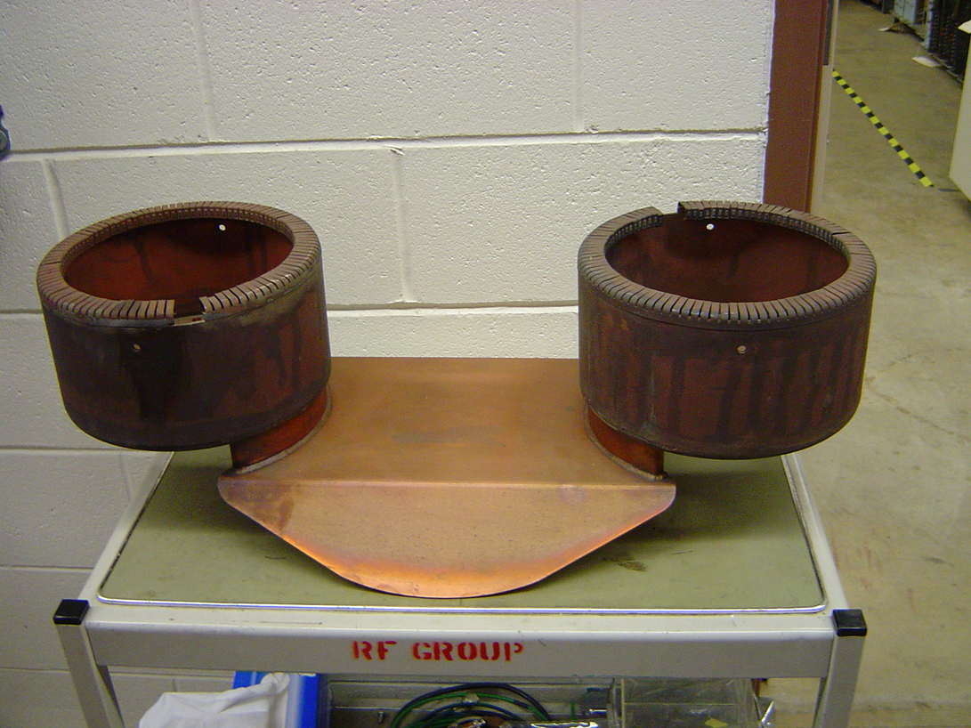
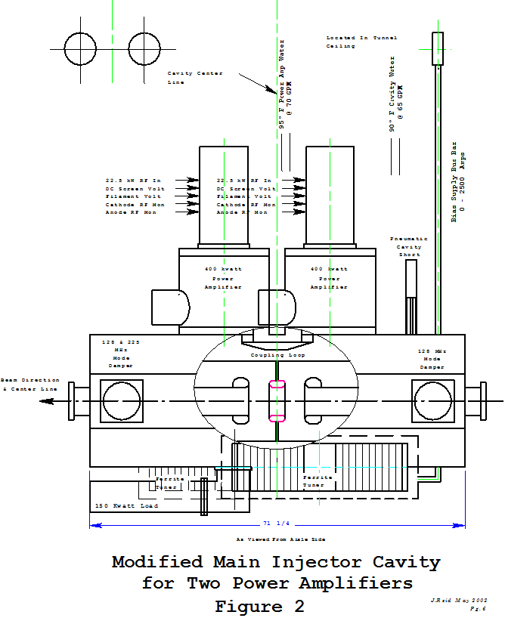
MI RF Power Upgrade (Option 1)
Current MI Cavity
Coupling Loop
Use two PA’s per cavity in a push pull configuration.
We will need to double the modulators and the SS drivers.
We have all the parts needed to test this option on the spare MI cavity.

Slide 14
MI RF Power Upgrade (Option 2)
Use new power amplifier (Eimac 4CW250000B)
Size constraints need to be evaluated (much longer tube).
Will need a new modulator.
Have purchased one tube for evaluation.

Slide 15
New RR RF Cavities
The present Recycler 53 MHz cavities used for slip stacking have a high power dissipation (90 KW, 60% DF) because of the low R/Q (13 Ohms).
Running MI at energies as low as 60 GeV will require the slip stacking cavities to run CW.
Running Booster at 20 Hz will require higher RF voltage (140 KV instead of 80 KV).
We only have space for 3 cavities
Design a cavity with higher R/Q and active beam loading compensation.
Preliminary design exists.
Estimate ~ 2years to finalizing the design and be ready to build a prototype.

Slide 16
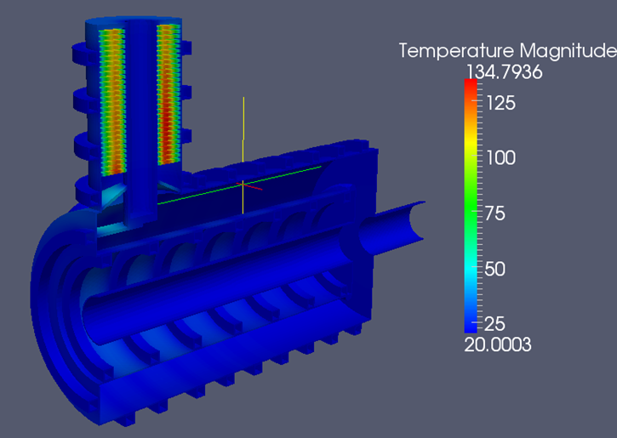
New RR RF cavities
Use the cavity design developed for MI in collaboration with SLAC.
Optimize the design for single frequency and lower voltage.
Investigate different cooling options for tuner.

Slide 17
Transition crossing
A design of a first order gamma-t jump system for the Main Injector was developed as part of the Project X Reference design (2.3 MW operation).
Transition crossing simulations for the PIP II intensities (1.2 MW) and emittances have confirmed that the gamma-t jump system is needed for loss free transition crossing.
Only half of the originally planned gamma-t jump ($±$1/2 unit) will be required.
We plan to revisit the MI transition crossing simulations with the new codes currently under development.
Design and build a gamma-t quadrupole.

Slide 18
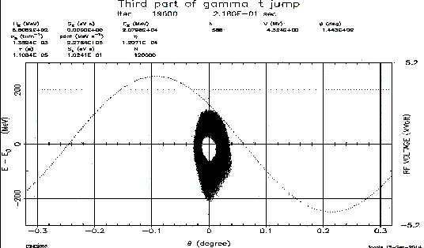
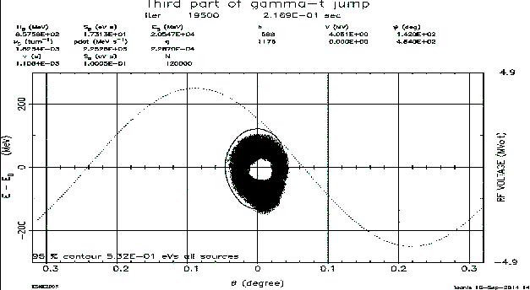
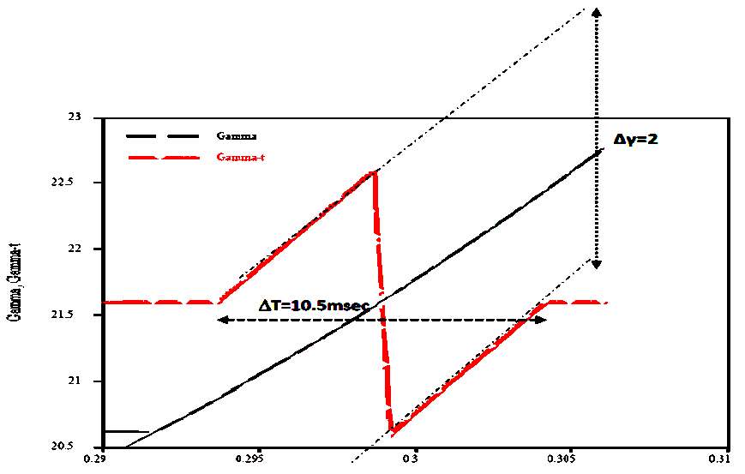
MI Transition Crossing Simulations
Phase space distributions after transition
No Jump
Half Jump
Full Jump

Slide 19
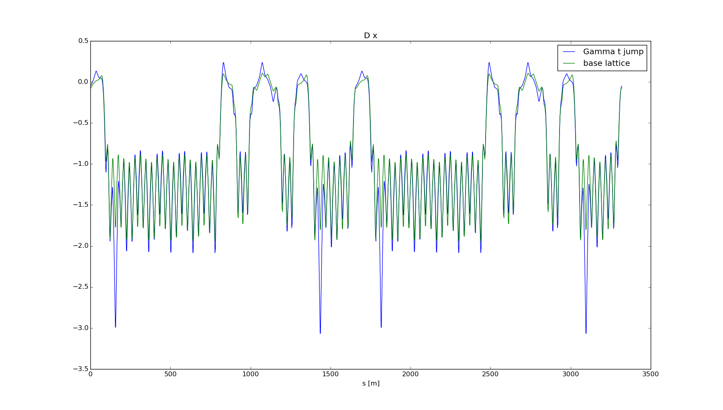
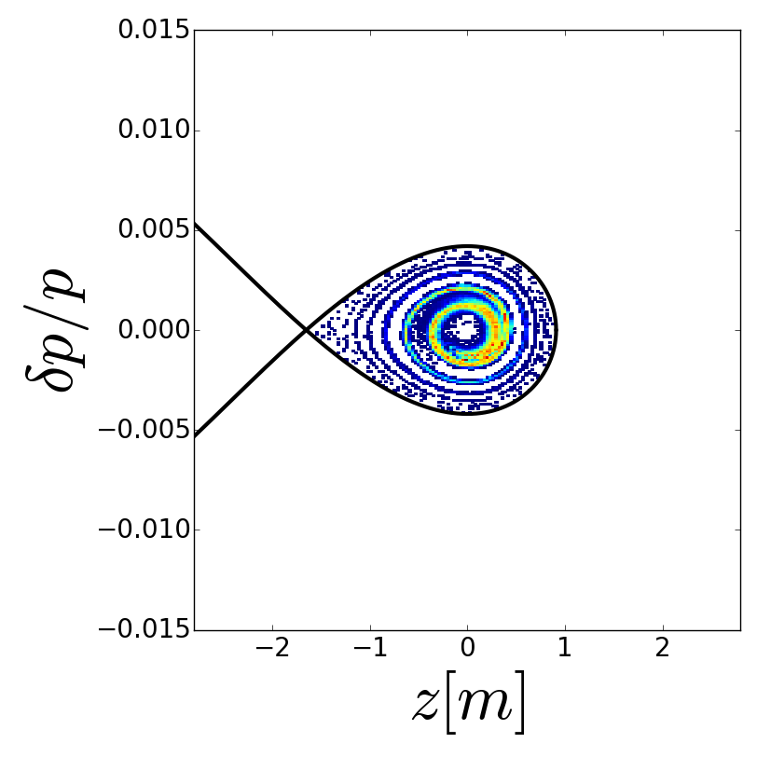
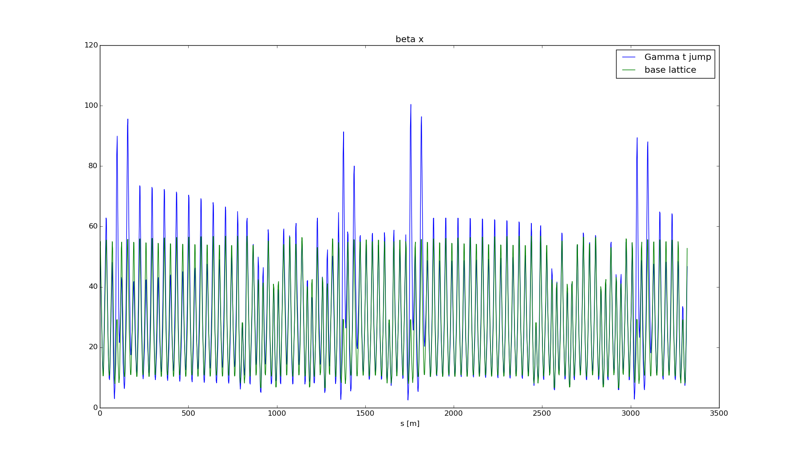
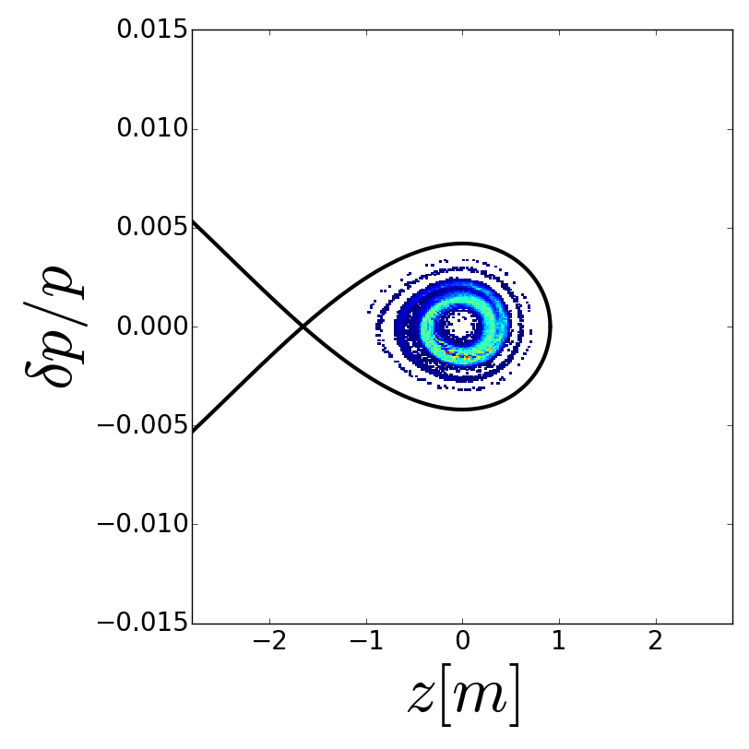
Synergia (3-D) Transition crossing simulations
Lattice Functions
Longitudinal Distributions at 40 GeV
Dispersion
SYNERGIA Simulations
R. Ainsworth et al.
No-Jump
Beta_x
$$±\frac{1}{2}unit jump$$
Beta_y

Slide 20
Loss control
Made great progress in understanding and controlling the losses with the higher intensity beam in MI and Recycler.
In MI the collimators intercept most of the losses.
Recycler collimators are now operational.
New “frequency” damper in the Recycler allows us to operate with low chromaticity during slip stacking.
Currently we are operating at 700 KW.
Realistic simulations(real apertures, magnet multipoles, space charge..) using SYNERGIA are under way.
Comparing slip stacking in PIP II to current operations.

Slide 21
Electron Cloud
Recent measurements in MI indicate that beam scrubbing is quite effective in reducing the SEY of the beam pipe so no electron cloud problems are anticipated.
Beam scrubbing has also been observed in Recycler during slip stacking commissioning.
Electron cloud simulations indicate that a SEY smaller than 1.4 will be sufficient for suppressing the e-cloud in both MI and Recycler.
NO e-cloud instabilities have been observed under normal operations.
We have the capability to coat both the MI and the Recycler beam pipe.
The MI beam coating has to be done in situ.
The Recycler beam pipe can be replaced.

Slide 22
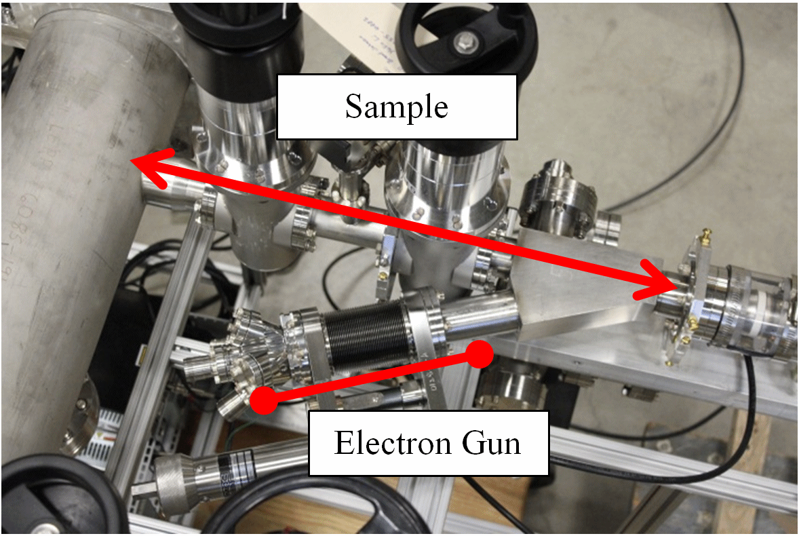
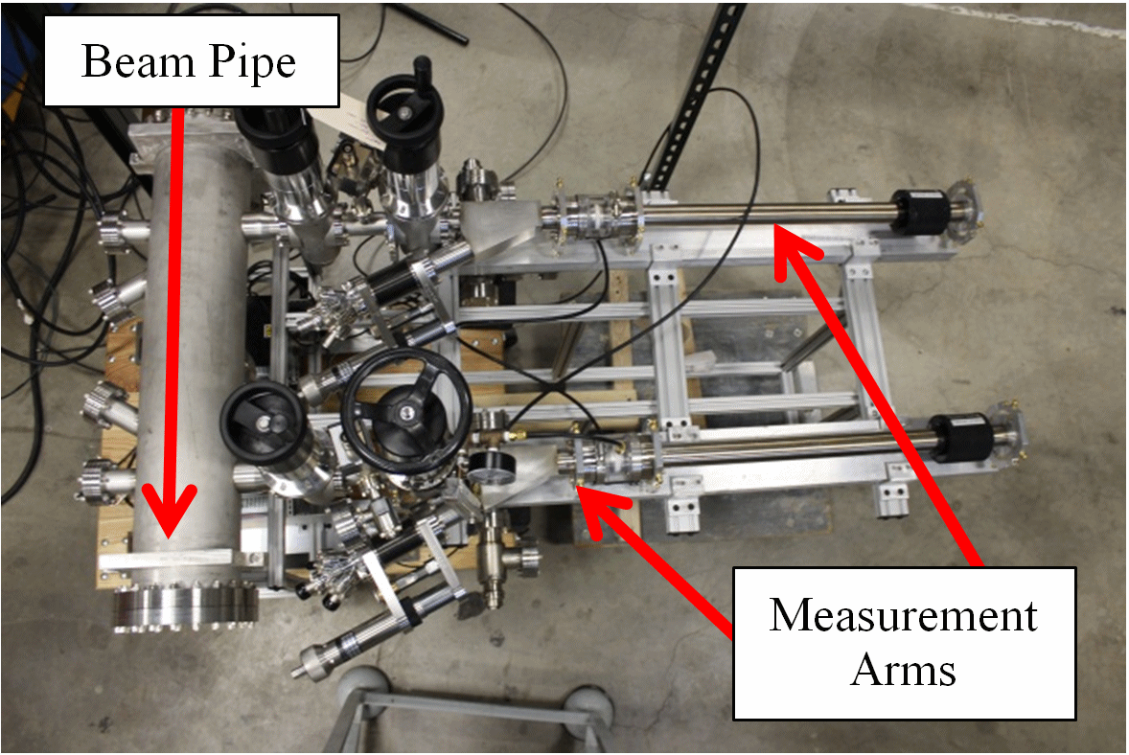
SEY Measurements in MI

Slide 23
Conclusions
We have identified the required MI/RR modifications/upgrades required for running at the PIP-II Intensities.
We have made great progress in controlling the Recycler losses.
Will continue to perform simulations to understand beam dynamics and losses.
We have developed R&D plans for the major MI/RR upgrades required for PIP II.
Verify MI Cavity operation with 2 PAs
Finalize new RR Cavity Design
Build gamma-t quad prototype.

