Slide 1
Low Level RF Control System
Brian Chase
PIP-II Machine Advisory Committee Meeting
10-12 April 2017

Slide 2
Outline
LLRF system overview and requirements
Simulation and Results
Project Status
RF Interlocks Overview

Slide 3
LLRF System Overview

Slide 4
LLRF Scope and requirements
RF field control of all Linac Cavities capable of pulsed and CW operation
  Individual cavities regulated to 0.01%, 0.01 deg. rms
multi-frequency Master Oscillator and Phase Reference lines
Beam Chopper Waveform Generator
  RF locking source for Booster during beam fill
  Timing source
Resonance control hardware

Slide 5
LLRF Systems needed to meet R&D Goals
325 MHz Horizontal test stand
  Support for CW and pulsed mode (Operational)
650 MHz Horizontal test stands
  Support for CW and pulsed mode operation(To be supplied by India)
PIP2-IT
  Master Oscillator and Phase Reference distribution line
    162.5 MHz & 325 MHz (Operational)
  RFQ – 162.5 MHz (Q4FY15)
    2 RF amplifier system (Operational in pulsed and CW modes)
  Buncher - 3 cavities - 162.5 MHz (1st buncher operational)
  Half Wave Resonators - 8 cavities @162.5 MHz
  SSR1 - 8 cavities @ 325 MHz
  Kicker waveform generator

Slide 6
LLRF System Approach
# 4 Cavity
LLRF Stations
1
1
2
4
9
15
• LLRF hardware is compatible for all frequencies and is repeated in racks controlling four cavities
• Each cavity frequency has its own phase reference and LO
• All systems have a common IF (20 MHz)
• Low noise and crosstalk, high linearity

Slide 7
Synergy Between LLRF DOE Projects at FNAL
 | RF Converters | Digital controller | Algorithms FW/SW | Phase Reference Line | Resonance Control
NML-ILC | FNAL v1,v2 | FNAL MFC | FNAL v1 | FNAL v1 | Development
PIP2 IT HTS | v3 | SOC-MFC | FNAL ongoing | in development
CMTS-1 | v3 | SOC-MFC | FNAL ongoing | simplified
LCLS-II 1.3 GHz | FNAL v4 | LBNL | LBNL | SLAC/FNAL | JLAB/FNAL
PIP2 IIFC HTS1, HTS2 | v5 | SOC and LCLS-II | Based on FNAL and LCLS-II | New design based off of NML | Based on our LCLS-II work
Mu2e G-2 |  | SOC-MFC

Slide 8
PIP2-IT RF Stations Diagram

Slide 9
Basic LLRF Station Diagram for 4 cavities

Slide 10
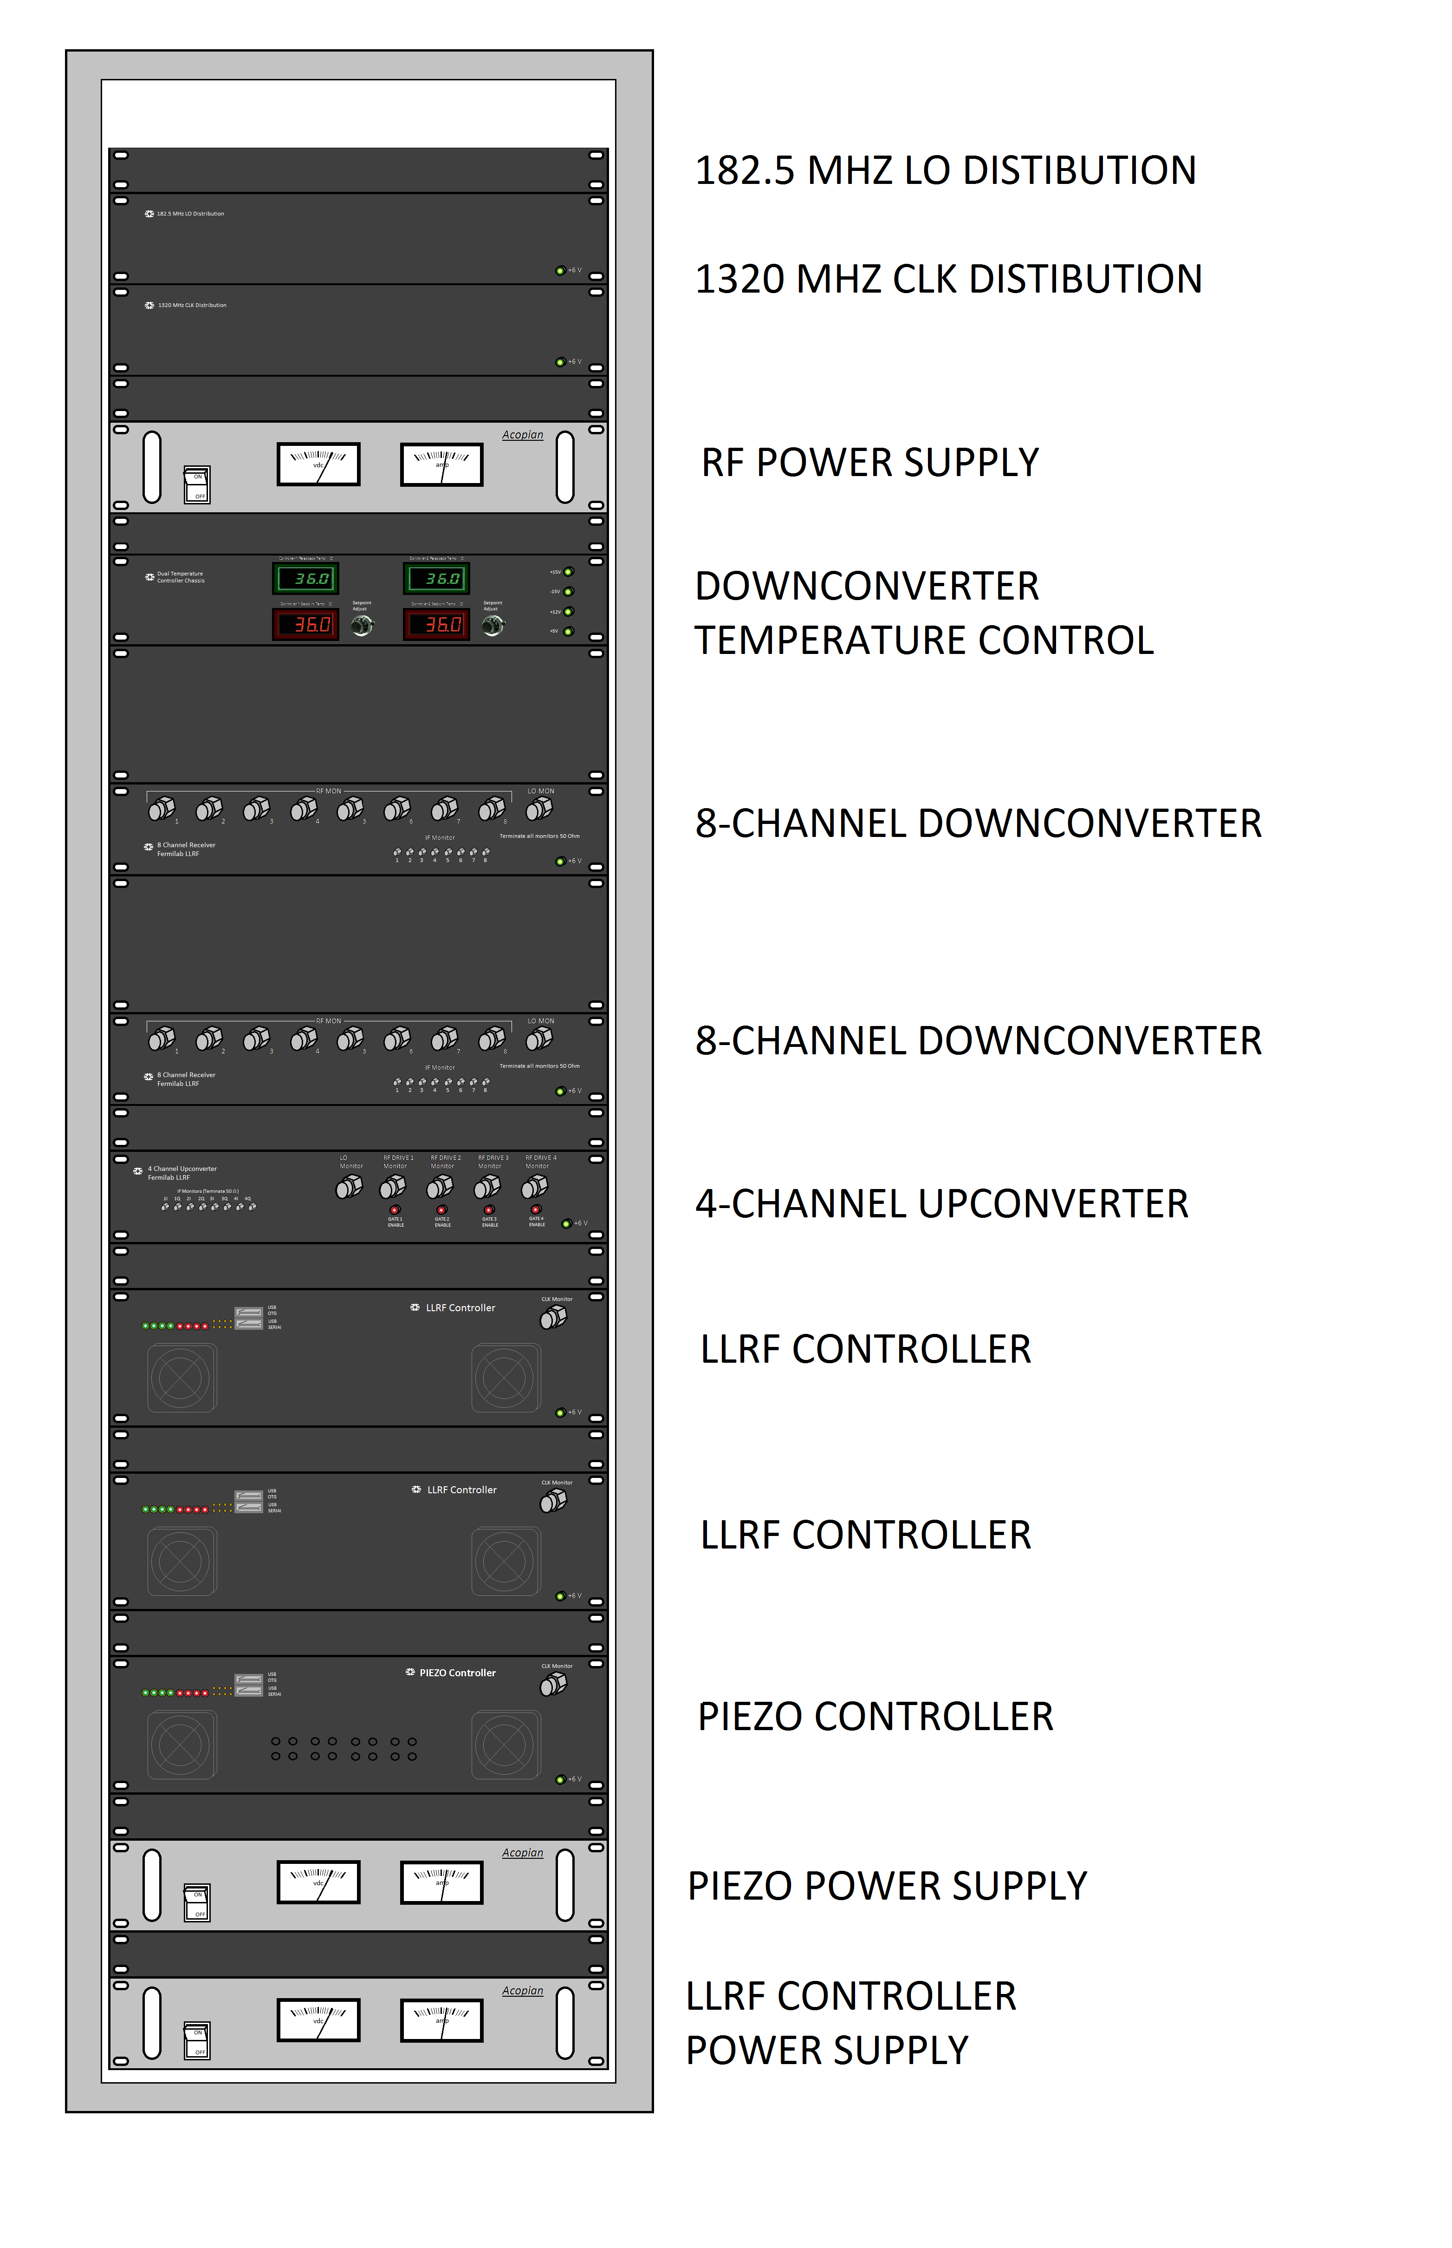
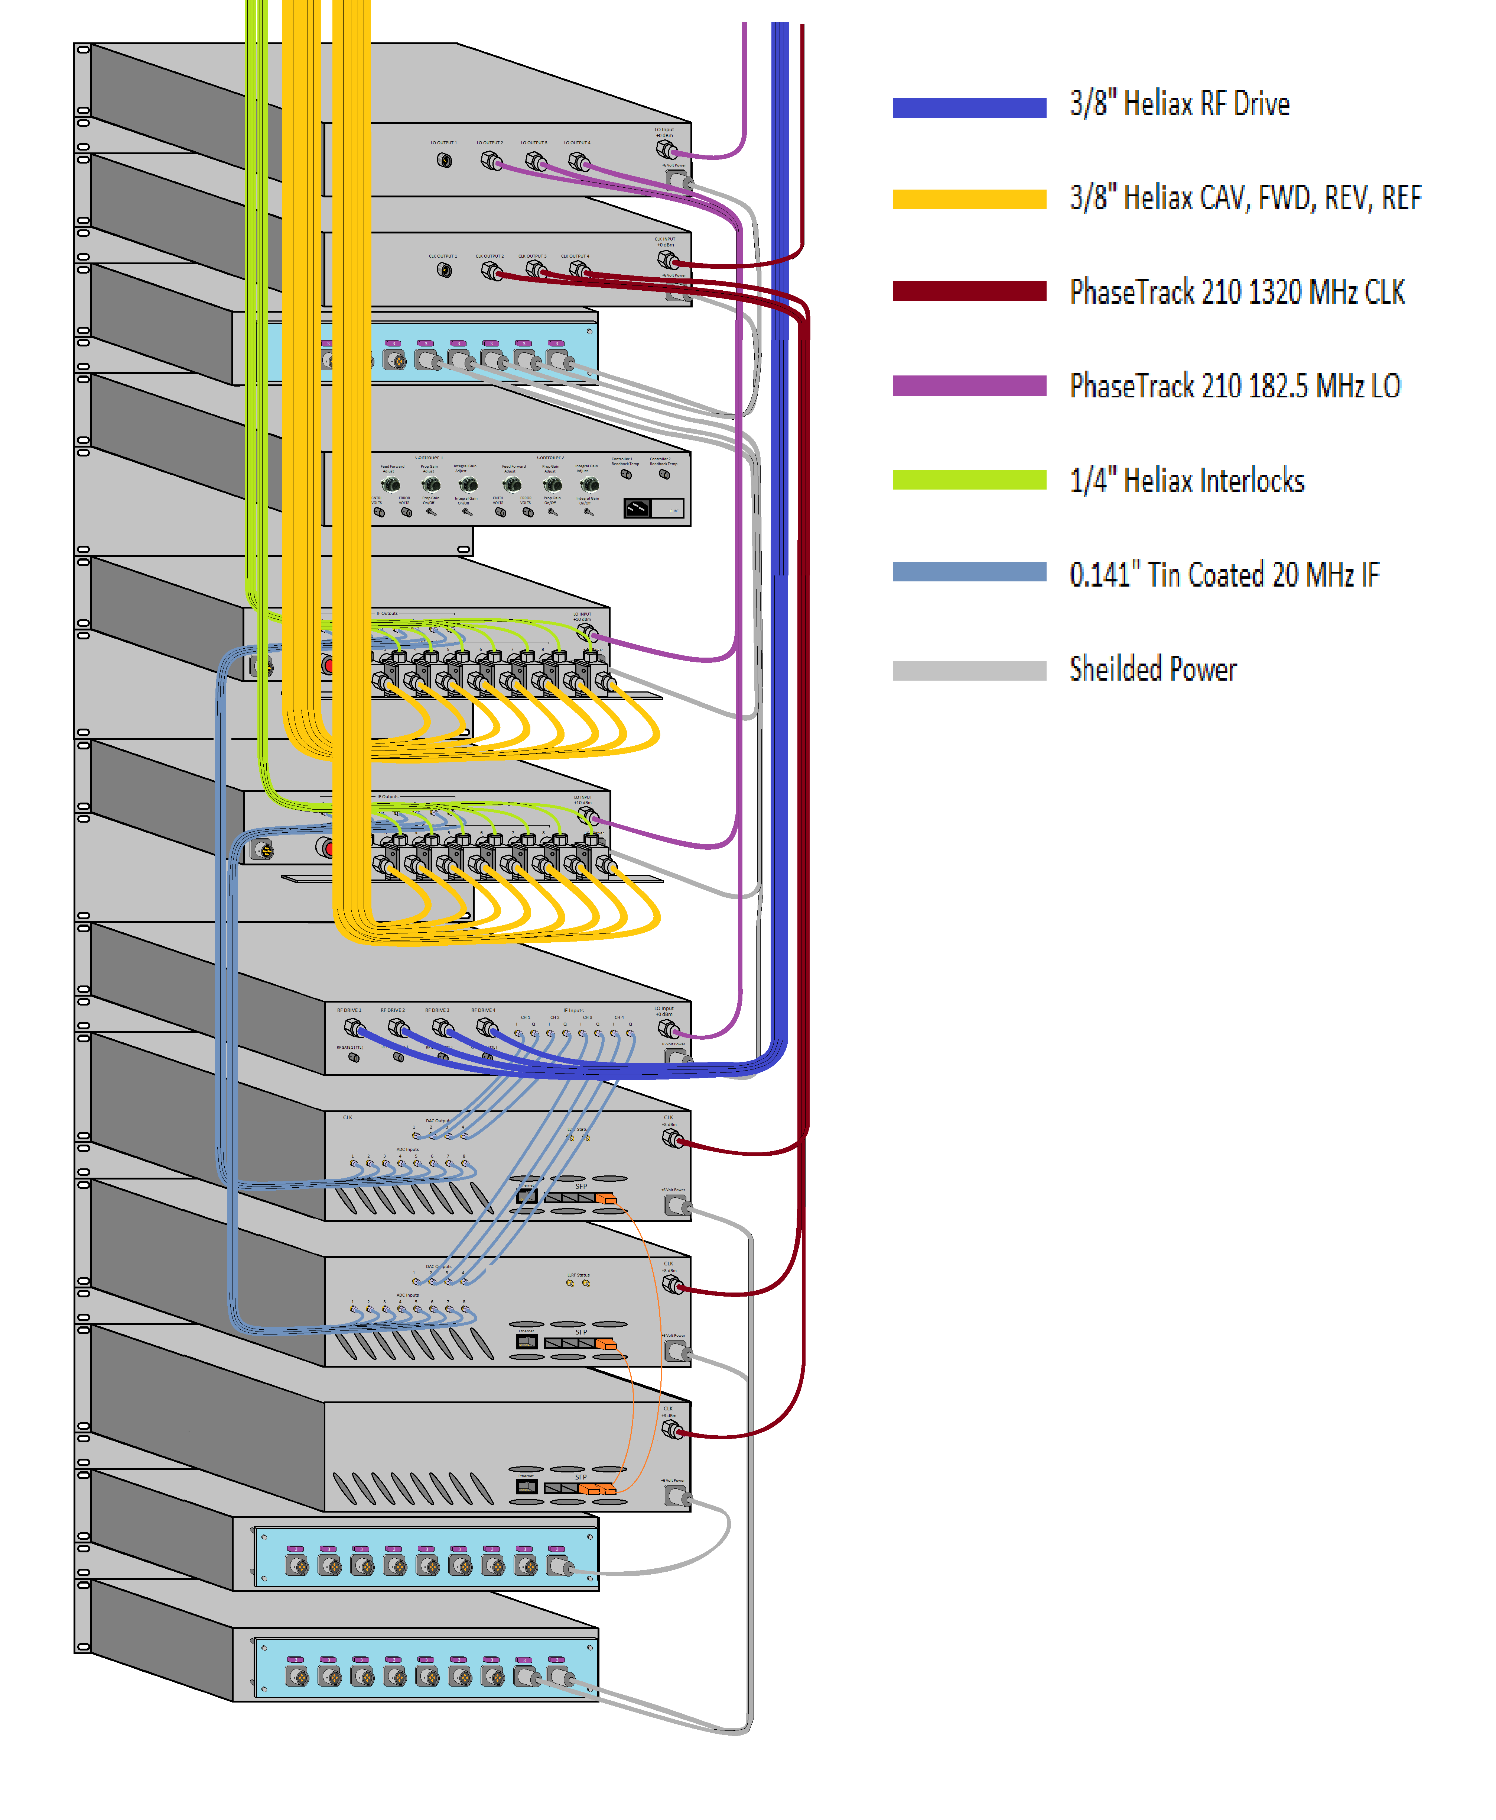
PIP-II LLRF rack layout - front and rear view

Slide 11
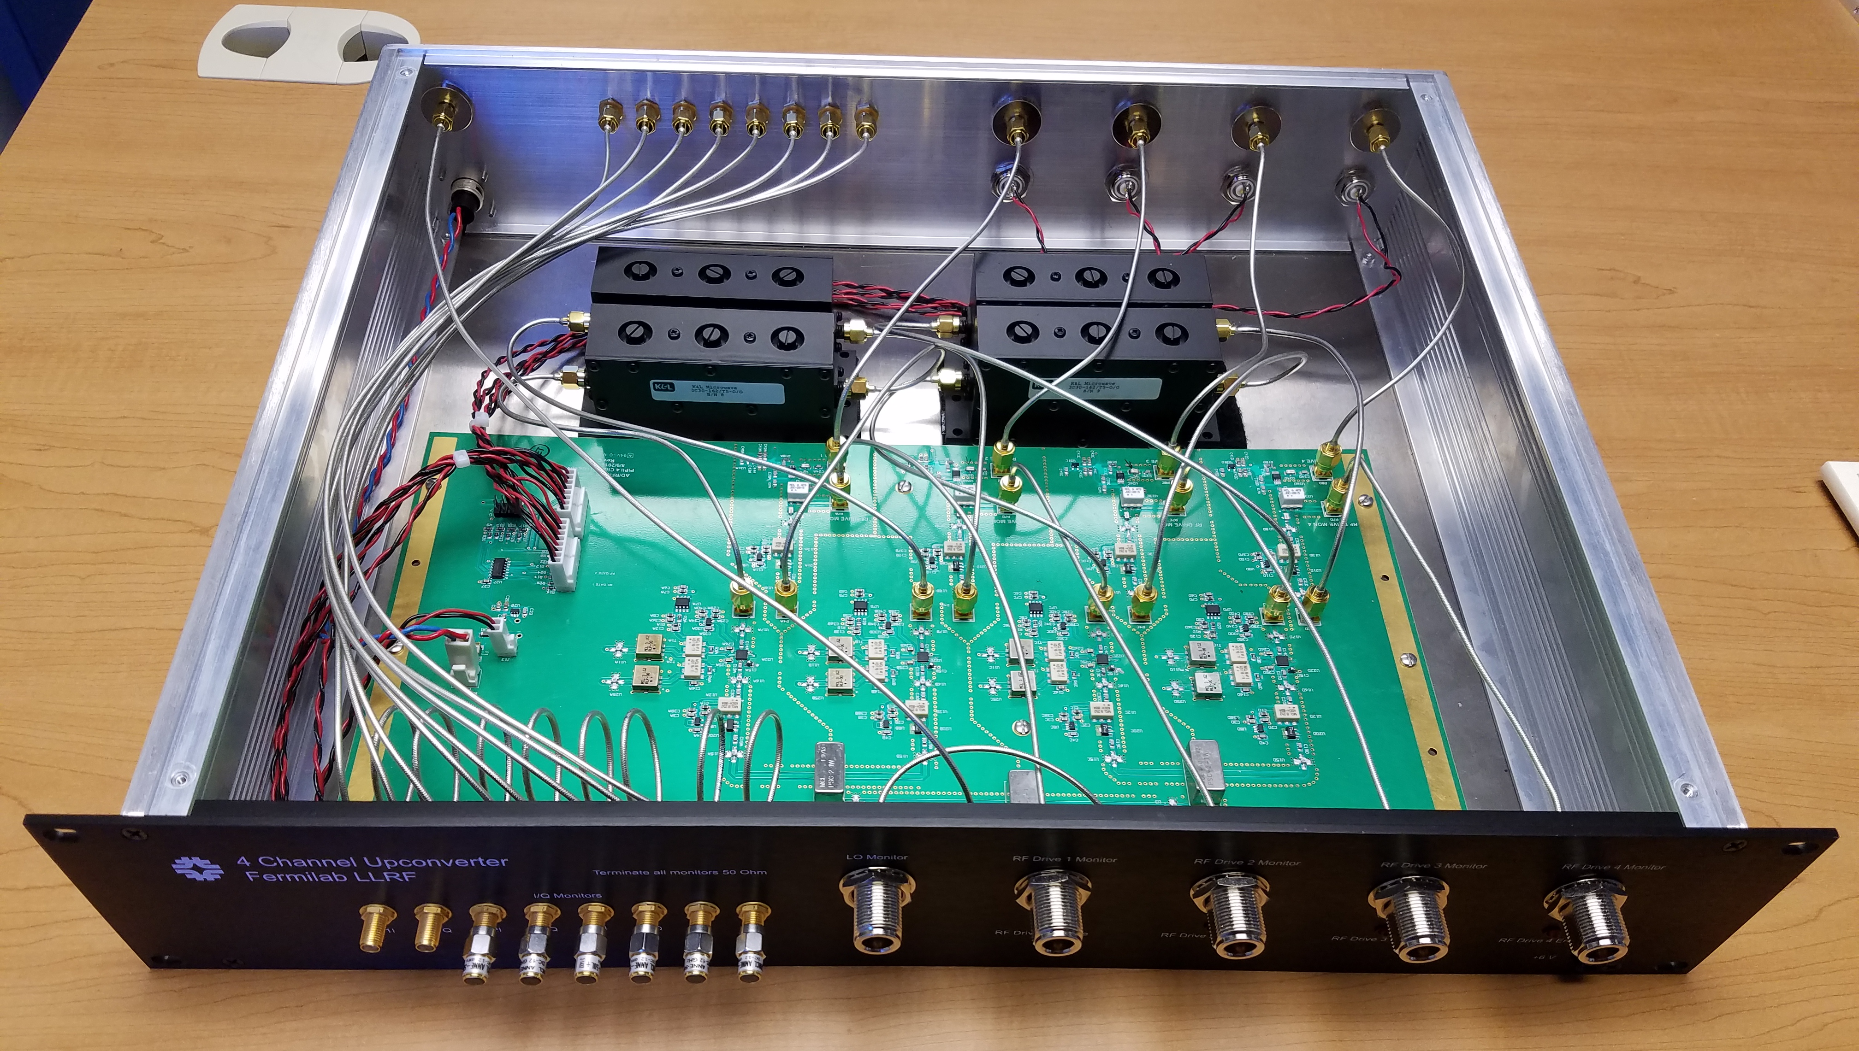
4-Channel Up-converter
20 MHz IF input -2 dBm max
162.5, 325, and 650 MHz Output, +11 dBm max
13 dB IF to RF Conversion Gain typ.
Channel to Channel Isolation > 88 dB
Spurious Signal Suppression > 80 dB
High isolation (>68 dB) TTL RF switch
Power Supply 6V, 1.8 Amp

Slide 12
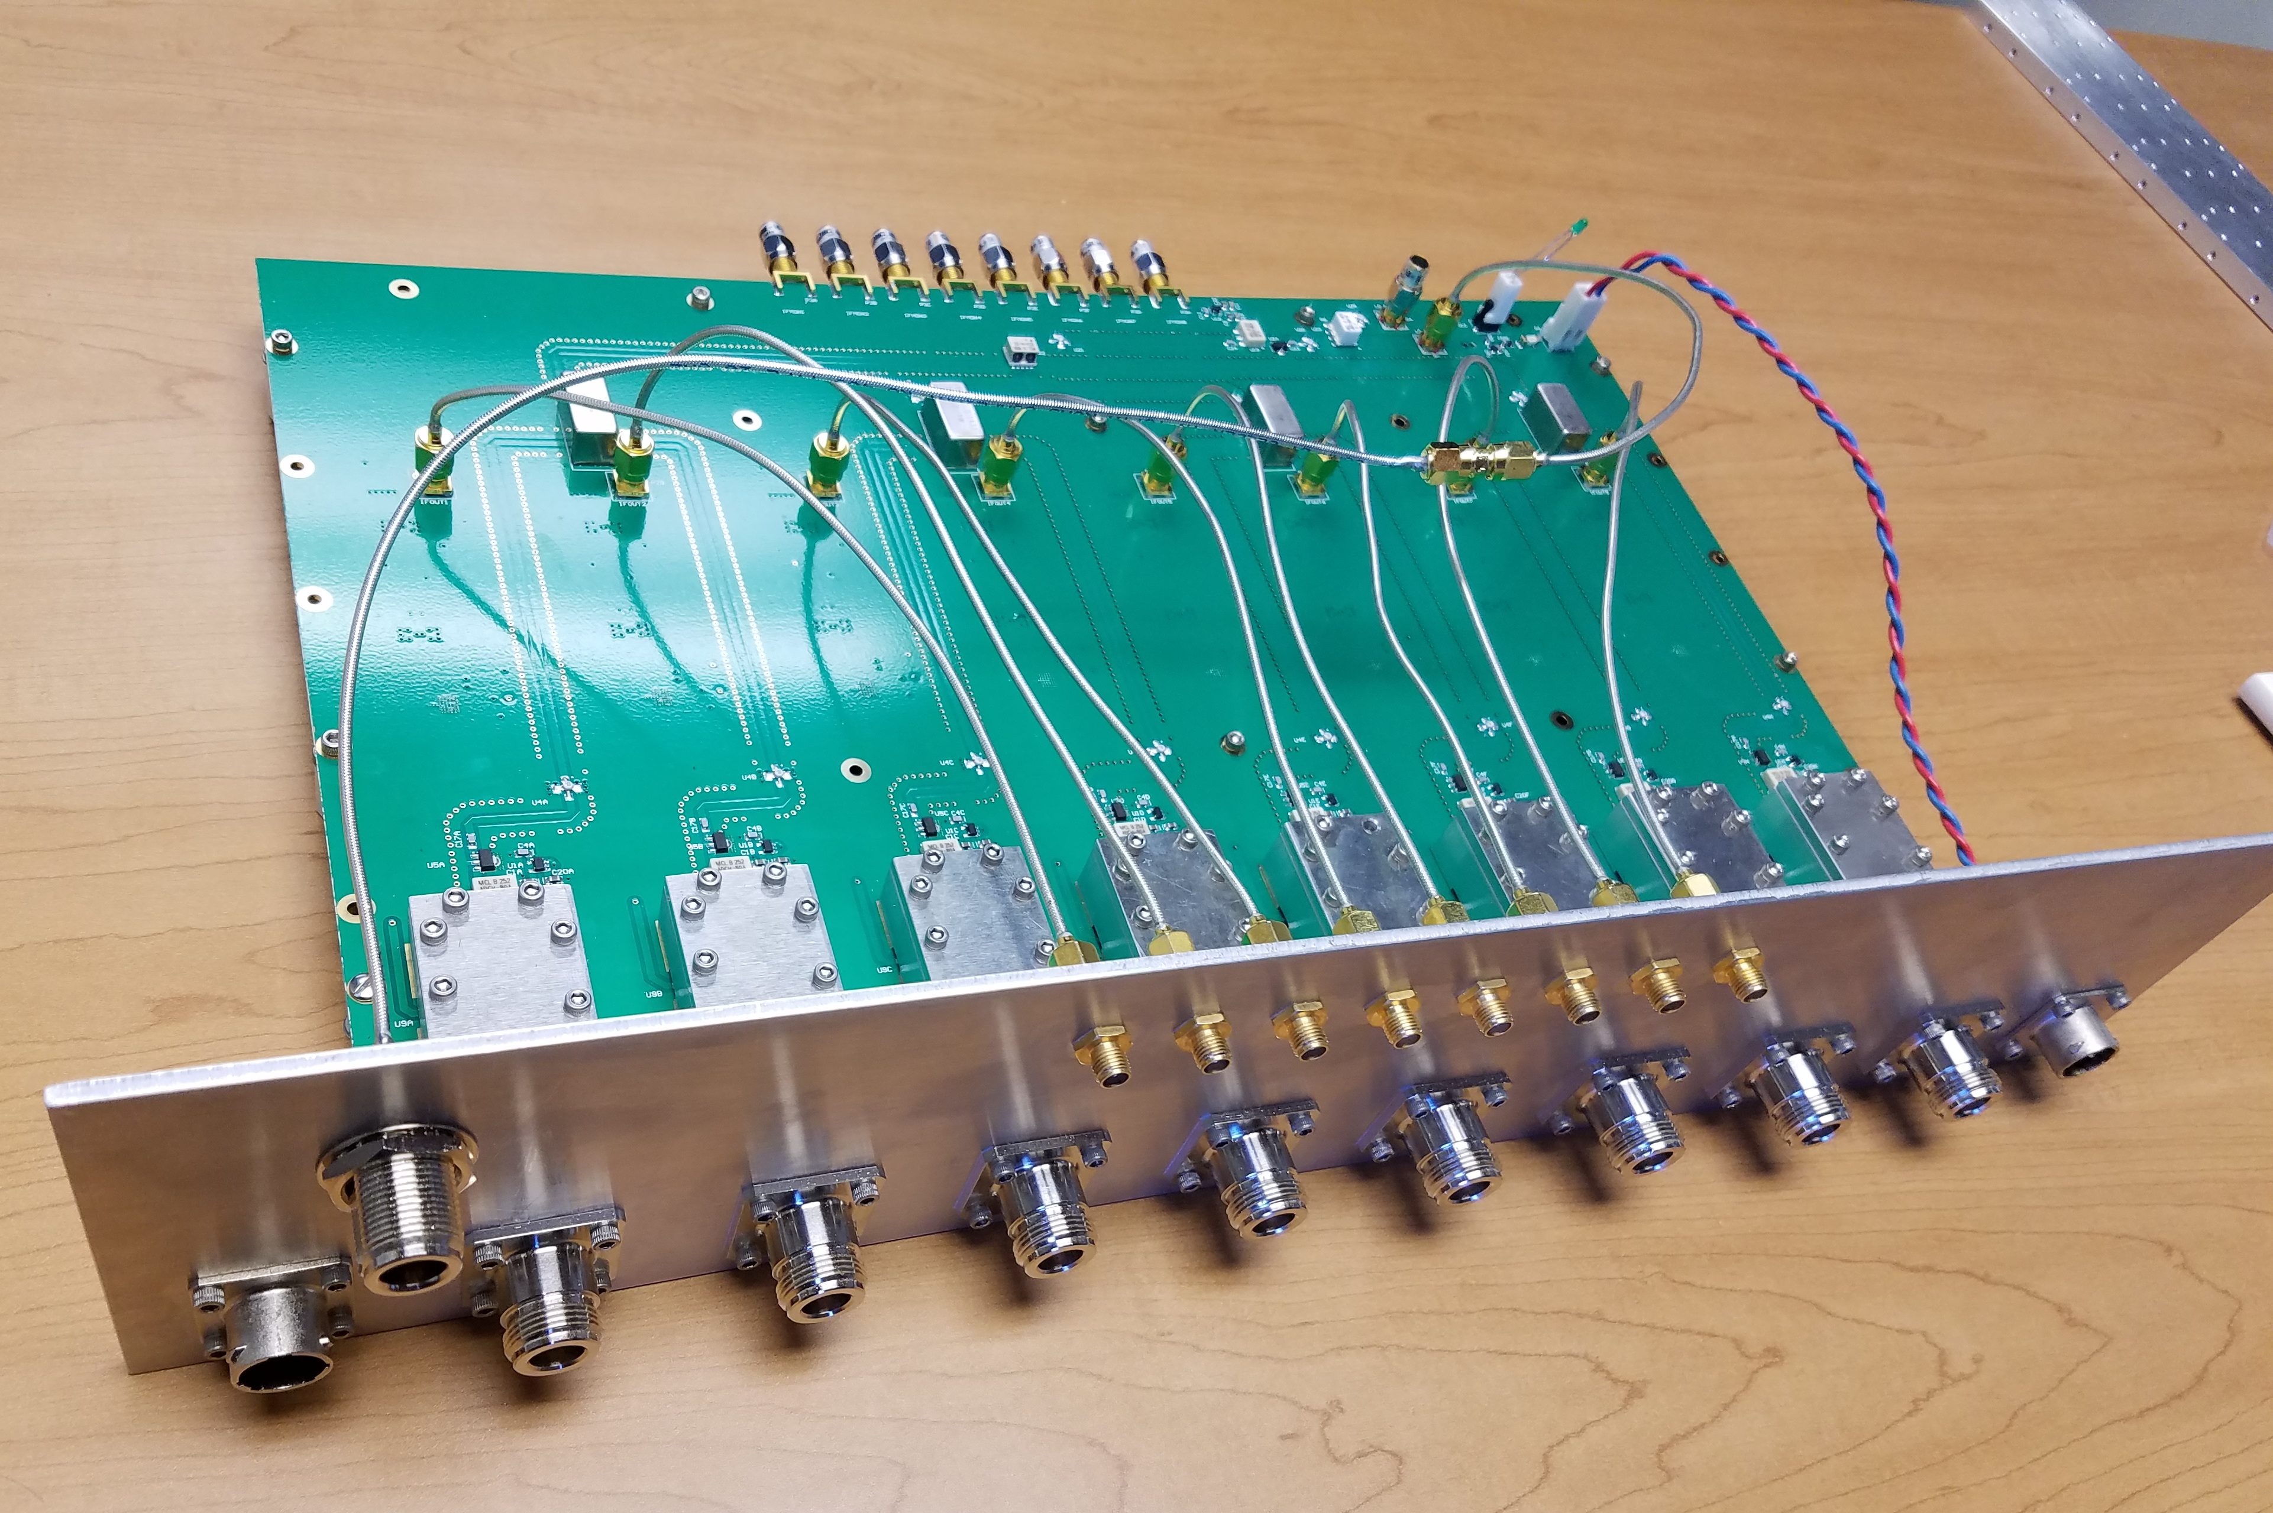
PIP-II LLRF 8-Channel Downconverter Prototype
RF input 162.5 MHz – 650 MHz
Less than 1% non-linearity up to 10 dBm RF input
1.8, 2.1, 2 dB conversion loss @ 162.5, 325, 650 MHz respectively
Better than 82 dB Channel to Channel Isolation
RF, LO, IF monitor ports
Absorptive IF output low pass filter
Noise output floor of -161 dBc/sqrt(Hz)
Integrated output 1/f noise < 1.84 fsec, (0.02 to 20 Hz)
LO Input power of 3.1, 3.8, and 5.7 dBm @ 162.5, 325, 650 MHz respectively
Power Supply 6V, 2.25 Amps

Slide 13
IIFC LLRF Status
Seven joint FRSs Approved (two more near approval)
  TRS in process
8-Channel Down-Converters
  BARC version is in manufacturing process
4-Channel Up-Converters
  FNAL version tested
  BARC version is in manufacturing process
FPGA Board
  In schematic review process
ADC-DAC FMC Module
  Ready for manufacturing
Resonance Control Chassis
  Leverage from FNAL LCLS-II design and is in progress

Slide 14
IIFC 8 Channel Down-converter
Layout finalization for the 8 channel down-convertor is almost complete
All components required to assemble the board and chassis are available at vendor site
Procedure to assemble the board in the chassis has been tentatively finalised.
Tentative delivery date at BARC: Last week of May 2017
Performance results of the boards should be available by: Second week of June 2017

Slide 15
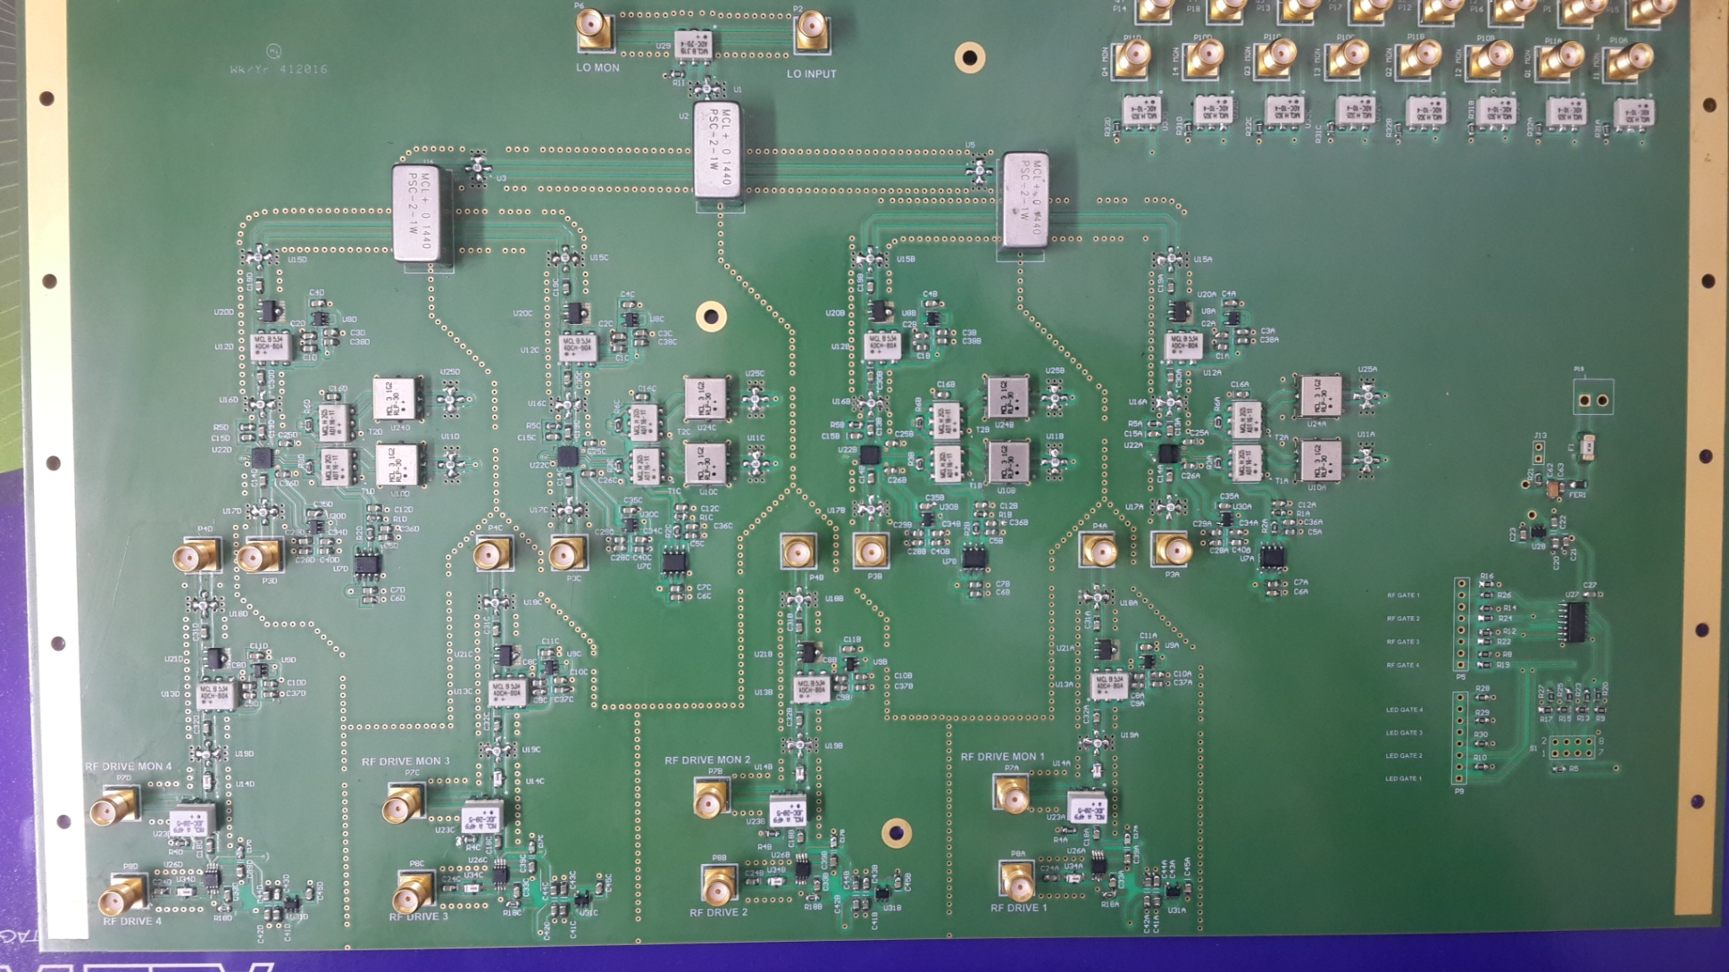
4 Channel Up-converter
Tentative delivery date at BARC: Third week of April 2017
Performance results of the board should be available second week of May 2017

Slide 16
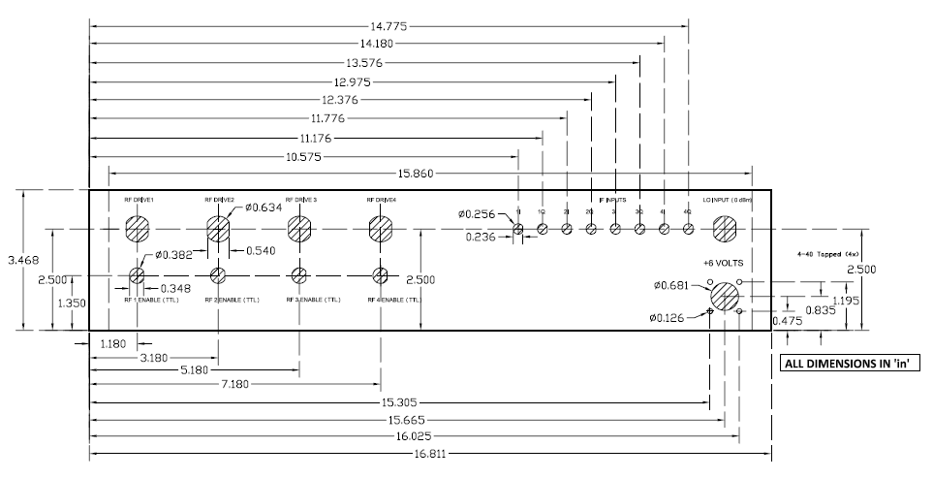
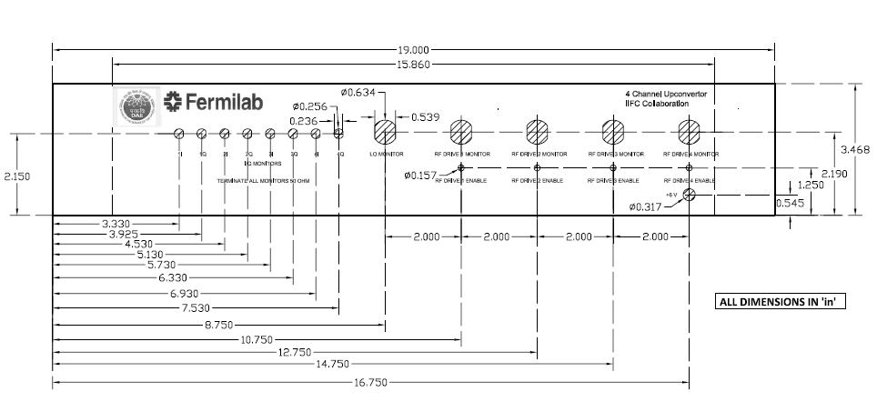
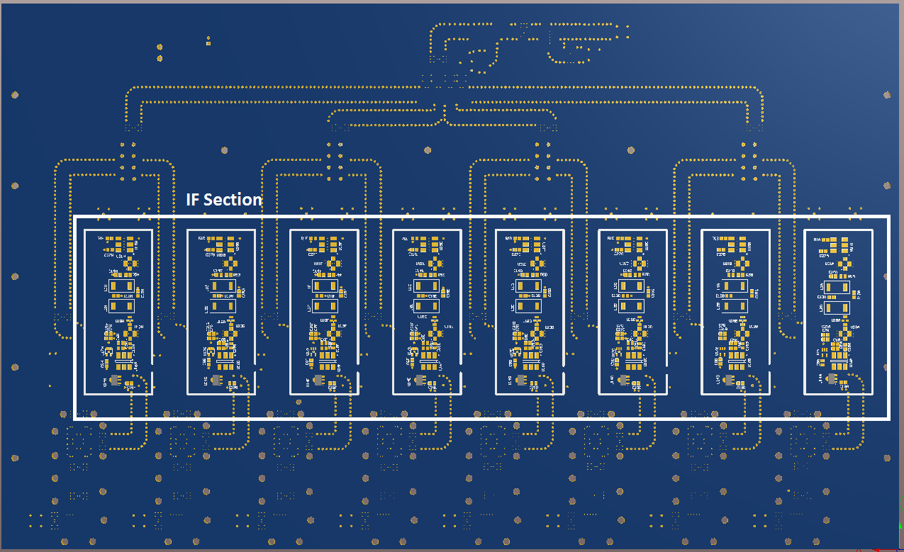
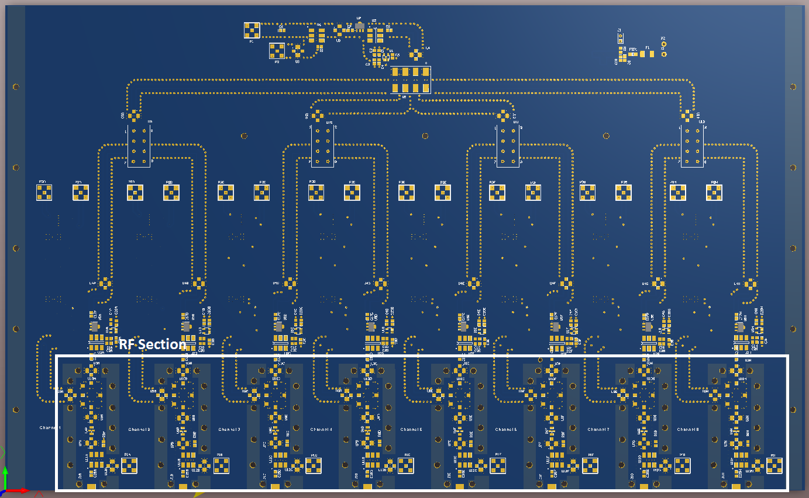
IIFC Designs

Slide 17
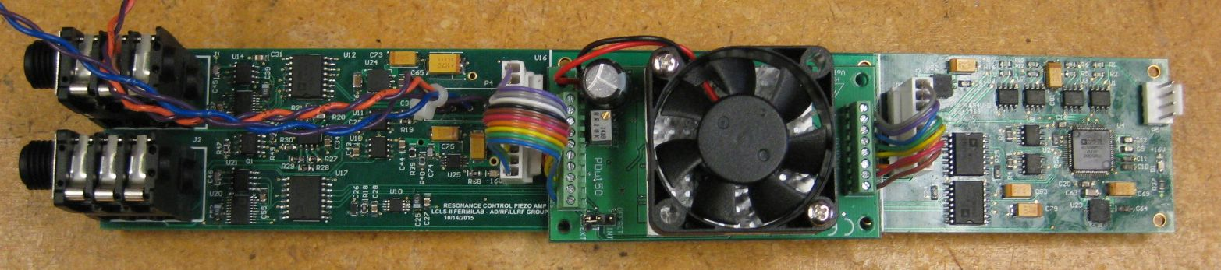
Piezo Resonance Control Requirements
Minimize microphonics and LFD to < 20 Hz
1 Hz or better resolution
+- 1kHz tuning range
2 drive amplifiers for 2 piezo stack groups per cavity
  (1 module per cavity)
  4 drive modules per chassis

Slide 18
Resonance Control Chassis

Slide 19
Digitizer Chassis

Slide 20
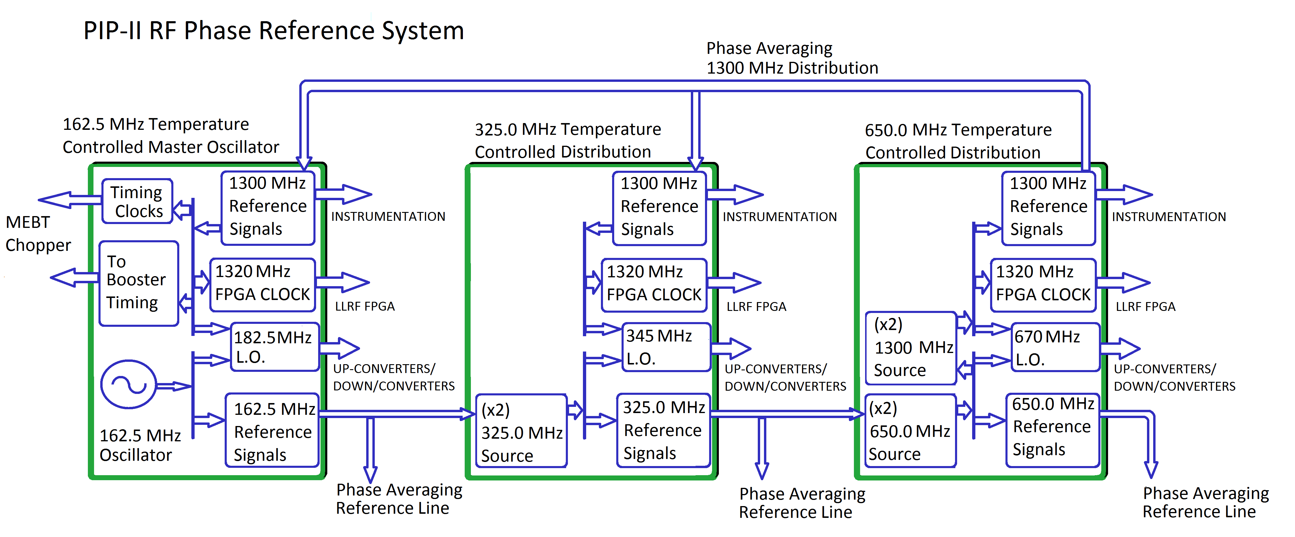
Phase Reference Lines (162.5, 325, 650 ,1300 MHz)
Multi-frequency Phase References and Local Oscillators
Being prototyped at BARC

Slide 21
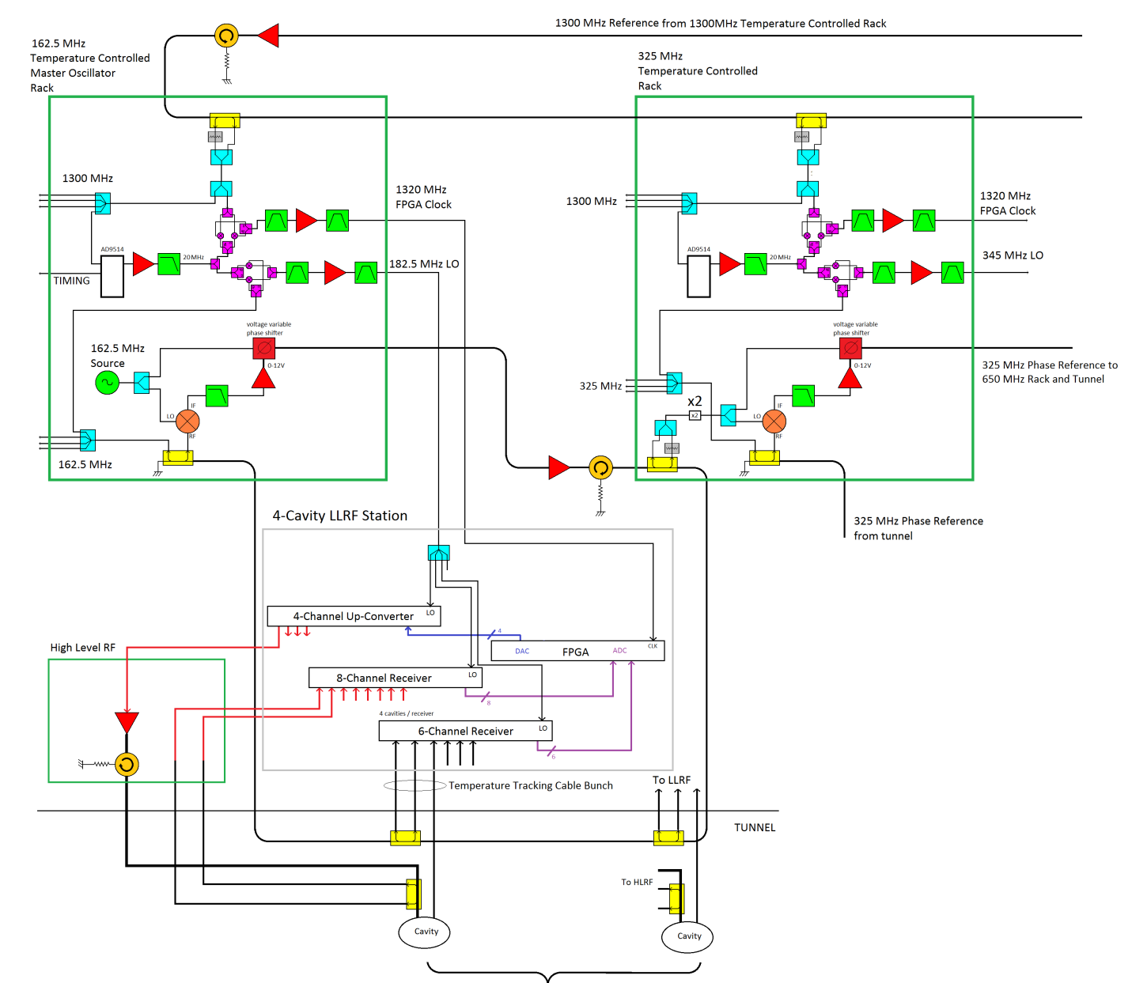
Details of First 162.5 MHz RF Section
Phase stability across
harmonics (400 fs)
Temperature controlled racks and component plates
We have this experience and see a path forward

Slide 22
Simulation and Results

Slide 23
Primary Technical Risks
Resonance and Field Control for 5 new cavity designs
  Lorentz Force Detuning compensation for narrow bandwidth cavities operated in pulsed mode
  New cavity designs with new mechanical properties
  20 Hz power BW with expected 420 Hz Lorentz Force Detuning in SSR1
  See resonance control talk
10⁻⁴ beam energy regulation with pulsed proton accelerator
  Fill to flattop transient
  Beam loading transient
  RF system transient response

Slide 24
RF system control diagram

Slide 25
Feedback requirements and analysis
Expecting large disturbances from LFD, want fast response from beam loading transient
  get 15 dB from feedforward beamloading compensation
Approach - find highest stable loop gain and determine system noise requirements
Determine best gain settings from operational experience and needs of beam-based feedback
  It is easy to turn down the gain on a well designed system, impossible to turn up gain on a poorly designed one
Assume a low noise oscillator
  Wenzel VHF ULN 100 MHz 13.7 dBm
  % http://www.wenzel.com/model/vhf-uln/
System loop delay of 2.1 μsec
Cavity bandwidth 30 Hz

Slide 26
Open loop transfer function of cavity and controller
Magnitude
Phase
Max gain
Nominal gain
Closed-loop bandwidth: ~50 kHz
Control system zero: 15 kHz
Proportional gain: 1500
Integral gain: 1.44e+08
Closed-loop bandwidth: ~25 kHz
Proportional gain: 750
Integral gain: 7e+07

Slide 27
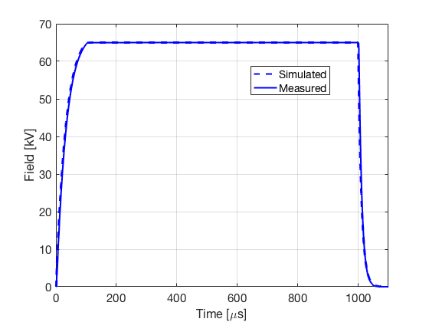
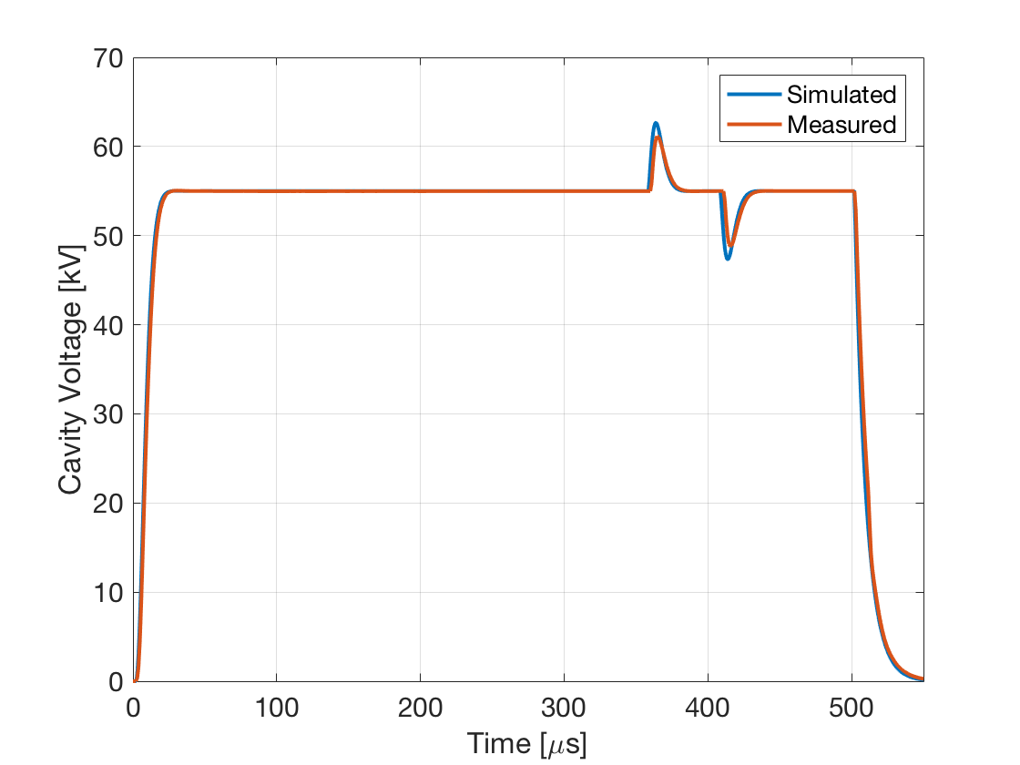
RFQ and Buncher pulsed response
RFQ Pulse measured vs. simulated (Proportional and integral gains were 9.0 and 8.0e5 respectively)
Buncher simulated vs. measured (kp 3.5, ki 6.0e5, Ql ~5000)

Slide 28
Total phase noise to SSA from controller and oscillator
Closed loop response
Cumulative SSA phase noise voltage
Careful attention to noise terms will allow high controller gains
Cavity: 0.00078° rms
SSA: 1.04°
SSA from ADC noise 0.96°
Code developed for LCLS-II
Larry Doolittle LBNL and FNAL

Slide 29
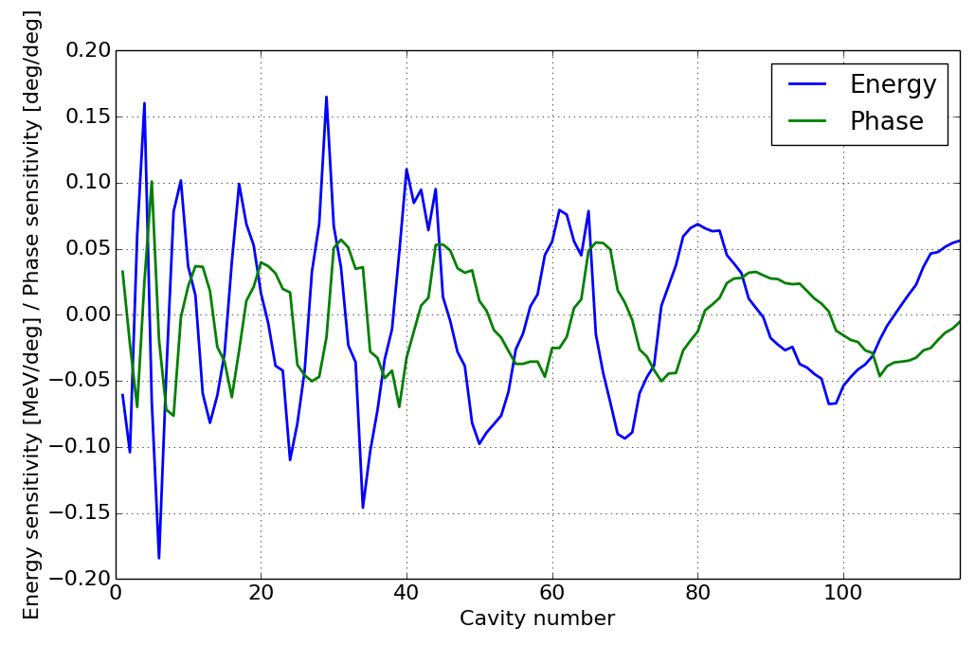
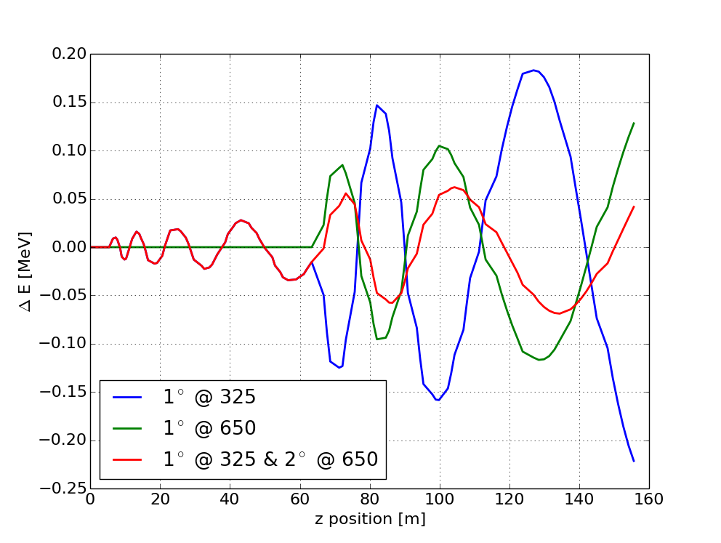
Phase-energy Stability Simulations
Studying the amplitude and phase regulation requirements and their impact on the LLRF system
  Study effects of perturbations on the cavities through beam simulations
  Develop code that performs basic beam dynamics calculations as well as RF feedback simulations to study the interaction between the RF system
Linac output energy sensitivity to single cavity phase errors
Linac output energy sensitivity to phase reference
line phase errors at frequency transitions
J. Edelen

Slide 30
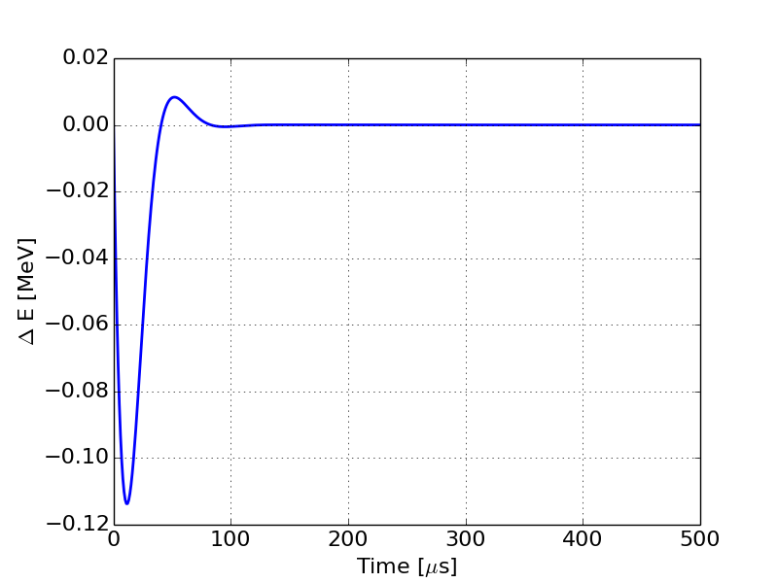
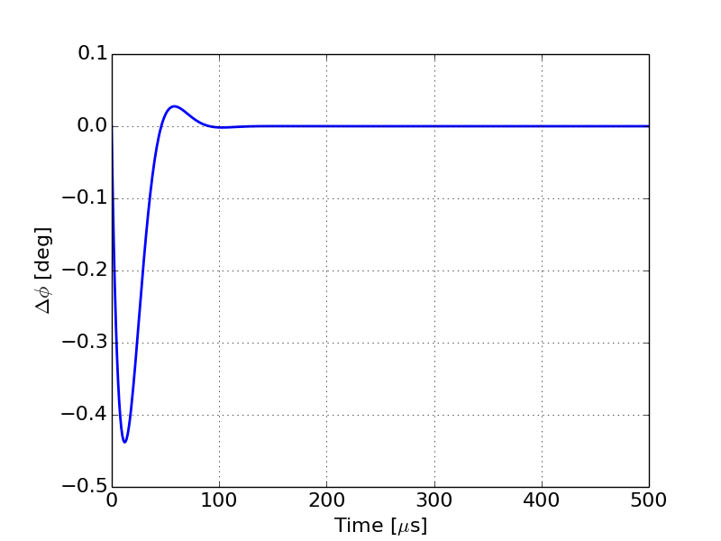
Simulating the impact of RF transients due to beam-loading on the beam-parameters
The feedback model for the RF cavity was done in python (and compared with existing MATLAB models)
The energy gain for each cavity was calculated using simulation results from PARMELA and TraceWin
The phase advance during drift spaces was calculated using analytic models
The beam current was assumed to be 2mA average during the pulse
Left: Change in energy along the beam pulse due to uncompensated transients in the RF system
Right: Change in phase along the beam pulse due to uncompensated transients in the RF system

Slide 31
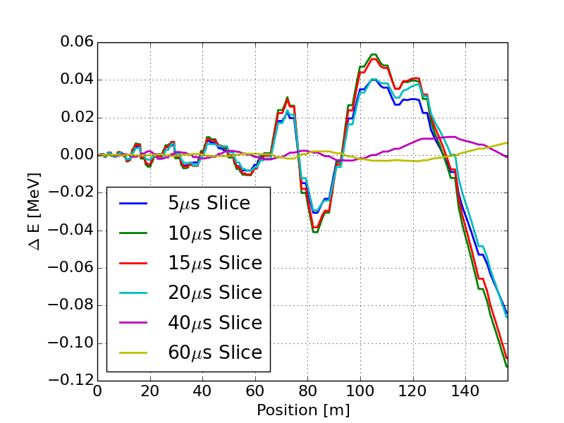
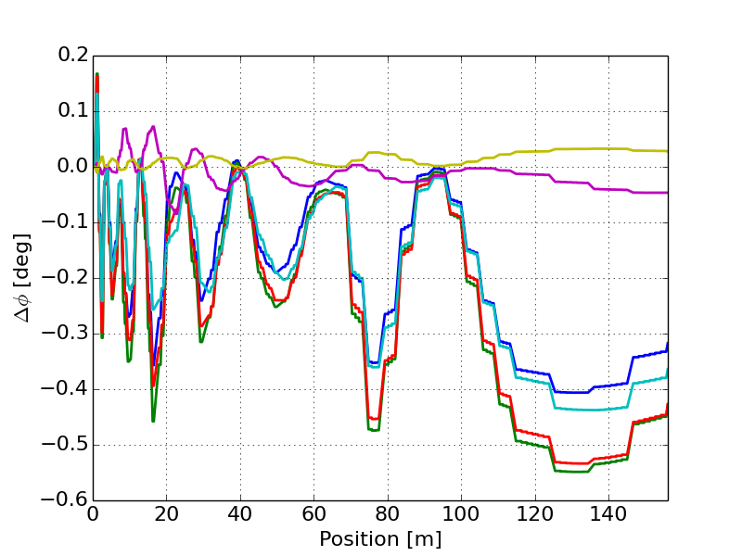
Simulating the impact of RF transients due to beam-loading on the beam-parameters
We can analyze both the beam profile and individual slices along the LINAC
Left: change in energy as a function of position along the LINAC for six different RF buckets along the beam pulse
Right: Change in phase as a function of position along the LINAC or six different RF buckets along the beam pulse

Slide 32
Cavity drive down to reduce cryogenic load
Pforward = 60 kW
Preverse = 230 kW
VSWR= -3.087922
Power coupler, waveguide and circulator:
-3x nominal forward Voltage
-5x power
Full drive down is not possible

Slide 33
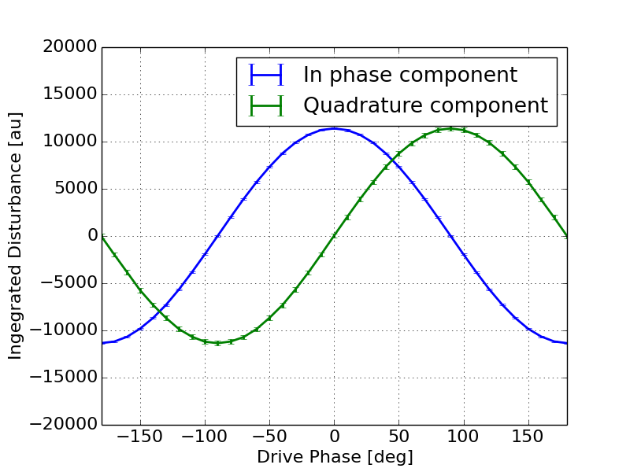
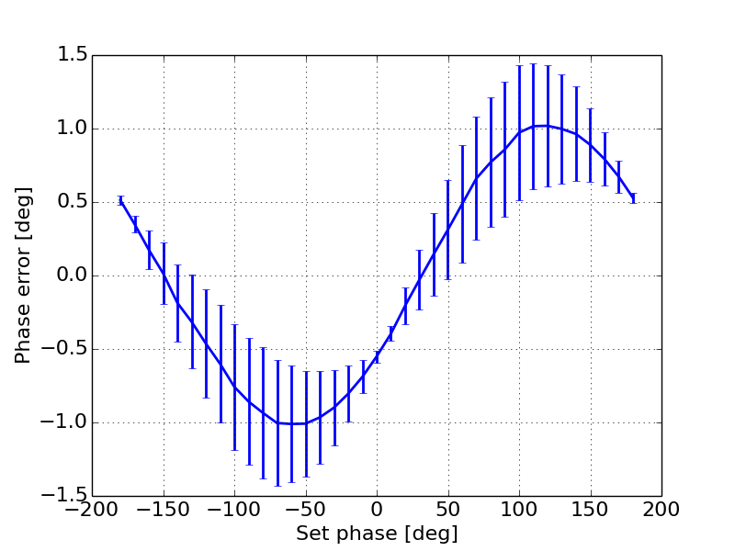
Beam-based Phase Calibration
In theory the average beam phase can be computed from cavity field due to beam-loading
However this relies on proper background subtraction and some, albeit minor, assumptions about the profile of the beam
First test is to try and reconstruct the phase of an ideal disturbance that is driven by the LLRF system
  Some unexpected behavior is still under investigation
Top: Integrated cavity voltage due to the ideal disturbance as a function of phase
Bottom: Difference between reconstructed phase and drive phase as a function of the drive phase

Slide 34
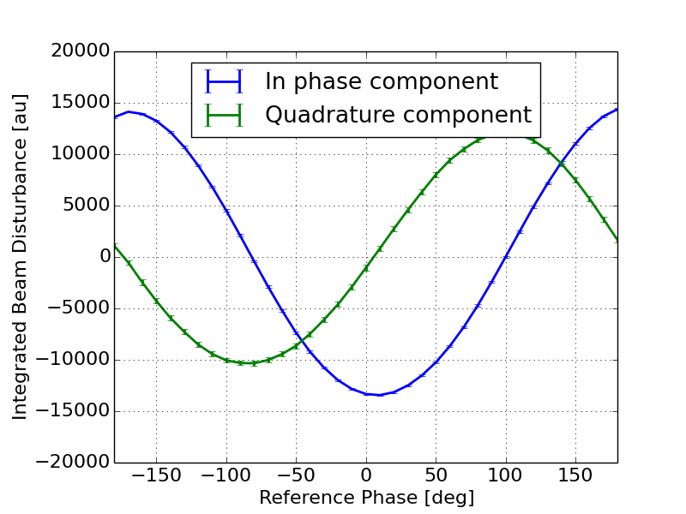
Beam-based Phase Calibration
Integrated cavity field due to beam loading as a function of the drive phase for an ideal disturbance driven from the LLRF system
Integrated cavity field due to beam loading as a function of the drive phase for a 4.9mA beam in the PI-Test bunching cavity. Note the I and Q components are not symmetric.
J. Edelen

Slide 35
Environmental Considerations
Cooling
Electrical service
Gallery temperature is not specified for tight regulation
  This may require closed water cooled racks to meet RF stability requirements
On mains power loss, cavities must be detuned to avoid mechanical distortion on warmup
UPS power will be required to drive tuner stepper motors on all cavities.

Slide 36
RF Interlocks Overview
P. Prieto

Slide 37
RF Interlocks Objectives
The primary objective of the RF Interlocks is to protect the SSA, Coupler, and Cavity from damage due to energy deposition during a fault condition.
To achieve this goal the system must monitor signals such as SSA forward power, coupler forward and reflected power as well as cavity transmitted power.
Additionally, signals such as coupler window temperature, presence of arcs in the coupler, field emission detection also are part of the interlocks system.
The RF interlocks inhibits the LLRF to the SSA by opening a fast switch < 1 usec preventing RF power from feeding an arc.

Slide 38
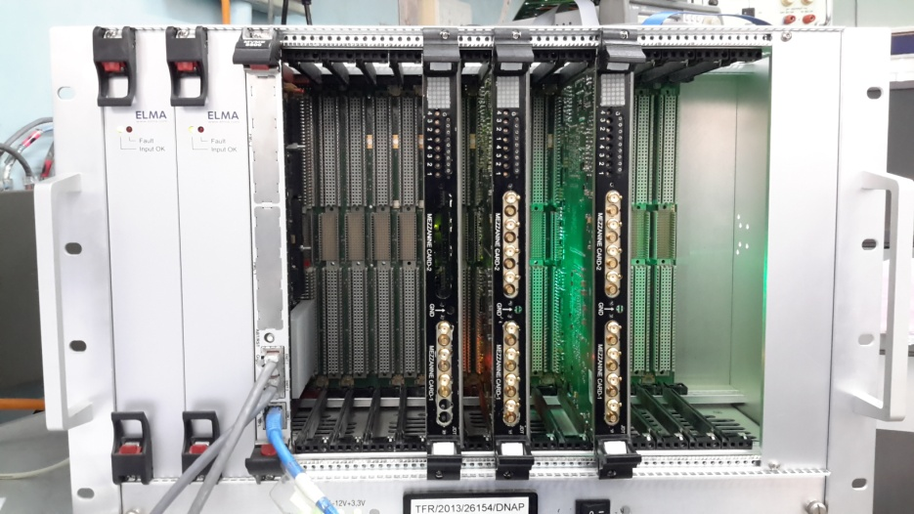
RFPI Hardware Prototype at Meson Detector Building

Slide 39
LLRF
GaAs LLRF Switch
LLRF
SSA
Coupler/Cavity
RF_INH
SSA Inhibit
Reset
VideoPLS
Reset
VideoPLS
Reset
VideoPLS
Reset
VideoPLS
Reset
VideoPLS
System Control
RF_INH
MODINH
PMT
FEP
OPTODET
FWR/REFL
RF_INH
MODINH
RF_INH
MODINH
RF_INH
MODINH

Slide 40
Conclusions
The PIP-II LLRF design is an evolution of Fermilab designs and our collaboration efforts with LCLS-II
IIFC joint designs in LLRF and RFPI are are making good progress and we are counting on their hardware and software contributions
We will continue to gain operational experience at PIP2-IT and the various test stands with narrowband pulsed SRF cavities.

Slide 41
Thank you for your attention!

Slide 42
Backup slides

Slide 43
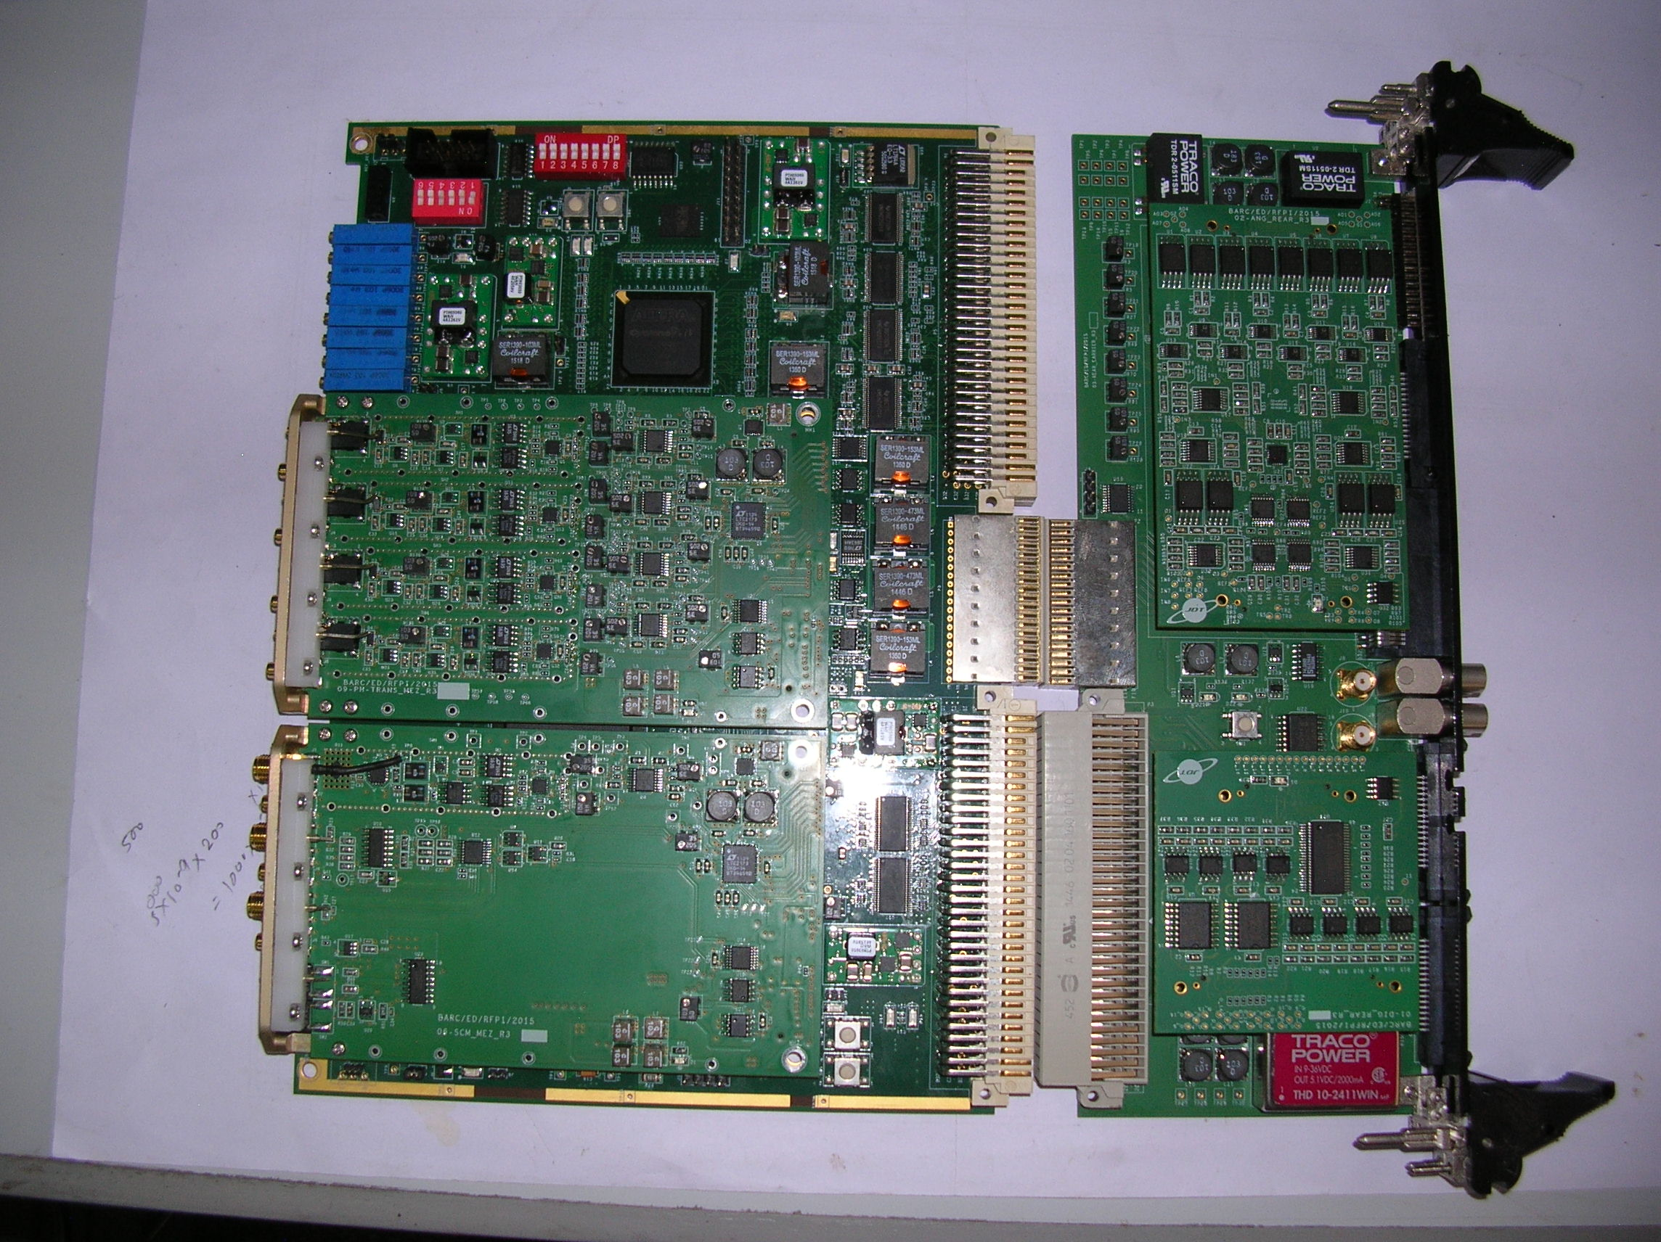
IIFC Deliverable Schedule
A prototype RF protection and interlock has been delivered and tested at Fermilab
LLRF is on a reasonable pace for 2018 delivery
RFPI boards

Slide 44
Brian Chase - Fermilab
Charge #1
SPM – Low Level RF and RF Integration
Started at Fermilab in 1982 and have work experience in cryogenics, power supplies, D0 detector electronics and beam Instrumentation
LLRF – Linac, Main Injector, Tevatron, Recycler Ring
SRF LLRF – Proton Driver, ILC, ILCTA, DESY (9mA Tests)
LCLS-II, CMTS, PIP-II
LLRF Team
  AD LLRF - E. Cullerton, P. Varghese, J. Edelen, J. Einstein-Curtis, D. Klepec
  IIFC - G. Joshi, S. Khole, D. Sharma, & many others
  CSU – A. Edelen

Slide 45
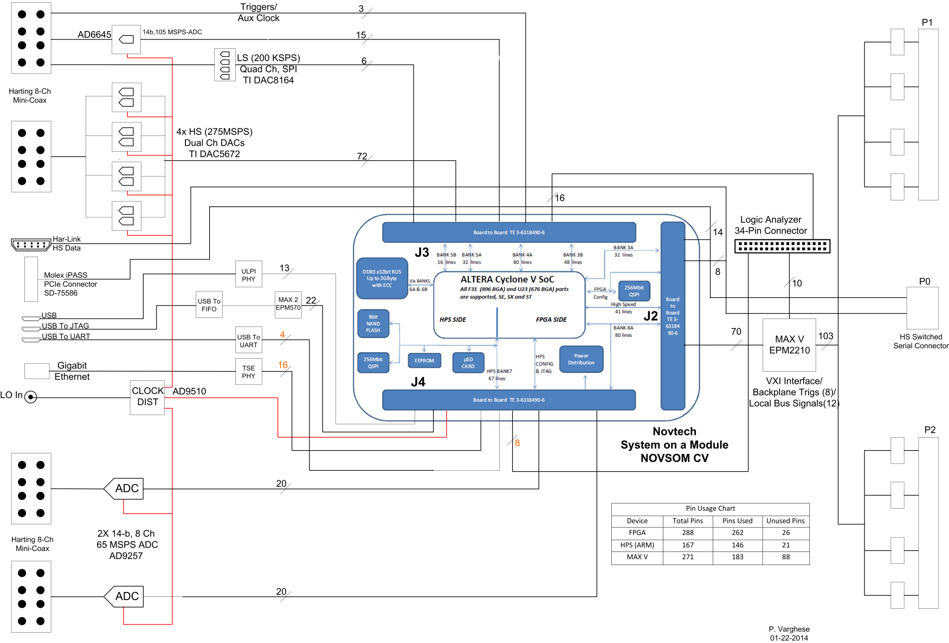
System on Module Multi-cavity Field Controller (SOM-MFC)
SOM is socketed
and upgradable

Slide 46
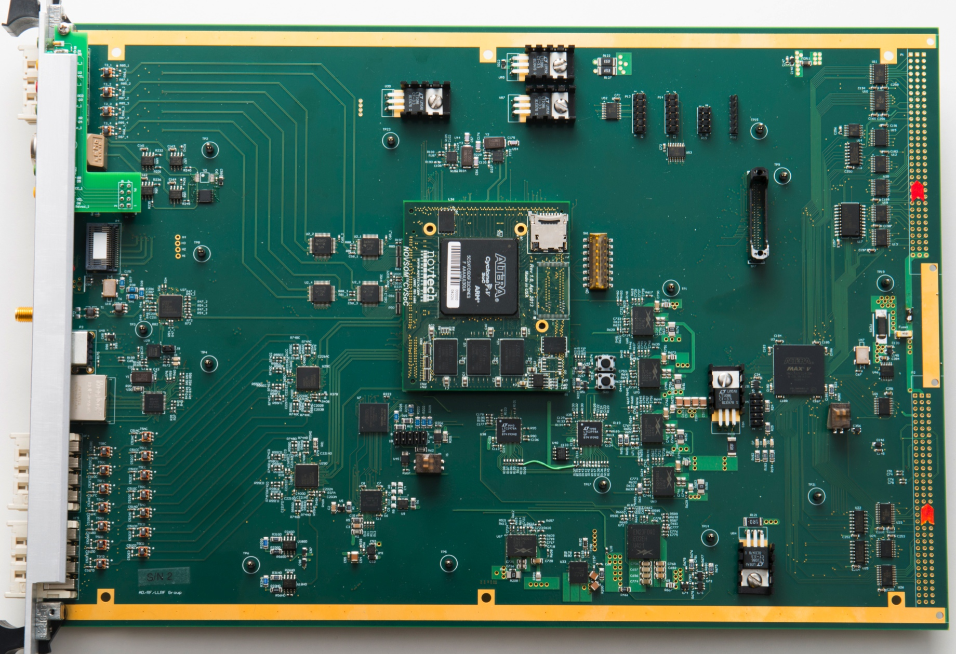
System on Chip Multi-channel Field Controller
(16) 14 bit ADCs
(8)14 bit DACs
System on Module
Dual core Arm processor
with FPGA eliminates
the need for a backplane and CPU card

Slide 47
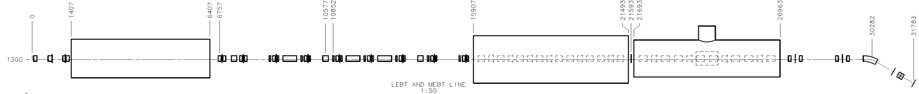
PIP2-IT Low Level RF
30 keV
2.1 MeV
10 MeV
25 MeV
RFQ
MEBT
HWR
SSR1
HEBT
LEBT
40 m, ~25 MeV
- Drive 20 accelerating structures
3 RF frequencies
Master Oscillator and phase reference lines
0.01% amplitude and 0.01 deg. Phase regulation goal
Cavity RF operating parameters

Slide 48
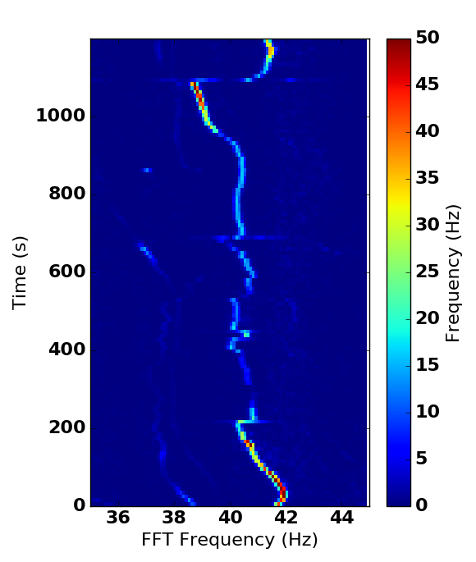
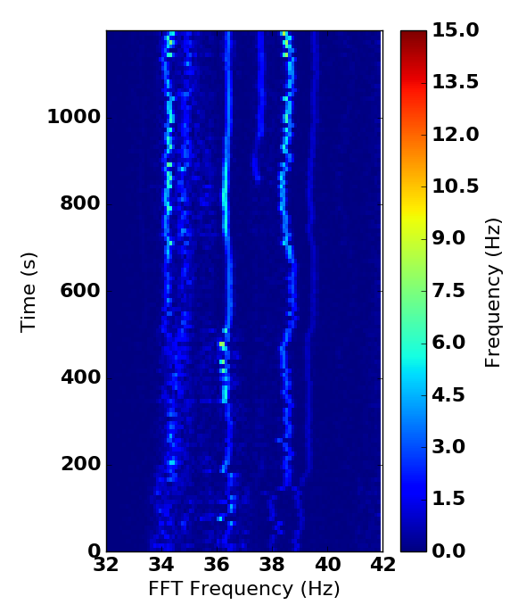
Example of Microphonic Detuning at CMTS-1
Main source is believed to be pressure fluctuation from a check valve in the helium return line and will be fixed in current shutdown. Resonance control is every system’s responsibility.

Slide 49
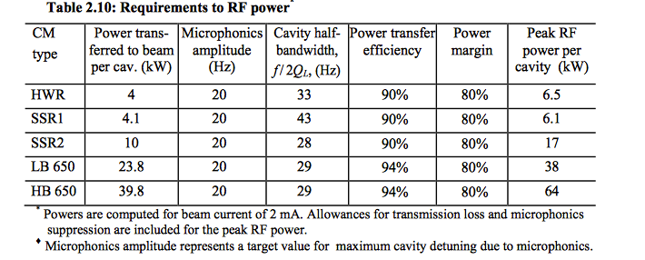
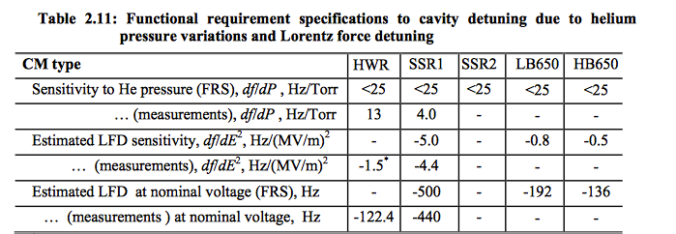
RF Power budget and Ql
Total cavity detuning budget including LFD
Measured LFD is 22 times
larger than the entire
resonance error budget
May need real-time feedback during pulse
Ongoing cavity design efforts
to lower these numbers

Slide 50
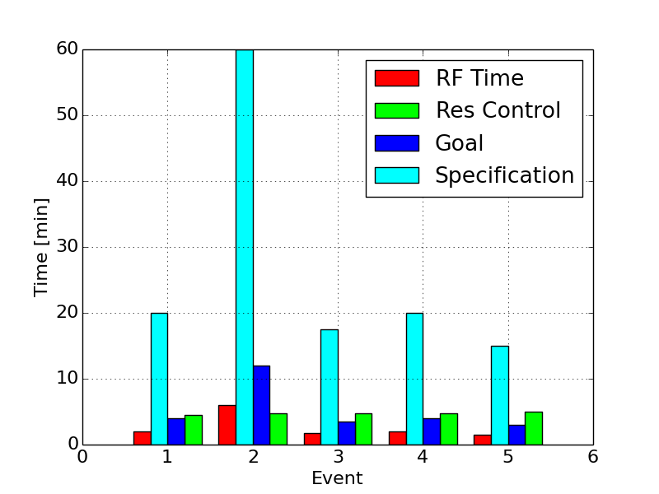
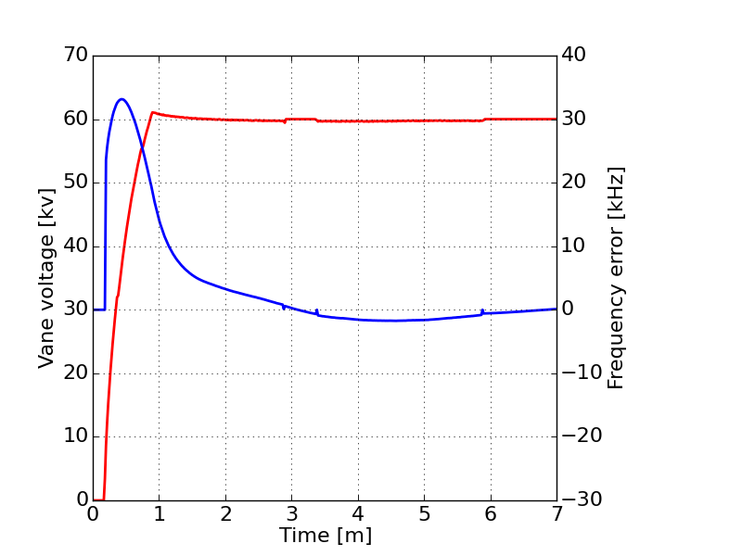
RFQ Resonance control status
Currently meeting specification
  Specification was to recover the RFQ in less than 10 times the RF recovery time
  Goal of less than twice the RF recovery time
  We anticipate meeting our goal requirement after the next round of improvements
The controller interfaces with the water instrumentation, ACNET, and LLRF
The controller framework is modular and can easily be improved or adapted to new systems
Plans to improve performance will decrease the initial start time and decrease the trip recovery time
Vane voltage: Red
Frequency error: Blue
Grey: RFQ ramp, resonance control is idle, LLRF is in SEL
Orange: Resonance control bringing RFQ to frequency, LLRF is in SEL
Green: RFQ is in GDR and LLRF feedback is active

Slide 53
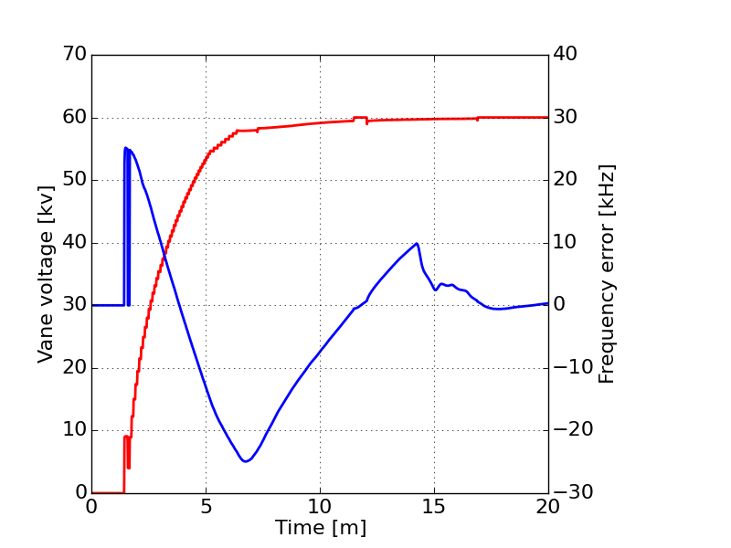
5 min ramp. Mostly automated (operator tuning at 14 minutes to speed things up a little)
Testing faster start, not fully automated. Kink in resonance frequency at 14 minutes was due to operator tuning not automatic tuning.
Vane voltage: Red
Frequency error: Blue
Grey: RFQ ramp, resonance control is idle, LLRF is in SEL
Orange: Resonance control bringing RFQ to frequency, LLRF is in SEL
Green: RFQ is in GDR and LLRF feedback is active

Slide 54
Baseband cavity and controller model

Slide 55
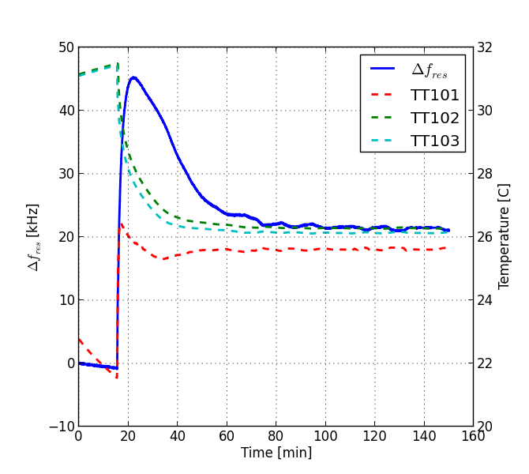
RFQ vane system step response
Transient response of the RFQ resonant frequency due to change in the vane flow control valve. Prior to changing the flow valve, the intermediate skid was cooled to approximately 25C. The control valve was stepped from 0% open to 50% open.
Notes:
\begin{tabular}{c|c|c|c}
& initial & transient & steady state \\ \hline
Time & 0 & 7.2 min & 115.4 min \\
$\Delta f_{res}$& 0 & 46.13 kHz& 21.15 kHz \\
$TT_{101}$ &22.280 $^o$C&25.796 $^o$C& 25.649 $^o$C \\
$TT_{102}$ &31.489 $^o$C& 28.126 $^o$C& 26.141 $^o$C\\
$TT_{103}$& 30.941 $^o$C& 27.639 $^o$C& 26.284 $^o$C\\
\end{tabular}
\begin{tabular}{c|c}
flow path & time delay [s] \\ \hline
$TT_{101} \rightarrow TT_{103} $& 1.0 \\
$TT_{103} \rightarrow TT_{102} $& 17.0 \\
\end{tabular}

