Slide 1
SRF Research
Martina Martinello
P2MAC
11th April 2017

Slide 2
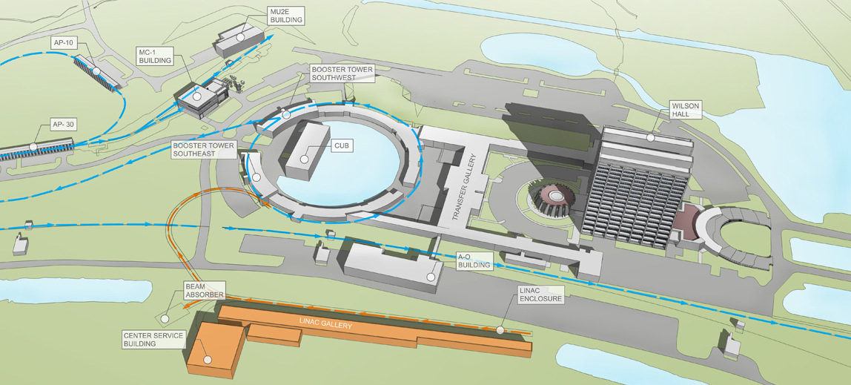
PIP-II SRF LINAC

Slide 3
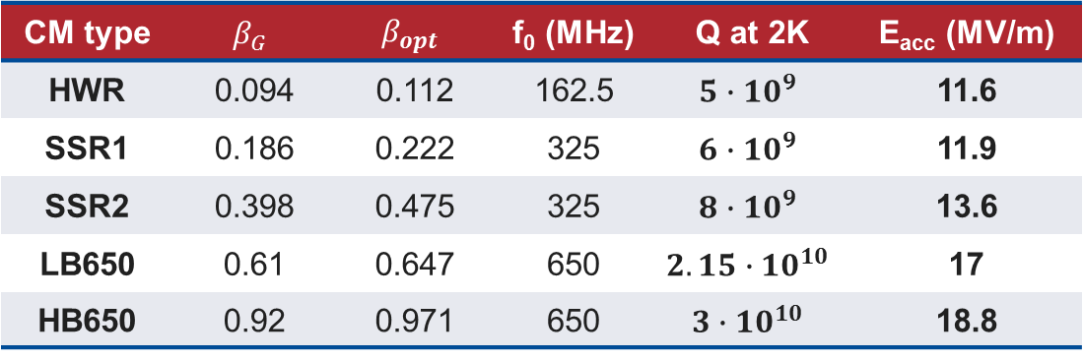
PIP-II: SC LINAC
10.3 MeV
185 MeV
800 MeV
To experiments
at 800 MeV
HWR β=0.112
SSR1 β=0.222
SSR2 β=0.475
LB650 β=0.647
HB650 β=0.97
2.1 MeV
35 MeV
500 MeV
To booster
CM type | $$β_{G}$$ | $$β_{opt}$$ | f₀ (MHz) | Q at 2K | E_{acc} (MV/m)
HWR | 0.094 | 0.112 | 162.5 | $$5∙{10}^{9}$$ | 11.6
SSR1 | 0.186 | 0.222 | 325 | $$6∙{10}^{9}$$ | 11.9
SSR2 | 0.398 | 0.475 | 325 | $$8∙{10}^{9}$$ | 13.6
LB650 | 0.61 | 0.647 | 650 | $$2.15∙{10}^{10}$$ | 17
HB650 | 0.92 | 0.971 | 650 | $$3∙{10}^{10}$$ | 18.8
In this presentation E_{acc} is defined calculating the effective cavity length using $β_{G}$ while the CDR uses $β_{OPT}.$ Therefore, the values of E_{acc} shown here are ~ 5 % larger than the values in the CDR.

Slide 4
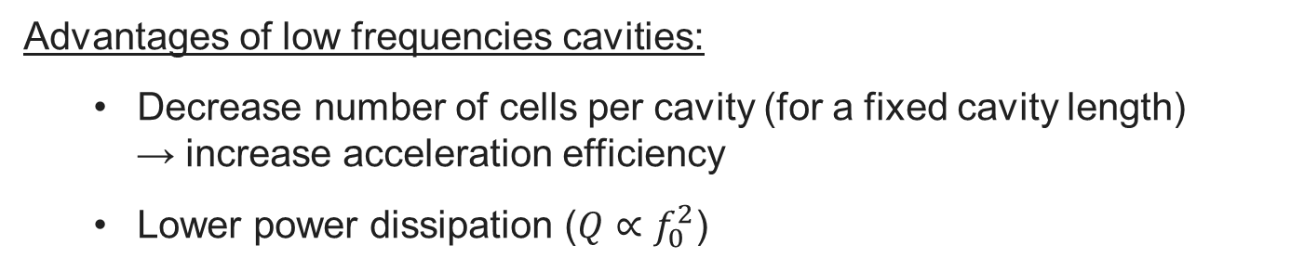
PIP-II: SC LINAC
Advantages of low frequencies cavities:
  Decrease number of cells per cavity (for a fixed cavity length)
  → increase acceleration efficiency
  Lower power dissipation ($Q∝f_{0}^{2}$)
Disadvantages of low frequencies cavities:
  Increase difficulties to suppress microphonics
  Large cost due to more niobium utilization

Slide 5
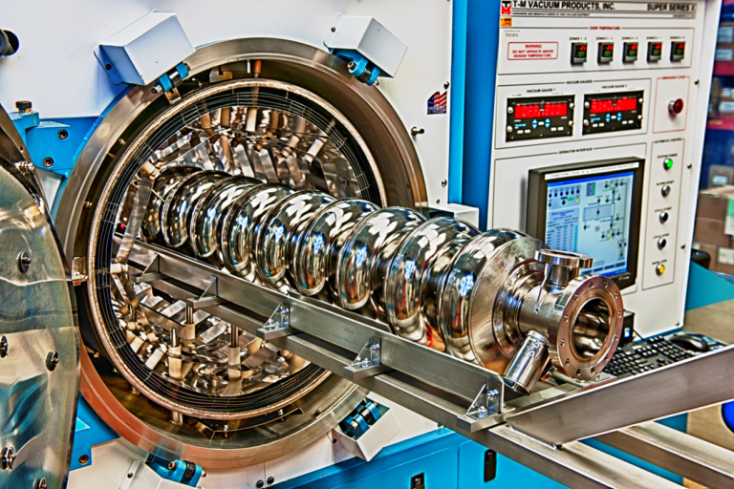
SRF Research on high-β 1.3 GHz cavities

Slide 6
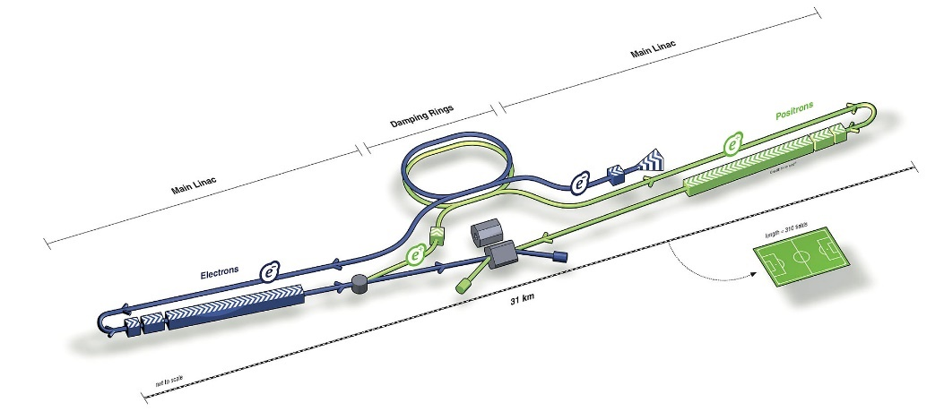
Standard SRF cavity surface treatments
Conventional Nb Cavities Surface Treatment (main steps):
Cavity after welding
3 h at 800 C UHV baking
48 h at 120 C baking
EP 140 μm
EP 40 μm
EP cavities
120C bake
cavities
Medium field
Q-slope
Treatment proposed for the ILC
High field
Q-slope

Slide 7
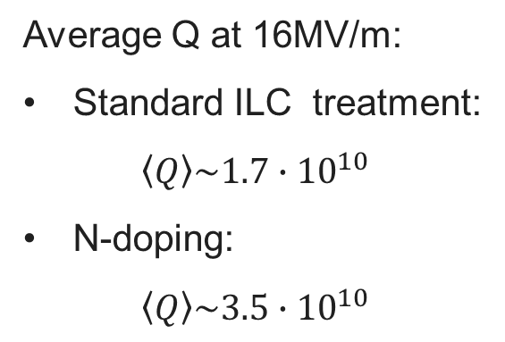
The discovery of N-doping
Q-factor improvement after N-doping – up to 4 times higher Q than standard Nb cavities
Typical Q vs Eacc curve obtained with 120C bake (standard ILC treatment)
Anti-Q-slope
Average Q at 16MV/m:
Standard ILC treatment:
$$\left\langle Q\right\rangle \sim 1.7∙{10}^{10}$$
N-doping:
$$\left\langle Q\right\rangle \sim 3.5∙{10}^{10}$$
A. Grassellino et al., Supercond. Sci. Technol. 26, 102001 (2013) – Rapid Communications

Slide 8
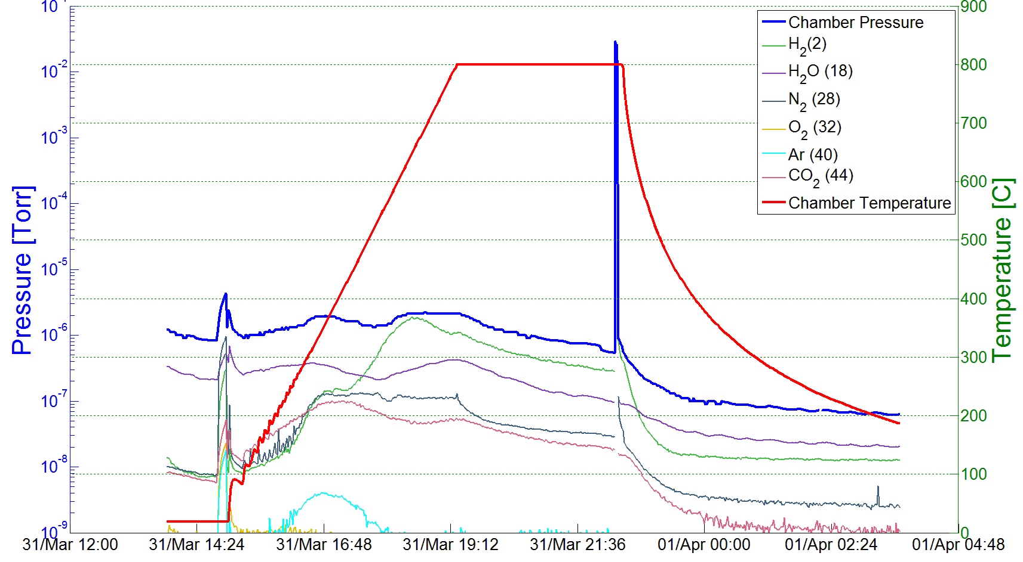

N-doping treatment
Cavity after welding
EP 140 μm
3 h at 800C UHV baking
48 h at 120C baking
N₂ injection 800C
EP 5 μm
Example of a N-doping process (2/6 recipe):
Nb bulk EP cavity annealed for 3 hours in vacuum (UHV furnace) at 800C
Nitrogen injected (25 mTorr) at 800C for 2 minutes
Cavity stays for another 6 minutes at 800C in vacuum
Cooling in vacuum
5 um electro-polishing (EP)
25 mTorr (2 minutes)
800 C (3 hours)

Slide 9
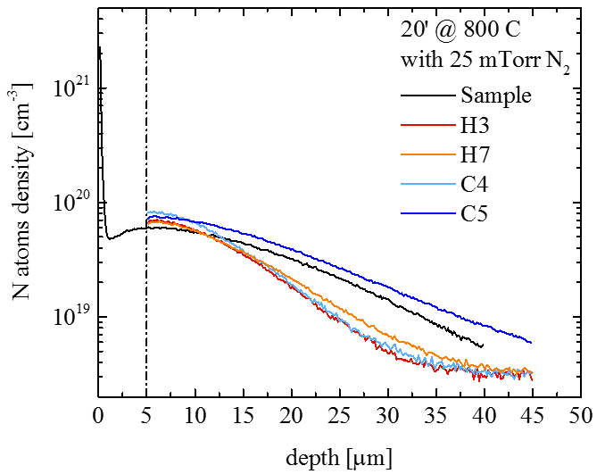
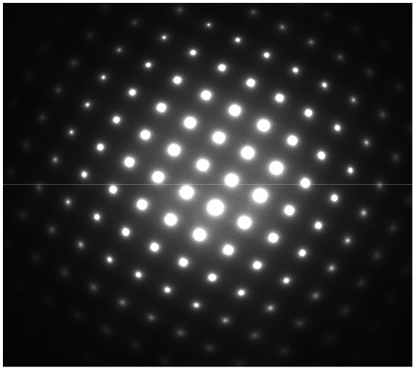
N-doping treatment (2/6 recipe)
Cavity after welding
EP 140 μm
3 h at 800C UHV baking
48 h at 120C baking
3 h at 800 C UHV baking
EP 5 μm
Only Nb from TEM/NED spectra:
N must be interstitial
Final RF Surface
Nb
Y. Trenikhina et Al, Proc. of SRF 2015
N
N Interstitial

Slide 10
Origin of the anti-Q-slope
$$R_{S} \left( 2 K,B_{Trap} \right)={R_{BCS} \left( 2 K \right)+R}_{0}+R_{Fl} ( B_{Trap},l )$$
Anti-Q-slope
Anti-Q-slope emerges from the BCS surface resistance decreasing with field
A. Grassellino et al, Supercond. Sci. Technol. 26 102001 (2013) - Rapid Communications
A. Romanenko and A. Grassellino, Appl. Phys. Lett. 102, 252603 (2013)

Slide 11
Effects of the nitrogen doping
LE-μSR measurements (Ba=25mT)
~15 nm - no screening
N-doped: mfp~40 nm
120C bake: mfp~2-16 nm
EP: mfp > 400 nm
A. Romanenko et al, Appl. Phys. Lett. 104, 072601 (2014)
A. Grassellino et al, Proc. of SRF2015
M. Martinello et al, Appl. Phys. Lett. 109, 062601 (2016)
N-doping modify the mean free path
→Mean free path close to theoretical minimum of R_{BCS}
N-doping seems to increase the reduced energy gap Δ/kTc at medium field

Slide 12
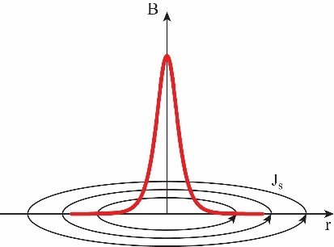
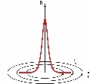
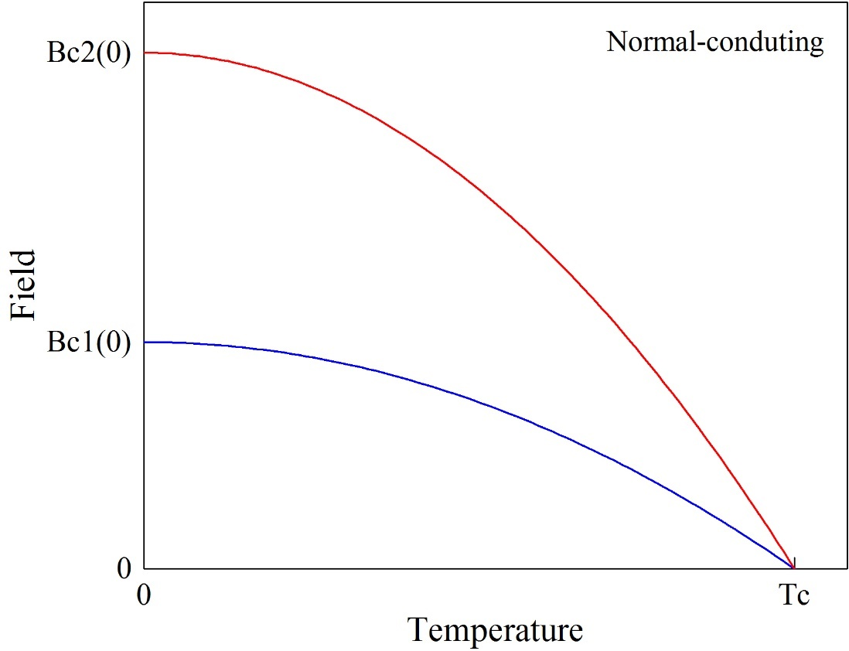
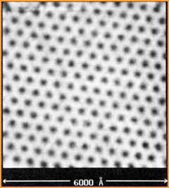
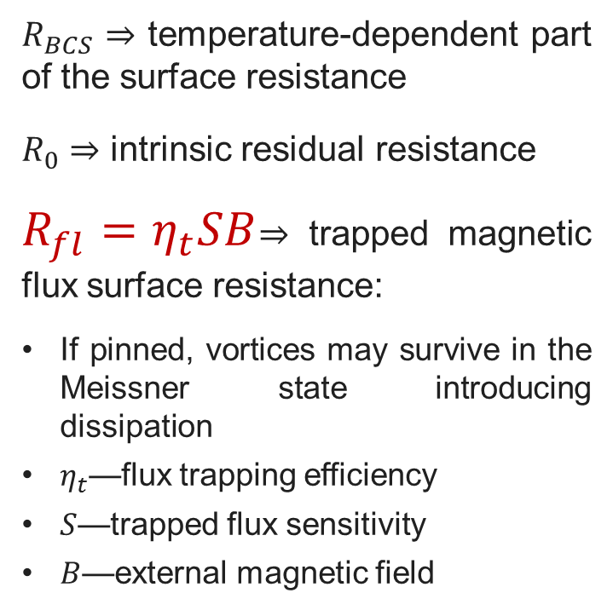

Trapped flux surface resistance
Vortex
Vortex lattice
$$R_{s}\left(T, B\right)=R_{BCS}\left(T\right)+R_{fl}\left(B\right)+R_{0}$$
$R_{BCS}$ ⇒ temperature-dependent part of the surface resistance
$R_{0}$ ⇒ intrinsic residual resistance
$R_{fl}=η_{t}SB$⇒ trapped magnetic flux surface resistance:
If pinned, vortices may survive in the Meissner state introducing dissipation
$η_{t}$—flux trapping efficiency
$S$—trapped flux sensitivity
$B$—external magnetic field
H. F. Hess et al., Phys. Rev. Lett. 62, 214 (1989)
$$B$$
Cooldown

Slide 13

Trapped flux surface resistance
$$R_{s}\left(2 K,B\right)={R_{BCS}\left(2 K\right)+R}_{0}+R_{fl}(B)$$
$$R_{fl}={B η}_{t} S$$
These losses can be reduced by minimizing these contributions:
$$B$$
𝐵
Magnetic shielding/hygiene improvement
$$η_{t}$$
𝜂_𝑡
Fast Cooling
Material Optimization
S
Optimizing mean free path

Slide 14

Trapped flux surface resistance
$$R_{s}\left(2 K,B\right)={R_{BCS}\left(2 K\right)+R}_{0}+R_{fl}(B)$$
$$R_{fl}={B η}_{t} S$$
These losses can be reduced by minimizing these contributions:
External magnetic field
$$B$$
𝐵
Magnetic shielding/hygiene improvement
$$η_{t}$$
𝜂_𝑡
Fast Cooling
Material Optimization
S
Optimizing mean free path

Slide 15
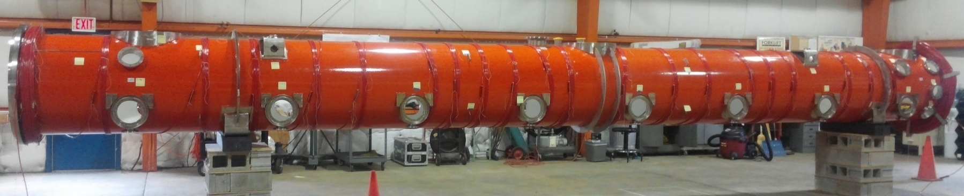
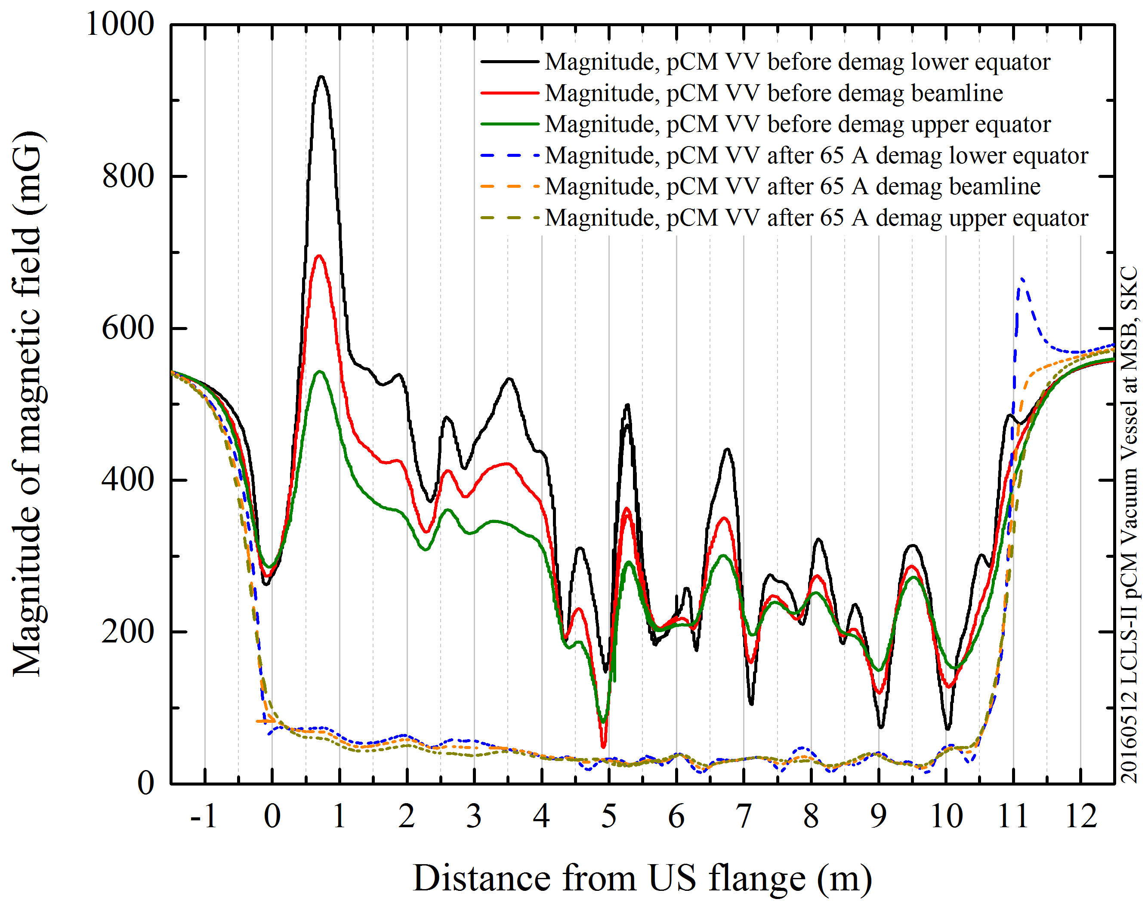
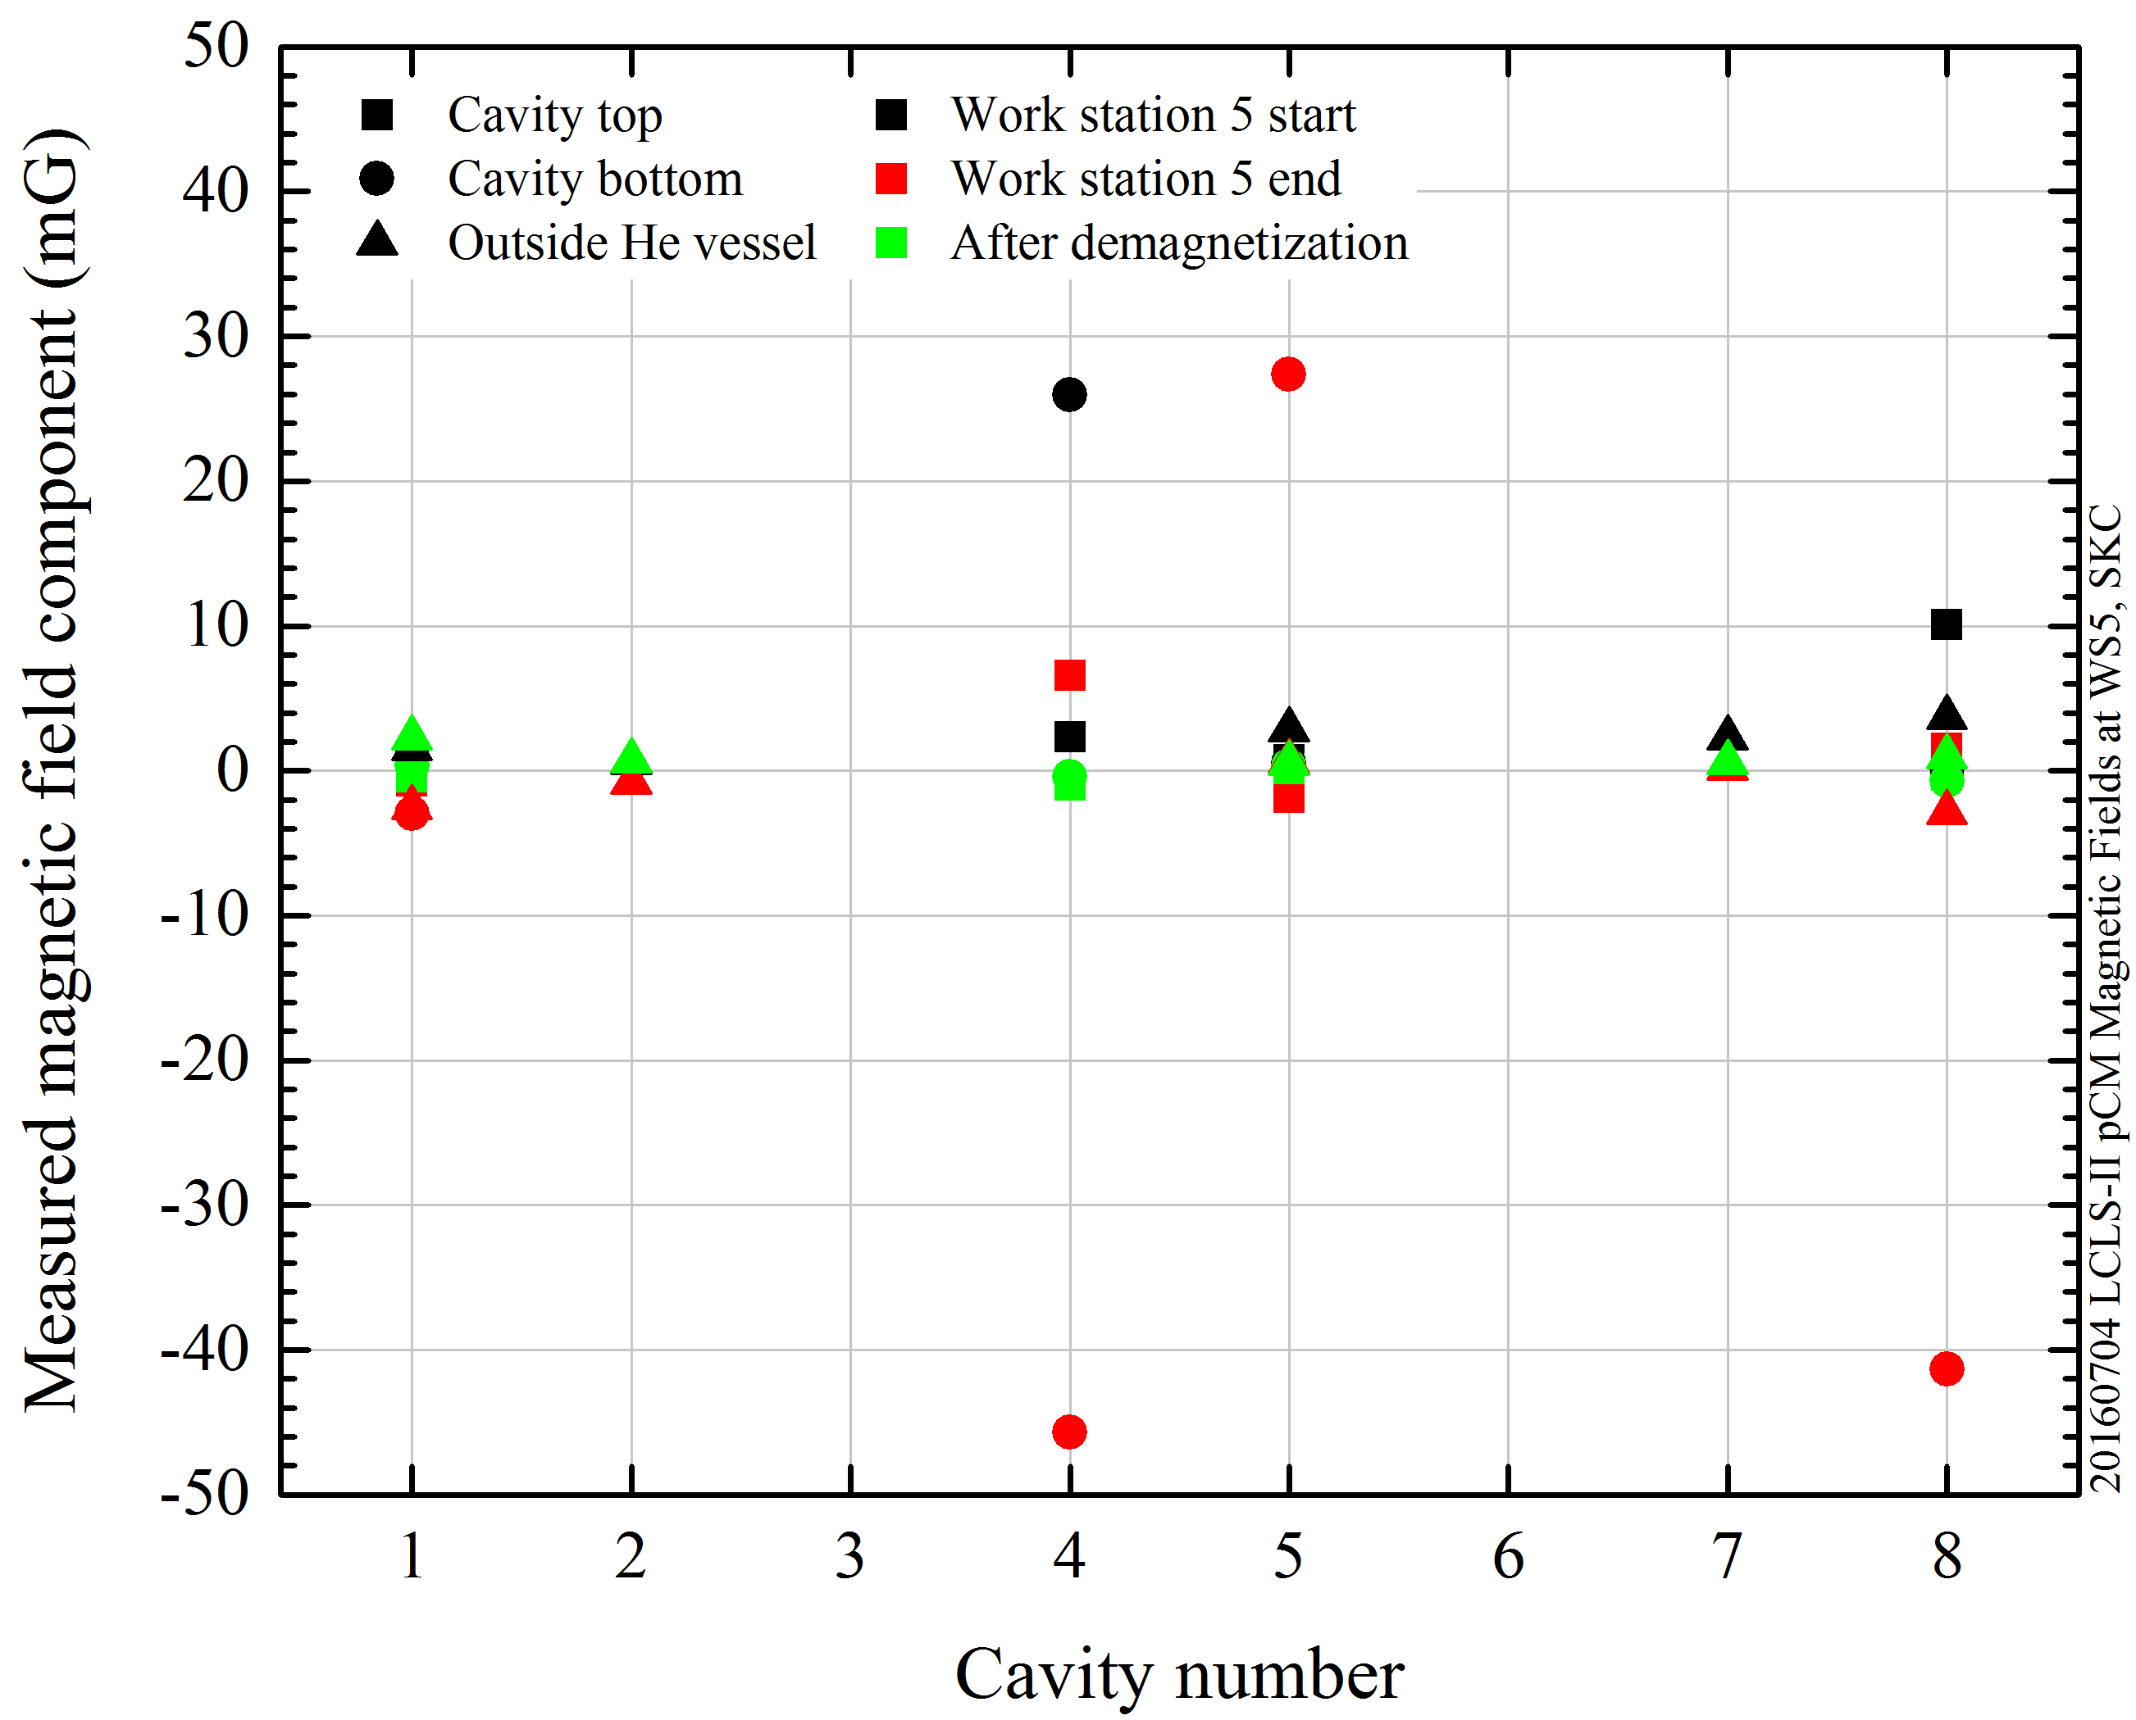
Minimization of remnant field in the cryomodule
Coils for magnetic field demagnetization
Empty vacuum vessel
Assembled Cryomodule
Demagnetization
Demagnetization

Slide 16
Trapped flux surface resistance
$$R_{s}\left(2 K,B\right)={R_{BCS}\left(2 K\right)+R}_{0}+R_{fl}(B)$$
$$R_{fl}={B η}_{t} S$$
These losses can be reduced by minimizing these contributions:
$$B$$
𝐵
Magnetic shielding/hygiene improvement
$$η_{t}$$
𝜂_𝑡
Fast Cooling
Material Optimization
S
Optimizing mean free path
Flux Trapping Efficiency

Slide 17
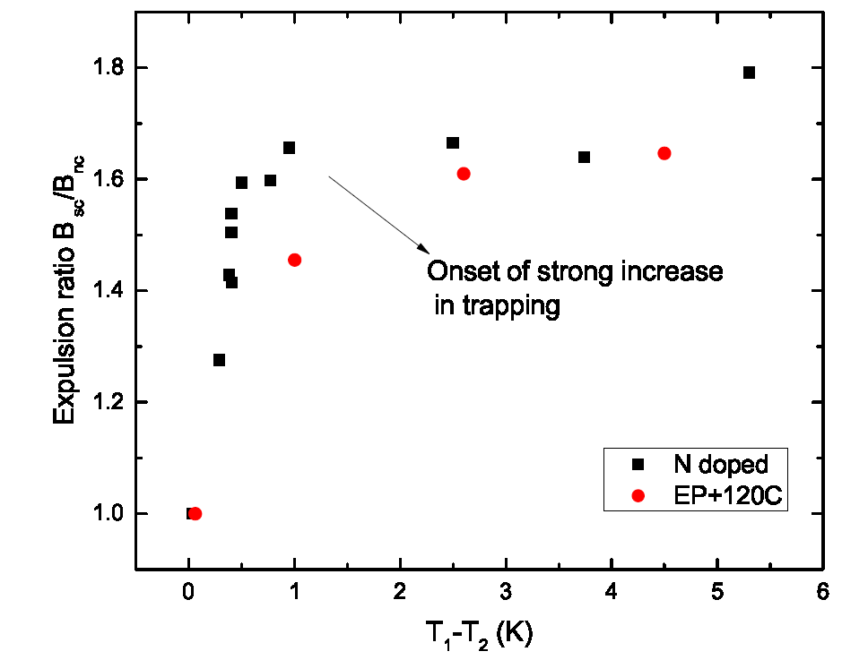
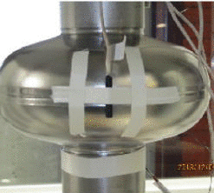
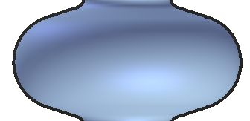
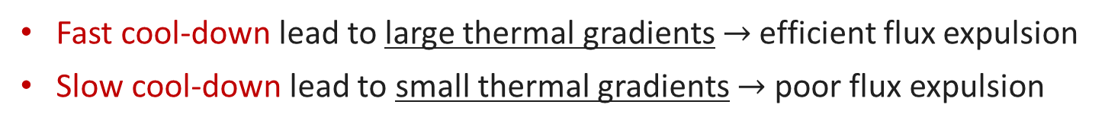
Fast cooldown helps flux expulsion
Fast cool-down lead to large thermal gradients $→$ efficient flux expulsion
Slow cool-down lead to small thermal gradients $→$ poor flux expulsion
T₁
B_{sc}/B_{nc}
Q₀
T₂
Efficient flux expulsion
All flux trapped
B_{sc}/B_{nc}=1.74 after complete Meissner effect
A. Romanenko et al., Appl. Phys. Lett. 105, 234103 (2014)
A. Romanenko et al., J. Appl. Phys. 115, 184903 (2014)
D. Gonnella et al, J. Appl. Phys. 117, 023908 (2015)
M. Martinello et al., J. Appl. Phys. 118, 044505 (2015)
S. Posen et al., J. Appl. Phys. 119, 213903 (2016)
S. Huang, Phys. Rev. Accel. Beams 19, 082001 (2016)
B_{sc}/B_{nc}=1 after full flux trapping

Slide 18
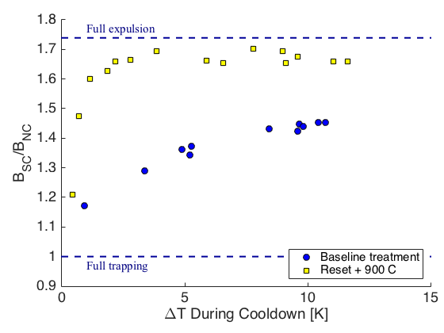
High T baking for flux expulsion improvement
Not all materials show good flux expulsion even with large thermal gradient
High T treatments are capable to improve materials flux expulsion properties
Full expulsion
Full expulsion
Full trapping
Full trapping
S. Posen et al., J. Appl. Phys. 119, 213903 (2016)

Slide 19
High T baking for flux expulsion improvement
Not all materials show good flux expulsion even with large thermal gradient
High T treatments are capable to improve materials flux expulsion properties
Full expulsion
Full expulsion
After 900C
After 1000C
Full trapping
Full trapping
S. Posen et al., J. Appl. Phys. 119, 213903 (2016)

Slide 20
Trapped flux surface resistance
$$R_{s}\left(2 K,B\right)={R_{BCS}\left(2 K\right)+R}_{0}+R_{fl}(B)$$
$$R_{fl}={B η}_{t} S$$
These losses can be reduced by minimizing these contributions:
$$B$$
𝐵
Magnetic shielding/hygiene improvement
$$η_{t}$$
𝜂_𝑡
Fast Cooling
Material Optimization
S
Optimizing mean free path
Trapped Flux Sensitivity

Slide 21
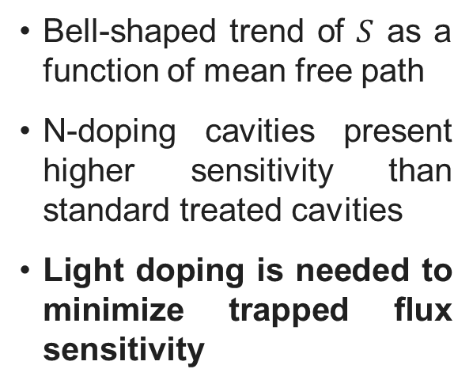
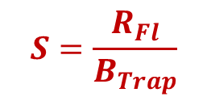
Light doping to minimize trapped flux sensitivity
Trapped flux sensitivity:
$$S=\frac{R_{Fl}}{B_{Trap}}$$
Bell-shaped trend of $S$ as a function of mean free path
N-doping cavities present higher sensitivity than standard treated cavities
Light doping is needed to minimize trapped flux sensitivity
M. Martinello et al., App. Phys. Lett. 109, 062601 (2016)

Slide 22
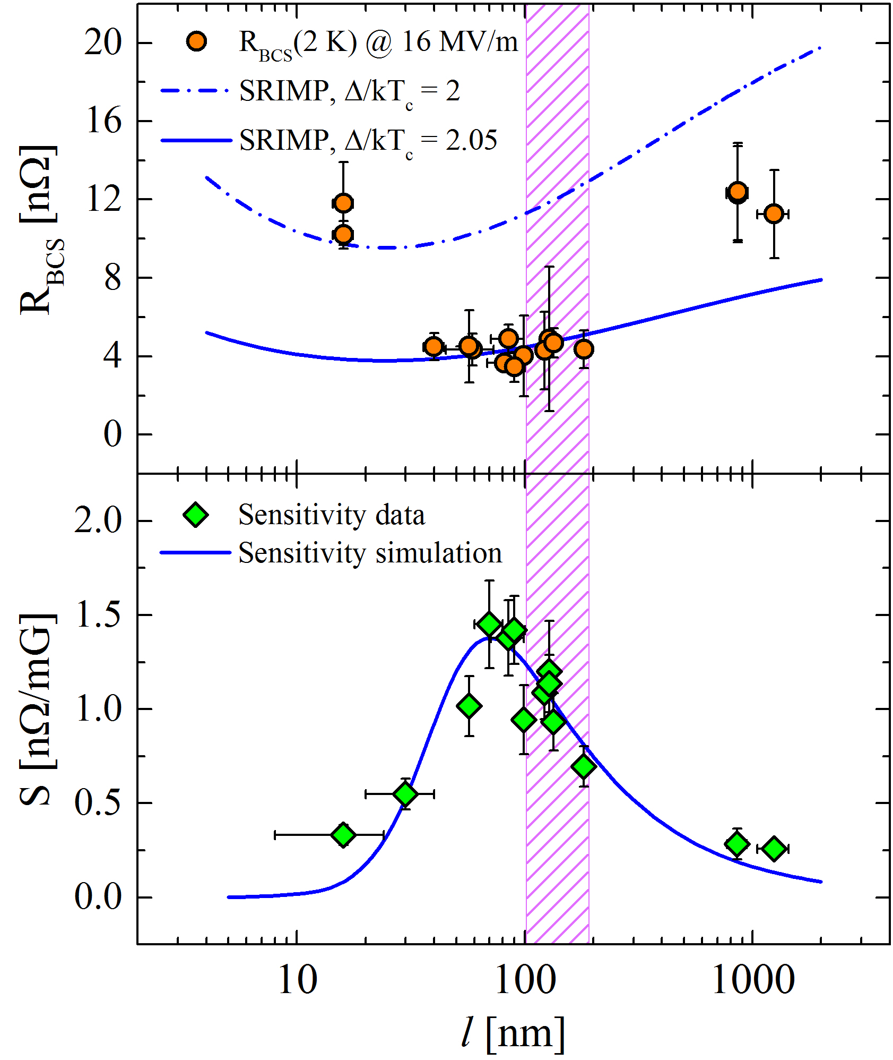
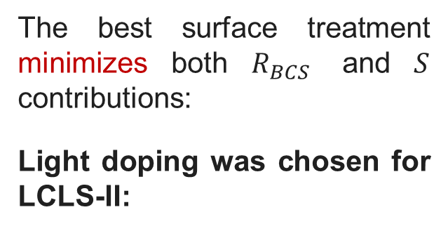
Minimizing $R_{s}$ at 16 MV/m
The best surface treatment minimizes both $R_{BCS}$ and $S$ contributions:
Light doping was chosen for LCLS-II:
Very low values of R_{BCS}
Acceptable values of sensitivity
Low residual resistance
M. Martinello et al., App. Phys. Lett. 109, 062601 (2016)
M. Checchin et al., Supercond. Sci. Technol. 30, 034003 (2017)

Slide 23
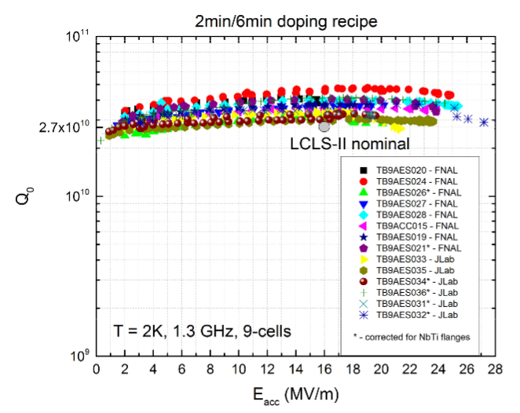
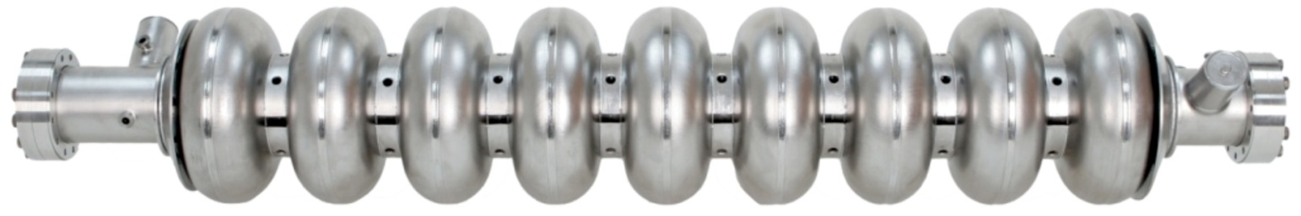
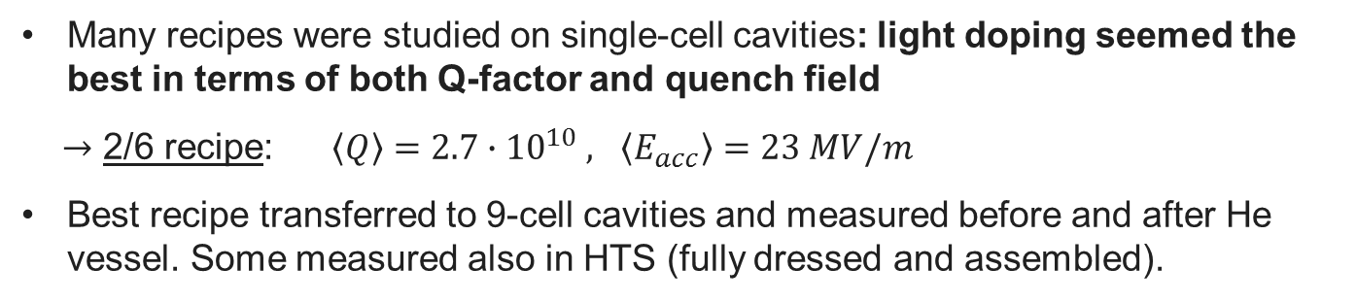
N-doping from R&D to production
FNAL single cell cavities
Bare 9-cell cavities with 2/6 doping recipe
Many recipes were studied on single-cell cavities: light doping seemed the best in terms of both Q-factor and quench field
$→$ 2/6 recipe: $\left\langle Q\right\rangle =2.7∙{10}^{10} , \left\langle E_{acc}\right\rangle =23 MV/m$
Best recipe transferred to 9-cell cavities and measured before and after He vessel. Some measured also in HTS (fully dressed and assembled).

Slide 24
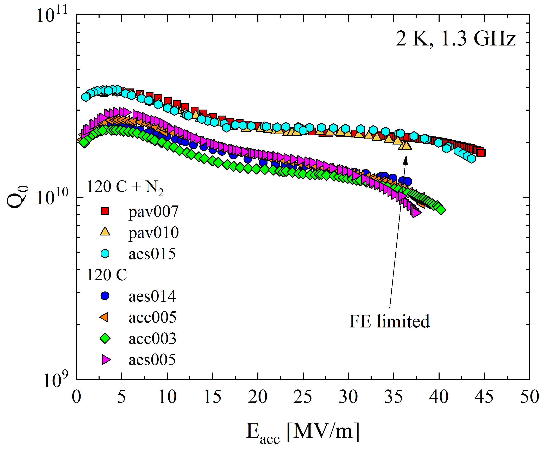
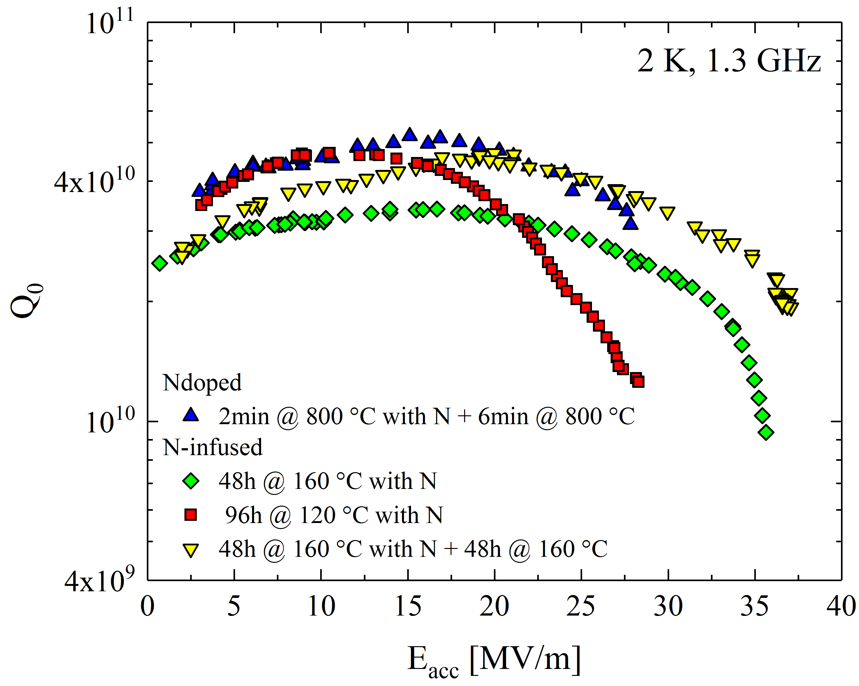

N-infusion Performance
A. Grassellino et al., arXiv:1305.2182
The N-infusion performance can be tuned by acting on time and temperature:
Shorter treatment and lower T → 120 C baking like behavior
Longer treatment and/or higher T → N-doping like behavior

Slide 25
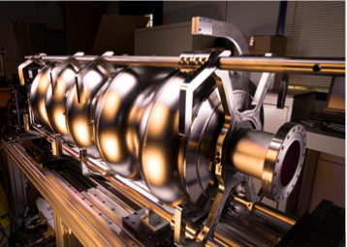
Status of SRF Technology for PIP-II

Slide 26
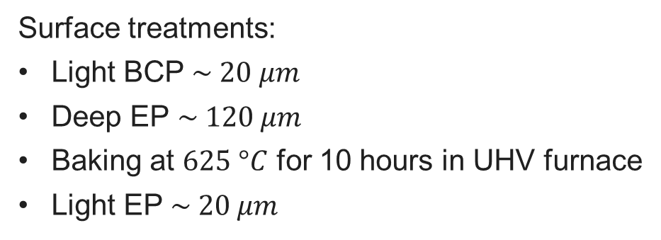
162.5 MHz Half-Wave Resonators
Surface treatments:
Light BCP $\sim 20 μm$
Deep EP $\sim 120 μm$
Baking at $625 °C$ for 10 hours in UHV furnace
Light EP $\sim 20 μm$
Bare HWR before jacketing
Bulk and light EP of jacketed HWR @ ANL
*HWR technology developed at ANL via ANL/FNAL PIP-II Collaboration.
Z. Conway, A. Barcikowski, S. Gerbik, C. Hopper, M.P. Kelly, M. Kedzie, S. Kim, P. Ostroumov, T. Reid.

Slide 27
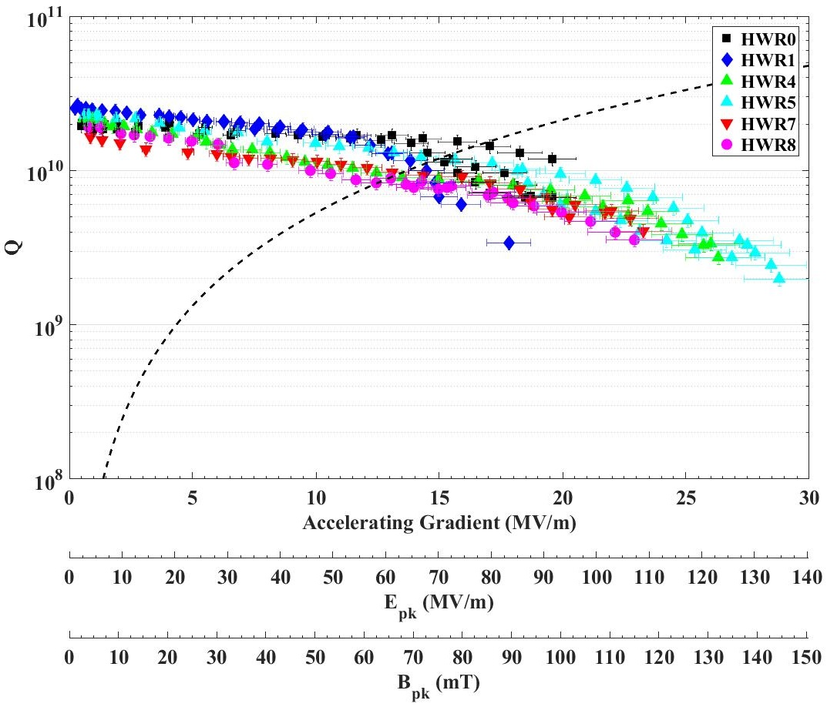
HWR 2 K Test Results
Curtesy of A. Lunin and Z. Conway
PIP-II specs

Slide 28
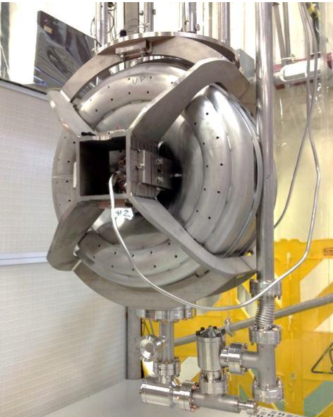
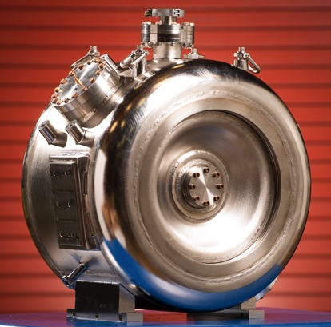
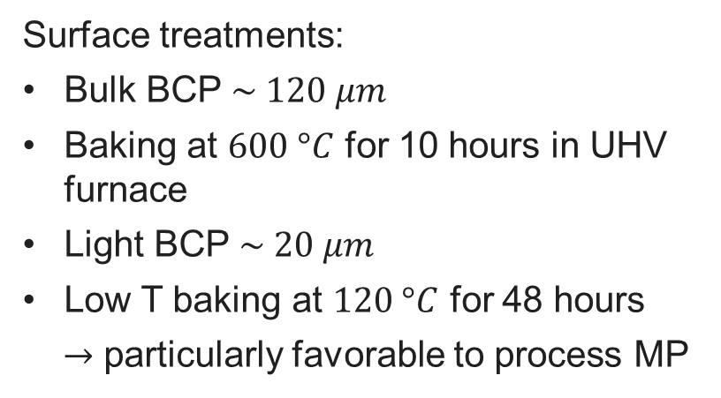
SSR1: 325 MHz Single Spoke Resonators
Surface treatments:
Bulk BCP $\sim 120 μm$
Baking at $600 °C$ for 10 hours in UHV furnace
Light BCP $\sim 20 μm$
Low T baking at $120 °C$ for 48 hours
$→$ particularly favorable to process MP
L. Ristori, M.H. Awida ,P. Berrutti, T.N. Khabiboulline, M. Merio, D. Passarelli, A. Rowe, D.A. Sergatskov, A.I. Sukhanov,
Proc. of IPAC 2013, Shangai, China

Slide 29
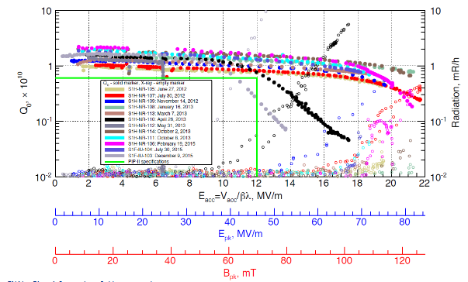
SSR1 VTS Test Result
Curtesy of A. Sukanov
PIP-II
specs

Slide 30
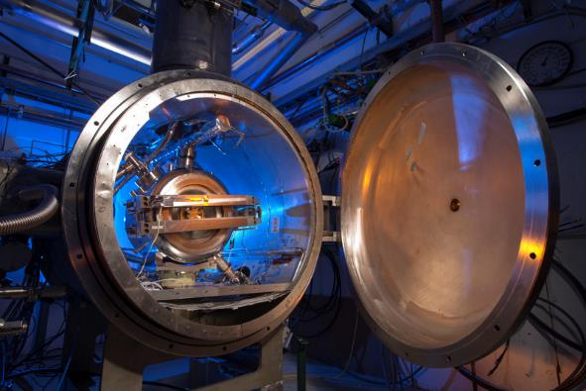
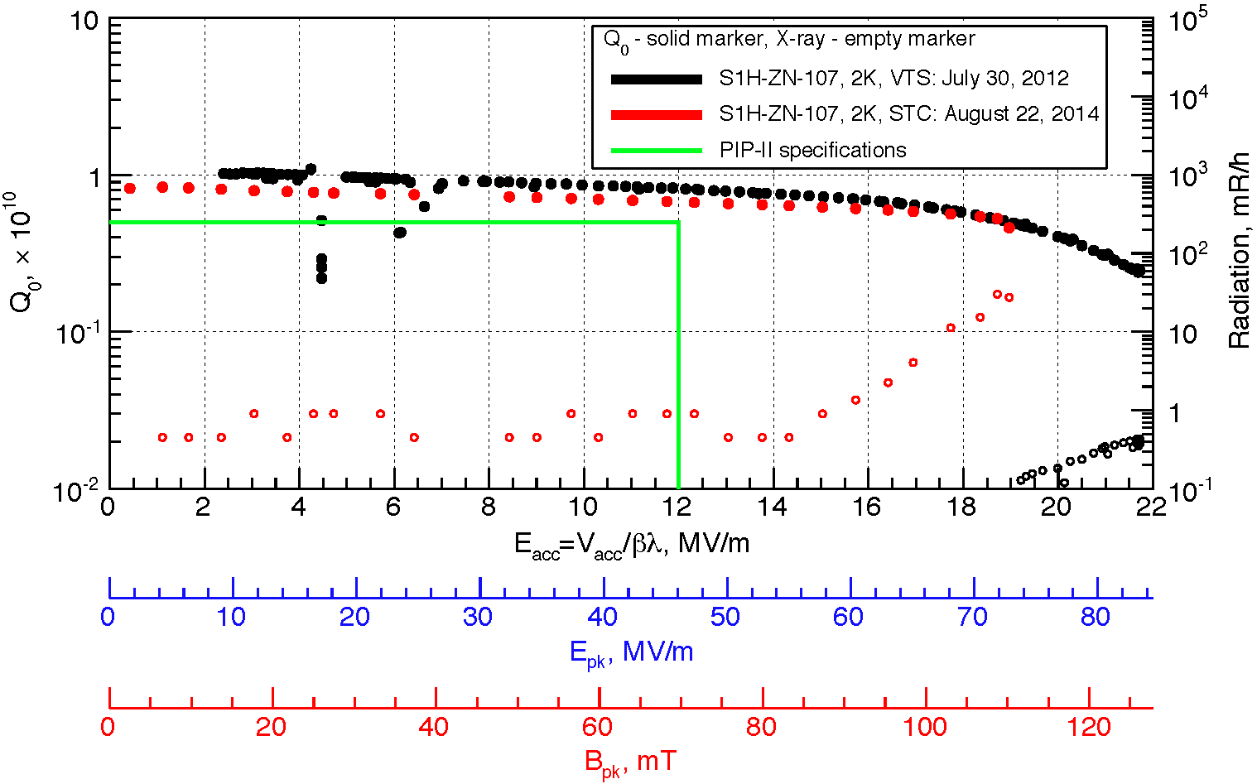
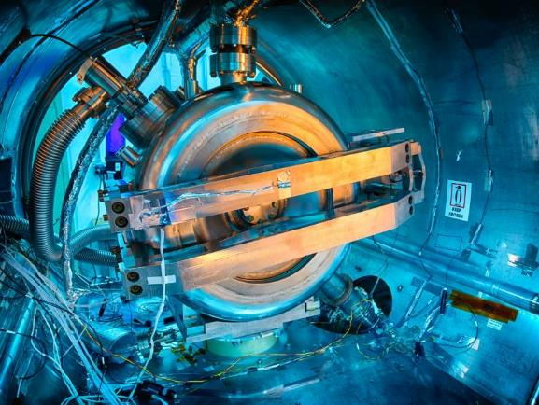
Fully-Integrated Tests in STC
First jacketed cavities tested in the Spoke Test Cryostat (STC)
2 cavities tested with unit coupling → successful test, no degradation between VTS and STC
3 cavities tested with prototype coupler → 2 showed high level of FE, cavities will be re-HPR, re-assembled in ANL clean-room and re-tested
Prototype tuner
PIP-II
specs
Prototype coupler
A. Sukhanov et al., Proceedings of LINAC2014, Geneva, Switzerland

Slide 31
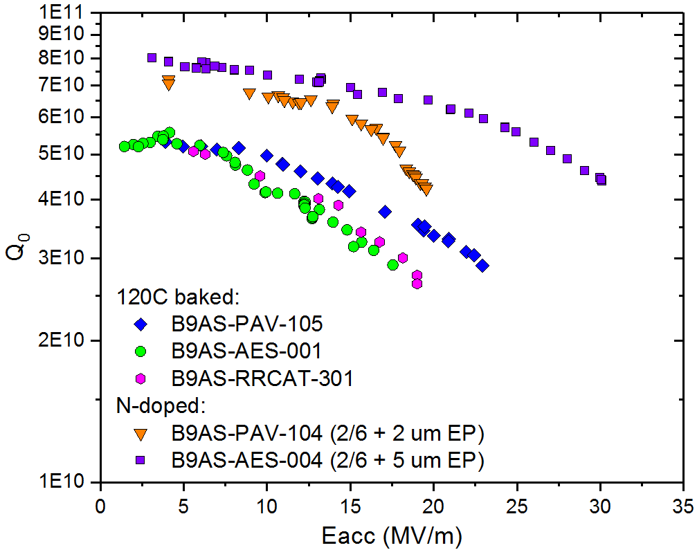
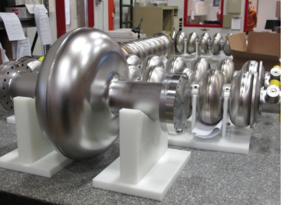
HB650 Single-cell Test Results
120C baked cavities not always meet specs
N-doping capable to double the Q-factor at medium field
World record Q-factor of 7e10 at 2K,17 MV/m and 650 MHz with N-doping
PIP-II
specs

Slide 32
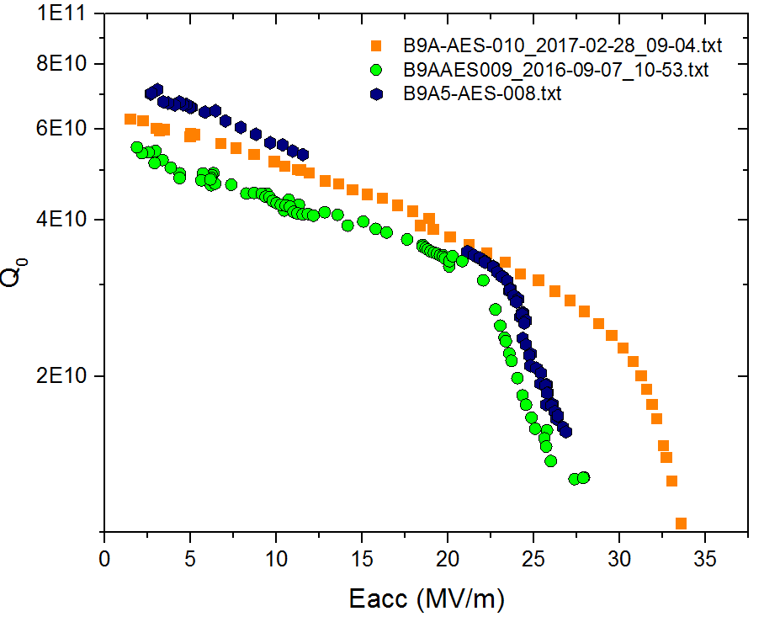
HB650 5-cells Tests Results (all N-doped)
Light N-doping applied to 650 MHz cavities
3 N-doped 5-cells 650 MHz cavities meet PIP-II specification
Optimal doping may increase Q-factor even more
B9A-AES-010
B9A-AES-009
B9A-AES-008
PIP-II
specs

Slide 33
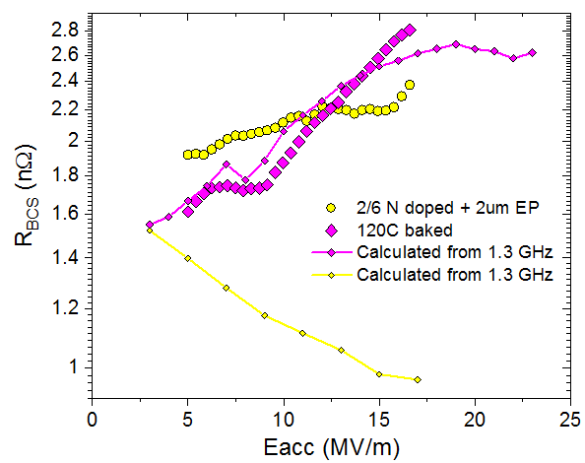
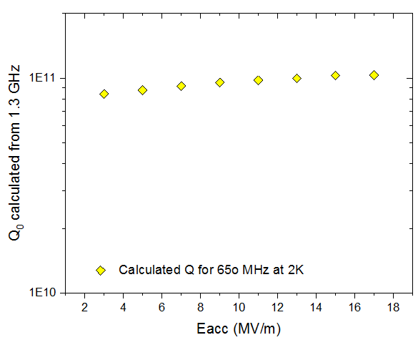
Expected Q-factor from 1.3 GHz scaling
The Q extrapolated at 2 K for 650 MHz from 1.3 GHz is really promising
The results obtained so far for 650 MHz N-doped cavities are encouraging but do not meet the Q extrapolated from 1.3 GHz, meaning that optimal doping for 650 MHz cavities has not been found yet

Slide 34
Conclusion and Future plan
HWR and SSR1 cavities meet PIP-II specs with standard treatments
It is established that N-doping can provide high Q-factors at medium field at 650 MHz
Optimal doping recipe for 650 MHz cavities to be investigated
Trapped flux sensitivity and flux expulsion to be studied to set specification of magnetic field shielding
Soon N-infused 650 MHz cavity will be tested, potentially good for both high-Q and high gradient

Slide 35
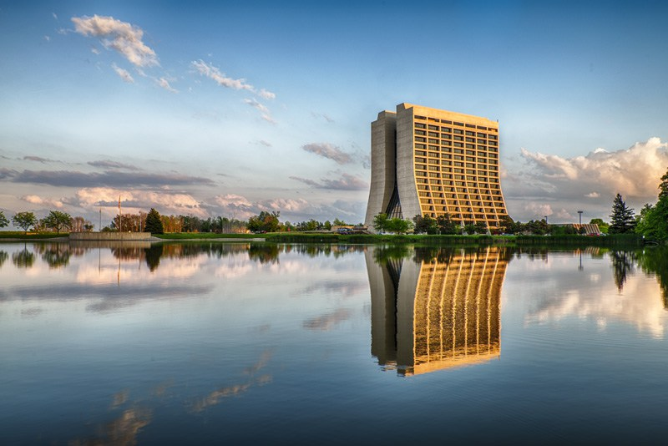
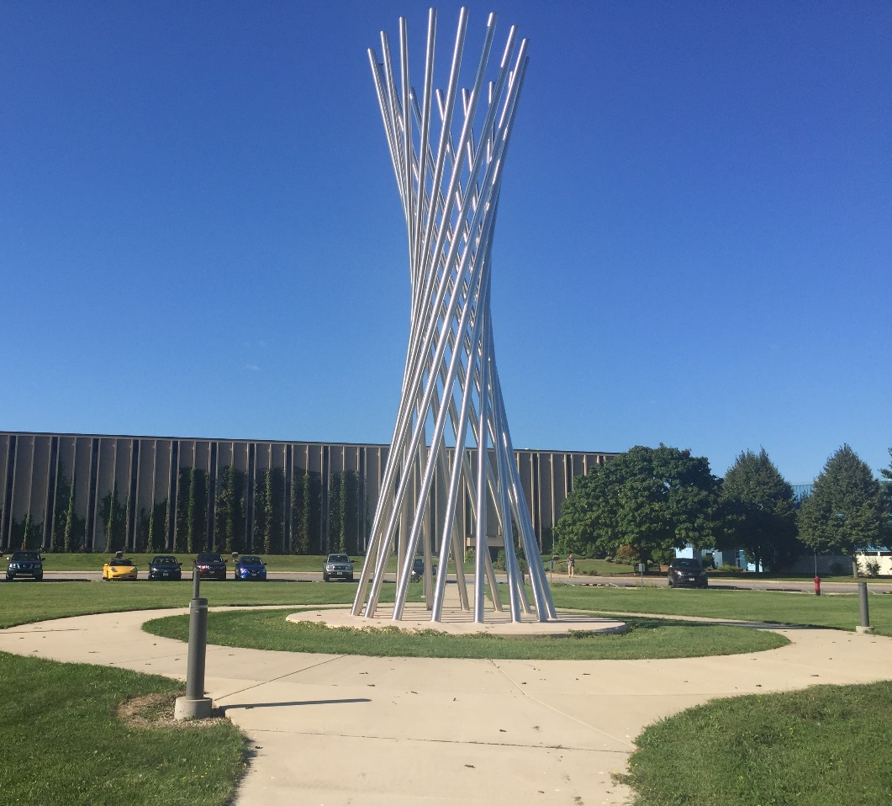
Thank you for your attention

Slide 36
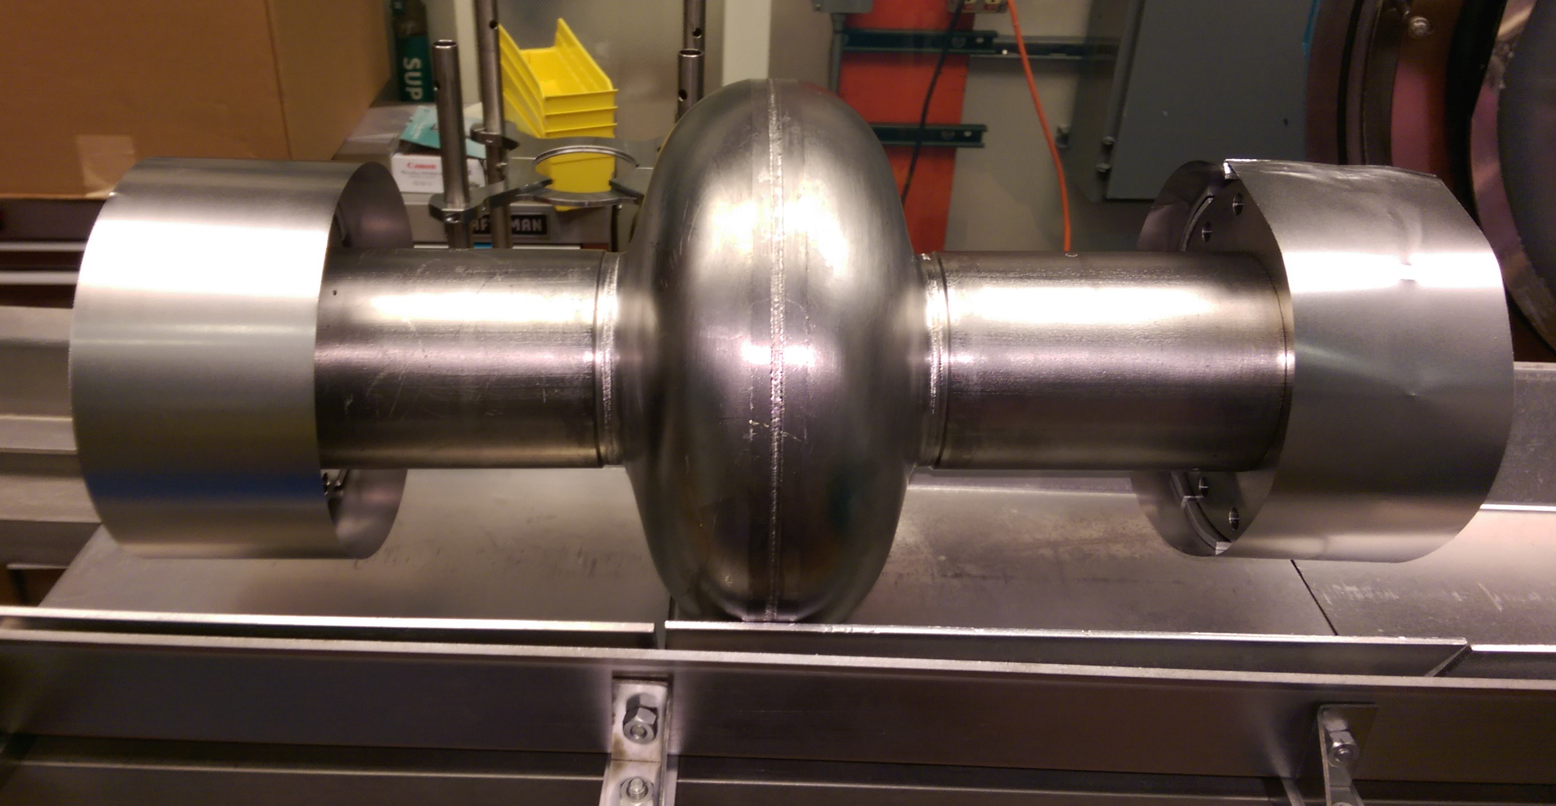
N-infusion Thermal Process
Bulk EP
High T furnace with caps to avoid furnace contamination:
  3h @ 800C in HV
  48h @ 120-160 C with N₂ (25 mTorr)
  Optional annealing 48h @ 120-160 C
NO chemistry post furnace
800 C
25 mTorr
Pressure (Torr)
Temperature (⁰C)
120 C
Protective caps and foils are BCP’d prior to every furnace cycle and assembled in clean room, prior to transporting the cavity to furnace area
A. Grassellino et al., arXiv:1305.2182

