Slide 1
Conceptual Design Development
PIP-II Warm Frontend
Lionel Prost
PIP-II Machine Advisory Committee Meeting
10-12 April 2017

Slide 2
Outline
Overall performance requirements
Conceptual design
From PIP2IT to PIP-II

Slide 3

Scope
The warm front end prepares a H⁻ beam optimized for injection into the Booster and provides capabilities for future CW operation
It is composed of a(n):
  Ion Source (IS) and
  Low Energy Beam
  Transport (LEBT)
    DC/long pulse operation
  Radio Frequency
  Quadrupole (RFQ)
    CW operation (RF)
    30 keV ⇒ 2.1 MeV
  Medium Energy Beam Transport (MEBT)
    Nominal current: 2 mA averaged
    over ~μs (from μs to CW operation)
    Bunch-by-bunch chopping
    capability

Slide 4
Overall performance requirements
Parameter | Requirement | Units
Particle species | H⁻
Output beam energy (kinetic) | 2.1 | MeV
Bunch repetition rate | 162.5 | MHz
Nominal output beam current (average) | 2 | mA
Nominal charge per bunch (RFQ current) | 30 | pC
Sequence of bunches | Programmable
Beam pulse duration* | 0.55 | ms
Beam pulse repetition rate* | 20 | Hz
Normalized rms beam emittance - Transverse | ≤ 0.23 | mm mrad
Normalized rms beam emittance - Longitudinal | ≤ 0.31 | mm mrad
* For injection into the Booster
Emittance requirements are specified for an ion source beam current (DC) in the range of 2-5 mA

Slide 5
Design choices highlights
SRF (HWR cryomodule) directly follows MEBT
High average current out of the RFQ (5 mA nominal, up to
10 mA) with fast chopper providing bunch-by-bunch selection to satisfy clean in-bucket injection into the Booster
  Also provides platform for future multi-user operation
  Long MEBT to accommodate chopping scheme
30 keV ion source to limit space charge effects in LEBT
  Compromise with adiabatic bunching in the RFQ, which is more efficient at low kinetic energy
Partial neutralization transport scheme in LEBT
2.1 MeV output energy to simplify maintenance
  Below neutron production threshold for most materials

Slide 6
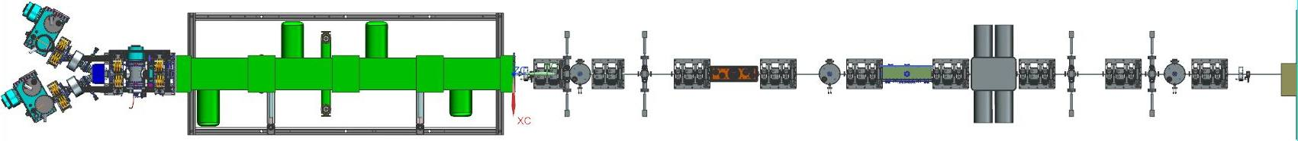
Design choices highlights (cont’)
Attention given to factors that may determine reliability and uptime
  Two ion sources with switching magnet to optimize beam availability
  Low gas flow to RFQ (→ Long LEBT)
  Proven-design RFQ
  Low particle loss to RFQ structure
  System of scrapers in LEBT and MEBT
    Passive and active parts of MPS
  Very low gas flow to SRF (→ Differential pumping section)
Ion sources
RFQ
LEBT
MEBT

Slide 7
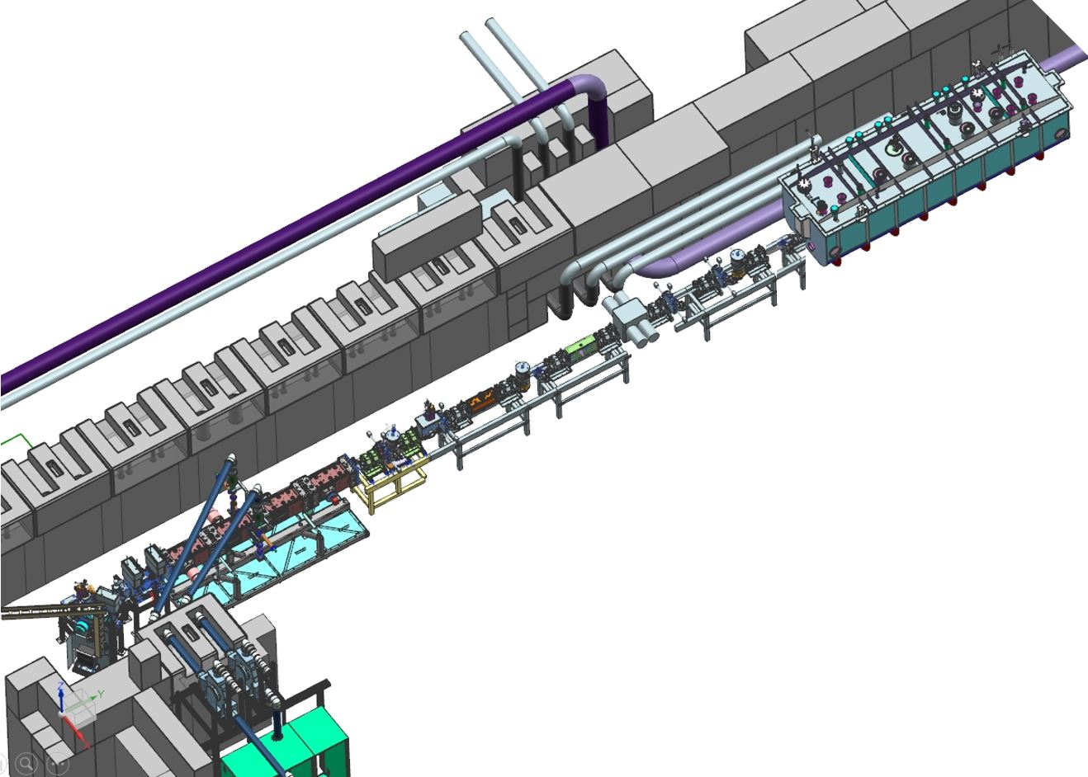
PIP-II Injector Test (PIP2IT)
Warm frontend at PIP2IT as close as possible to PIP-II front end as it is envisioned now
Will address all critical issues:
  LEBT with low emittance growth compatible with chopping ✓
    Vacuum management in the LEBT/RFQ region ✓
  Reliable CW RFQ, including couplers (partially ✓)
  Bunch-by-bunch selection in MEBT
    Bunch extinction, effective emittance
    growth
  Compatibility of high-power
  deposition in MEBT absorber
  with SRF downstream
    Absorber reliability & lifetime
Warm front end of PIP2IT with HWR installed

Slide 8
Findings and new prerequisites (since last P2MAC)
Warm front-end should be available for public viewing
  Radiation measured at PIP2IT (at 2.1 MeV) → Minimum safety distance
    No residual radiation
    Viewable from High-Bay gallery
    Adequate shielding from high energy part of the linac
Protection of SRF from absorber vacuum failure → Increased distance to HWR
  Determined by the time it takes to close a fast-acting valve and the speed of a shock wave propagation
    > 5m
Extend MEBT by ~3.5m and add space for a radiation protection wall

Slide 9
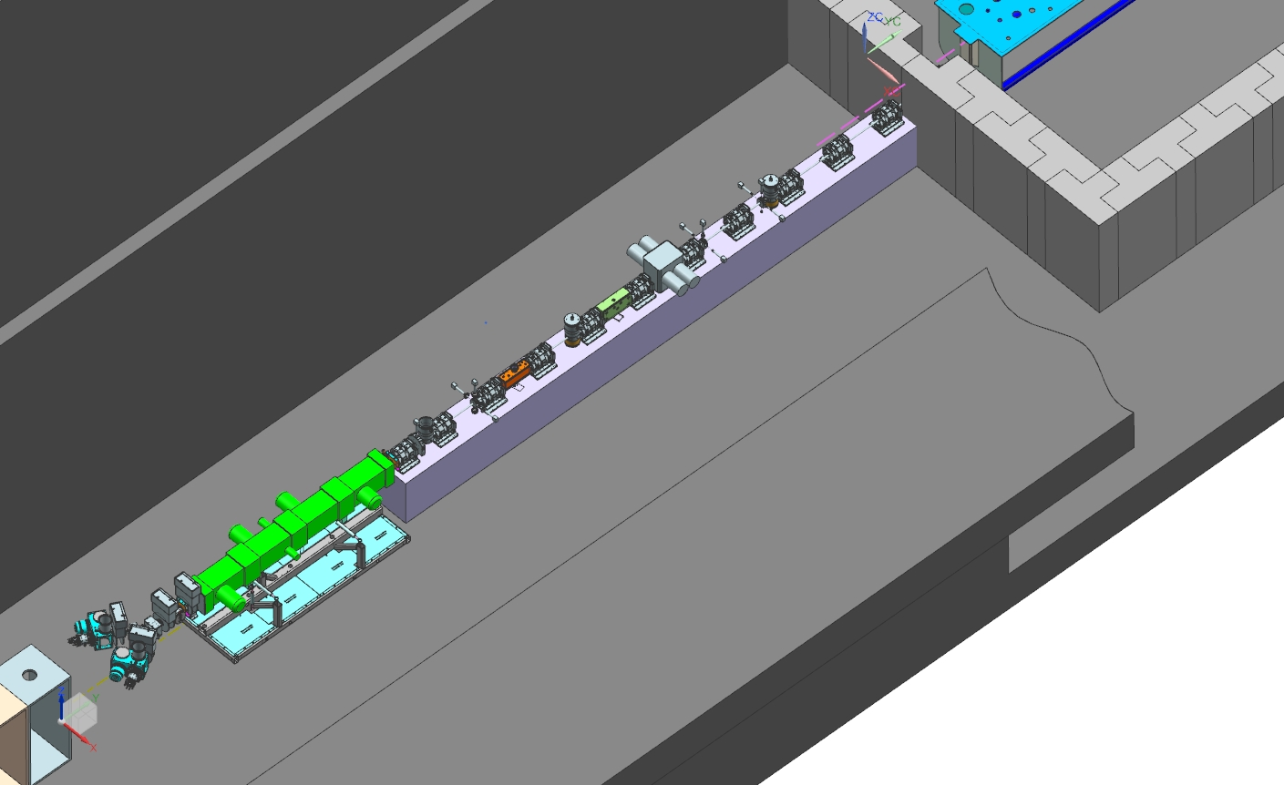
Conceptual design
Two ion sources with switching magnet (30 keV, 10 mA DC)
2-m long LEBT with partial neutralization
RFQ: 4.4-m, 2.1 MeV, 162.5 MHz CW, 4-vane
MEBT: 14-m, bunch-by-bunch chopping system; radiation protection wall; differential pumping after absorber
HWR
MEBT
LEBT
RFQ
Two ion sources

Slide 10
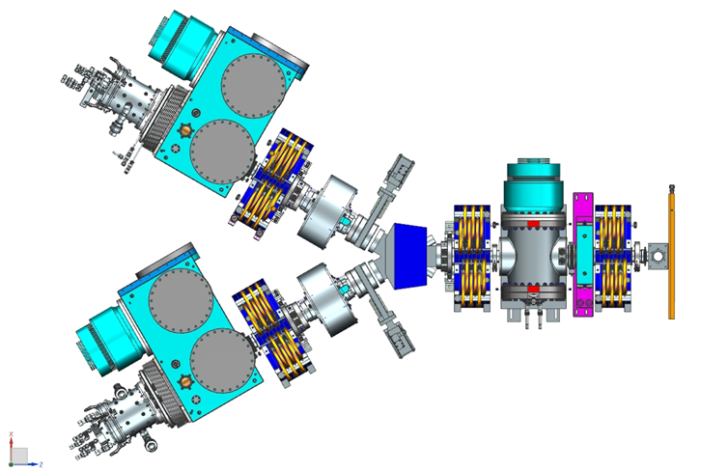
Ion source & LEBT PIP-II conceptual design
Two identical legs
  Ion source w/ differential
  pumping chamber and port
  for emittance scanner
Partially neutralized transport
  Vacuum at ion source and RFQ
  differ by ~10³. Hence,
  neutralization time changes
  from μs to ms → Optimal tune for short pulse may noticeably differ from long pulse or DC operation
  ⇒ Atypical transport scheme in which the beam is not neutralized in the downstream part of the LEBT, independently of its time structure
Bending magnet
Ion source
Solenoid
Toroid
Emittance scanner port
Valve
Movable scraper
DCCT
Chopper

Slide 11
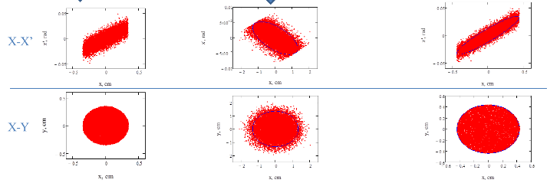
Transport scheme with un-neutralized section ✓
Beam generated by the ion source has a ~uniform current density distribution but thermal velocity distribution
  Neutralized transport is interrupted where the beam distribution is uniform again ⇒ ~linear space charge forces ⇒ ~No emittance growth in the remaining part of the LEBT
High vacuum pressure
  Gas load from ion source
Neutralizing particles confined by potential barrier
Low vacuum pressure
  Limits rate of production of neutralizing particles
Clearing electric field
  Sweeps neutralizing particles out of the beam
Potential barrier
Successfully tested at PIP2IT

Slide 12
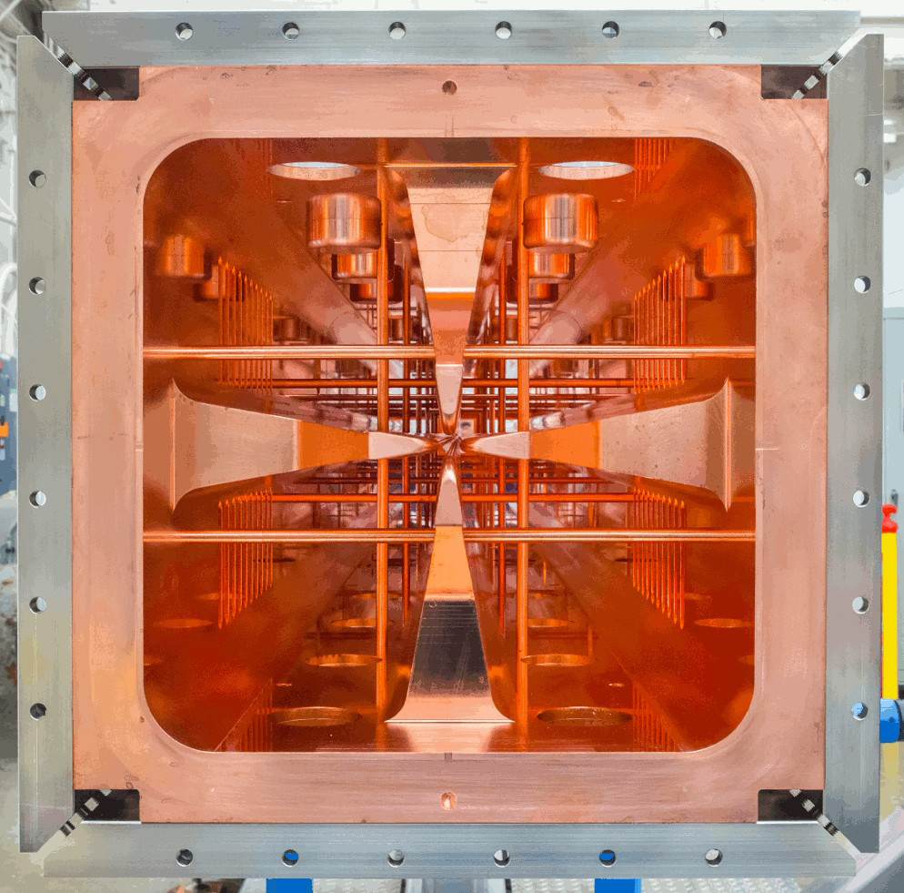
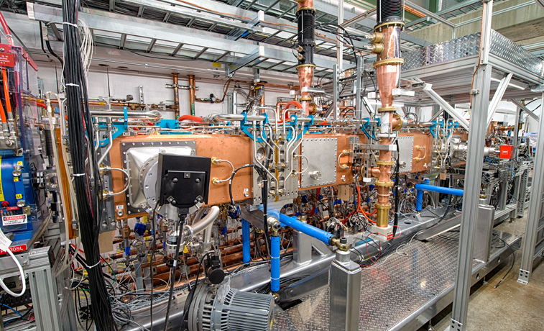
RFQ key design elements
2.1 MeV, 162.5 MHz CW RFQ ✓
Four-vane copper structure (LBNL design)
  Detailed RF and beam simulations have been
  performed
    Output emittances ε⊥ < 0.2 μm, ε_{L} < 0.28 μm
32 water-cooled pi-mode rods for transverse
quadrupole mode
stabilization
80, evenly spaced, fixed
slug tuners for final
frequency adjustment
and local field
perturbation corrections
RFQ installed at CMTF

Slide 13
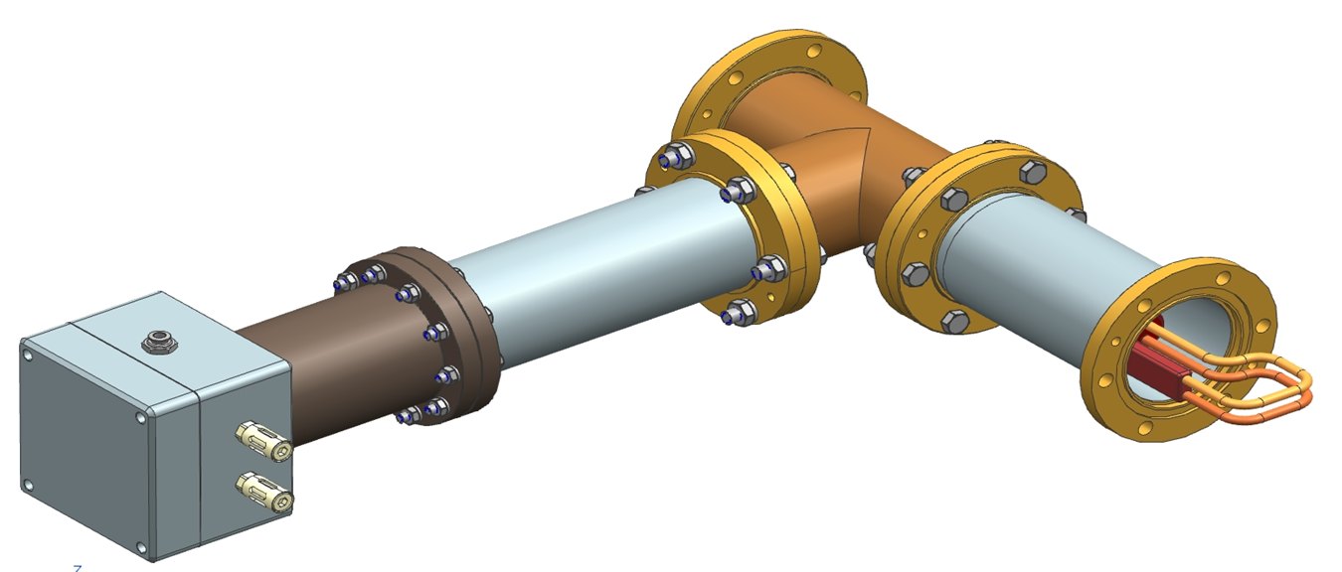
RFQ key design elements (cont’)
Two 75-kW input couplers
  Forced-air cooled antenna
  Antenna capacitively coupled to the end-wall, allowing DC
  biasing to reduce multipacting around the couplers
Two 75-kW, 162.5-MHz solid-state power amplifiers ✓
  Each amplifier protected from reflected power by a 75-kW circulator
Resonant frequency controlled by
adjusting ΔT between the vanes
and RFQ walls water circuits ✓
  Adaptive control system designed
  to regulate the steady state
  temperature of the RFQ cooling
  system to better than 0.1°C
Solid model of the RFQ input coupler design

Slide 14
PIP-II MEBT functions
Typical MEBT main functions
  Optical matching between the RFQ and main linac
  Instrumentation to measure beam properties
Additional features of the PIP-II MEBT
  Bunch-by-bunch selection
    Wideband kickers direct unneeded bunches to an absorber and transfer bunches chosen for further acceleration into the SC linac
  System of scrapers (distributed along the beam line)
    Protects both SRF cavities and sensitive elements of the MEBT itself from errant beam
  Differential pumping section
    Avoid migration of particles to SRF
  Allocates space for a wall protecting the low-energy part of the beam line from radiation generated in the high-energy part

Slide 15
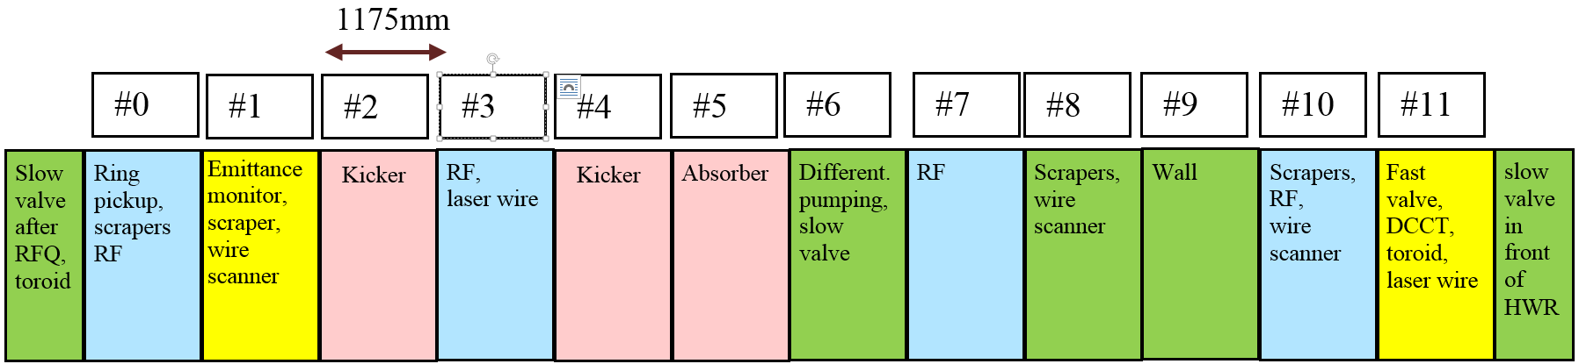
Conceptual design
14 m-long MEBT with equidistantly placed quadrupole triplets for transverse focusing
  Except for 2 doublets located just downstream of the RFQ
4 identical bunching cavities
MEBT is composed of 12 ‘sections’ (distance between neighboring doublets/triplets)
  Section #0 is shorter (480 mm) than the others (1175 mm)
  Last ~4m are dust-free, UHV
The MEBT structure. Sections are color-coded according to their main functions: green- vacuum, blue- RF, yellow- instrumentation, and pink – chopper.

Slide 16
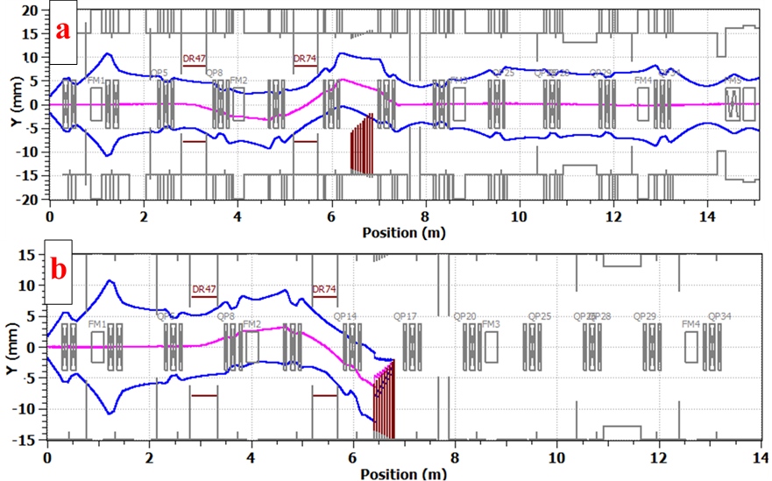
Chopping system
2 identical kickers in sync and a beam absorber
  Two broadband travelling-wave kickers separate bunches by 6σ
    Each plate potential changes by 500 V between passing and removing states
      Voltage variation < ±25V during 1.3 ns “flat top”
  Absorber is rated for 21 kW (i.e. full max. beam power)
    Beam comes at 29 mrad to decrease power density to <17 W/mm²
    Need to capture
    reflected/secondary
    particles
      Up to 20% in terms of
      power
Kicker
Kicker
3σ envelopes of the transmitted (a) and chopped-out (b) bunches simulated with TraceWin.

Slide 17
Scraping system
Purposes:
  Beam halo measurements & removal
  Protection of downstream equipment from beam loss caused by envelope and/or trajectory mismatches
  Auxiliary beam density distribution diagnostics
  Formation of a pencil beam for measurements downstream
4 sections contain a set of 4 scrapers (left, right, top, bottom)
  Electrically isolated TZM plates
    Rated to 75 W (no water cooling)
  Movable across the MEBT aperture
  Phase advance of ~90° between each pair
    Ensures effective removal of particles with large transverse actions
  ~1% of every bunch is removed by the first 2 sections and ~0.1% in the last 2 sections in CW mode

Slide 18
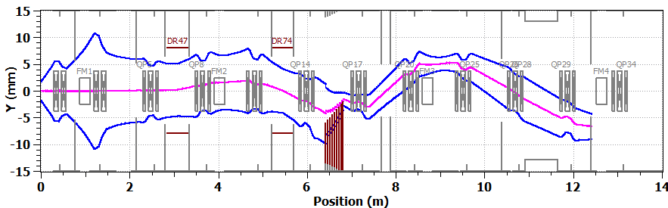
Downstream protection - Illustration
Kickers are mis-phased such that all kicker plates are ½ the nominal voltage value required for chopping bunches out
Scraper #1
Scraper #2
Scraper #3
Scraper #4
Kicker #1
Kicker #2
Absorber
Beam Y 3σ envelope with voltages on all kicker plates equal to half of the nominal value required for chopping bunches out

Slide 19
Overall philosophy for PIP-II warm front-end installation
Plan to move as much hardware as possible from PIP2IT to PIP-II
  Ion source and its infrastructure
  LEBT & RFQ
    Including power supplies, RF amplifiers…
  All validated components of the MEBT
Some exceptions may include
  PIP2IT specific controls systems
  Machine Protection System infrastructure
  Some diagnostics (e.g.: DCCT which might be replaced with a newer, more compact unit)
  Other miscellaneous components (e.g.: scraper drive motors)

Slide 20
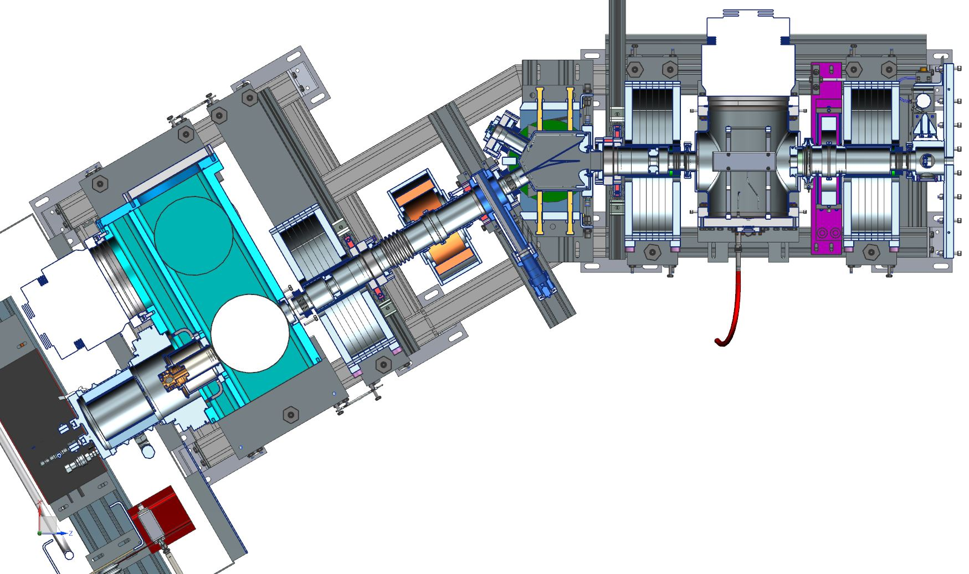
Additions to PIP-II warm front-end
PIP-II warm front-end includes 2 ion sources in a Y-configuration
  Purchase additional ion source
  identical to the one used
  at PIP2IT and other
  components needed to
  complete the second ‘leg’
  of the LEBT
Longer MEBT
  Possible small upgrades to various sub-systems (e.g.: kickers, absorber…)
PIP2IT ion source and LEBT

Slide 21
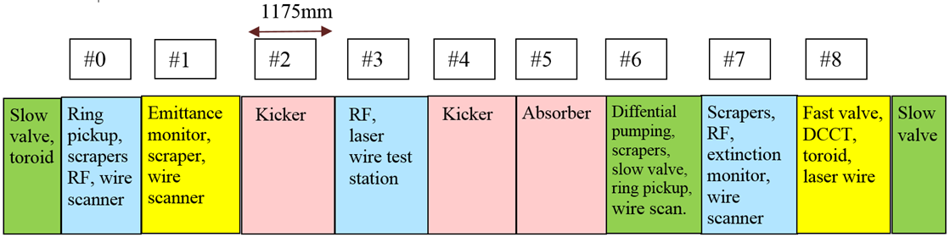
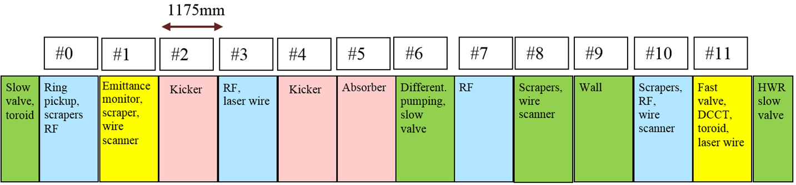
Comparison of PIP2IT and PIP-II MEBTs
PIP-II MEBT is
  Longer by ~3.5m
  Has one more bunching
  cavity
  3 more focusing triplets
  Free space to accommodate shielding wall

Slide 22
Summary
Proposed warm front end concept satisfies PIP-II requirements both for Booster injection and for future CW operation
  Except for the additional ~3.5m in the MEBT, the design has been stable for the past few years
Critical issues are being addressed at PIP2IT
  Performance of LEBT and RFQ has been demonstrated
  Preparations are under way to test elements of the chopping system
  All R&D questions related to the warm front end will be answered by the end of PIP2IT run

Slide 23
Additional slides

Slide 24
IS & LEBT Performance requirements
Ion Source (IS) capable of delivering 10 mA (5 mA, nominal) DC, H⁻ at 30 keV to the Low Energy Beam Transport section
Low Energy Beam Transport (LEBT) capable of creating pulses over a wide range of duty factors via a chopper
  Prevents beam propagation downstream when fault condition is identified (Machine Protection)
  Includes beam current diagnostics
Kinetic energy stability | 0.5% rms
Beam current stability [for frequencies > 1 Hz (ripples)] | ±5%
Output transverse emittance over 1-5 mA current range | < 0.18 mm mrad
Single pulse flat top | 1 μsec - DC
Maximum pulse frequency | 60 Hz

Slide 25
RFQ Main requirements & parameters
Design optimization aimed at minimizing RF power loss in the structure (thermal load)
Input energy (kinetic) | 30 keV
Output energy (kinetic) | 2.1 MeV
Energy stability | ±1%
Duty factor | 100%
Vane tip-to-vane tip nominal voltage | 60 kV
Frequency | 162.5 MHz
Nominal/Maximum beam current | 5/10 mA
Transmission (1-10 mA) | >95%
Output transverse emittance (1-10 mA) | <0.25 mm mrad
Output longitudinal emittance (1-10 mA) | 0.26-0.31 mm mrad
Length (vane) | 443 cm

Slide 26
MEBT Main requirements & parameters
Differential pumping after the absorber, followed with long particle free section going into the SRF
Output energy (kinetic) | 2.1 MeV
Energy stability | ±1%
Maximum frequency of bunches | 162.5 MHz
Nominal input beam current | 5 mA
Nominal output beam current | 2 mA
Nominal charge per bunch (RFQ current) | 30 pC
Relative residual charge of removed bunches | < 10⁻⁴
Beam loss of pass through bunches | < 5%
Longitudinal emittance tolerance | < 10% increase over input
Transverse emittance tolerance | < 10% increase over input

Slide 27
Kickers requirements
Electrostatic plates connected by a broadband, travelling-wave structure
Phase velocity of the kicking pulse | 20.0 mm/ns
Effective electric length | 16 mm
Minimum distance between opposite plates | 162.5 MHz
Special attention is paid to the survival of the kickers in real operation conditions
  Kicker electrodes should withstand a steady-state heat load from the beam of 40 W and an accidental loss of 20J per one assembly
  Kicker structure should not deteriorate from a steady-state irradiation of 20 μA per one assembly
  Kicker assembly incorporates 2 electrically isolated plates to protect the kicker from accidental scraping

Slide 28
Kicker drivers requirements
Two drive schemes are being considered
  (A) Unipolar: Voltage applied to kicker electrodes to deflect beam. No voltage for passing beam.
    Minimum voltage: 500 V
  (B) Bipolar: Voltage applied to opposite plates with opposite polarities to deflect or pass the beam.
    Minimum voltage: 250 V
    Kick applied to the passing bunches should not vary by more 5%
Pulse requirements
  Beam removal for longer than 200 ns is made by the LEBT chopper
Minimum pulse length (with respect to the bunch center) | ±0.65 ns
Voltage tolerance for passing bunches | ±25 V
Transition time between kicking patterns | < 0.5 ms

Slide 29
Absorber requirements
Absorber should be capable of withstand the entire beam that the RFQ can deliver i.e. 2.1 MeV, 10 mA = 21 kW (CW)
  Nominal beam size at absorber ~2 mm
  29 mrad angle of incidence w.r.t. beam
    Peak surface power density: 17 W/mm²
Lifetime & vacuum requirements
Expected calendar lifetime | ≥ 1 year
Expected absorbed current lifetime | ≥ 3×10⁴ mA∙hours
Thermal cycles from zero to max. power during lifetime | ≥ 10,000
Vacuum pressure with maximum power | < 1 μTorr
Ultimate vacuum pressure with no beam | < 0.1 μTorr
Absorber shall have the capability of measuring the beam current impinging on its surface
  Absorber surface biased to up to +300V w.r.t. vacuum chamber

