Slide 1
RF Sources
David W. Peterson
PIP-II Machine Advisory Committee
10-12 April, 2017

Slide 2
Outline
Scope of RF Sources
Amplifier Requirements
Installed Equipment
Amplifiers
Circulators
Distribution
Equipment to arrive
India Collaboration Amplifiers
Lessons Learned
Summary

Slide 3
Scope of RF Sources
“RF Power” includes
Amplifiers
Circulators
RF Distribution
Coax transmission lines and waveguide
Connectors, elbows, adapters, etc.
Directional Couplers
Loads
Controls & Interlocks (where not otherwise provided)
Reflected power and RF leakage detection
Interface to Accelerator Control Network

Slide 4
Amplifier Requirements
Section | Qty | Freq (MHz) | Power (kW) | Duty | Source
RFQ | 2 | 162.5 | 75 | CW | FNAL
Buncher | 4 | 162.5 | 3 | CW | FNAL
First HWR | 1 | 162.5 | 3 | CW | FNAL
Other HWR | 7 | 162.5 | 7 | CW | FNAL
SSR1 | 16 | 325 | 7 | Pulse/CW | IIFC
SSR2 | 35 | 325 | 20 | Pulse/CW | IIFC
LB650 | 33 | 650 | 40 | Pulse/CW | IIFC
HB650 | 24 | 650 | 70 | Pulse/CW | IIFC
= Room Temperature Cavities
= Superconducting Cavities
V. Lebedev, FNAL, The PIP-II Conceptual Design Report

Slide 5
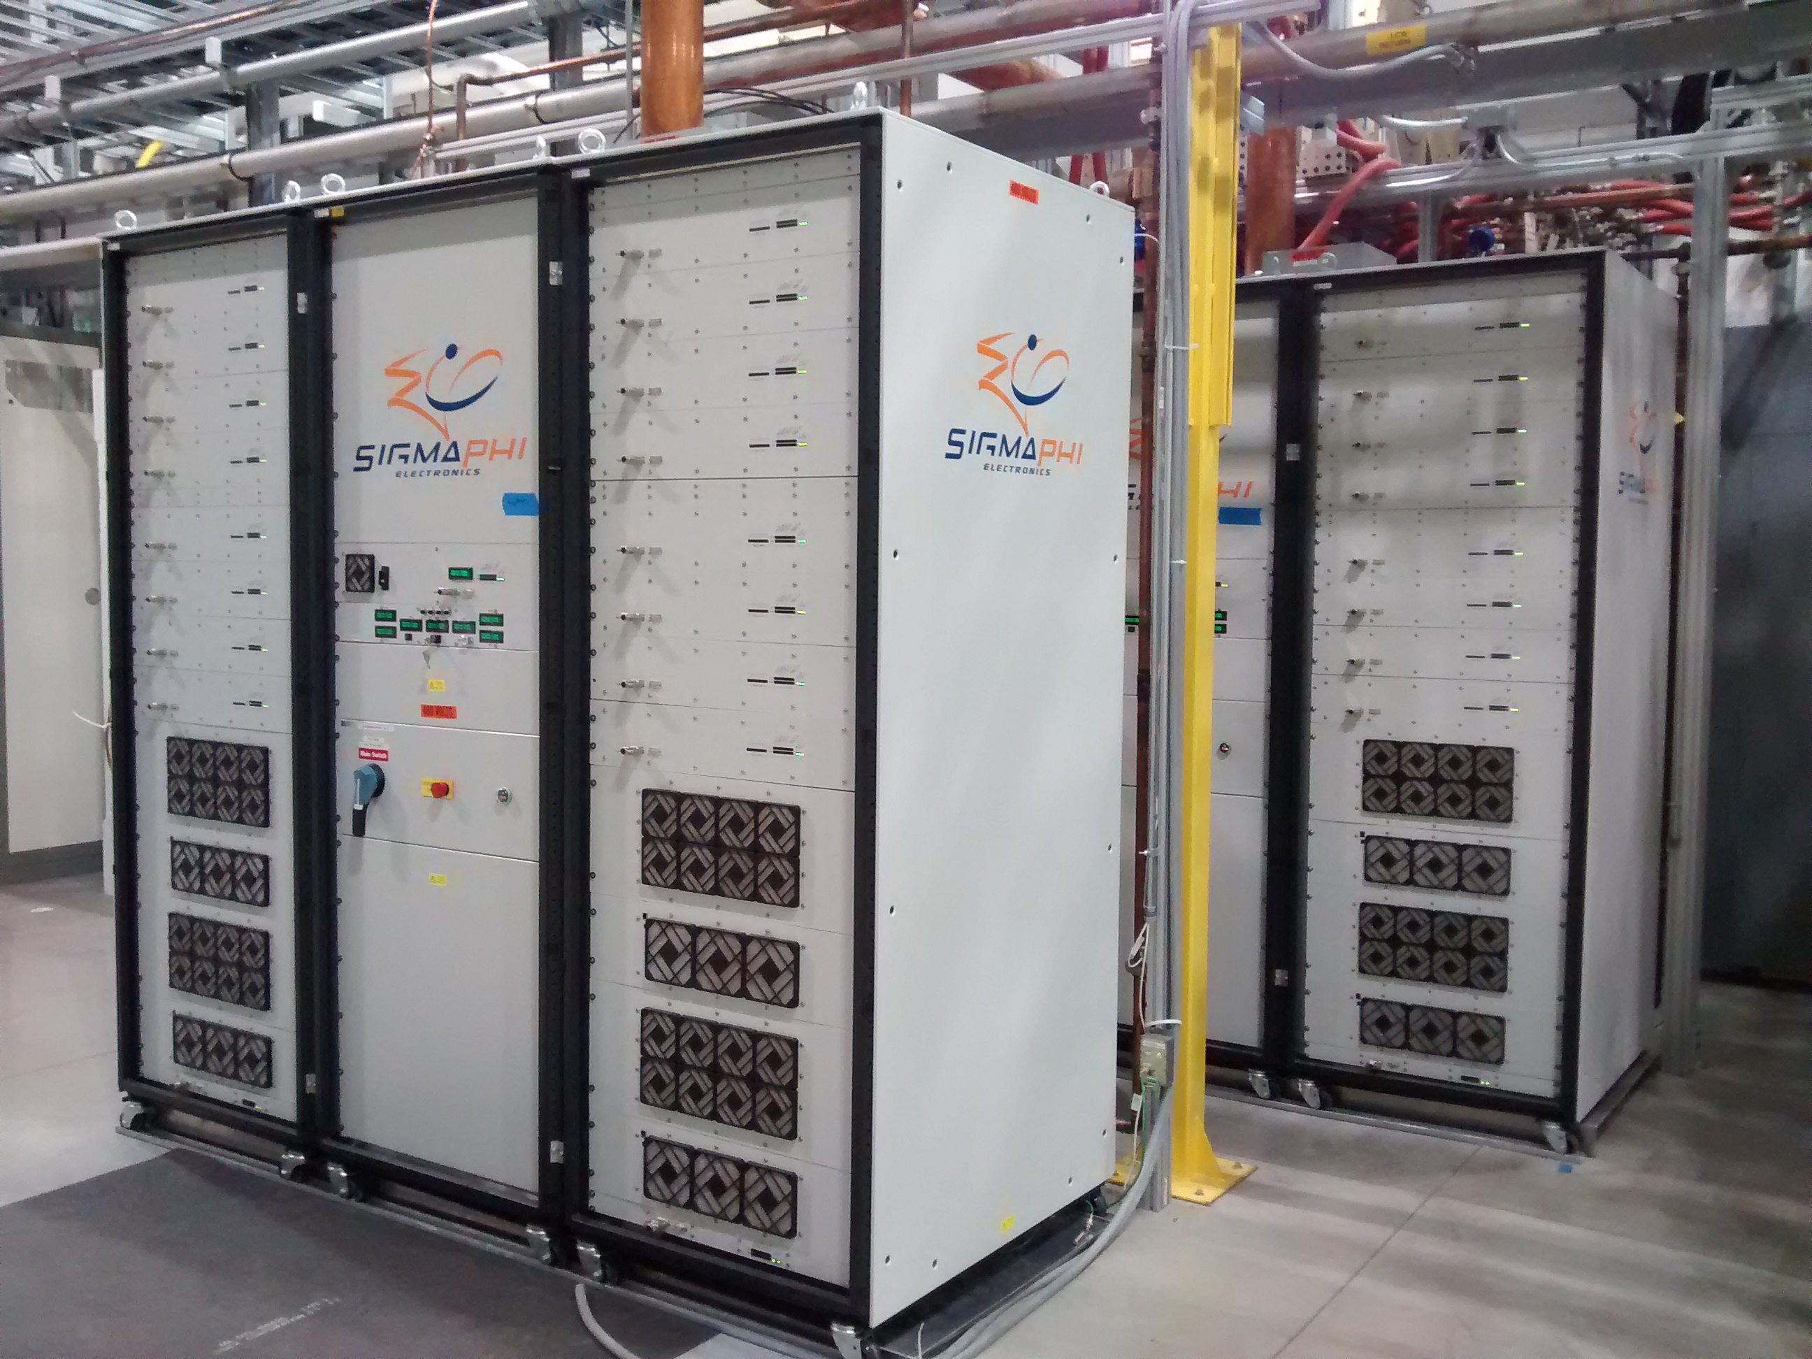
Installed Equipment – RFQ Amplifiers
SigmaPhi 162.5 MHz, 75 kW amplifiers for RFQ are operational.
First RF out of amplifier #1 Sept 2014 & #2 Nov 2014
First power to RFQ February 15, 2016
Over 37.6 million pulses and 368 hours of CW operation
Some failures
RF “Slices” had some poor solder and water tubing joints
480VAC input terminals insufficiently torqued
Some intermittent CAN Bus and Ethernet communications
Work continues on the module and slice test stand.
SigmaPhi 162.5 MHz 75 kW Amplifiers

Slide 6
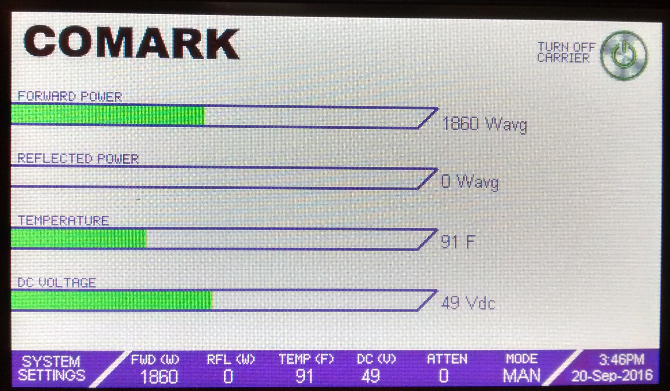
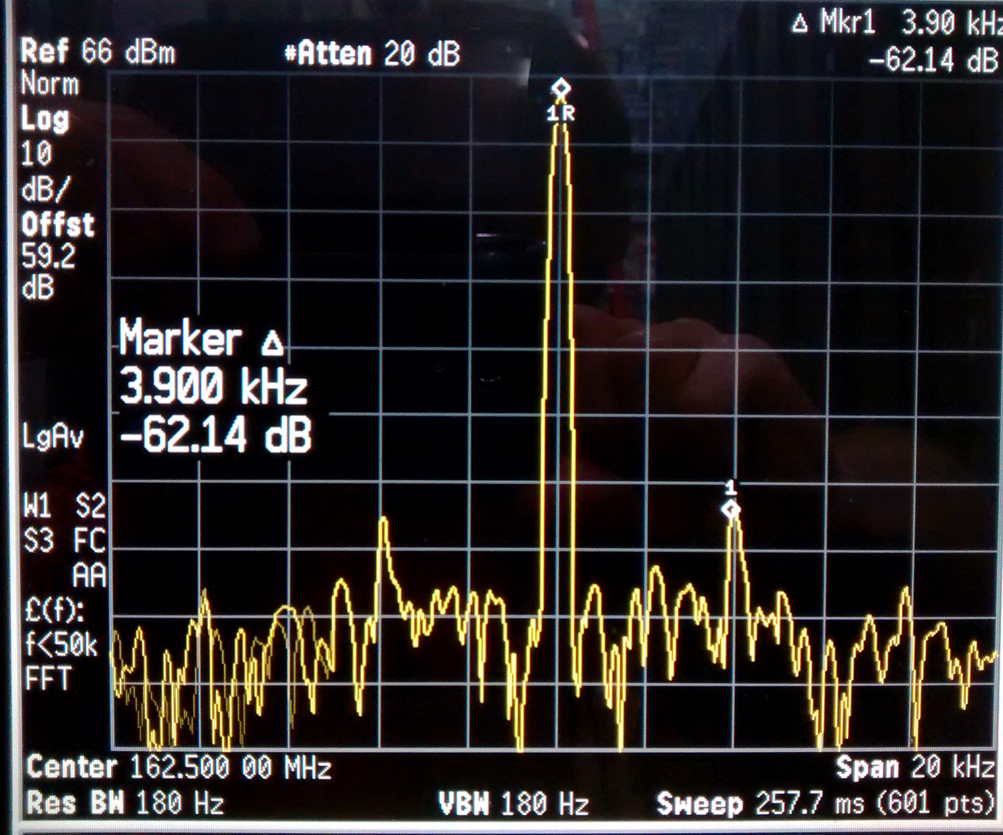
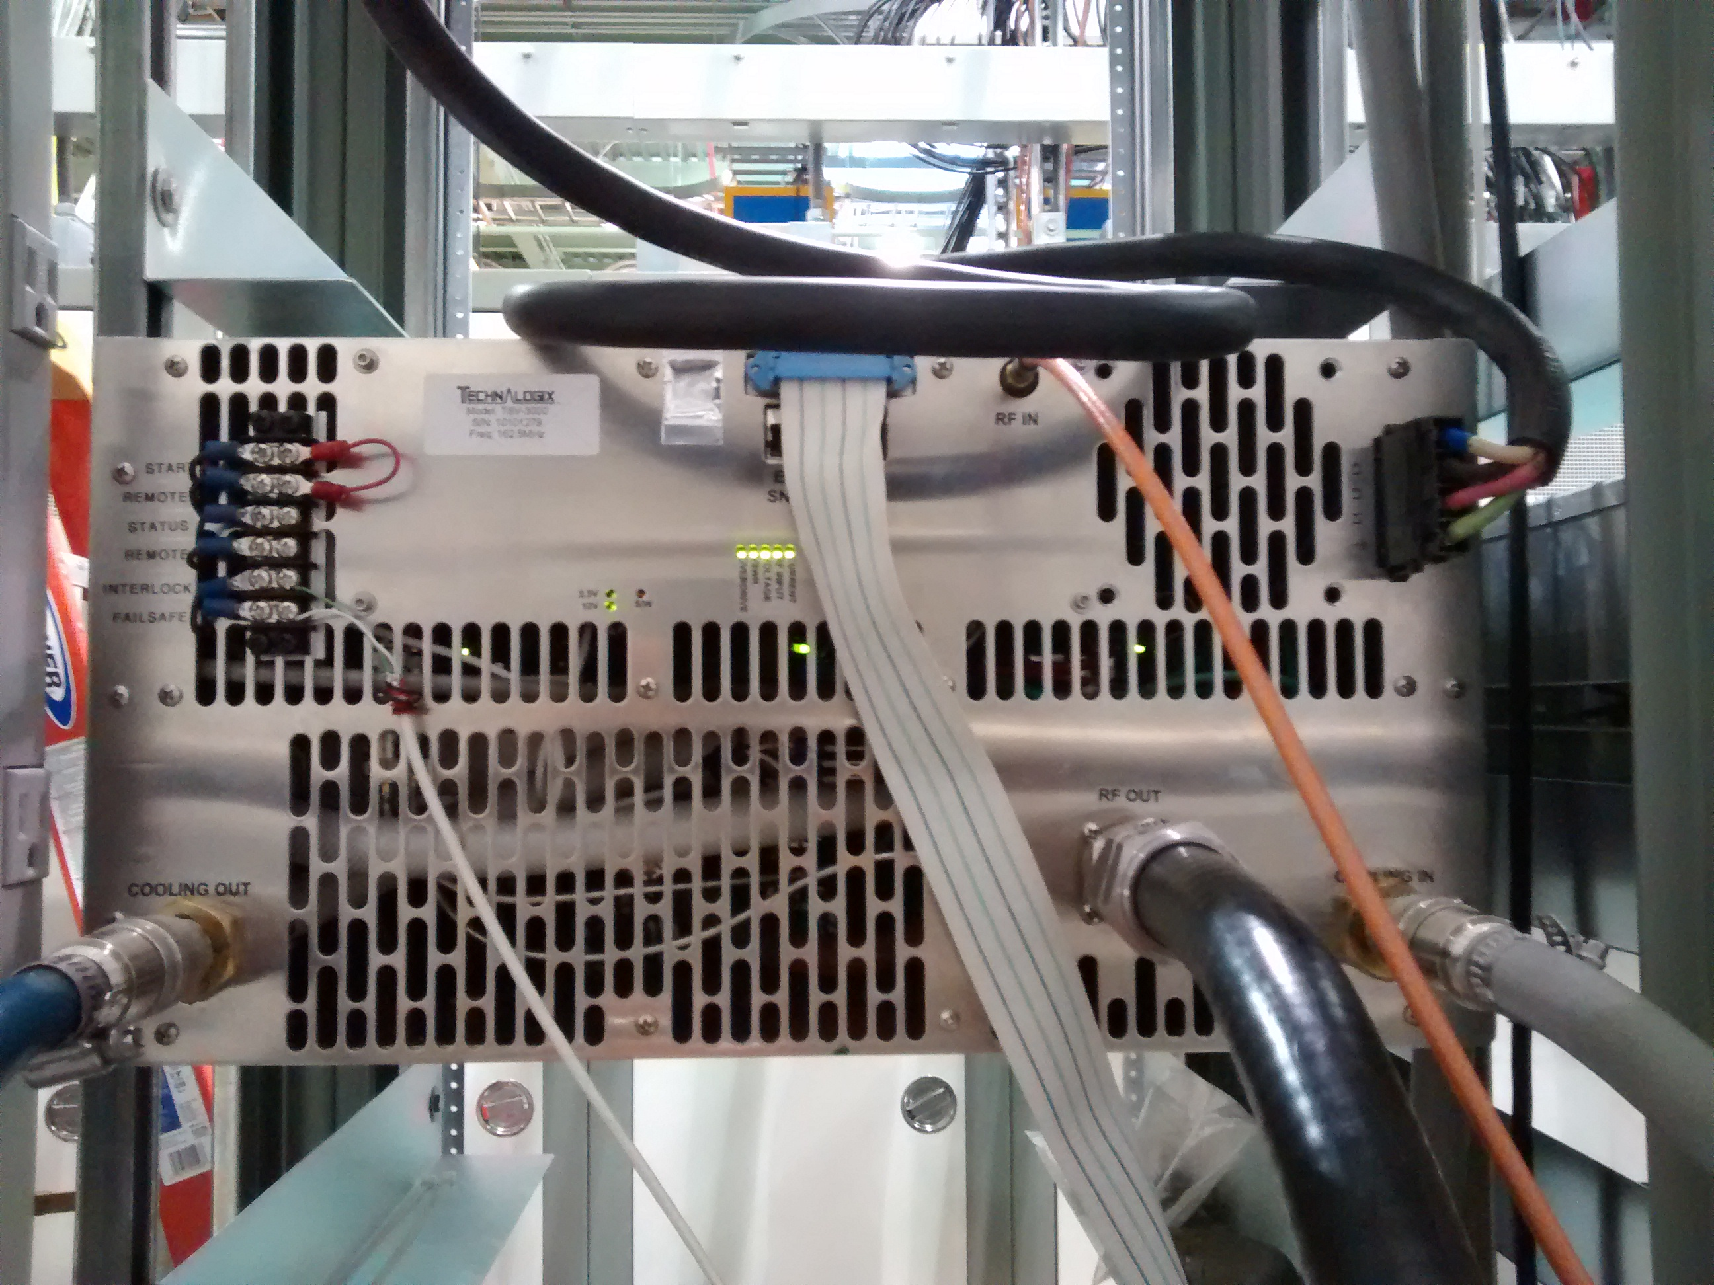
Installed Equipment – MEBT Amplfiers
Comark/Technalogix 162.5 MHz, 3 kW amplifiers
RF performance meets specifications
Gain, Gain and Phase vs Power, 1dB Compression, Spurious and Harmonics, Pulse performance
>100 hour continuous duty burn-in at 2 kW
Buncher 1 Cavity operational
Buncher 2 amplifier ready
Final revision accepted
Two amplifiers at Fermilab
Three more on the way
Improved filtering
Robust digital I/O
Combines RF and Power Supply units
Front Panel Display
Rear View
Spurious output: +/-3.9 kHz, -62.1 dBc.

Slide 7
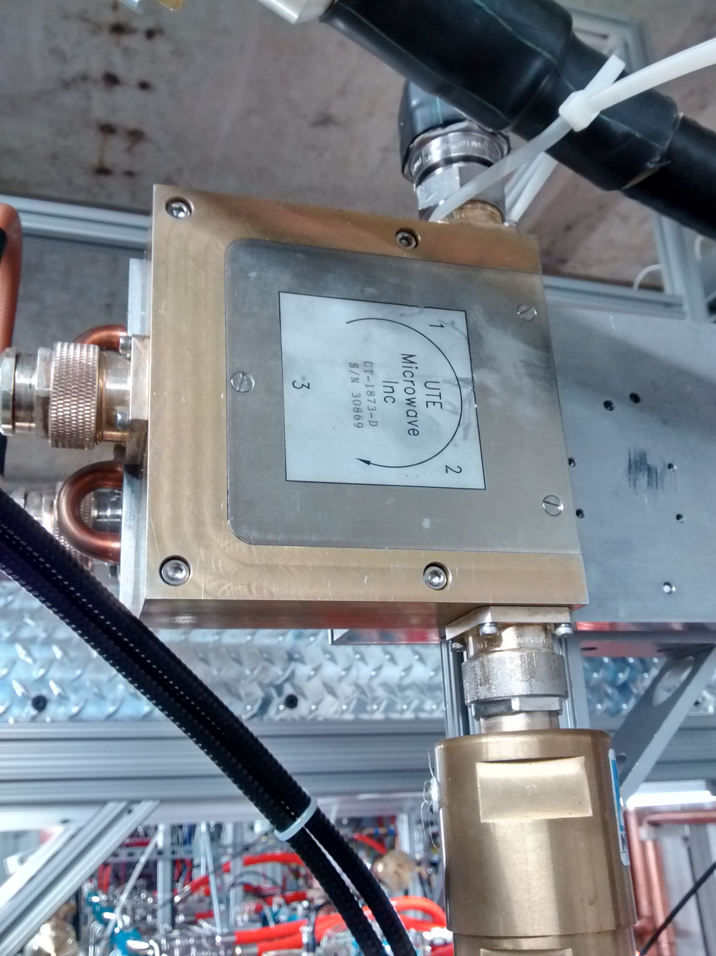
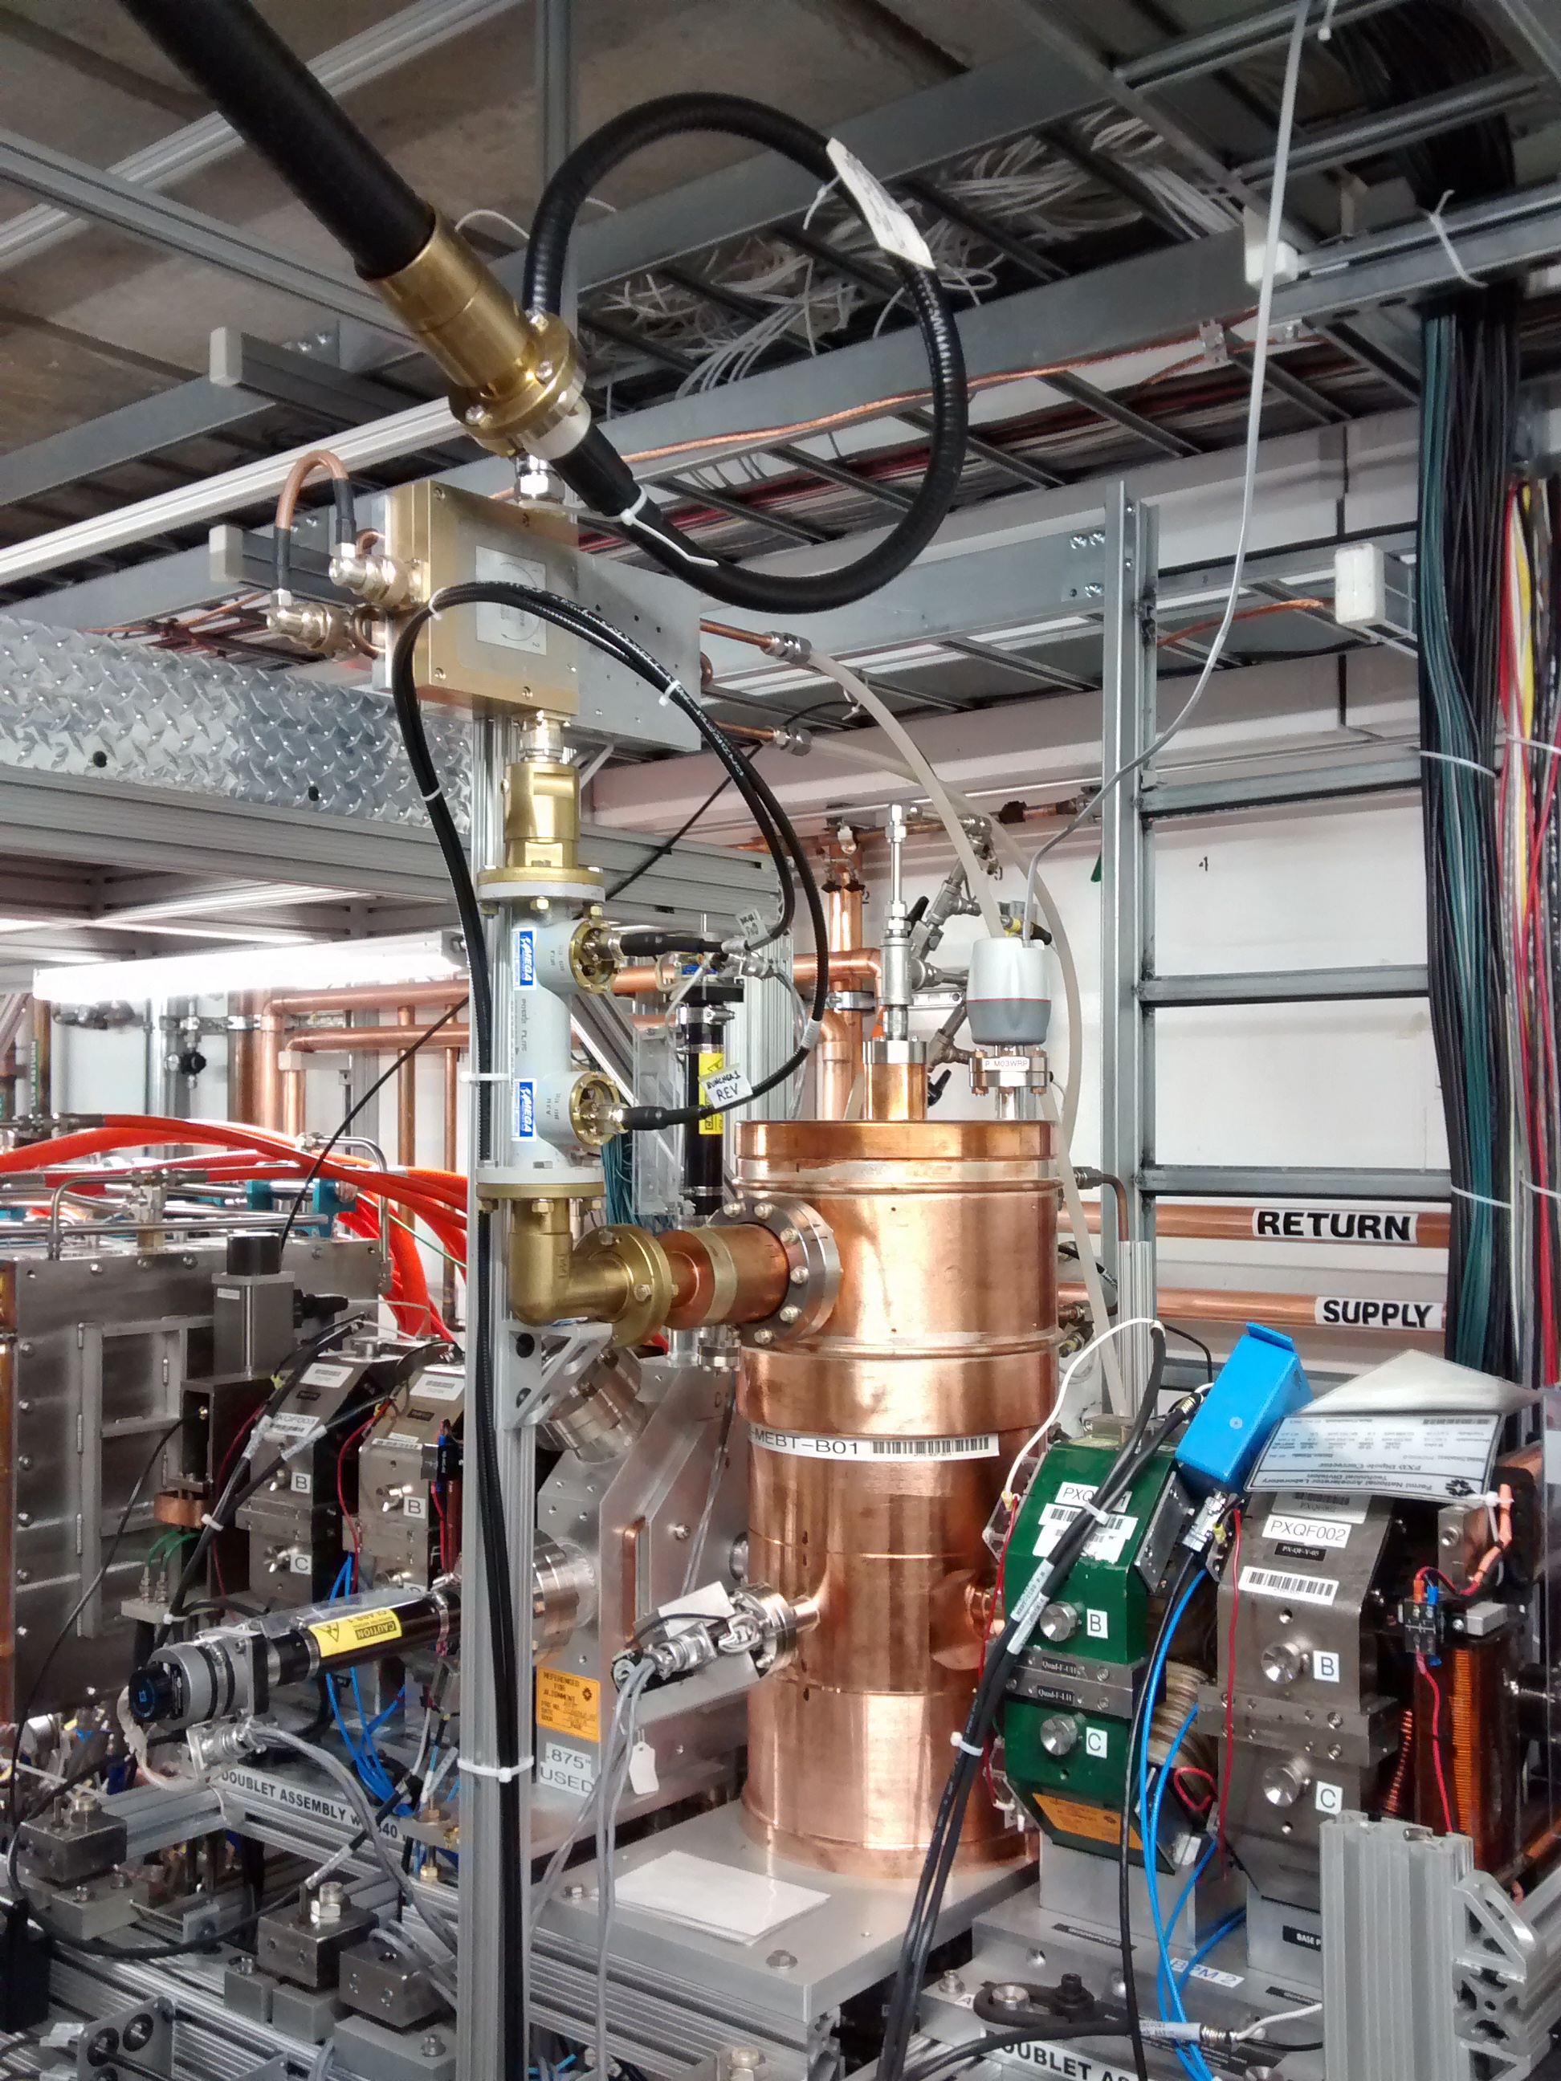
Installed Equipment - Circulators
Ferrite Co. Inc. 162.5 MHz, 75 kW circulators for the RFQ
Require LCW to be 83F for proper operation at high power
RF leakage corrected by application of copper tape at the water tubing entry
Comark provided UTE Circulator
Sufficient for Buncher1 cavity
Does not provide sufficient isolation for HWR operation: ~ 6 dB with short circuit
McManus 162.5 MHz, 7 KW Circulator
Passed 3 kW and 7 kW tests
7 kW Insertion loss <0.33 dB
Isolation 23.1 dB @ 162.5 MHz, >20 dB across 6 MHz BW
Short Circuit return loss 13.7 dB
Will be used in the 3 kW and 7 kW systems
UTE 3 kW Circulator
UTE Circulator and Buncher 1 Cavity
McManus 7 kW Circulator Test

Slide 8
Installed Equipment – RF Distribution
RF Distribution in place for RFQ and Buncher 1.

Slide 9
Equipment to Arrive
Four McManus 162.5 MHz, 7 kW circulators are due at beginning of May.
RFQ for 162.5 MHz, 7 kW CW amplifiers is out to vendors
Bids due April 10
One unit to be procured in FY2017
Up to 7 more units to be procured in FY2018

Slide 10
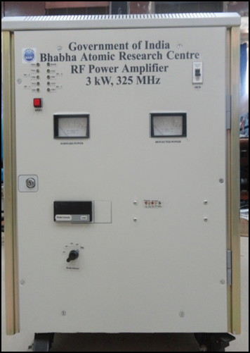
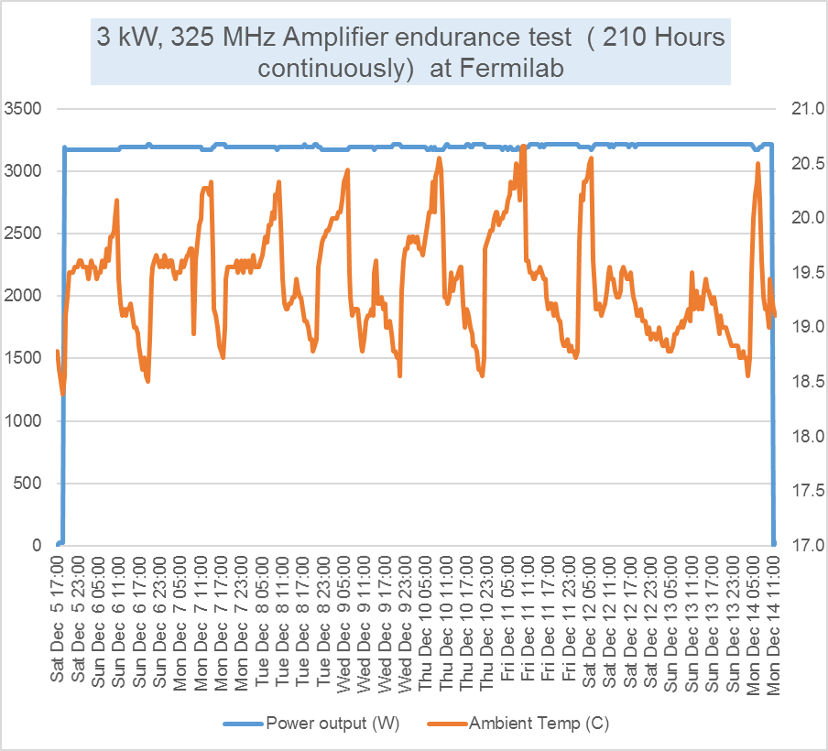
India Collaboration Amplifiers - 325 MHz
A 3 kW Solid State RF Amplifier (SSRA) system was developed based on FRS of Dec. 2010 by DAE and was jointly tested successfully at Fermilab in late 2015.
BARC 325 MHz, 3 kW Amplifier at Fermilab
Plot of 9 days of continuous CW operation

Slide 11
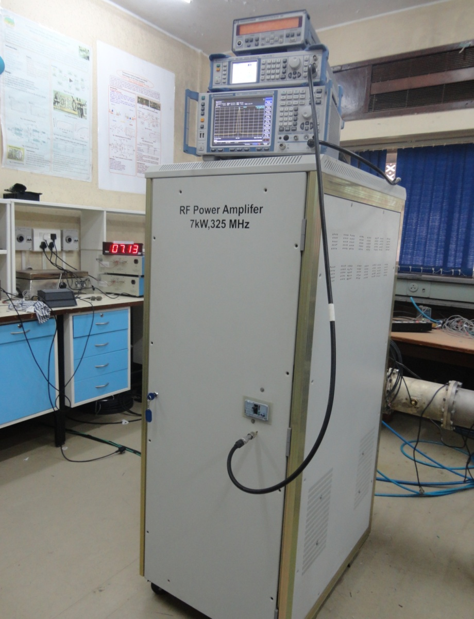
India Collaboration Amplifiers - 325 MHz
7kW prototype based on original specifications already tested at BARC.
New specifications based on experience with 3kW prototype complete.
7kW RF Power Amplifier TRS in Teamcenter ED0004290-Rev A.
Development and Testing in the scope of the R&D phase of PIP-II.
325 MHz, 7 kW Solid State Amplifier at BARC

Slide 12
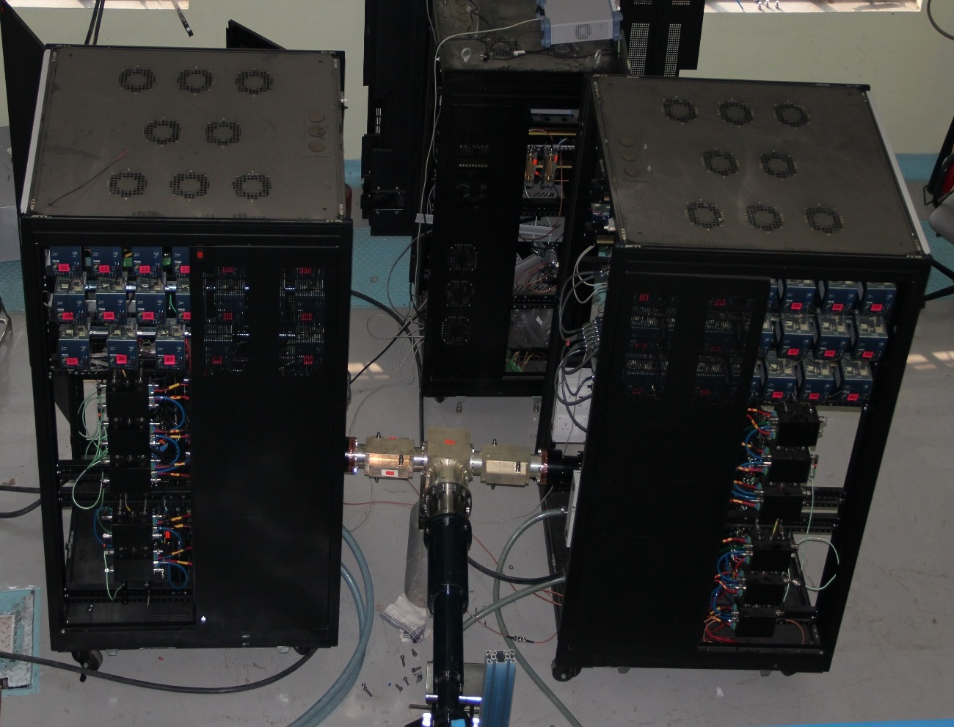
India Collaboration Amplifiers - 650 MHz
30 kW prototype based on early specifications constructed and tested.
Design modifications for 40 kW prototype underway; final specifications nearly complete.
40kW, 650 MHz Solid State RF Power Amplifier TRS in Teamcenter ED0005489-Rev (-).
Development and Testing in the scope of the R&D phase of PIP-II.
650 MHz, 30 kW Amplifier at RRCAT

Slide 13
India Collaboration Amplifiers – Design Experience
RRCAT Amplifier Design
75 kW 505.8 MHz
Solid State Amplifier
for Indus-2
India has settled on designing a solid state 70 kW amplifier for 650 MHz.
REVIEW OF SCIENTIFIC INSTRUMENTS 85, 024707 (2014)
System efficiency analysis for high power solid state radio
frequency transmitter
Akhilesh Jain,1,a) D. K. Sharma,1 A. K. Gupta,1 M. R. Lad,1 P. R. Hannurkar,1
and S. K. Pathak2
1RF Systems Division, Raja Ramanna Centre for Advanced Technology, Indore 452013, India
2Electromagnetics and Microwave Engineering, Institute for Plasma Research, Gandhinagar 382 428, India

Slide 14
Lessons Learned
Solid State Amplifier technology continues to rapidly improve
Increasing efficiency thus reducing size and power needs.
Increasing individual device output power.
Improved power combining schemes.
System costs are dropping.
Amplifier external control interface standards and protocols vary widely
Remote control is essential.
Some vendors understand the requirements and use industry standards, others use odd protocols or marginal circuitry. We provide guidance as needed.
RF Circulators require careful evaluation
Manufacturers of quality high power units are rare. We must choose carefully.
Many of them do not have the capability of testing their units at design power. We need to be prepared to test the units when they arrive.
Some effects are only fully revealed at high power
Detuning
Poor reverse isolation
Arcing
Poor insertion loss
Circulators are temperature sensitive and the thermal effects are difficult to compensate. We may want to consider bias coils and alternative temperature regulation.

Slide 15
Summary
RF amplifiers along with circulators and RF distribution are installed and running for the PIP-II Injector Test RFQ and Buncher1 cavity.
The full compliment of 3 kW, 162.5 MHz amplifiers arrived last week.
7 kW, 162.5 MHz circulators are due in May.
Bids for 7 kW 162.5 MHz amplifiers will be coming in April.
India has working amplifiers at 7 kW 325 MHz and 30 kW 650 MHz. They have experience with a 75 kW 505.8 MHz amplifier and are designing a 70 kW, 650 MHz SSA.
The R&D phase is providing valuable experience with solid state amplifiers and related high power technology.

