Slide 1
PIP-II Beam Instrumentation
Vic Scarpine
PIP-II Machine Advisory Committee Meeting
10-12 April 2017

Slide 2
Outline
PIP-II Requirements
Review of selected instruments
Risks and R&D plan
Summary

Slide 3
PIP-II Requirements
The scope of beam diagnostics are to identify and provide the instrumentation systems necessary to successful commission, characterize and operate all PIP-II sub-accelerators.
Present focus is development of instrumentation to test at PIP2IT
PIP-II focus on pulsed operation with an eye toward CW
CW operation has impact on instrumentation choices
Accelerator instrumentation
sections:
Ion source & LEBT
MEBT
Superconducting linac
Transport lines
Rings

Slide 4
Requirement Highlights from CDR
Minimum set of beam measurements:
Beam intensity
Beam position / orbit
Transverse beam profiles
Beam phase / timing
Beam loss
Operational parameters:
When possible the beam instrumentation and diagnostics systems must be able to operate over a wide bandwidth from few microsecond long pulses for machine commissioning and tuning to long operational pulses. In addition, these systems must be compatible with CW beam operation.
Beam instrumentation is required to be integrated into reliable, fail-safe machine protection system
Additional beam diagnostics:
Transverse emittance
Longitudinal bunch profiling
Transverse beam halo
Bunch-by-bunch chopping efficiency

Slide 5
From the CDR
Table 3.40 presents an estimate of quantities of different beam instrumentation systems by location for the linac and the 800 MeV beam transport line. In the table the SC linac also includes the linac extension capable to include 4 additional HB650 cryomodules.

Slide 6
Beam Position and Phase – BPM System
PIP-II requires 89 warm BPMs and 37 cold BPM for the linac and 800 MeV transfer beam line
capable of measuring horizontal and vertical position and beam phase relative to the RF, as well as a relative measure of the beam intensity
Single four-button BPM located near each beam focusing element (solenoid, quad, doublet, triplet)
The geometry of all BPMs will be similar with their aperture slowly increasing with acceleration
BPM Measurement modes
pulsed beam at a single trajectory
pulsed beam split into two trajectories – in MEBT chopper section
BPM Pulsed Beam Measurement Requirements
 | One-trajectory Mode | Two-trajectory Mode
Transverse position, μm | 10 | 100
Phase, degrees of 162.5 MHz | 0.05 | 0.5
Relative intensity, % | 1 | 2

Slide 7
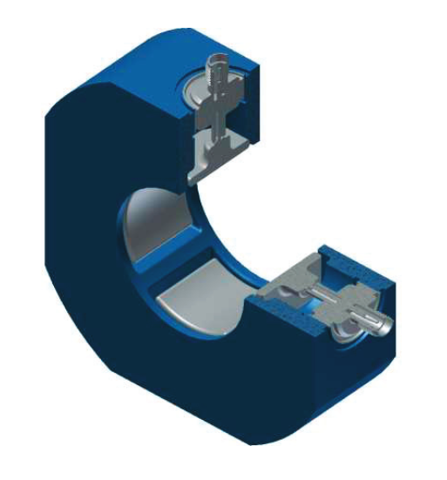
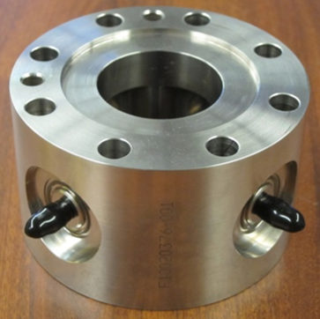
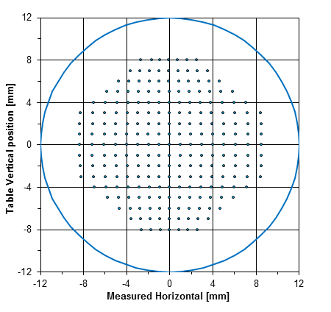
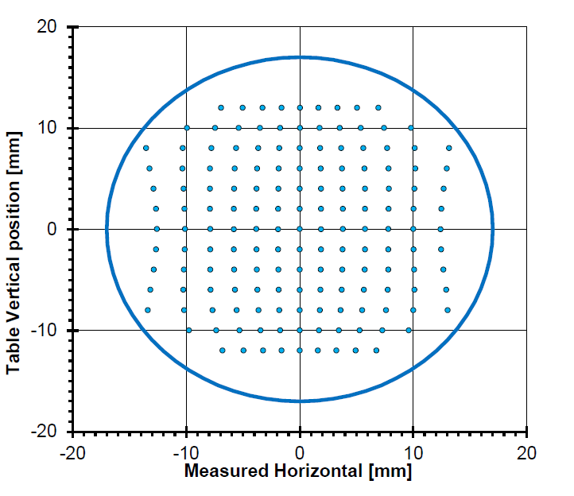
Warm and Cold BPM Designs
Section view of a PIP2IT warm MEBT BPM and BPM mounted to a MEBT quadrupole and benchtop stretched wire mapping
Section view of cold BPM and a SSR1 cold BPM assembly and benchtop stretched wire mapping

Slide 8
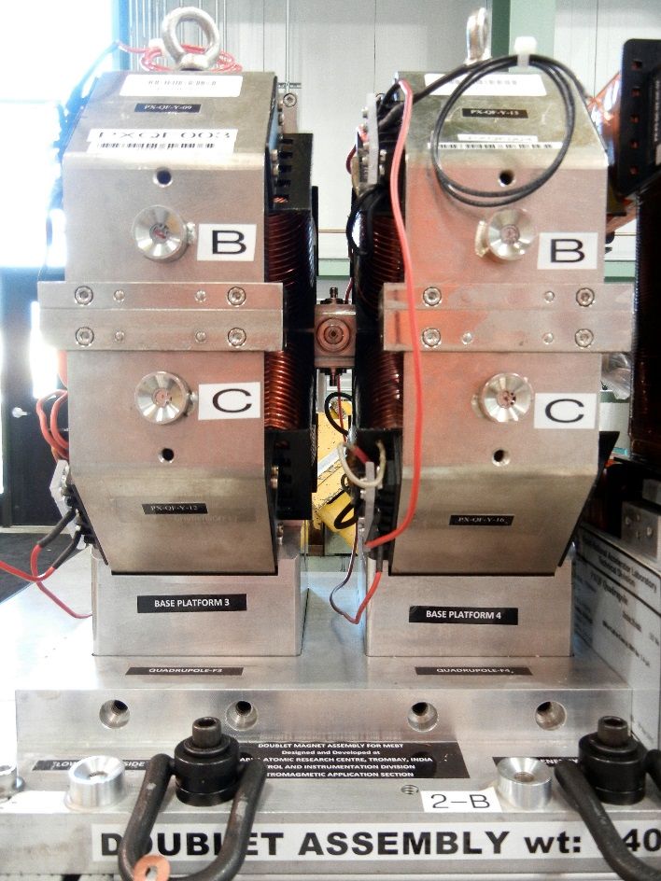
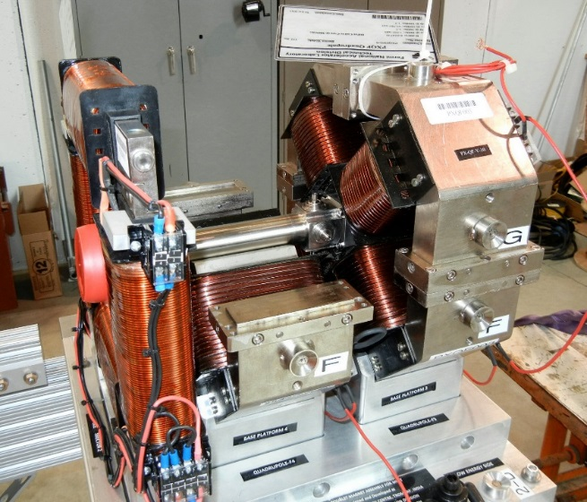
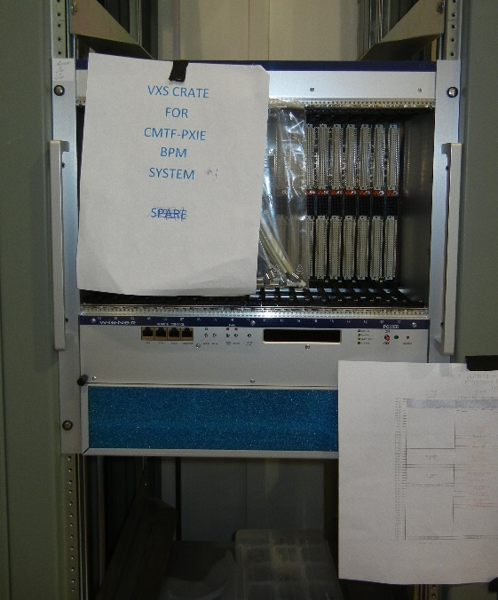
MEBT BPM Development at PIP2IT
Warm 4-buttom BPMs imbedded in quad doublets
Narrow-band DAQ with FPGA-based electronics for CW and pulsed beam operation
12 channel, 14 bit, 125 MHz boards
Analog filter and amplifier boards
Status:
BPMs operational
Pulsed beam only (<0.5 ms)
Average position, phase, intensity per pulse into ACNET
Position resolution ~10 μm
Phase resolution ~0.2 deg
Time-of-flight BPM installed and tested
BPM on movable stage
Energy resolution ~0.3%

Slide 9
Beam Current Measurement Systems
Primary Systems
DCCT
Bergoz DCCT
Tested in PIP2IT LEBT
Toroids
Pearson split-core toroids
0.1 V/A ±1%
~10 Hz to ~4 MHz
7% per ms droop
Testing in PIP2IT LEBT and MEBT
Studying limitations to long-pulse measurements
Input for MPS
Places tight requirements on toroid system performance
Secondary Systems
Relative measurements
Sensitive to beam effects
Bunch position, velocity and shape
Ring pickups
Testing in PIP2IT MEBT
Systematic effects being studied
Possible relative measurement for MPS
BPMs
Testing in PIP2IT MEBT
Resistive Wall Current Monitor

Slide 10
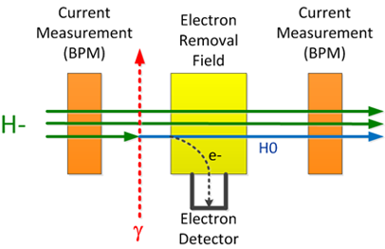
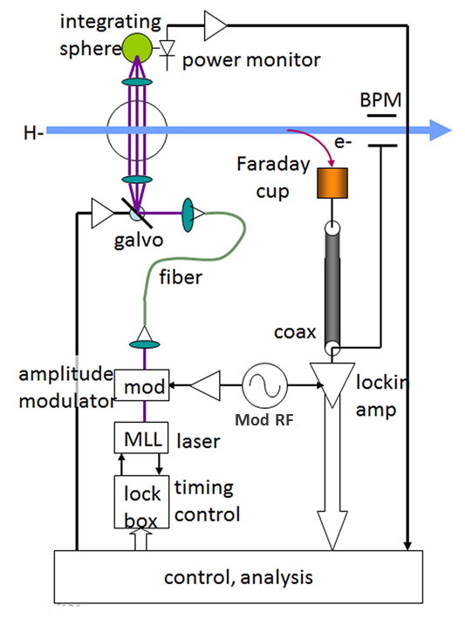
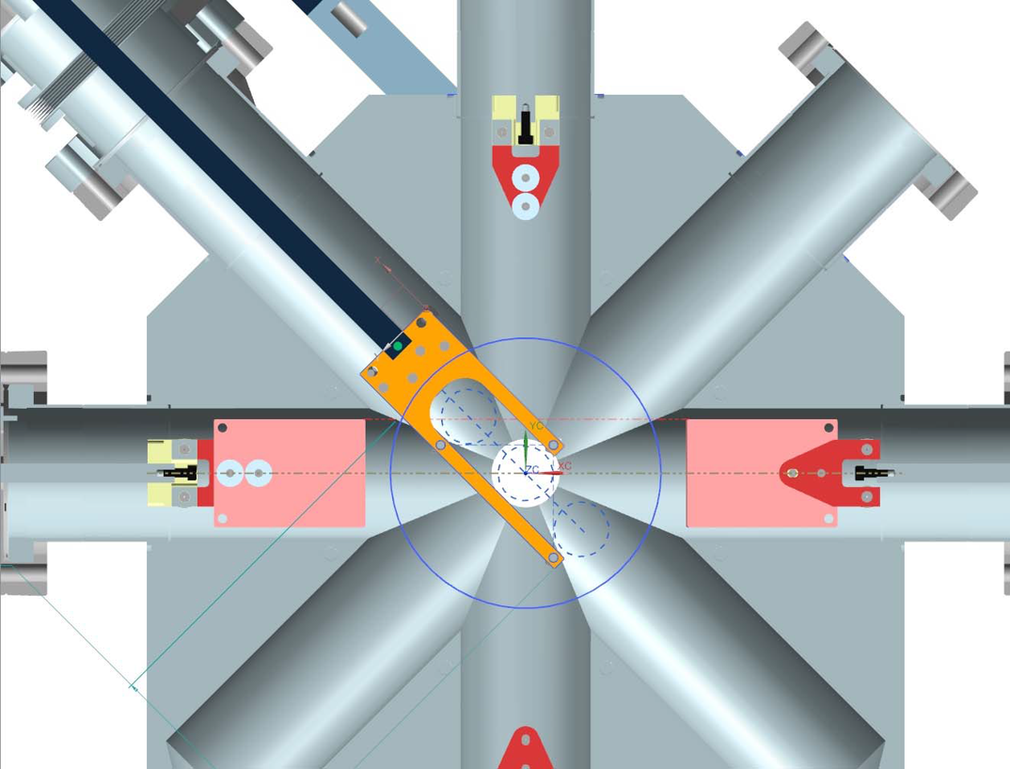
Transverse Beam Profiling Systems
Wire scanner system
MEBT and transfer beamline
Laserwire system
Linac
Parameter | Value
Spatial resolution | < 0.1 mm
Signal dynamic range | > 10³
Spatial range | ± 15 mm
Prototype Wire scanner
Prototype Laserwire
H⁻ + γ → Hº + e-
Single wire scan – step transversely through beam
Test in diagonal (45º) port of PIP2IT MEBT scraper
Horizontal and vertical transverse profiles in one scan
50 micron tungsten-rhenium
psec mode-locked laser (MML) used to measure both transverse and longitudinal profiles
Narrow-band lock-in amp detects modulated signal
Measure profiles by either:
Collection of electrons
reduced-beam current
Allows laser monitor to fit between cryomodules

Slide 11
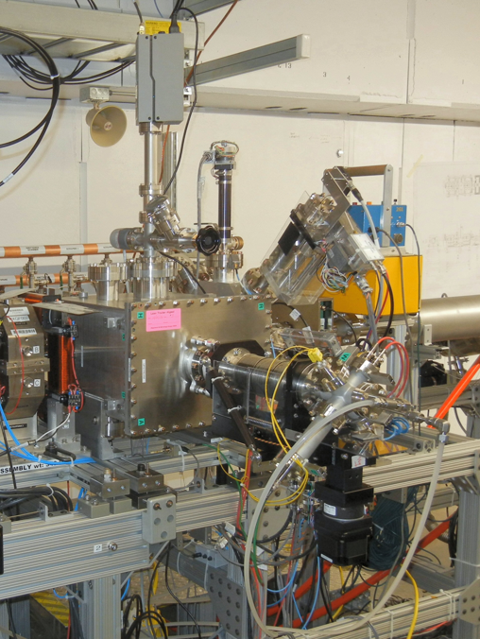
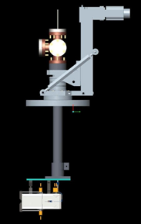
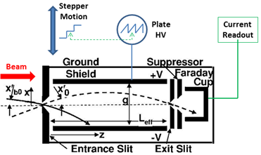
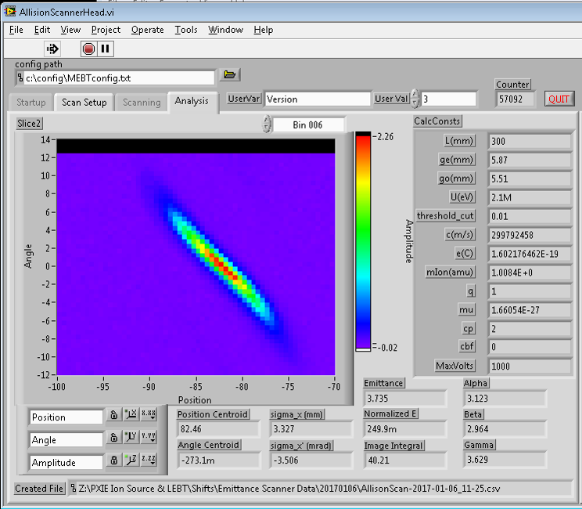
Allison Scanner for MEBT Transverse Emittance Measurements
Design a water cooled Allison-style MEBT emittance scanner based on LEBT scanner
Gives faster phase-space measurement
Reuse LEBT electronics
2.1 MeV → requires longer deflector plates → requires more beam line space
± 12 mrad angular range
Tight alignment requirements
Higher beam power → no CW operation
Installed in Dec 2016 for horizontal emittance measurements
Commissioned, calibrated and operational

Slide 12
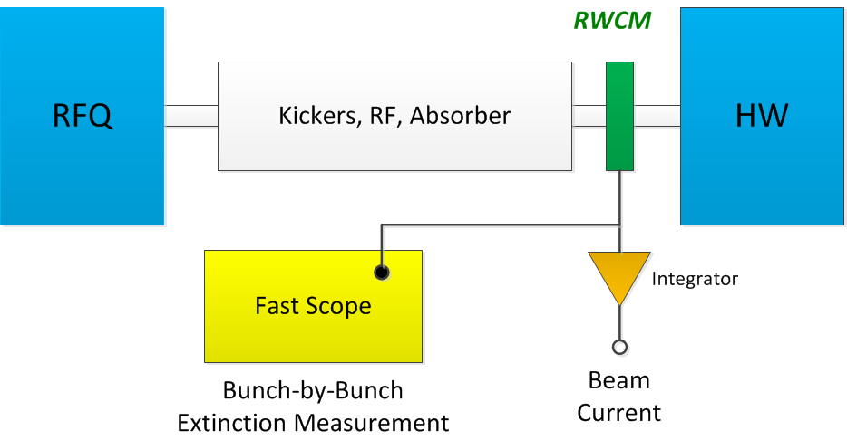
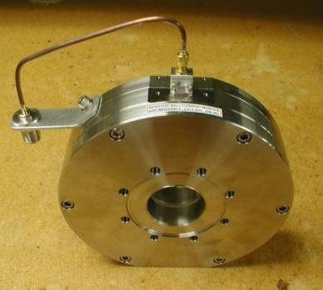
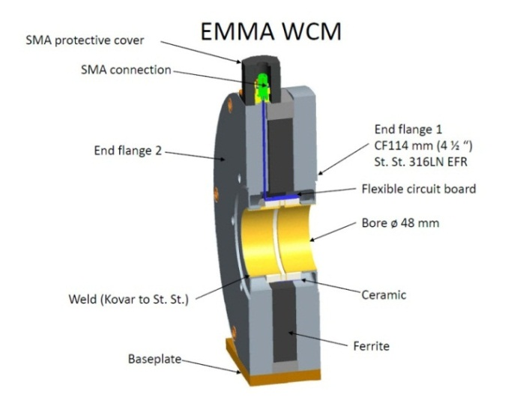
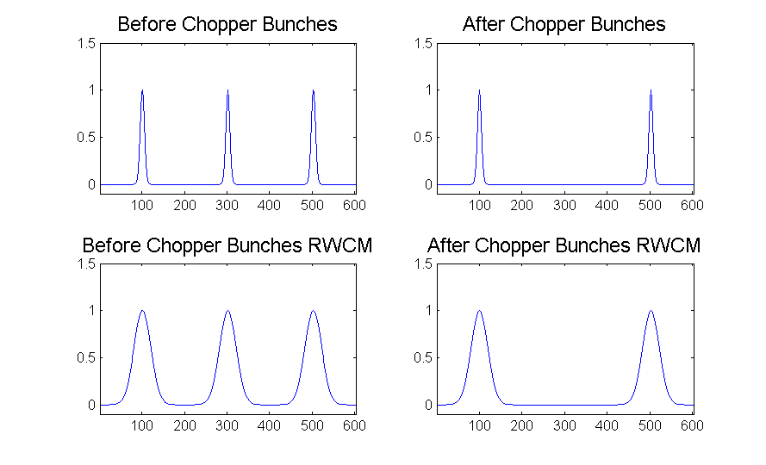
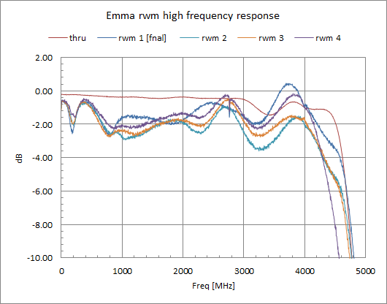
MEBT Chopper Extinction Measurement – Under Design
Use downstream Resistive Wall Current Monitors (RWCM)
Extinction
Can average over many bunches or take a single shot measurement
Measurement BW < 1 Hz
Fits to bunch shape
Measure impact on adjacent bunches

Slide 13
Summary
Specifications of required beam measurements solidifying
CDR giving better picture of beam instrumentation choices
PIP2IT allowing for a majority of beam instruments to be tested up real PIP-II beam conditions
Many systems operational or being tested
Continued R&D at PIP2IT essential to mitigate risks for PIP-II development

Slide 14
Backup slides

Slide 15
PIP-II Risks to Address and R&D Plans
Beam current measurement systems
Short pulses to CW operation adds difficulties
Integration into MPS may require changes in technology choices
Tight tolerances required to protect SCF cryomodules
R&D at PIP2IT
Testing hardware and algorithms for wide beam pulse range
Choice of laser profiling technology
Choice of technology impacts early in PIP-II design
Infrastructure for laser transport must be part of PIP-II building/tunnel layout
Profiling technique effects beamline space requirements
R&D at PIP2IT
Installation of prototype laserwire system
Allows for optional laser choices
Allows for opportunity to study different signal detection options
Allows for study of systematic effects

Slide 16
PIP-II Risks to Address and R&D Plans (continued)
Integration of instrumentation into MPS
Choice of MPS architecture effects development of instrumentation DAQ system design
Major architectural changes will need time to develop, prototype and test
R&D at PIP2IT
Testing of different MPS options
Beam loss monitor system
Choice of BLM technology for low-energy measurements not clearly defined
R&D at PIP2IT
Testing of fast, sensitive PMT based x-ray detectors
Testing of rad-hard, sensitive diamond detectors in vacuum
Possible halo detectors
Longitudinal beam profiling
Very small (4 ps) beam longitudinal size is difficult to measure
No clear choice of technology
OTR + streak camera?
fs laser?
Can not be tested at PIP2IT

