Slide 1
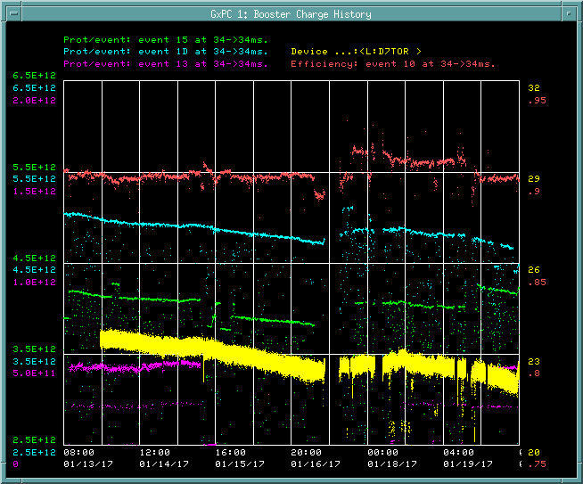
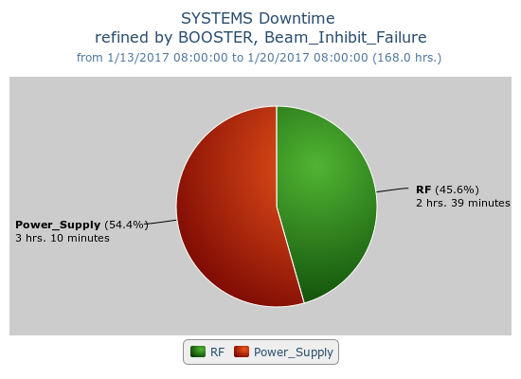
Booster Operations 01/13/17 – 01/20/17
F
T
F
F
Sa
Su
Su
M
F
F
F
W
F
Sa
W
F
Sa
F
F
F
F
F
Sa
Su
Su
M
Tu
F
F
F
M
M
Su
M
M
W
W
Sa
W
Th
F
Sa
Sa
F
F
Su
M
F
M
Th
Su
M
Tu
Sa
Su
F
Sa
F
Tu
F
W
Su
W
F
Sa
M
W
Th
Sa
Su
Tu
W
Th
F
F
Su
W
F
Sa
Su
M
Tu
Sa
Su
M
M
W
Th
F
Sa
Su
M
W
WAPS
Chopper
Capture/Transition Issues
Access to replace BRF16 Cavity
BRF8 Cable Fault
400 MeV Chopper Cable fault
DOGL3 Flow Switch
MKS06 Cable Termi
WAPS Trip
Collimator Studies
Access for BRF19
Downtime:
Total 5 hours 49 minutes
Mostly minor RF trips, longer DT for WAPS trip due to BRF17, BRF11 yard breaker trip on turn on after WAPS trip.
Chopper On plate to tube cable fault
Repaired BRF19 HV cable and water line
Accessed on Tuesday during the MI52 Septa Repaired BRF19 HV cable and water line
Chopper On plate to tube cable fault on Thursday
This week:
Beam to BnB, NuMI, SY120
$1D @ ~4.8E12 @90%, $15 @ 4.0E12 @ 91%,
TLGBDF back to ~12Hz
Orbit correction studies, one shot early injection studies,
On-shot Beam energy Spread Studies 15min. Dedicated beam study on Tuesday.
Request:
Orbit correction studies, one shot early injection studies
3hrs dedicated Collimator studies In up coming weeks

