Slide 1
MI/RR Machine Report
Meiqin Xiao
Jan 20, 2716

Slide 2
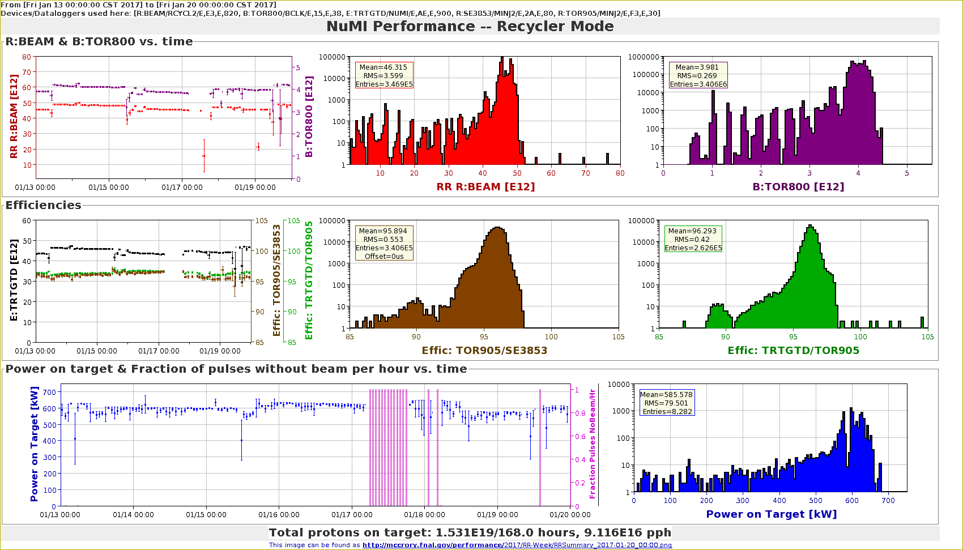
RR weekly summary for NUMI

Slide 3
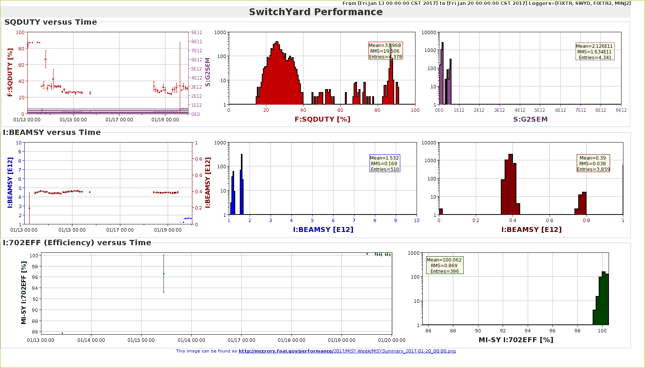
MI for SY weekly summary

Slide 4
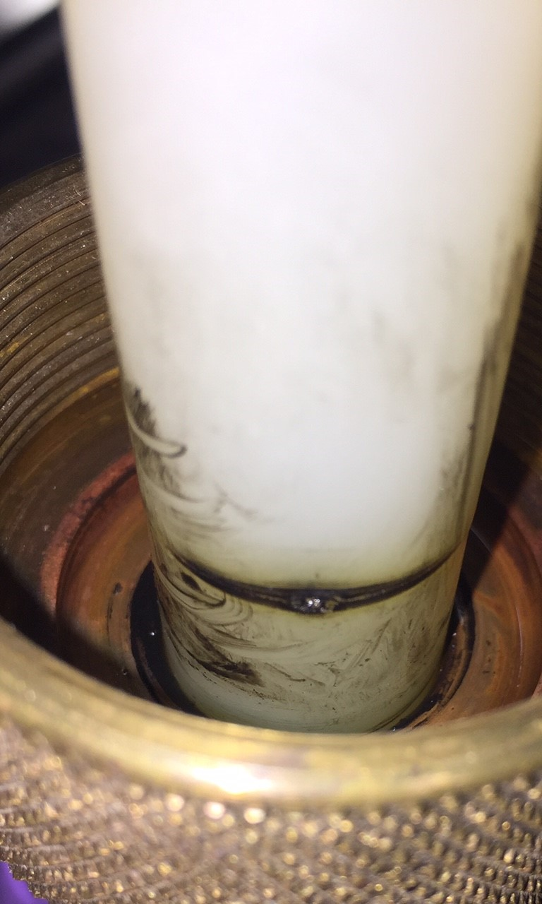
MI 52 Septa
SY was commissioned after Last week’s access for 2 mil Septum replacement, and started slow spill Friday afternoon @~3.3E11 until a vacuum bursts in the 52 region on Sunday morning.
Over the weekend, The septa faulted off with the indication of a fault in the downstream (4 mil) septa B. However, the investigation found Downstream Septa shorted HV cable Failure was at the connection to the high voltage feed feedthrough in the tunnel
The cable was re-terminated, The septa tank hipotted OK, and was not replaced.
The connection

Slide 5
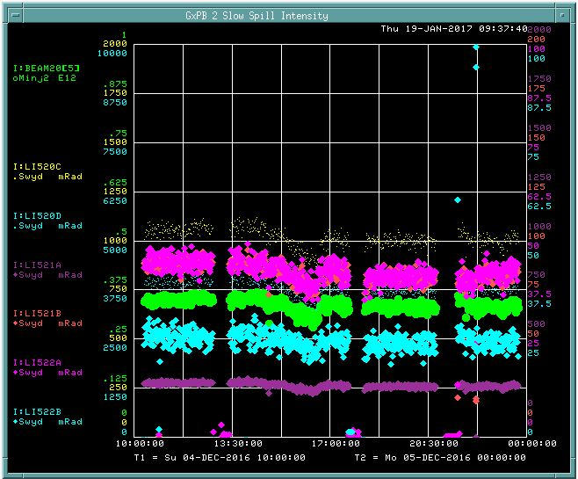
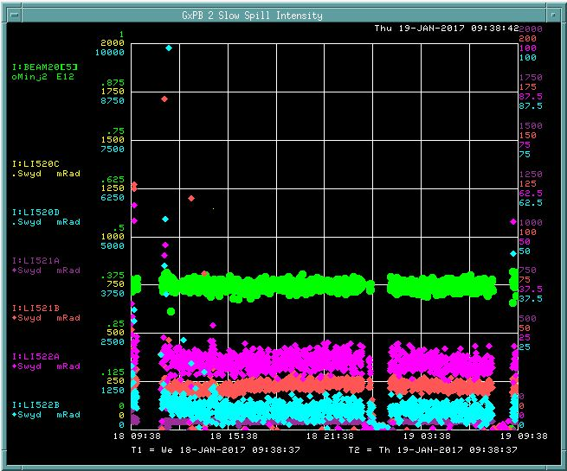
2 mil septum running
Losses on the last day of running 4 mil
Upstream septa prior to failure in December
Losses on the first full day of running 2 mil
Upstream septa.
Green is beam intensity, others are loss monitors at septa and Lambertson.
All scales are the same.

Slide 6
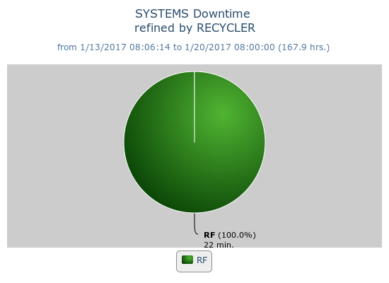
Recycler weekly Downtime
RF, Beam_Inhibit_Failure
1/19/17 Recycler Dampers not damping
The Muon kicker test event ($E9)
started not playing well with the
Recycler dampers.

Slide 7
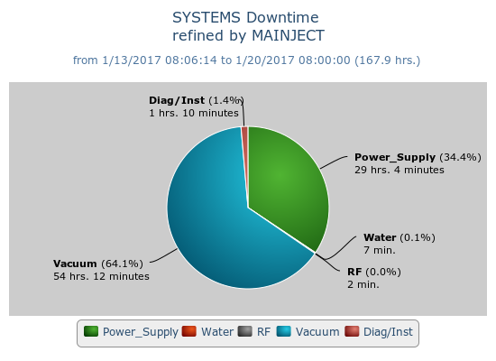
MI weekly Downtime
Diag/Inst, Beam_Inhibit_Failure
1/19/17 MI 453 card crate $14
Power_Supply, Beam_Inhibit_Failure
1/17/17 MI10 PS invertor/regulation card
MIPS investigation
MI PSLOOP: 20 Upper Volts to Ground
MI-52 Septa Conditioning
MI20-62 Access to fix SP52
Vacuum, Beam_Inhibit_Failure
1/18/17 MI8 Vacuum Burst
1/15/17 MI52 Septa issues
1/14/17 MI RF Watchdog, vac 603B
Water, Beam_Inhibit_Failure
1/16/17 MI30 LCW pumps tripped
RF, Beam_Inhibit_Failure
1/14/17 MI RF Watchdog APG-B Overdrive

Slide 8
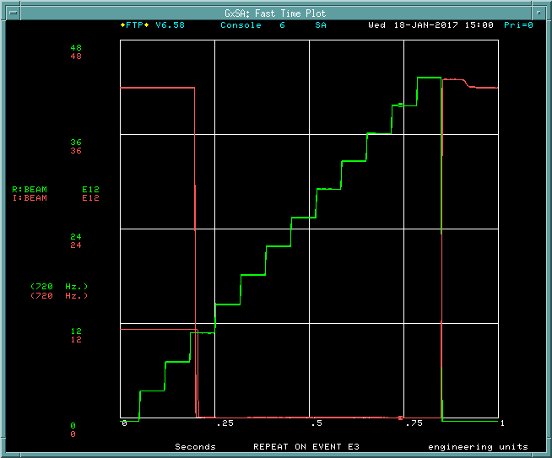
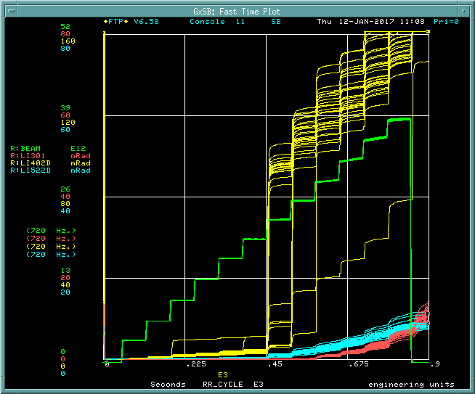
New Recycler DCCT
the Recycler DCCT board was swapped with a new modified one. The new board seems to work well, we no longer see the oscillations during slip stacking
R:Beam (green) with new DCCT
R:Beam (green) with old DCCT

Slide 9
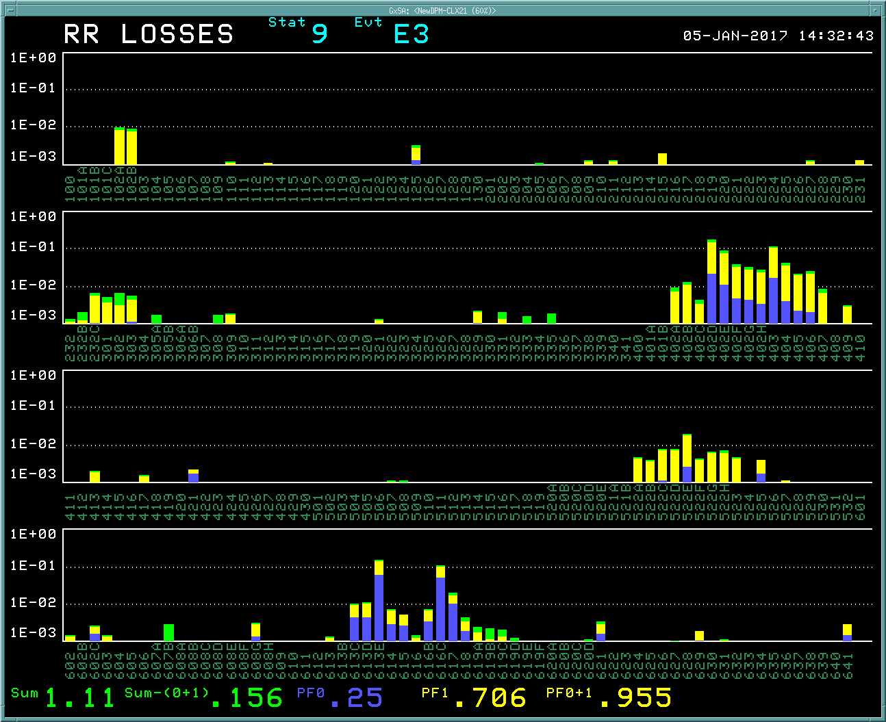
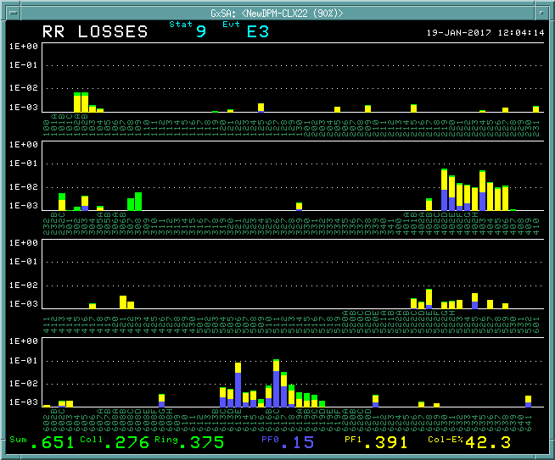
Slip stack damper applied to the operation
There has been “Slip stack damper” studies since last Friday, and it’s promising. It was applied to the operation and left running overnight yesterday. More tuning is coming
Before
After
Losses @ 14 booster turns before and after applied the slip stack damper

