Slide 1
Accelerator Division Status & Scheduling Meeting
Daniel Johnson
2017 Weekly Status and Plan Meeting
20 January 2017

Slide 2
Upcoming Events
Friday, January 20th
  ICW Curtailment ends with completion of work at Casey’s Pond
Friday, February 10th
  Master SubStation (MSS) yard is energized
Wednesday, February 15th
  Initial Loads added to Master SubStation
Monday, February 27th – Thursday, March 2nd
  Site loads begin to be added to Master SubStation
  See Schedule

Slide 3
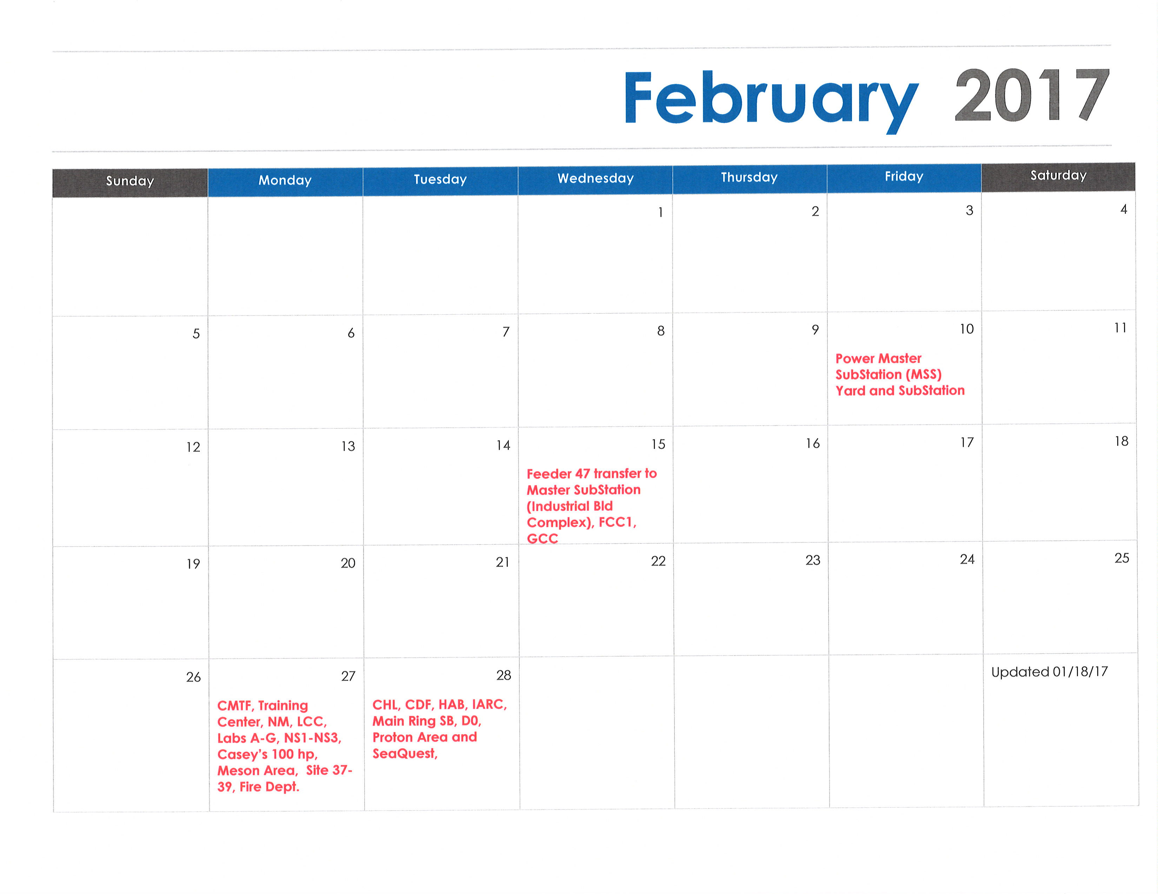
February 2017

Slide 4
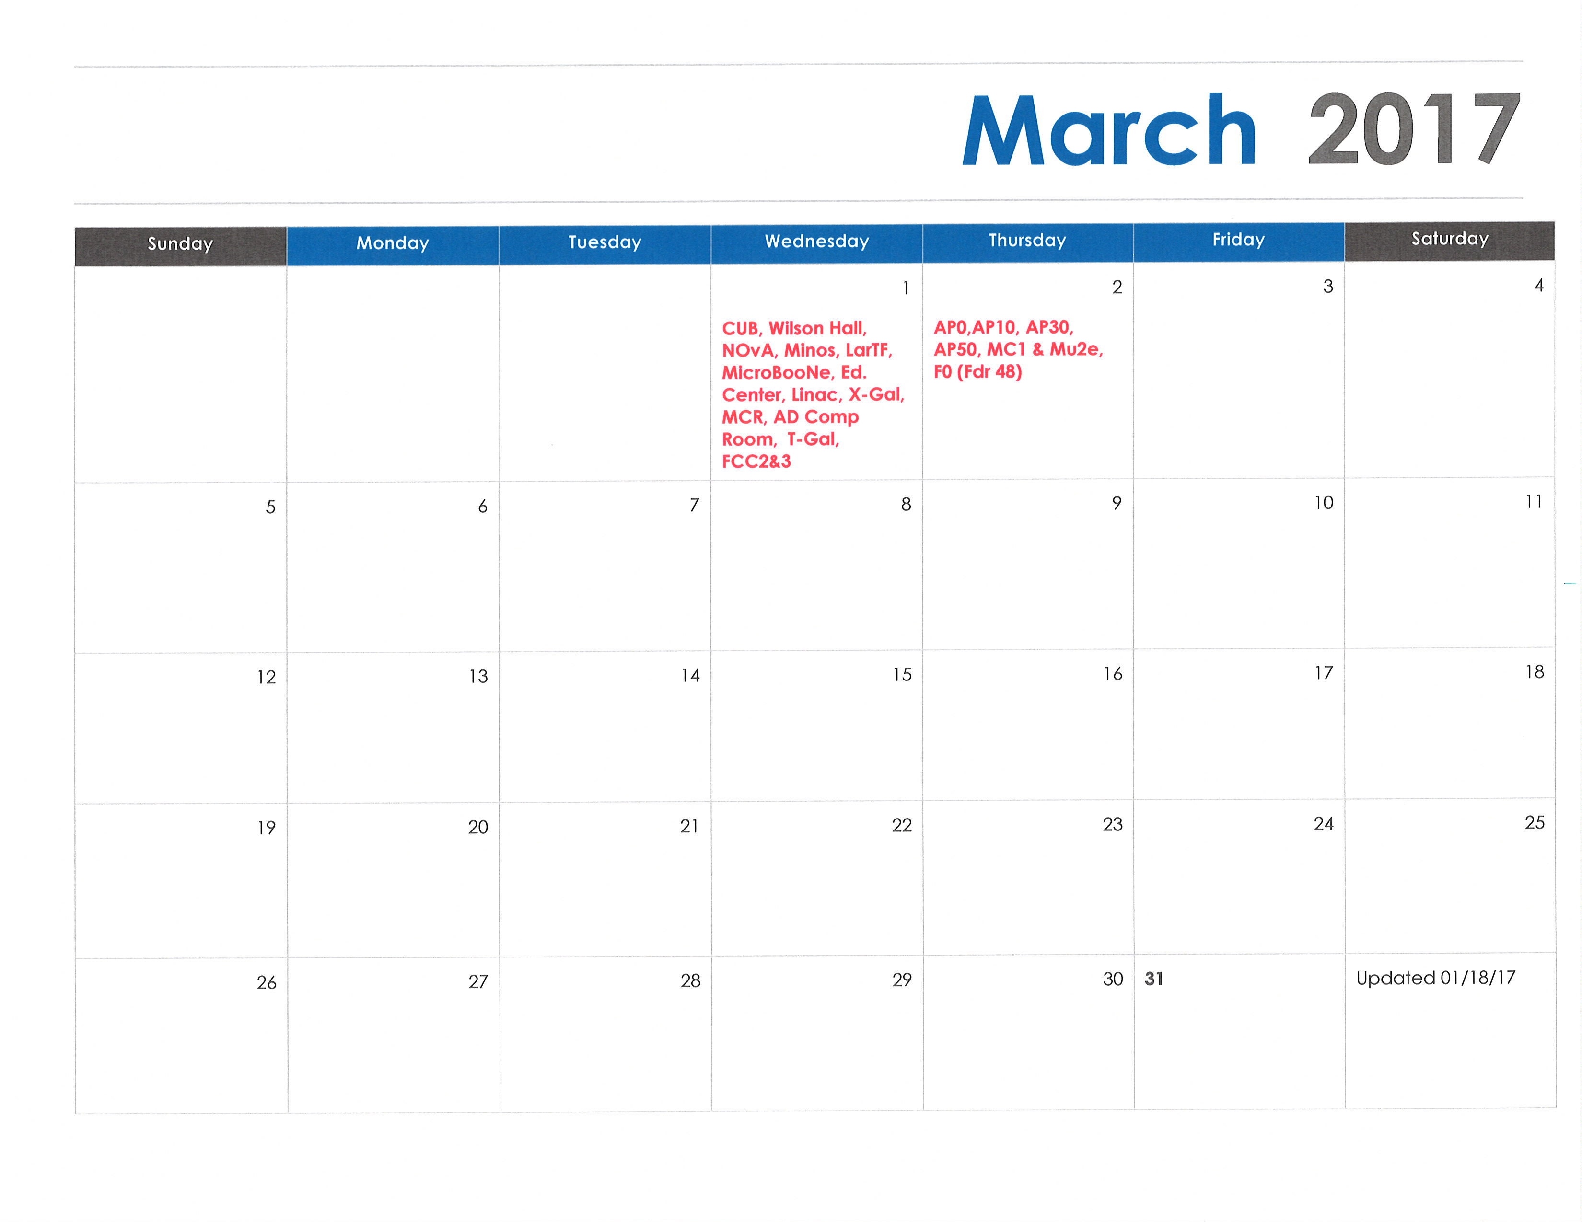
March 2017

Slide 5
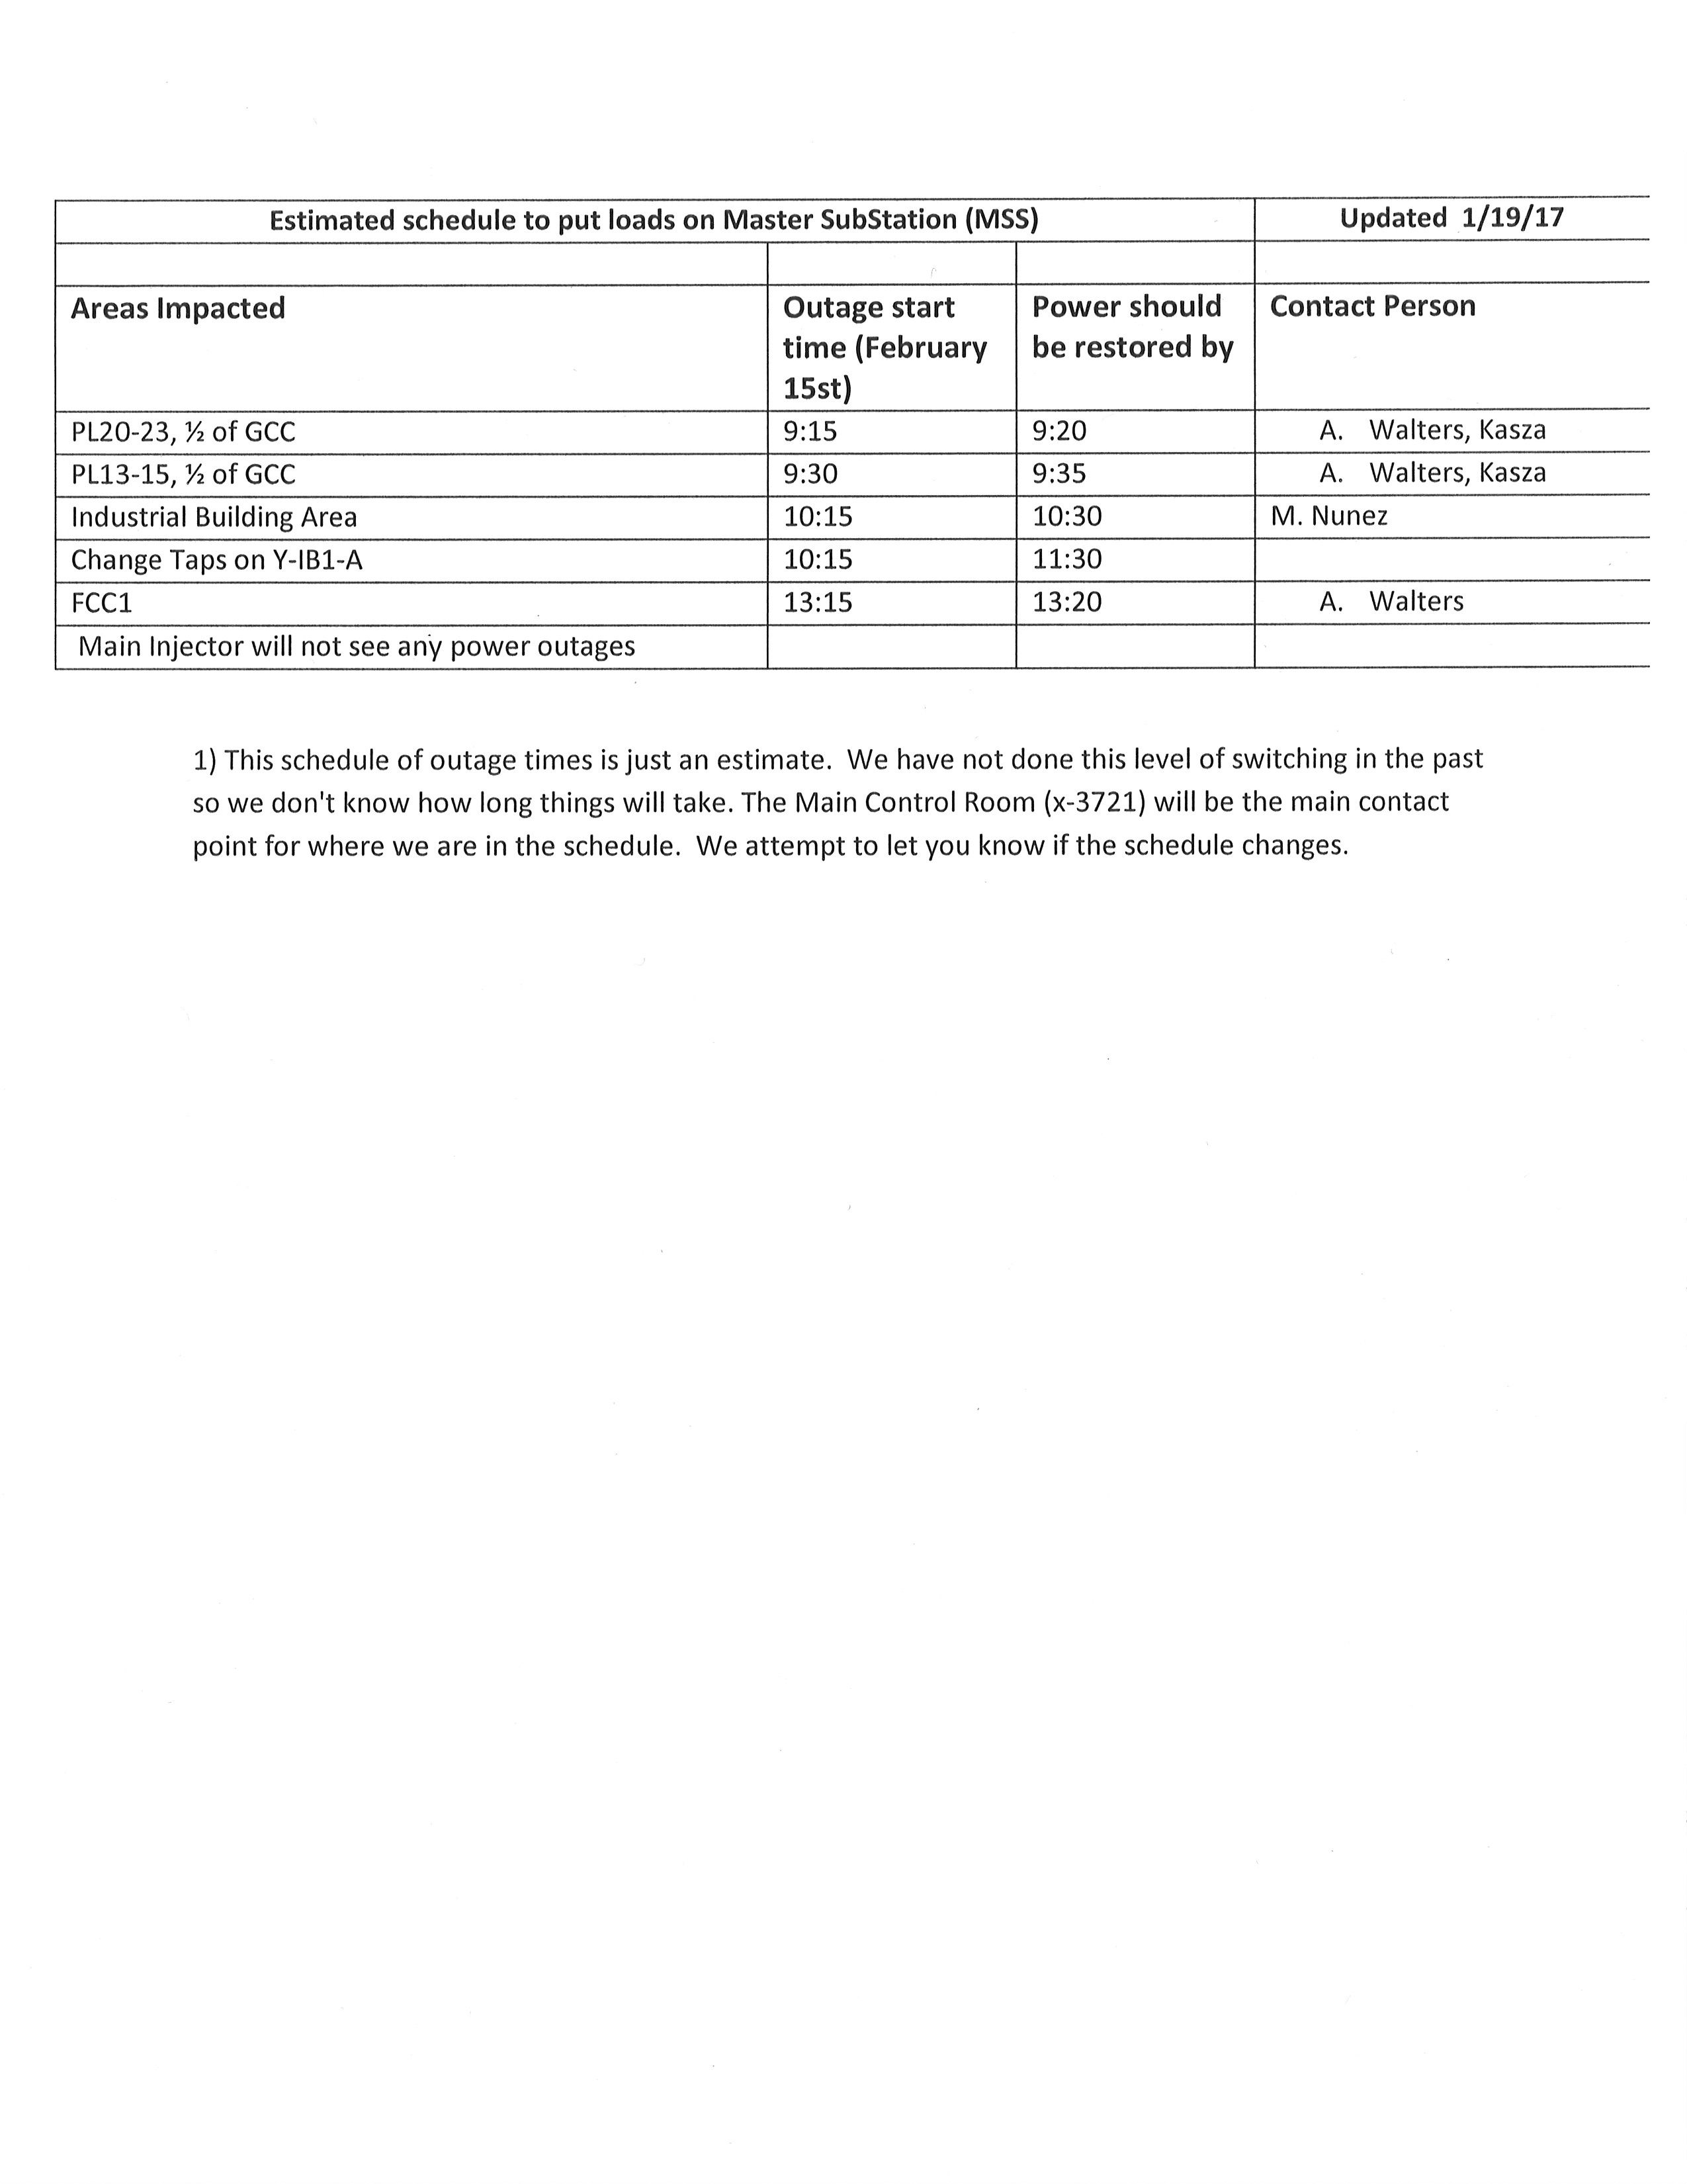
February 15th

Slide 6
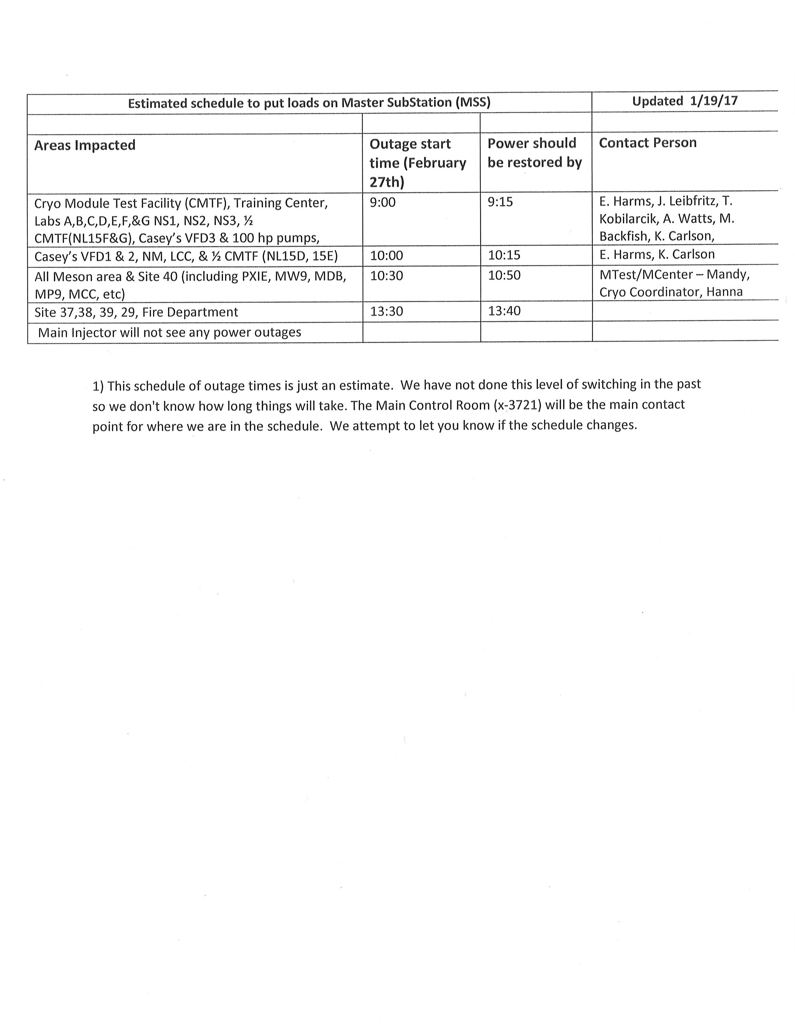
February 27th

Slide 7
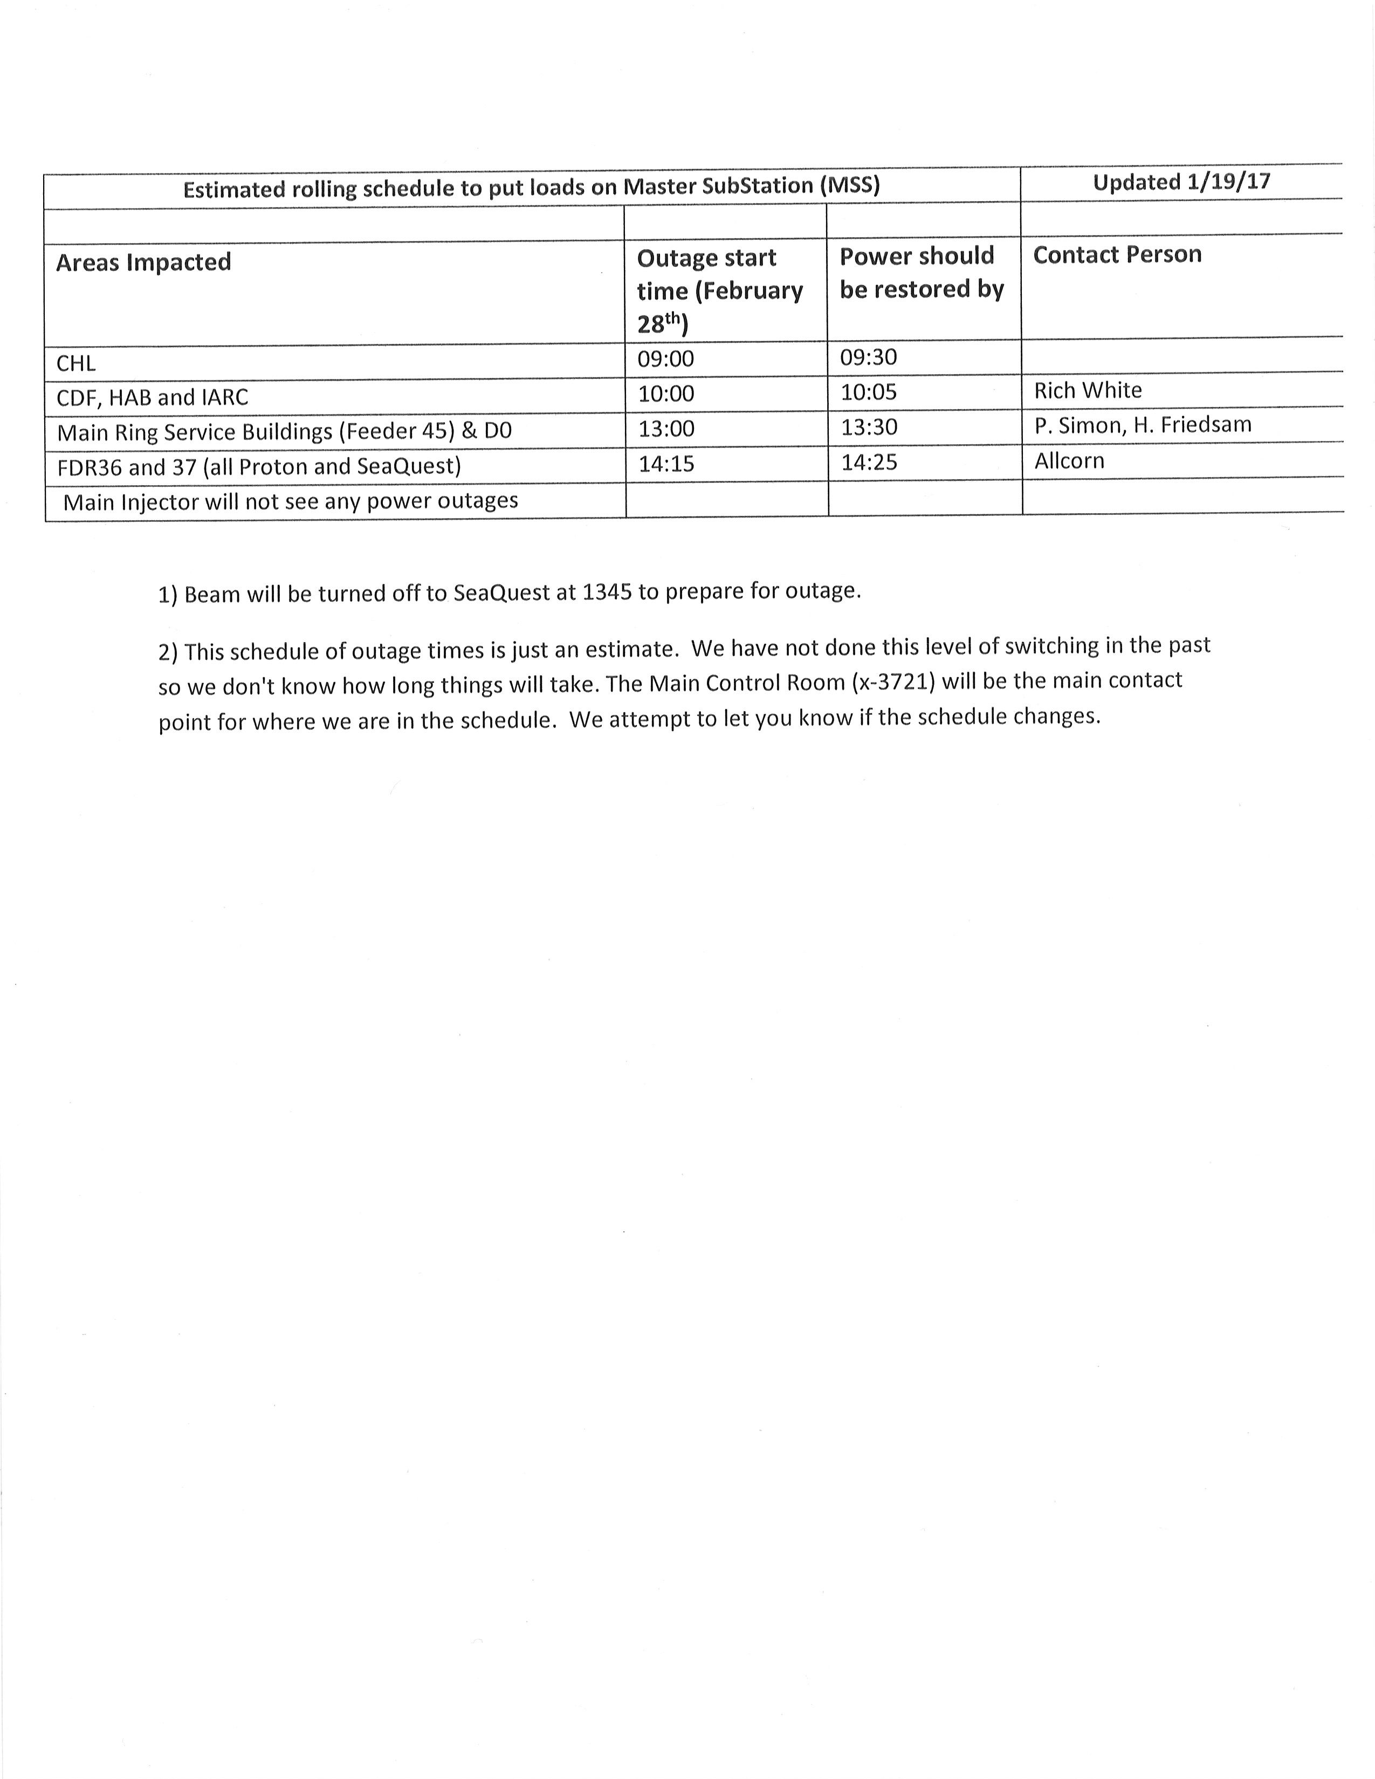
February 28th

Slide 8
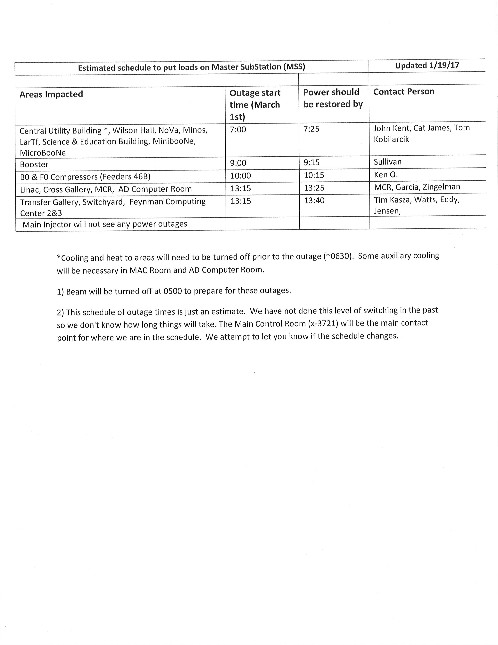
March 1st

Slide 9
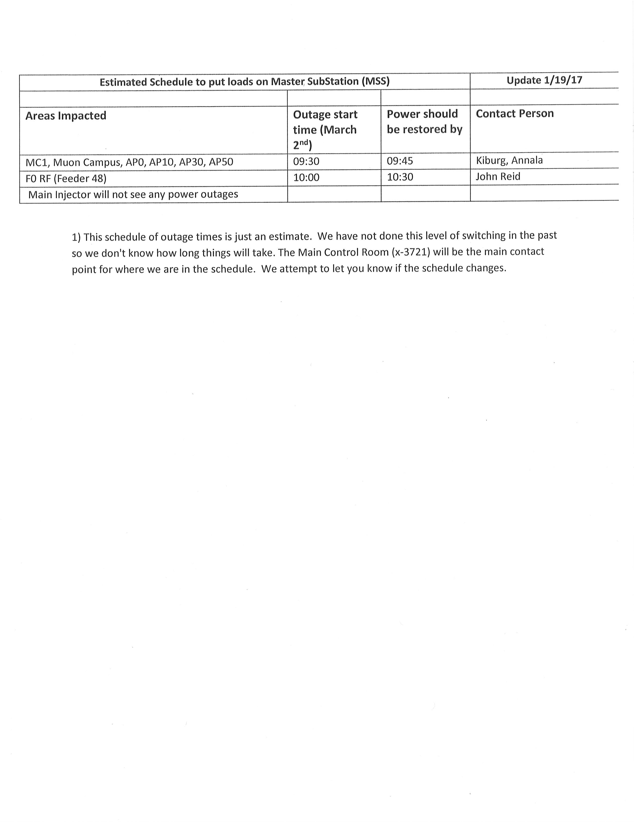
March 2nd

Slide 10
Schedules and Links
Schedule can be accessed from the Operations Department Home Page
  Schedules -> Operations Schedule
Direct link to schedule
  http://www-ad.fnal.gov/ops/schedule.html

