Slide 1
3.9GHz Cryomodule Assembly at Fermilab
Tug Arkan / Chuck Grimm
LCLS-II 3.9GHz CM Final Design Review
January 30-31, 2017

Slide 2
Outline
Production Strategy
Fermilab Cryomodule Assembly Facility (CAF) infrastructure
Detailed CM Assembly Workflow at CAF
Travelers and Part kits
Summary

Slide 3
Planned LCLS-II Production CMs Workflow at Fermilab
Receive dressed, ready to be tested in VTS (vertical test stand) cavities from the vendors (Beamline under vacuum)
Incoming Inspection at IB4.
Test cavities in VTS at IB1
Qualified Cavities go to CAF-MP9 cleanroom for cold end coupler assembly (WS0). Non qualified cavities will be re-processed (HPR, light EP etc.) and re-tested.
One cavity out of every sixteen will be tested in horizontal test stand (HTS) . Other cavities still stay in the cleanroom and ready to be assembled into a cavity string.
8 qualified cavities, BPM, Gate Valves, Interconnecting Bellows/Spool: Cavity String Assembly at CAF-MP9 Cleanroom (WS1)
Cold Mass Assembly at CAF-MP9 (WS2)
Cold Mass Assembly at CAF-ICB (WS3 & WS4)
Final Assembly and QC checks (WS5) and prep for transport to CMTS at CAF-ICB (WS6)
Cryomodule Test at CMTS
Transport the module back to CAF-ICB (WS6)
Prepare and Ship Module to SLAC

Slide 4
Supply Chain for Production CMs assembly at Fermilab
Dressed cavities delivered ready to be tested
Fundamental power couplers delivered ready to be assembled at WS0 and WS5
Gate valves (VAT) cleaned to Class 1000 standard at the vendor
BPM
Copper plated beamline components
Cavity String Assembly Hardware
Cold Mass Upper assembly (long lead procurement)
Cold Mass peripherals
Instrumentation
Vacuum Vessel (long lead procurement)
Vacuum vessel peripherals
Leverage from the supply chain experience gained during 1.3GHz CMs Production
Full or batch delivery Supply Chain Manager working with SOTRs & TD QMD for qualified parts storage in TD inventory system Parts are kitted & delivered to work stations Sort, magnetic hygiene QC, clean and use

Slide 5
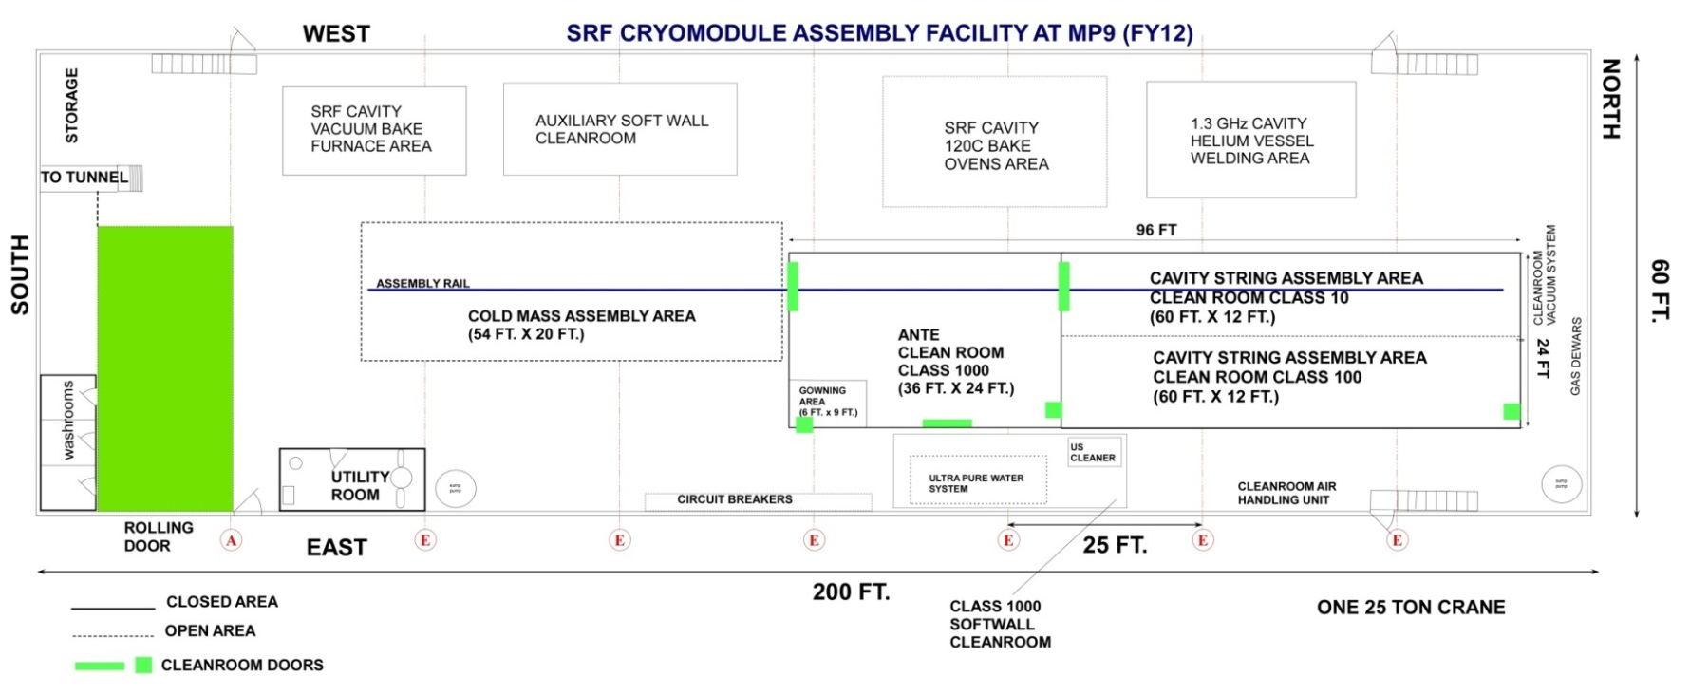
CAF-MP9 during LCLS-II Production
WS2
WS1
WS0

Slide 6
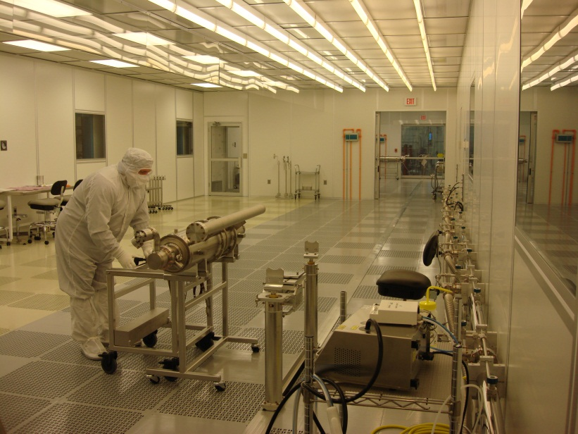
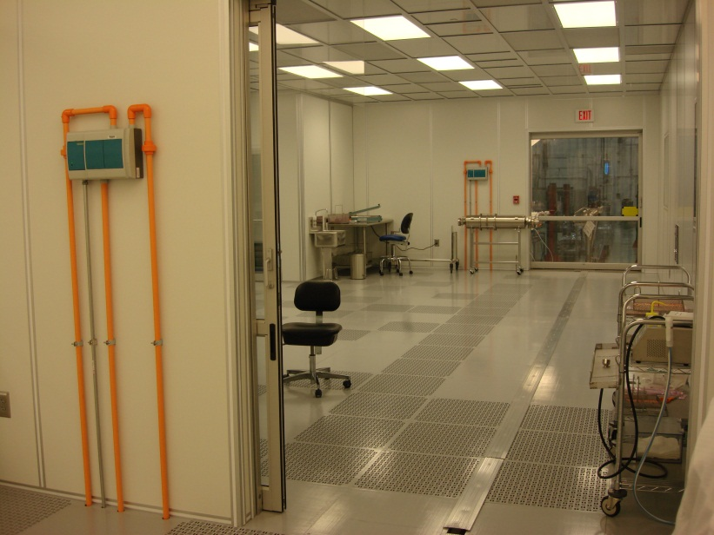
CAF-MP9 Clean Room
Cavity String Assembly Clean Room
A ~2500 square-feet clean room:
Class 1000 (ISO6) ante clean room area (36 ft. x 24 ft.)
Preparation of the dressed cavities for transportation into the assembly clean room.
Class 100 (ISO5) sluice area
Parts and Fixtures final preparation to enter the Class 10 assembly area.
Class 100 (ISO5) area ( 60 ft. x 12 ft.)
Parts and Fixtures preparation for assembly.
Class 10 (ISO4) assembly clean room area (60 ft. x 12 ft.)
Where the cavities vacuum is vented to interconnect them with bellows.
Class 100
Class 10
Class 1000
Rail

Slide 7
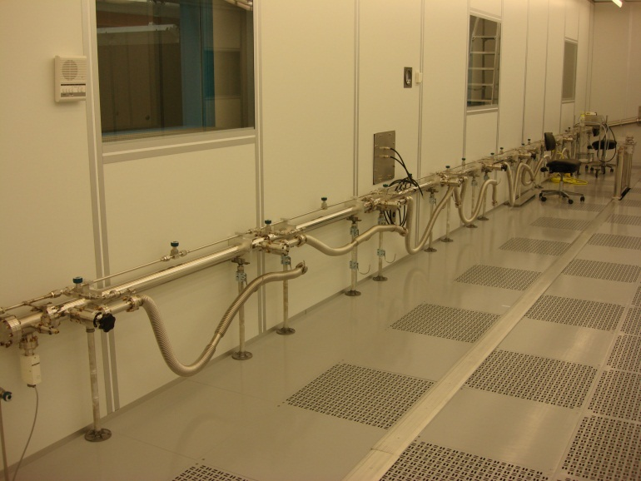
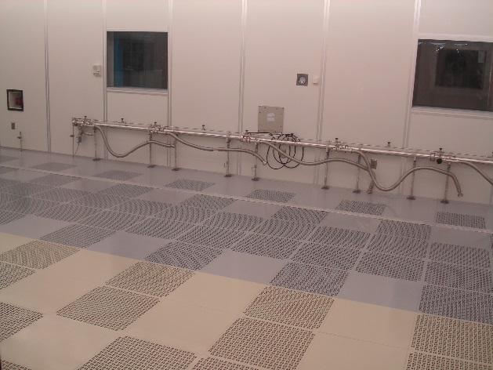
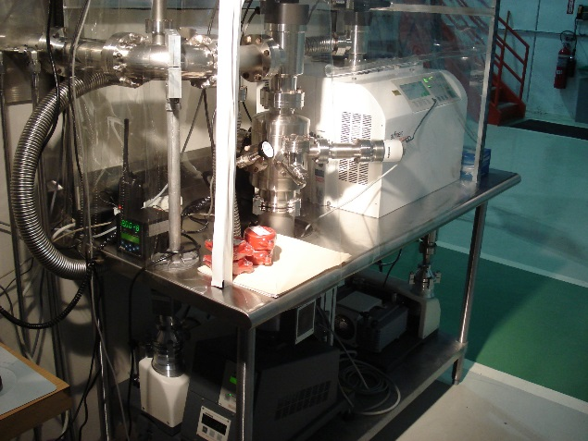
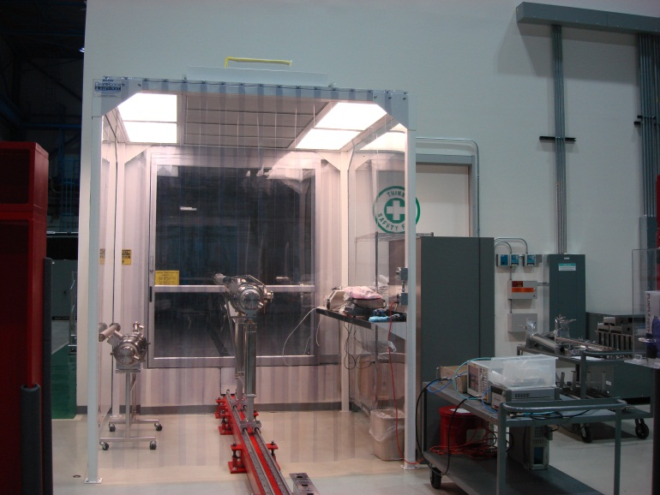
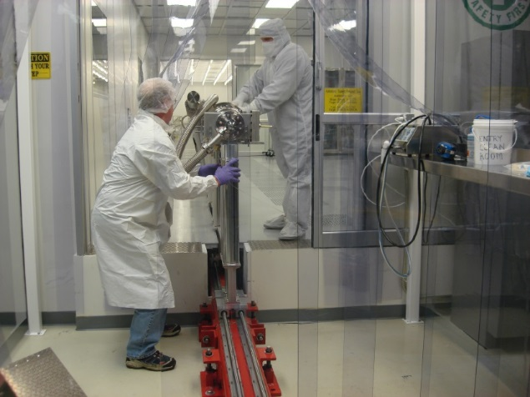
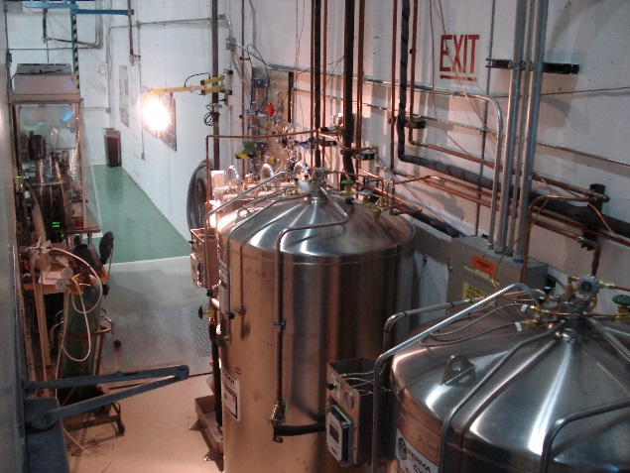
Cleanroom Infrastructure
Vacuum / Gas Manifold
8 stations for pumping, purging and backfilling
Particle Free UHV Pumps System
Cavity Support Fix Rail System
Boiled-off LN2 gas dewars and gas delivery panels
Class 1000 softwall cleanroom for dry cleaning before entry to ante cleanroom

Slide 8
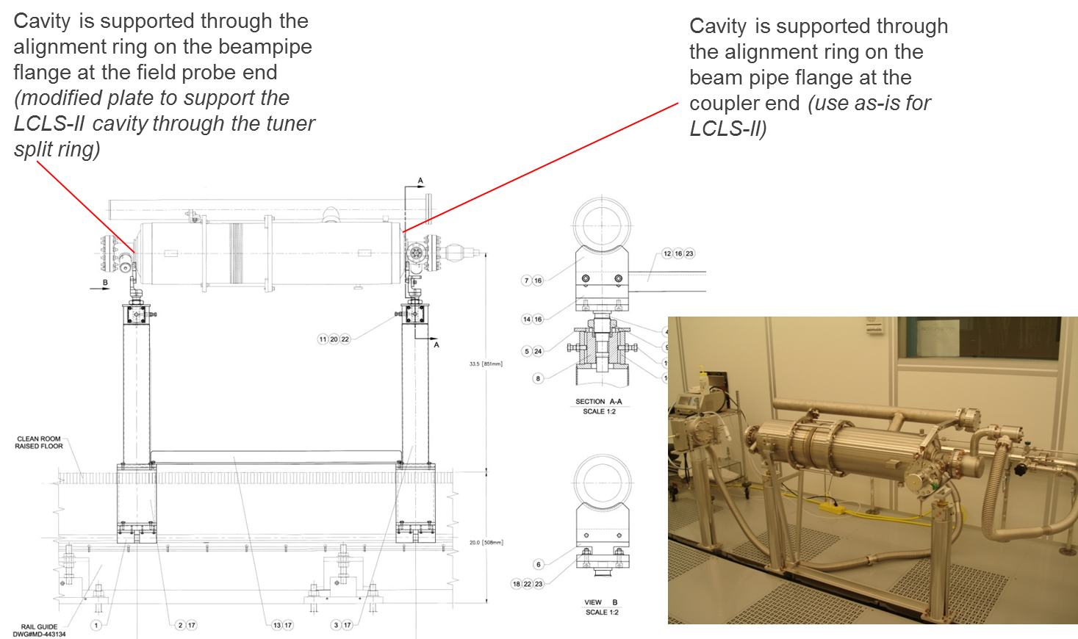
Tooling/Fixtures Strategy
Use 1.3GHz CM assembly fixtures/tooling as much as possible while reconfiguring to assemble 3.9GHz CM. Additional brackets, adapters are needed during reconfiguration.

Slide 9
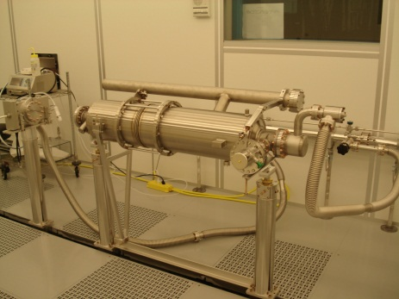
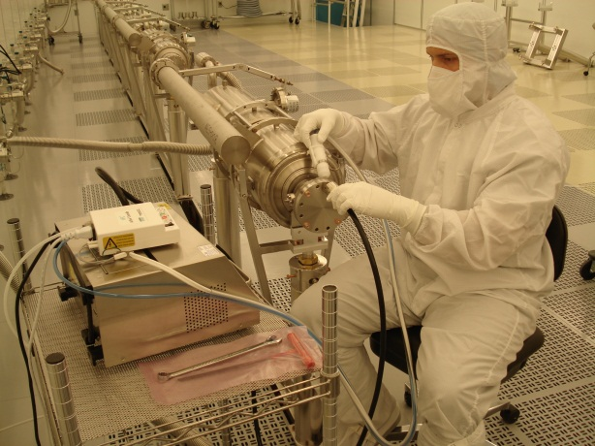
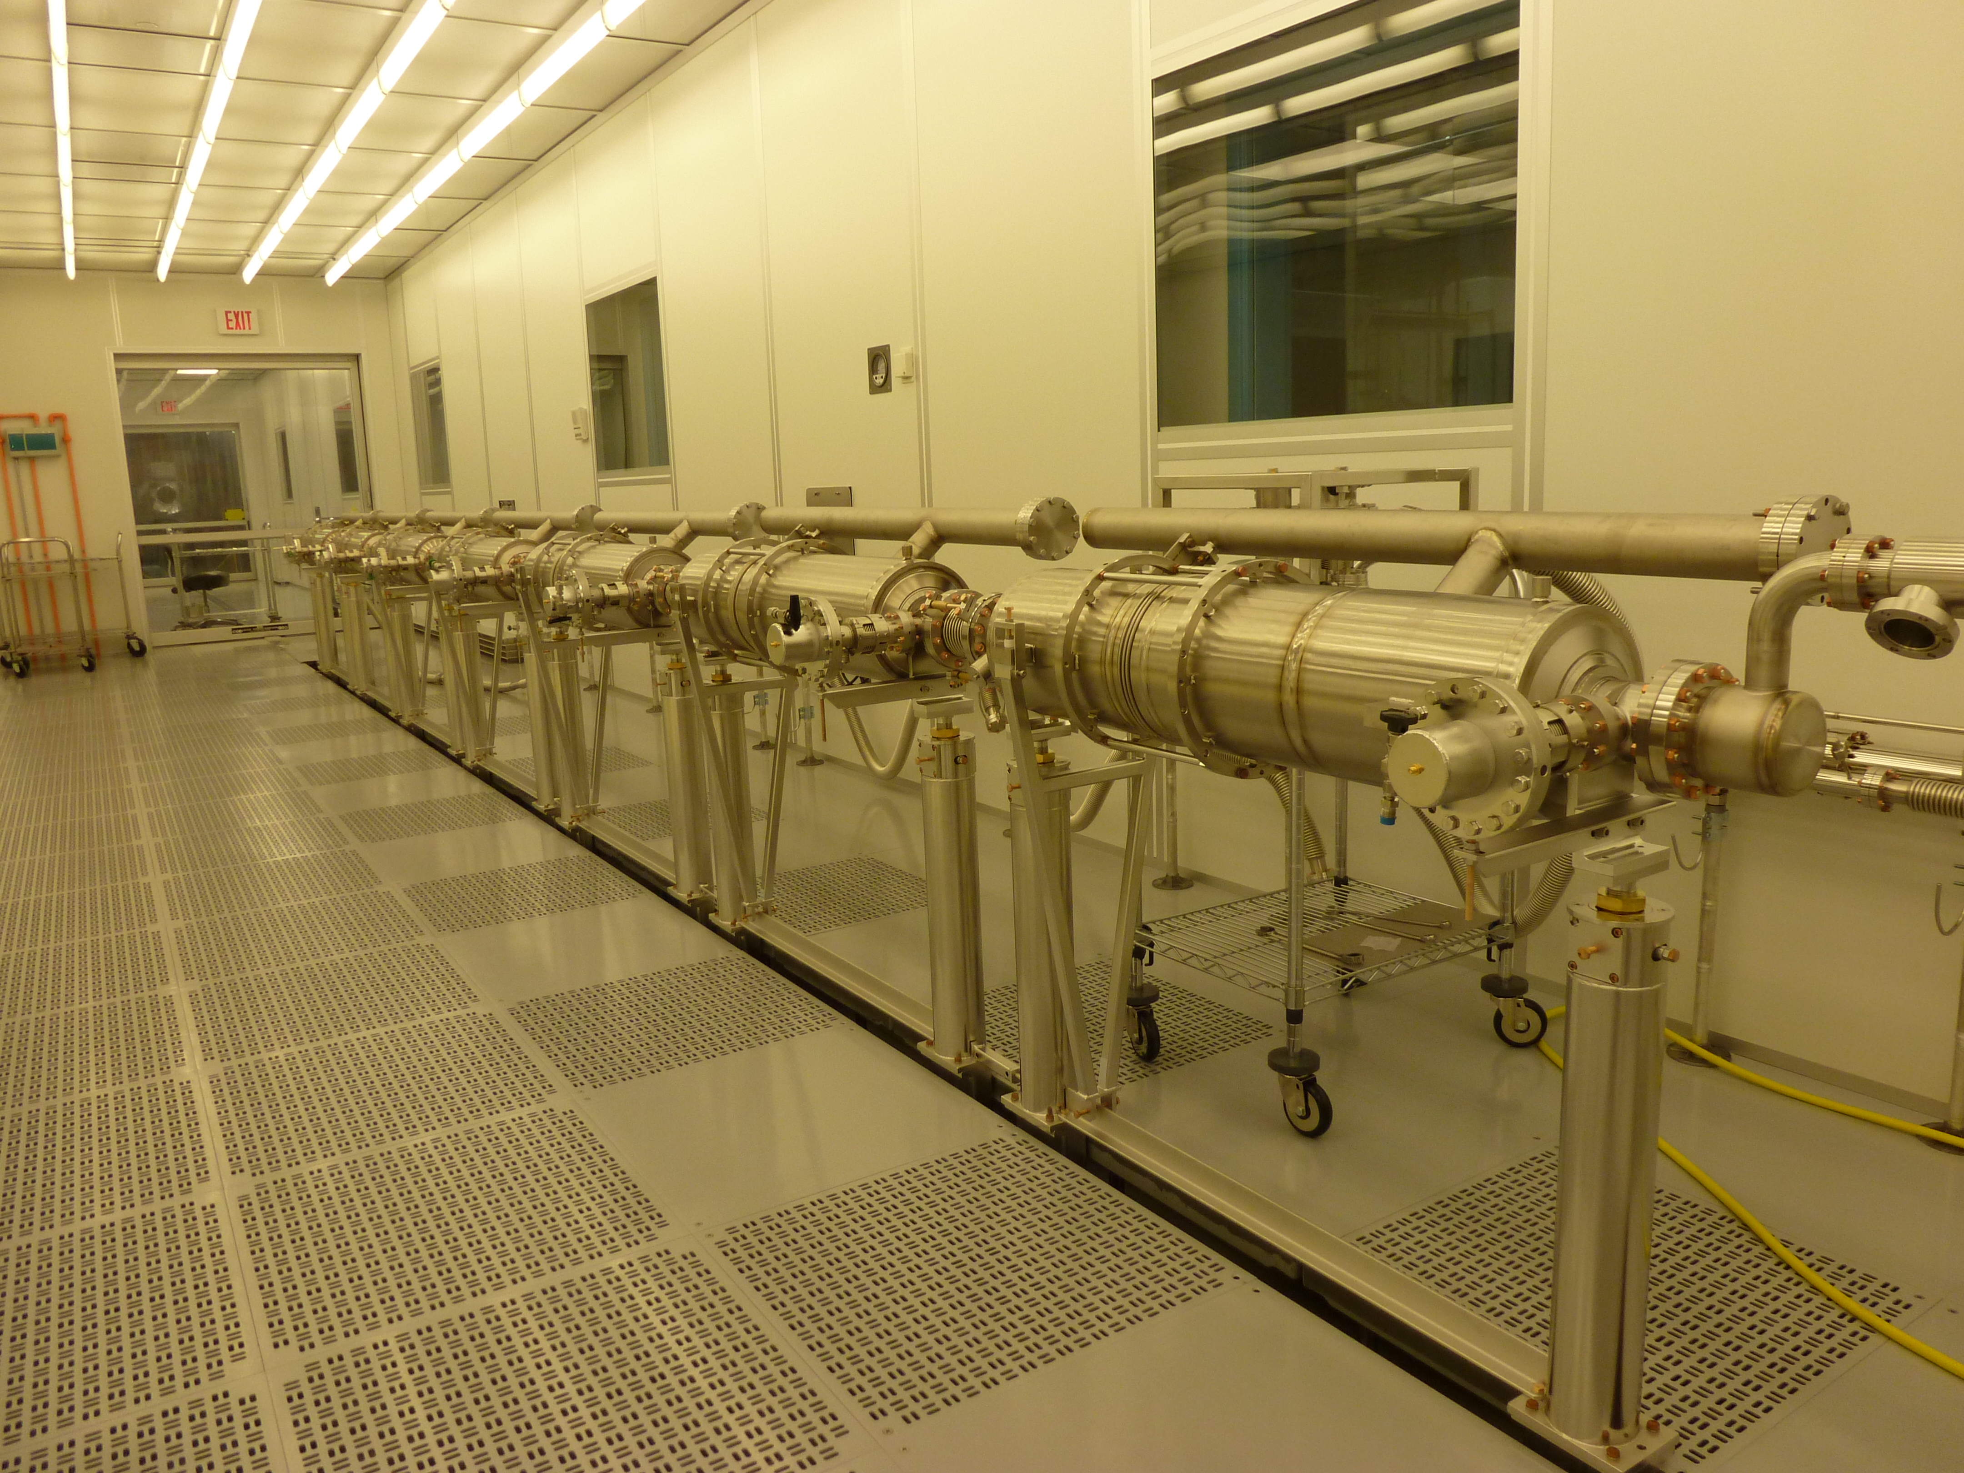
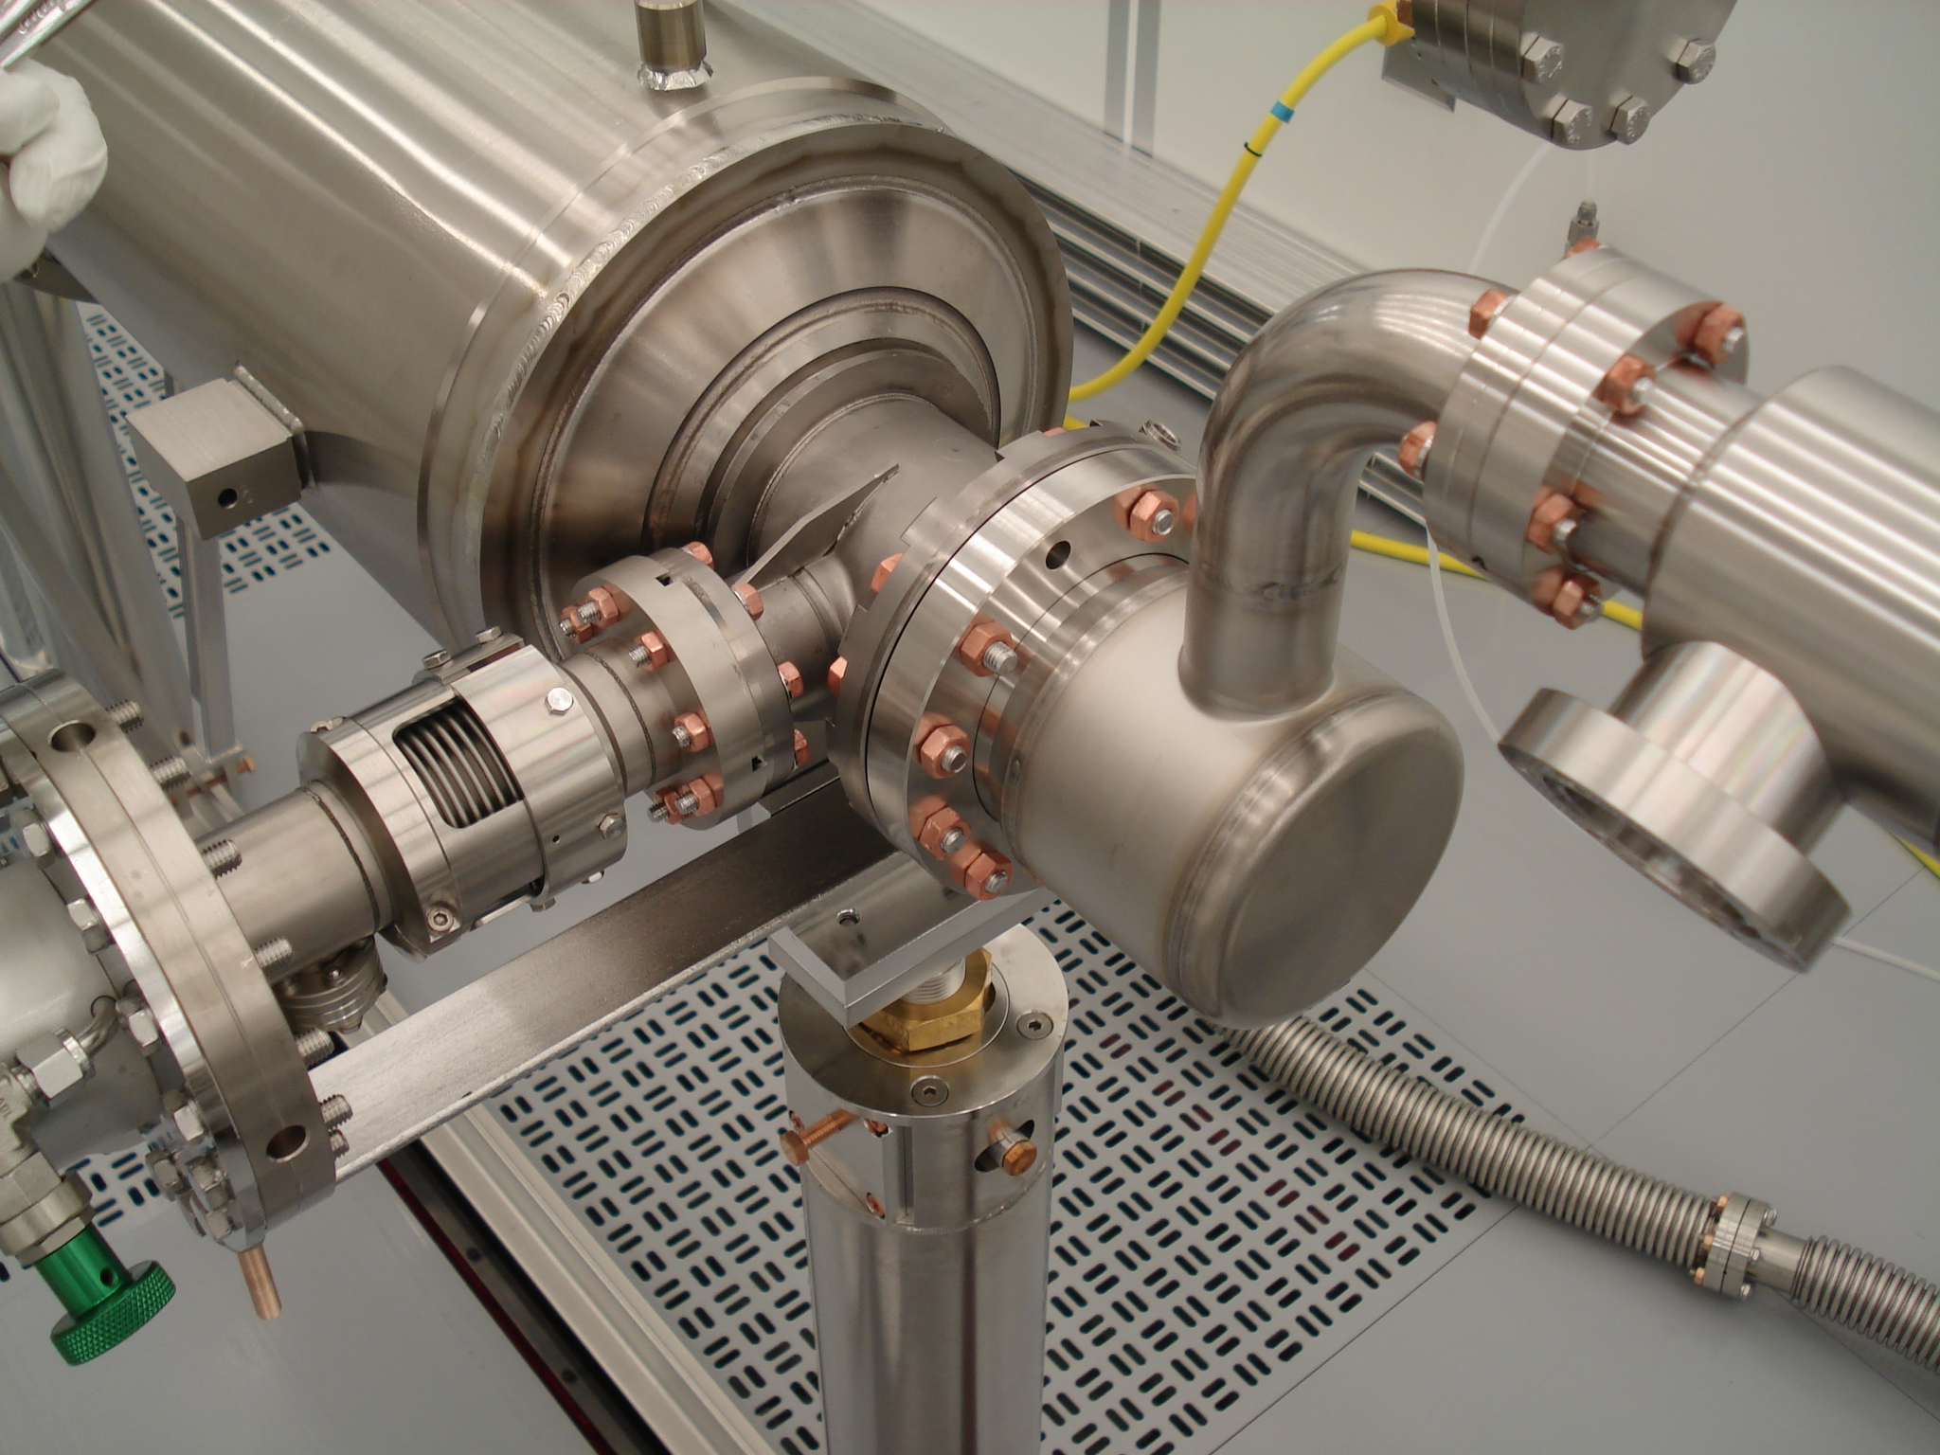
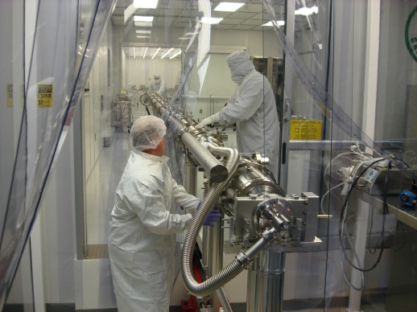
String Assembly Workflow
Receive/Clean peripheral parts/hardware
Receive dressed qualified Cavities
Assemble dressed Cavities to form a String in WS1
HTS tested
with FPC
Yes
No
Assemble cold end of FPC to the dressed cavity in WS0
Leak Check & Backfill
Roll the string out of the cleanroom to WS2

Slide 10
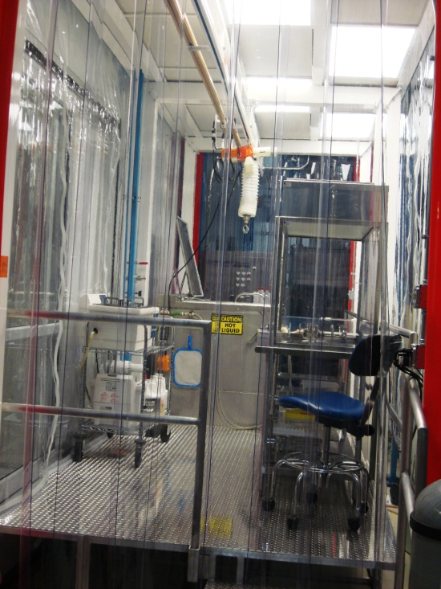
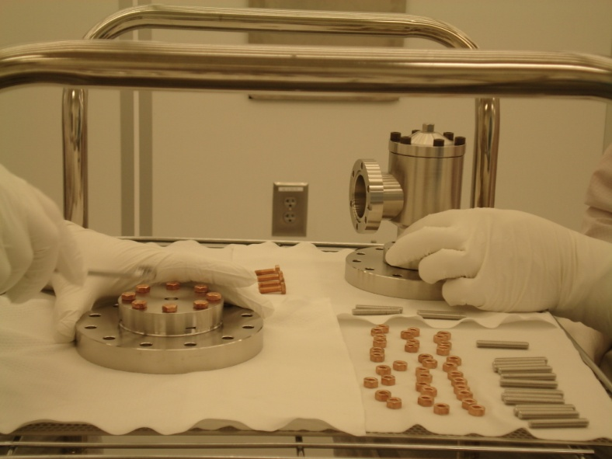
Parts / Fixtures / Hardware Entrance to Cleanroom Preparation
Magnetic Hygiene Quality Control for every part, hardware, fixtures, tools that will be used in the cleanroom for assembly prior cleaning
Class 1000 softwall cleanroom
Class 10 Hood
Assembly hardware:
Wash in the ultrasonic bath
Dry under Class100 hood
Move into the Class 1000 ante clean room
Blow clean with ionized nitrogen while monitoring the particle count in the sluice area (Class 100)
Transport into the Class 10 assembly area
US cleaners
Electro-polished, rolled thread 316L stainless steel studs; silicon bronze nuts

Slide 11
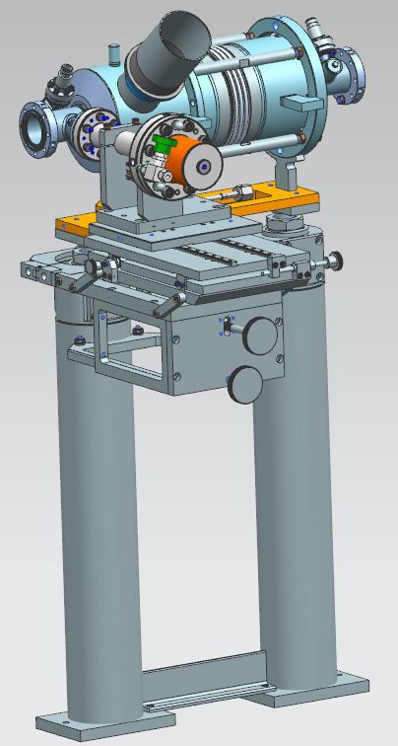
Cold End Coupler Assembly (WS0)
Leak check, RGA the dressed qualified cavity (received with beamline under vacuum)
Assemble pump/backfill/purge flex hose to the cavity
Backfill the cavity
Leak check the coupler pair in the processing stand as delivered
Backfill
Remove a cold end coupler from the stand
Assemble cold end coupler to the cavity using particle free flange assembly (PFFA) procedures.
Pump down, leak check, RGA
Backfill

Slide 12
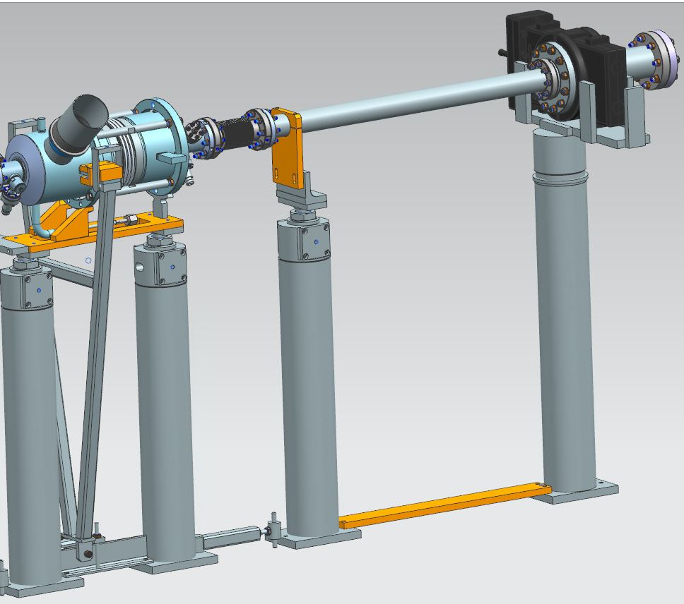
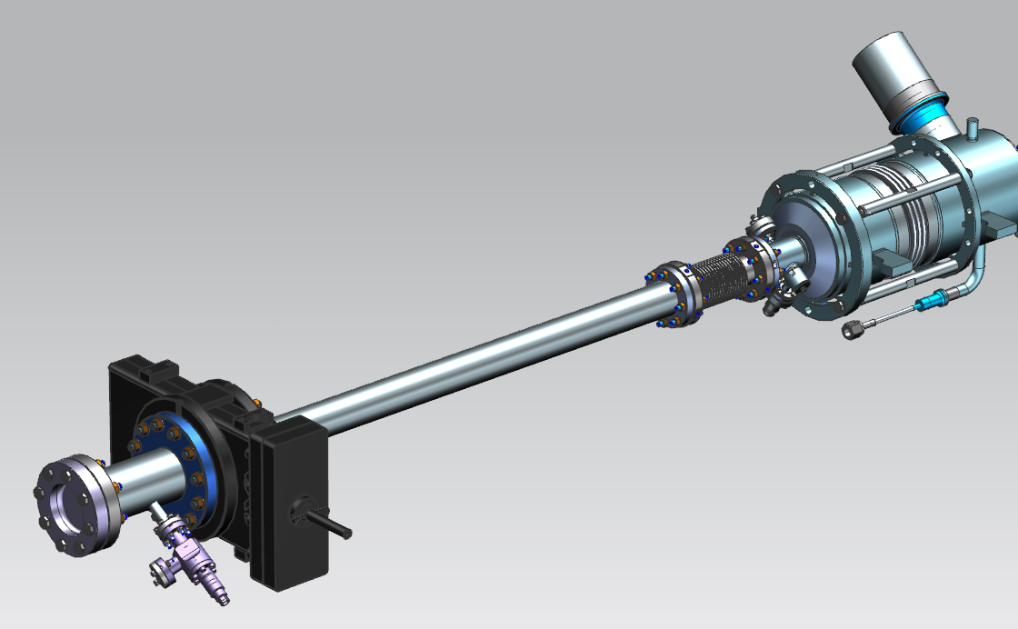
String Assembly-I (WS1)
Rotational alignment of cavities
Gate Valve (GV1) to Cavity #1 Assembly:
Check the particle free cleanliness of the GV and clean as needed
Sub-assembly of the GV peripherals
Installation to the support post and vacuum hose assembly
Alignment to the cavity beam line flange
Assemble the gate valve to the cavity

Slide 13
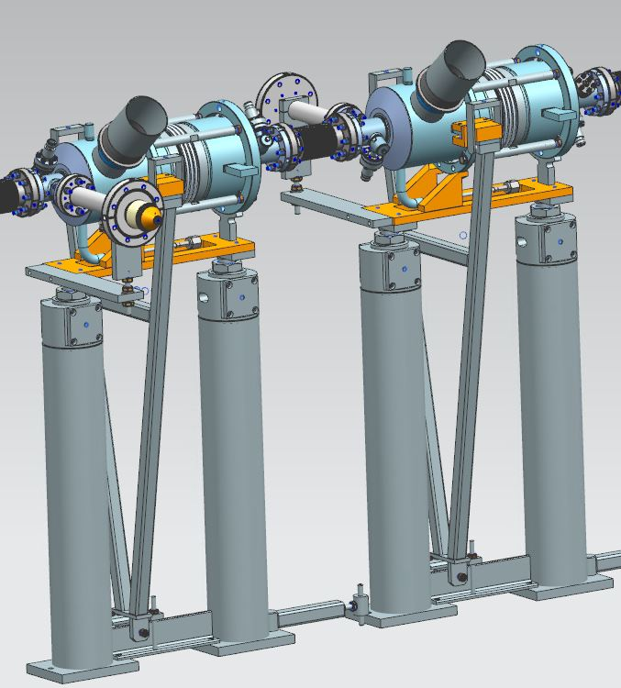
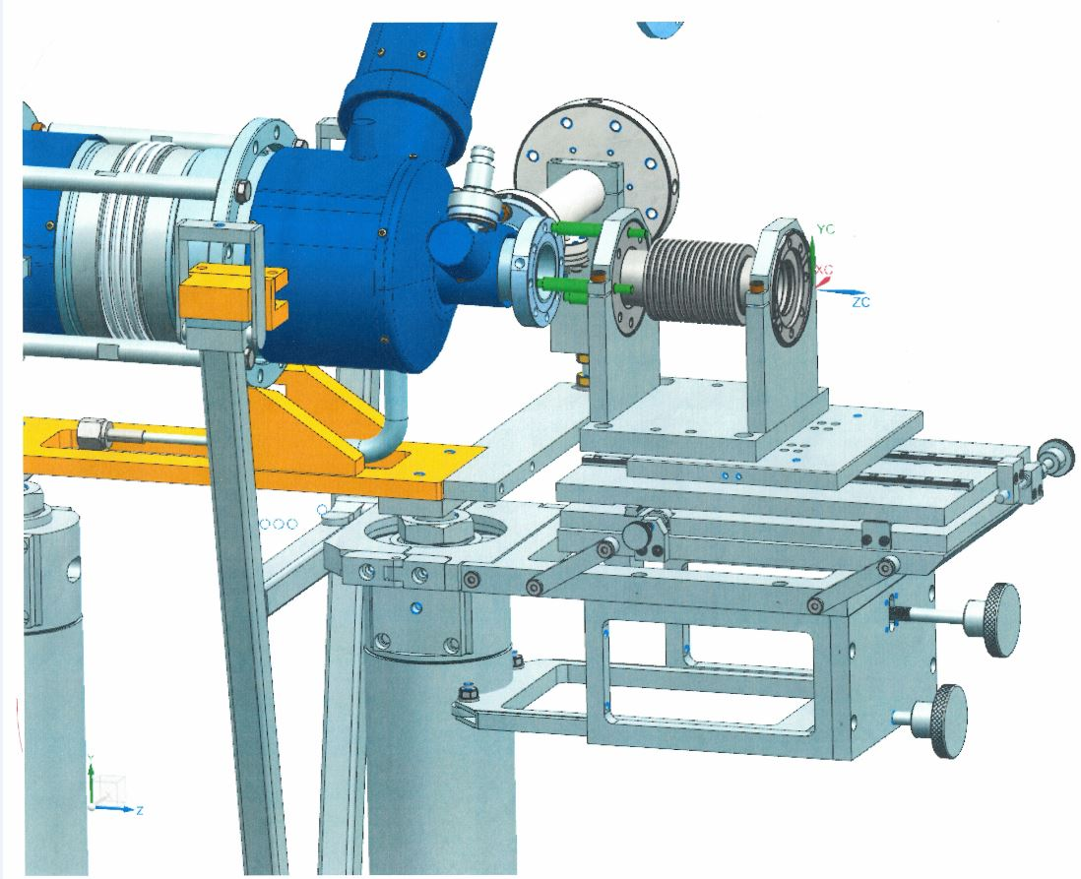
String Assembly-II (WS1)
Cavity to Cavity Assembly with the interconnect bellows:
Assemble flex hose to the cavity. Pump down and Leak check. Backfill
Align the interconnect bellows to the cavity field probe end beampipe flange
Assemble with PFFA
Align the bellows to the cavity coupler end beampipe flange
Assemble with PFFA

Slide 14
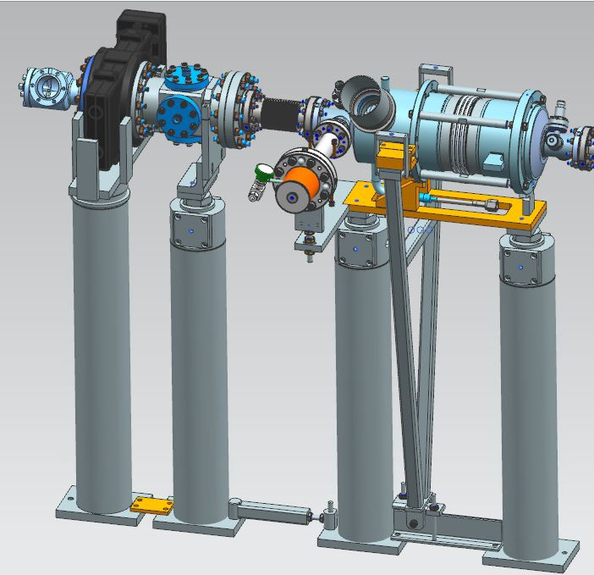
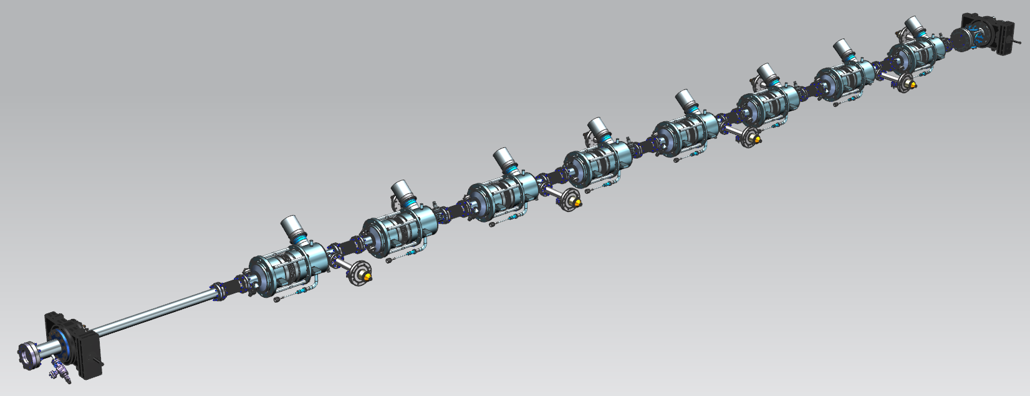
String Assembly-III (WS1)
BPM+GV2 assembly and leak check
BPM/GV2 subassembly to the 8 cavity string
Pump down fully assembled cavity string, bag the bellows, leak check. Backfill
Roll out of the cleanroom to WS2

Slide 15
CAF-MP9 During LCLS-II Production
WS2
WS1
WS0

Slide 16
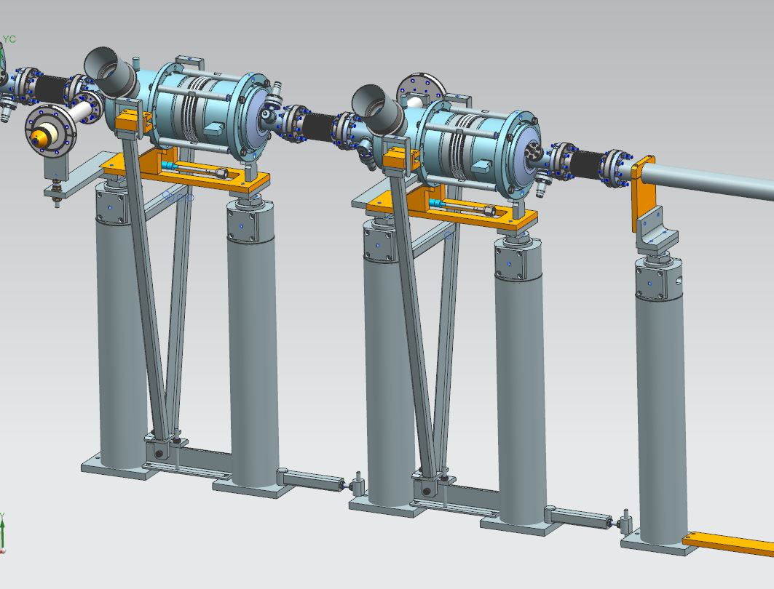
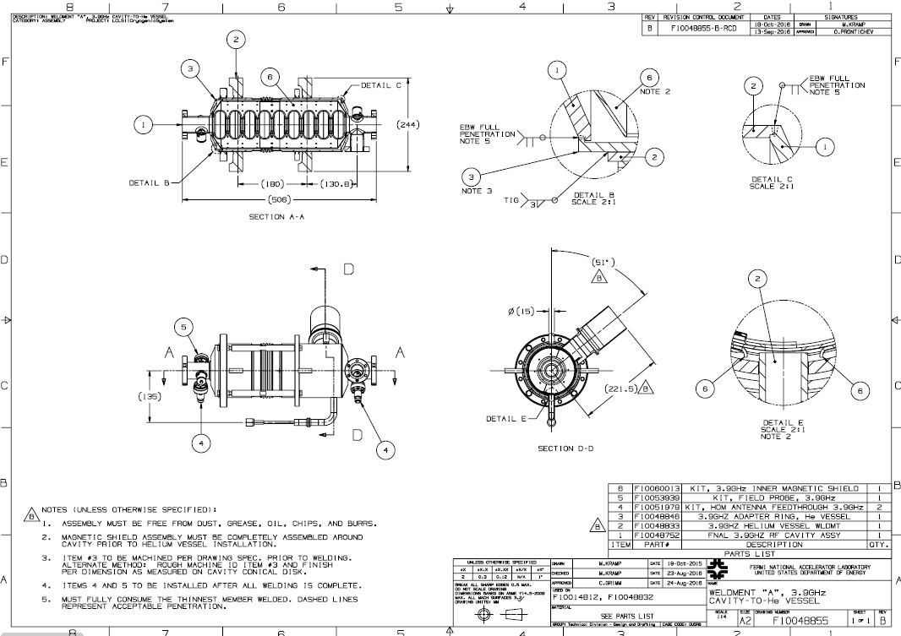
FNAL 3.9 GHz Cryomodule Assembly at WS2
After Roll-Out at WS1
Dressed Cavity Ordered Without Tee

Slide 17
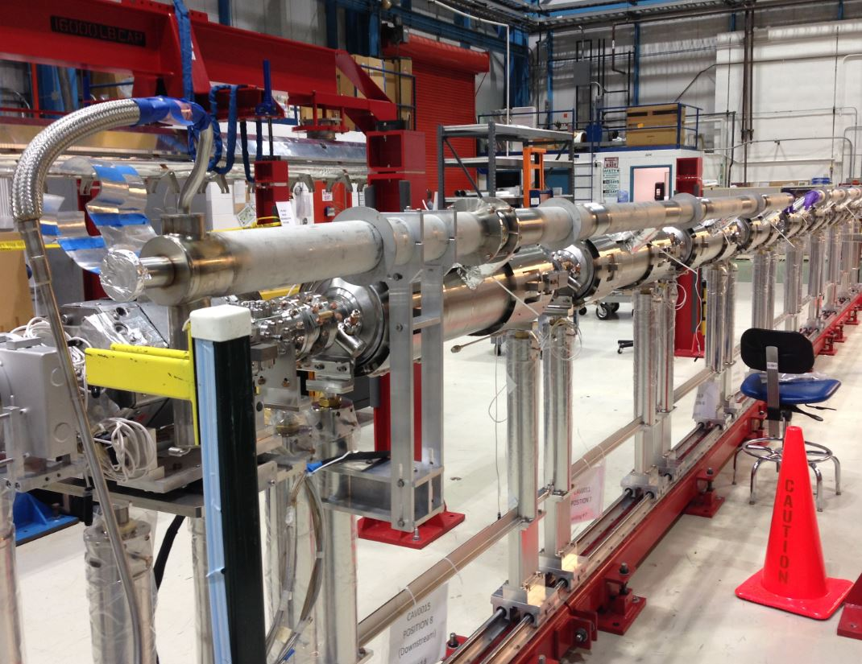
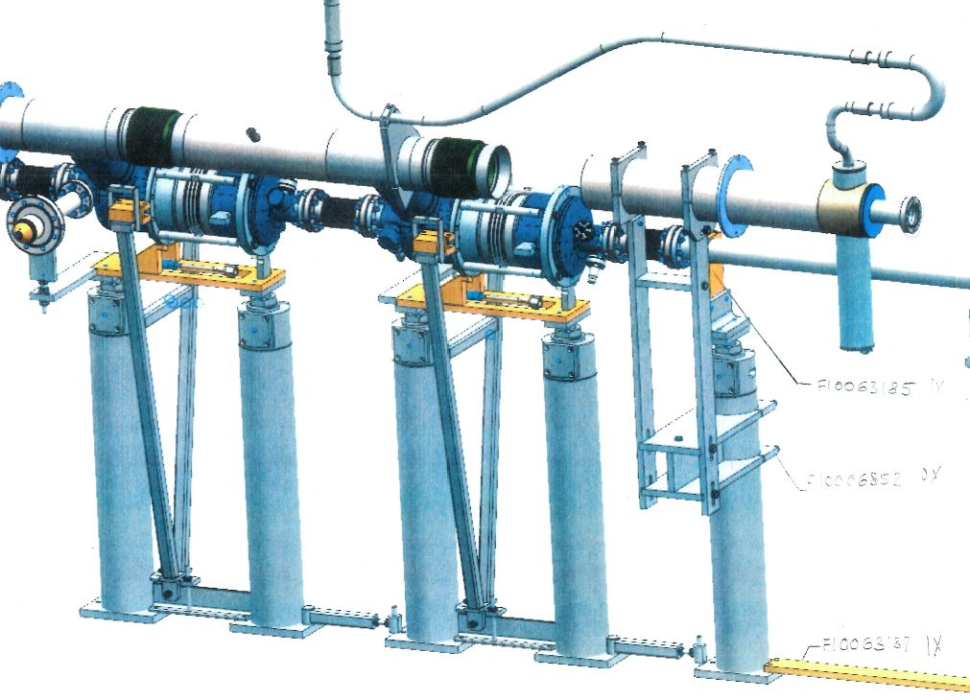
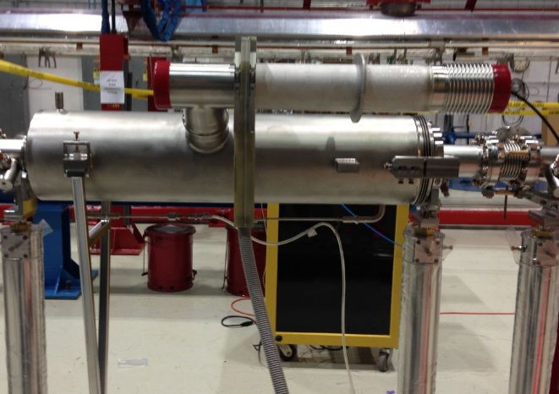
FNAL 3.9 GHz Cryomodule Assembly at WS2
2-Phase Line Welding
Same welding configuration and parameters.
Tee will be added as part of the procedure.

Slide 18
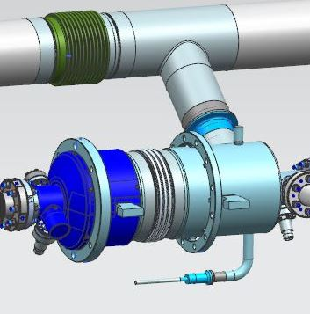
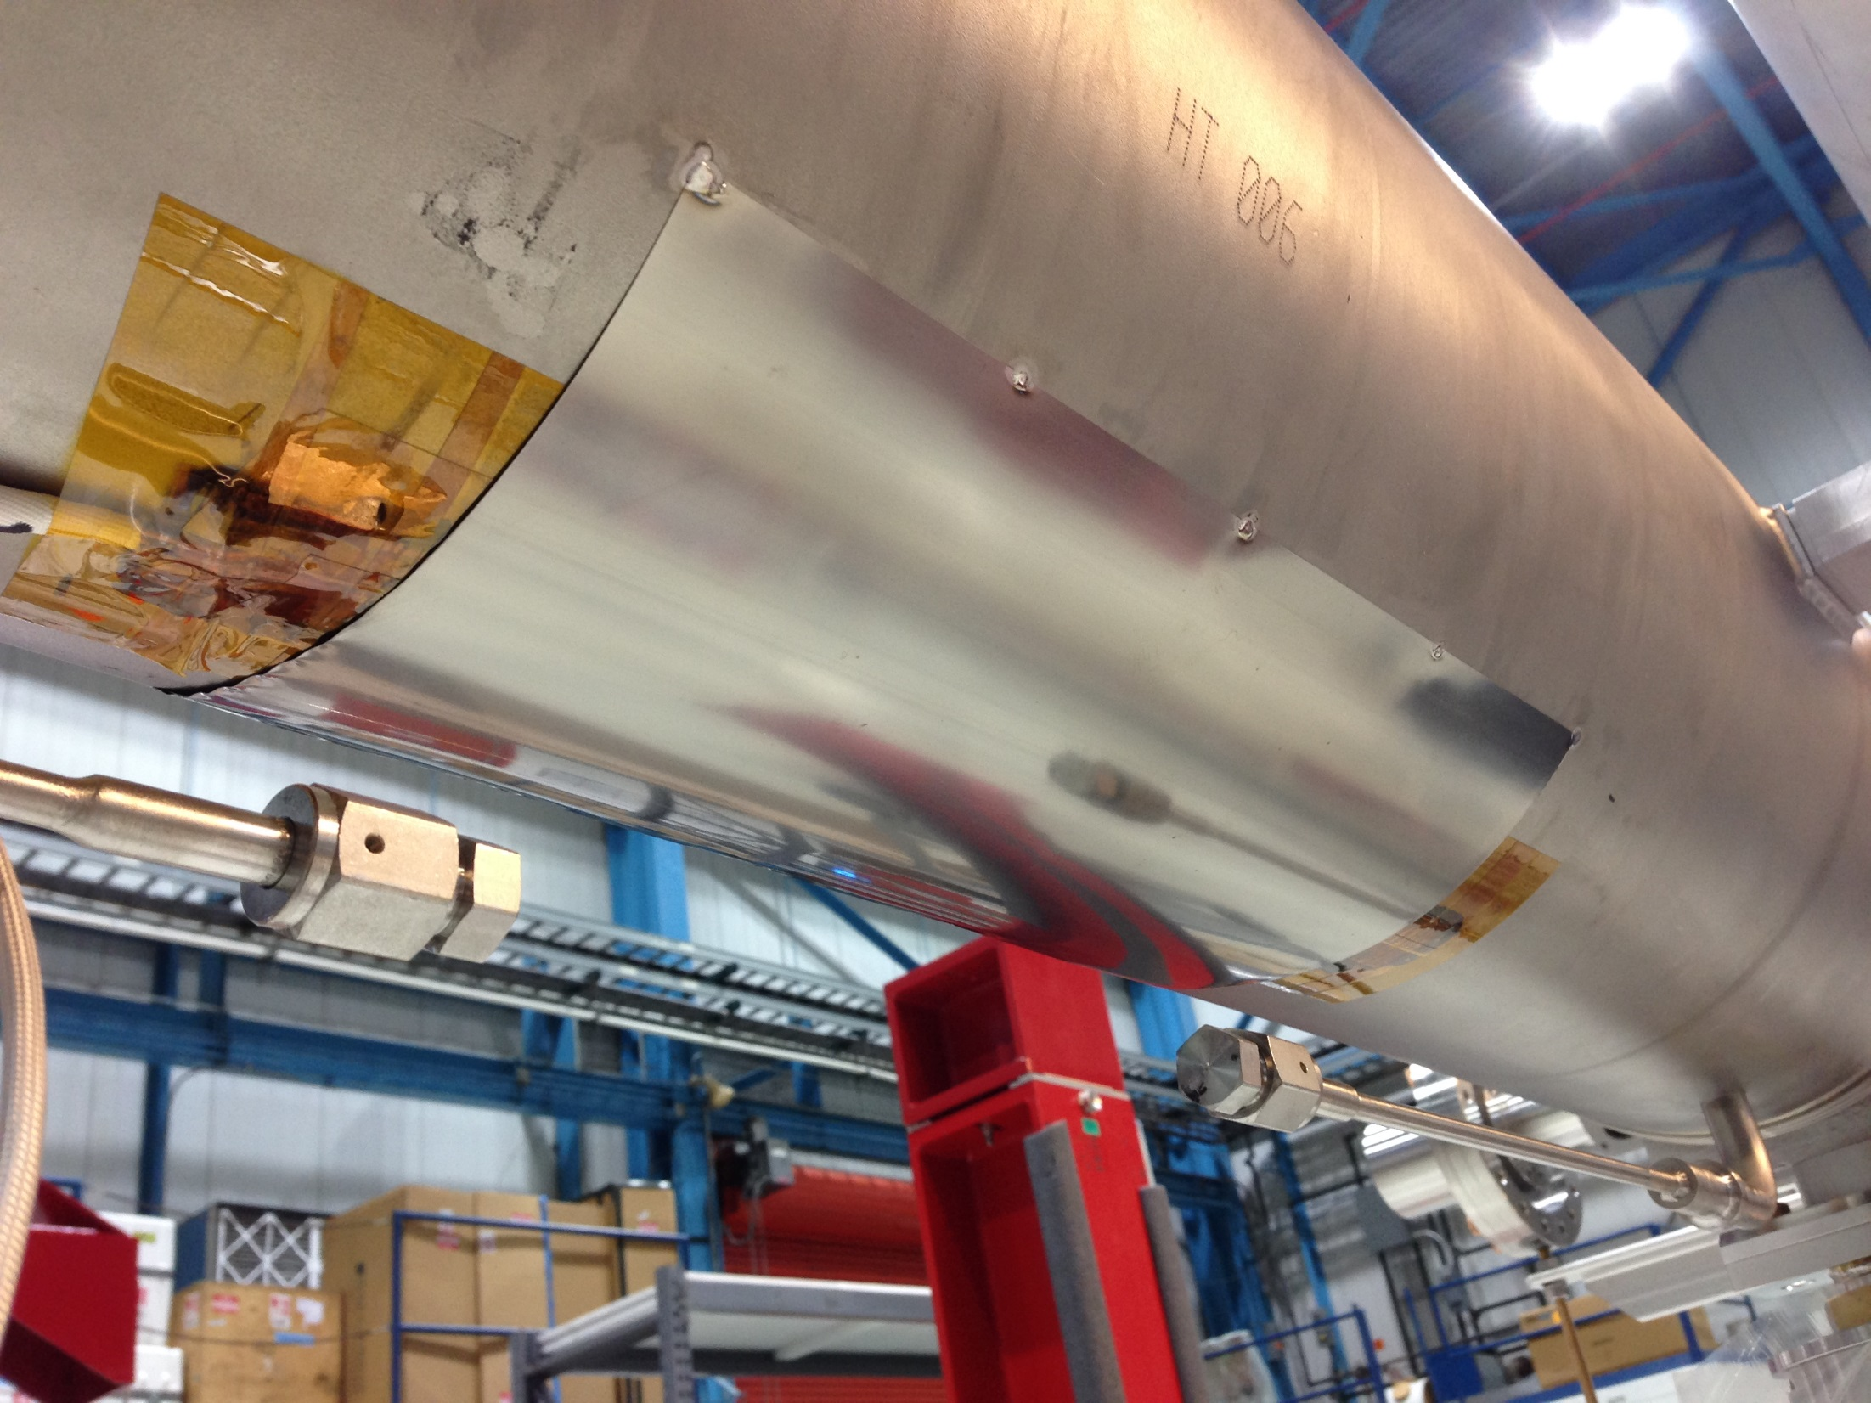
FNAL 3.9 GHz Cryomodule Assembly at WS2
Tank Heaters
Heaters will be installed in this location
Along with Kapton tape and Stycast, Ti shim material will keep
heaters securely fastened to He tanks like 1.3GHz

Slide 19
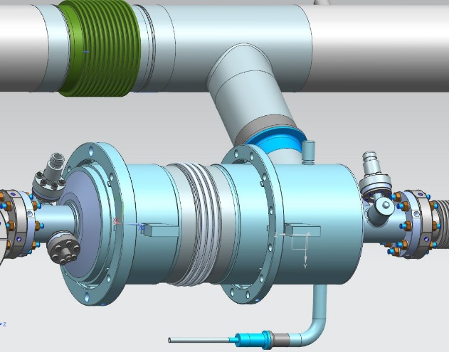
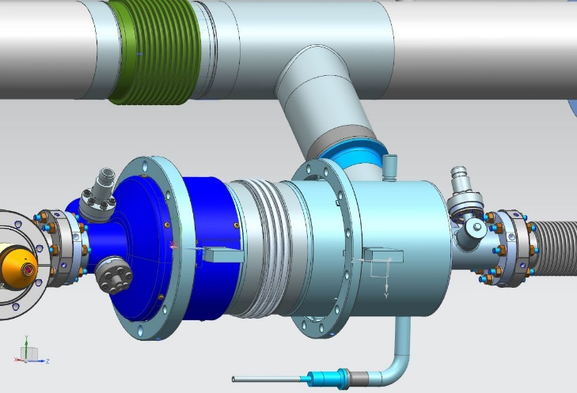
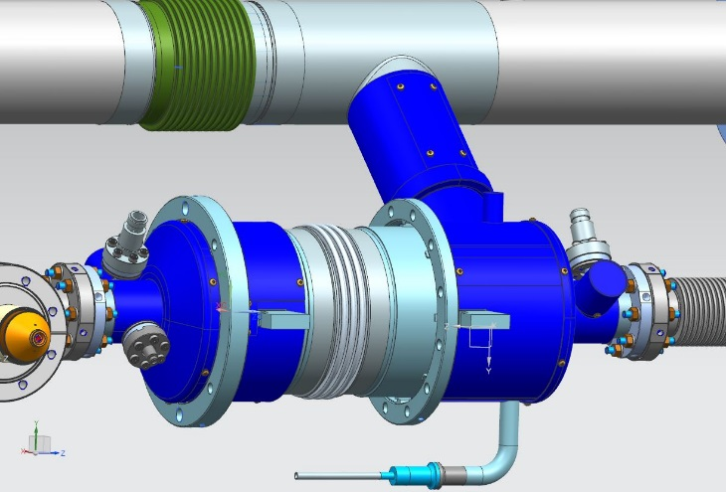
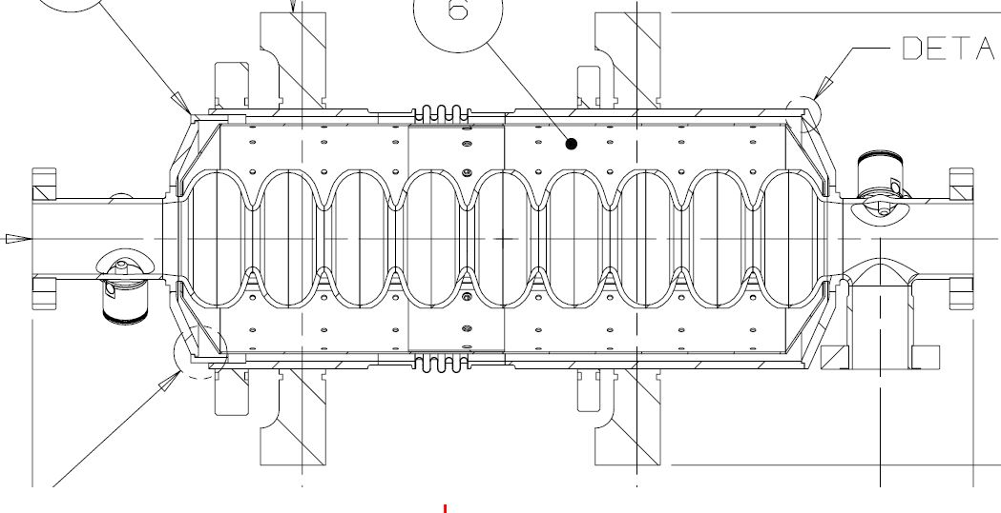
FNAL 3.9 GHz Cryomodule Assembly at WS2
Magnetic Shielding
Shields installed on the upstream and downstream ends and up the chimney – not on the outside center section
Internal He vessel shield will cover length of cavity end-to-end

Slide 20
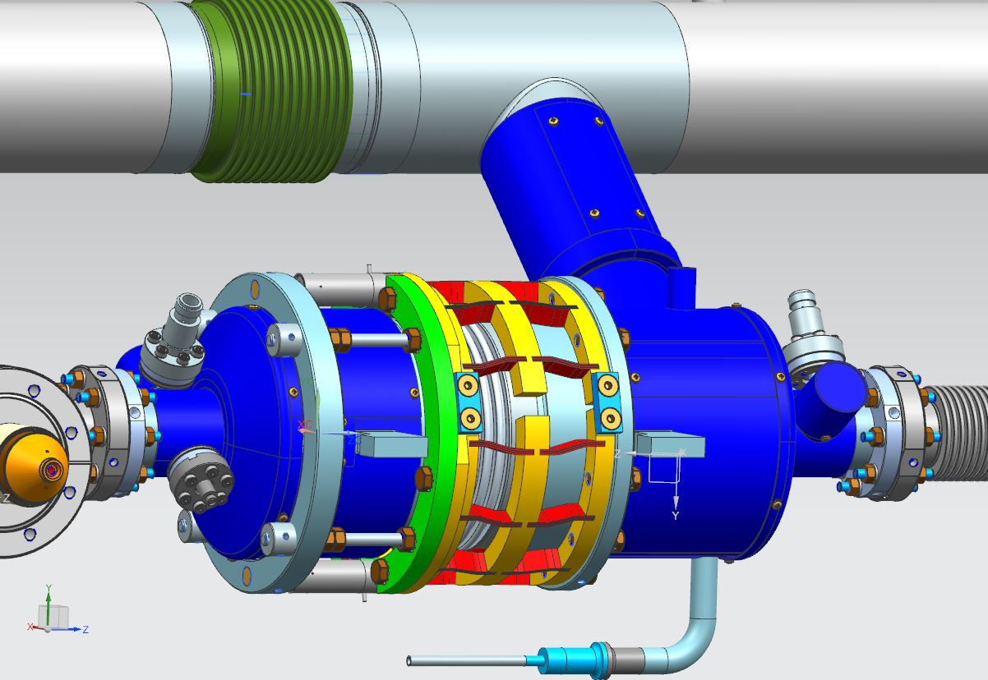
FNAL 3.9 GHz Cryomodule Assembly at WS2
Bladetuner Installation
Safety rods
Bladetuner and piezos installed at WS2, for 1.3 GHz lever tuner was installed at WS3.
Bladetuner has safety rods for safe transport

Slide 21
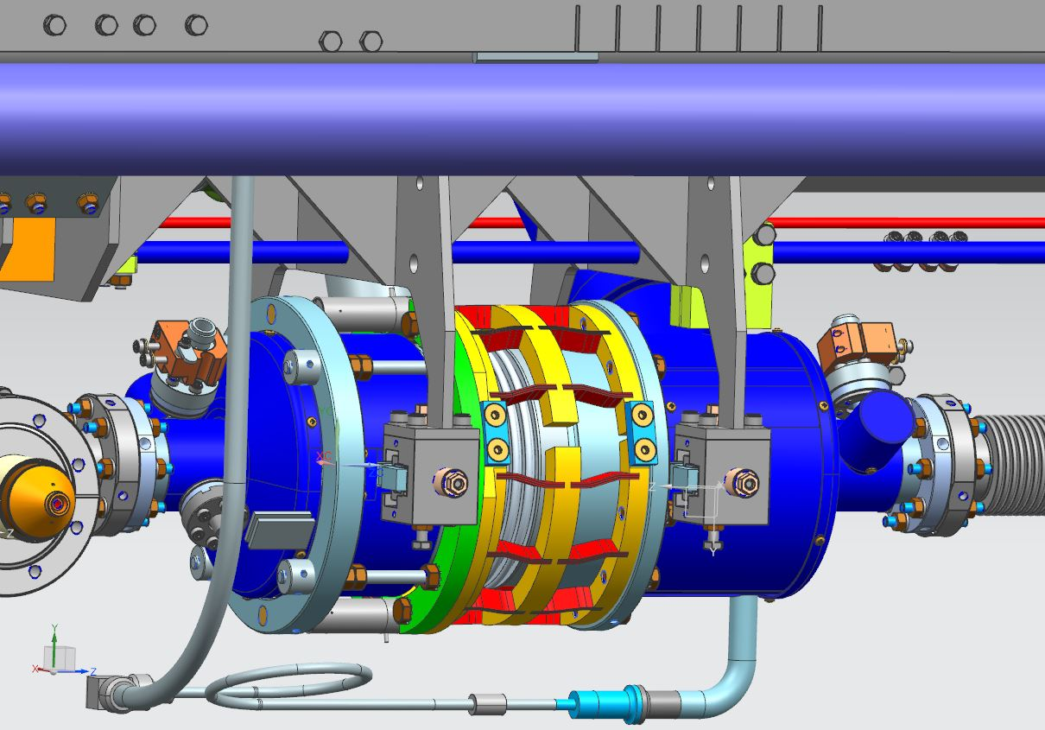
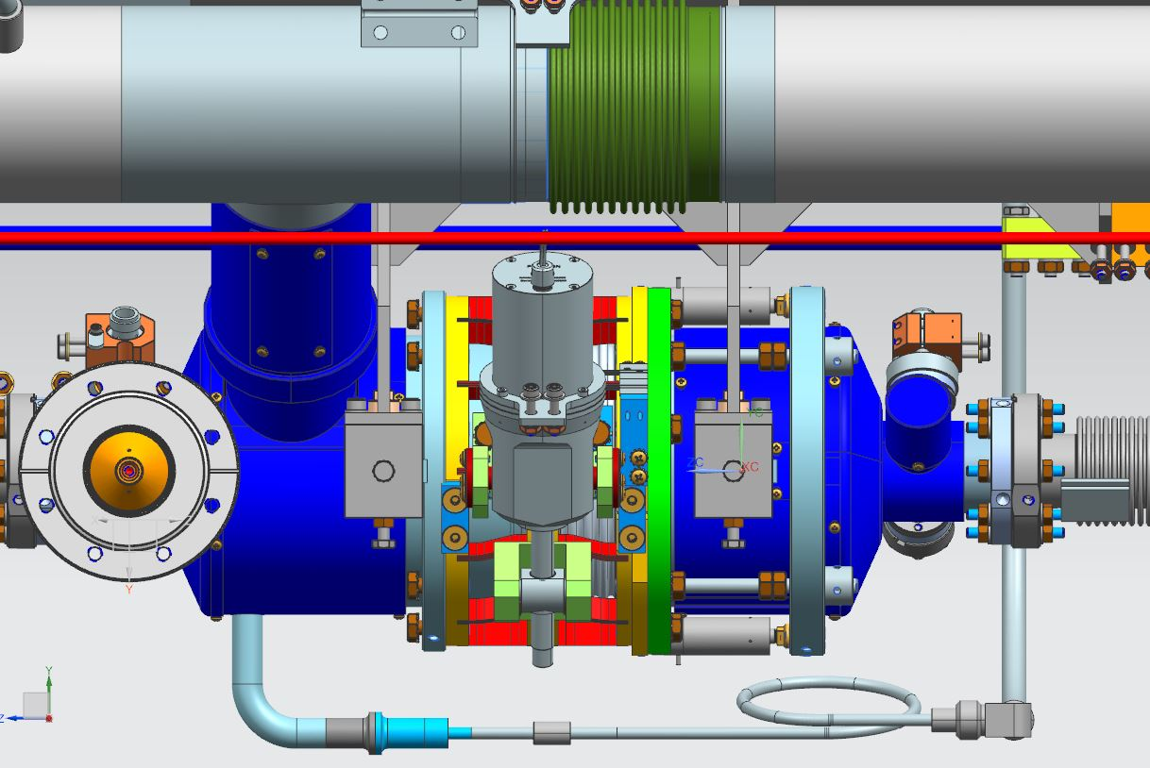
FNAL 3.9 GHz Cryomodule Assembly at WS2
Upper Coldmass Attachment
Warm-up/Cool-down welding same as 1.3 GHz
Due to a slight interference issue with the bearing block leg and 2-phase chimney, the cavity string will need to roll upstream slightly on the lollipop stands than back downstream after clearing the chimney

Slide 22
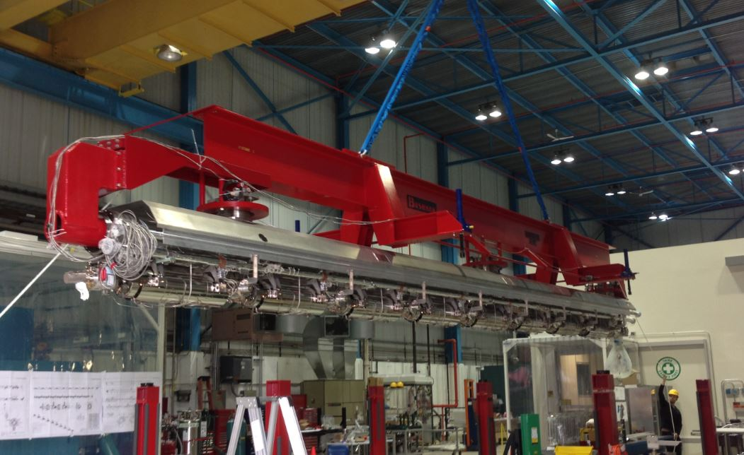
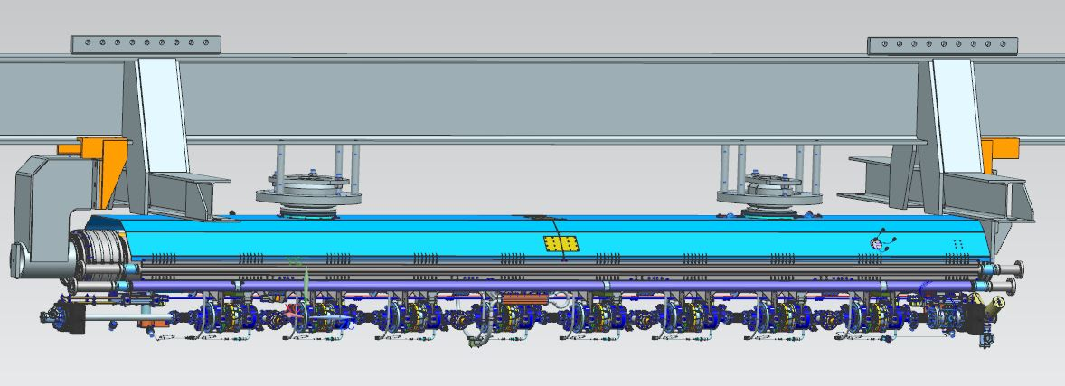
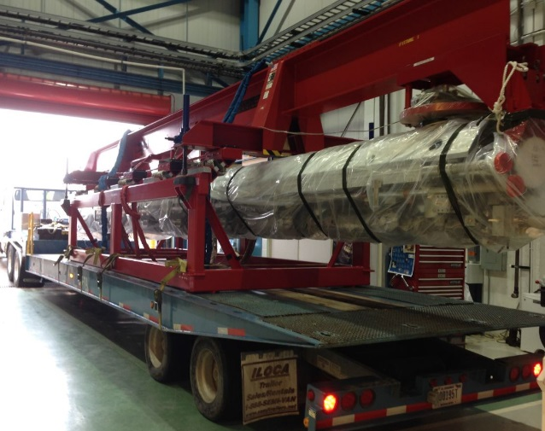
FNAL 3.9 GHz Cryomodule Assembly at WS2
Coldmass Transport to WS3 at ICB
Modifications to red fixture will allow use for 3.9 GHz upper coldmass move
1.3 GHz upper coldmass fixture
Same transport fixture will be used

Slide 23
CAF-ICB during LCLS-II Production
Sick CM
repair area
WS5
WS3
WS4
WS6

Slide 24
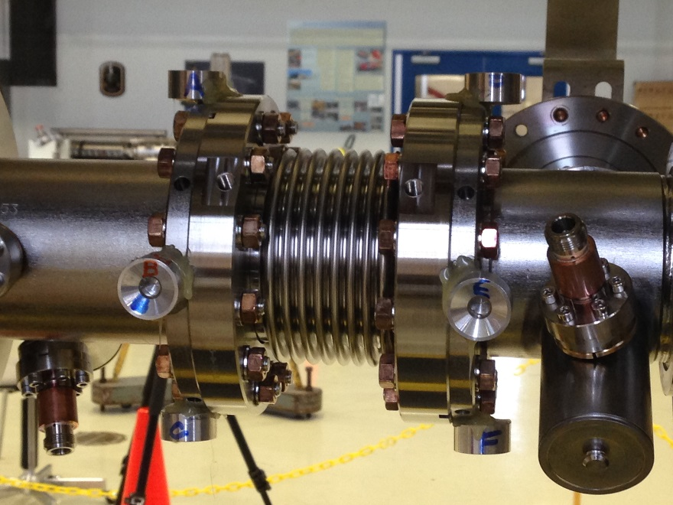
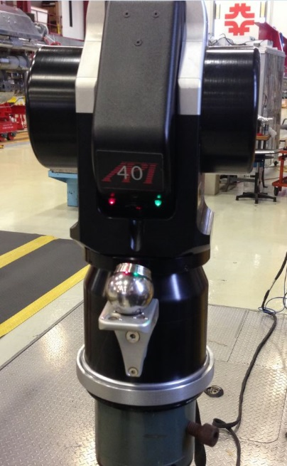
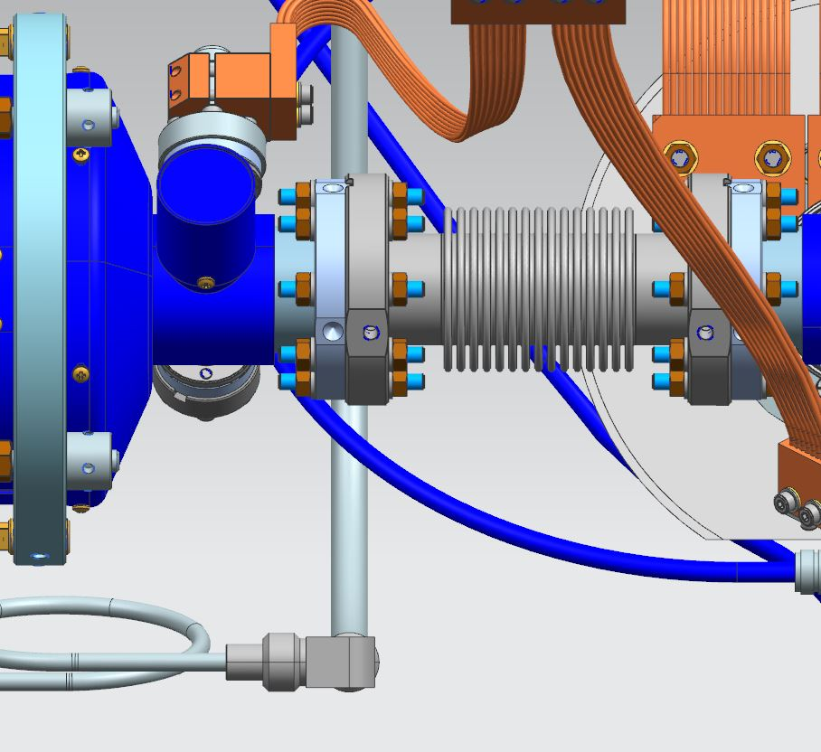
FNAL 3.9 GHz Cryomodule Assembly at WS3
Cavity String Alignment
Fiducials Glued on Beam Flanges
Laser Tracker
“Z” adjustment first
“X” and “Y” follow

Slide 25
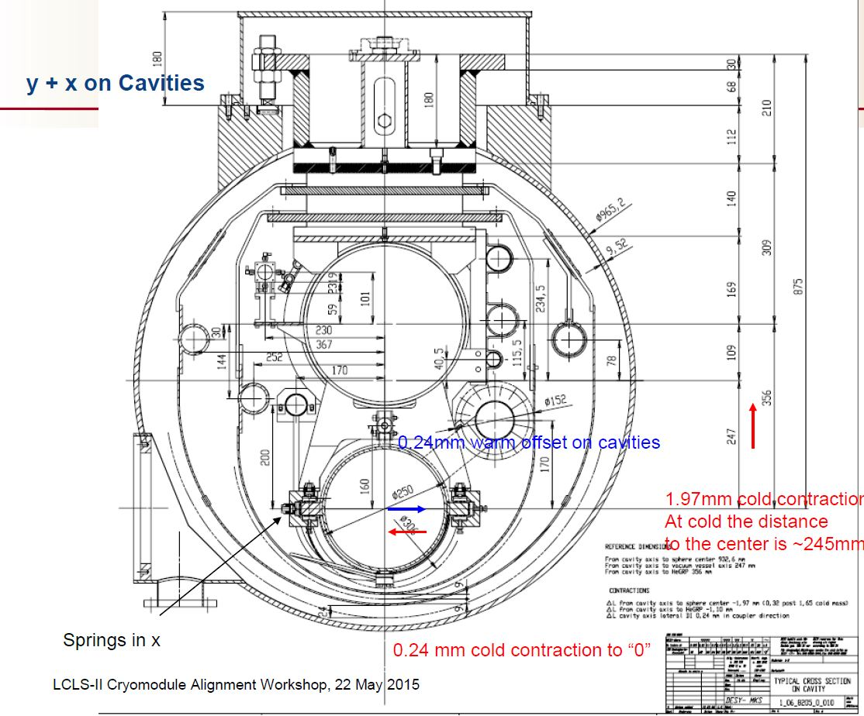
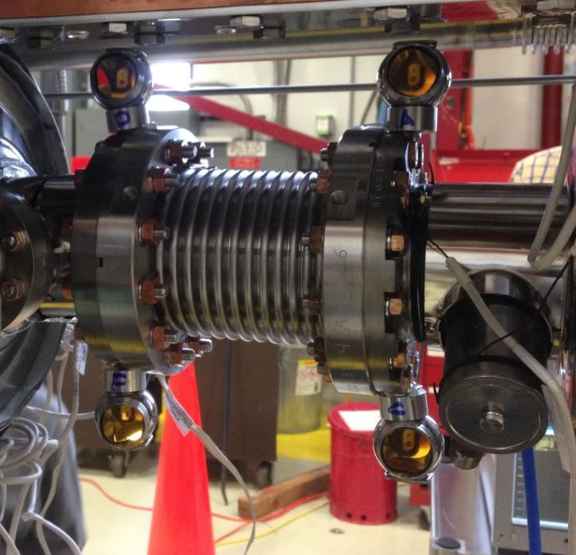
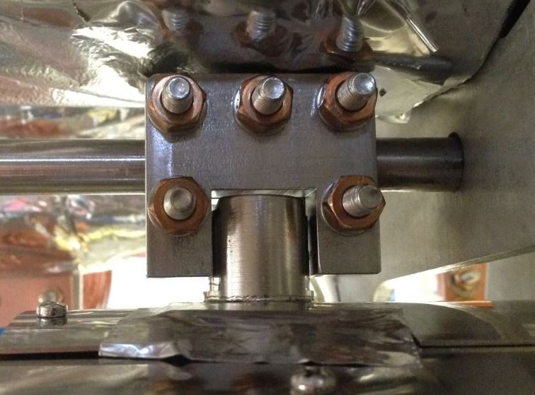
FNAL 3.9 GHz Cryomodule Assembly at WS3
Cavity String Alignment
Cavity clamp to invar rod
“Z” tolerance +/- 1mm
Relative to FPC spacing
“X” tolerance +/- .075mm
“Y” tolerance +/- .075mm
Relative to electrical centerline of cavity
“X” offset is set at this WS
Larger diameter prisms are more desirable

Slide 26
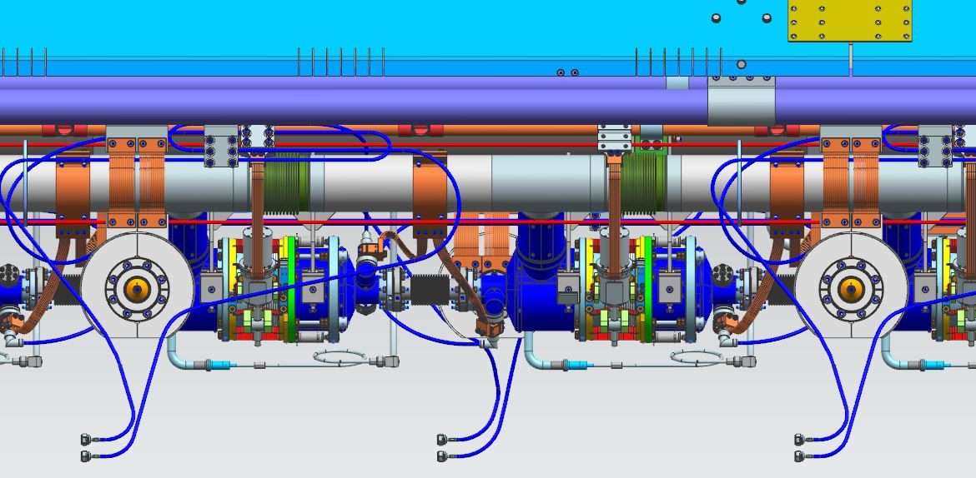
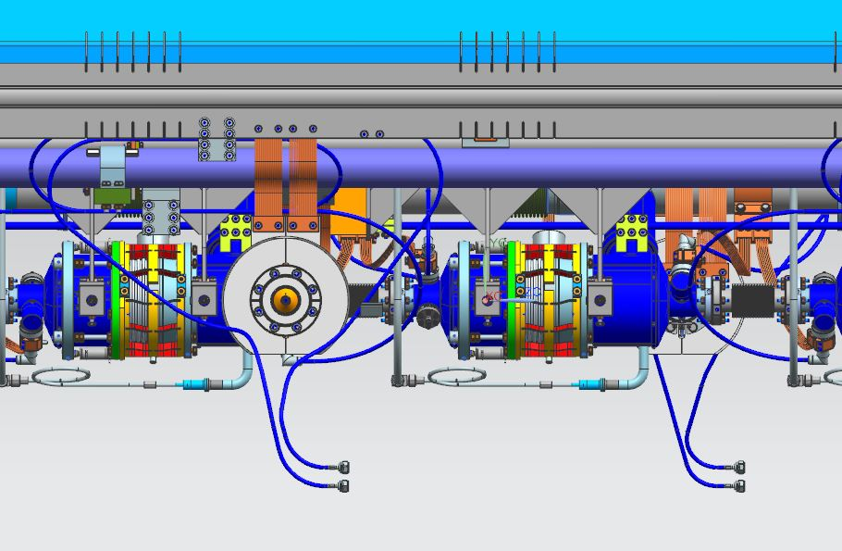
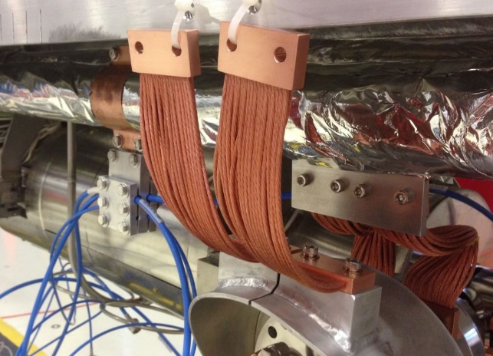
FNAL 3.9 GHz Cryomodule Assembly at WS3
Thermal Straps and Cables
Similar to 1.3 GHz

Slide 27
FNAL 3.9 GHz Cryomodule Assembly at WS3
Lower Thermal Shields Attached
Finger Welds
Same setup as 1.3 GHz except coupler ports on opposite sides

Slide 28
FNAL 3.9 GHz Cryomodule Assembly at WS4
Insulation Wrap and Vacuum Vessel Integration
Setup on fixture same as 1.3 GHz
MLI wrap same as 1.3 GHz
Coldmass integration to vacuum vessel same as 1.3 GHz

Slide 29
FNAL 3.9 GHz Cryomodule Assembly at WS4
Final Cavity Alignment and Cold Offset
Once the vacuum vessel and coldmass is leveled, the roll is taken out by adjusting the support nuts
Setup on fixture same as 1.3 GHz

Slide 30
FNAL 3.9 GHz Cryomodule Assembly at WS4
Final Cavity Alignment and Cold Offset
Bring the cavity string beam axis to the designed z (longitudinal) position wrt vv by using the along the vessel push bolts.

Slide 31
FNAL 3.9 GHz Cryomodule Assembly at WS4
Final Cavity Alignment and Cold Offset
Bring the 2 posts into a plane normal to local gravity and at such a height that the cavity string beam axis is at the designed dH vertical offset from the VV center. Use the up and down bolts.

Slide 32
FNAL 3.9 GHz Cryomodule Assembly at WS5
JT Valve Welding
X-ray location
Final welded configuration
JT valve assembly same as 1.3 GHz

Slide 33
FNAL 3.9 GHz Cryomodule Assembly at WS5
Warm End Coupler Installation, Waveguides, and Instrumentation
Same procedures as 1.3 GHz but installed on both sides due to alternating FPC’s
Final instrumentation connections
All final leak checks and pressures tests are performed at this workstation prior to move to CMTF

Slide 34
CM Assembly Travelers
Electronic Travelers will be developed for CM assembly.
We will use vector.fnal.gov (see Jamie Blowers talk)

Slide 35
Parts Kit Lists (MBOM)
Parts kit lists will be created
Parts/hardware will be stored at Technical Division (TD) Storage Areas and will be organized by the TD inventory management systems
When a kit is requested by the production floor, LCLS-II supply chain manager will ensure that the parts/hardware are kitted as specified and the kit is delivered to the specific work station
Excerpt from the 1.3GHz CM cavity string assembly at WS1 parts kit list

Slide 36
LCLS-II Cryomodule Assembly Team
Eng. Support
-E. Borissov
-Y. Orlov
-J. Kaluzny
-Y. He
-V. Roger
-J. Theilacker
Supply Chain Manager
(J. Rife)
Lead
(T. Arkan)
S
uppo
r
t
(K. Premo), deputy lead
Fundamental Power Coupler
(C. Grimm), deputy lead
Welding
Process Eng
(J. Szal)
QA/QC
(T. Beale)
Machine & Weld Shops
Components Storage
(l. Peters)
Cavity String Assembly @ MP9 [WS0, WS1]
(M. Battistoni)
Cold Mass Assembly
@MP9 & ICB [WS2 ~WS5]
(G. Smith)
Alignment
(V. Bocean)
Tuner
(Y. Pischalnikov)
RF
(T. Khabiboulline)
Instrumentation
(D. Orris)
Crew Chief
J. Yun
J. Wittenkeller
P. Berruti
F. Lewis
M. Chlebek
Technician
Magnet/ Current Leads
(A. Makarov)
Ryan Thiede
M. Awida
P. Dubiel
Technician
B. Kuhn (C)
Luis Bonilla
D. Eddy
Andrew Penhollow (C)
Electrical Tech (C)
Alexey Akimov (C)
Electrical Tech (C)
Technician (C)
James Focht (C)
Ryan Treece (C)
Magnetic Hygiene
(S. Chandrasekan)
Thermal Intercepts
(J. Kaluzny)
Jared Gaza (C)
Technician (C)
Technician (C)
M. Snyder (C)

Slide 37
Summary
CAF infrastructure is a proven, fully operational facility to assemble 1.3GHz and 3.9GHz cryomodules.
Each work station infrastructure is ready for the LCLS-II CMs assembly.
To date, we have assembled 1.3GHz pCM, CM02 is at WS3, CM03 is at WS2 and CM04 is at WS0
3.9GHz CMs will be assembled when we complete the 1.3GHz Production CM assembly at CAF. Trained and experienced technician workforce will be in place.
We plan to use the same tooling/fixtures from the 1.3GHz CM for 3.9GHz CM with reconfiguration strategy.

Slide 38
LCLS-II Helium Vessel Production CM FDR
Thank You!

