Slide 1
Production CM QA/QC Plans and Systems
3.9 GHz Cryomodule Final Design Review
Jamie Blowers
30-Jan-2017

Slide 2
Outline
My background
“Big Picture” (FNAL, SLAC)
Internal and external quality-related systems
Design Controls
Incoming Inspection
Production control, Travelers, and NCRs
Summary

Slide 3
My background
Engineering Physicist by title
Department Head (Quality & Materials, Machine Shop) and Technical Division QA Manager by role
BS Physics, coursework towards MS in Accelerator Physics
Been with Fermilab 17 years
Implemented QA and QE programs prior to Fermilab
Started my quality career in the automotive industry
ASQ certifications: CQE, CQA, CQM

Slide 4
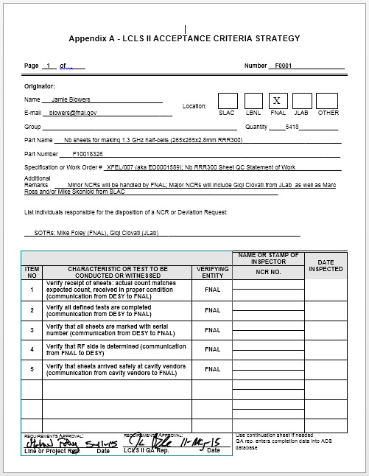
“Big Picture”
We have been working closely with QA staff from SLAC to coordinate quality efforts related to LCLS-II Cryomodule work
SLAC and Fermilab have formal QA programs, and LCLS-II-specific QA Plans have been put in place
We have included SLAC-specific QA requirements into our QA Plan (e.g. Acceptance Criteria Strategies)
SLAC LCLS-II QA Manager assessments:
QA program (so-called “crosswalk”, Nov/Dec 2014); fully compliant
Welding Program (Jul 2016); fully compliant
FNAL ACS forms: ftp://filesrv01.fnal.gov/t/td-ms/pick-up/LCLSII/ACS/ACS_list.xlsx

Slide 5
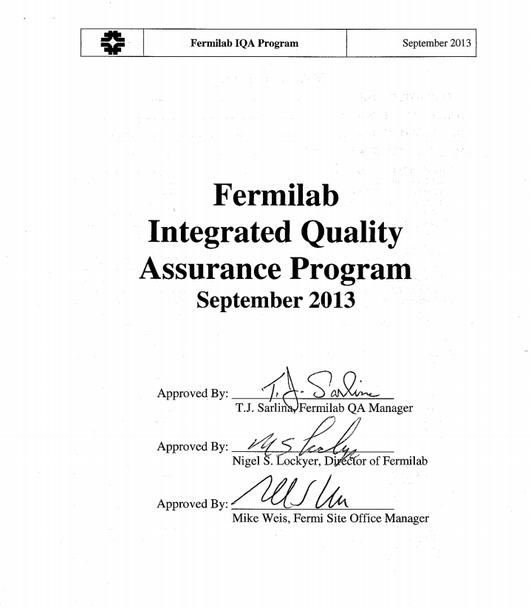
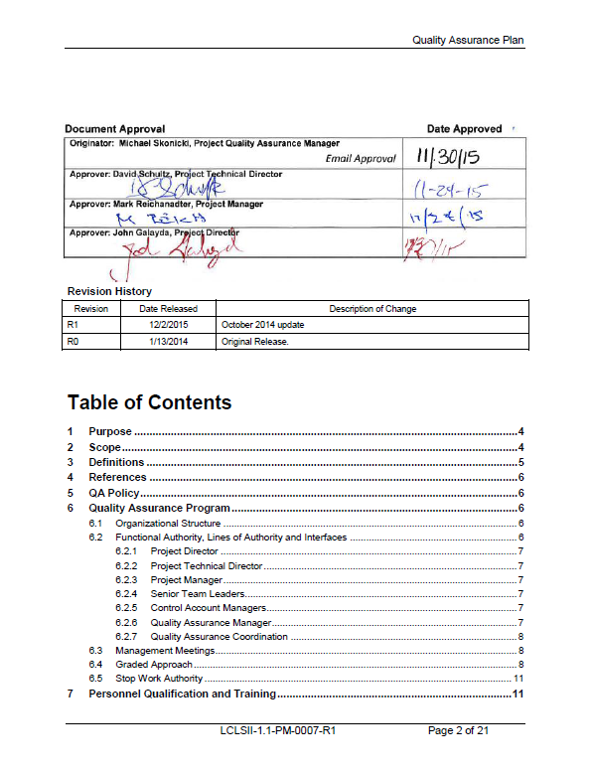
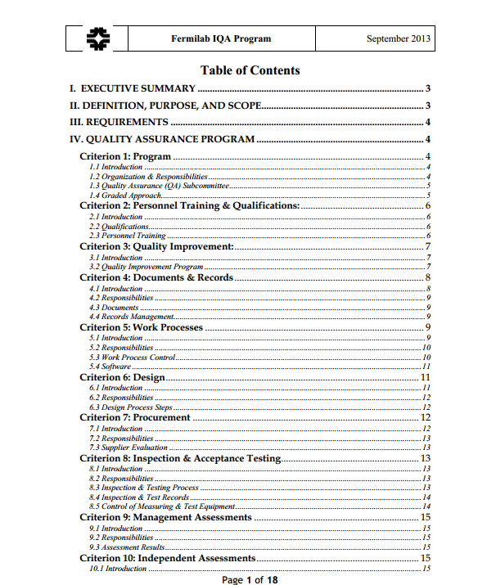
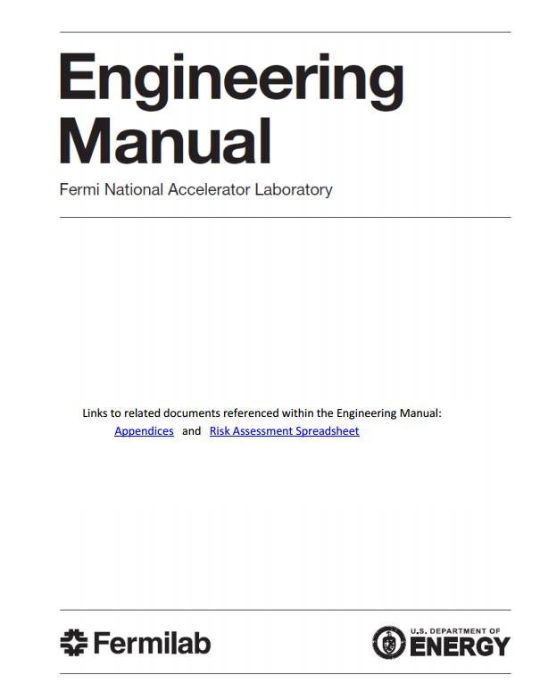
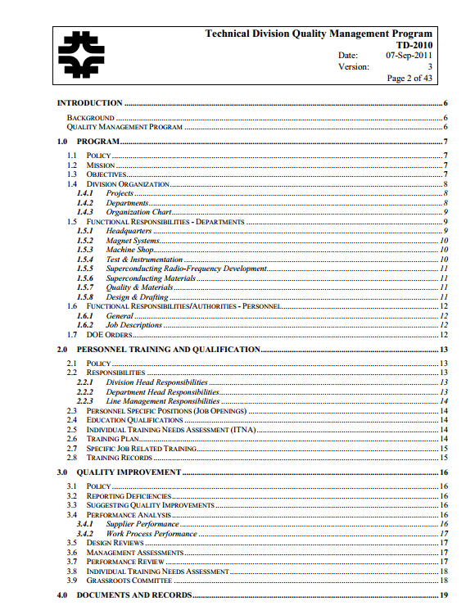
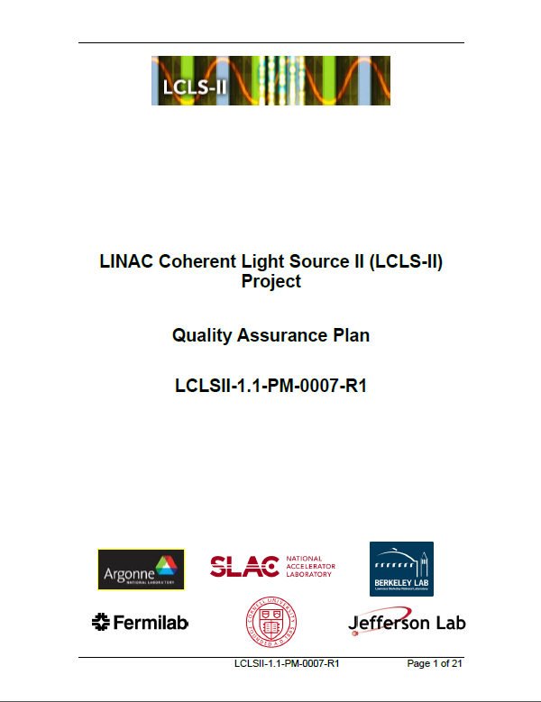
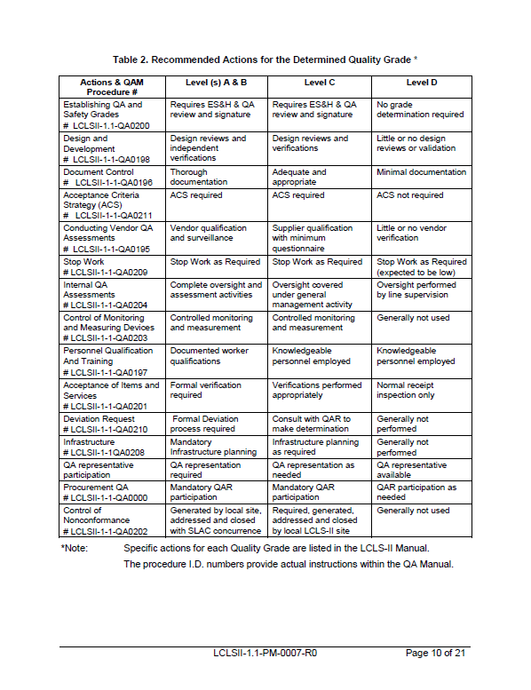
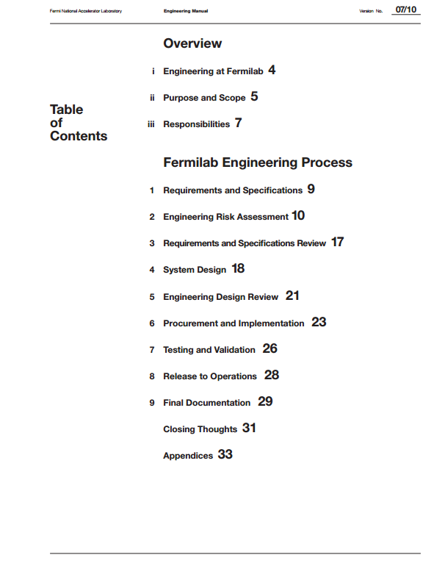
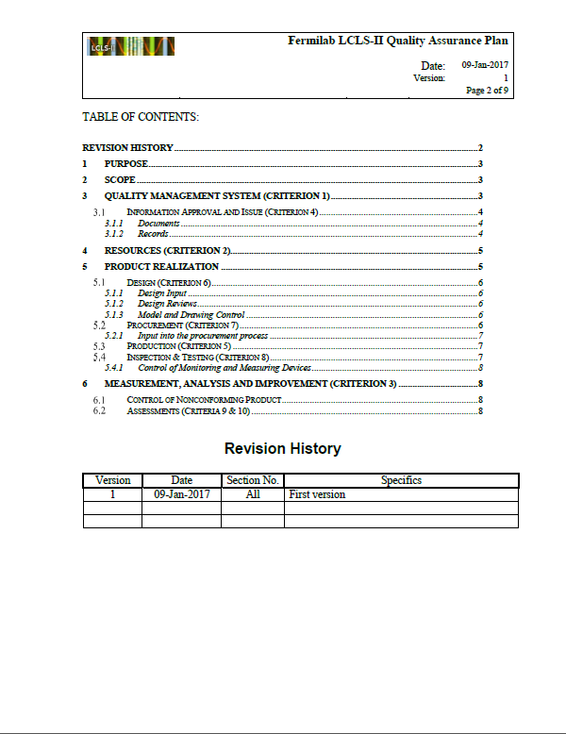
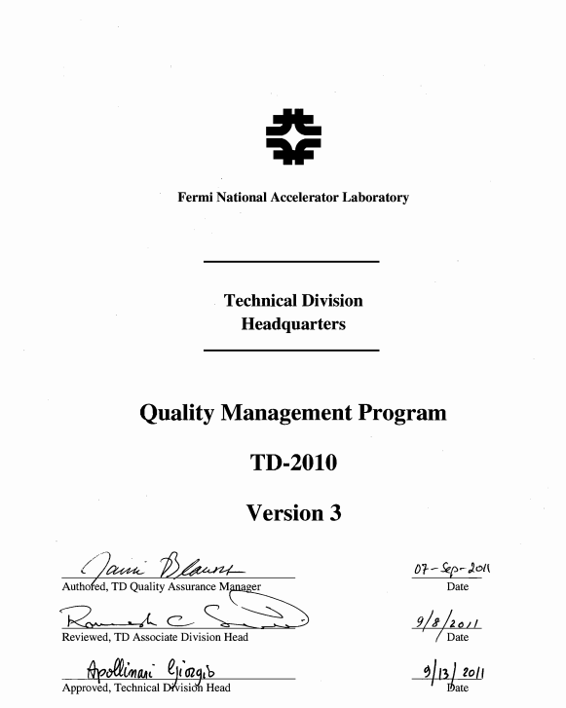
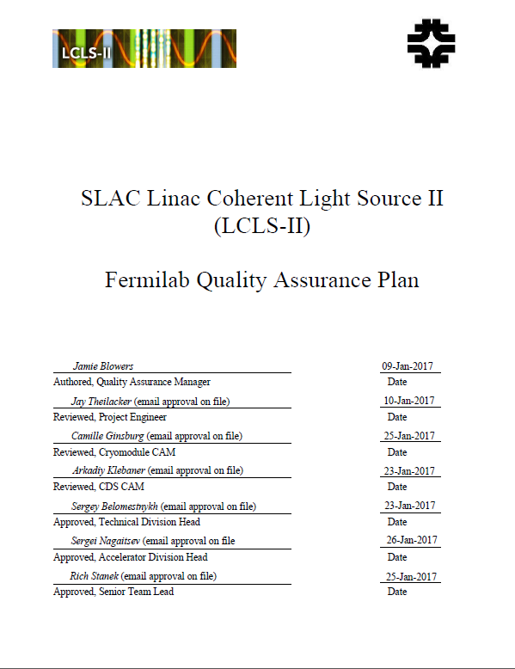
FNAL, TD, and SLAC Quality Systems

Slide 6
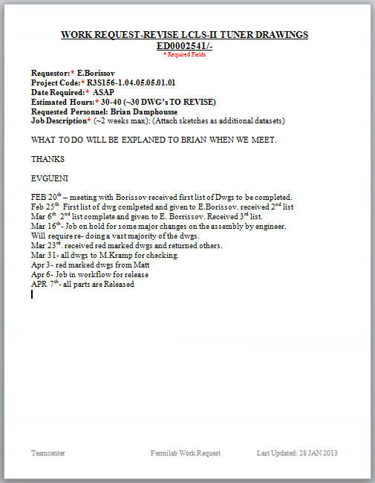
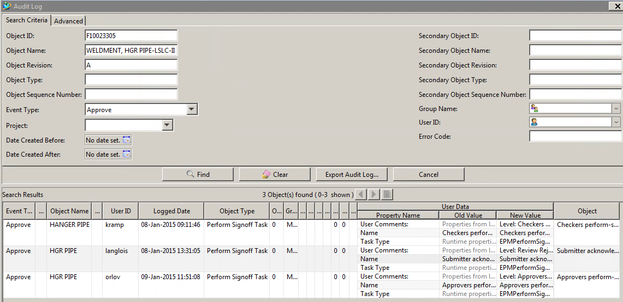
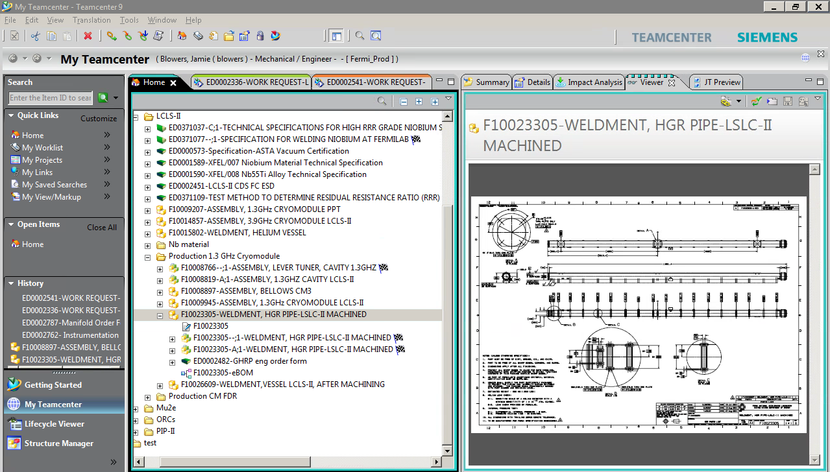
Design Controls
The outputs of all engineering work are managed in Teamcenter
Requests for design work are formalized
Design releases are reviewed and approved using a Teamcenter workflow
Design changes that affect the functional requirements will be brought to the attention of the SLAC Change Control Board for review and approval
Parts and material are not procured without approved drawings

Slide 7
Incoming Inspection
All parts and materials are inspected upon receipt
SOTRs* work with QC folks to define inspection drawings/plans
Inspections of serialized components are done using travelers
* Subcontracting Officer’s Technical Representative, a.k.a. technical lead for the specific procurement

Slide 8
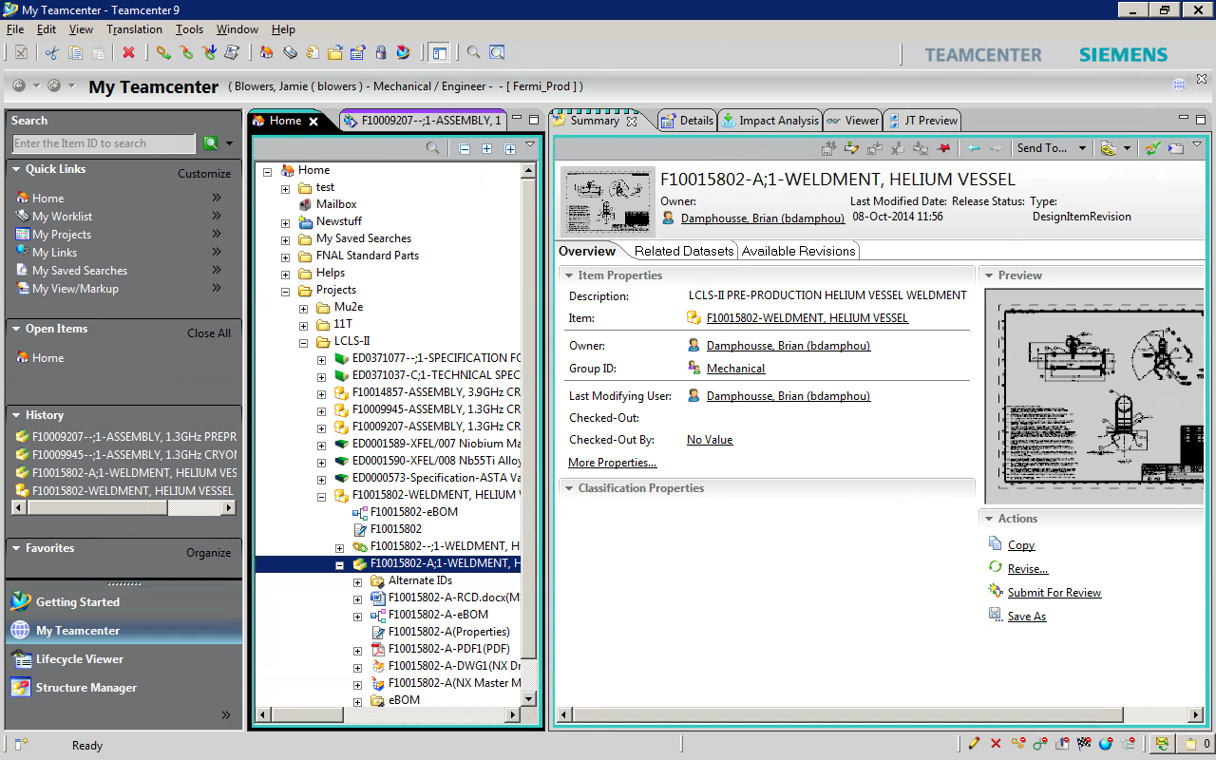
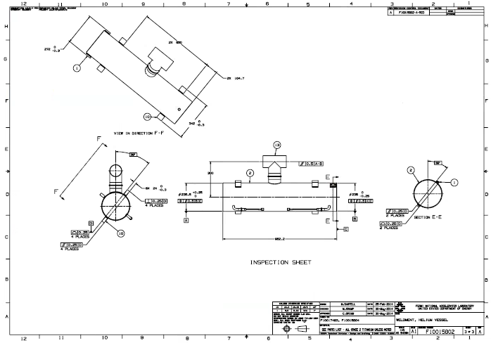
Incoming Inspection example

Slide 9
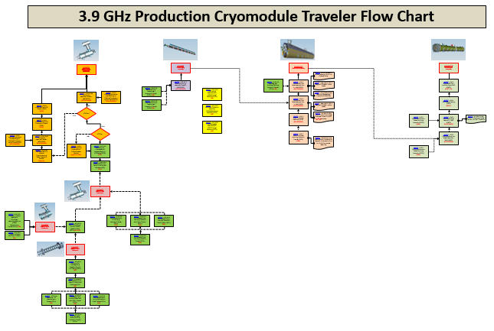
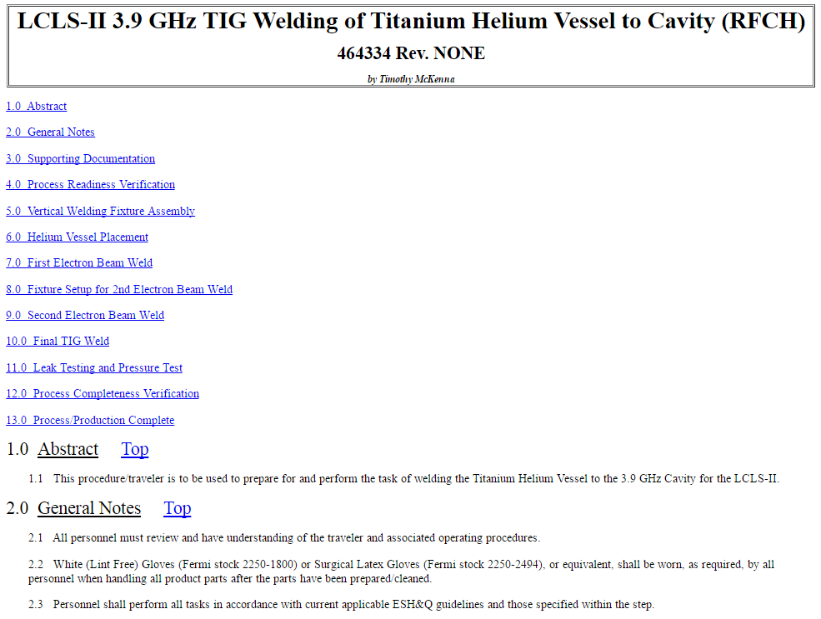
Production control
The LCLS-II Project is using travelers for all production work
Provide detailed step-by-step instructions covering whole process

Slide 10
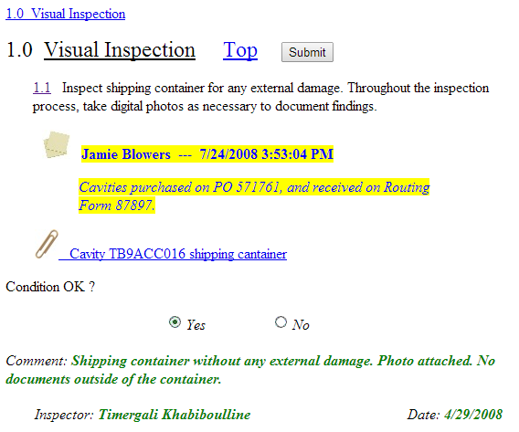
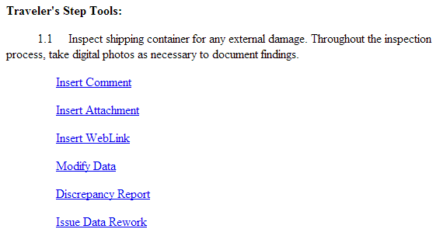
Process Control System: Vector
All travelers are fully electronic; http://vector.fnal.gov/
System is currently read-only to the world, so easy data sharing is in place
As much as we could, we replicated the functionality and flexibility of a paper traveler:

Slide 11
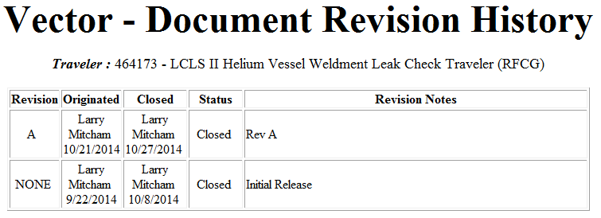
Document Control
All Travelers and Operating Procedures are under version control and any changes to those documents need to be reviewed and approved by Responsible Authorities

Slide 12
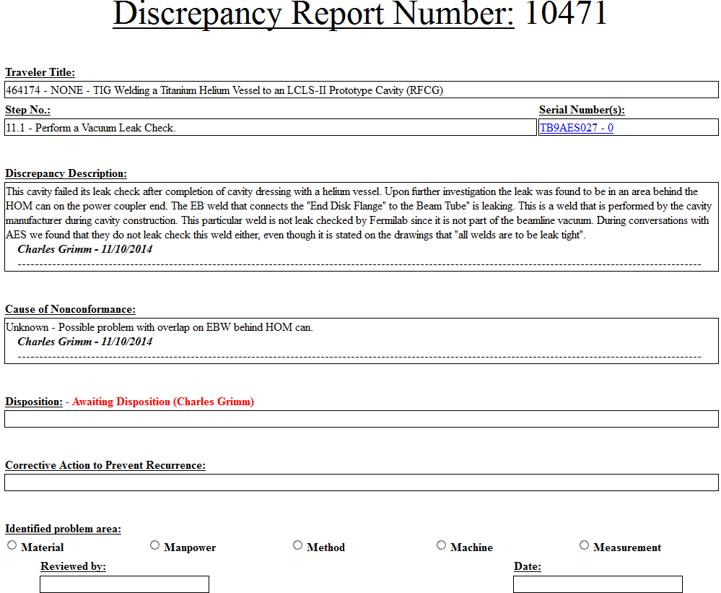
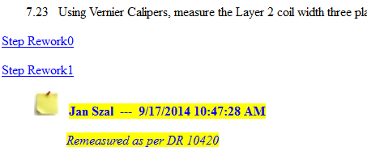
Nonconformance handling (Vector)
All non-conformances will be recorded using built-in Discrepancy Report System and have to be resolved by the Lead Engineer before proceeding to next step
Rework Steps will be issued if process repeat is needed

Slide 13
Summary
Quality system is in place, and has proven effective in numerous past projects
SLAC-specific requirements have been incorporated
Completed QA Cross-Walk and Welding assessments
Designs are controlled through Teamcenter
SLAC has access
Using electronic travelers
SLAC has access
Quality system is in use now for the 1.3 GHz Cryomodule work, and has been effective

Slide 14
Backup
Flowchart of 3.9 GHz travelers (see slide 2):
https://vector-offsite.fnal.gov/Tools/Reports/Custom/Projects/LCLS-II/LCLS-II_Traveler_Flow_Chart.pptx

