Slide 1
3.9 GHz Cryomodule Design Verification
Genfa Wu
LCLS-II 3.9 GHz FDR
January 30-31, 2017

Slide 2
Outline
Design Verification Status
Procurement Status
Summary

Slide 3
3.9 GHz Cryomodule Parameters
Physics Requirement Document: SCRF 3.9 GHz Cryomodule LCLSII-4.1-PR-0097-R2

Slide 4
3.9 GHz CM Design Verification Goals
Verify dressed cavity performance exceeds the specification
2.0e9@13.4 MV/m ( 1.5e9@14.9 MV/m )
Measure and insure the helium vessel heat load capacity meets the engineering specification (36 W)
Coupler CW operation at 1.6 kW
HOM coupler CW operation
Cavity microphonics (Measure and evaluate).
Magnetic shield design to achieve cavity Q0.
Integration with helium vessel
Two integrated horizontal tests are planned for design verification.

Slide 5
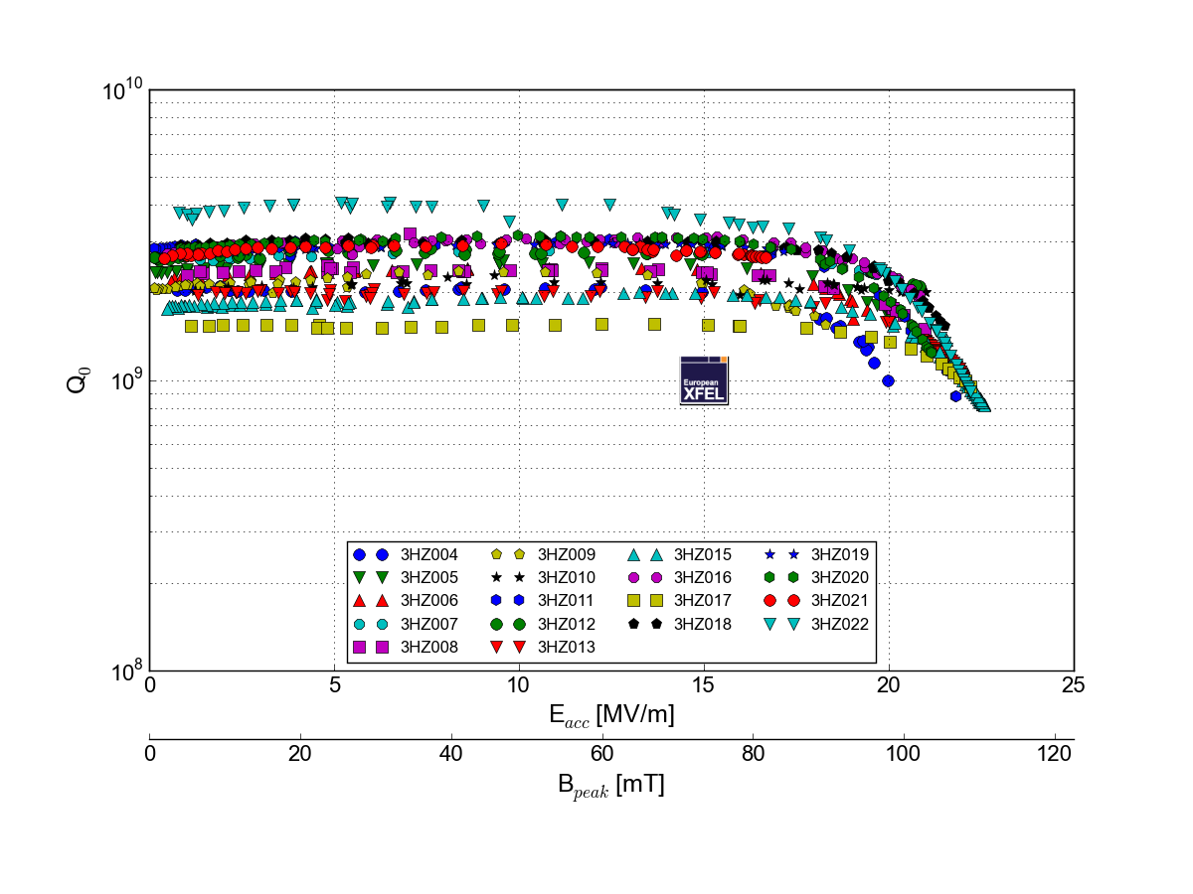
Cavity gradient and Q0 requirements (recent data from XFEL cavity production)
P.Perini, INFN
Recent XFEL production cavities (INFN-Zenon);
At 2K the all cavities have Qo in range ~(2-3)·10⁹ (except 2)
No field slope up-to ~17 MV/m; Quench at 20-23 MV/m, VTS
No Q degradation after welding to HV
Risk: LCLS-II cavity (cw) requirements more stringent than XFEL (pulse) !!!
➔ Require Prototyping and Testing
Slide by N. Solyak

Slide 6
Q expectations scaling from 1.3 GHz to 3.9 GHz – matches measurements
Process | 1.3 Rs_bcs (nΩ) | 1.3 Rs_res (nΩ) | 3.9 Rs_total (nΩ) | 3.9 Q @16 MV/m
BCP | 12 - 14 | 4 - 8 | 115 - 140 | 2.0e9 – 2.5e9
BCP + 120°C | 8 - 10 | 4 - 8 | 79 - 104 | 2.6e9 – 3.5e9
Design verification focuses on processing refinement to achieve >2e9@14MV/m
Four bare cavities to refine bare cavity processing steps
Two dressed cavities to support fully integrated horizontal tests
VTS Eacc > 18 MV/m
VTS Acceptance Q~ 2.0e9 @14 MV/m, >1.5e9@15 MV/m
LCLS-II 3.9 CM FDR, January 30-31, 2017
Courtesy of A. Grassellino

Slide 7
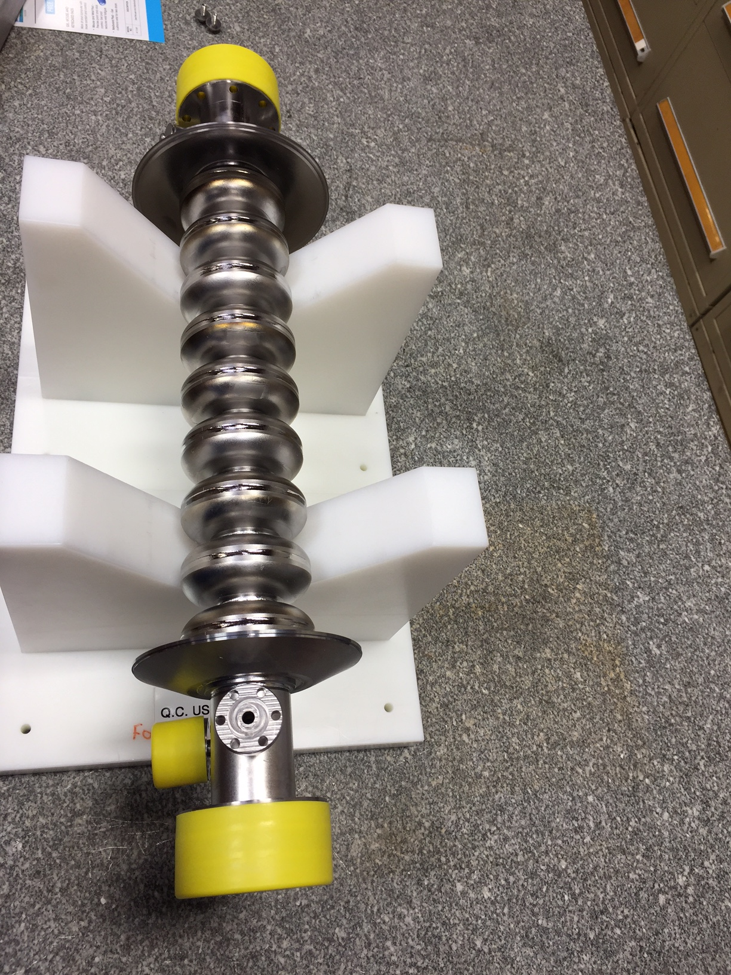
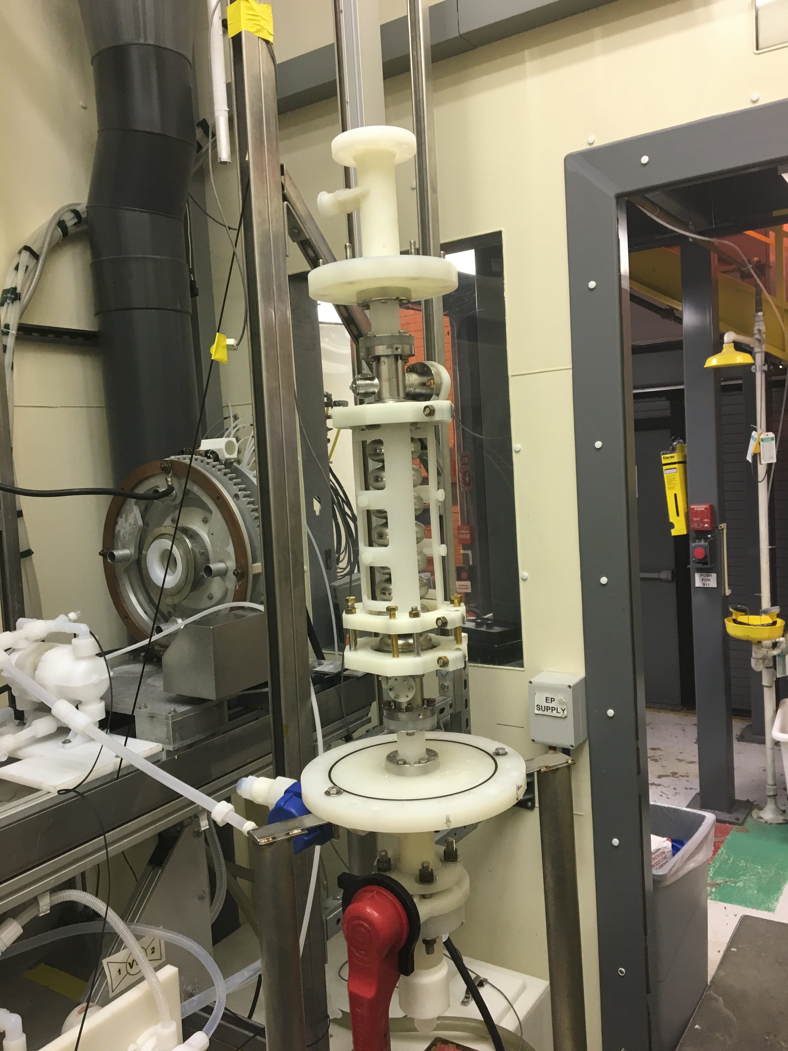
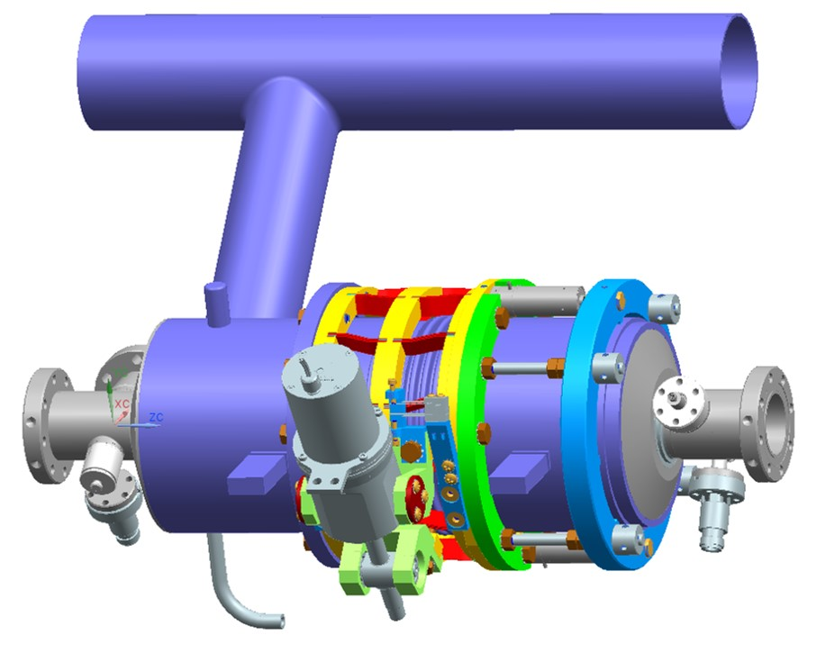
3.9 GHz CM Design Verification Status - Cavities
Four Bare Cavities ordered.
Three cavities received.
Final cavity delivery is expected in February after repairing at vendor
Cavity CMM inspection is in progress
3HRI02 Bulk BCP scheduled today
3HRI03 Bulk BCP next week
3HRI01 repair sealing surface
Two cavities will be dressed at Fermilab in February
Niobium bare cavity
BCP at ANL

Slide 8
3.9 GHz CM Design Verification Status - Cavities
Cold leak developed during vertical test. An inclusion defect on beam line flange was discovered after surface polishing.
Repair 3HRI01 sealing surface as soon as possible

Slide 9
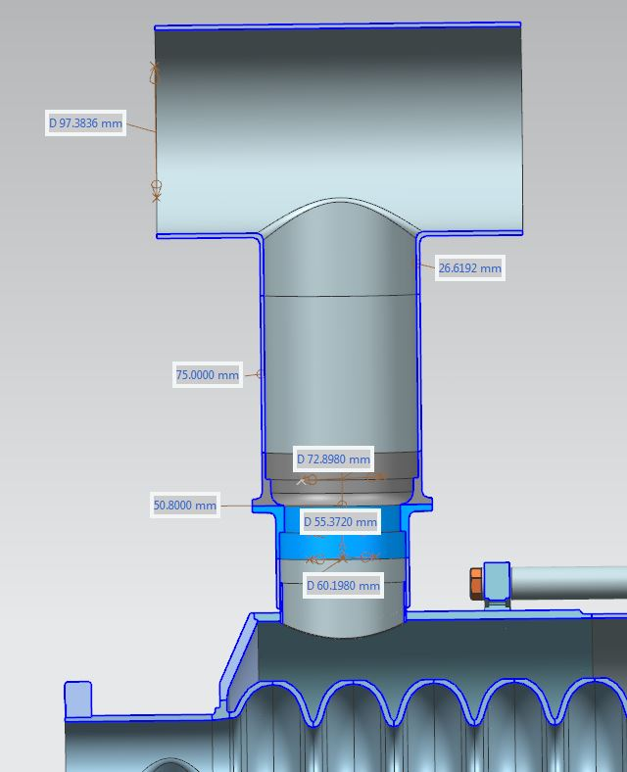
Cavity Dressing
Helium vessel parts procurement
Helium vessel (in progress)
2-phase Tee (received at vendor)
Bi-metal transition (received at vendor)
Ti bellows (received at vendor)
Delivery in Feb/March
E-beam welding service (PO)
C. Grimm and M. Foley

Slide 10
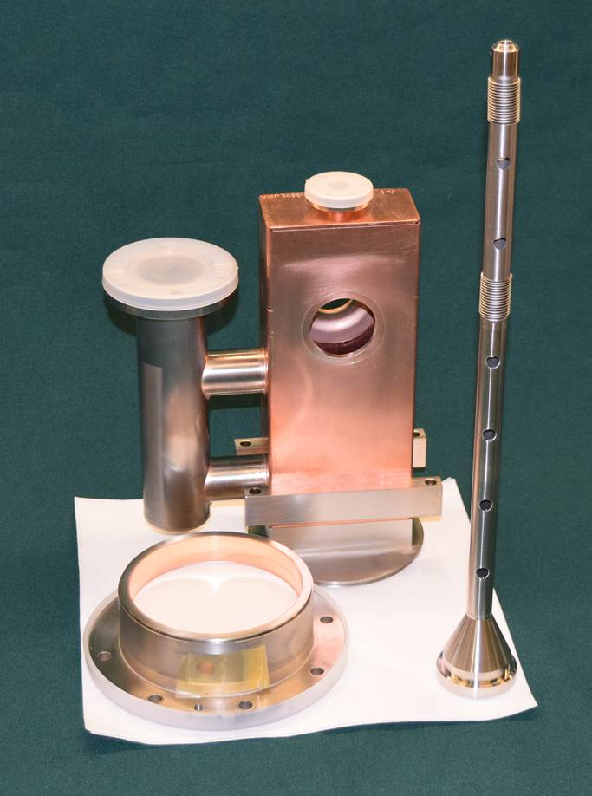
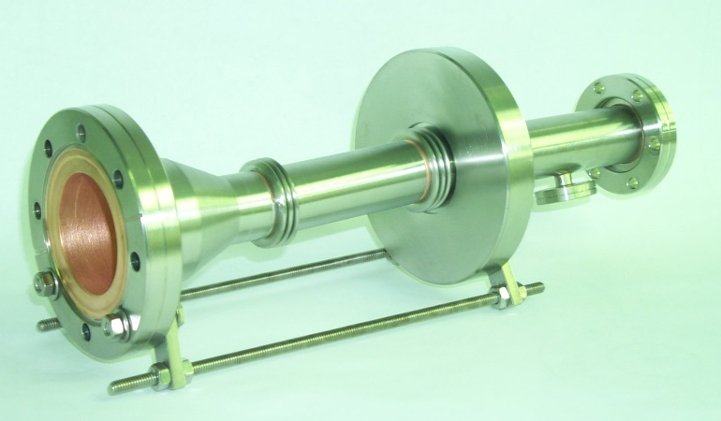
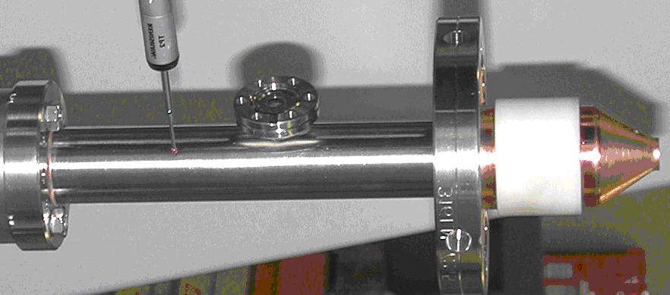
3.9 GHz CM Design Verification Status - Couplers
Three existing couplers were transferred from Fermilab stock to LCLS-2 with antenna modification
All three modified couplers are delivered.
Shorter antenna (Q_{L}~2.7e7 vs. 1.5e6)
Increased thickness of copper plating on inner conductor from 30 µm to 120 µm
Reduced length of 2 inner bellows in inner conductor from 20 to 15 convolutions.
Increased thickness of ceramics in cold window to move parasitic mode away.
Conditioning is planned in December
3kW CW source ready in February
Antenna measured and being trimmed do spec
LCLS-II requirements: P_{max}=0.8 kW cw; quasi traveling wave

Slide 11
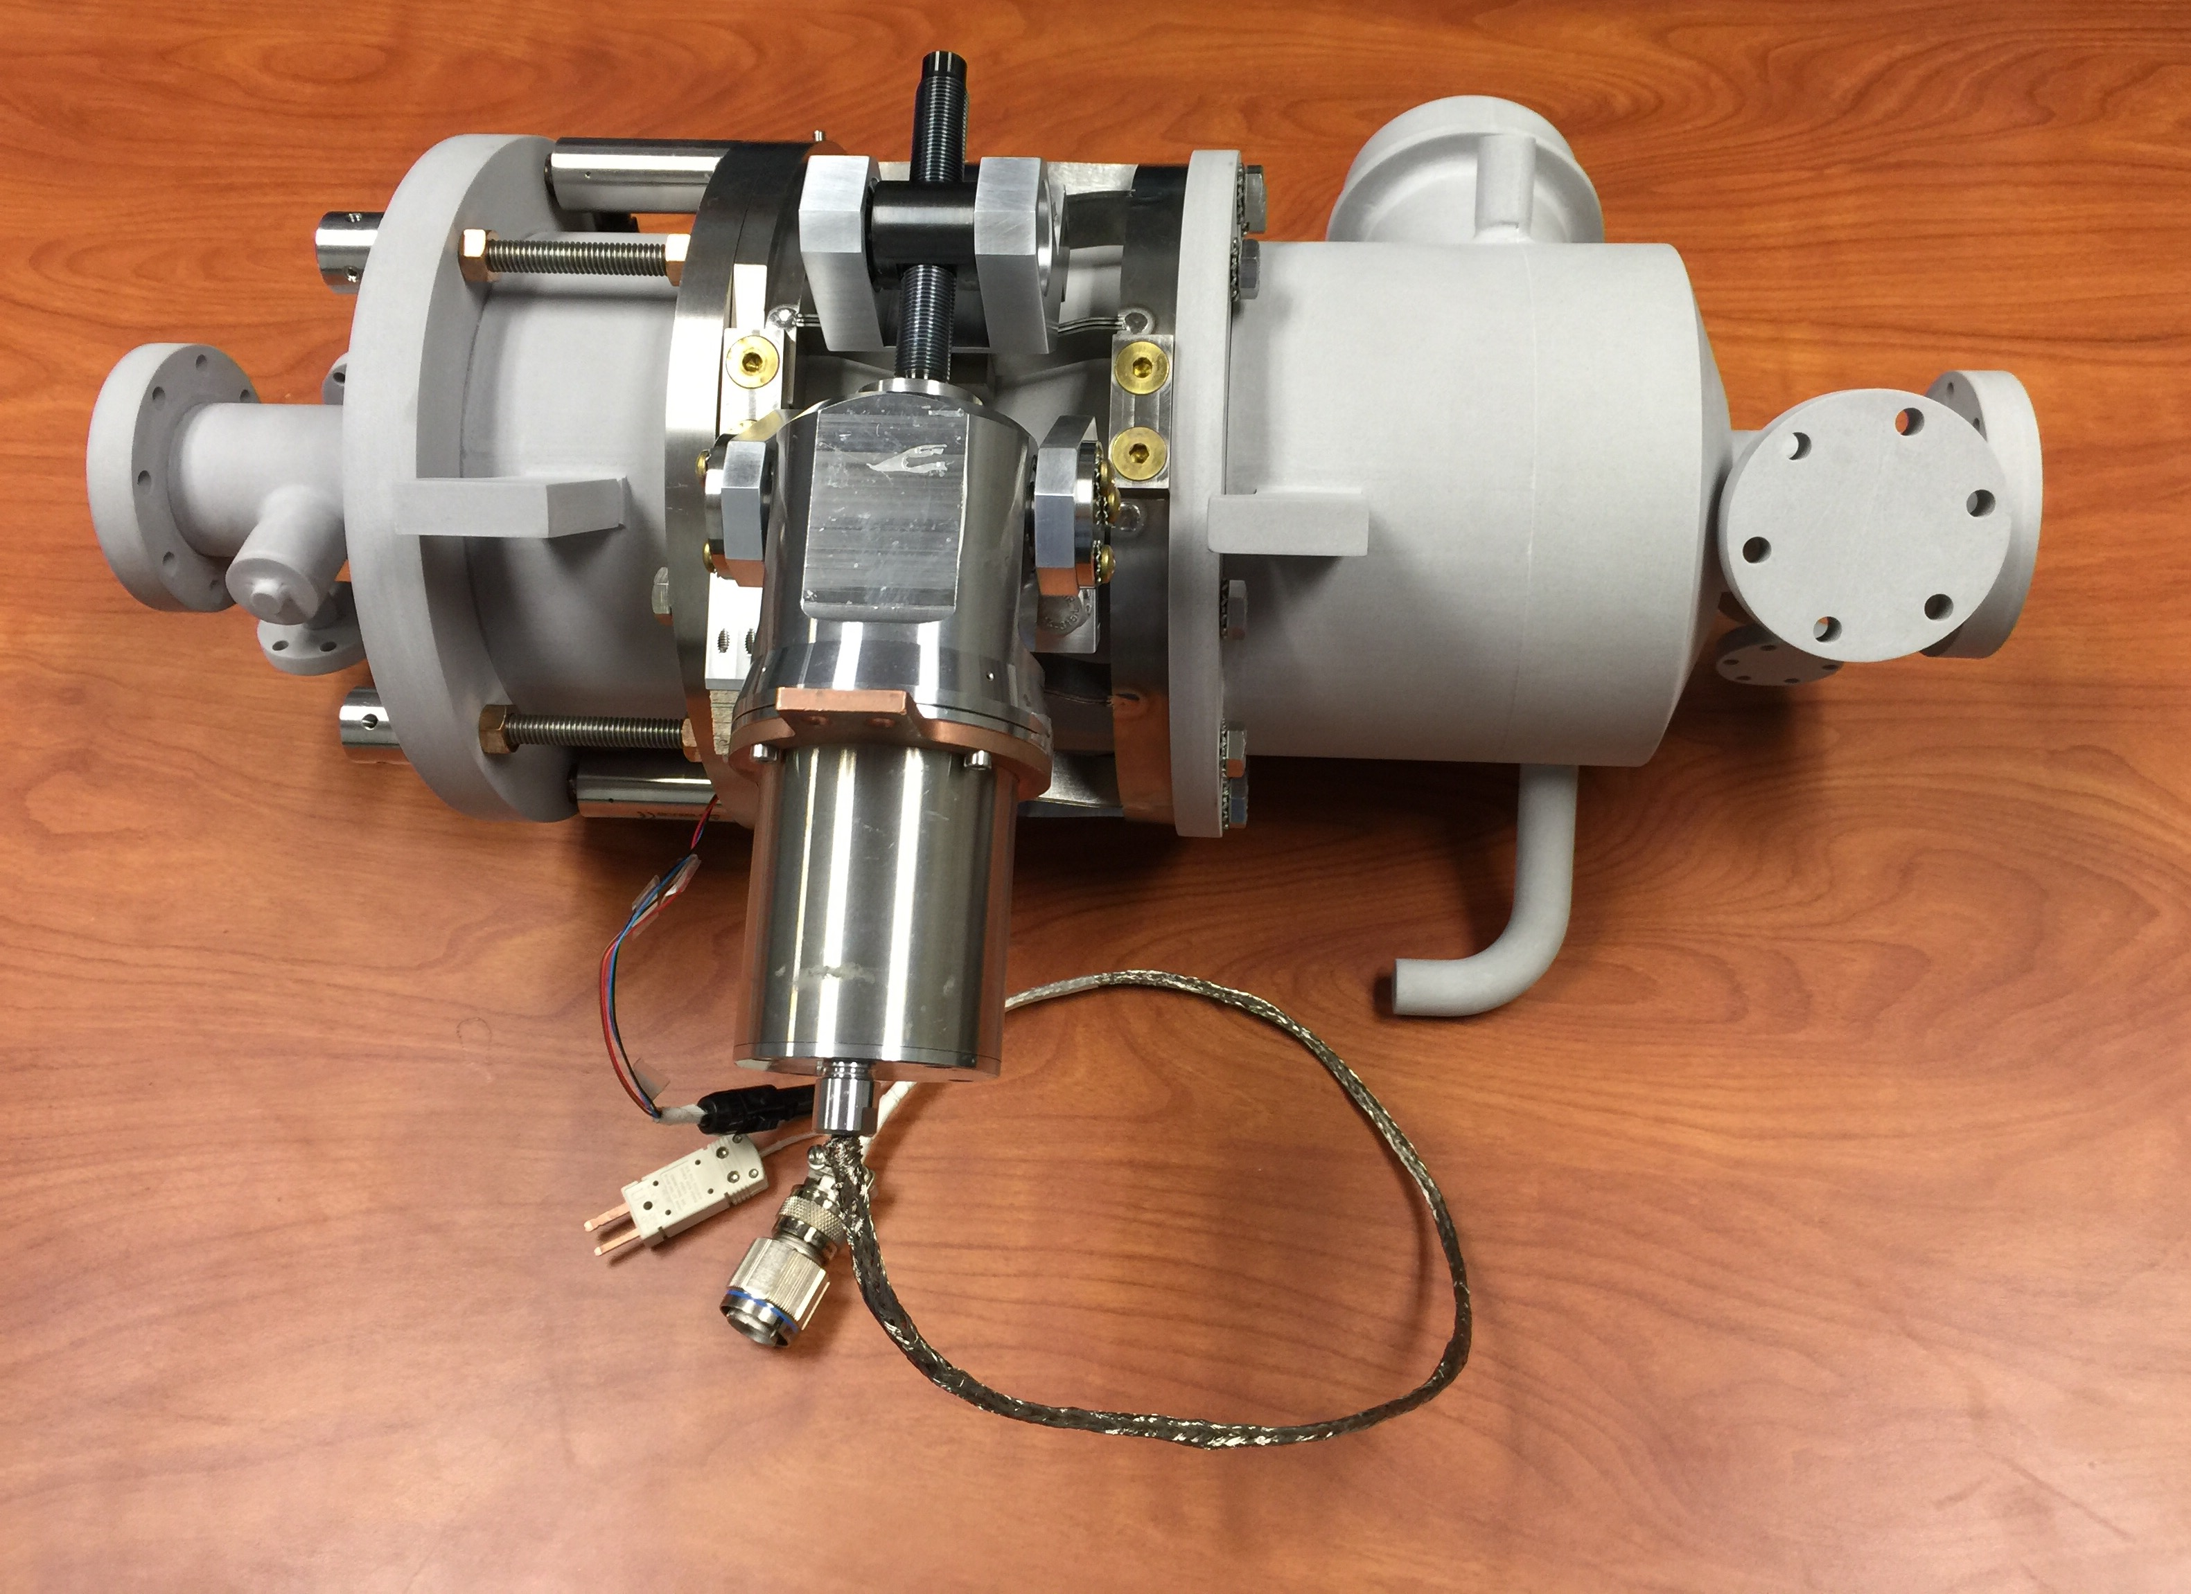
3.9 GHz CM Design Verification Status – Tuner/Piezo
One blade tuner was delivered
Mockup dressed cavity received
Using piezo and stepper motor from 1.3 GHz cryomodule inventory
Hysteresis studies based on XFEL experience
 | Parameter | Unit
Coarse tuning | 750 | KHz
Fine Tuning | 1 | kHz
Fine tuning resolution | 1 | Hz

Slide 12
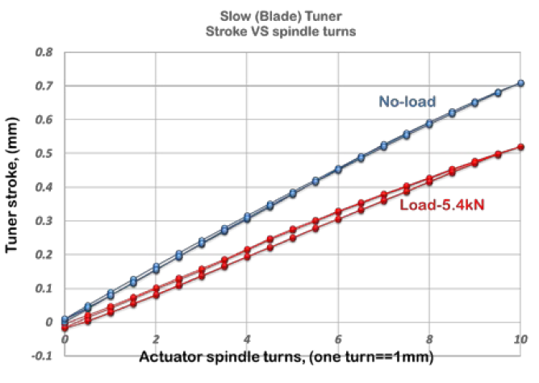
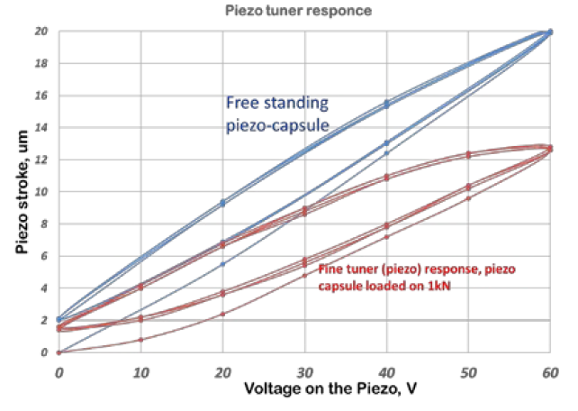
3.9 GHz CM Design Verification Status – Tuner/Piezo
Warm Test Successful
Slow Tuner stroke vs actuator spindle turns. Red – slow/blade tuner operated against spring with k~5.4kN (expected stiffness of the cavity/He-vessel system). Blue- tuner operated against “zero” load.
Fast (piezo) tuner stroke vs voltage applied to piezo (red). Blue –stroke of “free standing piezo-capsule” vs voltage applied to piezo-stack.
Y. Pischalnikov, E. Borissov, J.C. Yun, MOPOB32, NAPAC, Chicago, 2016

Slide 13
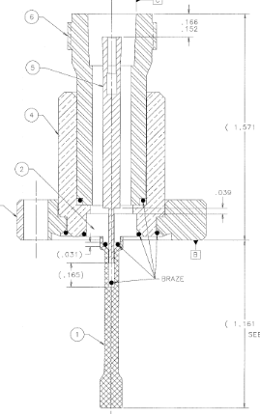
3.9 GHz CM Design Verification Status – HOM/FP
Production units are all received and inspected
Qext_hom >3.8e10, 1W maximum power leakage at 15.5 MV/m
Qext_fp ~5.7e10, 0.5 W power at nominal gradient 13.4 MV/m

Slide 14
3.9 GHz Cavity Internal and External Magnetic Shields
Internal shield
With R = 1.5 mm holes, 18 circumferential, 8 rows at irises
With three R = 12 mm chimney openings
External shields
Openings for cavity lugs, invar rod post, coupler flanges, pick up probe
HOM shall be covered by a separate can
Magnetic shape optimization completed.
PO awarded. Expected to receive in December
Magnetic sensor (fluxgate) will be installed inside helium vessel of prototype dressed cavity
Average remnant field B ≤ 15 mG

Slide 15
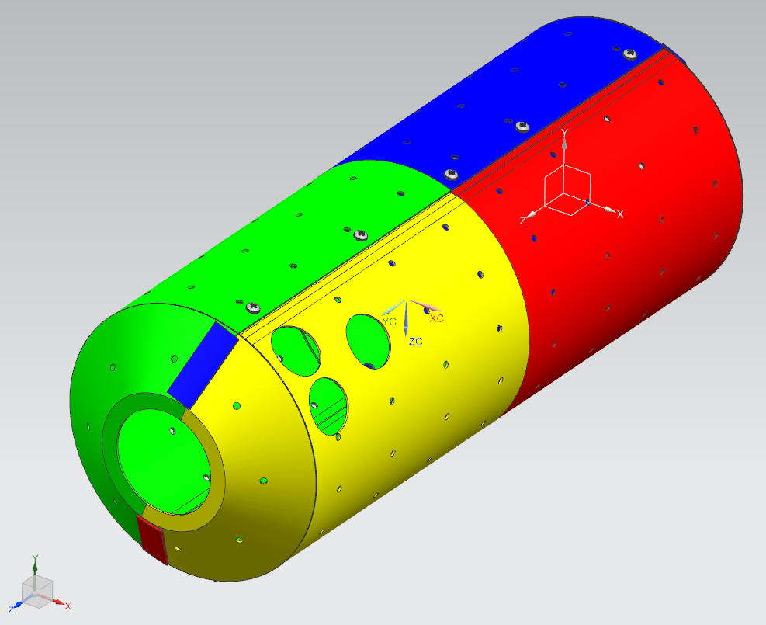
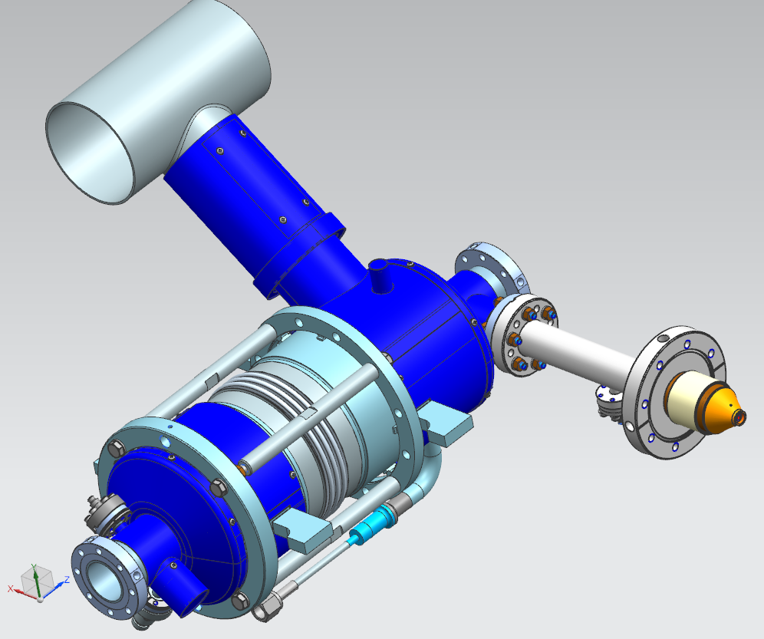
3.9 GHz Cavity Internal and External Magnetic Shields
Internal shields received
External magnetic shield (blue color)
To be delivered in February

Slide 16
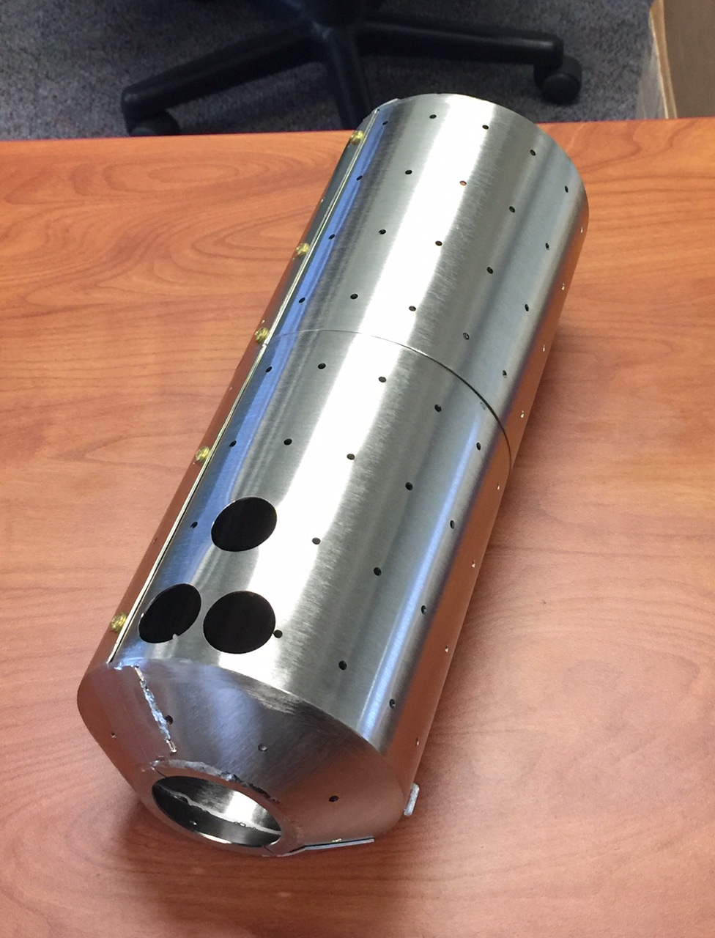
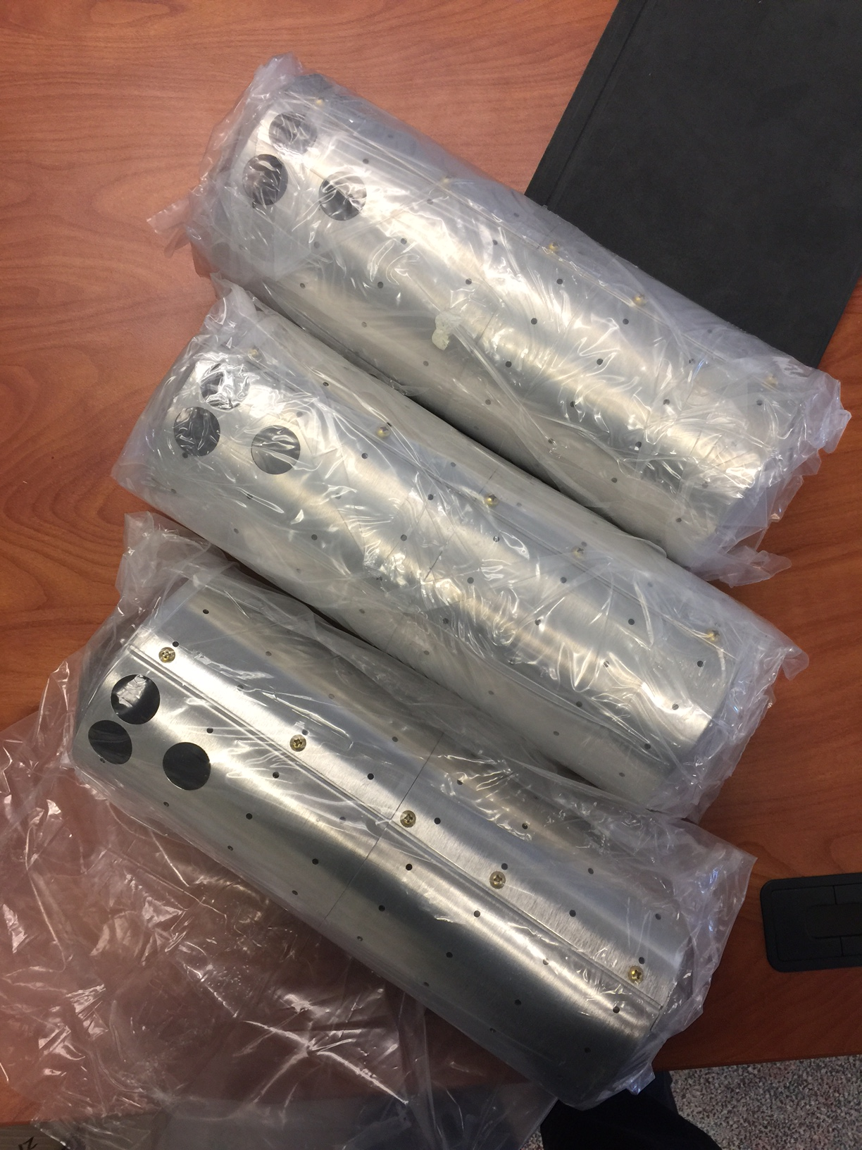
3.9 GHz Cavity Internal and External Magnetic Shields
Internal shields received

Slide 17
3.9 GHz CM Procurements
Tuner stepper motors delivered
Tuner piezo stacks delivered
HOM/FP delivered
Instrumentation procurement started in July
All other components will start procurement after FDR is completed
Bare cavity procurement is in progress
Dressed cavity procurement follows the 1.3 GHz cavity strategy

Slide 18
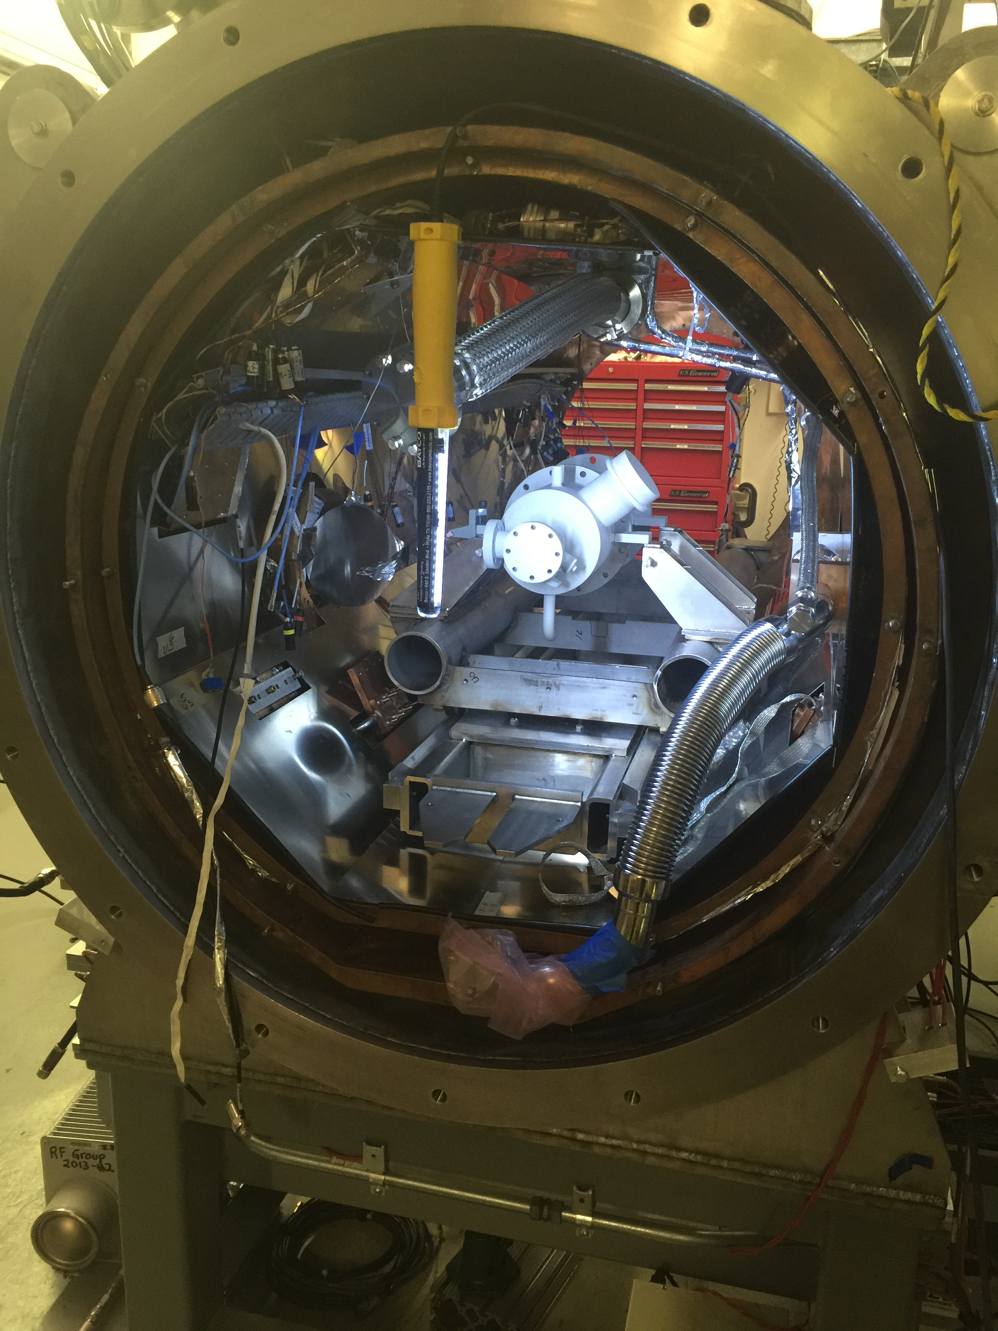
3.9 GHz Infrastructure for Design Verification
VTS
Clean room tooling is in place
Cavity test RF system is in place.
Dressed cavity tooling is in place
HTS
Tooling/fixtures are in storage
Clean room tooling (procurement in progress)
3.9 GHz CW klystron work is in progress
Thermal straps are being fabricated
J. Ozelis and O. Prokofiev

Slide 19
3.9 GHz Cryomodule Risks
Technical risks – resolve during design verification
Coupler
Tuner
Helium vessel
Schedule risks
Bare cavity delivery
Cavity prep and test resource sharing with other activities (1.3 GHz LCLS-2, PIP-2, SRF R&D)
HTS test facility availability
Mitigations:
Dress a cavity as soon as it meets specification
Dress prototype cavities in Fermilab

Slide 20
3.9 GHz Cryomodule Status Overview
20 November 2015 –Dressed Cavity FDR/CM PDR
26 May 2016 – Design Update Meeting
23 January, 2017 – Engineering Specification Document released
30 January, 2017 – Cryomodule Final Design review
December 2016 – Bare cavities test starts (DV)
February 2017 – Dressed cavity test starts (DV)
March 2017 – Horizontal test Starts (DV)
May 2017 – Two dressed cavity ready for string assembly (DV Completion)
December 2017 – Cavity Prep and Test Starts
April 2018 – String Assembly Starts
August 2018 – Cryomodule Tests
October 2018 – Second CM ships

Slide 21
Summary
3.9 GHz engineering design is in good progress.
3.9 GHz design verification started.
Bare cavity delivery is driving the schedule.
3.9 GHz procurement has started.
Low risk components are awarded or planned ahead of the final design review.
Mechanical components will be procured after final design review.
Couplers, cavity dressing and magnetic shields will be procured after horizontal validation tests.
Bare cavity procurement is in progress

Slide 22
Acknowledgement
Thanks to: Tom Peterson, Nikolay Solyak, Thomas W. Cummings, Elvin R Harms Jr, Camille M Ginsburg, Michael H Foley, Timergali Khabiboulline, Yun He, Charles J Grimm, Yuriy M Pischalnikov, Anna Grassellino, Sebastian Aderhold, Tug T Arkan, Matthew M Kramp, Kenneth S. Premo, Saravan K. Chandrasekaran, Andrei Lunin, Ivan Gonin, Sergey Cheban (Fermilab)
Paolo Pierini (INFN/LASA), Elmar Vogel (DESY/XFEL)
Marc Ross, Andrew Burrill (SLAC)

Slide 23
BACK UP SLIDES

Slide 24
Q expectations scaling from 1.3 GHz to 3.9 GHz – matches measurements
Process | 1.3 Rs_bcs (nΩ) | 1.3 Rs_res (nΩ) | 3.9 Rs_total (nΩ) | 3.9 Q @16 MV/m
BCP | 12 - 14 | 4 - 8 | 115 - 140 | 2.0e9 – 2.5e9
BCP + 120°C | 8 - 10 | 4 - 8 | 79 - 104 | 2.6e9 – 3.5e9
N-doping + EP | 4 | 1 - 3 | 38 - 43 | 6.0e9 – 7.0e9
LCLS-II 3.9 CM FDR, January 30-31, 2017
Courtesy of A. Grassellino

Slide 25
RF Surface Resistance breakdown and budget for R_{FL}
Very small budget for trapped magnetic flux induced residual resistance
Q dominated by BCS already at limit of specs with BCP only
Q should benefit from 120C bake as it reduces BCS surface resistance, and pushes onset of HFQS to higher gradients
Cavity treatment | Q₀ (17 MV/m, 2K) | R₀ (17 MV/m) [nΩ] | R_{BCS} (17 MV/m,2K) [nΩ] | R_{FL} (17 MV/m) max [nΩ]
BCP | 2 – 2.5e9 | ~14 | ~126 | <5
BCP + 120 C bake | 2.6 – 3.5e9 | ~14 | ~90 | ~30
Maximum allowable extra trapped flux induced residual to meet 2e9 specification
Courtesy of A. Grassellino

Slide 26
Therefore, remnant magnetic field spec in CM
To meet 2e9 attention has to be paid to remnant field in CM
Model below assumes full flux trapping
Seems very promising for BCP+120C bake
Cavity treatment | Sensitivity @ 17MV/m [nΩ/mGauss]★ | R_{FL} (17 MV/m) max [nΩ] | B_{MAX-CM} [mGauss]
BCP | 1.2 | 5 | ~4
BCP + 120C bake | 0.87 | 30 | ~34
Maximum allowable magnetic field in cryomodule to meet 2e9 specification
★Scaled with square root of frequency measurements from: Martinello et al, Proceedings of SRF 2015, MOPB015
Courtesy of A. Grassellino

Slide 27
3.9 GHz Engineering Design – ESD and FDR
Engineering Specification Document will be released four months ahead of the FDR
Mature engineering design leads to the release of ESD for high level RF, vacuum, infrastructure integration (Sep 2016)
Continue the integration engineering, support the design verification and early procurement (Jan 2017)
Complete the FDR and address review comments (Feb 2017)
Release the drawing packages for remaining components in support of production procurement. (March 2017)

Slide 28
ILC / XFEL CM Modifications for LCLS-II (components)
Component design – based on TESLA / ILC / XFEL designs
Cavities – XFEL identical
Transition to slightly smaller beam tube
Helium vessel – XFEL-like
3.9 GHz modified for addition of piezos in blade tuner, larger chimney
Magnetic shielding – increased from XFEL to maintain high Q0
Coupler – XFEL-like modified for CW operation
Tuner – 3.9 GHz XFEL-like blade tuner style
HOM coupler – XFEL-like
Magnet – provision for addition of future small magnet
BPM – DESY button-style with modified feedthrough
Design verification will be focused on design changes
Slide by T. Peterson

Slide 29
3.9 GHz cryomodule design for LCLS-II
3rd generation design
FLASH (Fermilab)
EuXFEL (LASA/INFN)
Significant changes due to CW operation
higher heat load (larger 2-phase chimney)
modifications to FPC
Retain blade tuner
add fine tuning by means of piezos
Modification to cavity ends
reduce trapped modes
Design Verification will be focused on Design Changes
Slide by T. Peterson

Slide 30
3.9 GHz CM Work Flow
Engineering Design
Final Design Review
Engineering Specification
Procurement
Design Verification
Fabrication and Testing
Engineering design and verification are parallel activities
Procurement of low risk components are before the FDR.

Slide 31
Lessons Learned
Incorporate the vast knowledge from 1.3 GHz cryomodule design
Follow the better procurement strategy
Better alignment of engineering design and design verification work flow
Collaborate with DESY and INFN-LASA staff to incorporate the lessons learned from XFEL

Slide 32
6-Month Outlook
Complete engineering design
Complete integrated horizontal test
Procurement

