Slide 1
3.9GHz SRF Cavity Tuner
Yuriy Pischalnikov
LCLS II 3.9 GHz Cryomodule Final Design Review
January 30, 2017

Slide 2
3.9GHz Tuner Functional Specification
Tuner must tune cavity (coarse/slow and fine/fast) and protect cavity/He Vessel system during CM production cycle and operation of the accelerator
High reliability of the tuner active components (electromechanical actuator and piezo-actuator);
Tight requirements for slow/coarse & fast/fine tuning resolution → cavity has narrow bandwidth (BW=130Hz) and resonance control requirements ΔF_{peak}=30Hz
Yu.Pischalnikov, SRF Cavity Tuner

Slide 3
Main Approach to Coarse/Fine Tuner design
To minimize design efforts adopt INFN slim blade tuner design (EuXFEL);
To meet req. specs:
add piezo tuner
use piezo capsule (2 capsules) designed & tested for 1.3GHz tuner (high reliability specs);
use Phytron electromechanical actuator (high reliability specs);
Use limit switches to protect cavity/Phytron actuator;
Use the same instrumentation (Phytron actuator; Pi piezos; limit switches ) that used for 1.3GHz tuner (tested for lifetime& rad hardness)
Yu.Pischalnikov, SRF Cavity Tuner

Slide 4
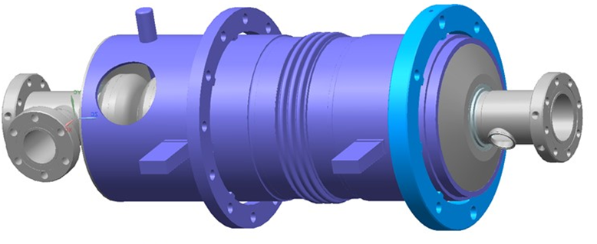
3.9GHz LCLS II Tuner – modified INFN slim blade tuner modifications: adding Fine/Fast (piezo) tuner (2 piezo capsules)
Moved second ring, welded to He Vessel. to accommodate 66mm piezo-stacks
INFN (EuXFEL) tuner
3D model of
LCLS II 3.9GHz Tuner
Active elements are the same as used for 1.3 GHz Tuner:
Phytron electromechanical actuator (and limit switches)
Two PI piezo-capsules
Yu.Pischalnikov, SRF Cavity Tuner

Slide 5
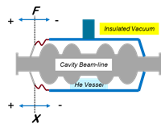
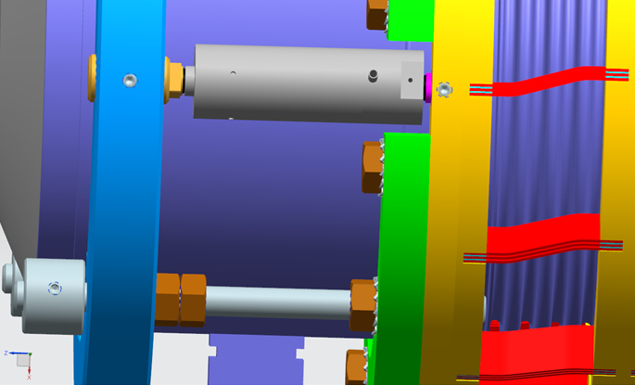
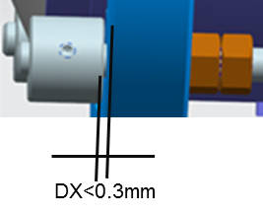
Impact of various pressure conditions during anticipated steps of assembly and operation.
Safety Rods
Table from FEA simulation by I.Gonin, T Khabibouline
ΔX<0.15mm
Safety gaps < 0.15mm
All leak check and pressure tests are safe with 4 rods installed
Pressure test with tuner installed without safety rods is not recommended
Yu.Pischalnikov, SRF Cavity Tuner

Slide 6
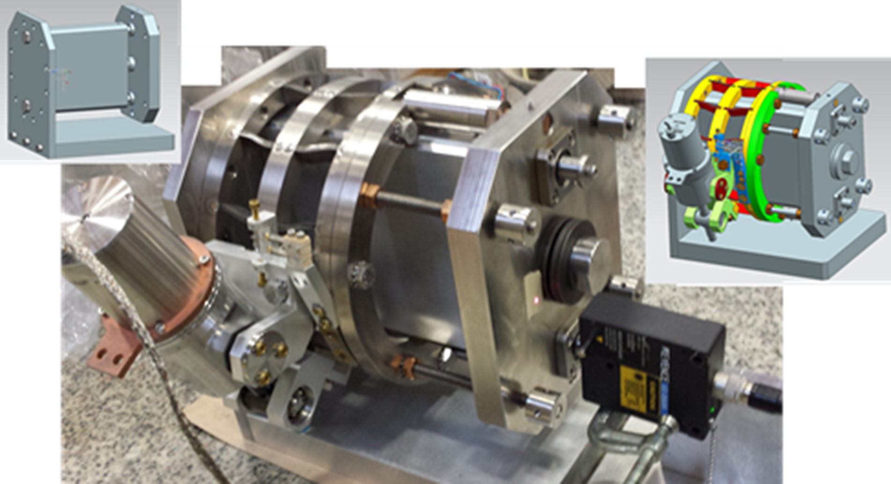
First 3.9GHz Tuner built and tested (warm)
Y. Pischalnikov, E. Borissov, JC. Yun, “Design and Test of the Prototype Tuner for 3.9GHz SRF cavity for LCLS II project.” NAPAC2016
Prototype Tuner, assembled on the “plastic” model
of 3.9GHz dressed cavity/helium vessel system.
Discs Springs to simulate cavity stiffness
Laser Displacement system to measure tuner performances.
Prototype Tuner, assembled on the “cavity/He vessel mock-up” stand.

Slide 7
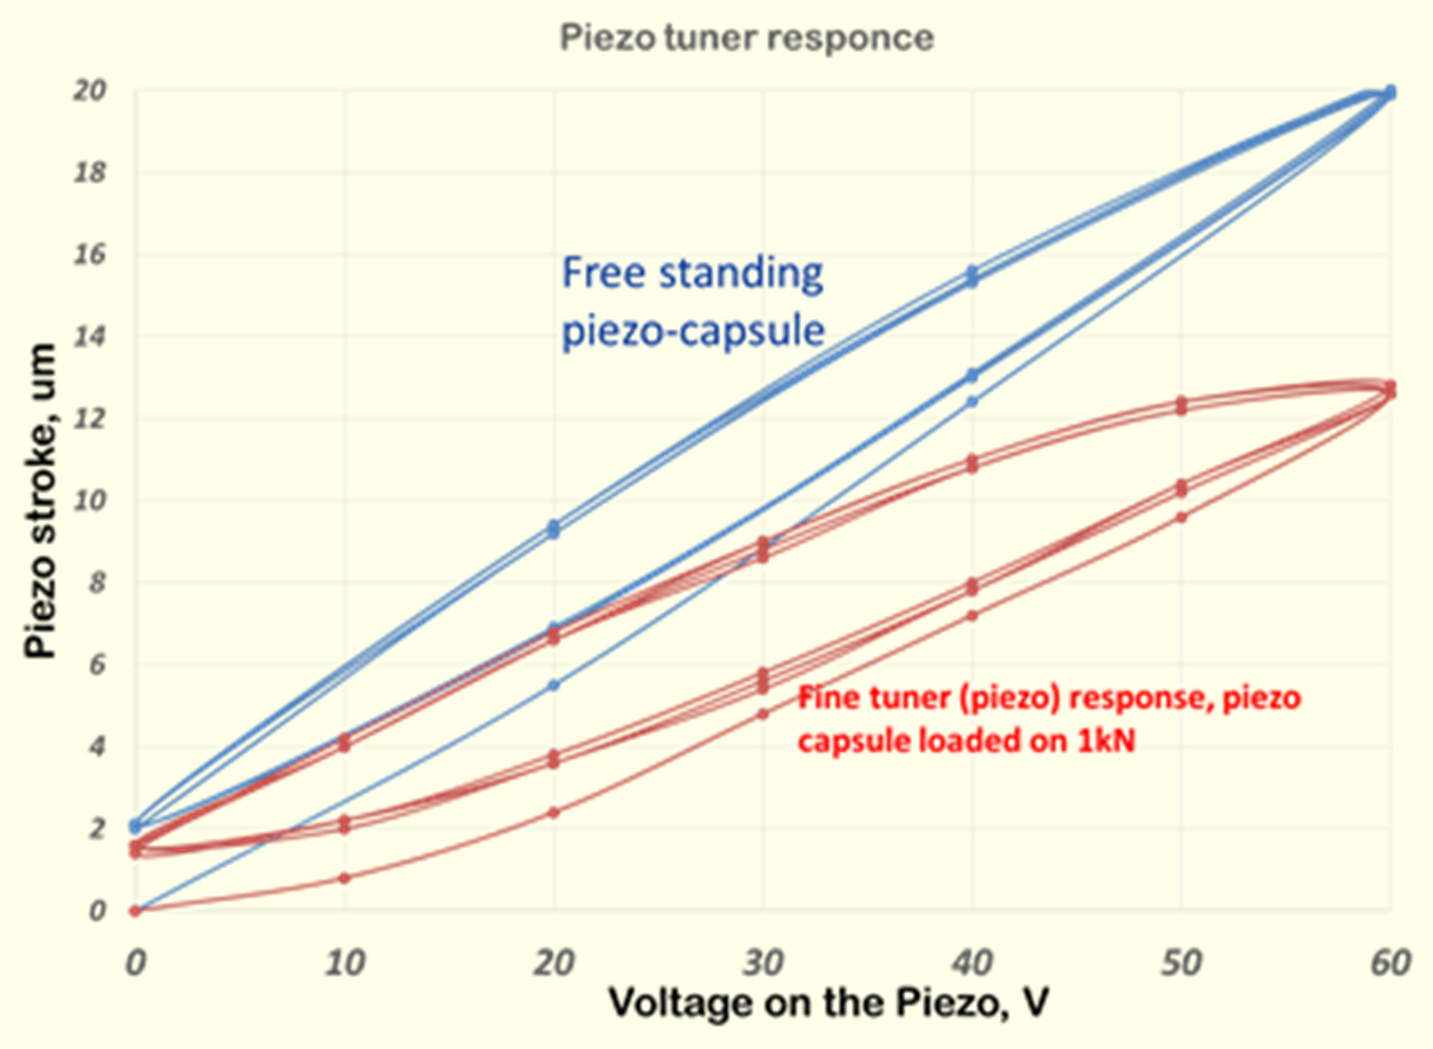
Warm Tuner Test Results
Slow Tuner stroke vs actuator spindle turns. Red – slow/blade tuner operated against spring with k~5.4kN (expected stiffness of the cavity/He-vessel system). Blue- tuner operated against “zero” load.
From the two curves (red- with load (5.4kN spring) and blue - with no-load) the stiffness of the blade tuner can be estimated at k_{tuner}~ 27kN/mm.
The coarse (blade) tuner ration changed from ~1:20 (when operated against 5.4kN load) to ~1:14 when the tuner operated against zero load. From the “5.4kN load” curve, the slow tuner resolution is estimated to be ~5nm/step or 10-12Hz/step (met tech. reqs specs)
.
The results of the tuner piezo test allowed estimating efficiency of the tuner system. The piezo efficiency (portion of the piezo stroke that will compress cavity) is near 67%. The expected piezo-tuner range at cryogenic temperature (even with 67% efficiency) will be near 5um or 10-12kHz. This is ten times large than the technical requirements of the piezo-tuner (1kHz).

Slide 8
Warm test results→ feedback to design
Tuner stiffness/Cavity Stiffness ~5-6
It is not any limit tuner (as is) to meet
Specs.
Simple modifications (adding more blades near piezos ) will increase stiffness… but at this point we think it is not nessesary

Slide 9
Summary
First 3.9GHz tuner built
Tested warm
Warm tests confirmed that tuner met specs
Ready for Design Verification test at HTS

