Slide 1
3.9 GHz RF components design
Speaker:
Nikolay Solyak (from behalf of LCLS-II design team)
LCLS-II 3.9GHz Cryomodule Final Design Review,
FNAL, Jan.30-31, 2017

Slide 2
Outline
Requirements, gradient and QO
Cavity RF design, incl. HOM
Mechanical design
Power Coupler design
Heating issues and cables
Wakefields
BPM; Gate Valve; HOM absorber
Conclusion

Slide 3
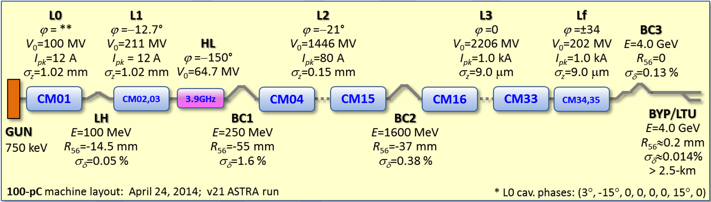
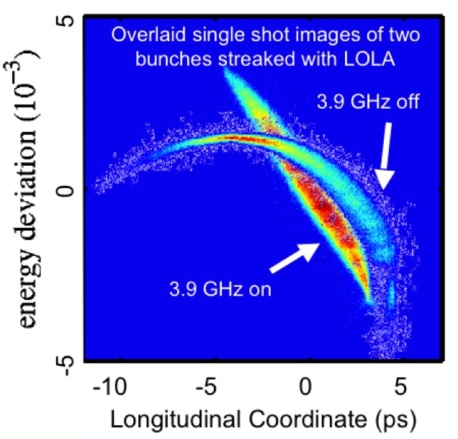
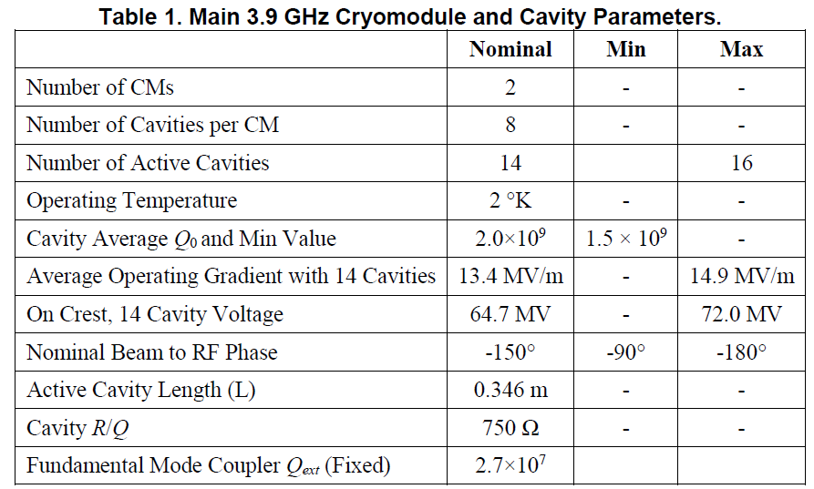
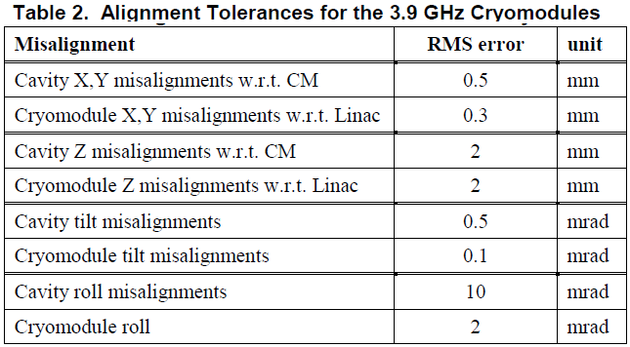
3.9 GHz CM Physical Requirements ( LCLSII-4.1-PR-0097-R2 )
XFEL result
2.4×10⁷
3.0×10⁷
0.01% amplitude and 0.01° phase stability on short (seconds) time scales

Slide 4
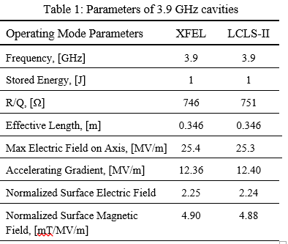
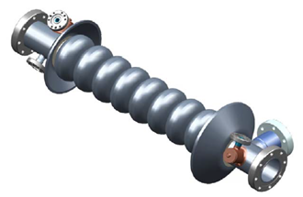

Cavity design parameters
For the same gradient fields in 3.9GHz cavity ~14% higher than in 1.3GHz cavity.
BCS resistance scale as freq²
Iris Ø=30mm; beam pipe Ø=40(38)mm

Slide 5
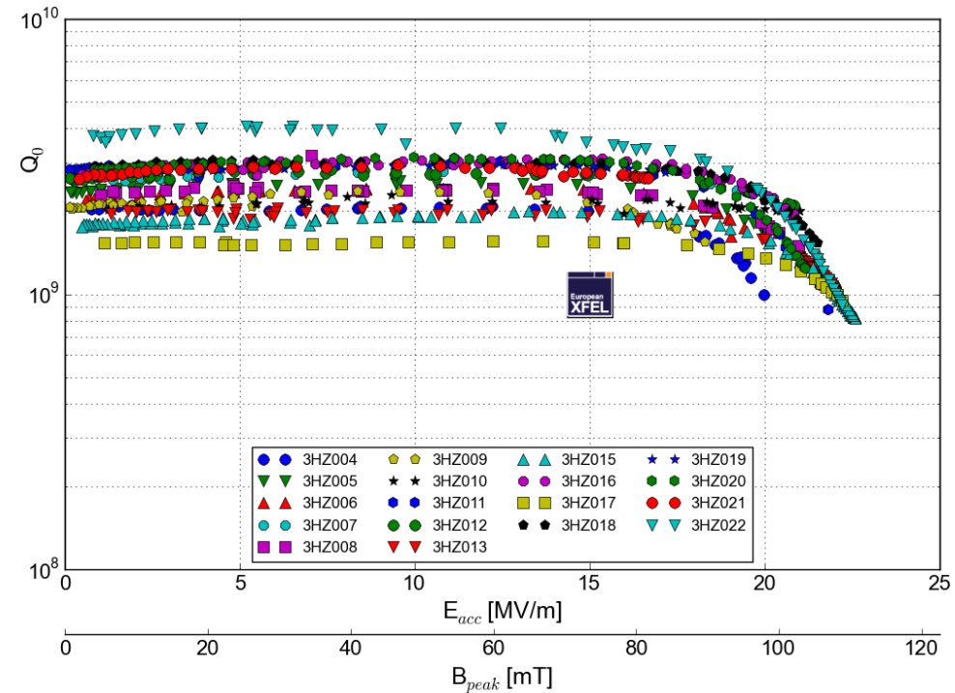
Cavity gradient and Q0 requirements (from XFEL cavity production)
P.Perini, INFN
XFEL production cavities (INFN-Zenon);
All cavities have Q0 in range ~(2-3)·10⁹ (2K)
No field slope up-to ~17 MV/m;
Quench at 20-23 MV/m, VTS
No Q degradation after welding to HV
Potential improvement of Q0 from 150C baking (FLASH cavities)

Slide 6
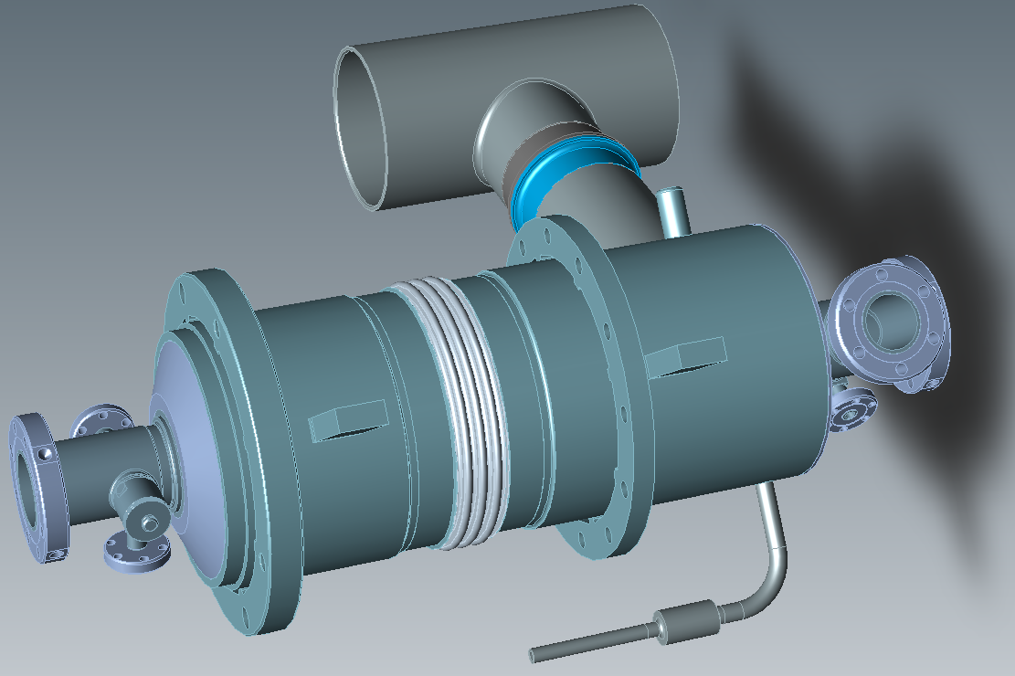
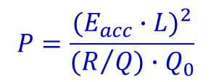
Chimney Power Limit
Table: Cryoload at 2K
 | Nominal param. | Max in CM | VTS/HTS param
E_{acc} (MV/m) | 13.4 | 14.9 | 18
Q0, x 10⁹ | 2 | 1.5 | 1.5 / 2
P/cav (W) | 14.3 | 23.6 | 25.9/34.5
LCLS2-1.3 GHz
LCLS2-3.9 GHz
$$P=\frac{{(E_{acc}∙L)}^{2}}{(R/{Q)∙Q_{0}}}$$

Slide 7
Cavity and couplers design issues and proposed modifications for LCLS-II CW operation
Cavity (end groups)
HOM coupler
Main Power Coupler

Slide 8
LCLS-II 3.9 GHz cavity design
FLASH/XFEL cavity design as a starting point.
CW operation in LCLS-II is more severe regime for the cavity.
Several important modifications introduced to reduce risks and eliminate tuning and heating problems.
Major modifications in cavity RF design:
Reduce beam pipe and bellow diameter from 40 to 38mm.
  Shift frequency of lowest trapped mode (in coupler end) away from 3.9 GHz to eliminate problems with tuning of HOM coupler notch frequency.
Modification of HOM coupler: increase length of bump in F-part
  Reduce penetration of antenna inside HOM cam →Eliminate overheating of the HOM antenna in cw regime. I
  Increase wall thickness on the top of HOM can to prevent cracks and vacuum leak
  Shortening length of antenna in HOM feedthrough

Slide 9
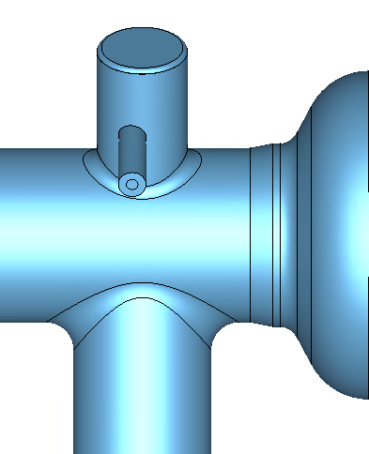
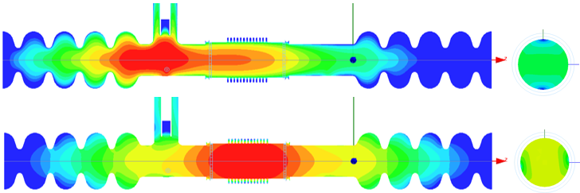
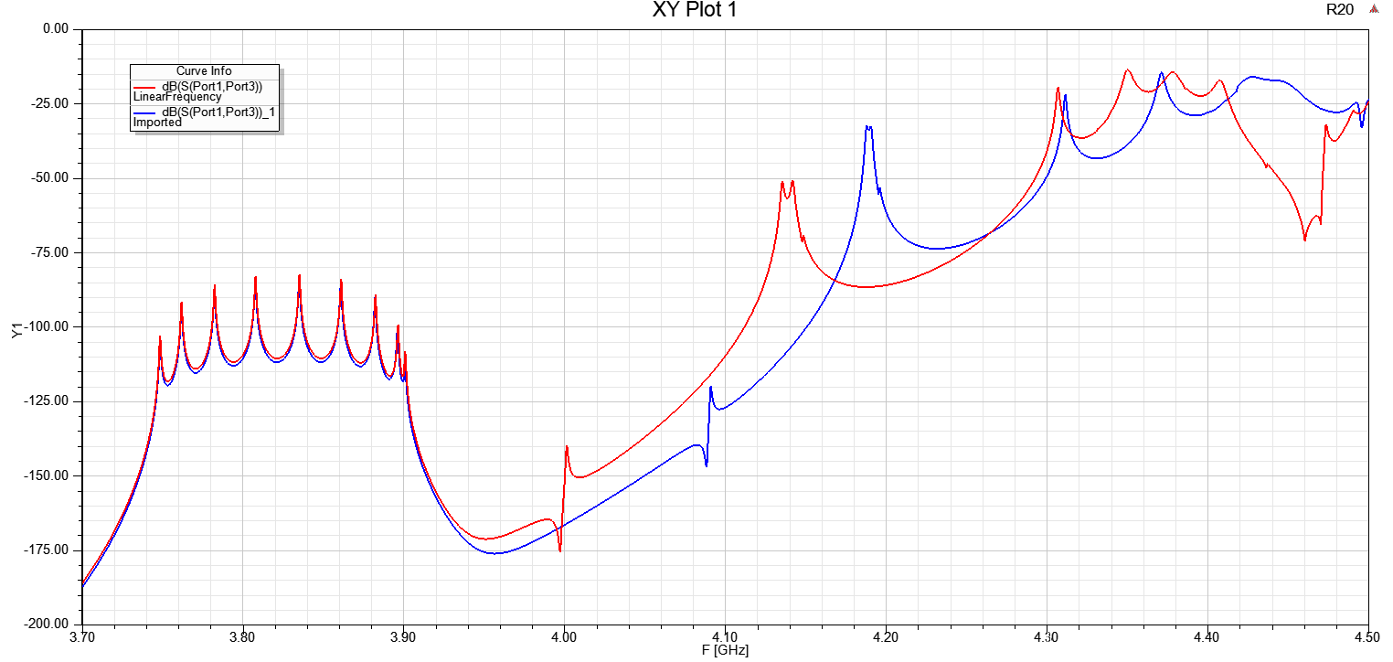
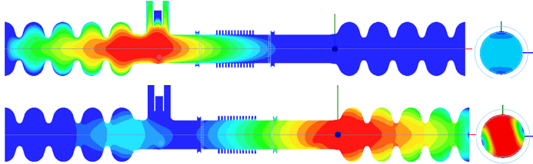
Reduce beam pipe diameter from 40mm to 38mm.
No modification of cavity cells.
Add small conical transition between beam pipe and end cell.
5mm
FLASH: Lowest Dipole HOMs. Beam Pipe Ø 40 mm and Bellows Ø 42 mm.
F = 3.992 GHz, Q_{E} = 3.6e4
Ø38 mm
F = 4.047 GHz, Q_{E} = 8.0e4
  A. Lunin/T.Khabiboulline
LCLS2: Lowest Dipole HOMs. Beam Pipe Ø 38 mm and Bellows Ø 38 mm.
F = 4.092 GHz, Q_{E} = 2.7e4
F = 4.188 GHz, Q_{E} = 7.4e3
In current design lowest mode separated by~10-20 MHz (vs. 100MHz in simulation)
Changing the beam pipe aperture to 38 mm detune nearest HOMmode by ~ 100 MHz up.

Slide 10
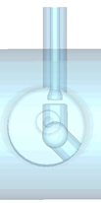
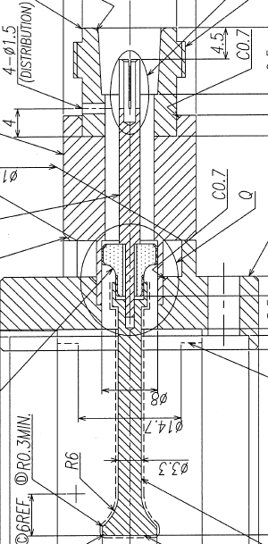
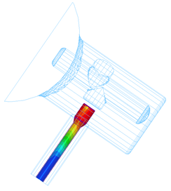
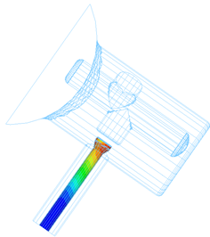
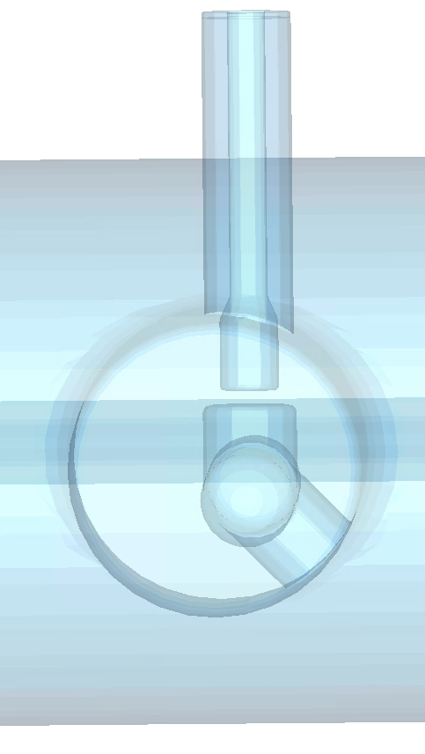
HOM F-part modification to reduce antenna heating
Reduce penetration of HOM to beam pipe. Increase length of bump in F-part.
XFEL design
LCLS-II design
G = 3.2e8 Ω
G = 1.74e9 Ω
RF power dissipation on HOM antenna reduced by factor of 5.4 after modification
1.3GHz feedthrough design modified for LCLS-II 3.9GHz HOM
coupler
  A. Lunin/khabiboulline

Slide 11
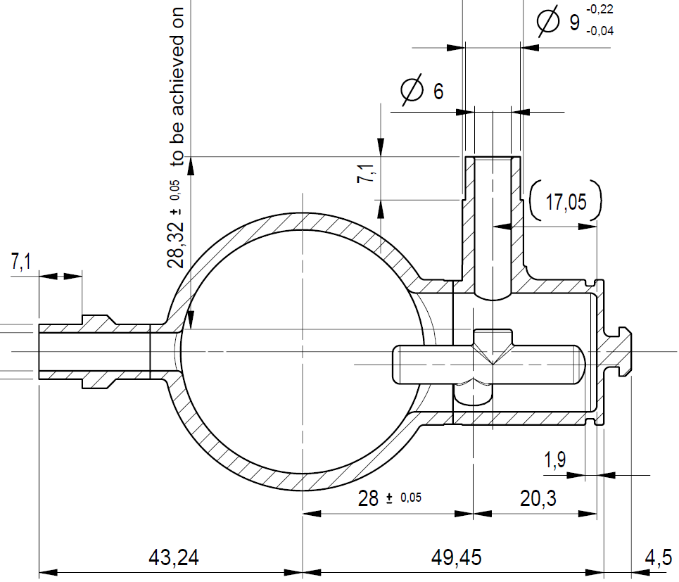
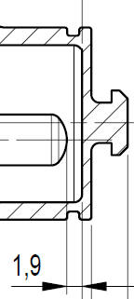
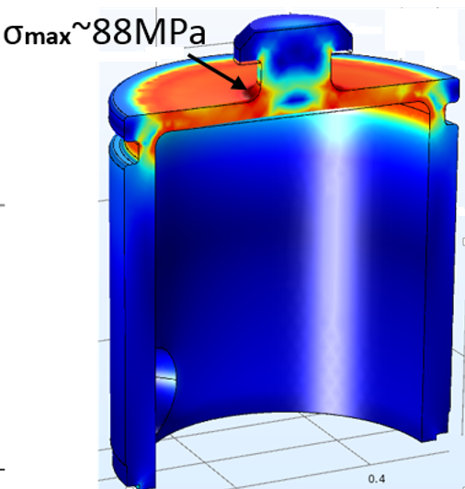
HOM can hat thickness increase to 1.3 mm.
  Thickness of hat is a concern. Was broken when h=1mm.
  XFEL design already has thickness of 1.15 mm → one prototype cavity has a leak. Proposal to have 1.3mm.
XFEL: 1.15mm
LCLS-II: 1.3mm

Slide 12
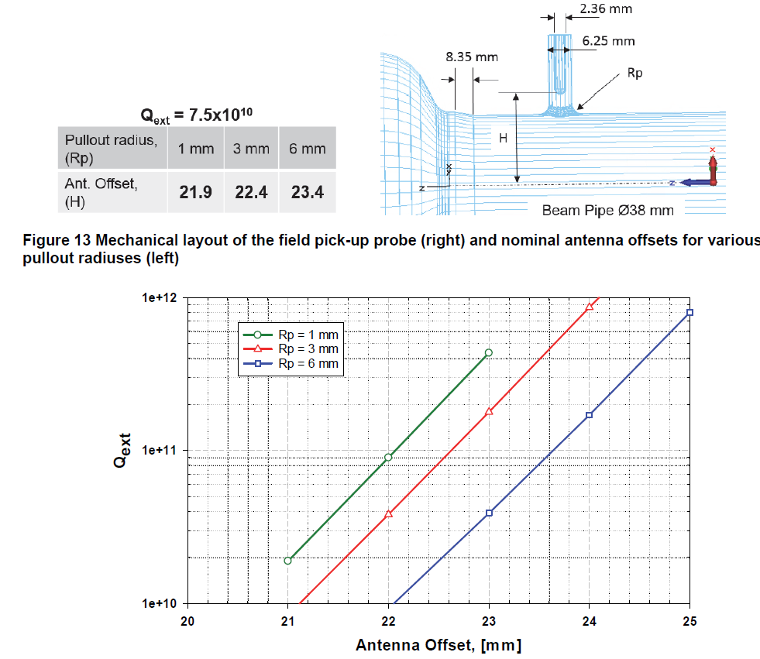
Pick-up antenna

Slide 13
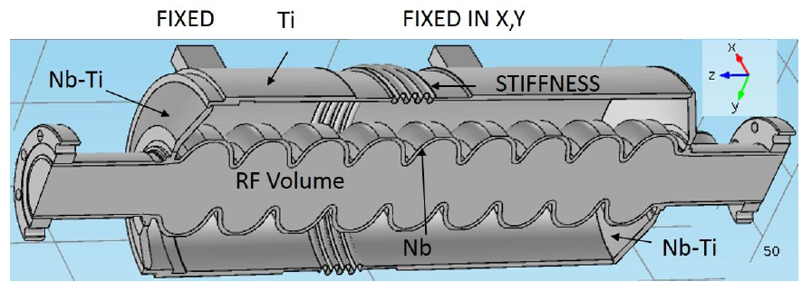
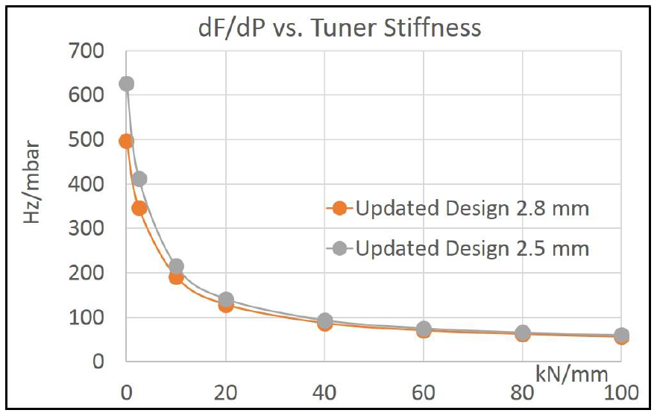
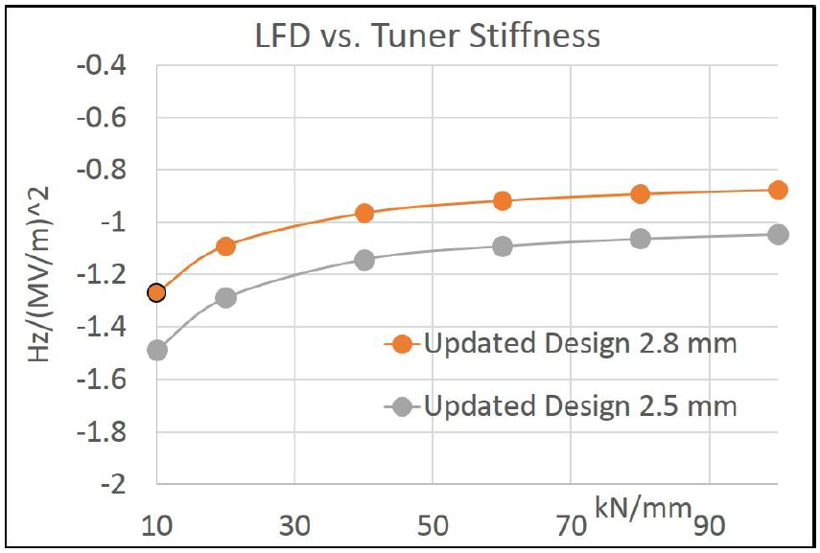
FEA analysis (Cavity+HV+Tuner)
CAD model of assembly.
dF/dP vs. tuner stiffness and cavity wall thickness
(<20Hz if dP <0.2mbar) Measurements done for FLASH 3.9GHz cavities shows dF/dP ~80-90 Hz/mbar
LFD vs. tuner stiffness and cavity wall thickness
~200 Hz for 14.9MV/m and 40kN/mm tuner stiffness

Slide 14
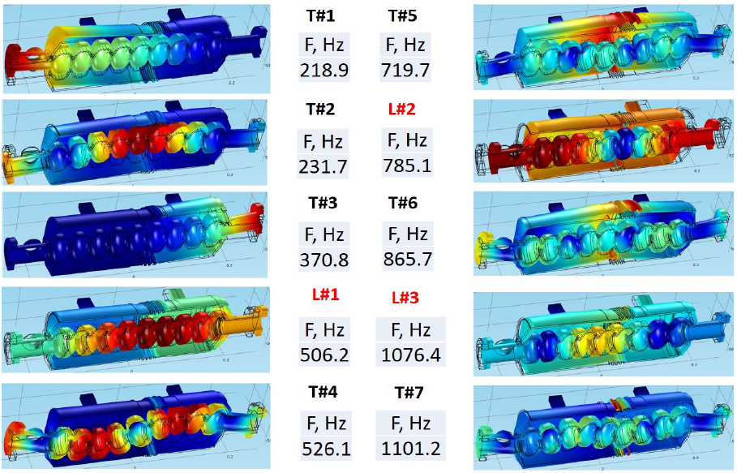
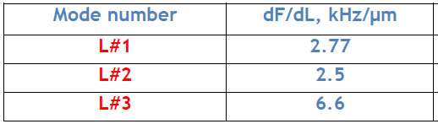
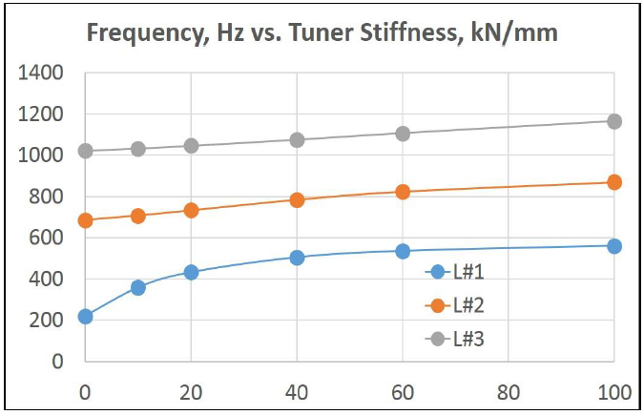
Modal analysis
Sensitivity of Longitudinal modes
Displacement and frequencies of 10 lowest natural modes
Frequencies of Longitudinal modes vs. stiffness of the blade-tuner
LCLS-II TN-16-05

Slide 15
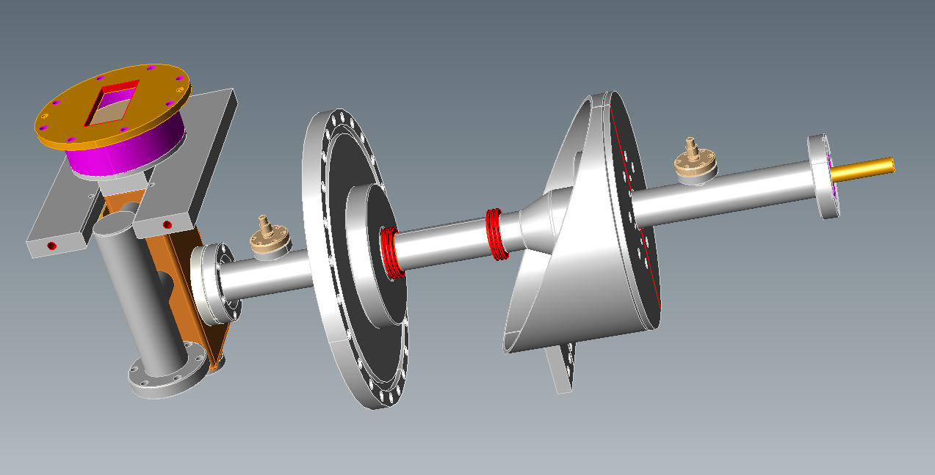
Proposed modification of 3.9 GHz power coupler for LCLS-II CW operation
Coupler was designed for pulse operation (P=50kW, DF=2%).
LCLS-II requirements: P_{max}=2kW cw; quasi – TW regime:
    W/o modification inner conductor of warm part will be overheated ~1000 K.
Proposed modifications:
    Shorter antenna (QL~2.7e7 vs. 1.5e6)
    Increase thickness of copper plating in inner conductor from 30µm to 150µm
    Reduce length of 2 inner bellows in inner conductor from 20 to 15 convolutions.
    Increase thickness of ceramics in cold window to move parasitic mode away.
Prototyping:
3 FNAL couplers were modified at CPI for testing:
  Warm - test stand
  Cold - HTS test on cavity
Fix coupling; Q=2.5e7
Cylindrical cold window (same as 1.3GHz)
Waveguide warm window

Slide 16
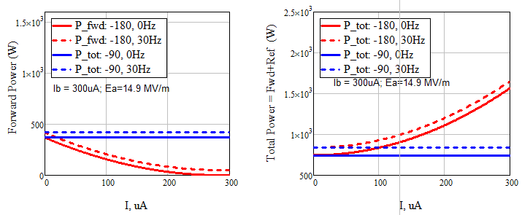
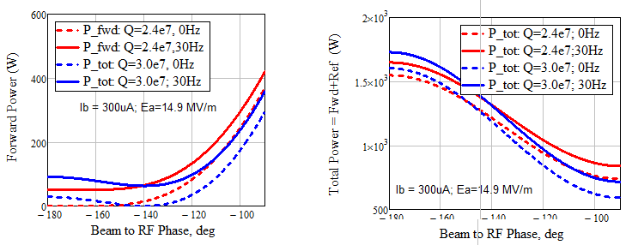
RF Power requirements
Qe=[2.4-3.0]x10⁷;
Acc. gradient: 0…16 MV/m
Max RF power 0.9kW
beam current = 0-0.3mA;
Beam-RF phase = -90..-180 degrees,
Microphonics < 30 Hz.
Max total power in coupler ~2kW in TW regime with the beam and
~1.8KW w/o beam (full reflection).
coupler max T < 450K.
Forward and total power vs. beam current. Qe=2.4e+7; Eacc=14.9 MV/m.
Forward and total power vs. beam-to-RF phase. I=300uA; Eacc=14.9 MV/m.

Slide 17
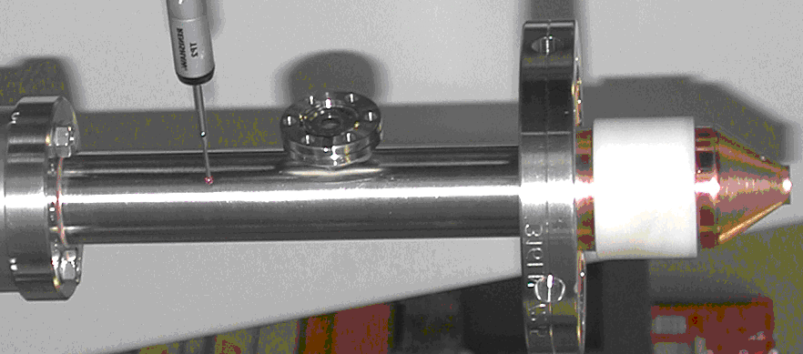
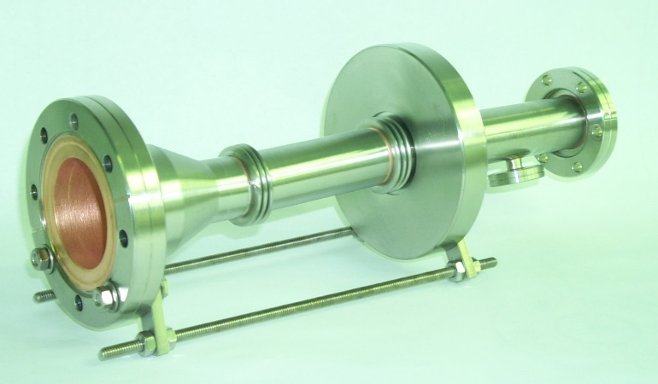
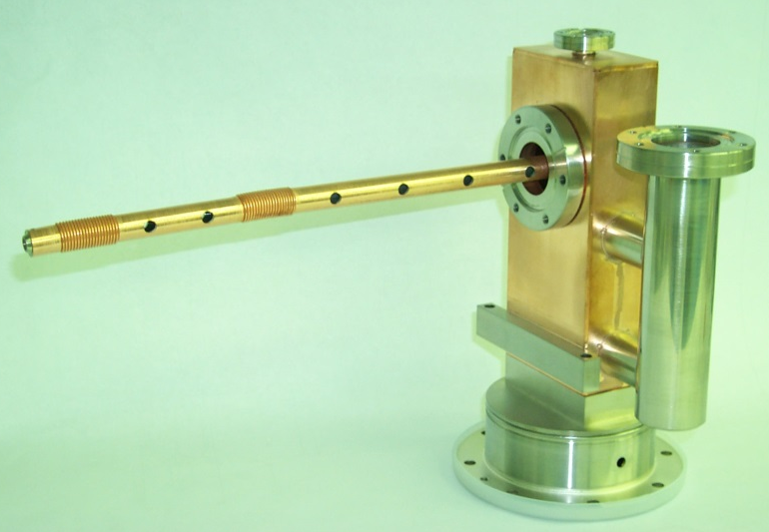
Main Coupler Design
Cold part
Input Coupler Modifications
Cold part – (in production FPC)
Dimensions of ceramic window
Length of antenna (cut at the last stage of production)
Warm outer part (middle picture)
  No changes
Inner conductor of warm section
Cu plating increased from 30 to 150 um.
  Reduce number convolution in both inner conductor bellows (15 vs 20)
Warm part (outer conductor)
Warm part:
Inner conductor and Waveguide with warm pill-box window

Slide 18
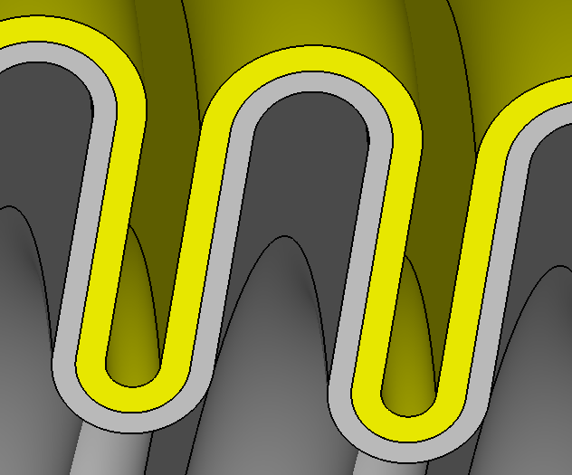
Main Coupler heating vs thickness of Cu plating
Parameters:
P_{in}=2kW TW, Cu plated 10μm on outer, ε=9.8, tan=3e-4, roughness 10%
SS inner conductor: SS bellow 50, 100, 150 microns RRR50 copper plated
Cu plating µm | T_{max}, K
 | 20 conv. | 10 conv.
50 | 747 | 590
100 | 510 | 445
150 | 429 | 391

Slide 19
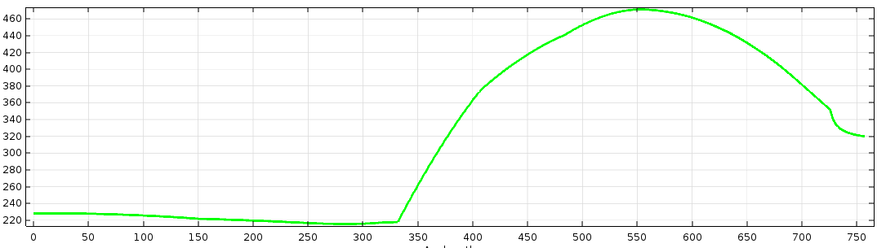
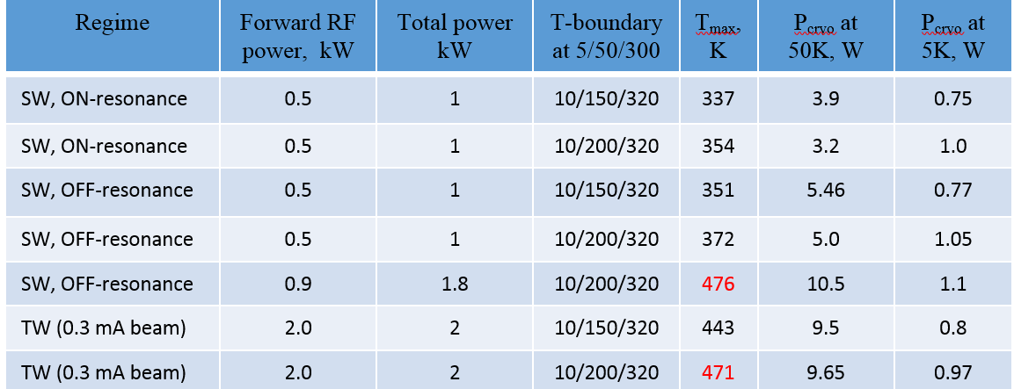
FPC Heating and Cryoload simulations
Parameters: P_{in}=2 kW TW, 10μm outer plating, ε=9.8, tan=3e-4, roughness 10%; 120 μm Cu coating of SS inner conductor, 15 bellows convolutions.
200K
T_{max} ~ 471 K
320K
Port 2
10 K
Port1 : 2 kW
Temperature distribution along surface of inner conductor

Slide 20
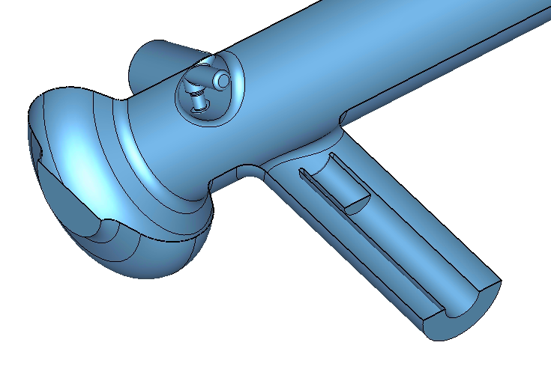
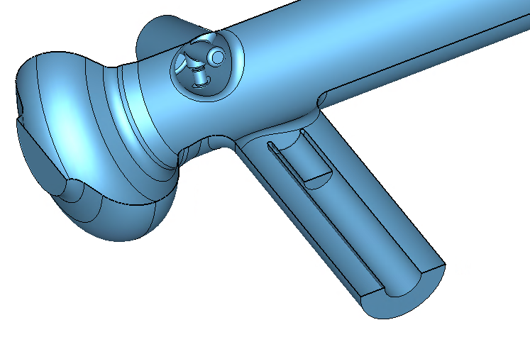
Main coupler antenna configuration
Beam PipeØ38 mm
 | Q_{ext} | Ant. depth [mm]
Original coupler, 40 mm | 2.5E7 | 11
Modified coupler, 38 mm | 2.5E7 | 9.5
Beam Pipe Ø40 mm
  A. Lunin
Beam Pipe Ø38 mm
Beam Pipe Ø40 mm
11 mm
9.5 mm
Coupler tip length should be longer by 1.5 mm

Slide 21
Power losses in 3.9 GHz Cryomodule

Slide 22
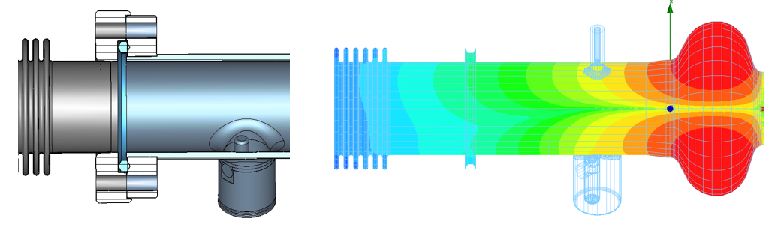
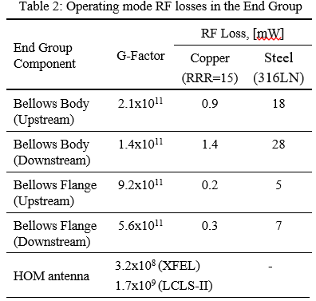
RF Losses in the Bellow due to the Operating Mode Fringing Field
CAD model of cavity and bellows connection (left). H-field distribution at 14.9MV/m (right)

Slide 23
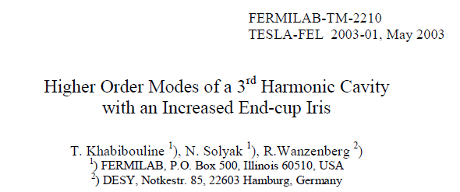
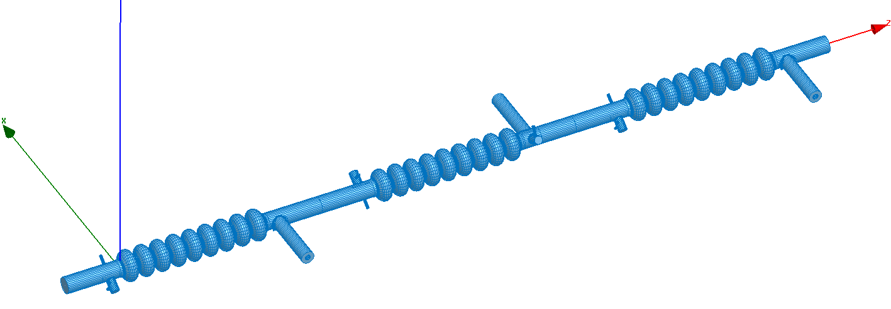
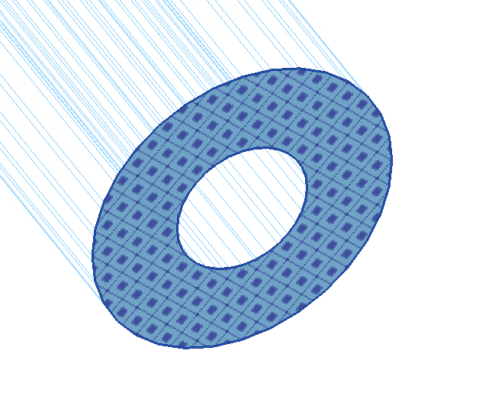
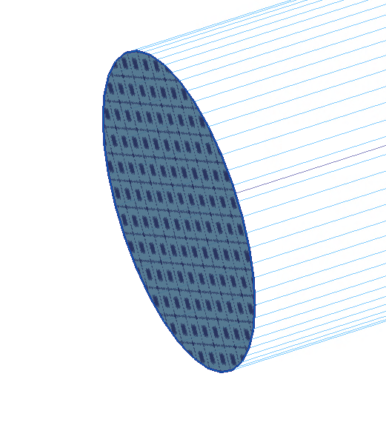
Analysis of HOM Spectrum in the 3.9GHz LCLS-II cavity
Recent HOM modeling in modified cavity
Modified cavities with random mechanical errors (± 0.1mm). Compare with INFN.
All cavities tuned to frequency and flatness (>90%)
Copper plated bellows in between cavities
Statistics: 10…20 cavities
> 1000 modes in 4- 10 GHz frequency band
Matched TEM Impedance Boundary
Matched Dipole HOMs
Impedance Boundary
A.Lunin / T.Khabiboulline

Slide 24
HOMs Resonant Losses in the 3.9 GHz LCLS-II cavity (run #1)

Slide 25
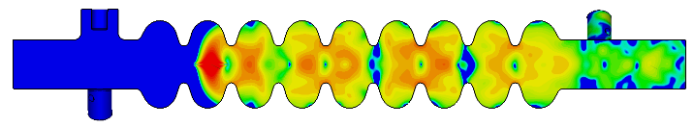
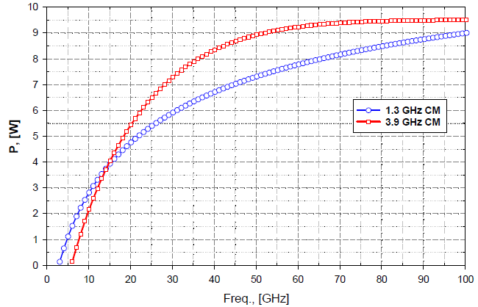
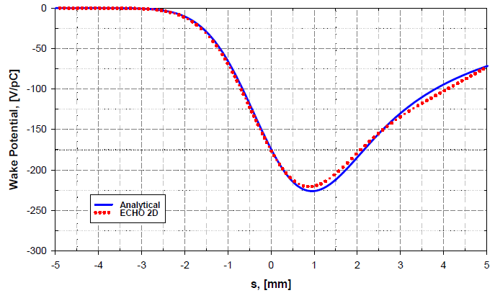
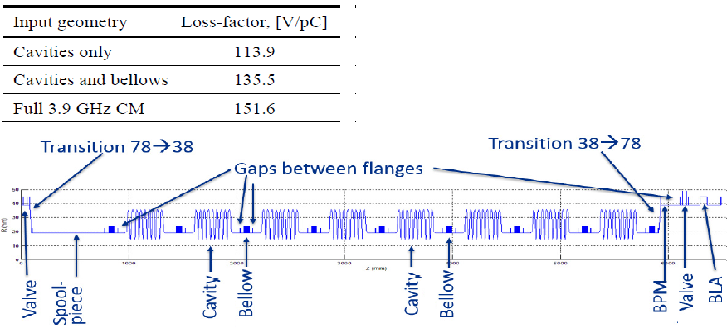
Wakefields in 3.9 GHz CM for 1mm beam
Integrated steady state wakefield power generated by 25 μm bunch (blue) and 1 mm bunch (red) of 300 pC and 1 MHz, in the 1.3 GHz and 3.9 GHz LCLS-II cryomodules respectively.
The overall powers of wakefields
above the TM01 mode cut off are estimated to be 12.8 W and 9.4 W respectively
Beam line layout of the 3.9 GHz cryomodule for the LCLS-II linac

Slide 26
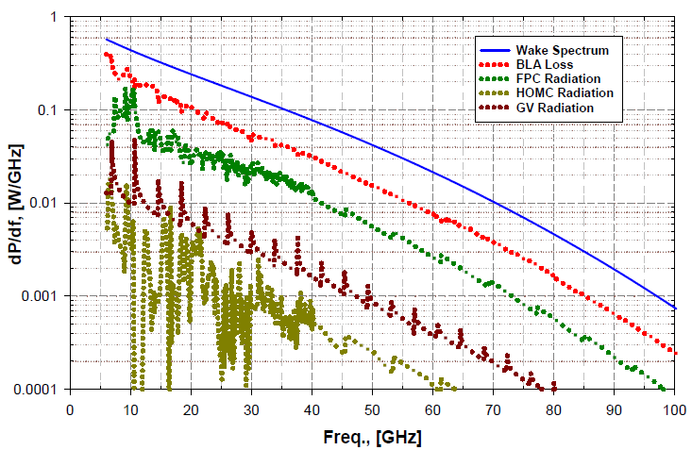




Wakefield loss distribution in CM
E-distribution for BLA and FPC components of 3.9GHz CM with TM01 mode excited at 20GHz
Spectrum of WF loss in beamline components
WF loss distribution in 2 CMs

Slide 27


3.9 GHz: Power removed by HOM coupler
For Q_{hom} = 10⁶: Median(50%) P<2W; Prob. <1%(1/100 cav) to have P > 8W
A. Sukhanov
R/Q of monopole modes in cavity chain
Simulation model includes copper plated bellows between cavities
HOM frequencies have random distribution ~ 1MHz rms
Max values of R/Q for each mode is used (vs. cavity to cavity distance)
Q_{HOM} < 10⁶ for most dangerous modes

Slide 28


Thermal simulation for HOM feedthrough and cable (TFlex401)
Expected power to HOM coupler < 5 W (incl. <1W max from fund, mode)
dissipated in cable (0.6dB/m) → may heat HOM antenna
Thermal intercept (2K) FF and cable intercepts (5K and 50K)
Power Flow[W] | 2K [mW] | 5K [mW] | 50K [mW] | 300K [mw]
0 | 9.27 | 164.76 | 242.83 | -416.87
1 | 21.91 | 193.01 | 313.60 | -326.02
2 | 34.61 | 221.87 | 393.03 | -226.41
3 | 47.43 | 251.44 | 483.14 | -116.22
4 | 60.39 | 281.94 | 586.51 | 6.86
5 | 73.47 | 313.74 | 706.51 | 145.86
6 | 86.67 | 347.22 | 847.86 | 304.90
7 | 100.05 | 383.02 | 1017.10 | 489.75
8 | 113.67 | 422.00 | 1223.63 | 708.57
9 | 127.78 | 465.89 | 1481.52 | 973.22
10 | 142.70 | 517.64 | 1812.94 | 1301.92
Wide cooling leads
(45mm x 2.5x10 mm²)
Cable is OK up to 9 W input power flow (80°C cable limit).
M.Hasan/T.Khabiboulline

Slide 29


BPM and HOM absorber
Concept: Use 1.3GHz beam line components (ID=78mm) in transition between cavity string:
BPM,
Spool piece,
Gate-valve,
Beamline HOM absorber
Optimize length and shape of transition from ø38mm to ø78mm for minimum wakefield.
Short ~25mm in flange (XFEL)
Long >300mm in spool-piece (upstream)

Slide 30
Conclusion
General Design and Technology exist (based on XFEL/INFN)
To meet LCLS-II requirements design of cavity, coupler, HV, tuner was modified to reduce risks and improve performance at cw operation.
Simulations of critical RF components complete, Design Verification program is focuses on prove proposed modifications and predict performance in LCLS-II cryostat.
Prototypes of auxiliary components (Tuner, main coupler, magnetic shielding, feedthroughs,…) are built and under studies.

Slide 31
Thanks:
R.Stanek, C.Ginzburg, E.Harms, G.Wu, T.Khabiboulline, I.Gonin, A.Lunin, Y.Orlov, S. Chandrasekaran, A.Saini, S.Kazakov,, C.Grimm, M.Foley, Y.Pischalnikov, T.Arkan, A.Rowe, A.Grassellino, J.Kaluzny, O.Prokofiev, J.Ozelis, A.Saini, J.Kaluzny, S.Yakovlev, M.Hasan, T.Peterson,, Y.He, E. Borissov, …

Slide 32
Back-up slides

Slide 33



Transverse deformations, for original (upper) and modified (lower) couplers
Longitudinal deformations, for original (upper) and modified (lower) couplers
Stresses, MPa/mm | 20 conv. | 10 conv.
Inner conductor, transverse | 26 | 45
Outer conductor, transverse | 44 | 44
Inner conductor, longitudinal | 150 | 290
Outer conductor, longitudinal | 96 | 96

Slide 34



LCLS-II 3.9GHz Cryomodule, (F10014857 in Team Center)
8 - 3.9GHz cavities
Power couplers from both sides
2-coldmass supports
Interconnection sliding bellow
38” OD vacuum vessel pipe
One thermo shields:50K
5K intercept
XFEL cavity orientation (z-rotation:180 deg)

Slide 35



LCLS-II. 3.9GHz Cavity String (F10014812)
Blade tuner
Spool piece
Spool piece
and BPM
3.9 cavity Style-B
3.9 cavity Style-A
Gate Valve

Slide 36





3.9 GHz Cryomodule Options
Δε_{x} (%) ~ 6.0 %
ε_{y}
Δε_{y} (%) ~ 24.0 %
ε_{x}
1.3GHz like Cryomodule Layout:
FLASH-like Cryomodule Layout:
XFEL/LCLS2 Cryomodule Layout:
 | 1.3GHz-like | XFEL
Δε_{x} (%) | 6 .0 | 0.09
Δε_{y} (%) | 24.4 | 0.15

