Slide 1
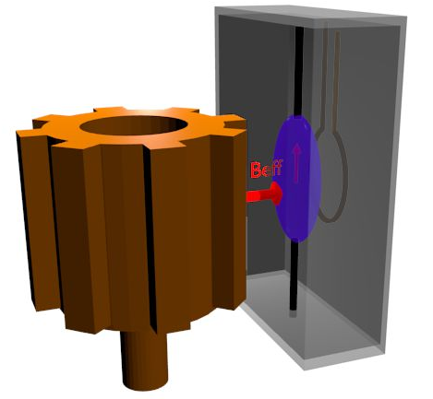


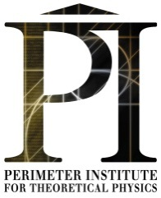



The Axion Resonant InterAction Detection Experiment (ARIADNE)
Mark Cunningham (UNR)
Mindy Harkness (UNR)
Jordan Dargert (UNR)
Chloe Lohmeyer (UNR)
Asimina Arvanitaki (Perimeter)
Aharon Kapitulnik (Stanford)
Eli Levenson-Falk (Stanford)
Sam Mumford (Stanford)
Josh Long (IU)
Chen-Yu Liu (IU)
Mike Snow (IU)
Erick Smith (IU)
Justin Shortino (IU)
Mofan Zhang (IU)
Andrew Rusch (IU)
Yannis Semertzidis (CAPP)
Yun Shin (CAPP)
Yong-Ho Lee (KRISS)
A. Arvanitaki and AG., Phys. Rev. Lett. 113,161801 (2014).
DOE Cosmic Visions Workshop, Mar. 22, 2017
A. Geraci, University of Nevada Reno

Slide 2
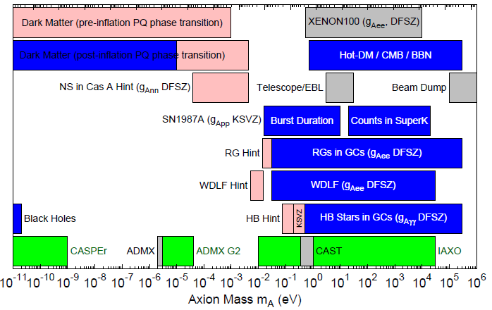
QCD Axion parameter space
DM Radio
LC Circuit
ABRACADABRA
ARIADNE
Adapted from http://pdg.lbl.gov/2015/reviews/rpp2015-rev-axions.pdf

Slide 3
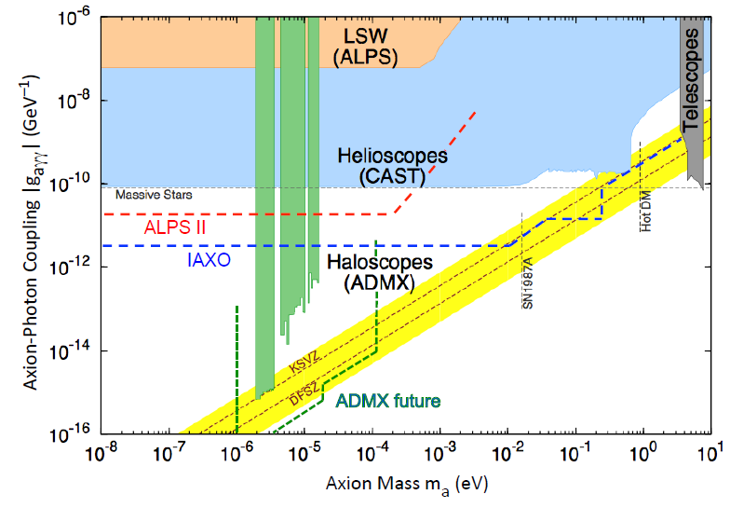
Axion Parameter space
CASPEr
DM Radio
LC Circuit
ABRA-CADABRA
ARIADNE
Orpheus
Adapted from Graham, arxiv: 1602.00039

Slide 4
Axion and ALP searches
Source
Coupling
Photons
Nucleons
Dark Matter (Cosmic) axions | ADMX, ADMX-HF DM Radio, ABRA- CADABRA,LC Circuit Orpheus, CULTASK | CASPEr-Electric CASPEr-Wind
Solar axions | CAST IAXO
Lab-produced axions | Light-shining-thru-walls (ALPS, ALPS-II) | ARIADNE

Slide 5

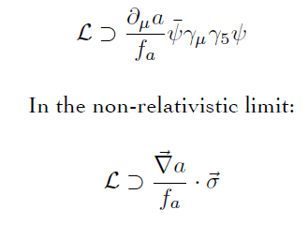
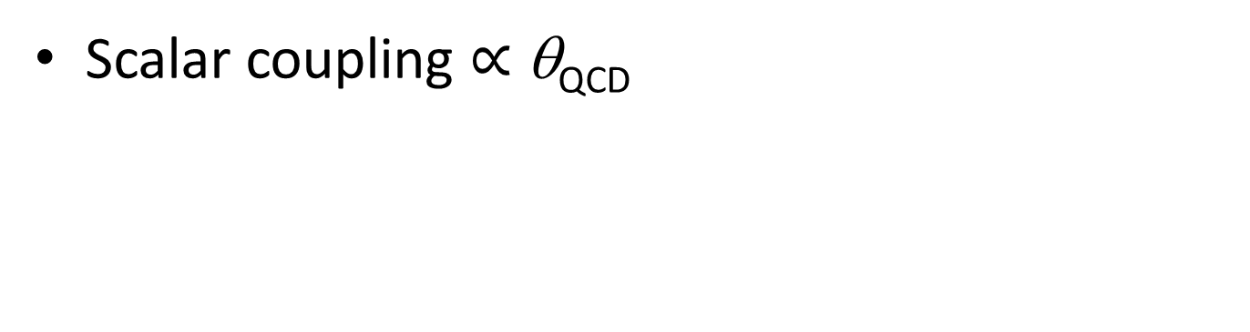
Axion-exchange between nucleons
Scalar coupling $∝$ θ_{QCD}
Pseudoscalar coupling
Axion acts a force mediator between nucleons
N
N
Monopole-monopole
Monopole-dipole
dipole-dipole

Slide 6
Spin-dependent forces
r
m_{f}
σ
Monopole-Dipole axion exchange
Different than ordinary B field
Does not couple to angular momentum
Unaffected by magnetic shielding
Fictitious magnetic field

Slide 7
Using NMR for detection
r
m_{f}
σ
Spin ½ ³He Nucleus
Bloch Equations
Spin precesses at nuclear spin Larmor frequency
Axion B_{eff} modifies measured Larmor frequency

Slide 8
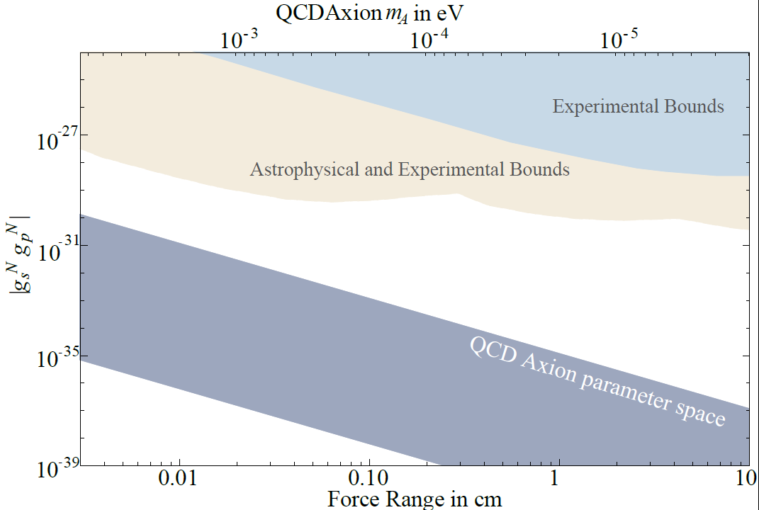
Constraints on spin dependent forces
G. Raffelt, Phys. Rev. D
86, 015001 (2012).
Magnetometry experiments
G. Vasilakis, et. al, Phys. Rev. Lett. 103, 261801 (2009).
K. Tullney,et. al. Phys. Rev. Lett. 111, 100801 (2013)
P.-H. Chu,et. al., Phys. Rev. D 87, 011105(R) (2013).
M. Bulatowicz,et. al., Phys. Rev. Lett. 111, 102001 (2013).
nEDM bound
Standard Model lower bound

Slide 9
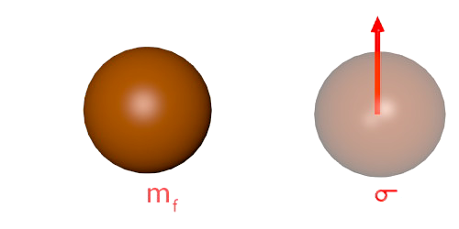
ARIADNE: uses resonant enhancement
Spin ½ ³He Nucleus
Oscillate the mass at
Larmor frequency
B_{eff}
Bloch Equations
Time varying Axion B_{eff} drives spin precession
→ produces transverse magnetization
Amplitude is resonantly enhanced
by Q factor ~ ωT₂.
Can be detected with a SQUID

Slide 10
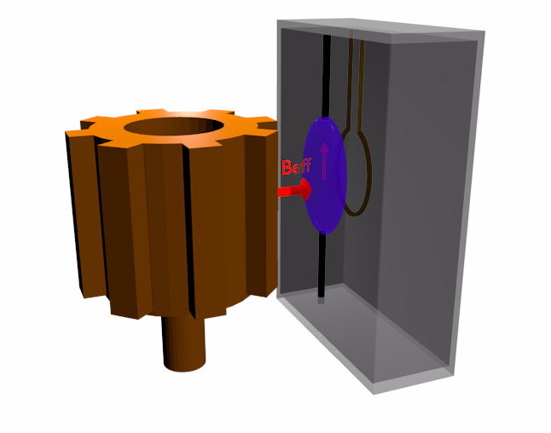
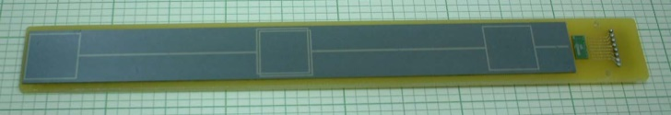
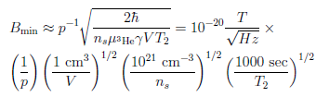
Concept for ARIADNE
Unpolarized (tungsten) segmented cylinder sources B_{eff}
Applied Bias field B_{ext}
Laser Polarized ³He gas senses B_{eff} (Indiana U)
Y.-H. Lee (KRISS)
squid pickup
loop
Limit: Transverse spin projection noise
Superconducting shielding (Stanford)
A. Arvanitaki and A. Geraci, Phys. Rev. Lett. 113,
161801 (2014).
Notes:
Similar techniques used in short-range gravity experiments

Slide 11
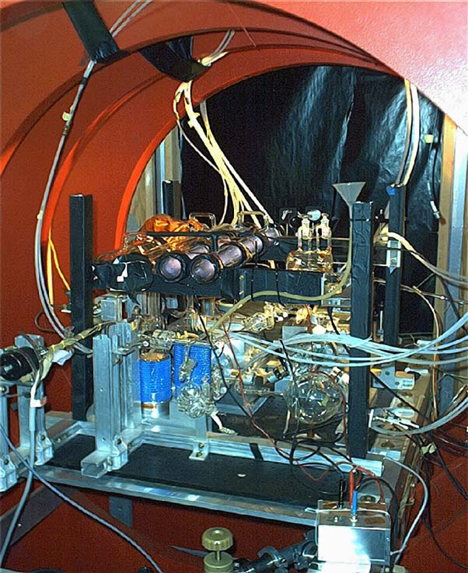
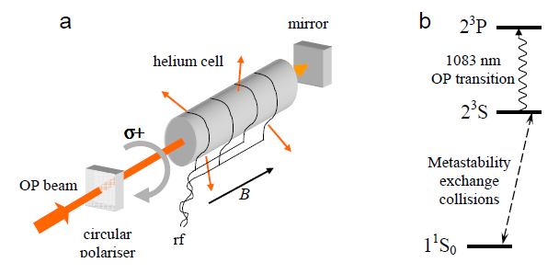
Hyperpolarized ³He
Ordinary magnetic fields cannot be used to reach near unity polarization
Indiana U. MEOP apparatus
Optical pumping techniques
Metastability exchange optical pumping
Rev. Sci. Instrum. 76, 053503 (2005)
M Batz, P-J Nacher and G Tastevin, Journal of Physics: Conference Series 294 (2011) 012002

Slide 12
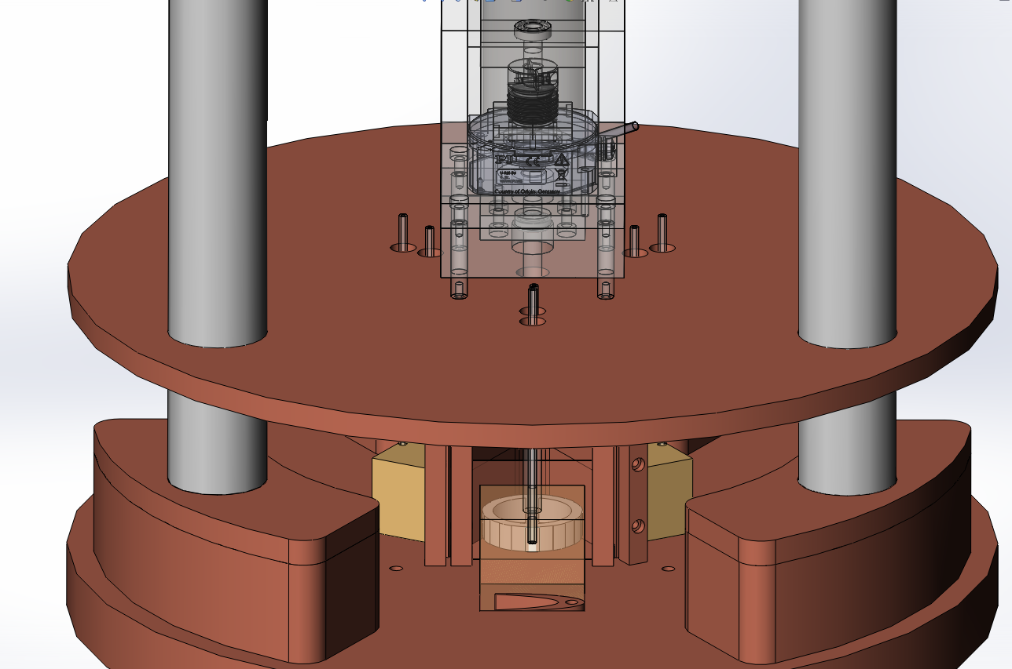
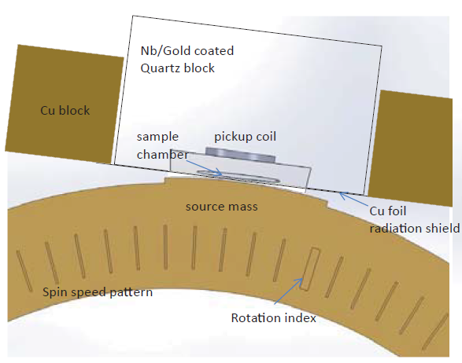
Experimental parameters
Rotational stage
3 sample chambers
source mass
4 mm
11 segments
100 Hz nuclear spin precession frequency
2 x 10²¹ / cc ³He density
10 mm x 3 mm x 150 µm volume
Separation 200 µm
Tungsten source mass (high nucleon density)

Slide 13
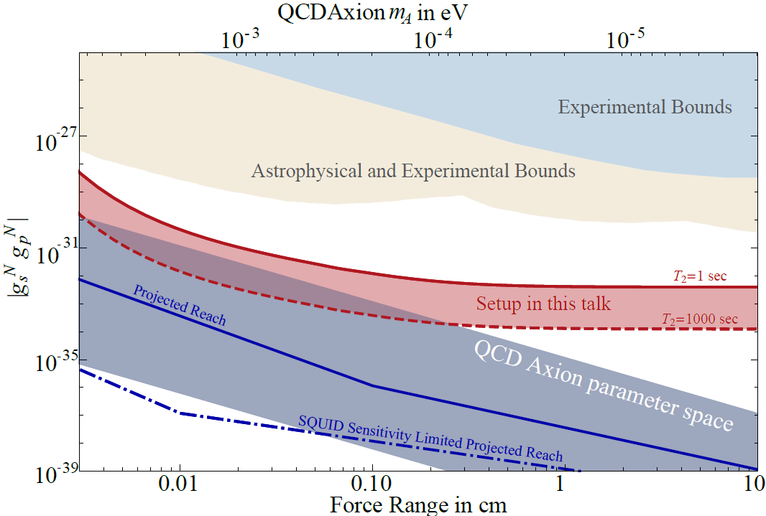
Sensitivity
A. Arvanitaki and AG., Phys. Rev. Lett. 113,161801 (2014).

Slide 14
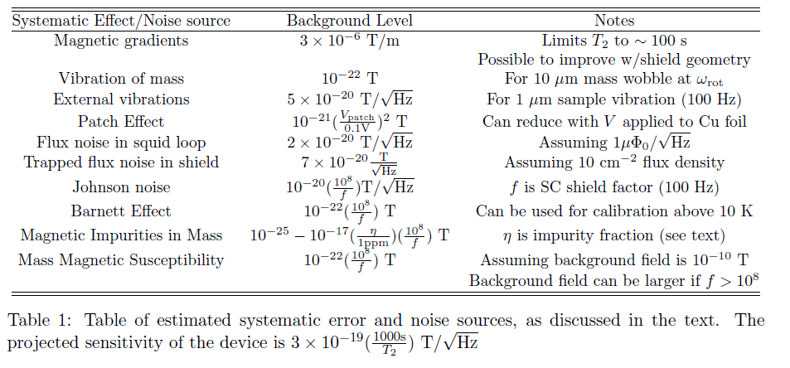
Experimental challenges
Magnetic gradients
Nonlinearities
Barnett Effect
Trapped magnetic flux
Vibration isolation
Magnetic noise from thermal currents
Design/Simulation Work: Magnetic gradient reduction strategy
Experimental testing in progress: Vibration tests, Shielding factor f test thin-film SC

Slide 15
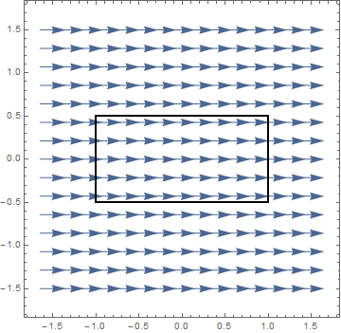
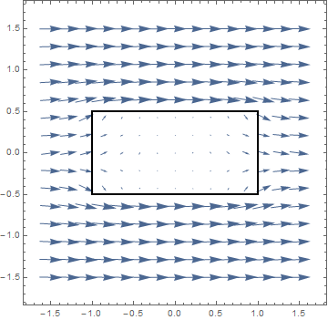
Superconducting Magnetic Shielding
→ Essential to avoid Johnson noise
Meissner Effect
No magnetic flux across superconducting boundary
Method of Images
Make “image currents” mirrored across the superconducting boundary
T > T_{c}
T < T_{c}
Dipole with image
Notes:
Magnetic shielding operates on the Meissner effect
No flux across superconducting boundary
Think of it like a perfect conductor is a perfect diamagnet, so Faraday’s Law means no flux
Superconducting boundaries have surface currents that are hard to analyze
We use the method of images instead
Treat the boundary like a “mirror” that reflects magnetic sources
The reflections are called “images”

Slide 16
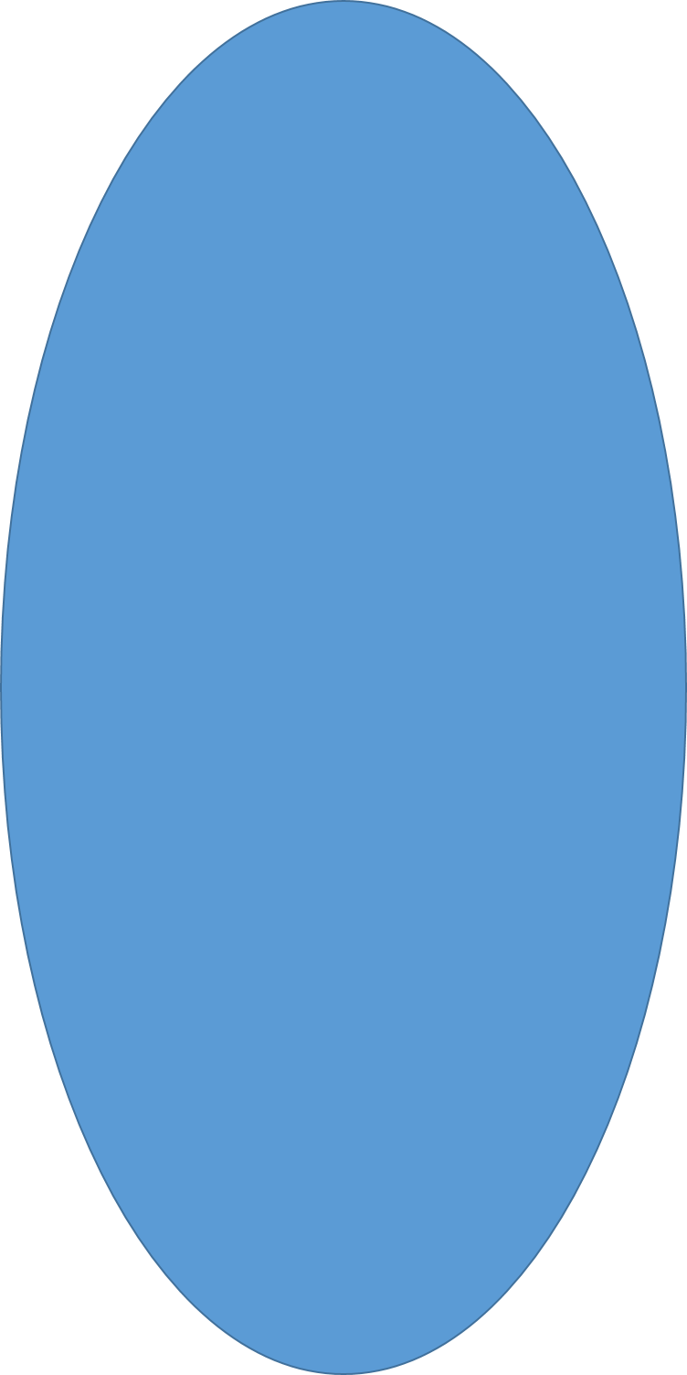


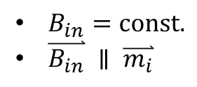
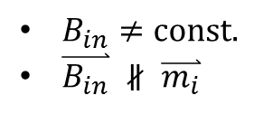



The Problem of Unwanted Images
$$\overset{⃑}{m}$$
ARIADNE uses magnetized spheroid
  Constant interior field
Magnetic shielding introduces “image spheroid”
  Interior field varies
→ variations in nuclear Larmor frequency!
3He
$B_{in}=const.$
$\overset{⃑}{B_{in}} ∥ \overset{⃑}{m_{i}}$
3He
3He
$$\overset{⃑}{B}$$
$$\overset{⃑}{m}$$
$$\overset{⃑}{m}$$
3He
$B_{in}≠const.$
$\overset{⃑}{B_{in}} ∦ \overset{⃑}{m_{i}}$
3He
3He
$$\overset{⃑}{B}$$
But want to drive entire sample on resonance
Notes:
ARIADNE detects + “transduces” axion forces w/ He-3 spheroid
Spheroids are nice b/c of constant field parallel to individual moments
When superconducting shielding is introduced, “image” spheroid appears
Field neither constant nor parallel to moments
We care about this b/c of…

Slide 17
Flattening Solution
1 coil – simple configuration
Expected field from spheroid ~1 μT
  I on the 0.1 – 1 A range
Spheroid
1 coil
(circular)
Symmetry
Notes:
Firstly, to flatten the field
Take advantage of the symmetry of the spheroid + block – any coil configuration must be symmetric
1 coil is easy to manufacture and means only 1 hole in the shield
Current constraints from expected field

Slide 18
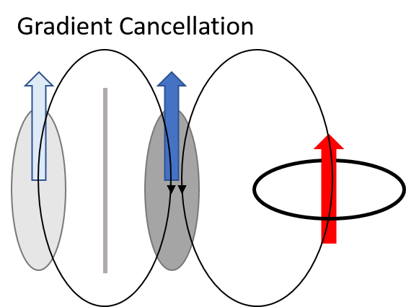
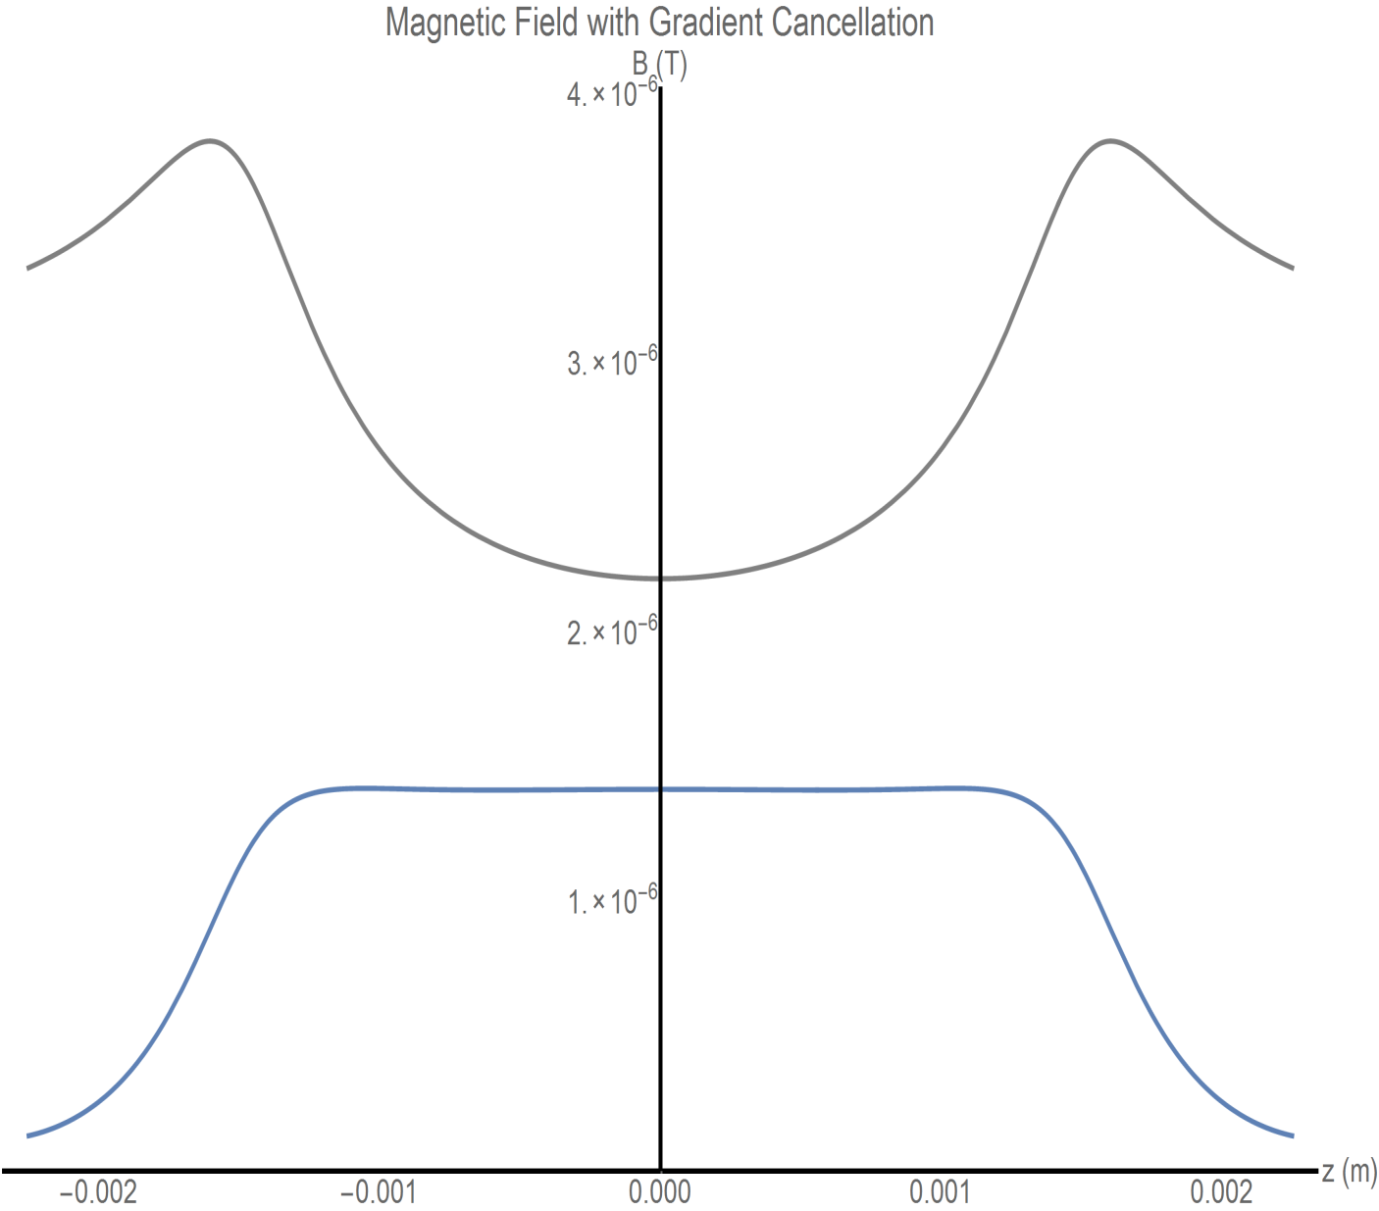
Gradient Cancellation
No cancellation
Gradient cancellation
98 times flatter
I = 1.6 A
s_{Frac} = 0.17%
enabling T₂ of ~100 s
Sample
area
Notes:
Gradient cancellation 98x flatter!
Maybe recover T₂ O(100 s)
Compare to T₂ O(1 s) w/o cancellation

Slide 19

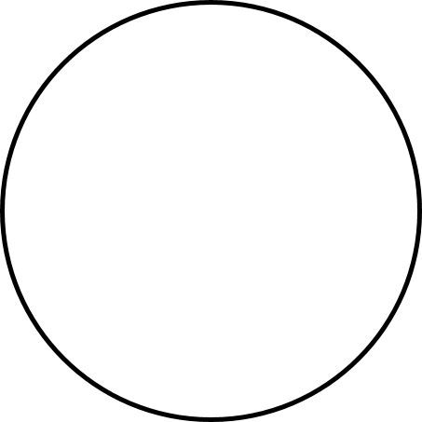
Tuning Solution – “D” Coils
Tune field with Helmholtz coils
  Helmholtz field only flat near the center
  Geometry restrictions prevent the spheroid from being centered in traditional Helmholtz coils
“D” coils
Spheroid
    “D” coils look like Helmholtz coils when their images are included
I
Inner straight-line currents cancel
Outer currents do not
One “D” coil and image (bird’s eye view)
Notes:
Standard tuning solution is Helmholtz coils
Helmholtz field only flat near center
Geometry (spheroid near wall) disallows “regular” Helmholtz field w/ spheroid @ center
Images would cause problems anyway
“D” coils actually make use of images
With the image included the coil looks like a Helmholtz coil
Inner straight-line currents cancel, leaving a circle

Slide 20
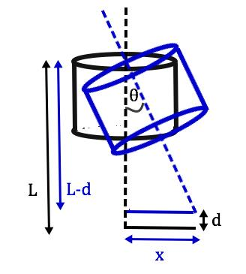
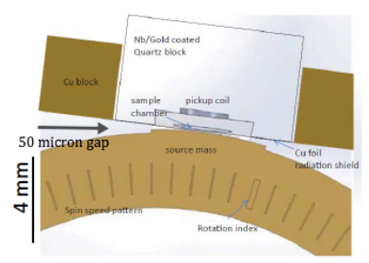
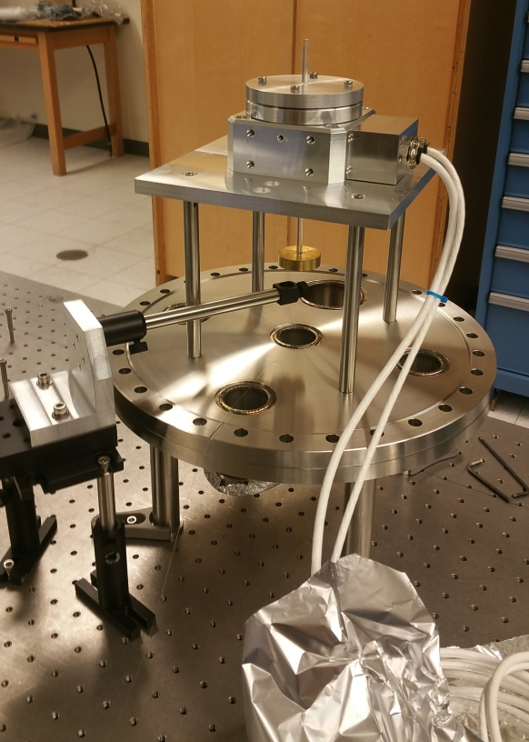
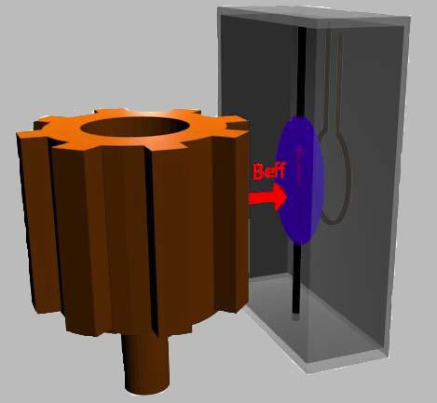
Rotary stage vibration and tilt
Rotary test chamber
Build an interferometer to measure the change in distance (d).
We can find theta (Ө) from:
Ө= cos⁻¹((L-d)/L)
We can solve for the wobble distance (X) by:
X= Lsin(Ө)
Interferometers

Slide 21
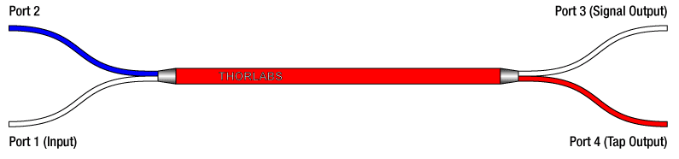
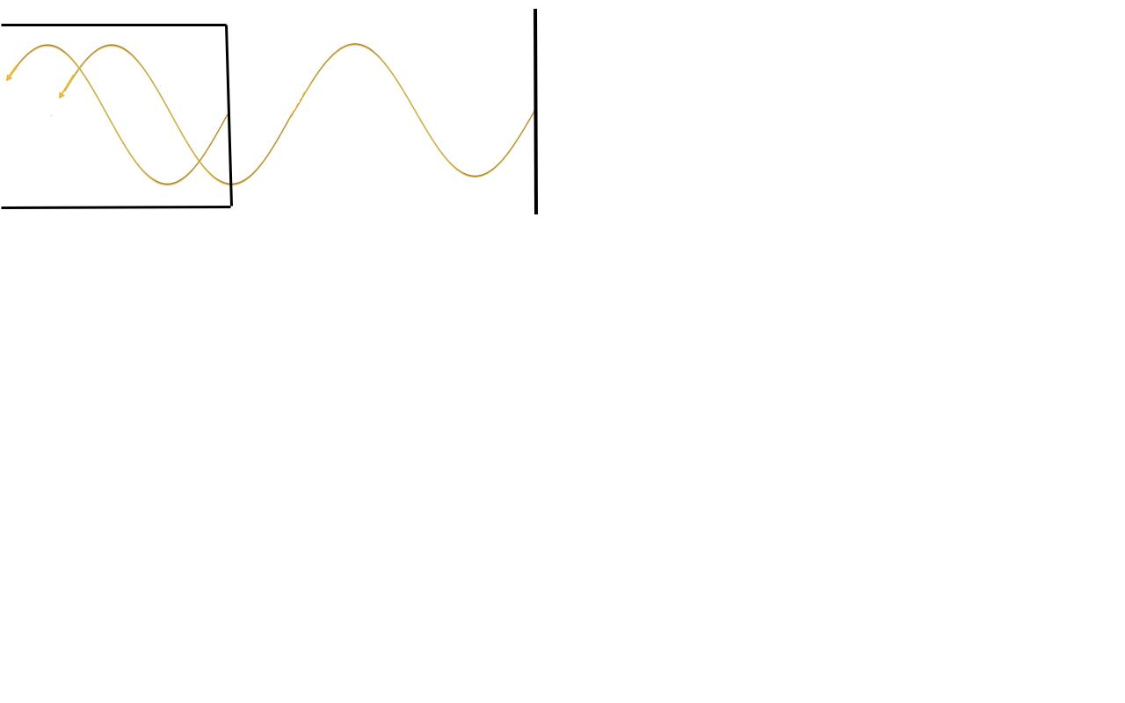
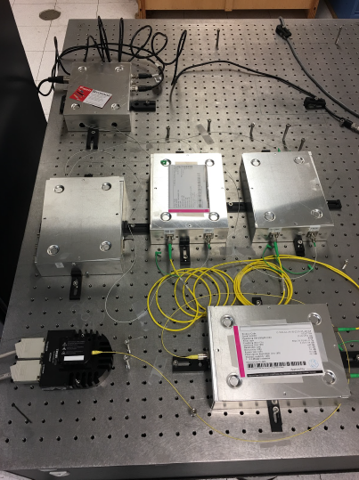
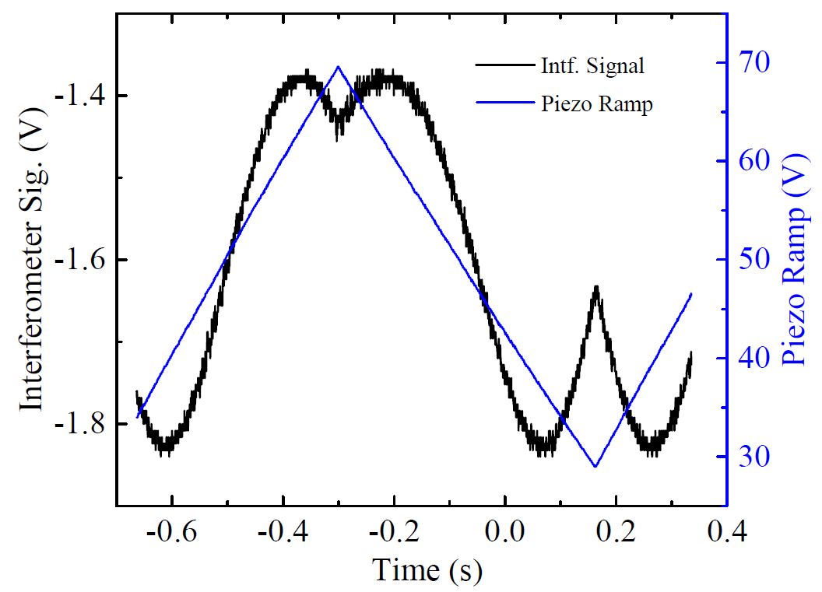
Fiber-coupled laser interferometers
Laser Source
Reference Photodiode
90:10 fiber coupler
Signal Photodiode
Fiber Tip
Reflector
PZT
Fringe visibility
~0.13
Sensitivity
~160 nm/V
Shot noise limit
~20 pm/Hz^{1/2}

Slide 22
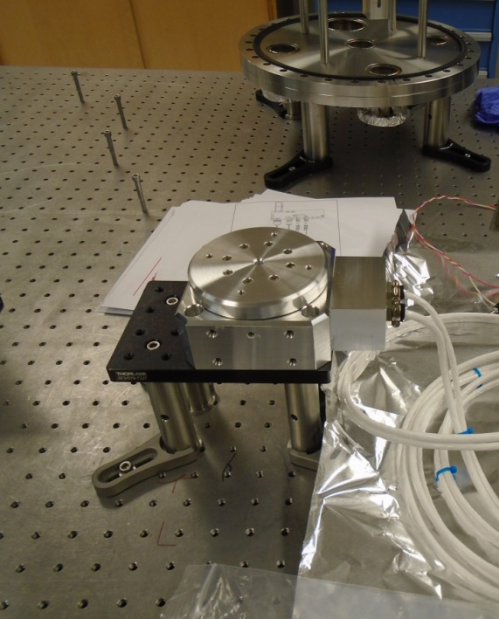
Speed stability test - direct drive stage
Stage speed stability error – unloaded, in air
Optical encoder
Current feedback control
Rotation speed control
8.3 Hz ~ 1 part in 10000
RMS ~ 1 part in 3000
Allows utilization of T2 > 100s

Slide 23
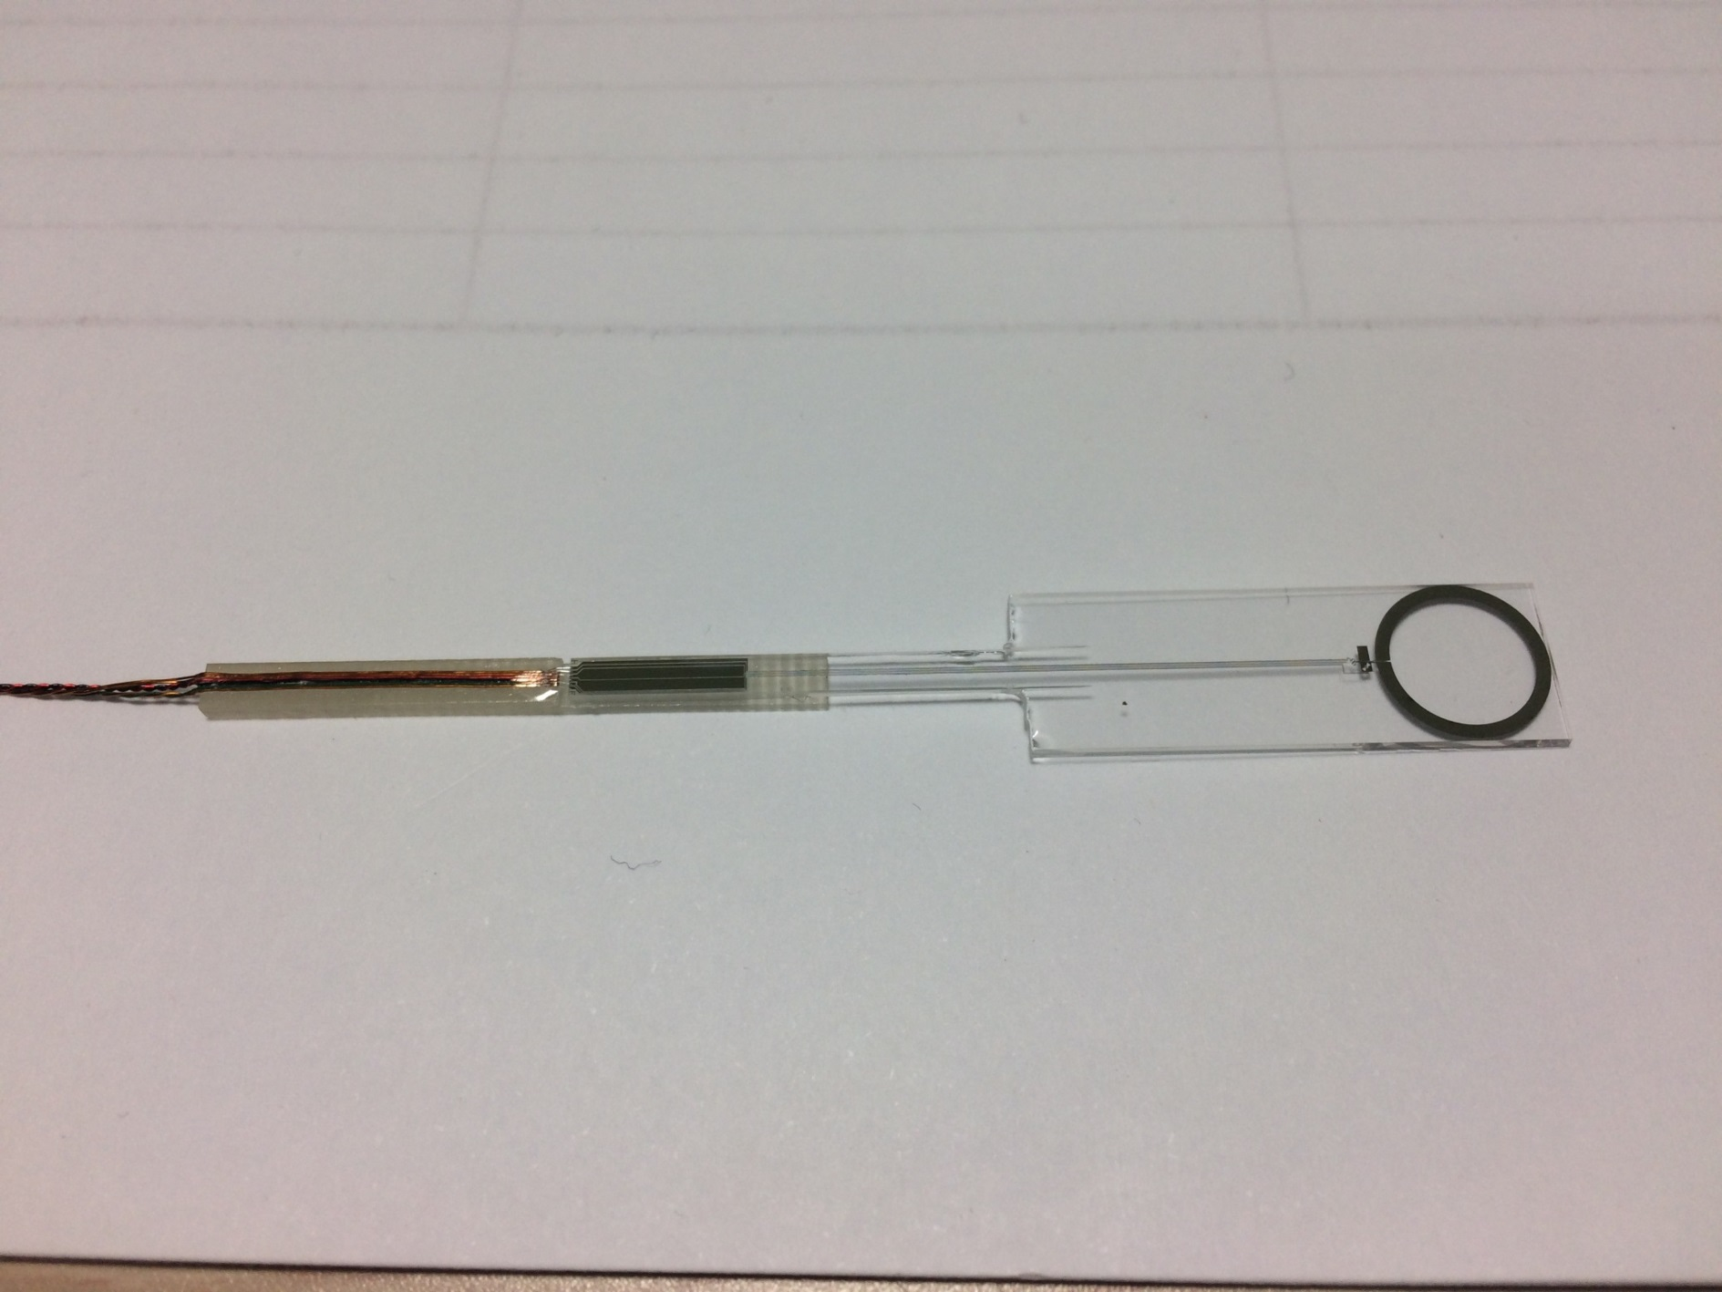
SQUID Magnetometers
Y.H. Lee, KRISS
1 cm
Field noise (fT_{rms}/√Hz)
4.5 fT_{rms}/√Hz
Frequency (Hz)
Measured inside a magnetically shielded room (without Nb tube)

Slide 24
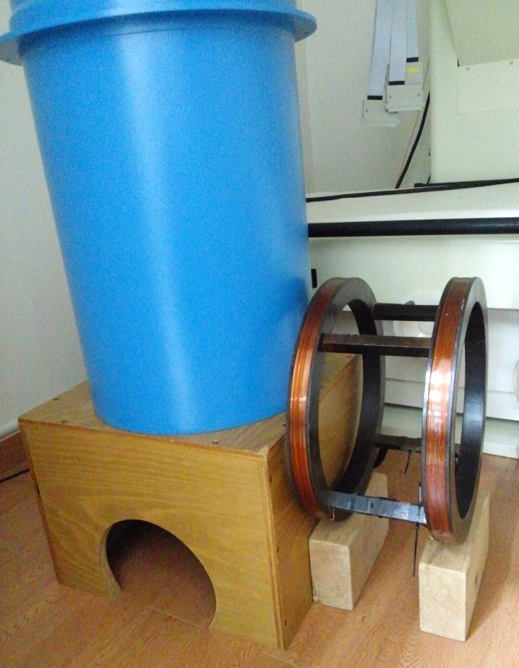
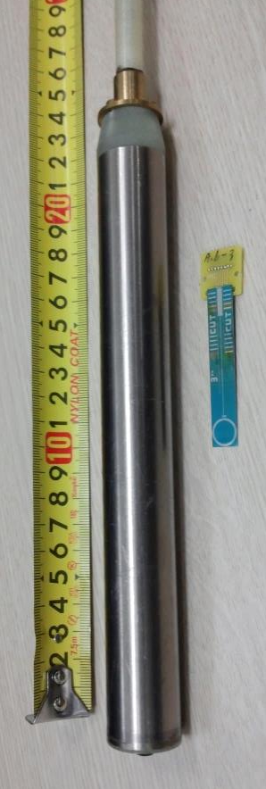
Preliminary test of superconductive shielding
Y.H. Lee, KRISS,
Yun Shin (CAPP)
Eli Levenson-Falk (Stanford)
L-He dewar
Nb tube:
23 mm ID
1 mm thick
Length 200 mm
Field coil
Applied field: 10-100 μT_{pp} range (at 8 Hz)
SQUID magnetometer: Near the center of Nb tube
Shielding factor: ≒(0.5-3) x10⁹ for transverse field
Goal: 10⁸ with thin film Nb SC shield – tests planned Apr 2017

Slide 25

R&D and Operating Costs/Timeline
Current funding for 1yr ($270k) for R&D, initial testing -- thank you!
Approx. 2-3 years to finish design/construction and bring to commissioning phase ($0.6 M/yr)
3 years data taking phase to reach QCD axion / R&D for upgrades ($0.6 M/yr)

Slide 26
Summary
ARIADNE → New resonant NMR method
Gap in experimental QCD axion searches
0.1 meV < m_{a} < 10 meV
Complementary to cavity-type (e.g. ADMX) experiments
No need to scan mass, indep. of local DM density
Next tests – shielding (Stanford/Korea), vibration (UNR), ³He system (Indiana)

Slide 27

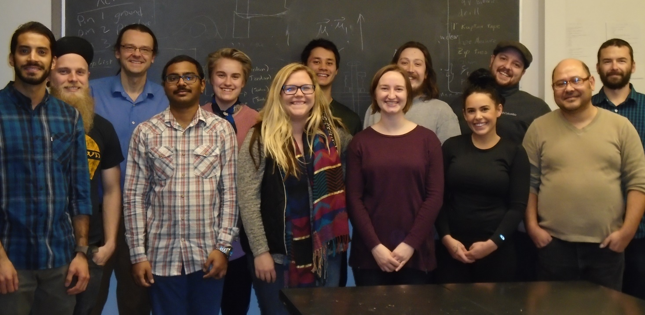
Acknowledgements
Thank you
PHY-1205994
PHY-1506431
PHY-1509176
1510484, 1509176
Mindy Harkness (UG)
Ryan Danenberg (UG)
Mark Cunningham(G)
Jordan Dargert (G)
Andrew Geraci (PI)
Jason Lim (UG)
Jacob Fausett (UG)
Cris Montoya (G)
Chethn Galla (G)
Chloe Lohmeyer(UG)
Kirsten Casey (UG)
Bella Rodriguez(UG)
Gambhir Ranjit (PD)
Not pictured: Apryl Witherspoon (UG),
Ohidul Mojumder (UG), Hannah Mason (UG)

