Slide 1
A DECam and LSST microlensing survey of intermediate mass black hole dark matter
U.S. Cosmic Visions: New Ideas in Dark Matter
2017 March 24
Will Dawson¹, Mark Ammons¹, Tim Axelrod²,
George Chapline¹, Alex Drlica-Wagner³,
Nathan Golovich⁴, and Michael Schneider¹
1 Lawrence Livermore National Laboratory, 2 University of Arizona,
3 Fermi National Accelerator Laboratory, 4 University of California: Davis

Slide 2
What you might not know about MACHOs
could SHOCK YOU!

Slide 3
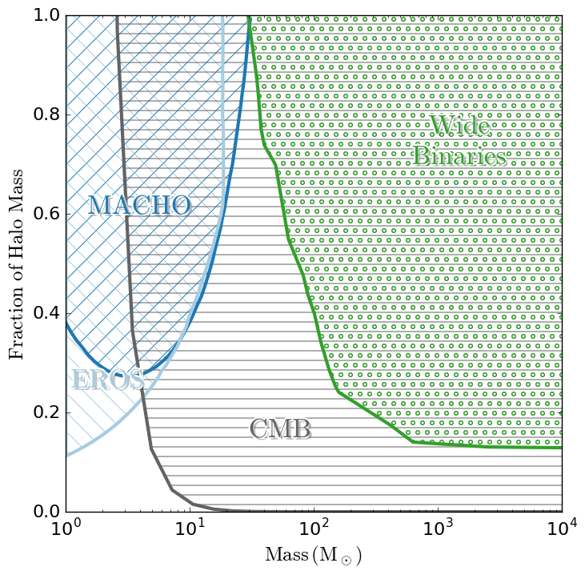
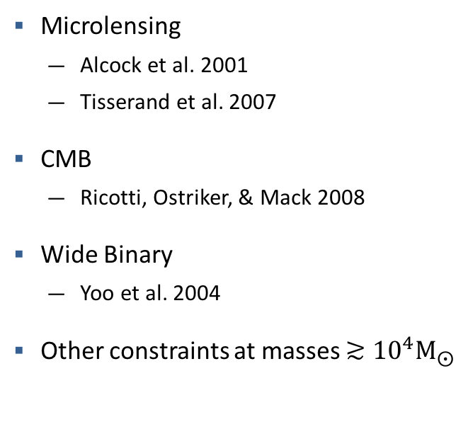
Massive MACHO Constraints circ. 2008
Completely ruled out massive MACHOs as Dark Matter
Microlensing
  Alcock et al. 2001
  Tisserand et al. 2007
CMB
  Ricotti, Ostriker, & Mack 2008
Wide Binary
  Yoo et al. 2004
Other constraints at masses $≳{10}^{4}{\text{M}}_{⨀}$

Slide 4
Massive MACHO Constraints circ. 2008
Completely ruled out massive MACHOs as Dark Matter
Microlensing
  Alcock et al. 2001
  Tisserand et al. 2007
CMB
  Ricotti, Ostriker, & Mack 2008
Wide Binary
  Yoo et al. 2004
Other constraints at masses $≳{10}^{4}{\text{M}}_{⨀}$
Complex assumptions and astrophysics involved

Slide 5
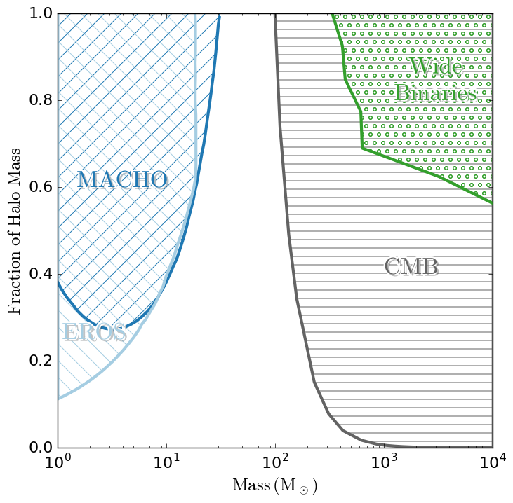
Massive MACHO Constraints circ. 2016
As assumptions and systematics explored constraints loosened
Microlensing
  Alcock et al. 2001
  Tisserand et al. 2007
CMB
  Ali-Haïmoud & Kamionkowski 2016
Wide Binary
  Quinn et al. 2009
"The limits that Ricotti and I reached for BH numbers were far to severe.”
-Ostriker

Slide 6
Because of limits in understanding of astrophysics still just order of magnitude estimate
Microlensing
  Alcock et al. 2001
  Tisserand et al. 2007
CMB
  Ali-Haïmoud & Kamionkowski 2016
Wide Binary
  Quinn et al. 2009
“order-of-magnitude”
"The limits that Ricotti and I reached for BH numbers were far to severe.”
-Ostriker

Slide 7
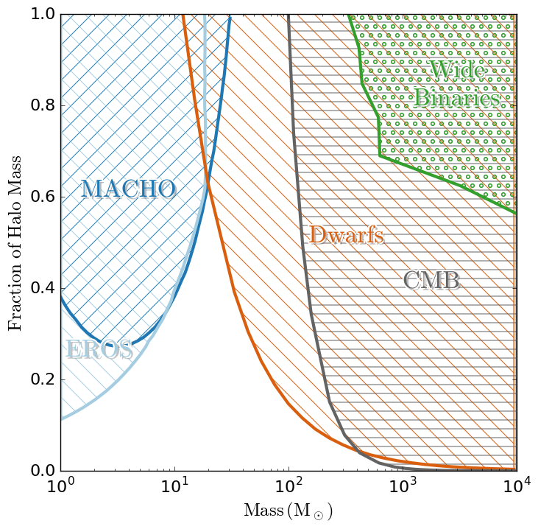
The latest astrophysical constraint from dwarf galaxies and star clusters
Microlensing
  Alcock et al. 2001
  Tisserand et al. 2007
CMB
  Ali-Haïmoud & Kamionkowski 2016
Wide Binary
  Quinn et al. 2009
Dwarf Galaxies
  Brandt 2016, & Li et al. 2017

Slide 8
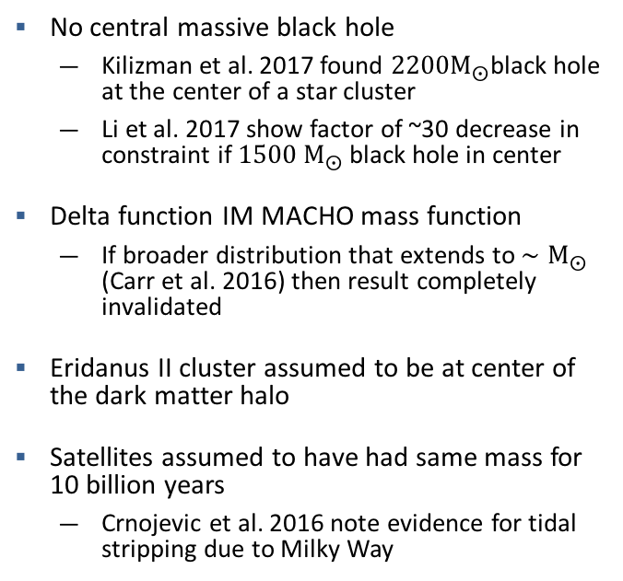
The dwarf galaxy constraint is reliant on several astrophysical assumptions, likely to be wrong
No central massive black hole
  Kilizman et al. 2017 found ${\text{2200}\text{M}}_{⨀}$black hole at the center of a star cluster
  Li et al. 2017 show factor of ~30 decrease in constraint if ${\text{1500 }\text{M}}_{⨀}$ black hole in center
Delta function IM MACHO mass function
  If broader distribution that extends to ${∼\text{M}}_{⨀}$ (Carr et al. 2016) then result completely invalidated
Eridanus II cluster assumed to be at center of the dark matter halo
Satellites assumed to have had same mass for 10 billion years
  Crnojevic et al. 2016 note evidence for tidal stripping due to Milky Way
Complex assumptions and astrophysics involved

Slide 9
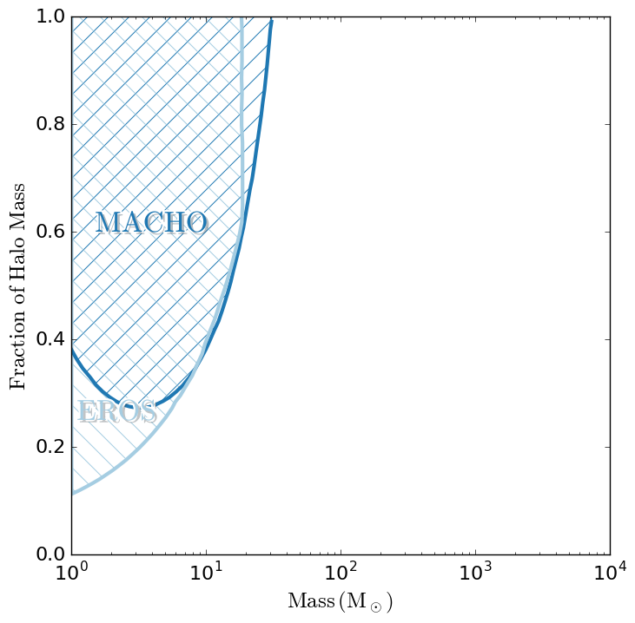
Microlensing is the closet thing we have to a direct measurement
We know there are black holes in this mass range.
  Extensive primordial black hole literature: from Chapline (1976) to Carr et al. (2016).
Rather than tackle an array of astrophysics we prefer a direct measurement.
Microlensing is the most direct way of constraining this parameter space.
OGLE III
2016
LIGO
2015
47 Tucanae
2017
Extend Existing
MACHO Constraints
Notes:
Why is it the most direct measurement
don't have to assume know the rest of astrophysics

Slide 10
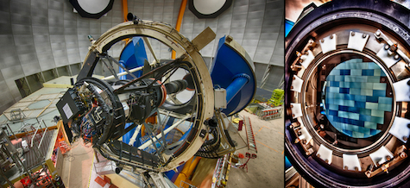
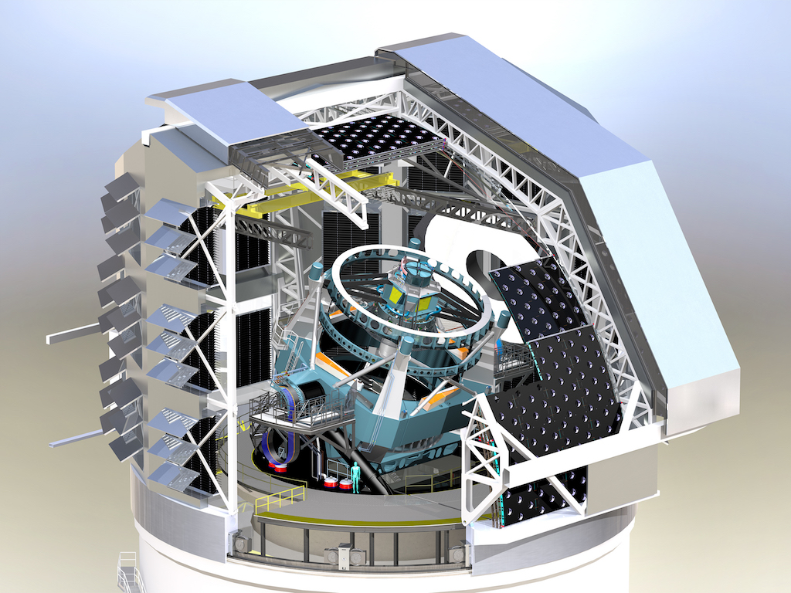
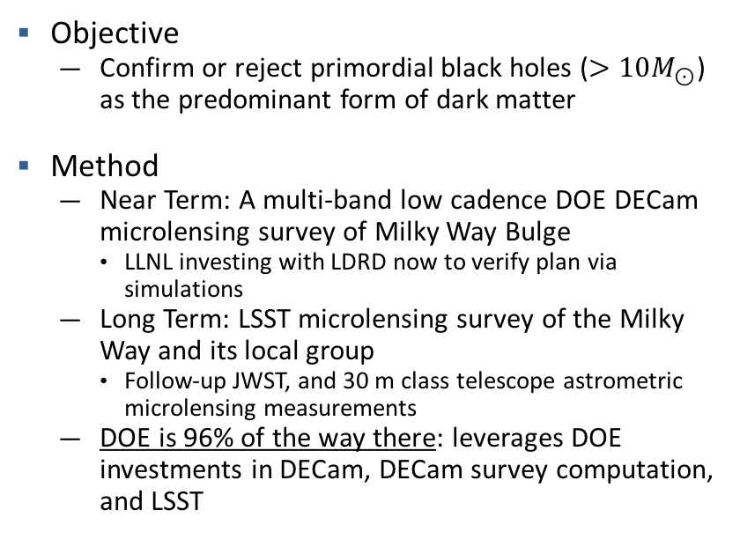
How do we discover or rule out primordial black holes as dark matter
Objective
  Confirm or reject primordial black holes ($>10M_{⊙}$) as the predominant form of dark matter
Method
  Near Term: A multi-band low cadence DOE DECam microlensing survey of Milky Way Bulge
    LLNL investing with LDRD now to verify plan via simulations
  Long Term: LSST microlensing survey of the Milky Way and its local group
    Follow-up JWST, and 30 m class telescope astrometric microlensing measurements
  DOE is 96% of the way there: leverages DOE investments in DECam, DECam survey computation, and LSST
DECam
LSST

Slide 11
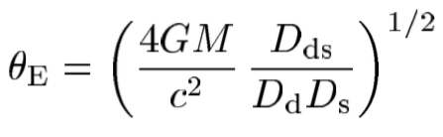








Gravitational microlensing basics
Einstein Radius
Image +
$$\text{Ima}{\text{ge}}_{\text{+}}$$
$$θ$$
Source
Observer
Lens
Source
$$θ_{E}$$
Image -
Lens
$$D_{ds}$$
$$D_{d}$$
$$D_{s}$$
$$\text{Ima}{\text{ge}}_{−}$$

Slide 12


Total magnification is what is measured
Relative Ground Based Resolution
$$\text{Ima}{\text{ge}}_{\text{+}}$$
Total magnification:
Source
$$θ_{E}$$
$$μ≡μ_{+}+\left|μ_{−}\right|$$
Lens
$$\text{Ima}{\text{ge}}_{−}$$

Slide 13
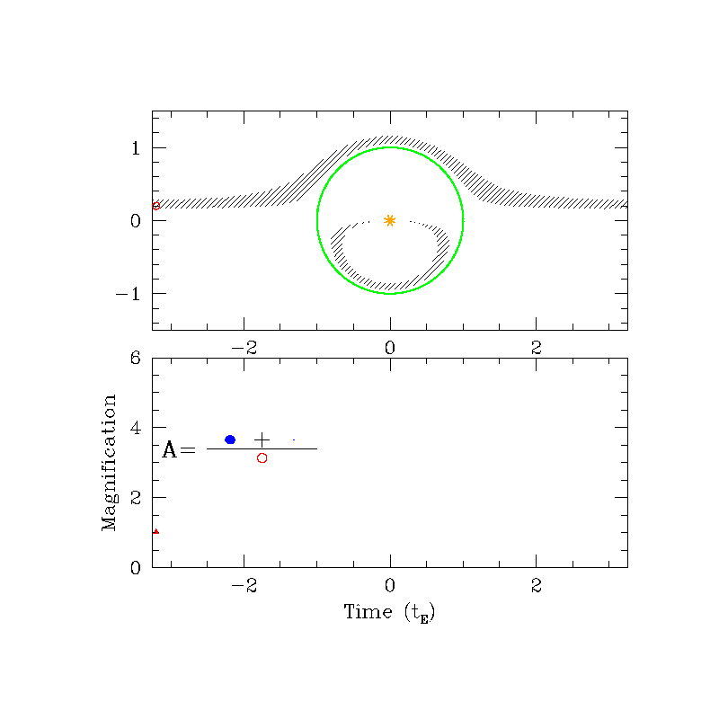
Microlensing Basics
Black Hole – Observer Frame
Gaudi

Slide 14
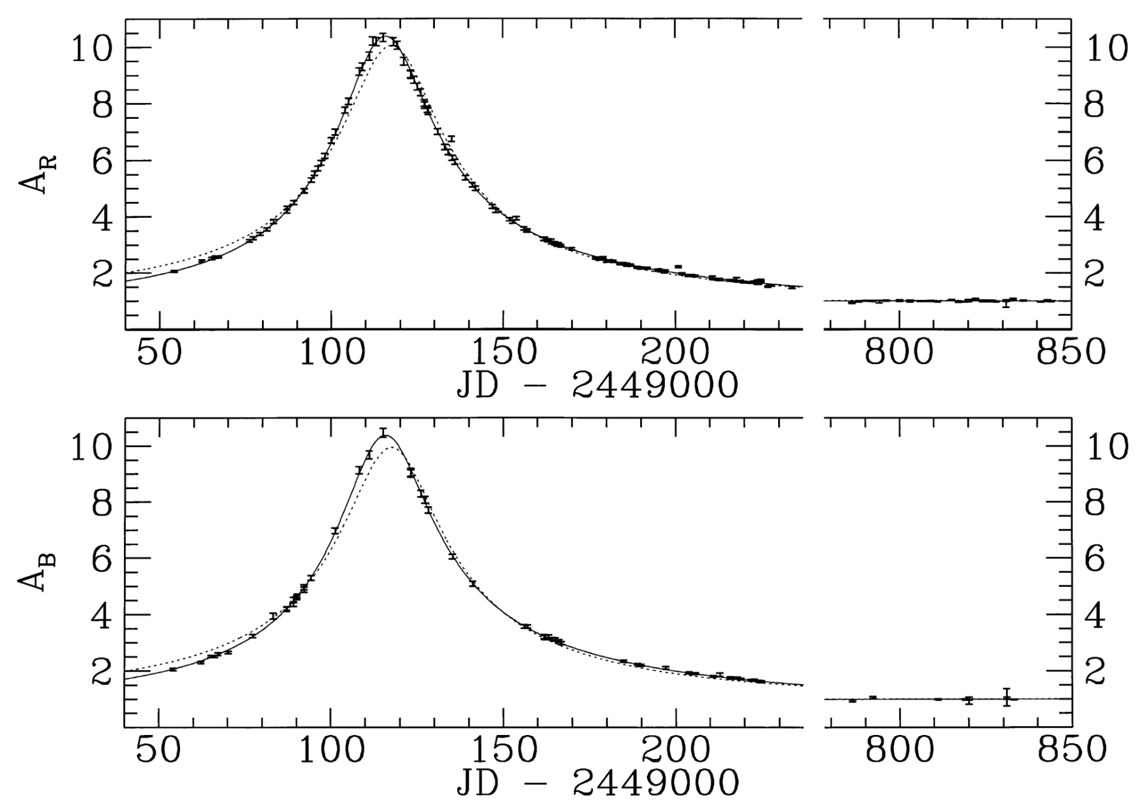
Microlensing is achromatic. Powerful discriminator.
Motivates multi-band microlensing survey.
Microlensing signal does not vary with color!
Typically astrophysical variable sources
vary with color.
Supernova
Alcock et al. 1995
Guy et al. 2007

Slide 15

Existing microlensing constraints only go up to
Why did they stop at $\sim 30{\text{M}}_{⨀}$?

Slide 16
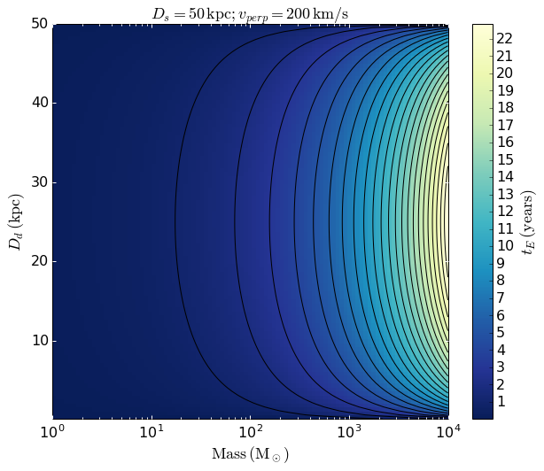


Previous surveys were limited by survey length relative to event time-scale and detection methods.
MW Bulge
Magellanic Clouds
$$t_{\text{E}}$$
$$t_{\text{E}}$$
Notes:
Note that while 200 is the average circular velocity in the Milky Way there can be many events with v_perp much smaller due to elliptical orbits, thus some events

Slide 17
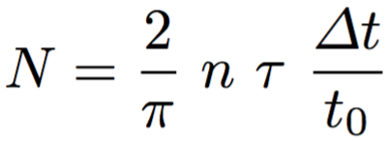

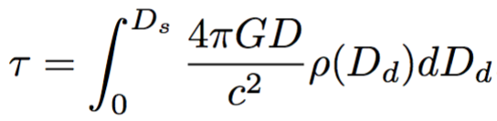
Statistical Ensembles
Expected number of events
(assuming all have same timescale)
Number of monitored stars
Timescale of Survey
Timescale of lensing event
Optical Depth
Average dark matter density at D_{d}
Paczynski 1986, 1996
Notes:
Note that optical depth is independent of the MACHO mass.
Note what we can do to increase N
Increase survey time
Increase number of monitored stars
Look in higher optical depth regions
Increase photometric precision so that we can use parallax

Slide 18
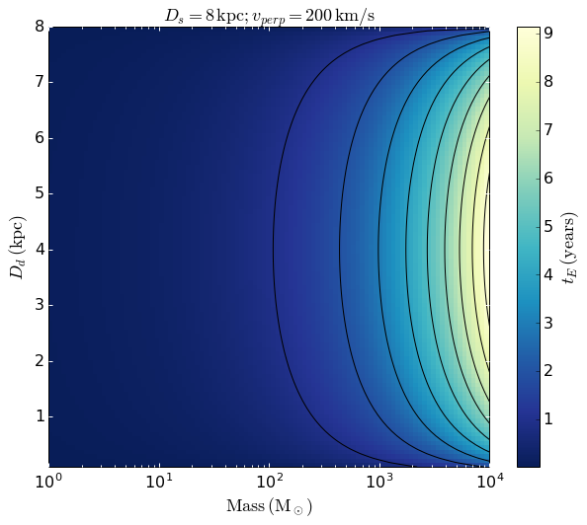
Time-scale of microlensing events.
For high mass MACHOs MW Bulge is better.
MW Bulge
Magellanic Clouds

Slide 19
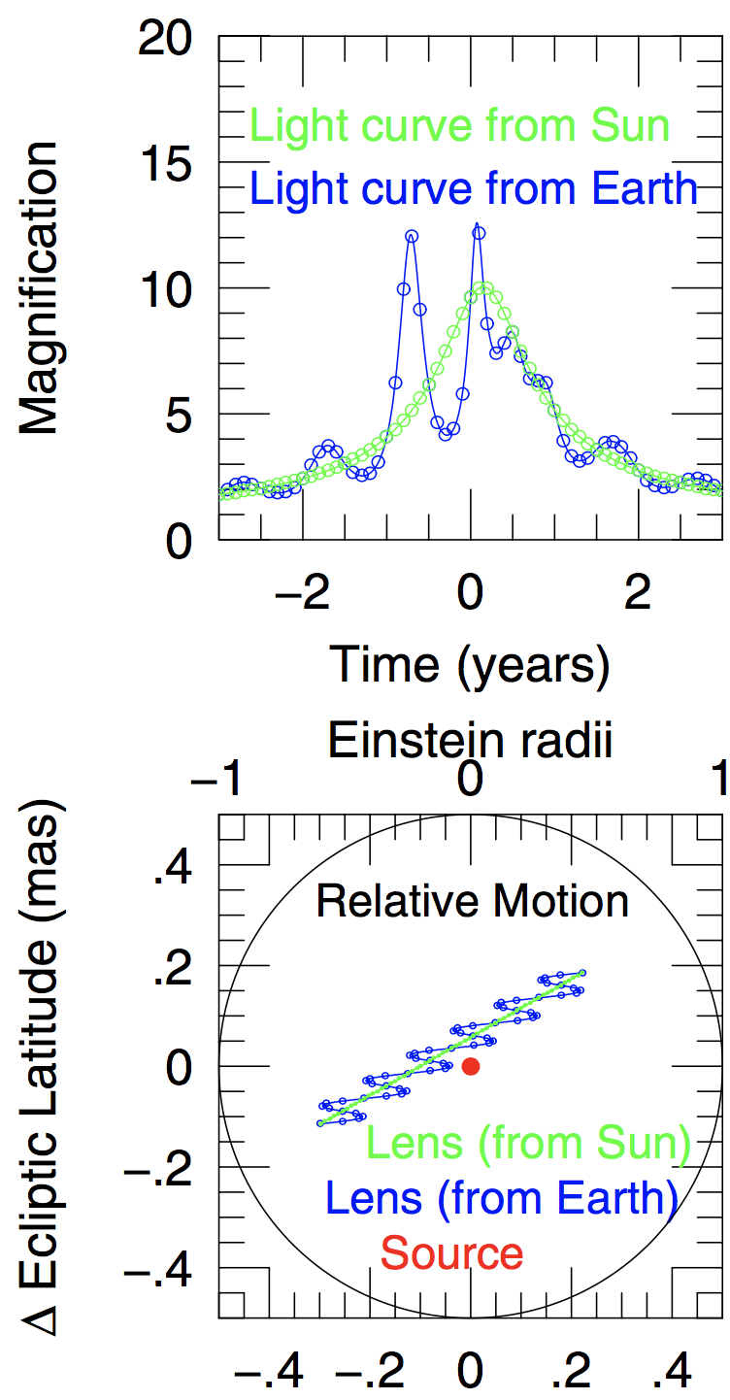

Parallax:
Multi-year lensing events detected on order of 6 months
Source Star
Gould & Horne 2013

Slide 20
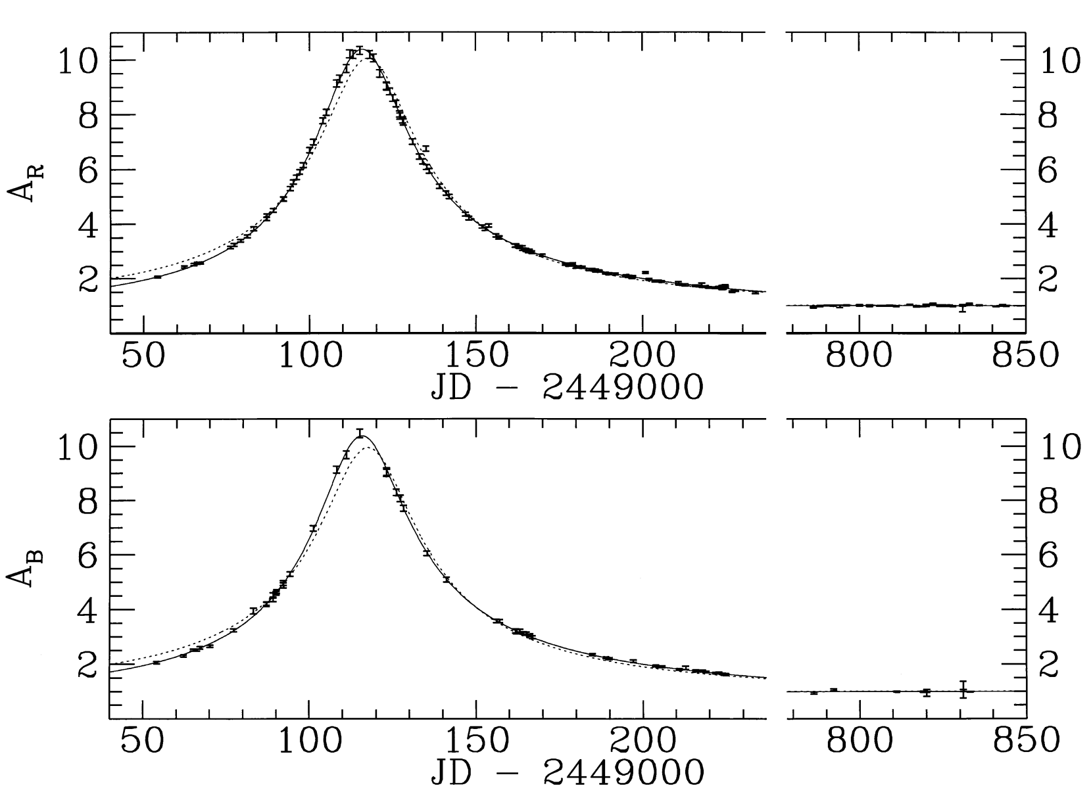
Parallactic effect first discovered at LLNL
Enables even short baseline surveys detect IM MACHOs
MACHO Survey (1995)

Slide 21
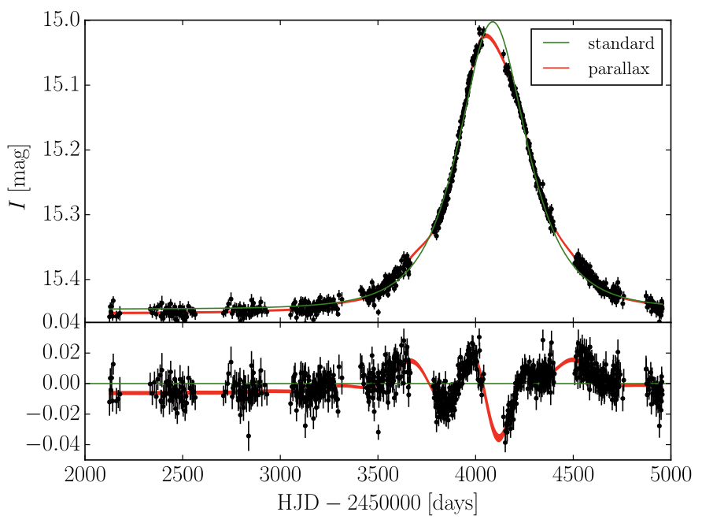
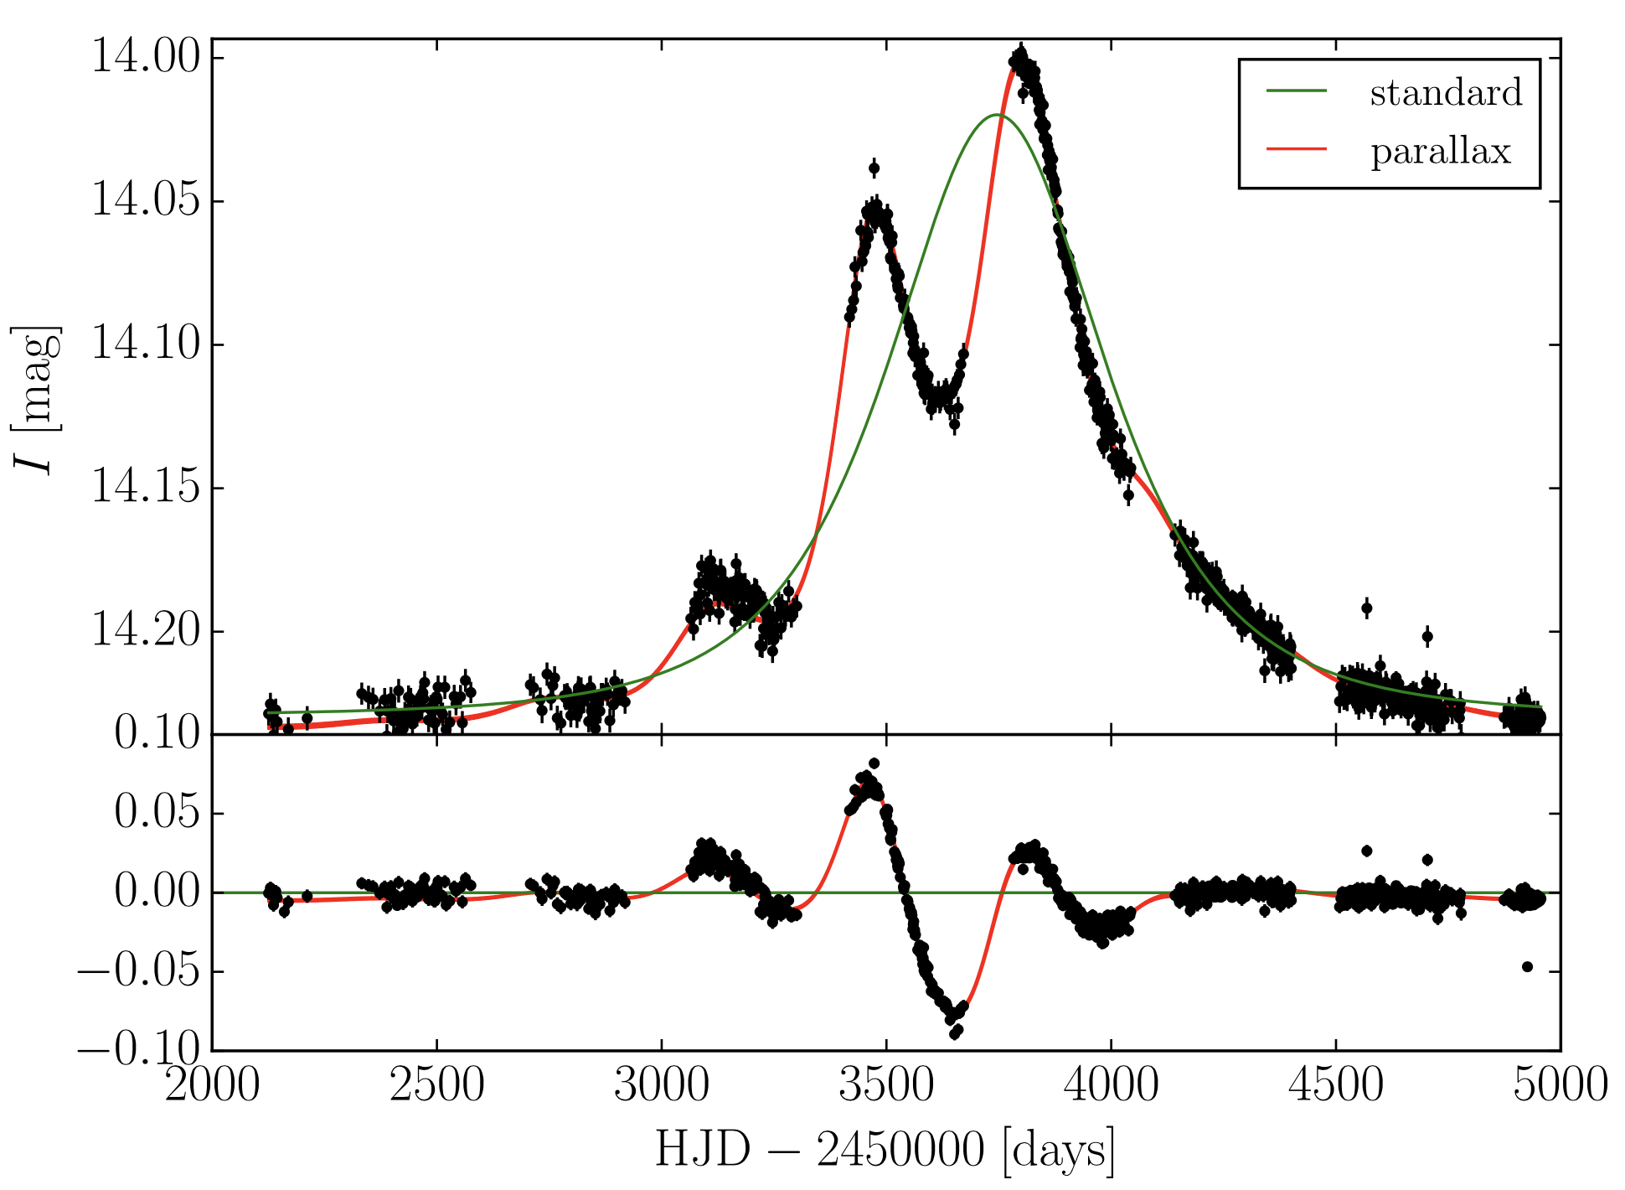
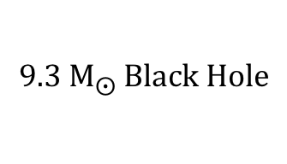
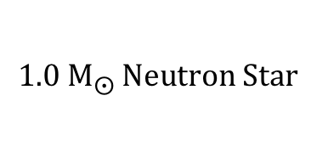
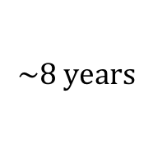
Recent OGLE III parallax events
$$9.3 {\text{M}}_{⨀} \text{Black} \text{Hole}$$
$$1.0 {\text{M}}_{⨀} \text{Neutron} \text{Star}$$
$$\sim 8 \text{years}$$
Wyrzkowski et al. 2016

Slide 22
Can have a significant and secure detection of multi-year event with 6 months of data!
$$9.3 {\text{M}}_{⨀} \text{Black} \text{Hole}$$
$$1.0 {\text{M}}_{⨀} \text{Neutron} \text{Star}$$
Significant event detection in
6 months.
$$\sim 8 \text{years}$$
Wyrzkowski et al. 2016

Slide 23
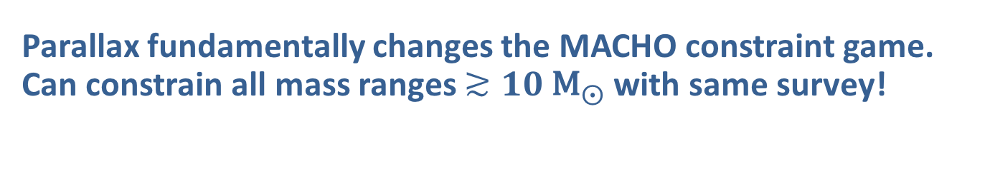
Parallax fundamentally changes the MACHO constraint game.
Can constrain all mass ranges $≳10 {\text{M}}_{⨀}$ with same survey!
Expected number of events
(assuming all have same timescale)
Number of monitored stars
Timescale of Survey
From 10’s of years to ~6 months!
Timescale of lensing event
Optical Depth
Average matter density at D_{d}
Paczynski 1986, 1996
Notes:
Note that optical depth is independent of the MACHO mass.
So there is basically no high mass limit that we can’t constrain!

Slide 24
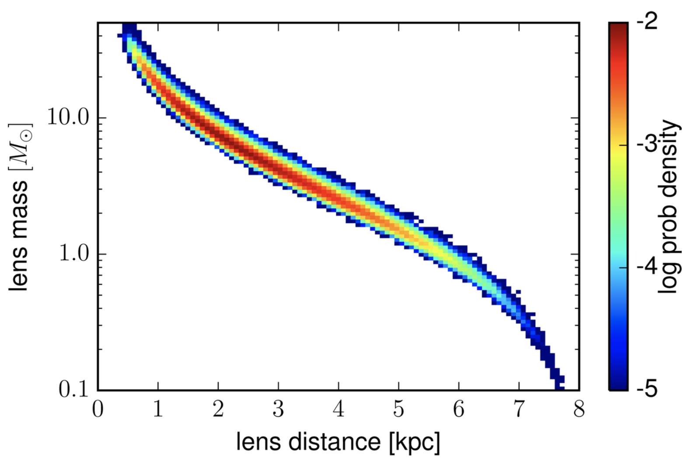

Microlensing parallax constraint on black hole mass
Parallactic signal is a strong function of mass
  Without the parallax you basically have no constraint on the lens mass.
However there is still a degeneracy between lens mass and lens distance.
With an ensemble can place tighter constraints on the population mass spectrum, by utilizing our knowledge of the MW dark matter halo density function.
$$\text{OGLE} \text{Black} \text{Hole}$$
Wyrzkowski et al. 2016

Slide 25
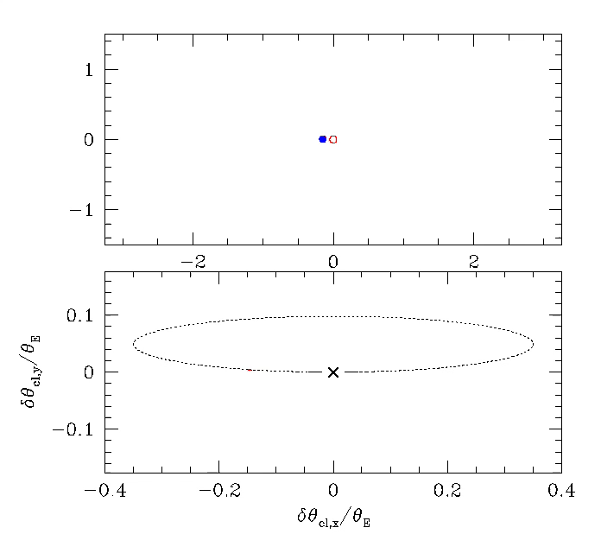
Microlensing also affects the astrometry of the source star
We can break the mass – lens distance degeneracy by measuring the microlensing astrometric signal
Current Keck (Lu et al.) and HST (Kains et al.) studies underway to measure astrometric shifts
Relative Centroid Shift
Gaudi
Notes:
Backup if no time.

Slide 26
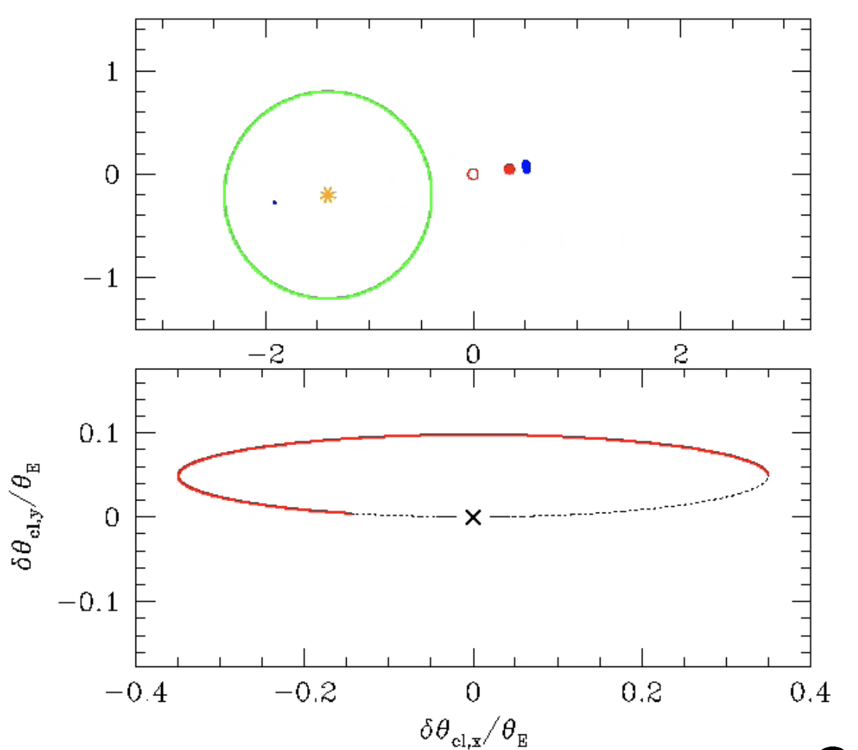
Astrometric follow-up is easily facilitated
Max astrometric shift occurs
before/after peak magnification.
Time Since Closest Approach
Lu et al. 2016
Gaudi
Notes:
Backup if no time.

Slide 27
Parallax + Astrometric Microlensing = Tight Mass Constraint
Yee 2015

Slide 28
Parallax + Astrometric Microlensing = Tight Mass Constraint
If primordial BHs make up dark matter, then measuring their mass spectrum will be especially exciting because it will tell us something about the fundamental physics of the Big Bang.
Yee 2015

Slide 29
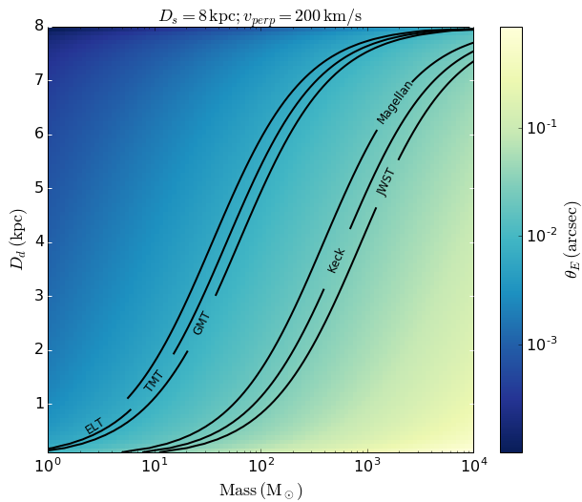
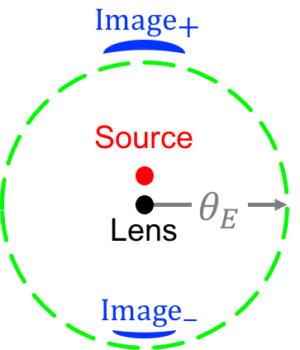
Ability to resolve multiple lensed images
Potential to resolve multiple images from IM MACHO events!
MW Bulge
Adaptive Optics
Resolution

Slide 30
What are we actually proposing
Model a microlensing survey off DOE supported DECaLS
  DECam imaging survey
  Survey time through NOAO
  Data analysis on LLNL and FNAL computing
  Project effort funded through DOE
Building to and supplementing the LSST microlensing survey
  LSST is currently not optimized for microlensing science
  LSST will survey the Milky Way Galaxy, but not as much as the extragalactic fields. Need to supplement the survey with DECam microlensing survey

Slide 31
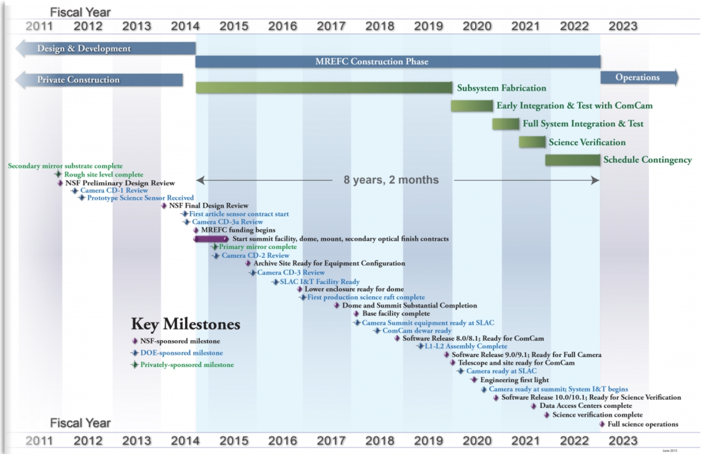
Proposing a 5 year DECam MACHO Survey
Influence and bridge to LSST
LSST Survey Starts
DECam MACHO Survey
LSST Survey Schedule
LSST Survey Strategy Determined
Notes:
We need to influence the LSST Survey now.

Slide 32
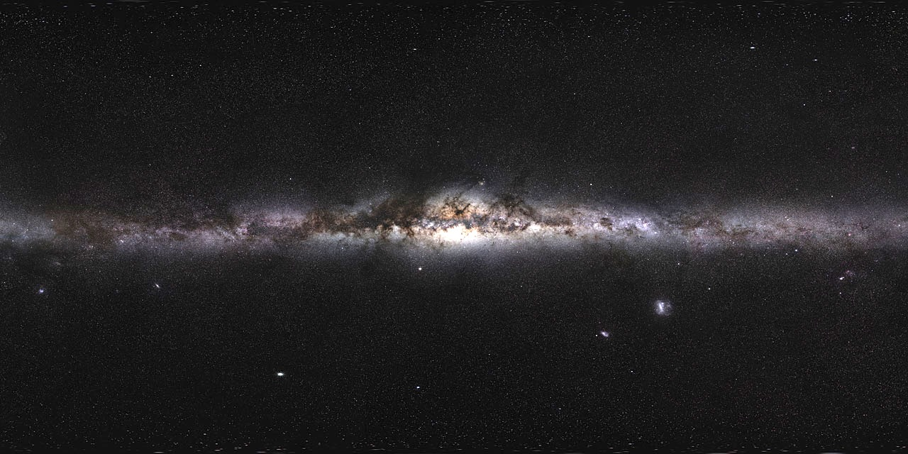

Survey Footprint
$$A≈π{{15}^{∘}}^{2}=700 \text{sq}\text{.}\text{deg}\text{.}≈200 \text{DECam} \text{Pointings}$$
ESO/S. Brunier

Slide 33

Survey Numbers
10σ limiting magnitude of 23.3
  70 s in g; 130 s in r = 200 s per g & r epoch
~500 Million stars
13 hours per g & r epoch
4 nights per month
8 months per year
5 years
~60 measurements per year per star
$$≈100$$
$$\text{black} \text{hole}$$
$$\text{microlensing} \text{events}\text{ (}\text{if} \text{all} \text{dark} \text{matter}\text{)}$$

Slide 34
Algorithm focus
Old
  Detect based off complete rise and fall
  Photometry from difference imaging
Modern computation enables better new ways
  Maximum likelihood parallactic event detection (see e.g. Dawson, Schneider, & Kamath 2016)
  Bayesian image analysis to forward model variability (Schneider & Dawson in prep)
  Leverage experience with first weak lensing measurement through galactic plane (Dawson et al. 2015; Jee et al. 2015)

Slide 35
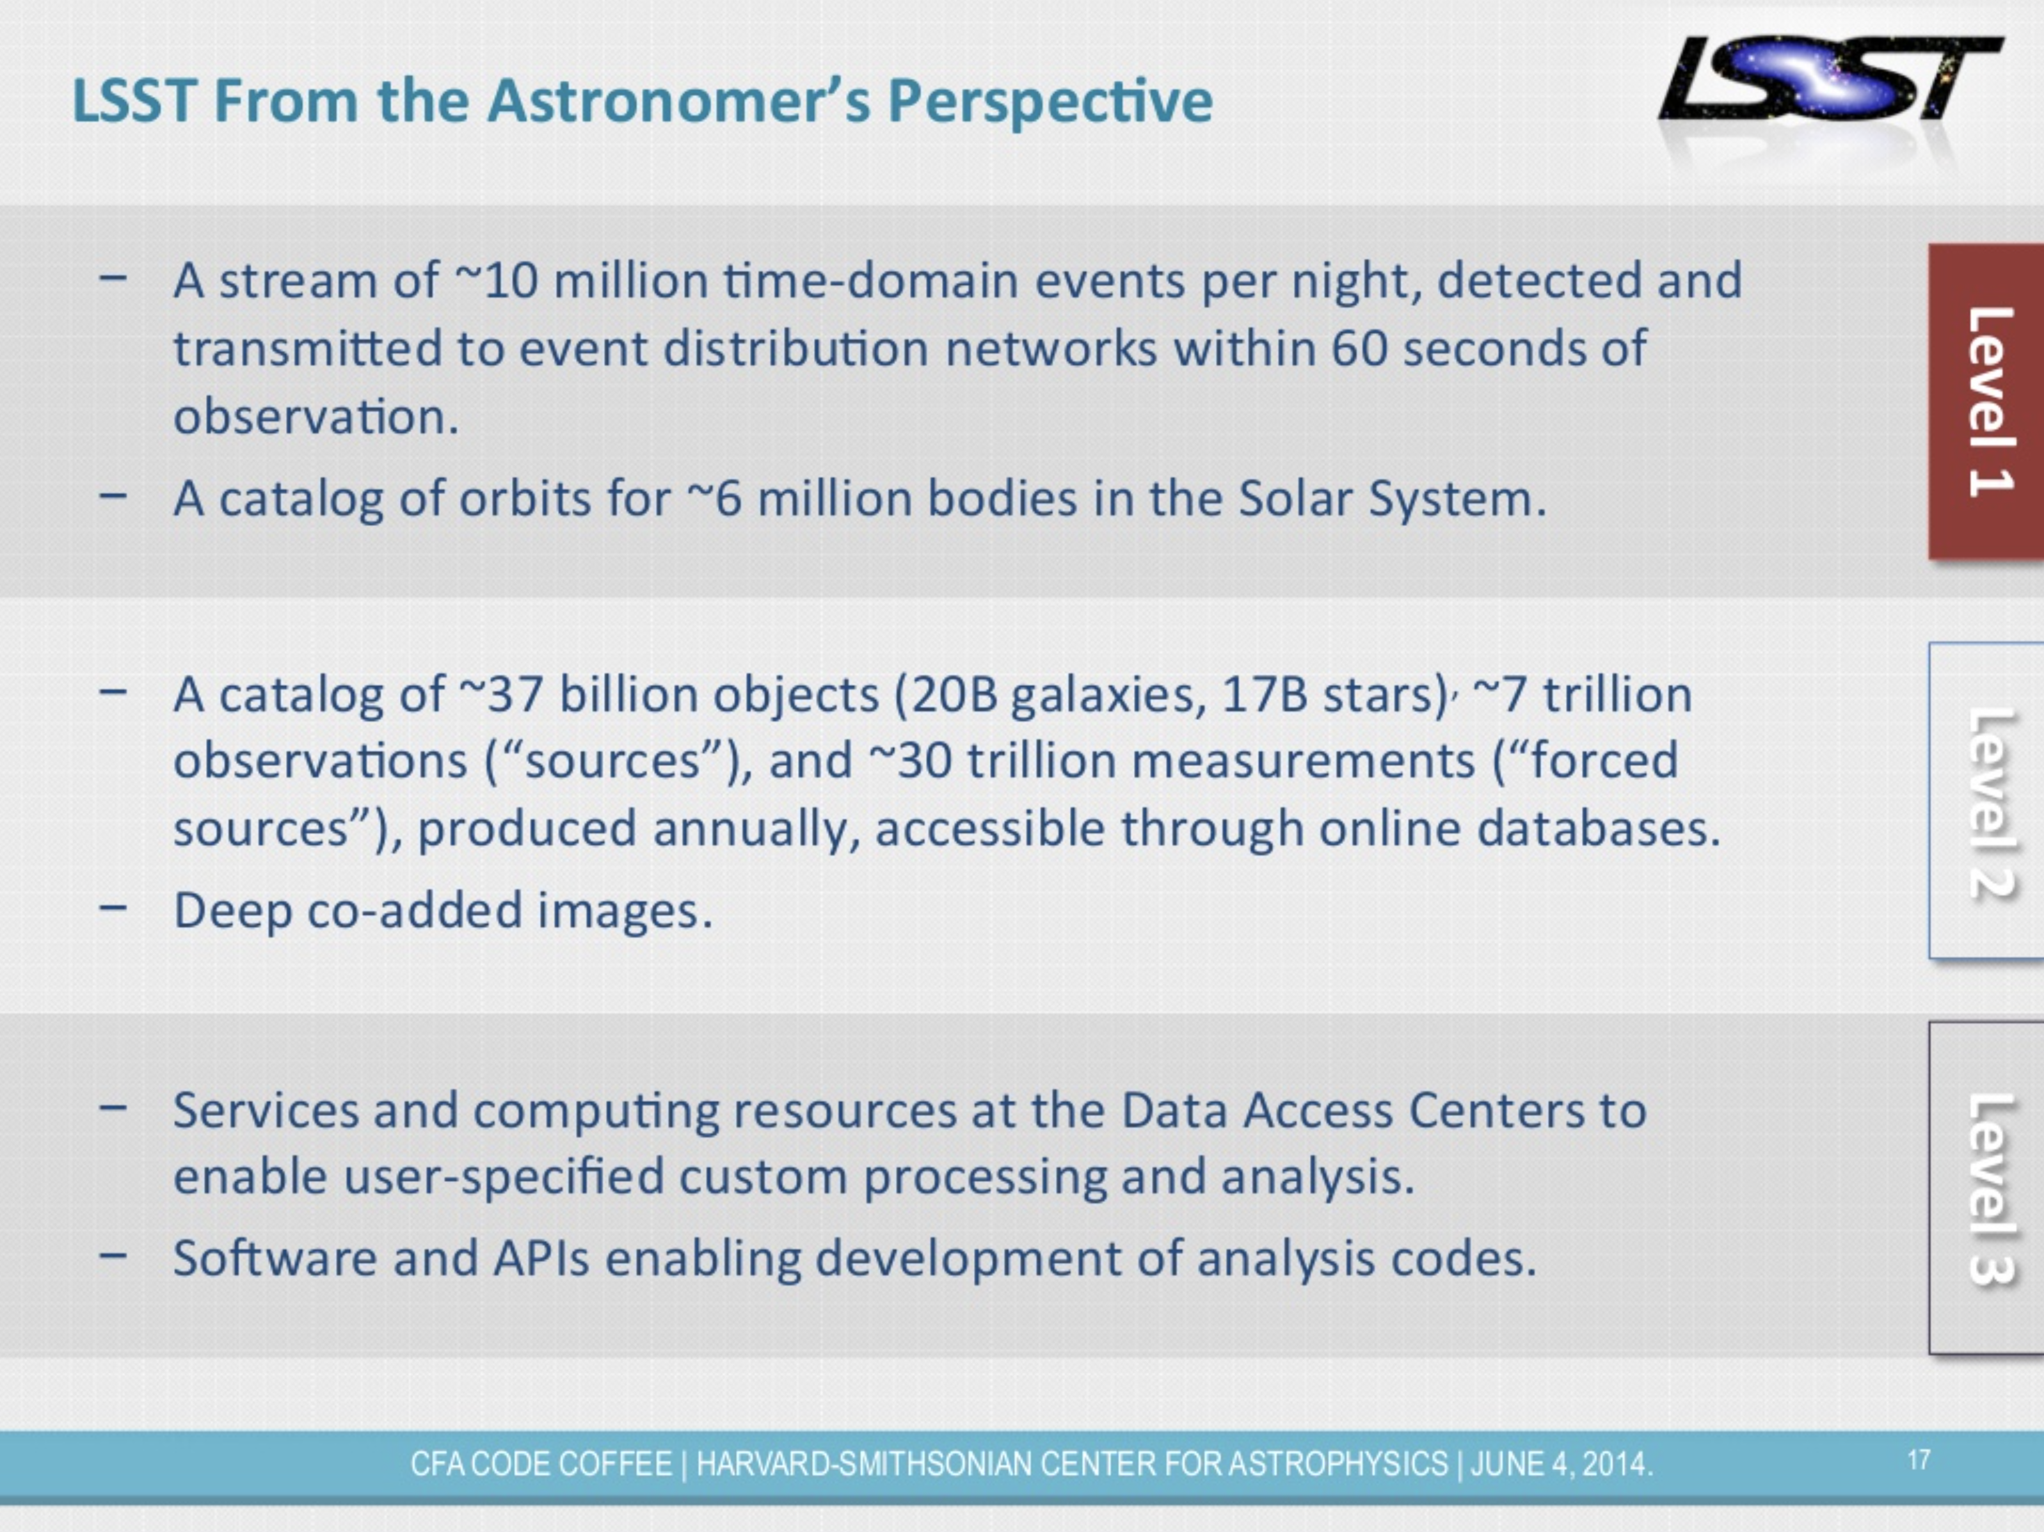
Leveraging existing DOE investments in pipeline development:
LLNL will develop the Level 3 microlensing plugin
Leverage existing DECam & LSST pipeline investments
We develop the Level 3 microlensing analysis plugin
M. Juric
Notes:
Skip if short on time.

Slide 36
DOE has already invested in the vast majority of the needed resources
Office of Science Current Investment
Item | Investment
DECam | ~$50 M
LSST | ~$175 M
DECam data reduction | FNAL Computing
New Investment
Item | Investment
Obs. Travel | 8 runs/year
Univ. Summer Salary | 2 months/year
Postdocs | 2 FTE
Grad. Student | 2 FTE
LLNL Current Investment
Item | Investment
Staff Support | 0.5 FTE
Postdoc | 1 FTE
Microlensing analysis | LLNL Computing
LLNL and FNAL will contribute staff support.

Slide 37
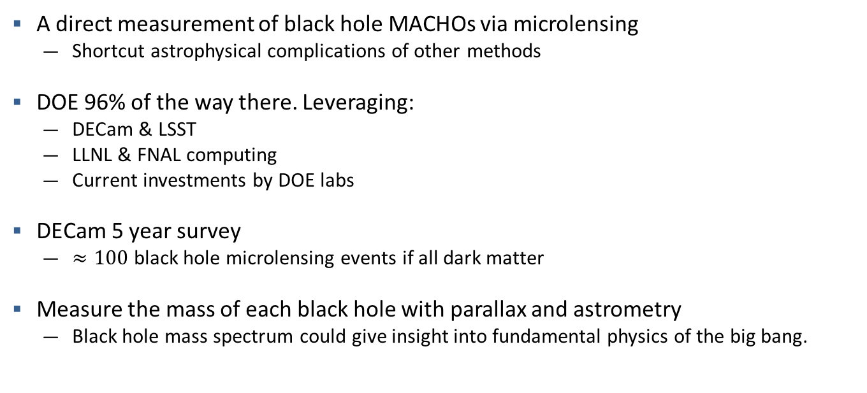
Summary
A direct measurement of black hole MACHOs via microlensing
  Shortcut astrophysical complications of other methods
DOE 96% of the way there. Leveraging:
  DECam & LSST
  LLNL & FNAL computing
  Current investments by DOE labs
DECam 5 year survey
  $≈100$ black hole microlensing events if all dark matter
Measure the mass of each black hole with parallax and astrometry
  Black hole mass spectrum could give insight into fundamental physics of the big bang.

Slide 39
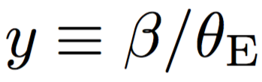


Microlensing Basics
Einstein Radius
Image 1
$$θ$$
Source
Observer
$$β$$
Lens
Convenient coord. system
$$D_{ds}$$
$$D_{d}$$
$$D_{s}$$

Slide 40
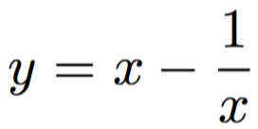
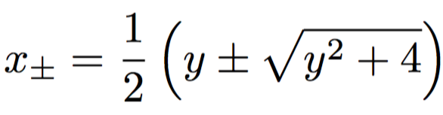
Microlensing Basics
Solving the lensing equation:
Image 1
$$θ$$
Source
Observer
$$β$$
Lens
2 solutions… 2 images
Image 2
$$D_{ds}$$
$$D_{d}$$
$$D_{s}$$

Slide 41
Microlensing Basics
Einstein Radius
Image 1
$$θ$$
Source
Observer
Lens
Image 2
$$D_{ds}$$
$$D_{d}$$
$$D_{s}$$

Slide 42

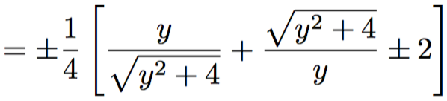



Microlensing Basics
$$\text{Ima}{\text{ge}}_{\text{+}}$$
Magnification of the two images:
Source
$$θ_{E}$$
Lens
$$\text{Ima}{\text{ge}}_{−}$$

Slide 43


Microlensing Basics
Relative Ground Based Resolution
$$\text{Ima}{\text{ge}}_{\text{+}}$$
Magnification of the two images:
Source
$$θ_{E}$$
Lens
Total magnification:
$$\text{Ima}{\text{ge}}_{−}$$
$$μ≡μ_{+}+\left|μ_{−}\right|$$

Slide 44
Statistical Ensembles
Optical Depth
Average matter density at D_{d}
Expected number of events
(assuming all have same timescale)
Number of monitored stars
Timescale of Survey
Timescale of lensing event
Paczynski 1986, 1996
Notes:
Note that optical depth is independent of the MACHO mass.
Note what we can do to increase N
Increase survey time
Increase number of monitored stars
Look in higher optical depth regions
Increase photometric precision so that we can use parallax

Slide 45
Microlensing parallax also provides constraint on black hole mass
Parallactic signal is a strong function of mass
  Without the parallax you basically have no constraint on the lens mass.

Slide 46
Method Summary
Parallax means no high mass limit to the constraining power of a microlensing survey
Parallax provides constraint on the black hole mass
  Despite degeneracies with lens distance, powerful for an ensemble
Parallactic + astrometric = tight mass constraints
New telescopes can resolve the multiple images
Achromatic, parallax, and astrometric microlensing signals are extremely powerful

Slide 47
OGLE III
2016
LIGO
2015
47 Tucanae
2017
Extend Existing
MACHO Constraints

Slide 48
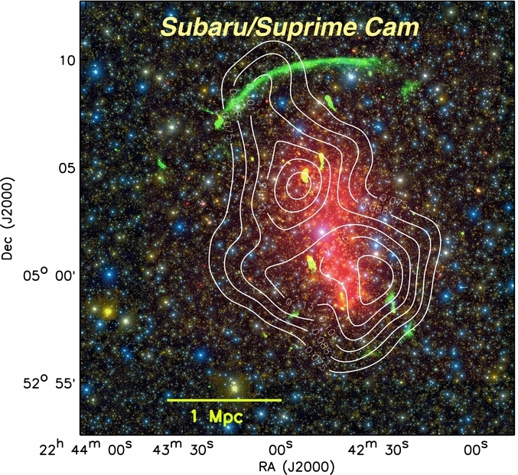
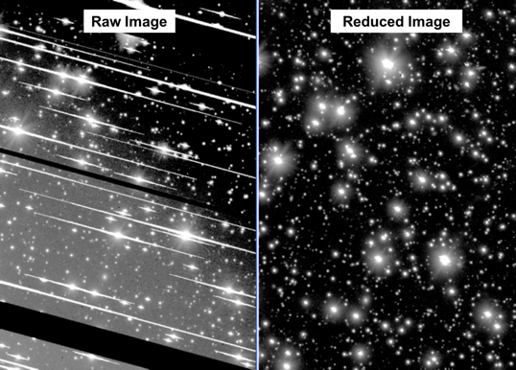
We have experience in dense environment survey planning and analysis
First weak lensing measurement through the galactic plane.
Dawson et al. 2015
Jee, Stroe, Dawson et al. 2015

