Slide 1
Cosmic Visions: PICO Bubble Chambers
Andrew Sonnenschein,
Fermilab
Cosmic Visions Workshop, University of Maryland, March 23, 2017

Slide 2
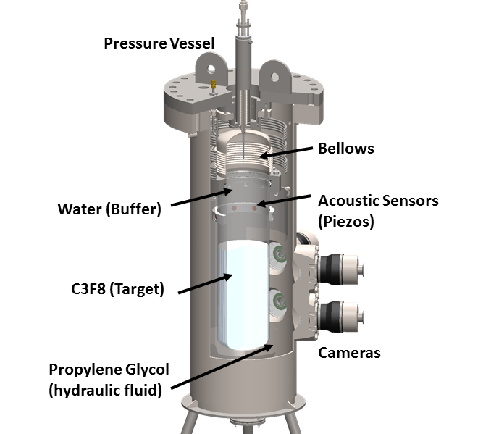
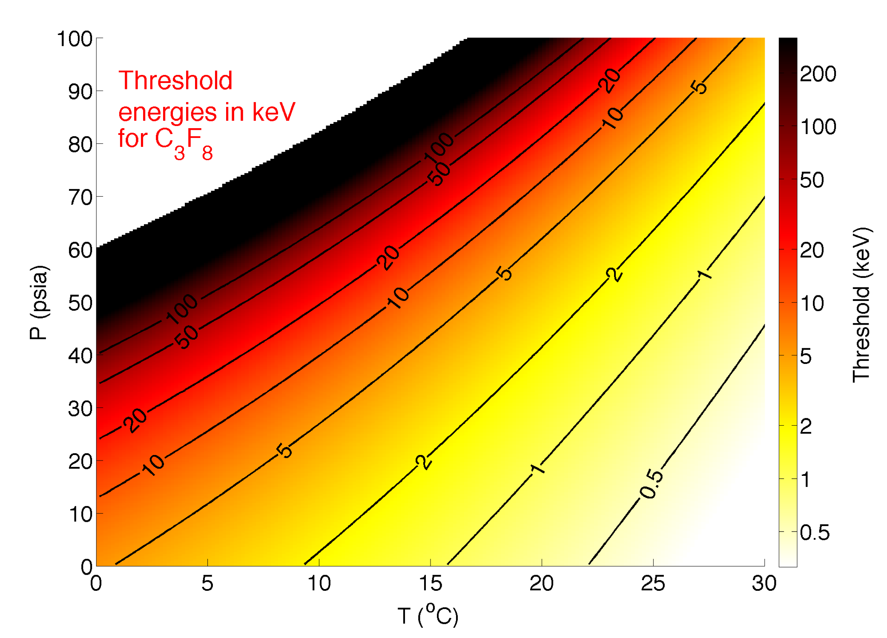
Bubble Chamber Technology for WIMP Detection
Bubble chamber operator chooses a pressure and temperature, determining the minimum deposited energy and energy loss density (dE/dX) that will nucleate bubbles.
Video cameras and piezoelectric acoustic sensors record the signals from bubble nucleation.

Slide 3
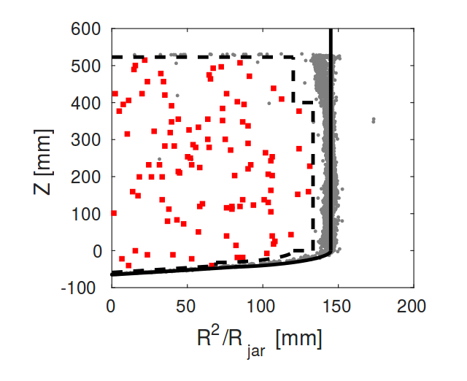
New Result from PICO-60
Data taken November 2016- January 2017.
Aggressive cleaning to remove Inner Vessel particulate contamination.
52 kg of C₃F₈ target liquid (46 kg fiducial)
1167 kg-day efficiency-corrected exposure.
3.3 keV threshold (14 degrees C, 30 psi)
106 single bubble events passing basic data quality and optical fiducial volume cuts.
Details in arXiv:1702.07666

Slide 4
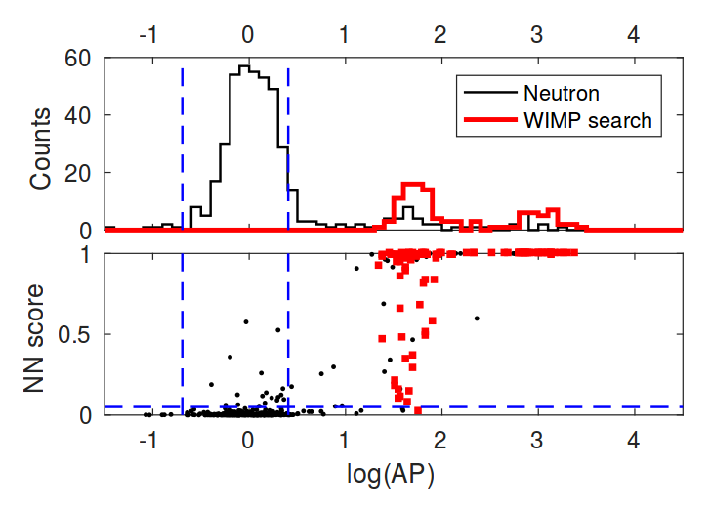
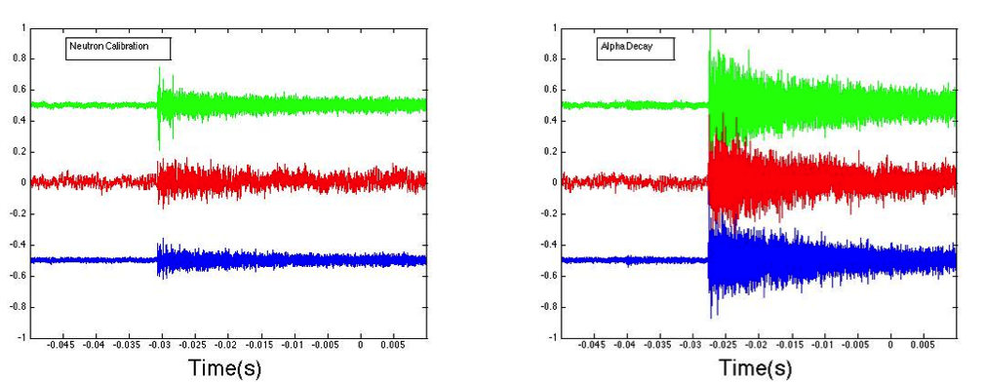
PICO-60 2017 Acoustic Analysis
Two parameter acoustic analysis:
  Acoustic Power (AP)
  Neutral Network score
Blind analysis- first time for PICO.
Zero WIMP candidates passing acoustic cuts!
Acoustic Signals
Volts

Slide 5
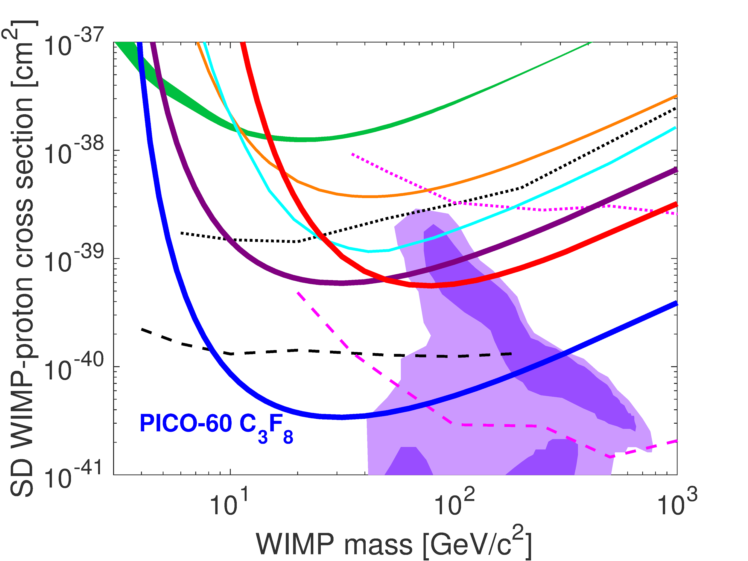
2017 PICO Result: Factor of 17 Improvement in Spin-Dependent Sensitivity
PICASSO
SIMPLE
IceCube (bb)
PandaX-II
SuperK (bb)
PICO-60 CF₃I
PICO-2L
IceCube (𝜏𝜏)
SuperK (𝜏𝜏)
cMSSM

Slide 6
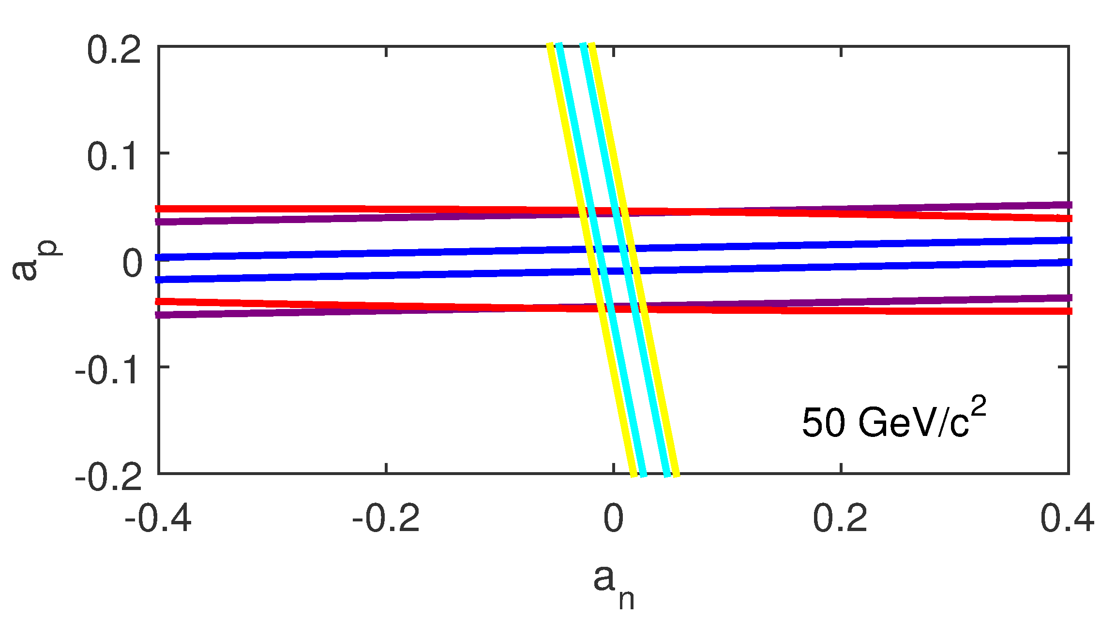
Comparison LUX, PandaX Spin-Dependent Sensitivity
Comparison of sensitivity to effective proton (a_{p}) and neutron (a_{n}) spin coupling.
LUX
PandaX-II
PICO-60 CF₃I
PICO-2L
PICO-60 C₃F₈

Slide 7
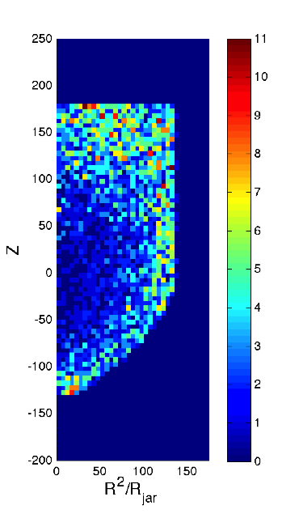
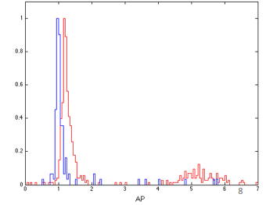
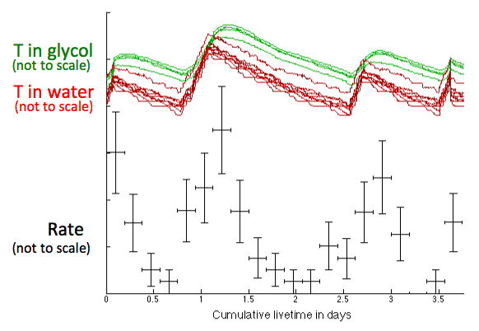
Time & Spatially Dependent Background in 2013-2014 Run
Time-dependent background
Background events:20% excess acoustic power
Calibration neutrons
Alphas
Time
Acoustic Power (AP)

Slide 8
Studies of Particulates in Inner Vessel After 2013-2014 Run
Liquids passed through Teflon filters with 200 nm pore size.
Studied using optical and electron microscopy, X-ray fluorescence, Alpha spectroscopy, mass spectroscopy.
Result: majority of contamination from quartz and stainless steel materials used in chamber construction.
PICO-60 sample:
  7 μg quartz particles
  240 μg stainless steel and iron oxide
quartz
Stainless steel

Slide 9
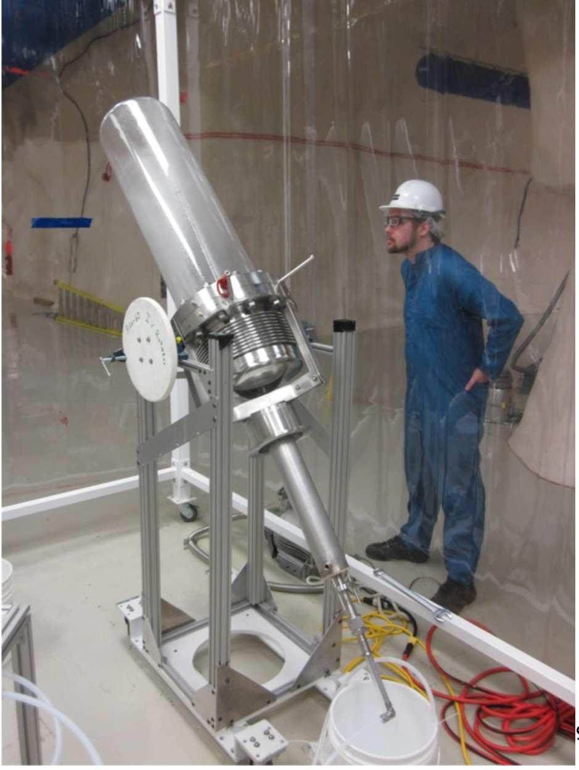
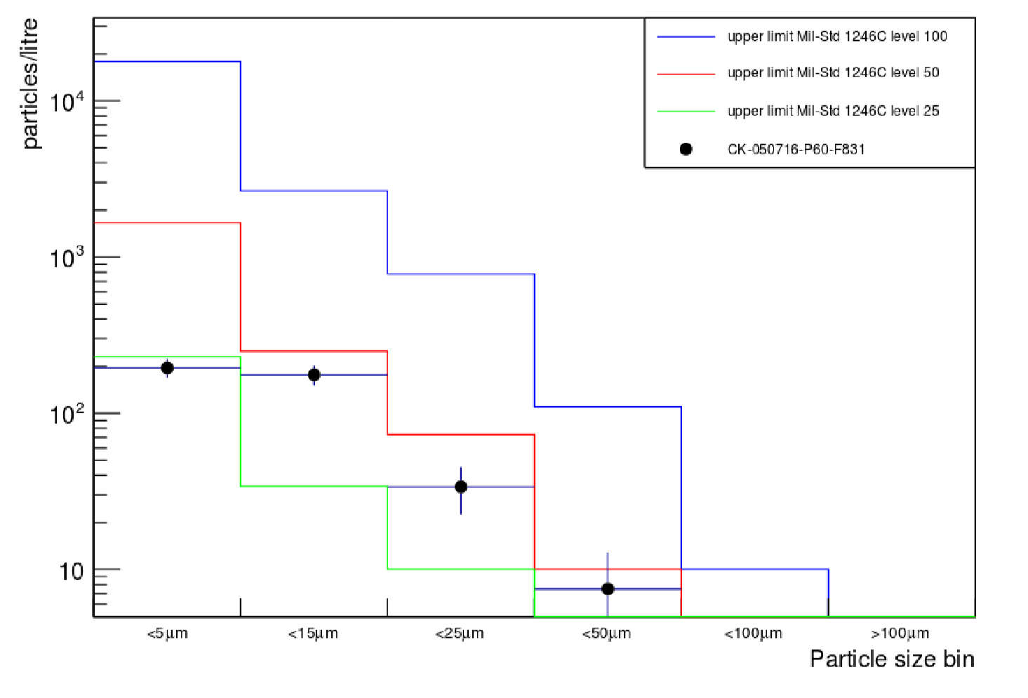
Improved Cleaning Procedures for 2016-2017 Run
Spray jet cleaning with high purity, hot detergent system.
Measurements of fluid particle counts for quality control.

Slide 10
PICO-60 Incipient Neutron Background
Three multiple scatters observed, no singles.
Marginally compatible with background model expectation (0.96 multiple, 0.25 single)

Slide 11
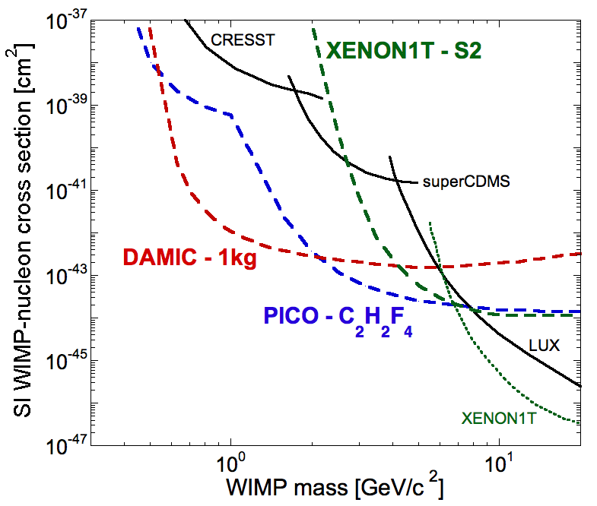
Bubble Chambers Offer A Diversity of Target Nuclei
Capability to instrument a wide range of target nuclei with sensitivity to diverse WIMP-nucleon couplings. For example,
    ¹⁹Fluorine: Best sensitivity to spin-dependent interactions.
    Iodine, Bromine, Xenon, Argon: High- A targets to exploit A² dependence of spin-independent cross section.
    Hydrogen: Enhanced sensitivity to low-mass particles.
Very low backgrounds, due to unique discrimination mechanisms.
Thresholds below 3 keV nuclear recoil energy.
Lowest cost per ton of target mass.
Fitzpatrick, Haxton et al. Effective Field Theory Couplings
Proton
Neutron
1 keV threshold

Slide 12
Neutrino Floor Lower for Fluorine Than Xenon
WIMP searches ultimately will be limited by background from coherent scattering of atmospheric neutrinos.
Xenon will be limited first due to larger nucleus.
Fluorine target sensitivity (E.g. C3F8) extends another two orders of magnitude.

Slide 13
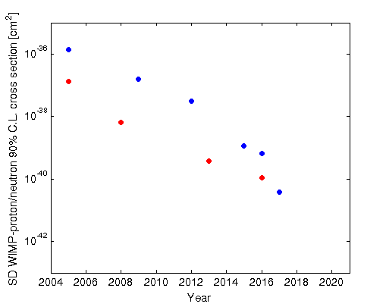
Progress of PICASSO/COUPP/ PICO Program
50 GeV WIMP constraints
PICASSO (1 L SDD)
PICASSO (4.5 L SDD)
ZEPLIN-I
PICASSO (4.5 L SDD)
XENON10
PICO-2L run-1
PICO-2L run-2
XENON100
LUX
PICO-60 C₃F₈
PICO-40L
WIMP-proton
WIMP-neutron
PICO-500

Slide 14
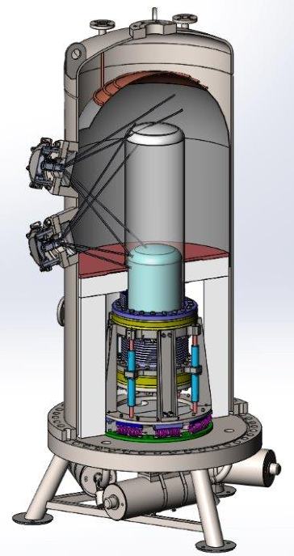
PICO-40L: A ”Right Side Up” Bubble Chamber without Water
New design concept eliminates water buffer layer from chambers.
  Water/ target liquid interface traps contamination.
  Water coating of particulates suspected to play a role in bubble nucleation mechanism.
Goal: background-free 15 ton-day physics run.
Pacific Northwest National Lab (PNNL) R&D Initiative with FY17 DOE funding & PNNL institutional investments.

Slide 15
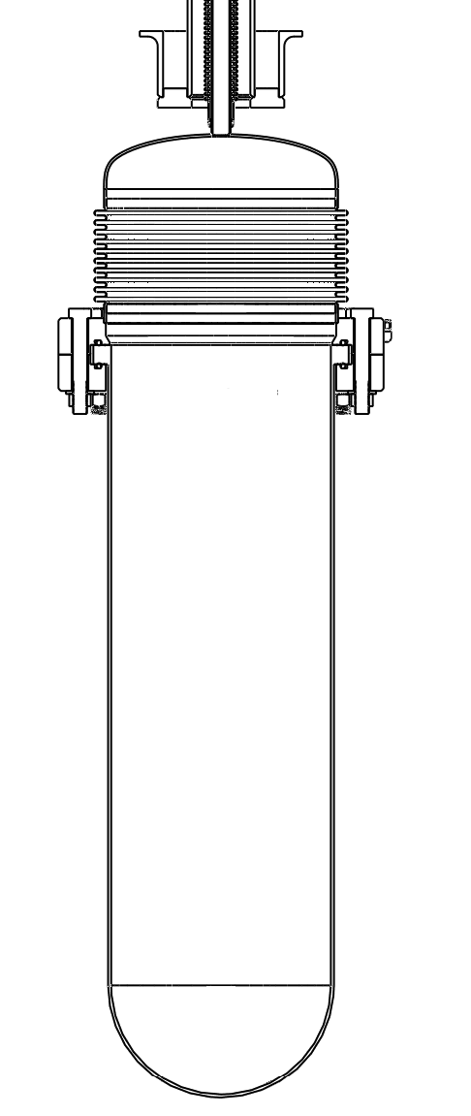
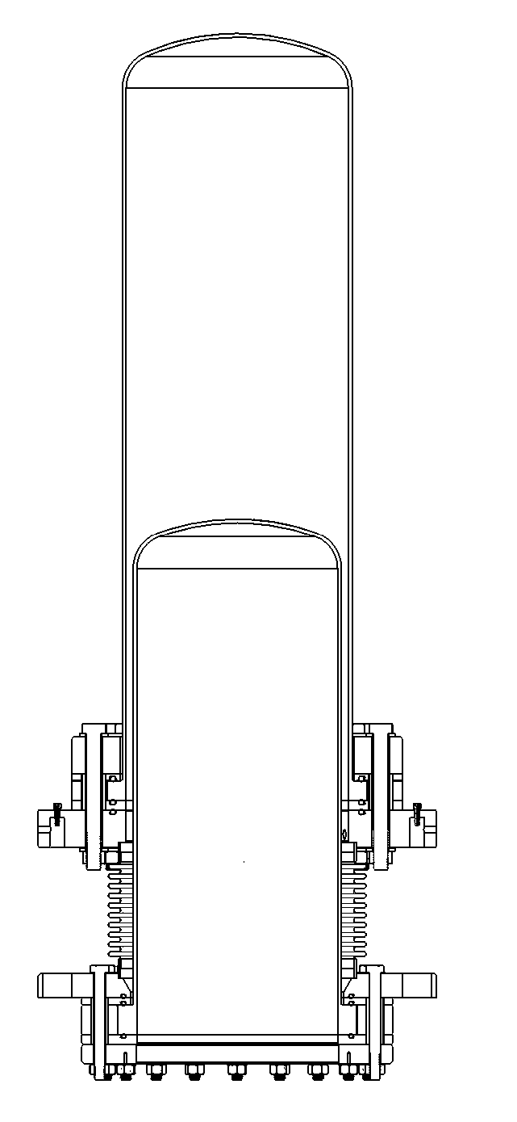
PICO-60
PICO-40L
(RSU)
hydraulic
Fluid
15ºC
hydraulic
Fluid
15ºC
H₂O
15 ºC
C₃F₈
15ºC
active volume
“water piston”
insulation
fused silica
piston
hydraulic
fluid
-5ºC
hydraulic
Fluid
15ºC
C₃F₈
15ºC
hydraulic
fluid
-5ºC
active volume

Slide 16
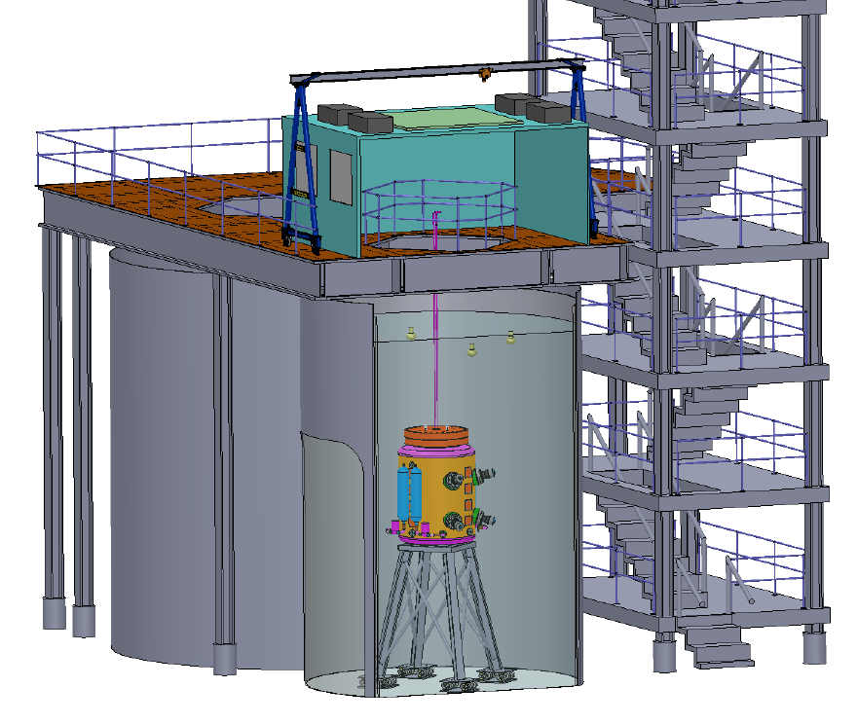
PICO-500: ~1 Ton Scale Detector at SNOLAB
Ton – scale detector builds on design work originally funded by NSF and DOE for G2 project.
PICO-500 proposal submitted to Canada Foundation for Innovation (CFI) last year. Decision expected in June 2017. Budget is $4M CAD.
PNNL will provide scientific and technical leadership for US contribution.
This
Project

Slide 17

















Queen's University, Kingston, ON, Canada
C. Amole, G. Cao,
U. Chowdhury, G. Crowder,
G. Giroux, A. J. Noble,
S. Olson
The PICO Collaboration
University of Alberta, Edmonton, AB, Canada
S. Fallows, C. B. Krauss,
P. Mitra
Université de Montréal, Montréal, QC, Canada
M. Laurin, A. Plante,
N. Starinski, F. Tardif,
V. Zacek
Universitat Politècnica de València, València, Spain
M. Ardid, M. Bou-Cabo,
I. Felis
Northeastern Illinois University, Chicago, IL, USA
O. Harris
Virginia Tech, Blacksburg, VA, USA
D. Maurya, S. Priya, Y. Yan
Pacific Northwest National Laboratory, Richland, WA, USA
I. J. Arnquist, D. M. Asner,
J. Hall, E. W. Hoppe
University of Chicago, Chicago, IL, USA
J. I. Collar, A. Ortega
Universidad Nacional Autónoma de México, México D. F., México
E. Vázquez-Jáuregui
Saha Institute of Nuclear Physics, Kolkata, India
P. Bhattacharjee, M. Das,
S. Seth
SNOLAB, Lively, ON, Canada
K. Clark, I. Lawson
Indiana University South Bend, South Bend, IN, USA
E. Behnke, H. Borsodi,
I. Levine, T. Nania,
A. Roeder, J. Wells
Laurentian University, Sudbury, ON, Canada
J. Farine, F. Girard, A. Leblanc, R. Podviyanuk,
O. Scallon, U. Wichoski
Czech Technical University in Prague, Prague, Czech Republic
R. Filgas, F. Mamedov, I. Štekl
Northwestern University, Evanston, IL, USA
D. Baxter, C. J. Chen,
C. E. Dahl, M. Jin, J. Zhang
Drexel University, Philadelphia, PA, USA
P. Campion, R. Neilson
Fermi National Accelerator Laboratory, Batavia, IL, USA
P. S. Cooper, M. Crisler, W. H. Lippincott, A. E. Robinson, R. Rucinski, A. Sonnenschein

Slide 18
Summary / What Should Cosmic Visions White Paper Say About PICO?
By incorporating a diversity of target nuclei, bubble chambers are sensitive to WIMP dark matter interactions beyond the reach of other techniques.
Fluorine target has potential spin-dependent sensitivity two orders of magnitude beyond xenon due to lower neutrino backgrounds.
In the last year, PICO achieved a factor of 17 increase in sensitivity to spin-dependent WIMP couplings by reducing backgrounds to zero for 1.2 ton-days.
A future bubble chamber project (PICO-500) has been proposed in Canada (funding decision expected in June 2017).
There are opportunities for DOE to either continue its leadership role (larger investment) or to be in a supporting role (smaller investment).

