Slide 1


Neutron—Mirror-Neutron Oscillations
Exploring new avenues for Dark Matter searches
Ben Rybolt University of Tennessee
Leah Broussard Oak Ridge National Laboratory
on behalf of N-N’ Collaboration

Slide 2
History of Mirror Matter Theory
Left-Right symmetry can be restored in nature
Lee&Yang (1956)
Mirror fermions can not have common E-M, Weak and
Strong Interactions but only common Gravity
Kobzarev, Okun, Pomeranchuk (1966)
MM as a viable candidate for DM if T′/T <<1
Berezhiani, Comelli, Vilante (2001)
Mirror Dark Matter: cosmology, galaxy structure and
direct detection
  Foot (2014)
Neutron Mirror-Neutron Oscillation
Berezhiani (2006-2014)
Review: “Mirror particles and mirror matter: 50 years of speculations and search.” by L.B. Okun,
(Moscow, ITEP), 2006, http://arxiv.org/abs/hep-ph/0606202 (contains all references before 2006)

Slide 3
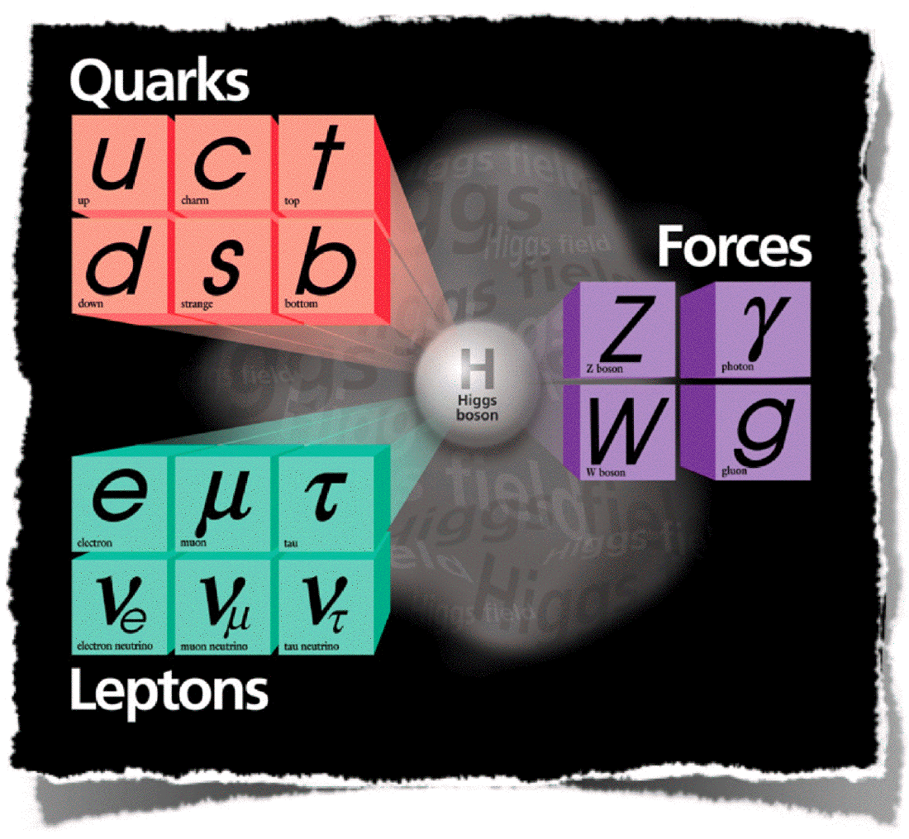
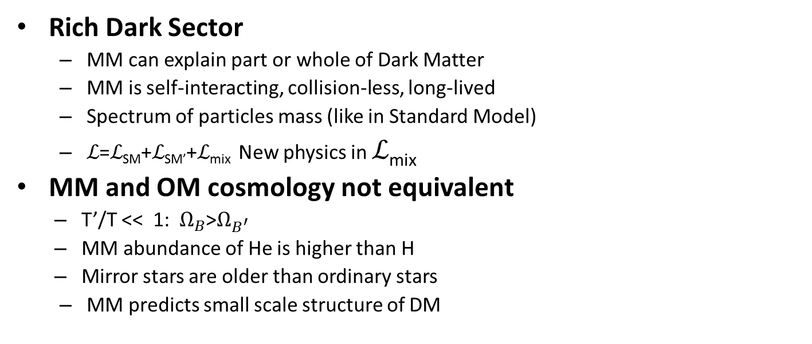
Features of Dark Matter within Mirror Matter Paradigm
Rich Dark Sector
  MM can explain part or whole of Dark Matter
  MM is self-interacting, collision-less, long-lived
  Spectrum of particles mass (like in Standard Model)
  ℒ=ℒ_{SM}+ℒ_{SM’}+ℒ_{mix} New physics in ℒ_{mix}
MM and OM cosmology not equivalent
  T’/T << 1: $Ω_{B}$>$Ω_{B^{′}}$
  MM abundance of He is higher than H
  Mirror stars are older than ordinary stars
  MM predicts small scale structure of DM
SM
SM′

Slide 4

Portals to the mirror world
  ℒ_{mix}
All neutrals:
Neutrinos
Neutrons
Photons
+ Heavy neutral messenger particles

Slide 5
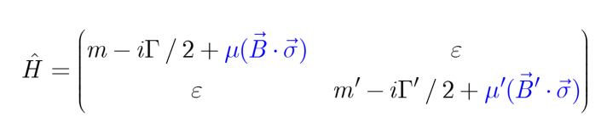
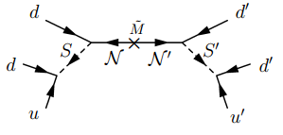
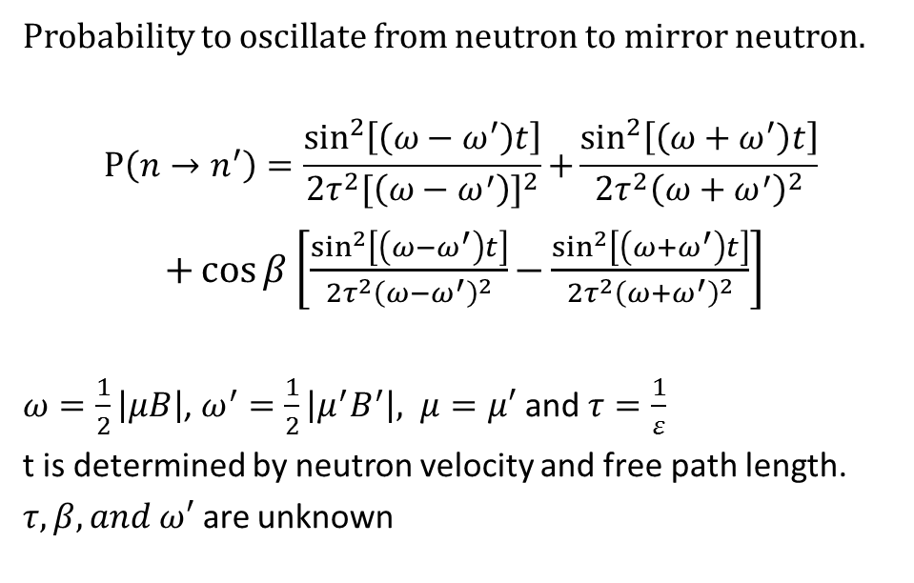
Neutron-Mirror Neutron Oscillation
Hamiltonian of free neutron in the presence of a magnetic field
Berezhiani, Bento
Phys.Rev.Lett. 96 (2006) 081801
Probability to oscillate from neutron to mirror neutron.
$$P\left(n→n^{′}\right)=\frac{\sin^{2}\left[\left(ω−ω^{′}\right)t\right]}{2τ^{2}{[\left(ω−ω^{′}\right)]}^{2}}+{\frac{\sin^{2}\left[\left(ω+ω^{′}\right)t\right]}{2τ^{2}{\left(ω+ω^{′}\right)}^{2}}}$$
$+\cos{β}\left[\frac{\sin^{2}\left[\left(ω−ω^{′}\right)t\right]}{2τ^{2}{\left(ω−ω^{′}\right)}^{2}}−{\frac{\sin^{2}\left[\left(ω+ω^{′}\right)t\right]}{2τ^{2}{\left(ω+ω^{′}\right)}^{2}}}\right]$
$ω=\frac{1}{2}\left|μB\right|$, $ω^{′}=\frac{1}{2}\left|μ^{′}B^{′}\right|, μ=μ′$ and $τ=\frac{1}{ε}$
t is determined by neutron velocity and free path length.
$τ, β, and ω′$ are unknown

Slide 6
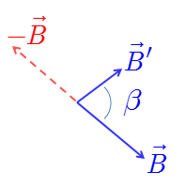
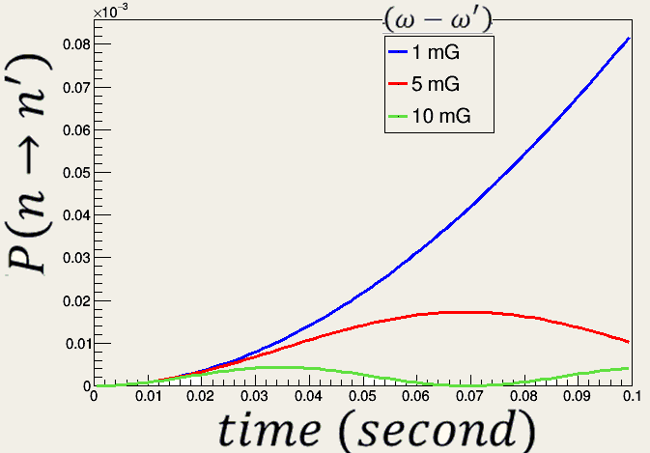
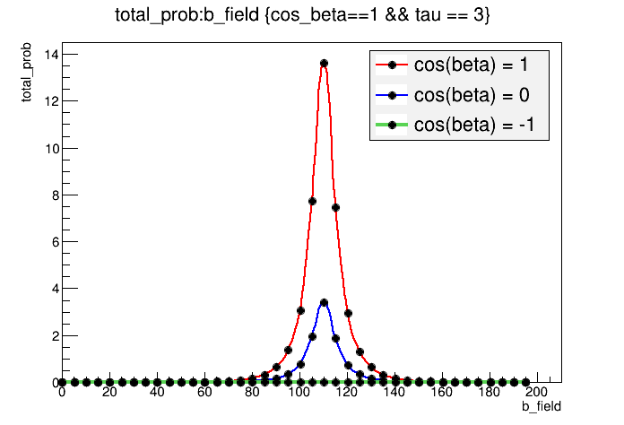

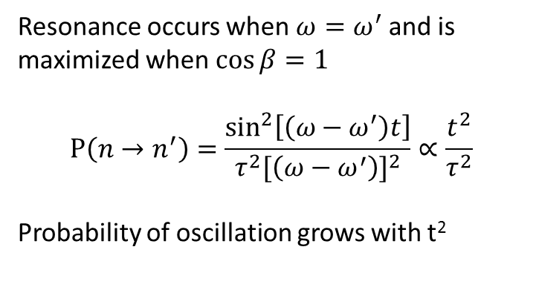


Resonance occurs when $ω=ω^{′}$ and is maximized when$\cos{β}=1$
$$P\left(n→n^{′}\right)=\frac{\sin^{2}\left[\left(ω−ω^{′}\right)t\right]}{τ^{2}{[\left(ω−ω^{′}\right)]}^{2}}∝\frac{t^{2}}{τ^{2}}$$
Probability of oscillation grows with t²
$$Δω=\sqrt{{\left(ω−ω^{′}\right)}^{2}+ε^{2}}$$
Effect of misalignment of B and B’
Example: $τ=3$, B’ = 110 mG
$$τ=15 s$$
$\cos\left(β\right)=1$
4x
Neutrons/MWs
x

Slide 7
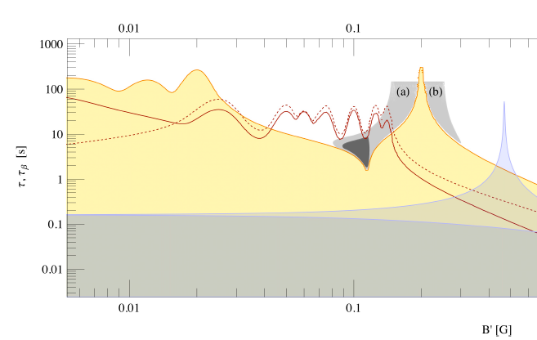
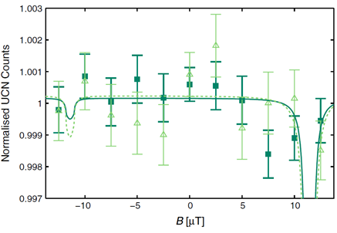

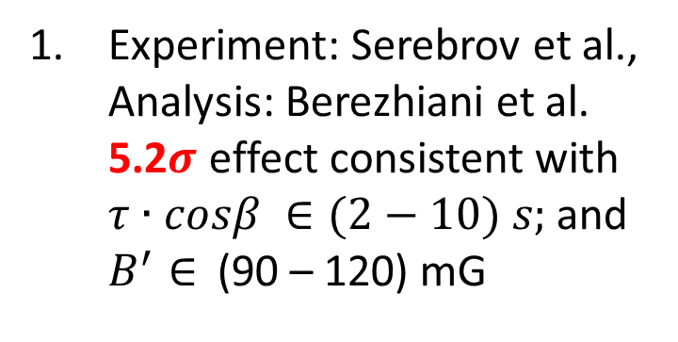
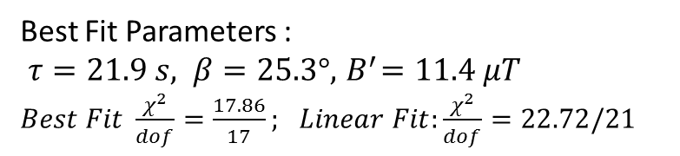
Controversial Results of two UCN experiments (see PDG)
Experiment: Serebrov et al., Analysis: Berezhiani et al. 5.2$σ$ effect consistent with $τ∙cosβ ∈(2−10) s;$ and $B^{′}∈$ (90 – 120) mG
Experiment and Analysis: Altarev et al. no effect at 95% CL. $→$ $τ$ >12 s for $B^{′}∈$ (0 – 125) mG
Measured ⇅ asymmetry →
~ (7±1.4)×10^{4} (~5σ)
Best Fit Parameters :
$τ=21.9 s, β=25.3°, { B}^{′}=11.4 μT$
$Best Fit \frac{χ^{2}}{dof}=\frac{17.86}{17};$ $Linear Fit:\frac{χ^{2}}{dof}=22.72/21$

Slide 8



Resolve controversy using an inexpensive neutron beam experiment
Disappearance Mode
Oscillation signal is a disappearance of neutrons at detector as function of B-Field
$$N→N′$$
Neutron source
B-Field Control
Flux Monitor
Neutron Detector
Regeneration Mode
Oscillation signal is an increase in neutrons at detector as function of B-Field
$$N→N′$$
$$N^{′}→N$$
Neutron source
B-Field Control
Absorber
B-Field Control
Flux Monitor
Neutron Detector
Regeneration and Disappearance Modes can be run concurrently and can be run parasitically with other cold neutron experiments

Slide 9
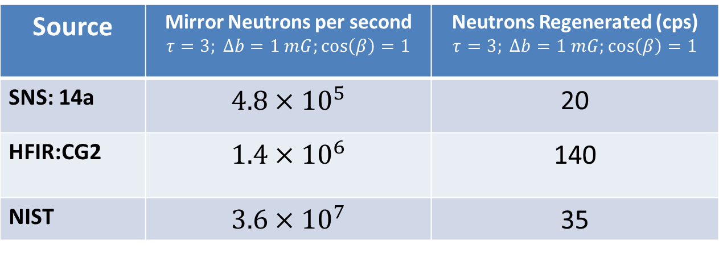
Requirements for Mirror-Neutron Oscillation Experiment
Neutron Source with free flight path > 20 m
  only a few available in US
Magnetic Field control - Helmholtz coils or cos(theta) coil
Neutron Absorber
Neutron Detectors:
  flux monitor,
  3He current mode detector for disappearance
  3He counting mode for regeneration
“Neutron Disappearance and Regeneration from Mirror State” arXiv:1703.06735
Source | Mirror Neutrons per second $$τ=3; Δb=1 mG;\cos\left(β\right)=1$$ | Neutrons Regenerated (cps) $$τ=3; Δb=1 mG;\cos\left(β\right)=1$$
SNS: 14a | $$4.8×{10}^{5}$$ | 20
HFIR:CG2 | $$1.4×{10}^{6}$$ | 140
NIST | $$3.6×{10}^{7}$$ | 35

Slide 10
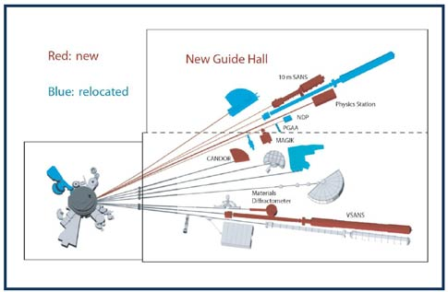

SNS
BL13
NIST
BL14B
60 m
BL14A – not used
HFIR CG2

Slide 11
Search for Mirror Neutrons at HFIR
Existing instrument GP-SANS well suited:
  Long & large area guides, shielded large area detector, spacious
  Improvements required are modest
  Minimal impact on SANS research program
100% detector and beamstop: Only mirror neutrons can pass
Cold neutron source
Disappearance
region
Regeneration
region
Control of B field to “turn on” oscillation

Slide 12
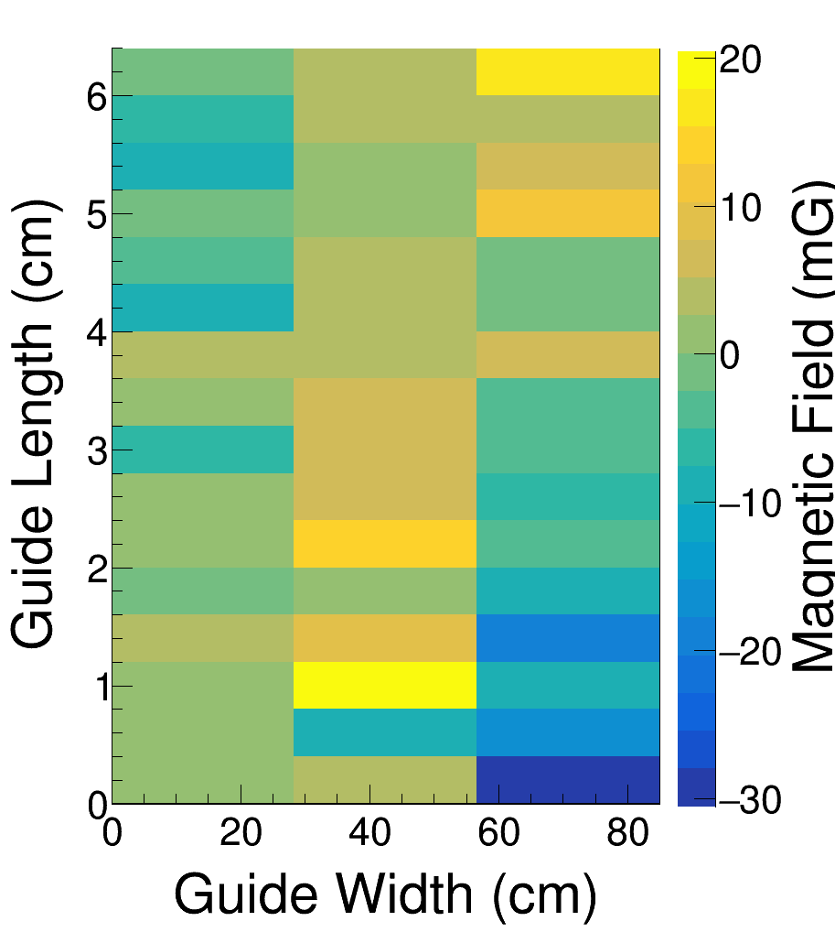
HFIR B field control
Preliminary scan ~ 20 mG nonuniformity + some hot spots
Desired uniformity ~ few mG very reasonable with B control coils + shielding
Guide upgrade in 2018: include considerations for B field uniformity/control
Developing prototype mapping/control systems
(m)

Slide 13
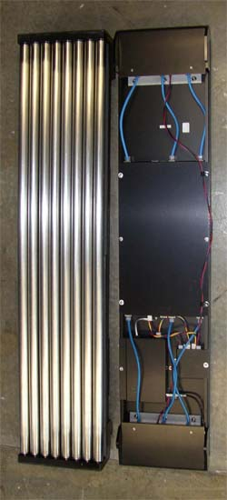
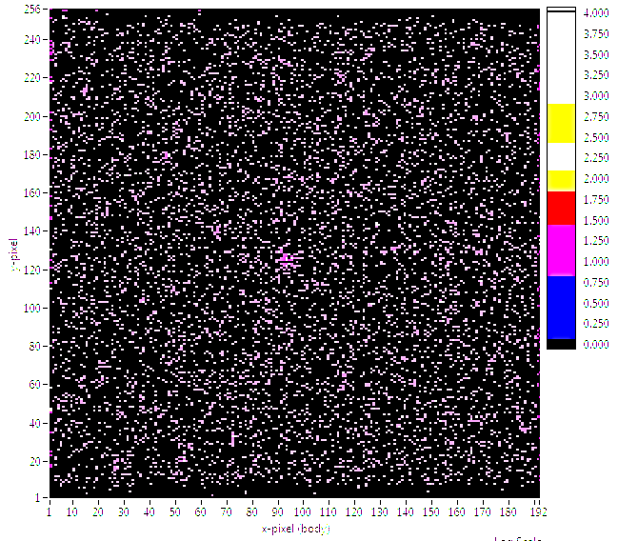
HFIR Background
Regeneration sensitivity depends on Signal : Background
  Goal ≤ 0.05 cps
1mx1m ³He position sensitive detector¹
  ~5 mm position resolution
Measured background with minimal shielding: ~2 cps
  Goal: 0.05 cps with further
  shielding, position cuts
  Measurements with add’l
  shielding after detector
  upgrade later this spring
¹K. D. Berry et al, NIMA 693 (2012) 179

Slide 14
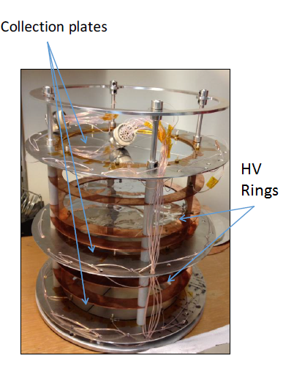
Disappearance Detector
Require 10⁻⁶ level or better monitoring for neutron flux
Use detector provided by n-³He experiment
  n+³He→t+p
Flux monitoring should be statistics limited

Slide 15
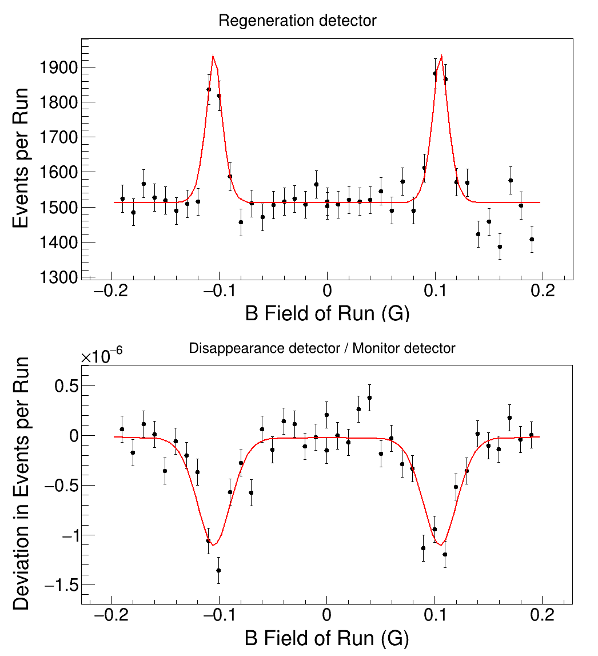
Expected sensitivity @ HFIR
Neutron flux ~ 10⁹ n/s¹
Phase 1: Disappearance
  2 years R&D/implementation
  Limit of τ > 15 s (2 σ) in 2 weeks (with statistics-limited monitor)
Phase 2: Regeneration
  1 year R&D/implementation (req. coordination with BES)
  Limit of τ > 15 s (2 σ) in 2 weeks (with 0.05 cps bkgd)
Project funds < $0.5M
Simulated positive signal at τ = 10 s,
14 days beam time, 10 mG step size
(0.05 Hz bkgd, stats-limited n detectors)
¹L. Crow et al, NIMA 634 (2011) S71

Slide 16
Conclusion
Mirror Matter is a viable candidate for Dark Matter with testable predictions in n-n’ oscillations.
New search using GP-SANS: small, low cost, short beamtime, large potential impact
  Controversy in UCN storage experiments will be resolved
  Pursuing ORNL partial support through LDRD program
Stepping stone to future parasitic experiment at SNS Second Target Station or ESS
Dark Sectors 2016 Workshop: Community Report

Slide 17




Collaboration
K Bailey, B Bailey, L Broussard, V Cianciolo, L DeBeer-Schmitt, A Galindo-Uribarri, F Gallmeier, G. Greene, E Iverson, S Penttila
Oak Ridge National Laboratory
J Barrow, L Heilbronne, M Frost, Y Kamyshkov, C Redding, A Ruggles, B Rybolt, L Townsend, L Varriano
University of Tennessee Knoxville
C Crawford
University of Kentucky Lexington
I Novikov
Western Kentucky University
D Baxter, C-Y Liu, M Snow
Indiana University
A Young
North Carolina State University

