Slide 1
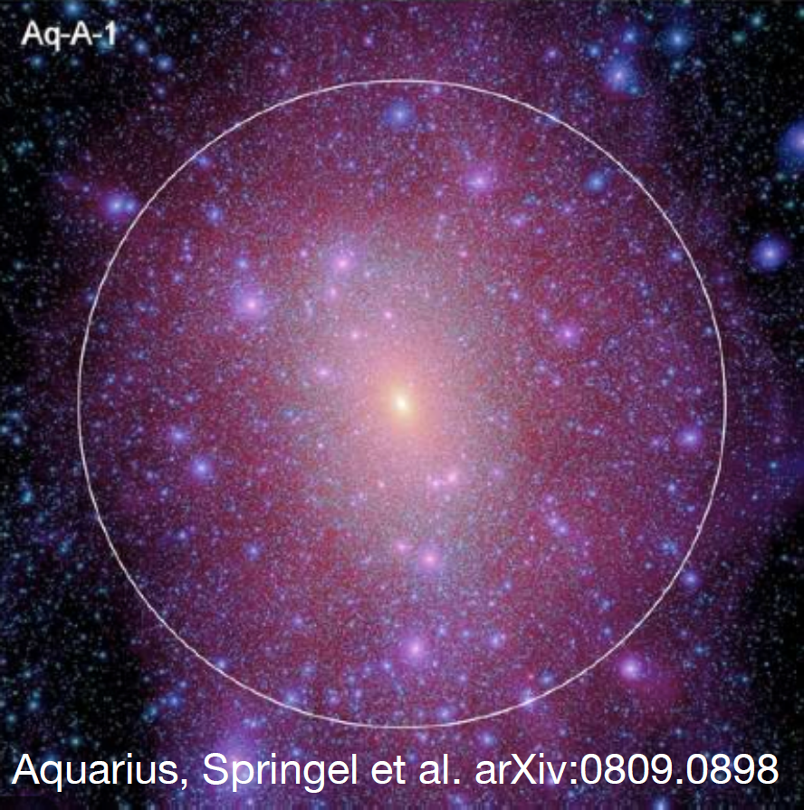
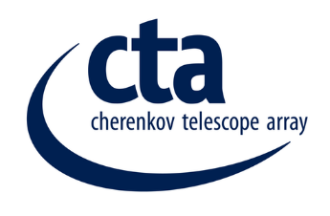
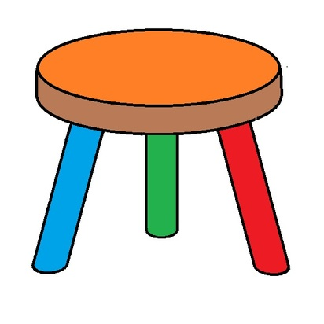
Indirect Searches for Dark Matter with CTA
Aquarius, Springel et al. arXiv:0809.0898
Brian Humensky, for the CTA Consortium
Columbia University
Cosmic Visions, University of Maryland
March 24, 2017
Dark Matter Searches
Cherenkov Telescope Array Concept & Timeline
Dark Matter Search Plans & Complementarity
U.S. Plans & Impact
Summary
Direct Detection
Indirect Detection
Collider

Slide 2
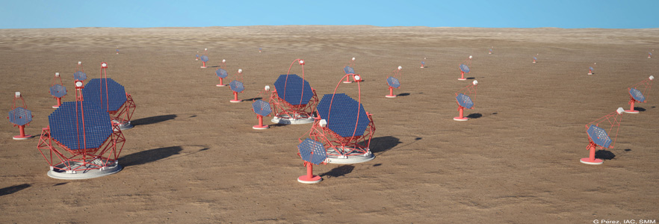
The CTA Concept
Arrays in northern and southern hemispheres for full sky coverage.
  4 large (23 m) telescopes (LSTs) in the center: 20 GeV threshold.
Southern array adds:
  25 medium (9-12 m) telescopes (MSTs): 100 GeV – 10 TeV.
  70 small (~4 m) telescopes (SSTs) covering >3 km² – expand collection area >10 TeV (up to 300 TeV).
Northern array adds 15 MSTs (no SSTs).
Project cost estimate €297M + 1480 FTE-years ~ €400M.
Operations cost estimated to be €20M/year.

Slide 3
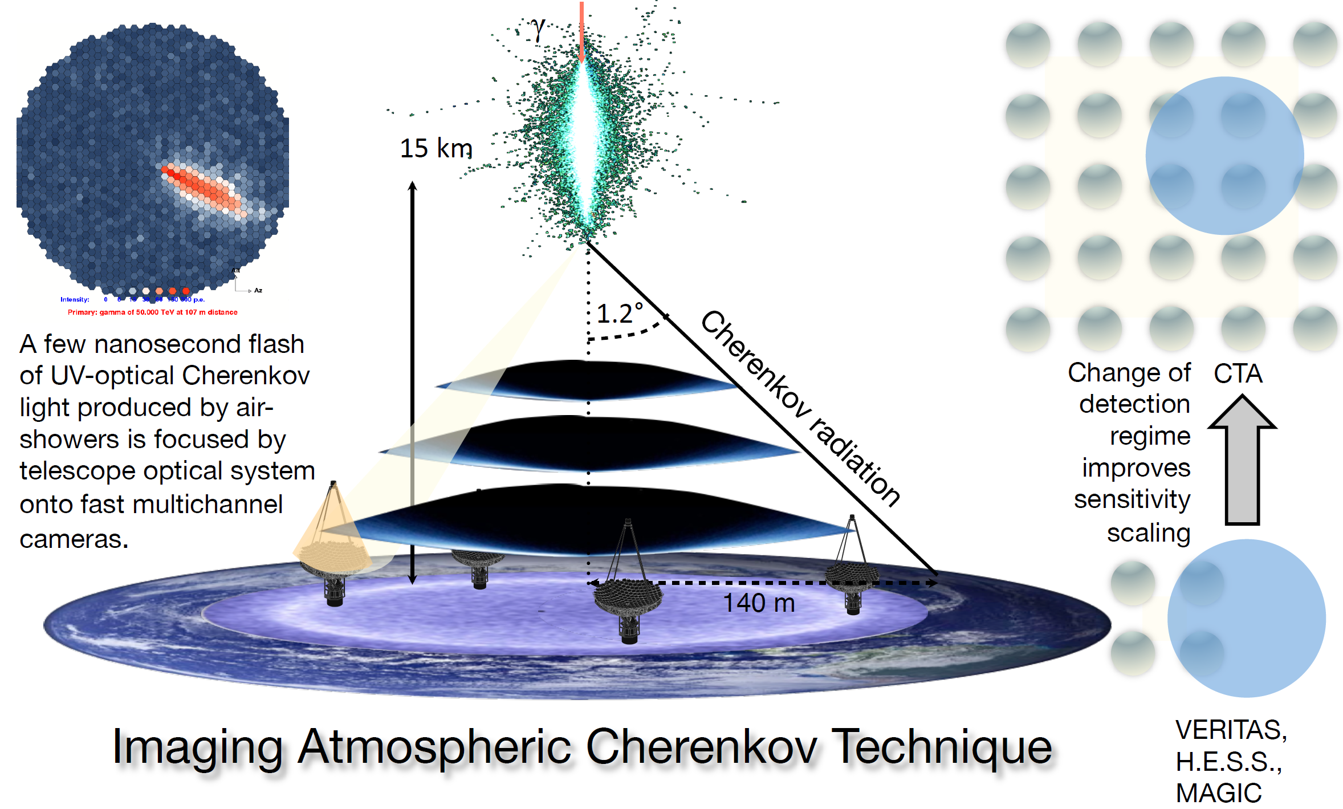
CTA Technique
Adapted from V. Vassiliev, UCLA DM

Slide 4
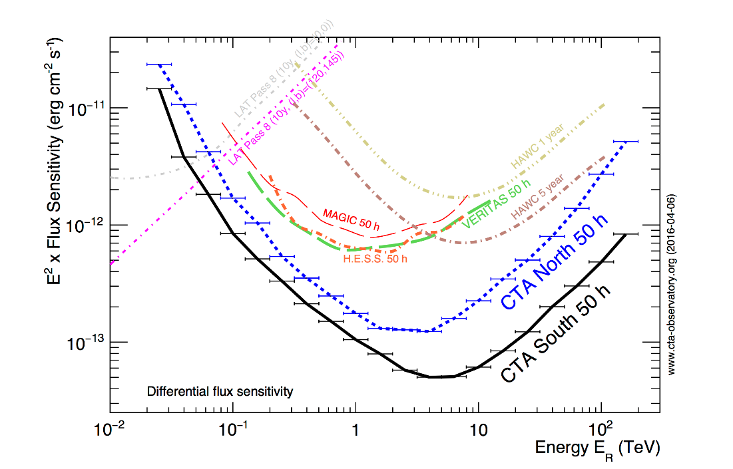
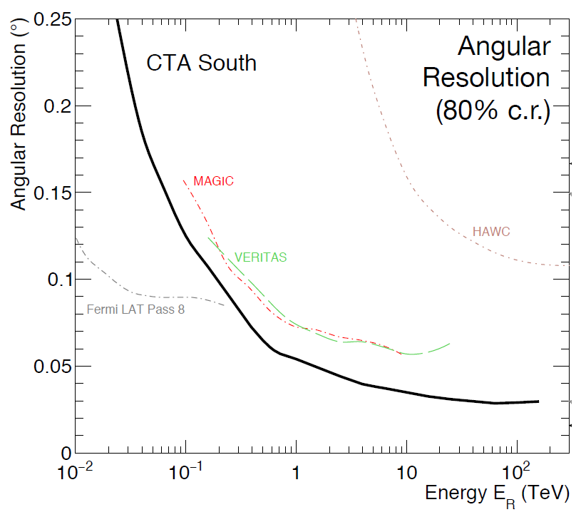
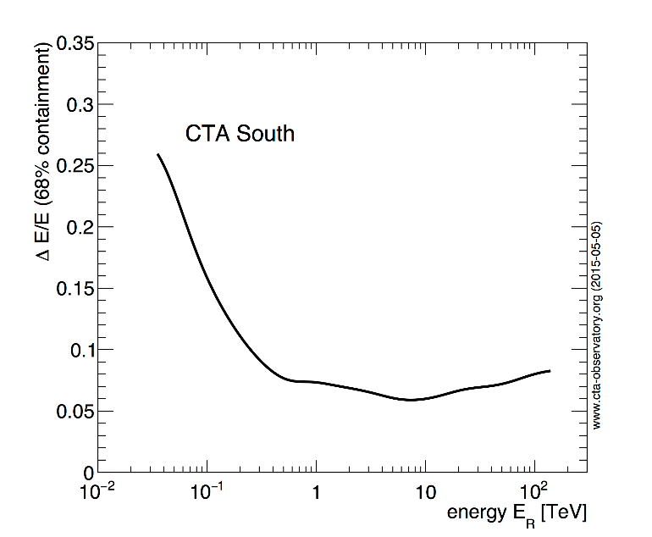
CTA Performance & Sensitivity
Highlights
10 x improved sensitivity.
Wide FoV combined with arcmin-scale angular resolution for efficient surveys and study of extended sources.
  LST: >4.5°, MST/SST: >7.5-8° FoV.
Energy resolution < 10% to resolve spectral features.

Slide 5
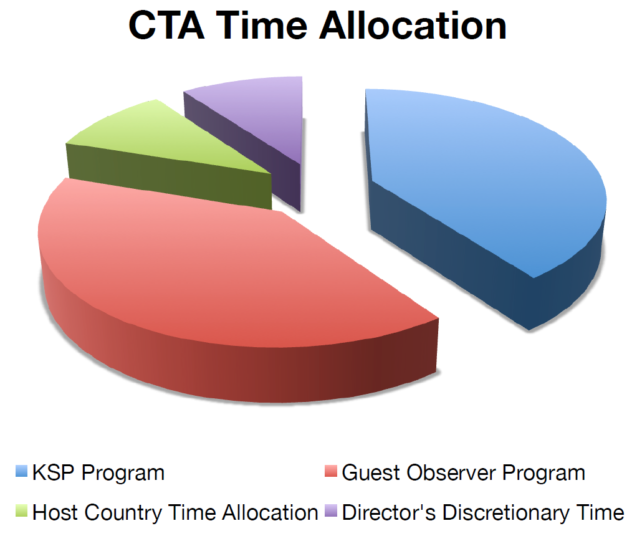
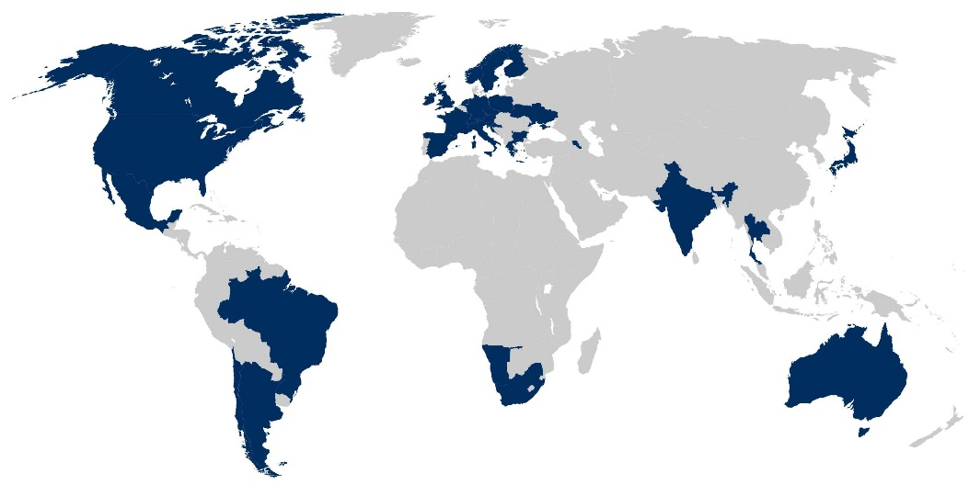
CTA Globally & Data Access
CTA is being developed by the CTA consortium (CTAC) comprising ~1350 scientists (~420 FTEs) from ~210 institutions in 32 countries.
All CTA data and associated tools will be fully open after a proprietary period.
Products delivered to a user: FITS data files, FERMI-like analysis tools, etc.
Over observatory lifetime, majority of time will go to Guest Observer proposers from CTA member countries. The remaining time consists of Director’s Discretionary time and, in the first decade of operations, a ~40% share used by the CTA Consortium to deliver a Core Program consisting of a number of Key Science Projects (KSPs).
https://www.cta-observatory.org/about/cta-consortium/

Slide 6
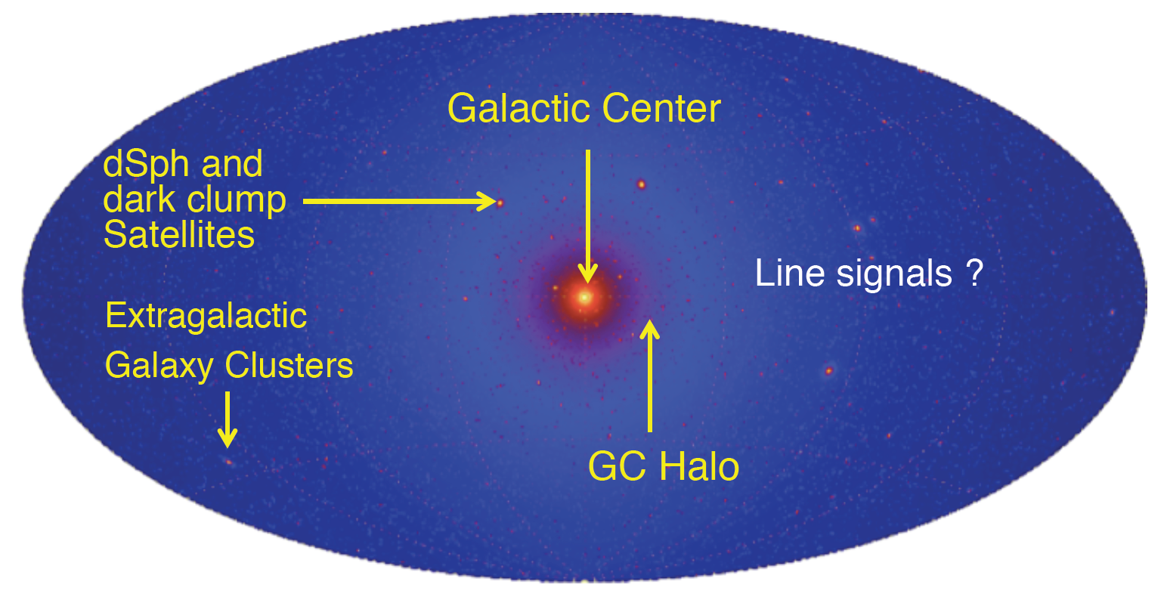
Dark Matter Key Science Program
The priority is to discover the nature of dark matter with a positive observation complementary to the searches for DM at LHC and in direct-detection experiments.
  Capability to discover a thermal relic WIMP, with the “natural” velocity- averaged cross-section of 3 × 10⁻²⁶ cm³s⁻¹, drives the program.
    But sensitive to wide range of DM scenarios.
DM simulation
(Pieri et al., 2011)
The balance between the strength of expected DM annihilation signal, its uncertainty, and the strength of the astrophysical backgrounds drives the prioritization of targets.

Slide 7
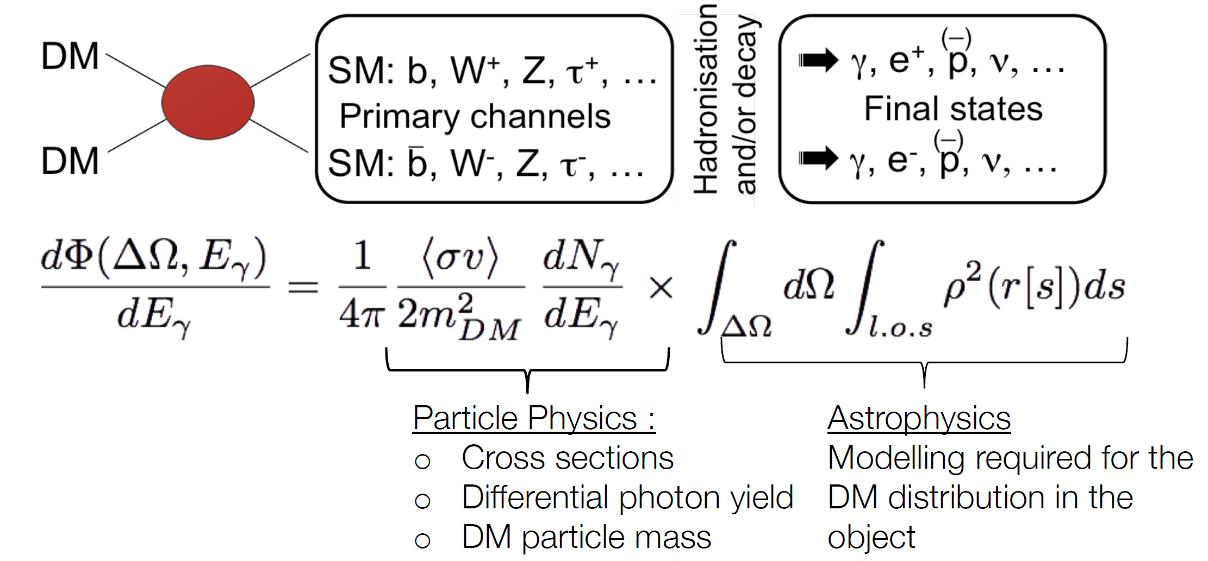
Gamma Rays from DM Annihilation
Can reveal the abundance and distribution of dark matter.
Do not suffer from propagation effects at Galactic scale.
May show characteristic features in their energy spectrum.
Slide adapted from E Moulin

Slide 8
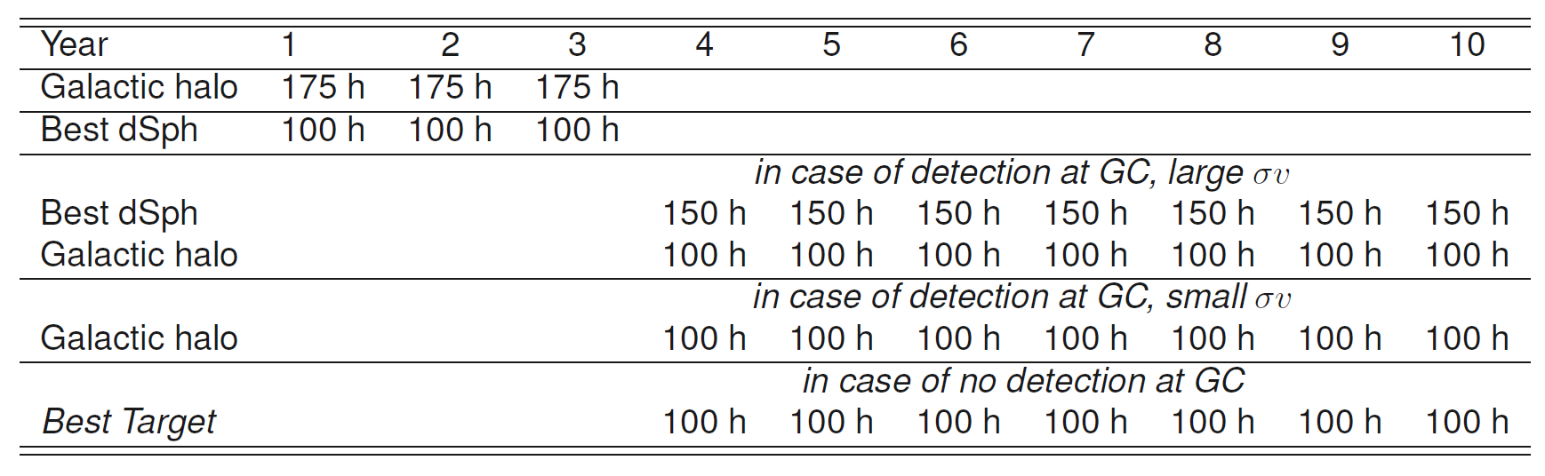
DM Detection Strategy
Observation times under discussion
First 3 years
  The principal target is the Galactic Center Halo (most intense diffuse emission regions removed);
  Best dSph as “cleaner” environment for cross-checks and verification (if hint of strong signal).
Next 7 years
  If there is detection in GC halo data set (525h)
    Strong signal: continue with GC halo in parallel with best dSph to provide robust detection.
    Weak signal: focus on GC halo to increase data set until systematic errors can be kept under control.
  If no detection in GC halo data set, focus observations on the best target at that time to produce legacy limits.

Slide 9
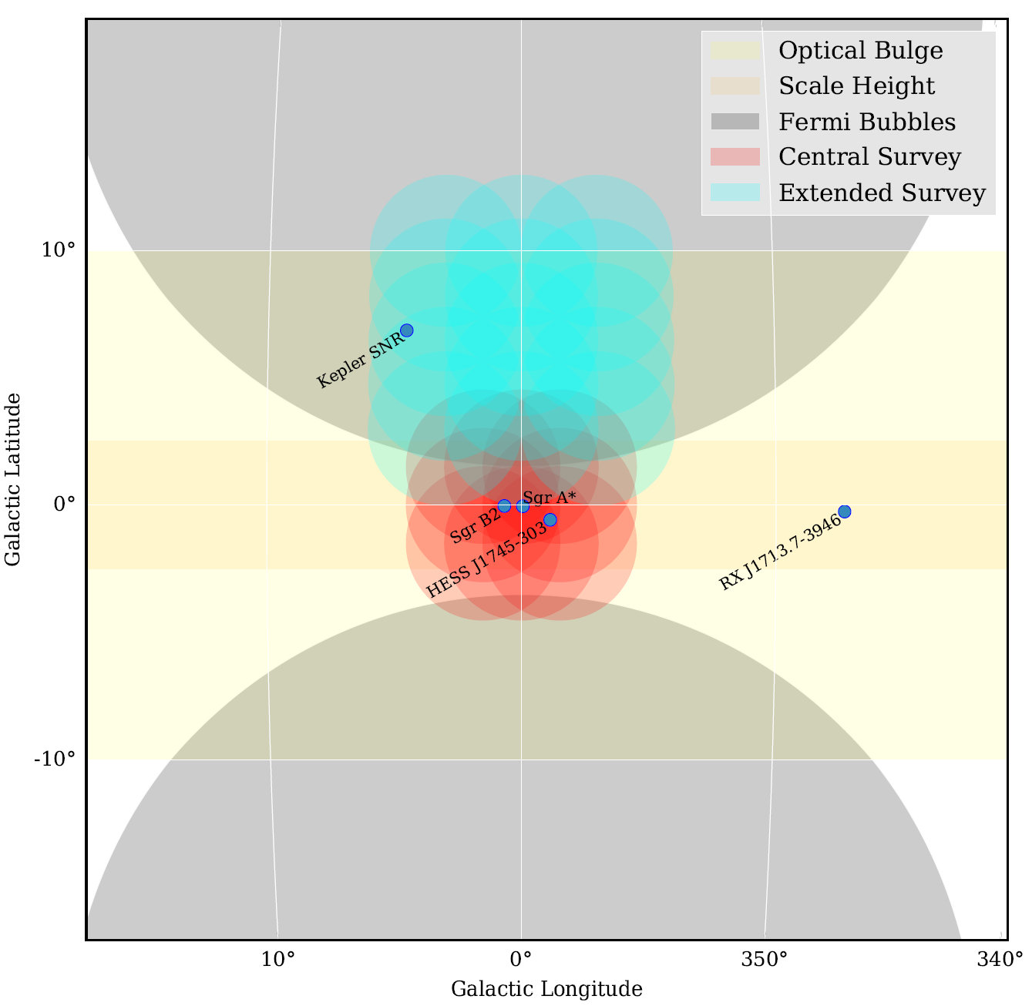
Deep Look at Galactic Center/Halo
Deep 525 h exposure in the inner 5° around Sgr A*.
Extended 300 h survey: 10° x 10° region.
Produce CTA legacy data set for broad set of scientific topics:
  GC and GC DM halo.
  Understand astrophysical backgrounds: pin down VHE sources, map diffuse emission.
  Astrophysics of SNRs (e.g. G1.9+0.3), PWNe, and Pulsars.
  Extended objects such as Central Radio lobes (central ±1°) and arc features; base of Fermi Bubbles.

Slide 10
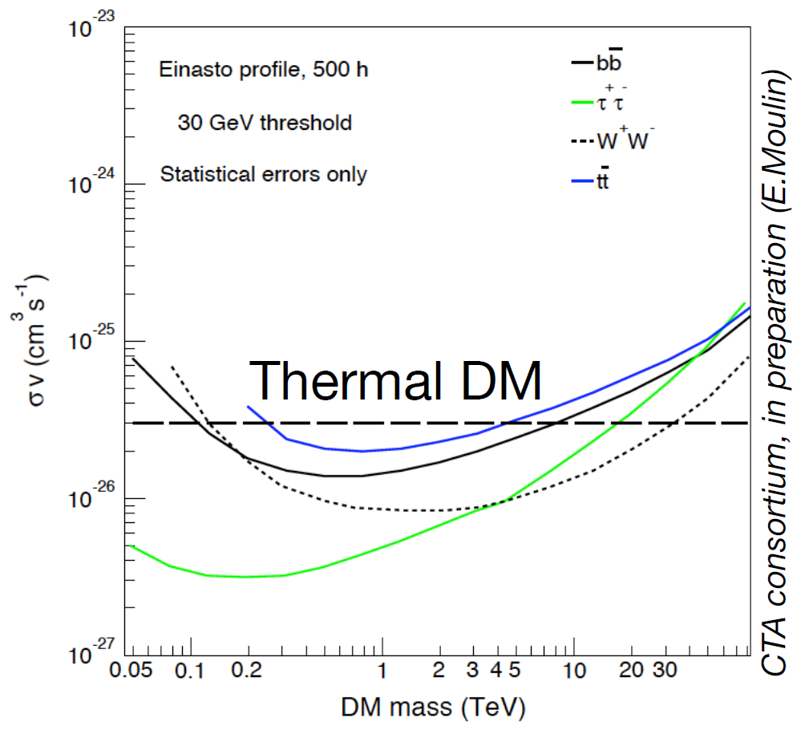
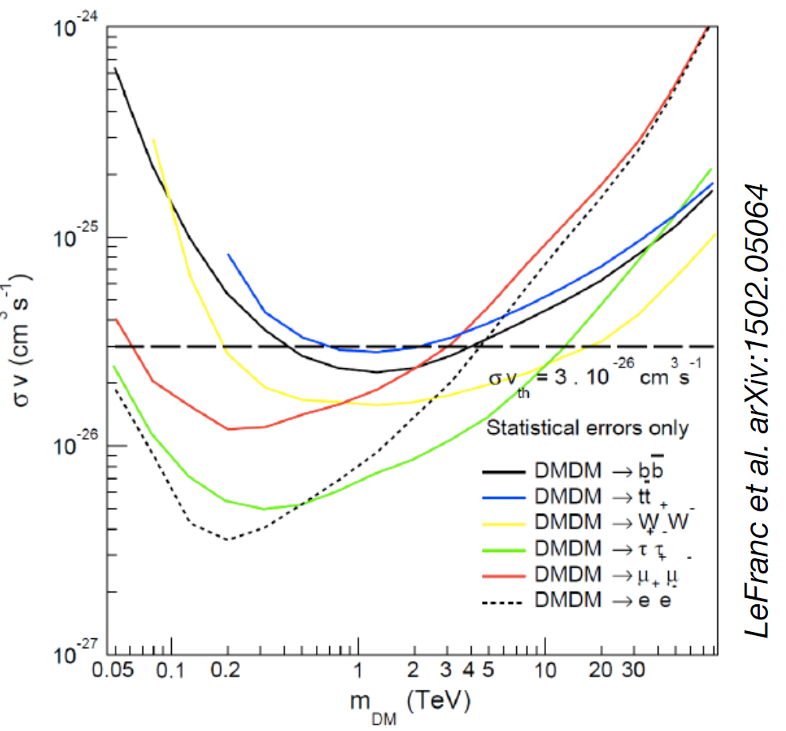
GC Halo DM Sensitivity
Thermal value of the annihilation cross-section is within CTA reach – for the first time an array of IACTs will be able to probe predicted WIMP parameter space.
The observing strategy is based on the detection of the gradient in the rings (1° - 5°; width 1°) centered on GC with the strip |b|<0.3° removed.

Slide 11
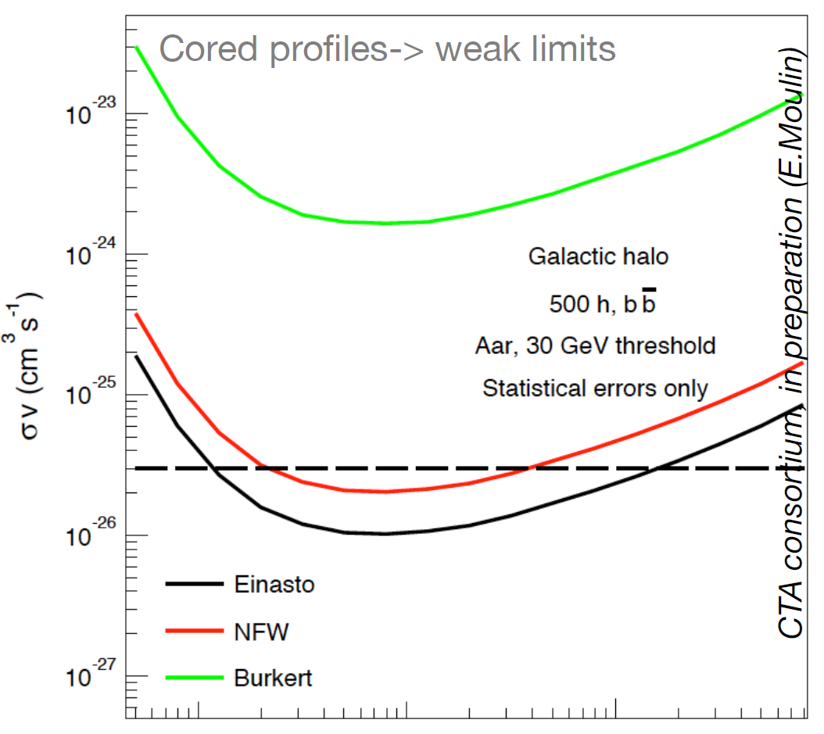
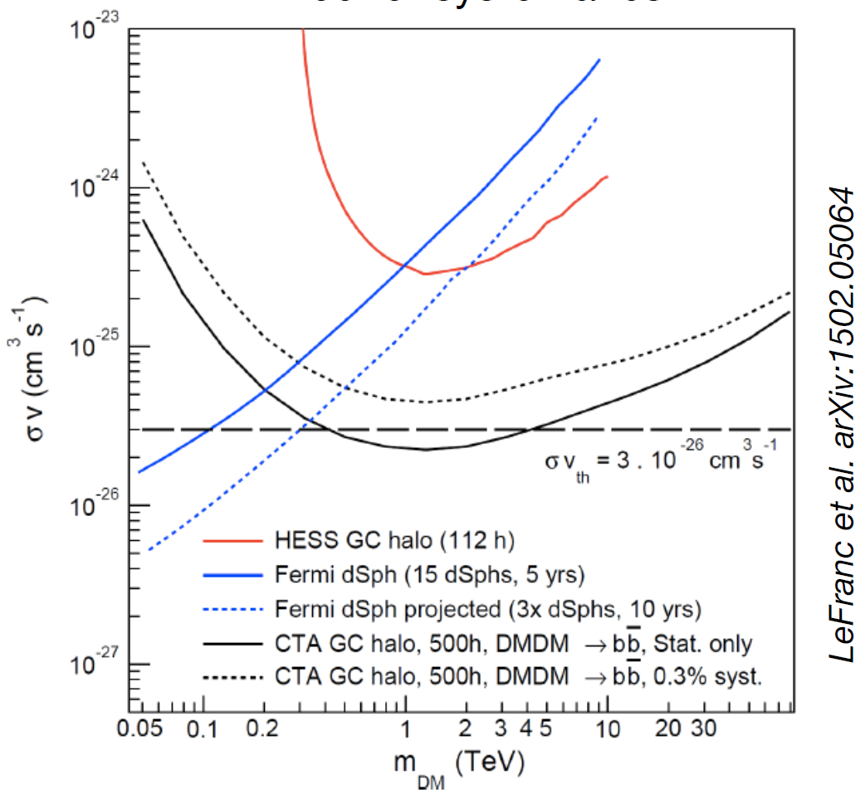
GC Halo DM Sensitivity
Dark Matter Profiles
Effect of Systematics
Cored profiles generate weaker limits and typically large systematics.
Estimated systematic errors have dramatic effect particularly on the detectability of the hadronic channels.

Slide 12
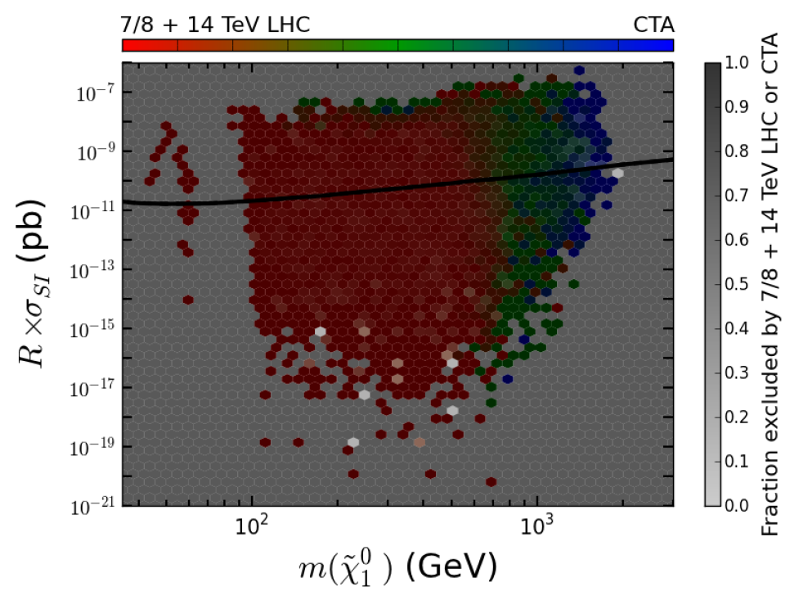
Complementarity with DD, Colliders
LHC: 7-8 TeV
Cahill-Rowley et al. 2015
Indirect detection (CTA), direct detection, and LHC together cover much broader parameter space than any one technique alone.
Overlapping regions provide multiple handles constraining DM properties.
Indirect detection key at high masses.
Dark Matter Searches
Direct Detection
Indirect Detection
Collider

Slide 13
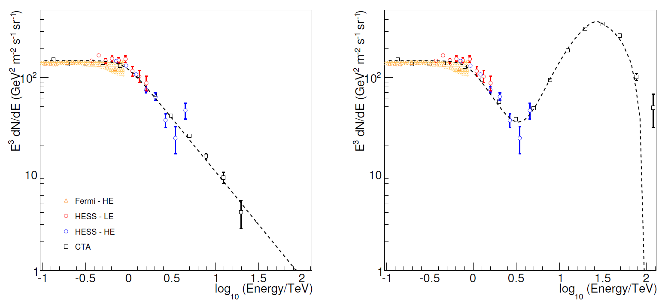
Complementarity with other Particles
Cosmic-Ray Electrons:
No local sources
Parsons 2011
CTA will extend the CR electron spectrum to >20 TeV.
  Extend further if local sources or DM contribute.
CTA is sensitive to axions /axion-like particles (ALPs) through ALP-photon conversion in magnetic fields.
  ALPs modify γ-ray spectra of active galactic nuclei.
CTA will test a unique region of phase space, including a region in which they would behave as cold dark matter.
Cosmic-Ray Electrons:
Local source similar to Vela PWN

Slide 14
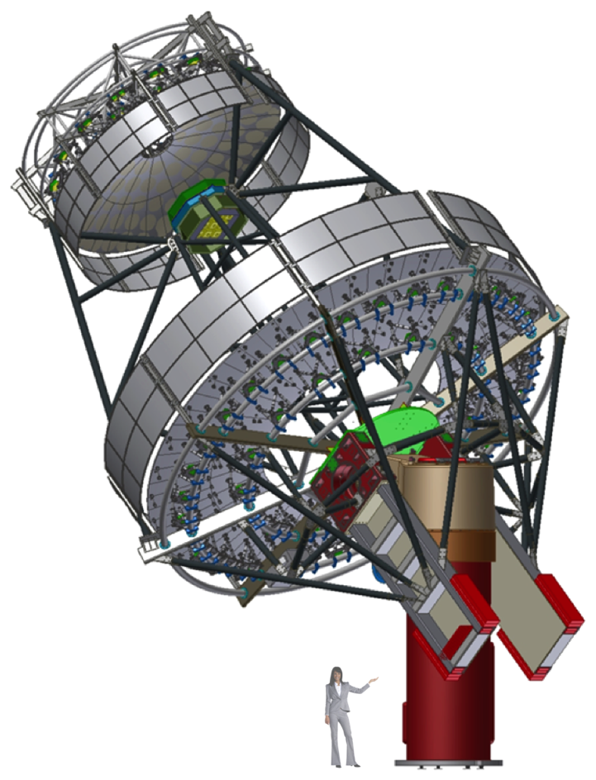
US Plans: Schwarzschild-Couder Telescope (SCT)
Designed to deliver performance close to theoretical limit of Cherenkov technique.
Innovative U.S. design key to boosting CTA performance.
  Corrects aberrations → higher resolution, wider field.
  Small plate scale enables SiPM camera.
Deep analog memory waveform samplers to minimize dead-time and allow flexible triggering.
  High level of integration into ASICs allows dramatic cost savings (<$80 per channel) and high reliability (11,328 channels).
Cost comparable to 1-mirror medium-size telescope.
Adopted by European groups for small-sized telescopes.
P5* Review (2014) recommends U.S. participation in CTA:
  Particle physics science prospects justify particle physics funding investment.
  Broad science case calls for joint astronomy participation.
SCT now a strong international partnership: US, Germany, Italy, Mexico.
Uses the same positioner and foundation as single-mirror MST

Slide 15
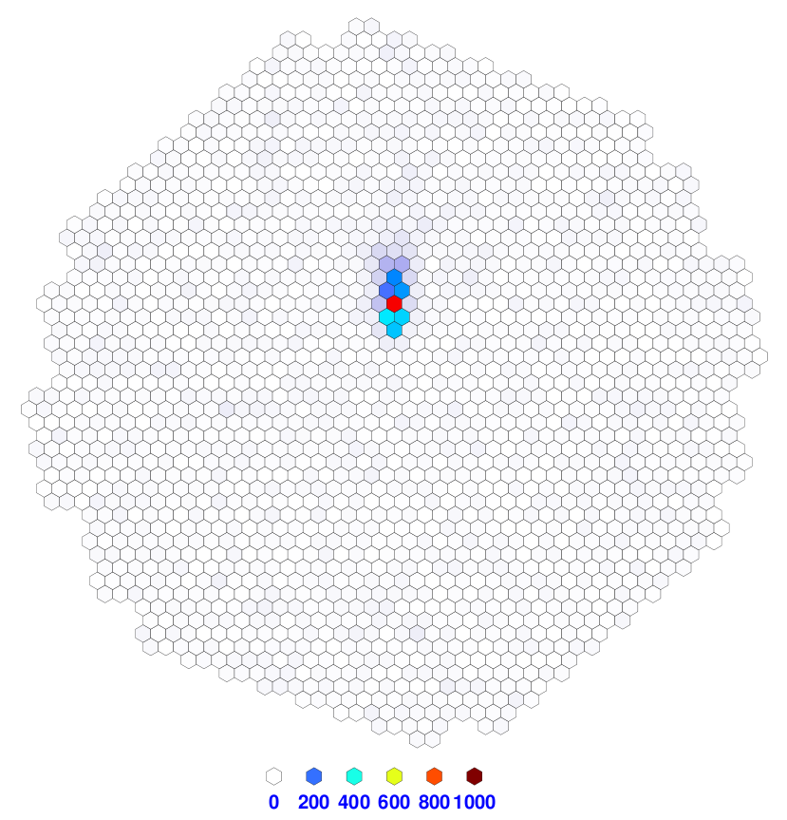
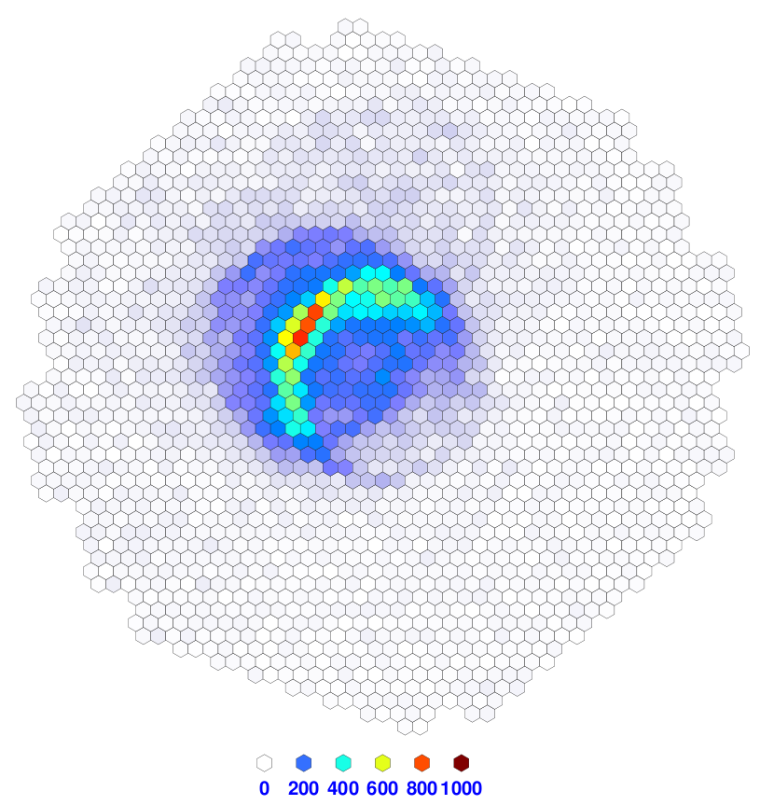
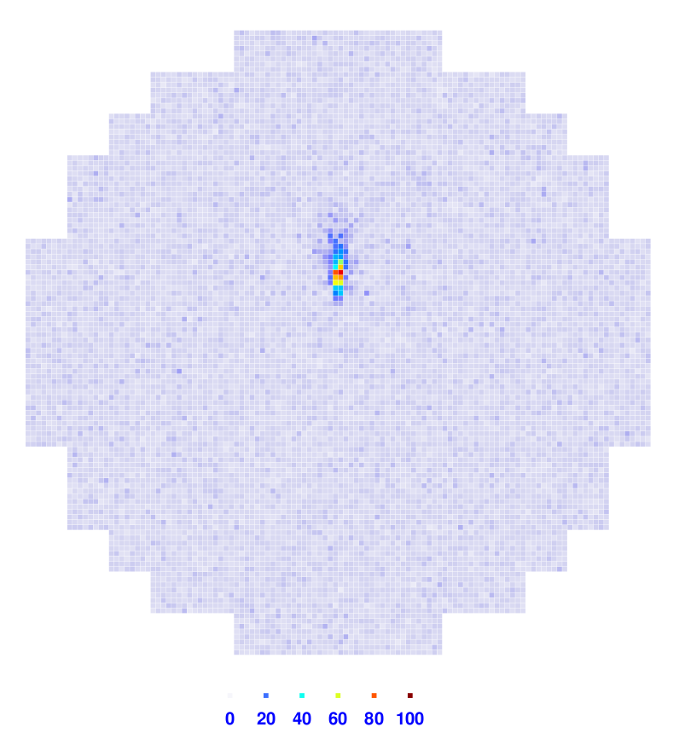
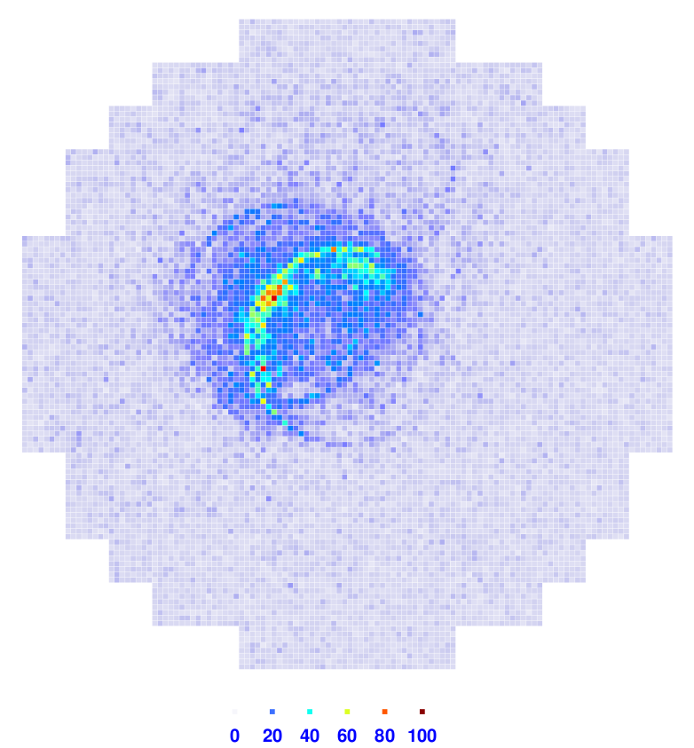
SCT: Better Shower Characterization
Single-Mirror
MST
Images
8° field of view
0.18° pixels
1,570 channels
Background:
Proton Shower
Energy: 3.2 TeV
Signal:
γ-ray Shower
Energy: 1 TeV
U.S. Design
SCT
Images
8° field of view
0.067° pixels
11,328 channels

Slide 16
SCT: Better Shower Characterization
Single-Mirror
MST
Images
8° field of view
0.18° pixels
1,570 channels
Performance simulations comparing arrays of single-mirror MSTs and (slightly smaller) SCTs show that for the SCT array:
  The γ-ray angular resolution is ~30% better
  The γ-ray point source sensitivity is ~30% better (as much as 50% better in some cases)
  The effective field of view has 25% larger radius
M. Wood et al. 2016, Astroparticle Physics 72, 11
T. Hassan et al. 2015, Proc. ICRC, arXiv:1508.06076
Background:
Proton Shower
Energy: 3.2 TeV
Signal:
γ-ray Shower
Energy: 1 TeV
U.S. Design
SCT
Images
8° field of view
0.067° pixels
11,328 channels

Slide 17
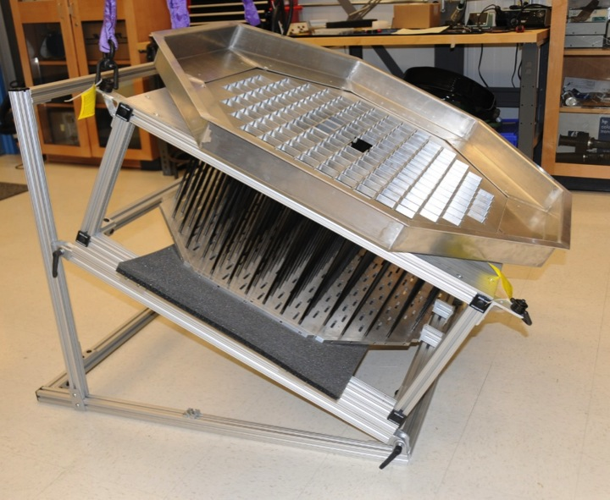
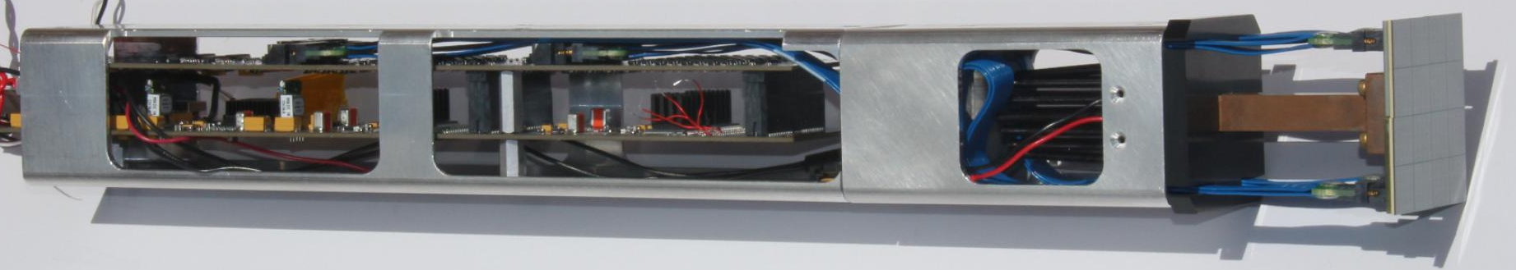
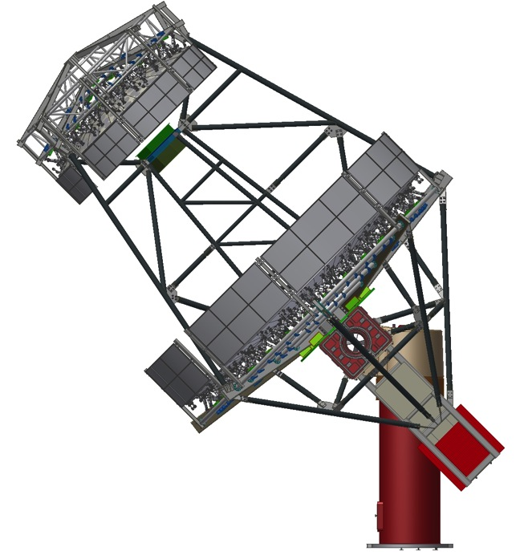
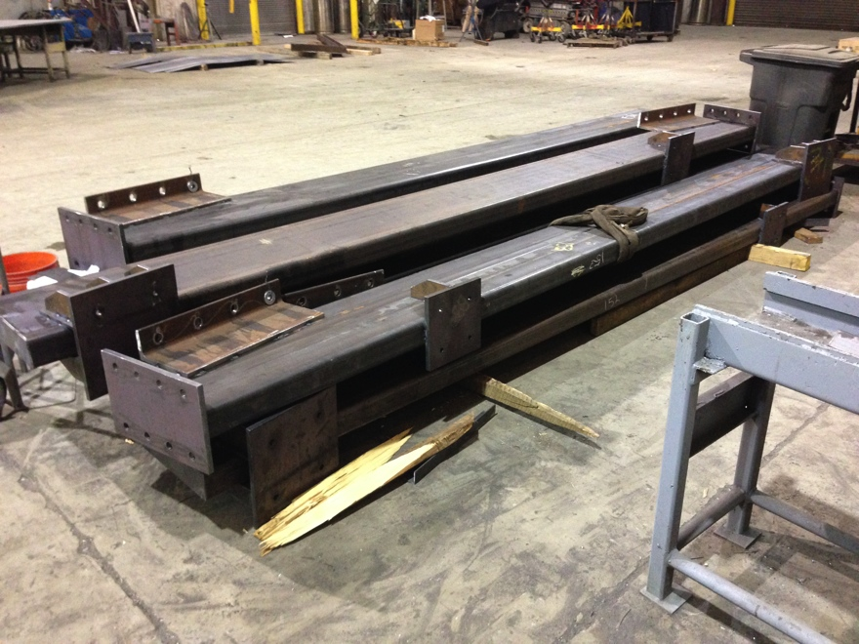
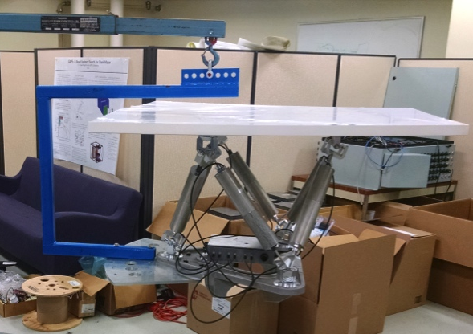
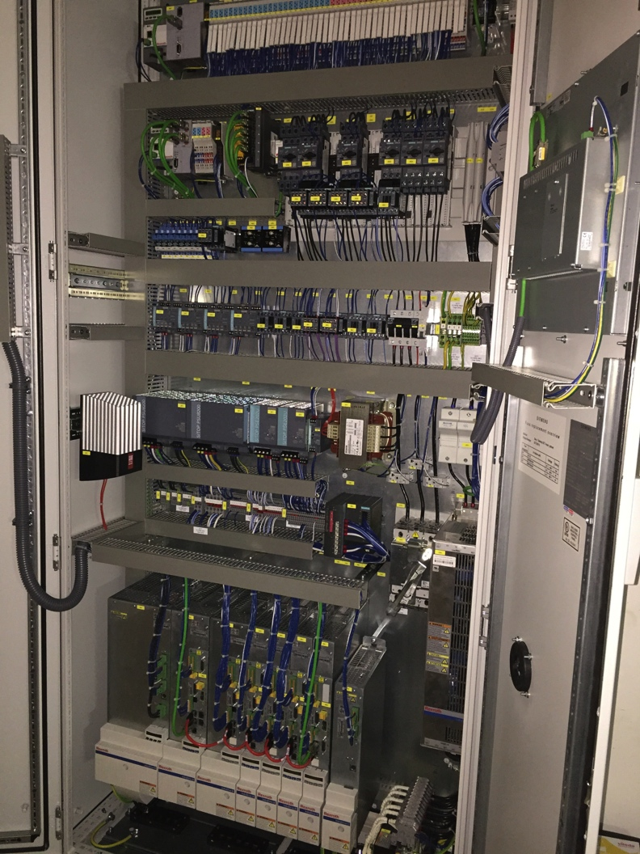
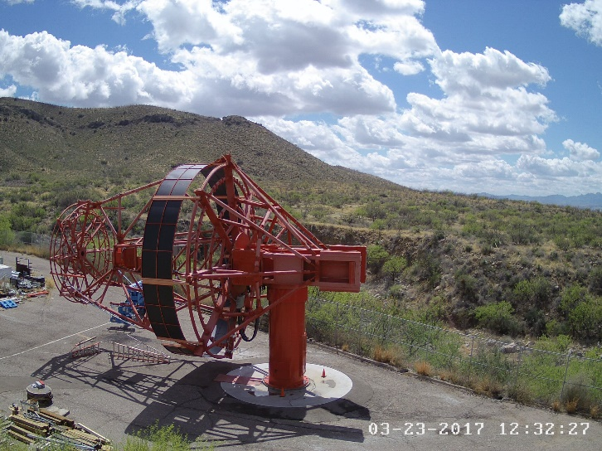
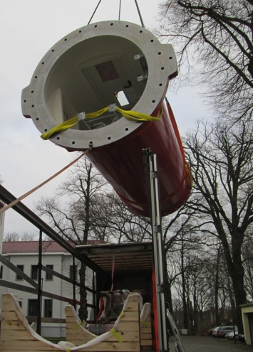
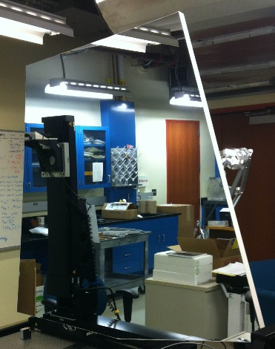
Prototype SCT Takes Shape
Camera Module
Camera Frame
Mirror Panel Module
Optical Support Structure Beams
pSCT —Live feed:
http://cta-psct.physics.ucla.edu
Positioner
Tower
Tracking Control Cabinet
Mirror Panel

Slide 18
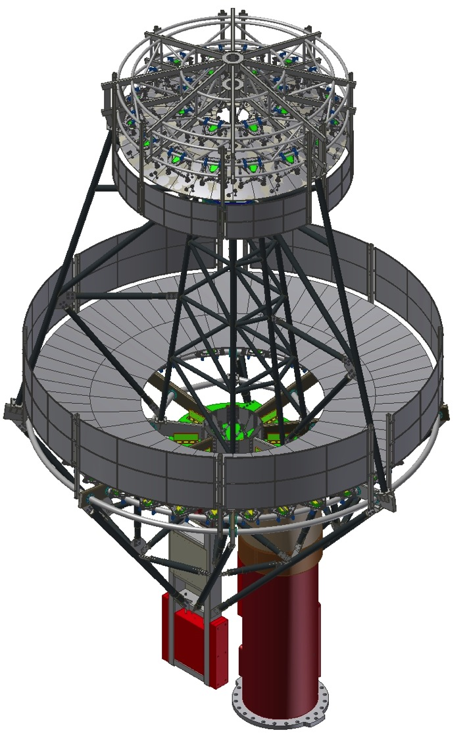
CTA-US Goals
Implementation of the baseline MST arrays:
  Dominate sensitivity over 100 GeV – 10 TeV.
Complete prototype SCT:
  Verify performance.
  Vette performance and cost through CTA reviews.
Lead completion of baseline MST array(s) in S or N with 15 SCTs:
  In collaboration with international partners.
  In S would add to 10 single-mirror MSTs.
Secure $25M in construction funding from the U.S. agencies, in part from the NSF Astronomy MSIP program (2017 call).
Support CTA operations at a commensurate level:
  ~$1.8M per year for 10 years, starting ~2023.
Participate in full spectrum of CTA science:
  Key Science Projects, open-time proposals.

Slide 19
Impact of $25M on a €400M Project
The highly integrated nature of the project means that it will readjust based on available resources. MST Baseline: S – 25, N – 15 telescopes.
Three subjective hypotheses do lead to some conclusions:
  With substantial U.S. and French participation, both baseline MST arrays can be complete.
  Without U.S. participation, only single-mirror MSTs will be built.
  The U.S. brings one of the MST arrays into its complete baseline configuration with 15 SCTs, and it would otherwise be 6 telescopes smaller (and all single-mirror telescopes).
 | South | North
Telescopes w/o U.S. | 19 single-mirror MST | 9 single-mirror MST
Telescopes w/ U.S. | 10 single-mirror MST + 15 SCT | 15 SCT
 | Improvement Factors with U.S. Participation
Angular resolution (containment radius) | 1.25 | 1.5
Point source sensitivity | 1.3 | 1.7
Point source time to significance | 1.7 | 2.9
Field of view (effective radius) | 1.14 | 1.25
Survey speed | 2.2 | 4.5
or

Slide 20
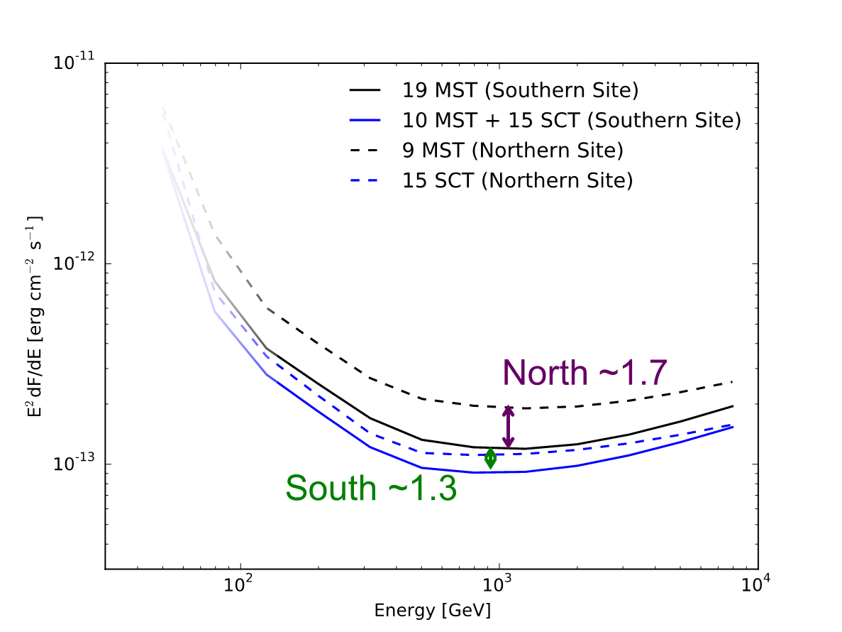
Impact of $25M on a €400M Project
The highly integrated nature of the project means that it will readjust based on available resources. MST Baseline: S – 25, N – 15 telescopes.
Three subjective hypotheses do lead to some conclusions:
  With substantial U.S. and French participation, both baseline MST arrays can be complete.
  Without U.S. participation, only single-mirror MSTs will be built.
  The U.S. brings one of the MST arrays into its complete baseline configuration with 15 SCTs, and it would otherwise be 6 telescopes smaller (and all single-mirror telescopes).
 | South | North
Telescopes w/o U.S. | 19 single-mirror MST | 9 single-mirror MST
Telescopes w/ U.S. | 10 single-mirror MST + 15 SCT | 15 SCT
 | Improvement Factors with U.S. Participation
Angular resolution (containment radius) | 1.25 | 1.5
Point source sensitivity | 1.3 | 1.7
Point source time to significance | 1.7 | 2.9
Field of view (effective radius) | 1.14 | 1.25
Survey speed | 2.2 | 4.5
More sources detected;
reduced impact of systematic errors
or

Slide 21
Summary: Indirect DM via CTA
DM science motivation as compelling as ever – too important for the U.S. not to participate
  Together with Fermi, CTA will be able to exclude thermal WIMPs within the mass range from a few GeV up to a few tens of TeV.
  For heavy WIMPs (>TeV) CTA will provide unique observational data to probe parameter space not reachable by any other experiments planned today.
  CTA is complementary instrument to LHC and direct DM searches probing some non-overlapping regions of DM particle parameter space.
  If DM is detected by CTA, it will also be possible to explore some properties of DM particle through the study of annihilation channels, etc.
  Control of systematics in deep observations of GC halo and dSph(s) is critical for these studies; will require full knowledge of the instrumentation (hence CTA KSP)
    Better understanding of J factors is essential for interpretation of observational data and derivation of limits.
Builds on decades of U.S. leadership, investment and success.
U.S. participation is essential to CTA achieving its DM science goals.
Single worldwide effort leverages U.S. contribution.
U.S. access to the next premier VHE γ-ray observatory – an opportunity not to miss!

Slide 22
Backup Slides

Slide 23
Outline
Cherenkov Telescope Array Concept & Timeline
Dark Matter Search Plans
Complementarity
U.S. Plans & Impact
Summary

Slide 24
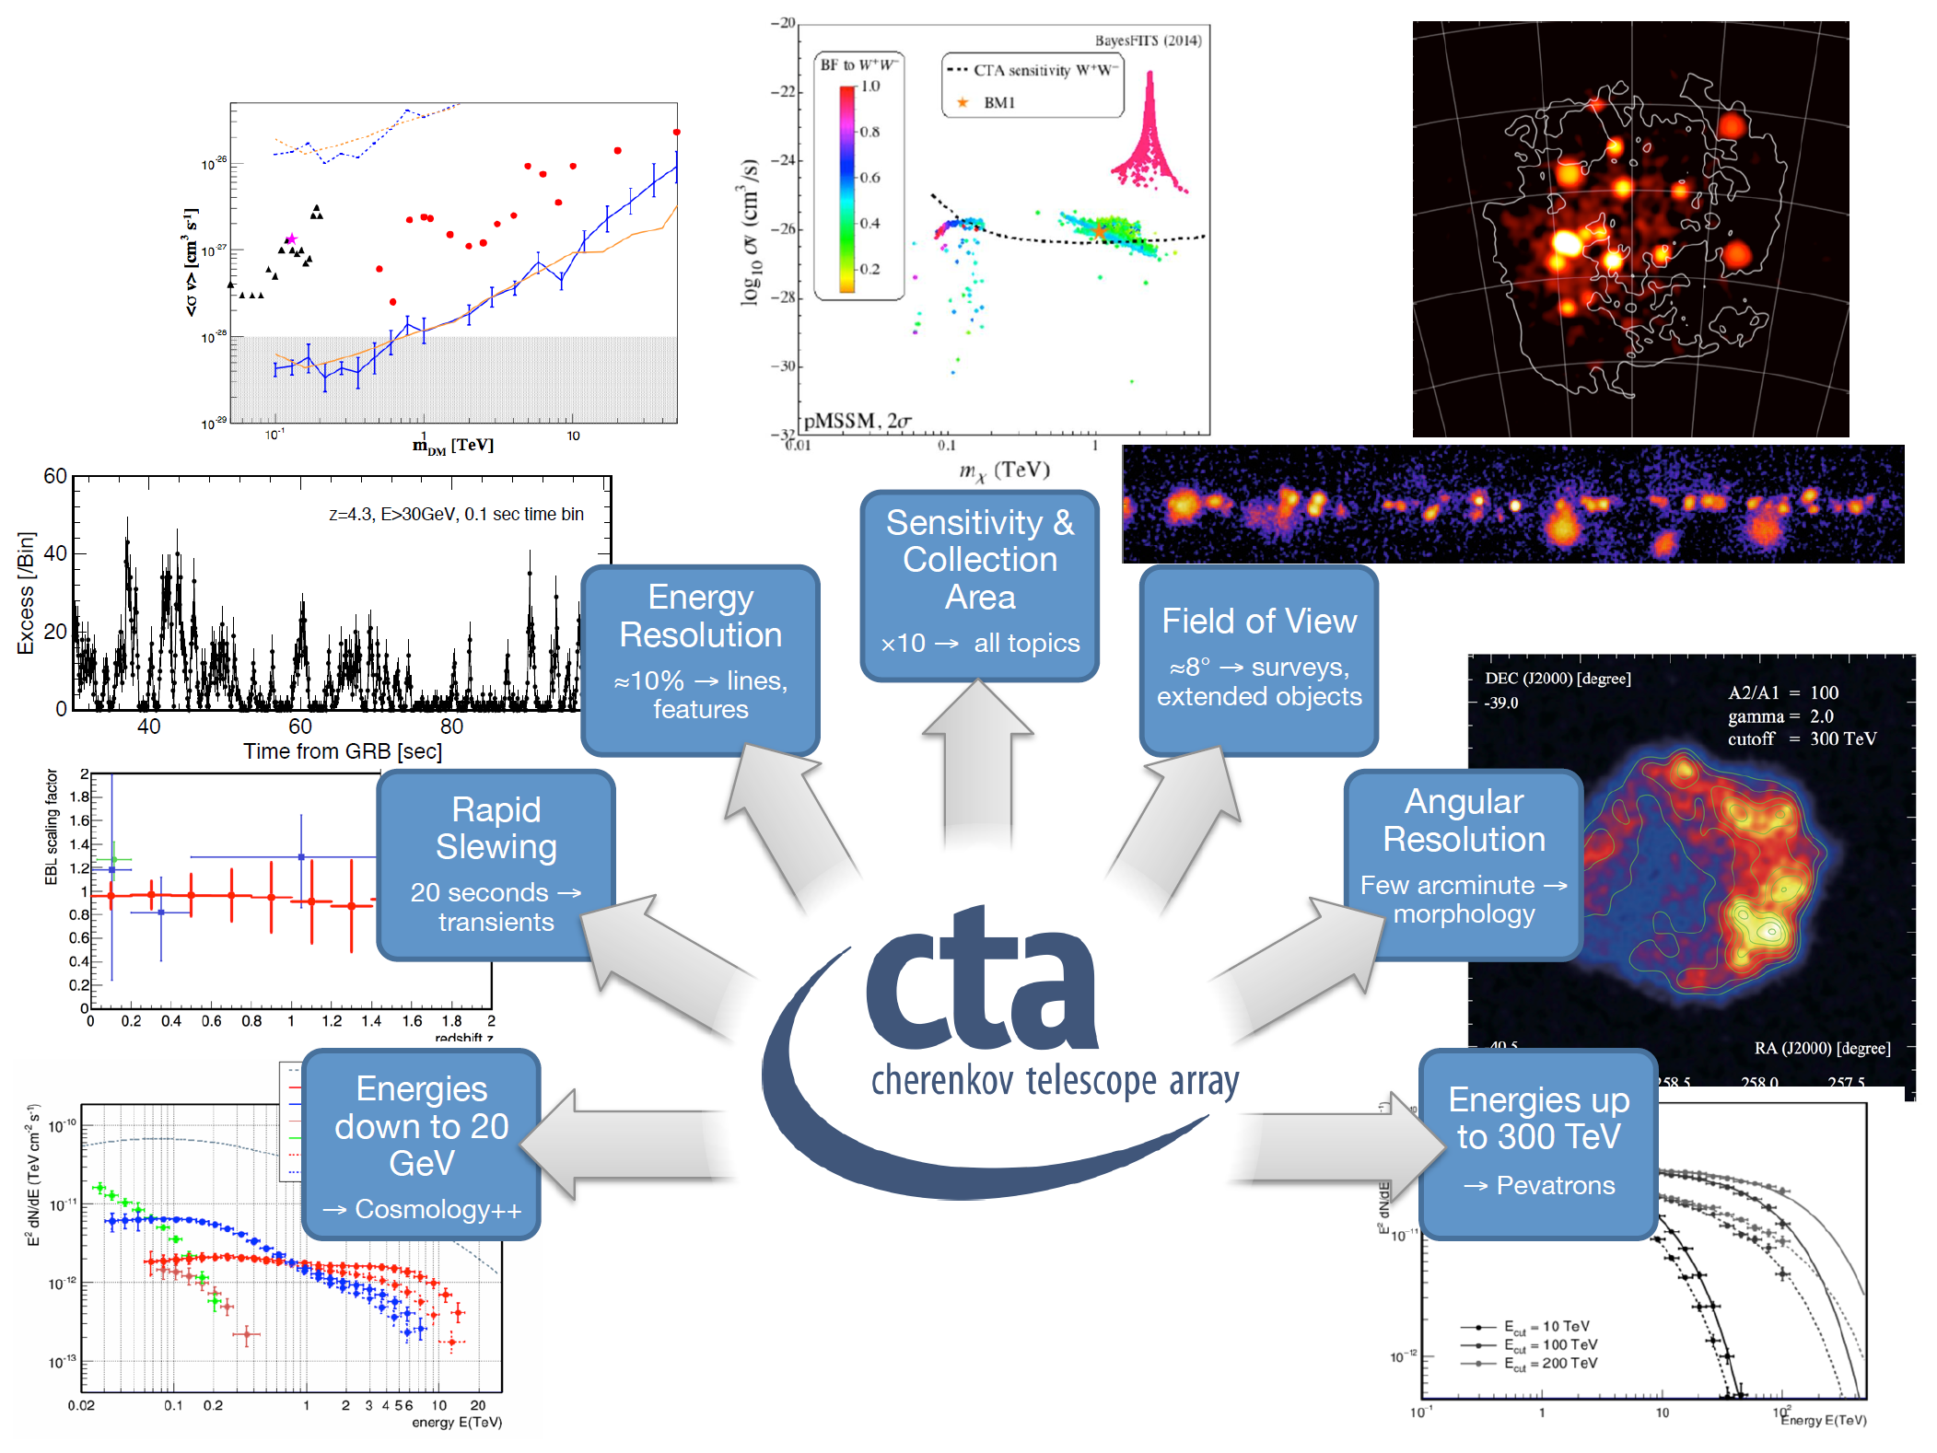
CTA Advances in State of the Art
Adapted from J. Hinton, CTA CDR

Slide 25
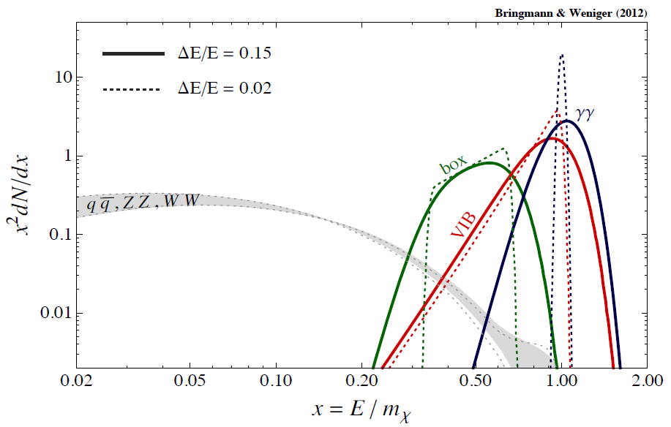
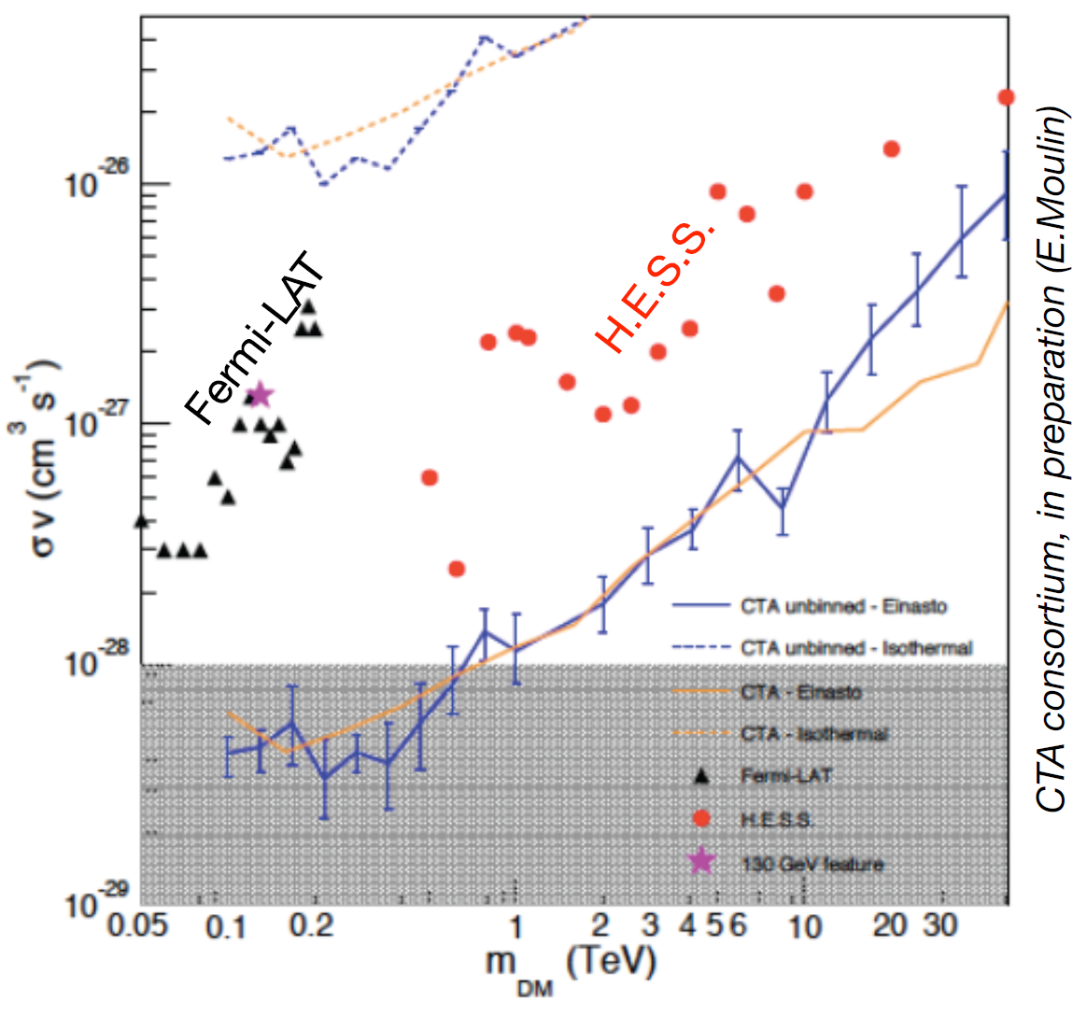
DM Annihilation Spectral Features
Gamma-ray lines
from two-body annihilation into photons; forbidden at tree-level, generically suppressed by O(α2).
Virtual Internal Bremsstrahlung (VIB)
radiative correction to processes with charged final states; generically suppressed by O(α).
Owing to improved energy resolution CTA is ideally suited for search of DM annihilation spectral features, line and VIB (arguably “smoking gun” for WIMPs), in the signal from GC region.

Slide 26
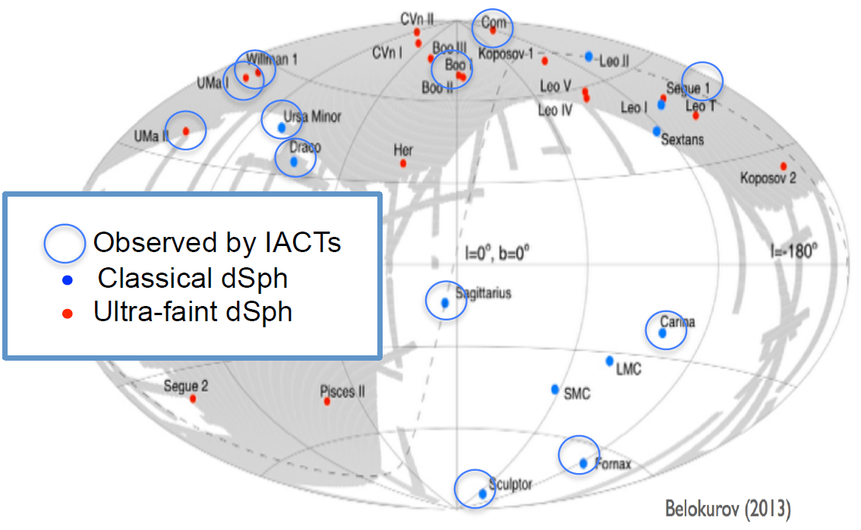
Alternative Targets for DM
Many DM sub-halos are predicted to populate the Milky Way DM halo.
Both dwarf spheroidal galaxies and DM clumps (no significant baryonic matter) could potentially be detected in CTA surveys.
Dwarf spheroidal galaxies have long been targets favored by IACTs for indirect DM searches due to
  Arguably most DM-dominated systems in the Universe.
  Lowest astrophysical backgrounds due to conventional VHE physics.
No VHE detection has been reported so far.

Slide 27
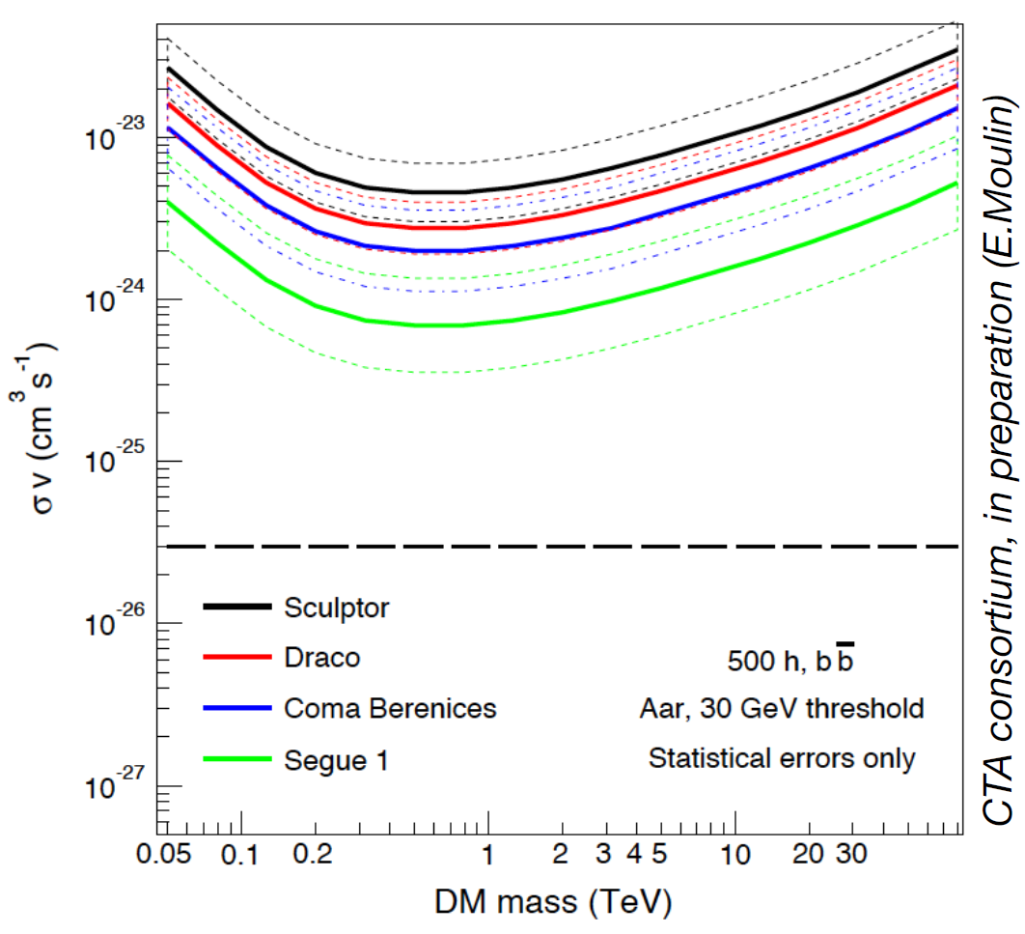
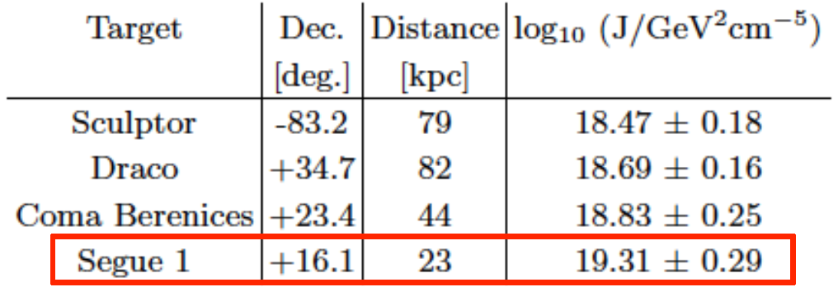
CTA Sensitivity to dSph Galaxy DM
dSph’s J-factor controversies:
  Possible anisotropy in the velocity dispersions;
  Possible contamination from foreground
  Milky Way stars (Segue I’s J-factor is particularly questionable Bonnivard, Maurin, Walker arXiv: 1506.08209)
New ultra-faint dSphs discovered in DES survey in the Southern hemisphere, e.g. Reticulum II, and more such discoveries are anticipated with the start of LSST operation.
Best dSph targets for CTA will be selected on the latest knowledge prior to the observations.

Slide 28
Complementarity with other Particles
No local sources
Parsons 2011
Local source similar to Vela PWN
CTA will extend the cosmic-ray electron spectrum to at least 20 TeV (assuming index G = -4.1 above 1 TeV).
Can go further if new contributions due to local sources or DM appear.

Slide 29
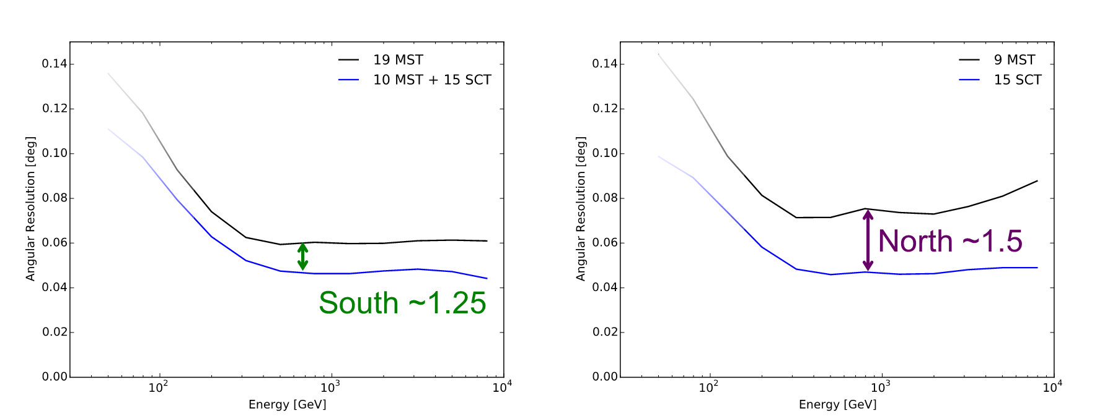
Impact of $25M on a €400M Project
The highly integrated nature of the project means that it will readjust based on available resources.
Three subjective hypotheses do lead to some conclusions:
  With substantial U.S. and French participation, both baseline MST arrays can be complete.
  Without U.S. participation, only single-mirror MSTs will be built.
  The U.S. brings one of the MST arrays into its complete baseline configuration with 15 SCTs, and it would otherwise be 6 telescopes smaller (and all single-mirror telescopes).
 | South | North
Telescopes w/o U.S. | 19 single-mirror MST | 9 single-mirror MST
Telescopes w/ U.S. | 10 single-mirror MST + 15 SCT | 15 SCT
 | Improvement Factors with U.S. Participation
Angular resolution (containment radius) | 1.25 | 1.5
Point source sensitivity | 1.3 | 1.7
Point source time to significance | 1.7 | 2.9
Field of view (effective radius) | 1.14 | 1.25
Survey speed | 2.2 | 4.5
Sources resolved in more detail
or

Slide 30
Impact of $25M on a €400M Project
The highly integrated nature of the project means that it will readjust based on available resources.
Three subjective hypotheses do lead to some conclusions:
  With substantial U.S. and French participation, both baseline MST arrays can be complete.
  Without U.S. participation, only single-mirror MSTs will be built.
  The U.S. brings one of the MST arrays into its complete baseline configuration with 15 SCTs, and it would otherwise be 6 telescopes smaller (and all single-mirror telescopes).
 | South | North
Telescopes w/o U.S. | 19 single-mirror MST | 9 single-mirror MST
Telescopes w/ U.S. | 10 single-mirror MST + 15 SCT | 15 SCT
 | Improvement Factors with U.S. Participation
Angular resolution (containment radius) | 1.25 | 1.5
Point source sensitivity | 1.3 | 1.7
Point source time to significance | 1.7 | 2.9
Field of view (effective radius) | 1.14 | 1.25
Survey speed | 2.2 | 4.5
More objects studied
or

Slide 31
Impact of $25M on a €400M Project
The highly integrated nature of the project means that it will readjust based on available resources.
Three subjective hypotheses do lead to some conclusions:
  With substantial U.S. and French participation, both baseline MST arrays can be complete.
  Without U.S. participation, only single-mirror MSTs will be built.
  The U.S. brings one of the MST arrays into its complete baseline configuration with 15 SCTs, and it would otherwise be 6 telescopes smaller (and all single-mirror telescopes).
 | South | North
Telescopes w/o U.S. | 19 single-mirror MST | 9 single-mirror MST
Telescopes w/ U.S. | 10 single-mirror MST + 15 SCT | 15 SCT
 | Improvement Factors with U.S. Participation
Angular resolution (containment radius) | 1.25 | 1.5
Point source sensitivity | 1.3 | 1.7
Point source time to significance | 1.7 | 2.9
Field of view (effective radius) | 1.14 | 1.25
Survey speed | 2.2 | 4.5
Better diffuse measurements;
serendipitous discoveries
or

Slide 32
Impact of $25M on a €400M Project
The highly integrated nature of the project means that it will readjust based on available resources.
Three subjective hypotheses do lead to some conclusions:
  With substantial U.S. and French participation, both baseline MST arrays can be complete.
  Without U.S. participation, only single-mirror MSTs will be built.
  The U.S. brings one of the MST arrays into its complete baseline configuration with 15 SCTs, and it would otherwise be 6 telescopes smaller (and all single-mirror telescopes).
 | South | North
Telescopes w/o U.S. | 19 single-mirror MST | 9 single-mirror MST
Telescopes w/ U.S. | 10 single-mirror MST + 15 SCT | 15 SCT
 | Improvement Factors with U.S. Participation
Angular resolution (containment radius) | 1.25 | 1.5
Point source sensitivity | 1.3 | 1.7
Point source time to significance | 1.7 | 2.9
Field of view (effective radius) | 1.14 | 1.25
Survey speed | 2.2 | 4.5
Faster, deeper surveys
or

