Slide 1
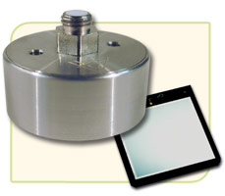
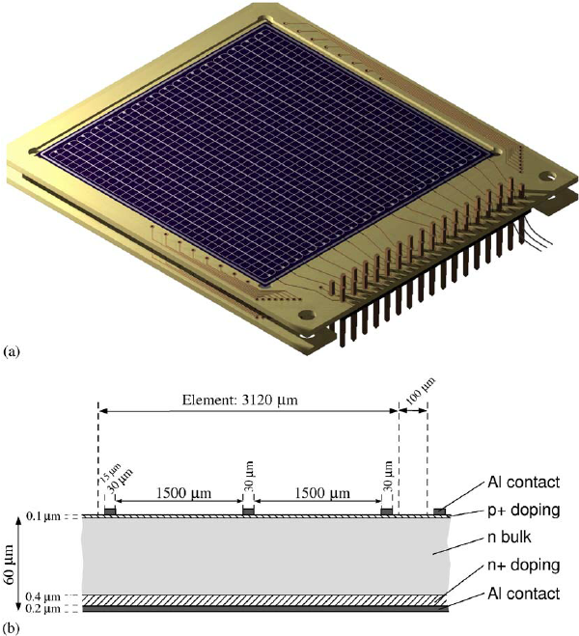
A ⁸Be IPC Decay Measurement at the Notre Dame-NSL
Electroweak Interactions Group
M. Brodeur (U. Notre Dame) and K.G. Leach (Colorado School of Mines)
In design stage. Location: Nuclear Science Laboratory (NSL) at Notre Dame.
Initial goal: confirm/refute Atomki measurement using different technique.
Use ⁷Li(p,γ) reaction to produce 18.15 MeV state in ⁸Be.
Proton provided by 5 MV, 200 μA 5U accelerator gives factor of 200 increase in beam intensity relative to previous measurement.
Experimental setup: solid ⁷Li target surround by 4π array of Si strip detectors
Increase production rates, better angular and E resolution vs. Atomki.
$750k to proceed with initial confirmation measurement, includes manpower.
Time scale: 1-2 years after receiving funds.
Sketch of detector system
(Not shown: front and back annular Si detectors)
⁷Li target
p beam
e⁻
e⁺
Thick Si wafer
Si strip detector

Slide 2
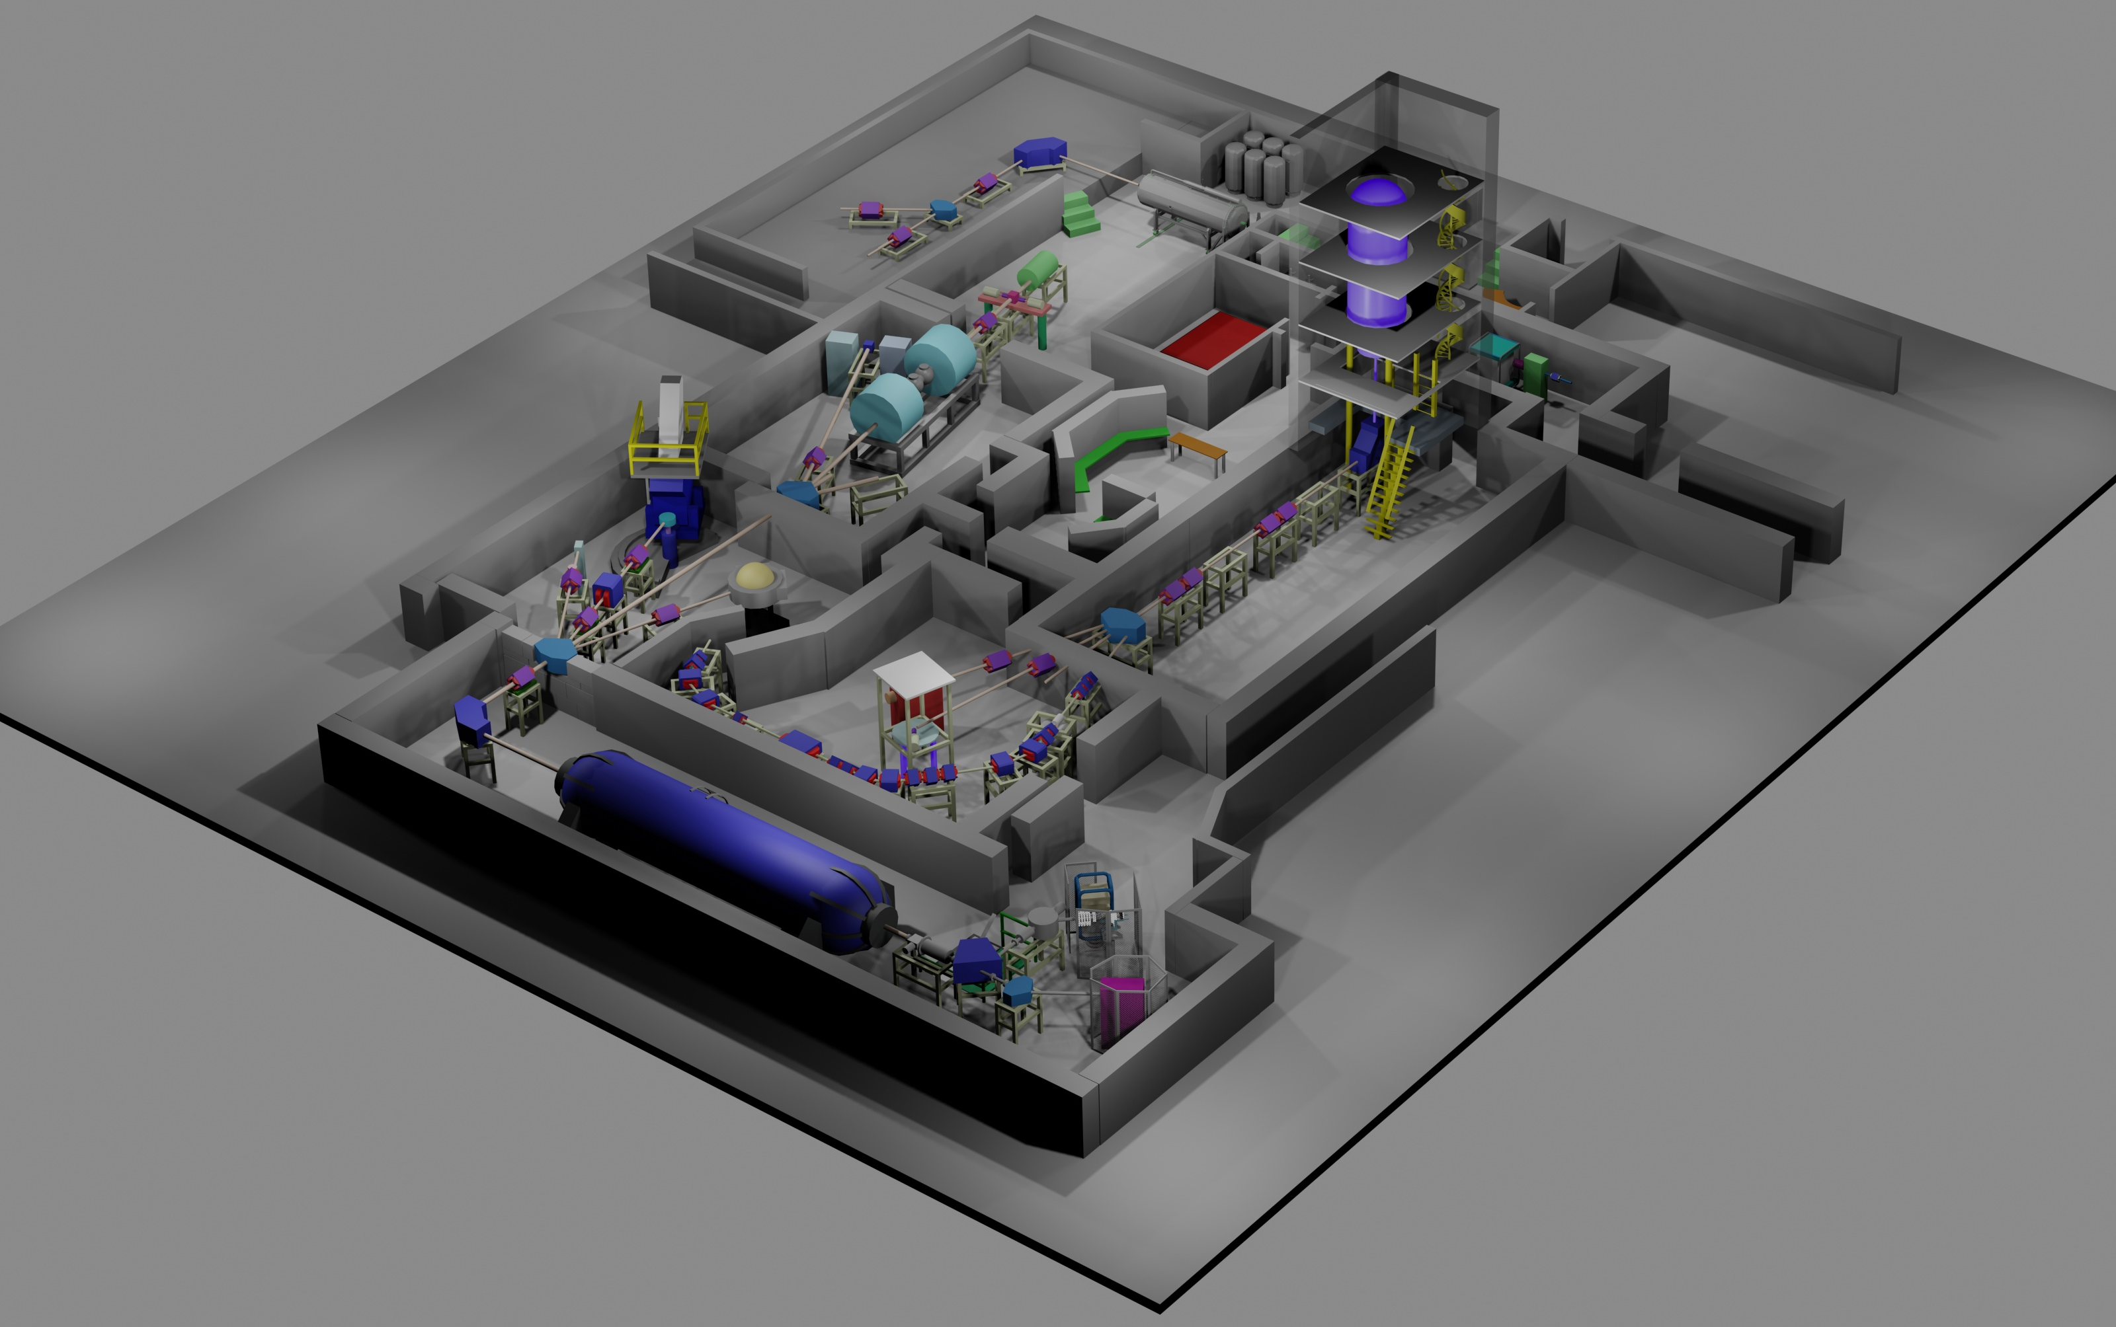
The Nuclear Science Laboratory of the University of Notre Dame
Electroweak Interactions Group
Possible location for ⁸Be decay station
Proton beam
5 MV single-end 5U accelerator
Max current ~ 200 μA
10 MV FN tandem accelerator
Max current ~ 10 μA

