Slide 1
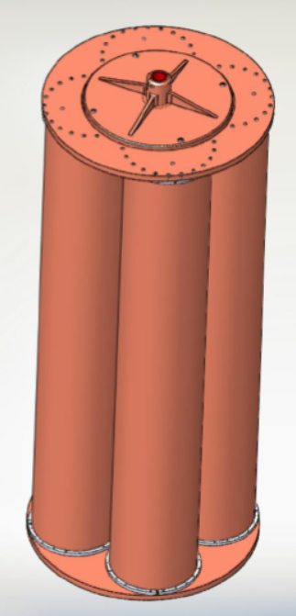
Higher fields for axion cavity searches and lower frequency axion searches with an LC circuit
Nicole Crisosto, J. Gleason, I. Stern, Pierre Sikivie, Neil Sullivan, D.B.T.
University of Florida
Mark Bird, Huub Weijers
Seungyong Hahn
NHMFL
C. Boutan, R. Khatiwada, R. Ottens, L.J Rosenberg, G. Rybka, D. Will
University of Washington
G.P. Carosi, Chris Hagmann,
Livermore
John Clarke, S. O'Kelley, Karl van Bibber
UC Berkeley
L.D. Duffy
Los Alamos
Richard Bradley
NRAO
Ed Daw
Sheffield

Slide 2
Outline
Dark matter axions and ADMX
Higher fields
Goal: to have >DFSZ sensitivity at 20 µeV (4–5 GHz) and above
The LC circuit detector, using the ADMX 8 T magnet

Slide 3
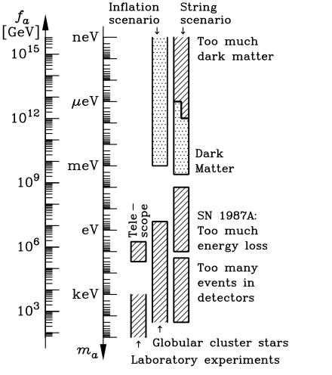
Present window for the axion mass
Very light axions forbidden:
else too much dark matter
Depends on Ω_{CDM} ~ 27%
Dark matter: “invisible axions”
Heavy axions forbidden:
else new pion-like particle
A very light axion (~20 μeV) would be an ideal dark-matter candidate

Slide 4
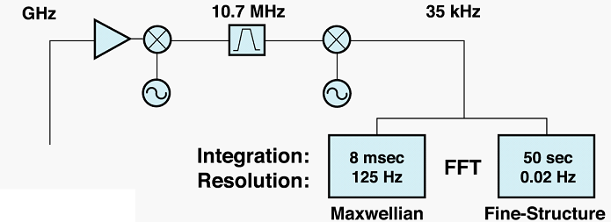
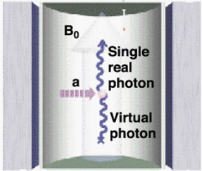
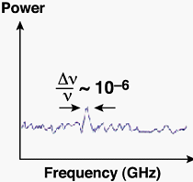
Making axions visible: Cavity axion detector (Sikivie, 1983)
Resonance condition: hν = m_{a}c²[1 + O(β²~10⁻⁶)]

Slide 5
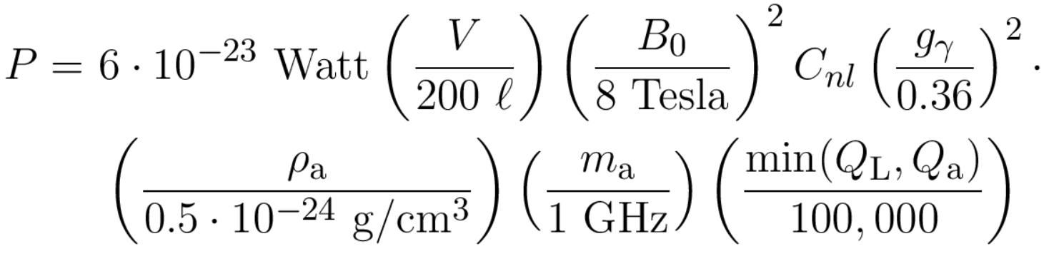

The signals are very weak
Power from the cavity is
1 GHz ⬄ 4 µeV ⬄ 50 mK
6x10⁻²³ W is about 100 photons/sec
Q_{L} ~ 120,000 (GHz/f )^{2/3} (ASE) and Q_{a} ~10⁶
g_{γ} ~ 0.36 (DFSZ) while g_{γ} ~ 0.97 (KSVZ)
C_{nl} is a form factor, overlap of in the cavity.

Slide 6
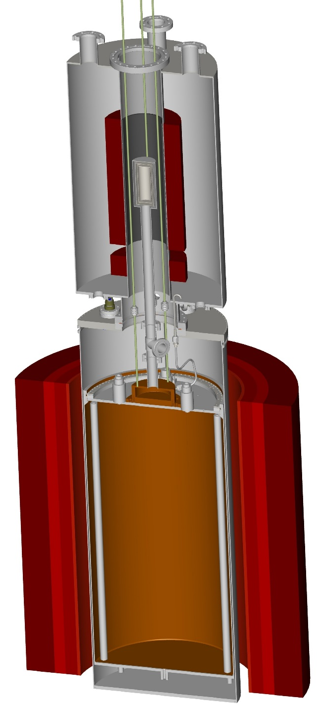
Detector Design
Field-free region
SQUID
Field cancellation coil
Force compensation coil
Mixing
chamber
Main Magnet
2 opposed windings give zero net force
between compensation coil and main magnet
Dil fridge cools cavity and SQUID
T_{N} ~ 50 mK at T = 100 mK
Cavity
50 cm

Slide 7
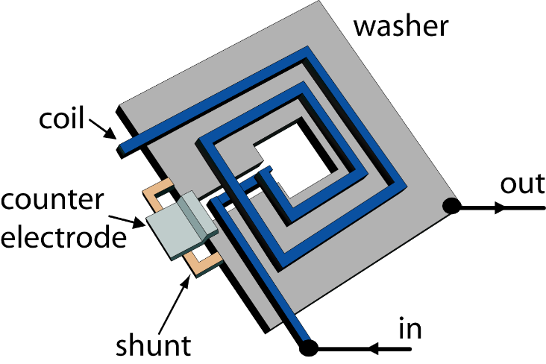
Microstrip SQUID amplifiers
GaAs
T_{QL}
More than an order of magnitude quieter than current GaAs HFET amplifier
Our latest SQUIDs are now within 15% of the Standard Quantum Limit

Slide 8
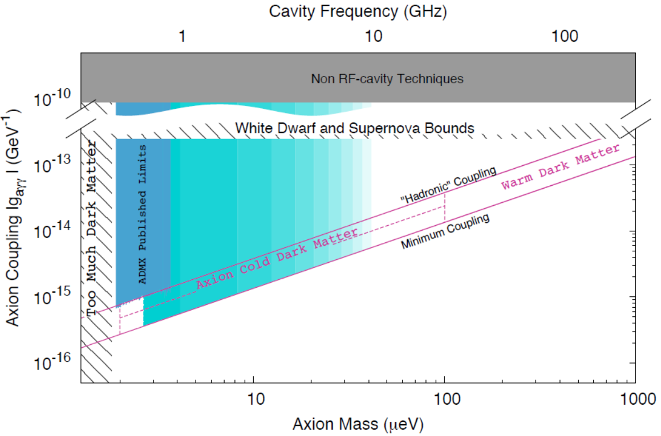
Misalignment gives ~ 16-20 μeV (4-5 GHz) if Ω_{a} ~ 0.27
KVSZ
DFSZ
ADMX
(complete)
ADMX
(Phase II)
Ω_{a} ~ 0.27

Slide 9
ADMX should procure a new magnet
Higher field ➔
Smaller volume ➔
Higher frequencies

Slide 10
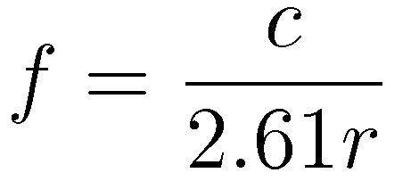
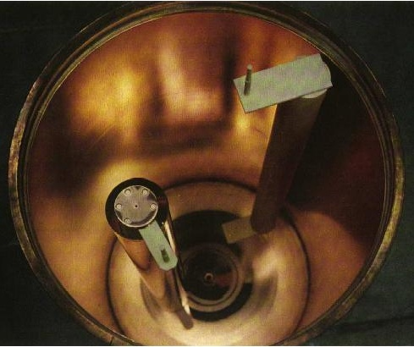
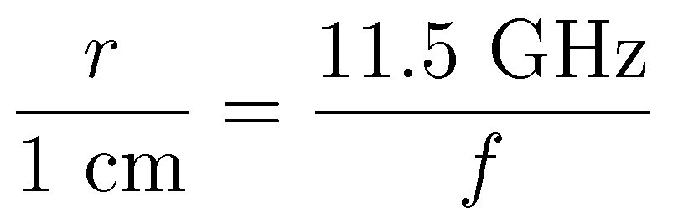
Simplest cavity is a right circular cylinder
Or:
For E_{a} = 20 µeV
r = 2.6 cm
f = 4.5 GHz
L = 5.6 cm

Slide 11
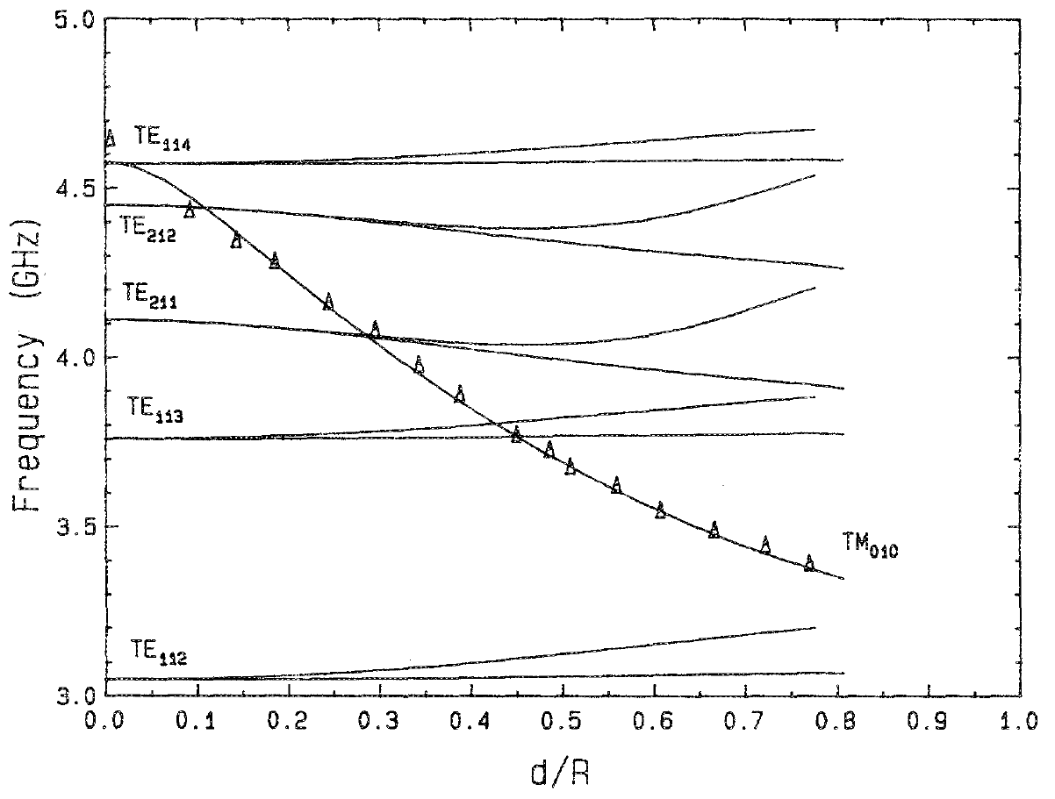
Note: Length cannot get too long
The longer the cavity, the more TE modes there are in the tuning range.
With metal tuning rod, there are also TEM modes
Typically:
L ~ 5r
Modes for r = 3.6 cm, L = 15 cm cavity. d is
the distance the metal rod is from the center.

Slide 12
Our signals are very weak
Power from the current cavity is
Where C is form factor, ρ_{a} is the halo density, m_{a} the axion mass, and Q_{L} ~ 120,000(GHz/f)^{2/3} (ASE); Q_{a} ~10⁶ are quality factors
g_{γ} ~ 0.36 (DFSZ) or g_{γ} ~0.97 (KSVZ) are coupling strengths
We use DFSZ; look for ~6x10⁻²³ Watts power

Slide 13
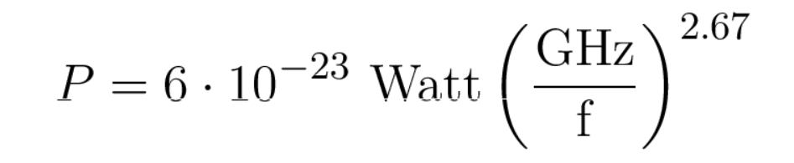
Strawman: Single cavity
Single cylinder, 8 T field; change size to resonate at search frequency
Volume decreases as f ⁻³, the Q decreases as f ^{-2/3} while the mass increases as f
Fix: Use multiple cavities, tuned together and added in phase
Complexity reduced at a given frequency if volume of high-field space is decreased
Need to compensate with higher field
B²V is the factor to maintain

Slide 14
To optimize s/n or search rate:
Maximize B²V. Minimize T_{n}.
At 100 mK, ADMX has perhaps 3x more s/n (4 bars on Mars) than needed for DFSZ sensitivity
Can go big in volume or big in field
A number of big magnets exist
But I think it is desirable to reduce volume, increase field.

Slide 15
Top level requirements
The design must be sensitive to the most weakly coupled axions and be able to detect axions with mass in the “sweet spot.”
Measurement times and scan rates similar to current ADMX.
It is possible (but IMO not wise) to disconnect the magnet from cavity and cryogenics.

Slide 16
Concept (Heising Simons)
26 T field. (26/8)² = 10
7.6 cm radius (6 inch diameter) and 33 cm (13 inch) length. (7 l/150 l) = 1/21
Magnet details: Mark Bird’s talk
Single cavity would have f = 1.5 GHz
Multiple cavities used for higher frequencies

Slide 17
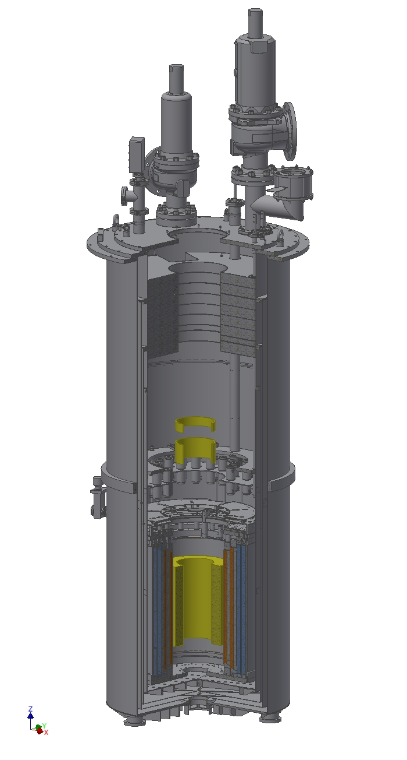
24 T, 6.3” bore
24 T coils
Higher field could be attained with larger magnet.
Max helium level
Shield coils 0.6 m above magnet
2.5 m
Yellow: HTS coil (44 modules)
Red: Nb₃Sn coils
Blue NbTi coils
0.9 m
H.W. Weijers – Axion detector magnet for UF– NHMFL – Aug. 2015

Slide 18
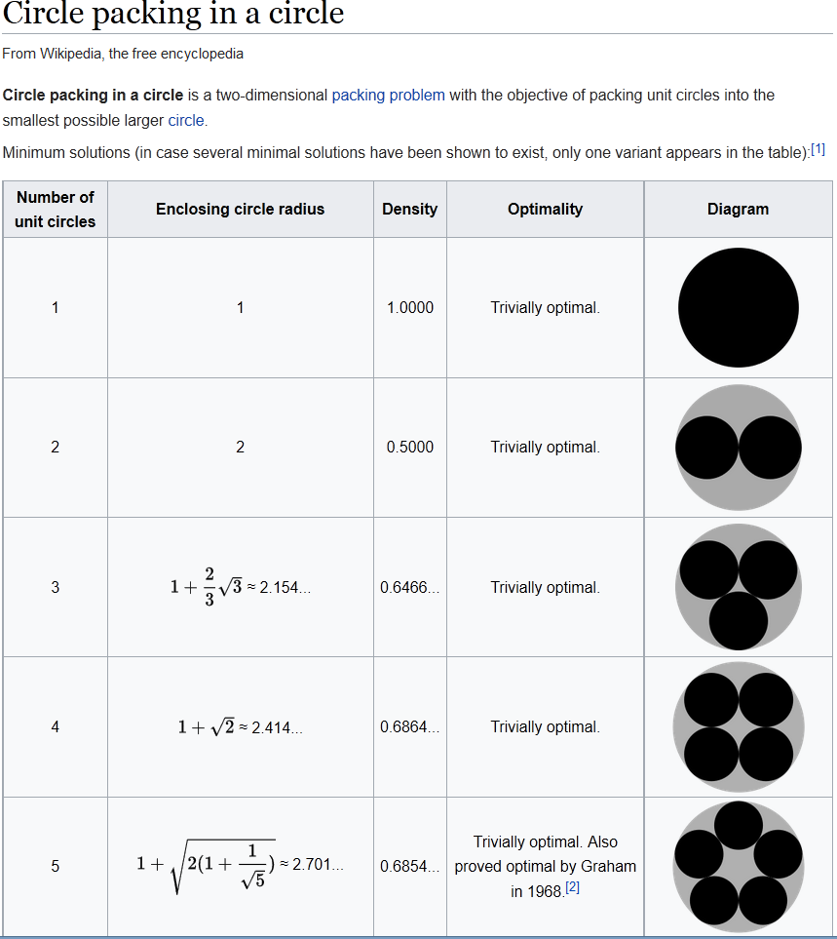
Cavity numbers: 4 or 8
Avoid mode crowding and mode localization; good Q; good C.
  Cylindrical cavity.
Use as much as possible of the volume.
  Four in cross section; 68% of area
r < 0.414 R or ~ 3 cm
f = 3.8 GHz
Metal rod tuning range ~ 4-6 GHz

Slide 19
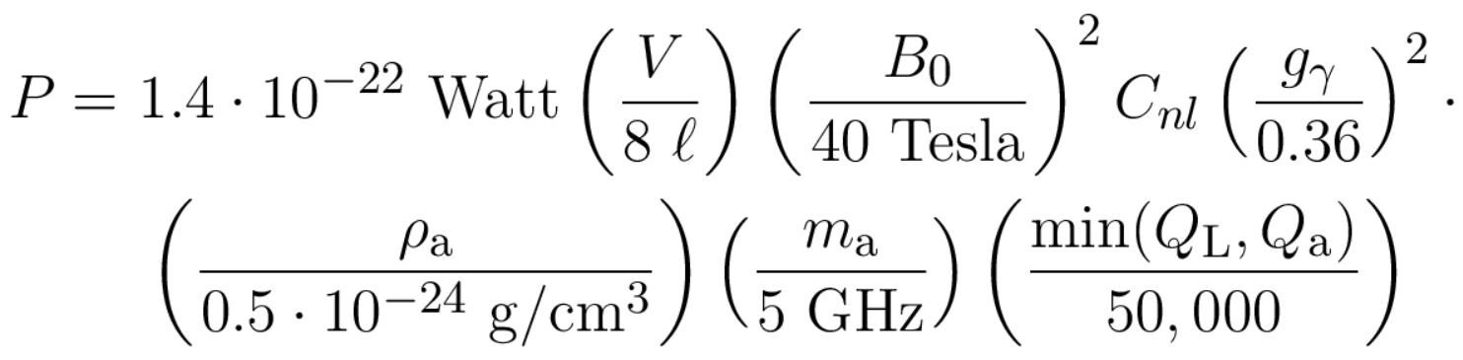
Assume a 40 T magnet
Power from 4 or 8 cavities at 5 GHz is
Q_{L} ~ 120,000(GHz/f)^{2/3} (ASE) ~ 40,000
At DFSZ, look for ~1x10⁻²² Watts

Slide 20
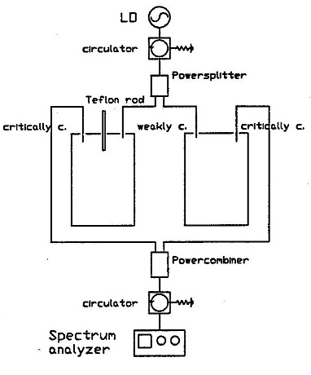
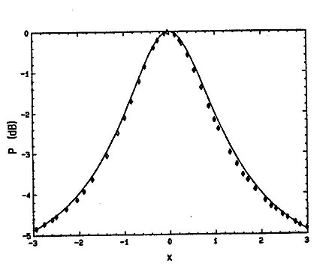
Cavities must be added in phase

Slide 21
Requires them to have identical resonances
Tune (dead reckoning), measure, adjust…
Use a servomechanism
Need a method to bring all resonances to a common frequency
Method: Pound, Drever, Hall (PDH) (or Pound) reflection locking
Used by LIGO, VIRGO and other gravity experiments

Slide 22
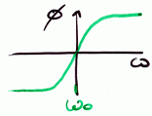
Each cavity can be driven to resonance at the carrier
5 GHz oscillator
φ
N-way splitter
20 MHz
oscillator
Lock-in
amplifier
Circulators
Mixer
Cavities
Tuning rod actuators

Slide 23
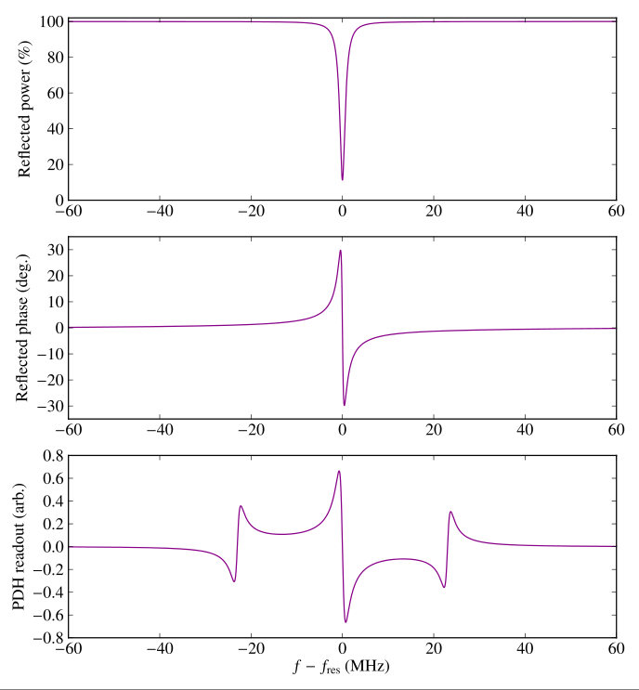
Simulated PDH signal

Slide 24
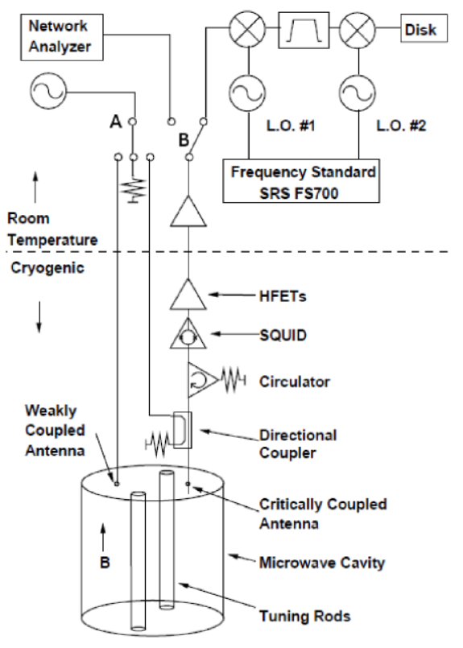
Allow for the needs of high resolution search
Measure cavity output for ~100 sec.
Signal bandwidth
~ 50 kHz
10 million points
FFT, search for power in one or two bins.
Phase noise in local oscillators is an issue
Search must allow for a Doppler shift of ~ 80 Hz in 6 months
But: signal always there!

Slide 25
Known knowns
40 T or even 26 T ➔ High temperature superconductors.
Dilution refrigerator, like current ADMX.
  800 microwatt cooling power
  Detector is smaller, so perhaps T_{physical} ~ 50 mK
SQUID or JPA front end.
  Requires zero-field region
100 sec integration time.
  Allows search for fine structure from late-infall axions

Slide 26
Known unknowns
“Warm bore” (like current ADMX) or put cavity/dilution refrigerator in inner vacuum can, surrounded by the 4.2 K liquid He used for magnet cooling?
Coil arrangement? Currents and power supply?
Quench protection
Persistent mode (probably not for HTS coils)
Zero field region: part of coil or separate subsystem?
Is 40 T available?
Cost?

Slide 27
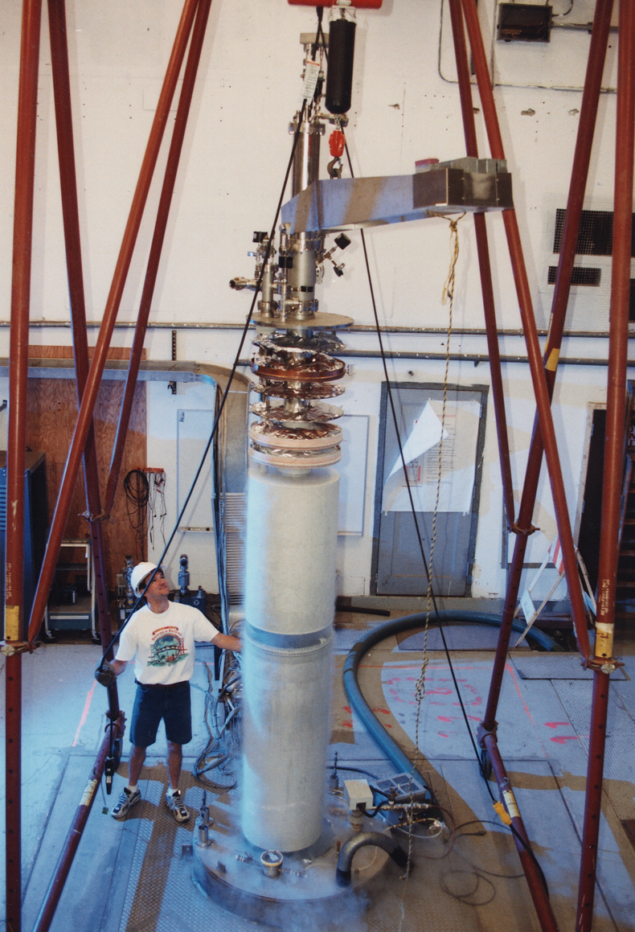
Make use of the existing ADMX magnet and insert
8 T, 50 cm bore, 1 m length
Insert has zero field region
Equipped with high cooling capacity dilution refrigerator
800 microwatt at 100 mK

Slide 28
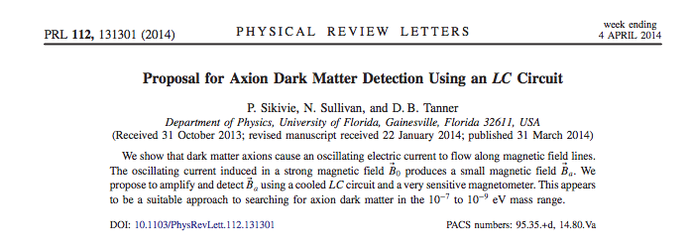

Slide 29
LC circuit premise
Axion field alters Maxwell’s Equations
In the presence of an external magnetic field

Slide 30
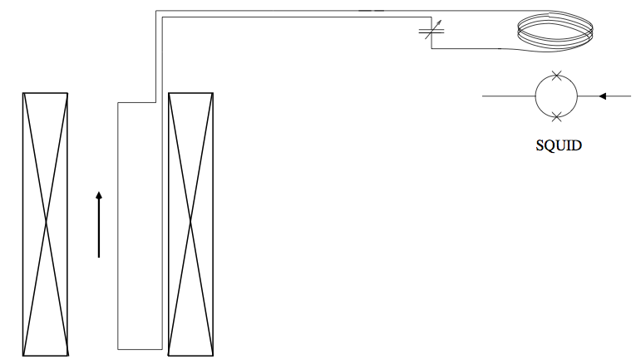
LC Circuit Sketch
Figure 1: Proposed LC Circuit diagram, adapted from Sikivie et al.

Slide 31
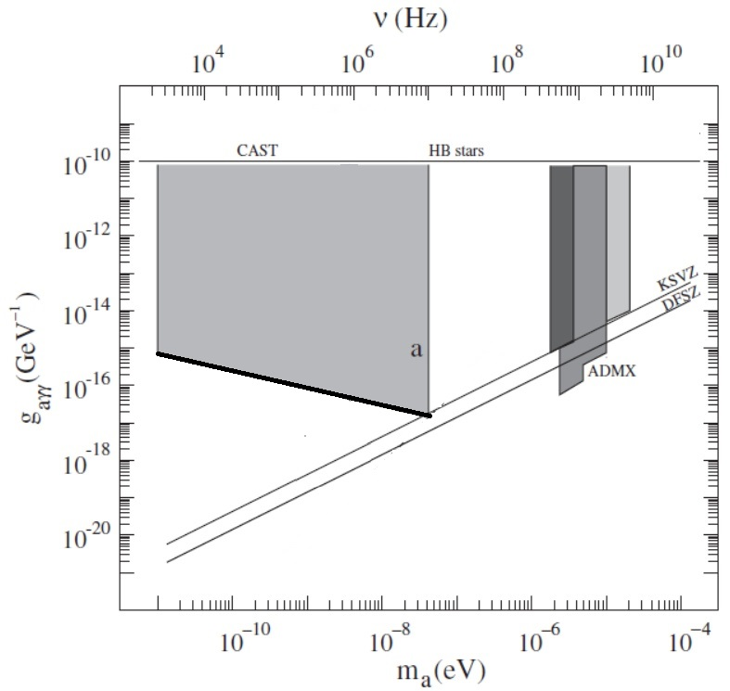
Projected sensitivity

Slide 32
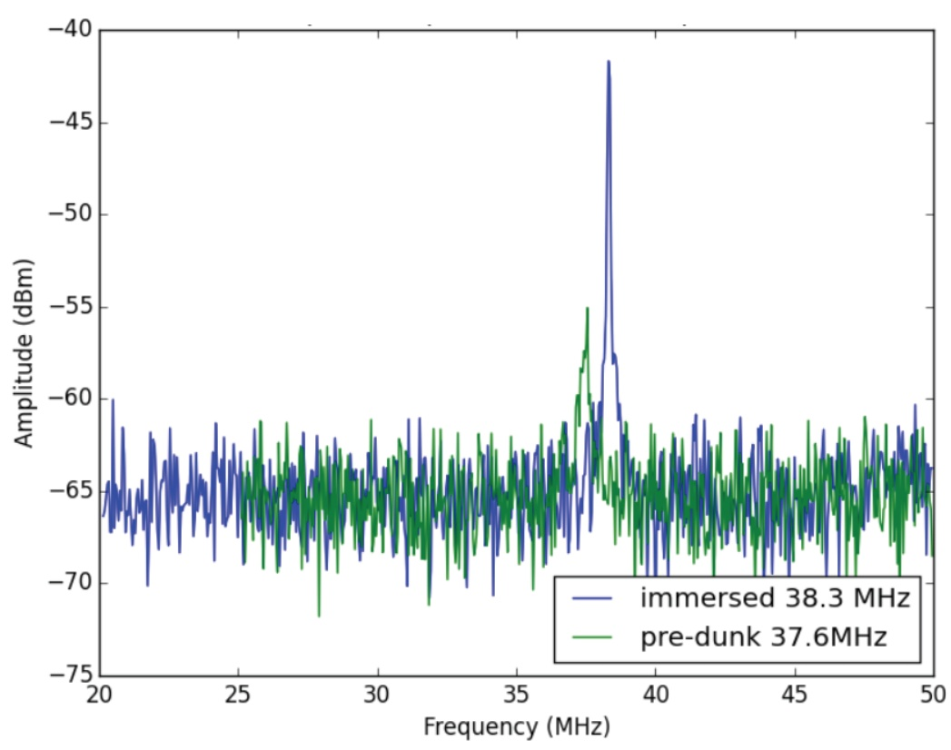
Pilot experiment
Thesis project for Nicole Crisosto
NbTi loop, parallel plate capacitor
To run in 8 T magnet, 15 cm diameter, 45 cm length
Target Q is 10,000; target T_{N} is 4 K
Present Q is 1000; radiative losses
a problem.
Scan 12 to 100 neV (3-30 MHz)

Slide 33
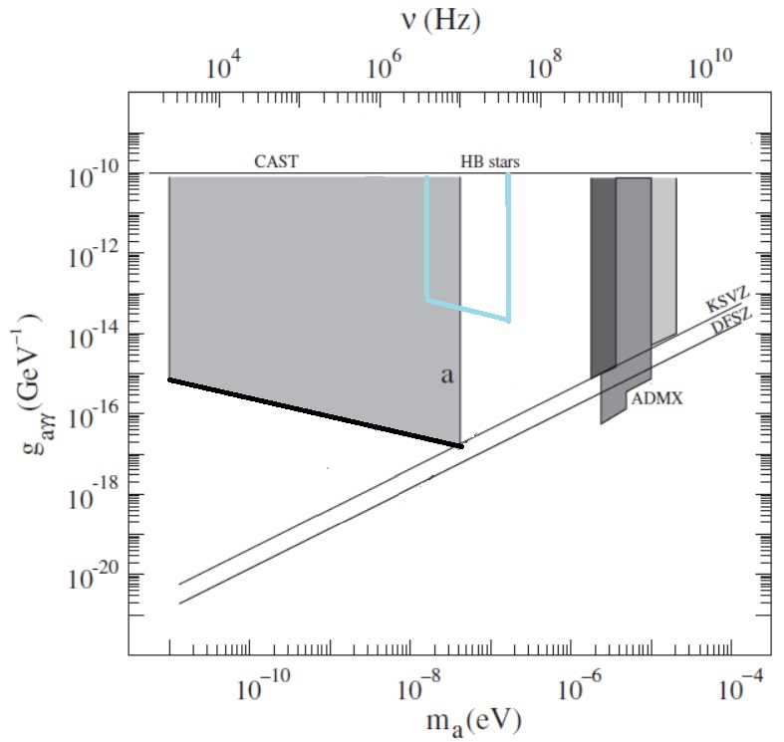
Pilot sensitivity

Slide 34
Summary and conclusions
Axions are an attractive dark-matter candidate.
Future experiments will need higher fields and multiple cavities
Technology for a 3x or even 5x increase in field is available or will be soon
Technology for locking cavities together exists
LC circuit can search for axions and axion-like particles in the neV range.
LC circuit is a low-cost repurpose of ADMX’s 8 T magnet
This is an exciting time for axion searchers!

Slide 35
THE END

Slide 36
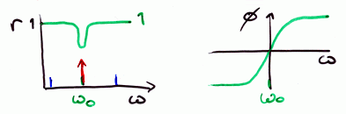
Pound reflection locking
Cavity reflects (promptly) waves that are not on resonance
Reflection dip at resonance, along with phase change

Slide 37
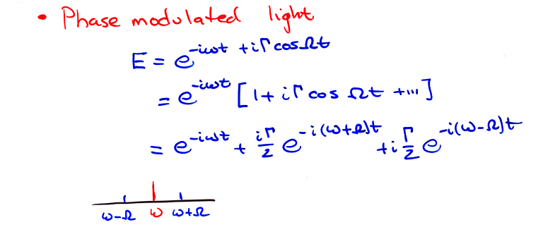
Phase-modulated light

Slide 38
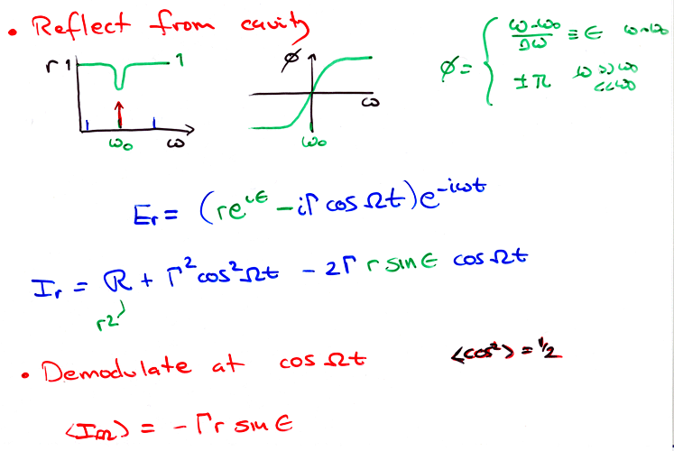
As cavity tunes, phase of reflected carrier shifts

Slide 39
Simulated PDH signal

Slide 40
PDH references
Electronic Frequency Stabilization of Microwave Oscillators
R.V. Pound, Rev. Sci. Instrum. 17, 490 (1946).
Laser phase and frequency stabilization using an optical resonator
R.W.P. Drever, J.L. Hall, F.V. Kowalski, J. Hough, G.M. Ford, A.J.
Munley, and H. Ward, Appl. Phys. B31, 97 (1983).
An introduction to Pound–Drever–Hall laser frequency stabilization
Eric D. Black, Am. J. Phys. 69, 79 (2001).
Understanding Pound-Drever-Hall locking using voltage controlled radio-frequency oscillators: An undergraduate experiment
C.E. Liekhus-Schmaltz and J.D.D. Martin, Am. J. Phys. 80, 232 (2012).

Slide 41
Requirements flow down (3)
0.004 inch (100 microns) tolerances shift frequency by 2 MHz.
  Q_{L} ~ 100,000 gives linewidth of 14 kHz (+/- 7 kHz)
  Fine tuning needed, with tuning range of 20 MHz (TBD)
  Ability to lock frequencies +/- 1 kHz. (TBD; in phase its 20 degrees)
  PDH reflection lock baseline, some adaptive digital control possible
Power combine with Wilkinson interference devices
  P = P₁ + P₂cosΦ
  cos(20º) = 0.94
  4 → 1 or 2x (4→ 1) + 2 → 1 plus switching.

Slide 42
Unknown unknowns

Slide 43
World’s Most Sensitive RF Receiver
How sensitive?
  ~ 10⁻²⁶ W ( yoctoWatt)
  ~1 photon per minute

Slide 44
World’s Most Sensitive RF Receiver
How sensitive?
  < 10⁻²⁶ W ( yoctoWatt)
  ~1 photon per minute
A cellphone with equivalent capabilities

Slide 45
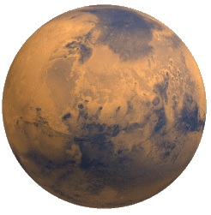
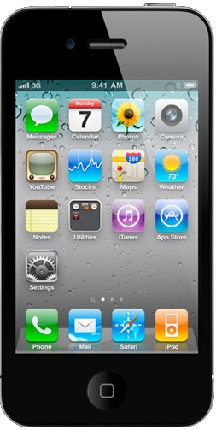
World’s Most Sensitive RF Receiver
How sensitive?
  < 10⁻²⁶ W ( yoctoWatt)
  ~1 photon per minute
A cellphone with equivalent capabilities
  4 bars on Mars!!!

