Slide 1
Pure NaI/CsI at Cryogenic Temperatures for Rare-event Searches
Supported by
NSF PHY-1506036
JSPS Grant-in-Aid(B) 26800122
Cosmic Visions: New Ideas in Dark Matter
Maryland, March 24, 2017
Jing Liu
University of South Dakota

Slide 2
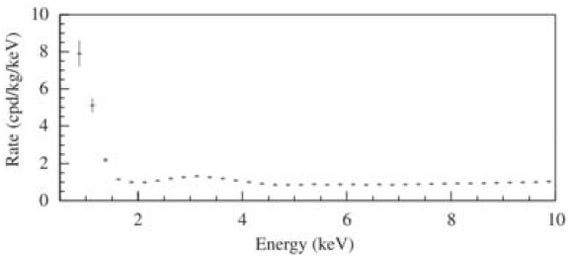
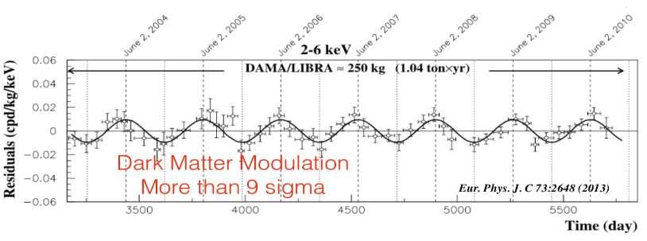
DAMA
Energy spectrum of NaI(Tl) from DAMA
X-rays/Auger electrons from Ar-40, the daughter of K-40 EC-decay
NaI/CsI based effort:
COSINE
  DM-ICE
  KIMS
ANAIS
SABRE
etc.
How about here?
Focus:
Location
Purification
Active shield
PMT
Light collection

Slide 3
Low energy threshold ← high light yield
Higher light yield with still the SAME crystal?

Slide 4
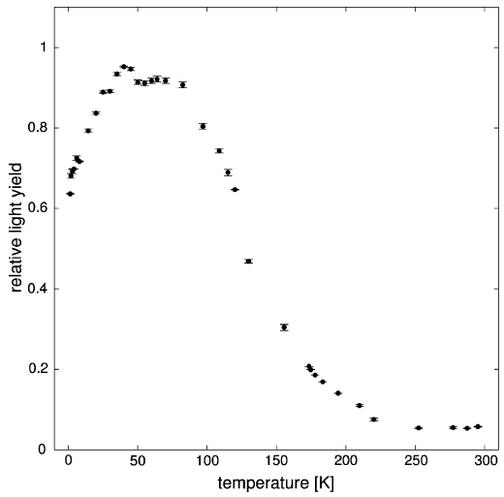
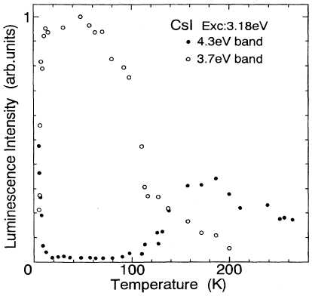
Light yield as a function of temperature
Phys. Rev. B 5 (1995) 2195
Eur. Phys. J. C (2012) 72:2061
Part of CRESST
LY of Pure NaI VS Temperature

Slide 5
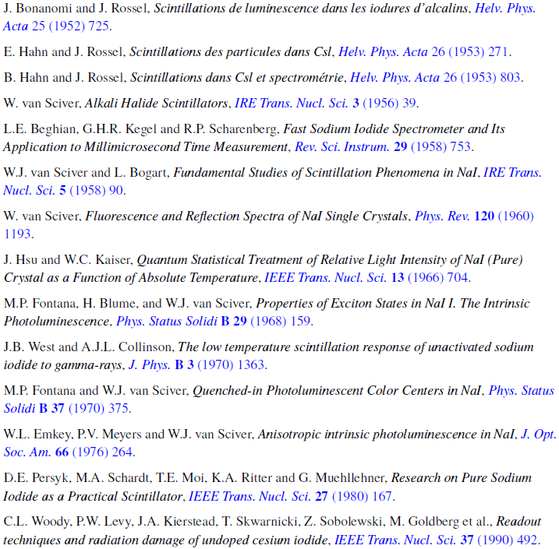
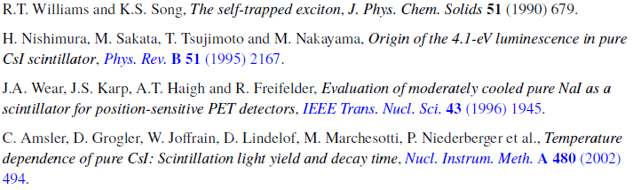

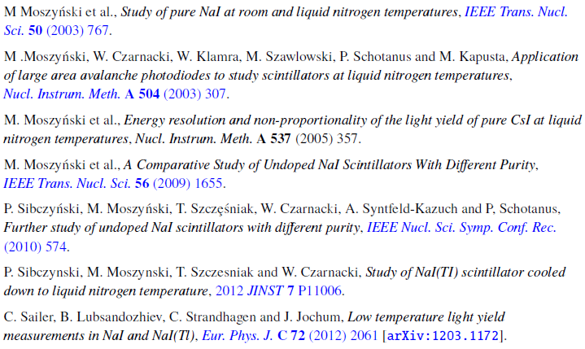
History of studies of pure NaI/CsI
Inconsistent results on absolute light yield,
the best are about twice higher than those of doped ones at RT

Slide 6
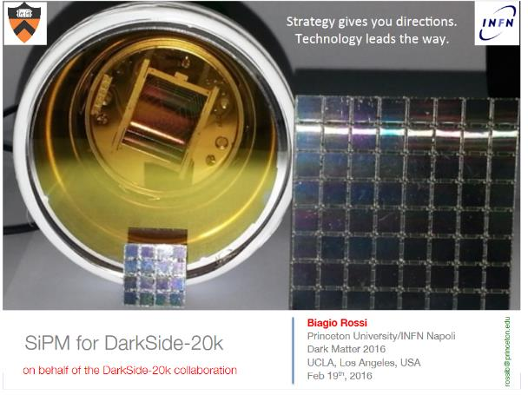
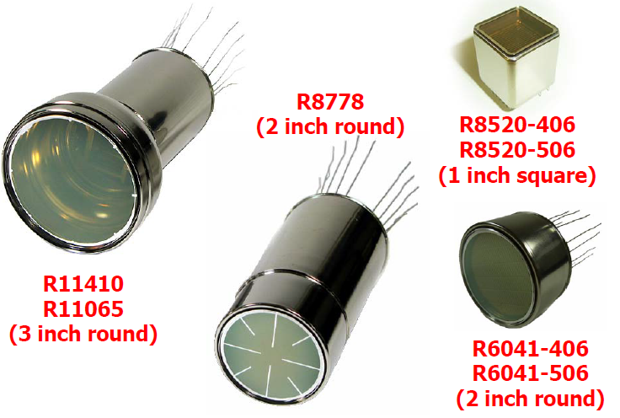
Light readout devices
Light loss in complicated readout system cancels out the gain from light yield ☹
PMT at RT
Light guide
Crystal at LNT
Light guide
PMT at RT
PMTs working at 77 K (Hotta, DM2014)

Slide 7
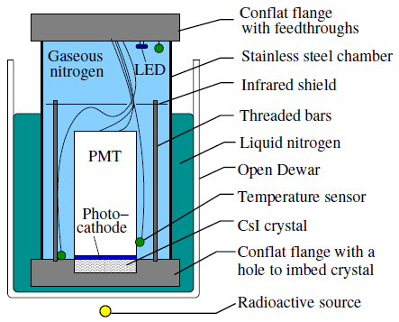
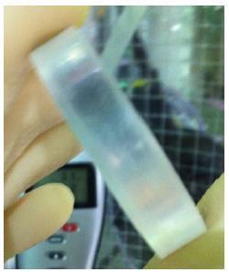
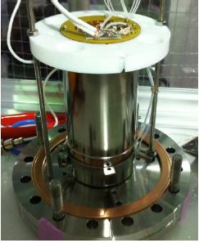
Proof-of-concept measurement
R8778MODAY (AR)
CsI
PTFE wrapped side surface
Bottom CF flange
NaI

Slide 8
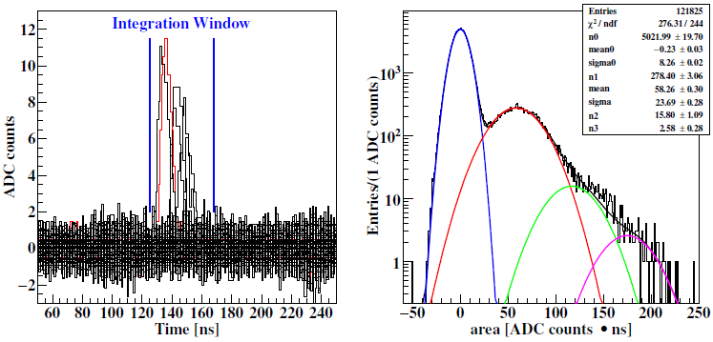
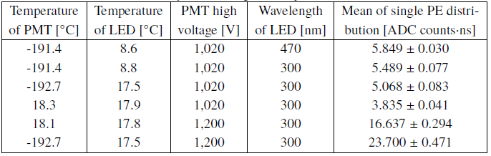
Single-photoelectron response of the PMT

Slide 9
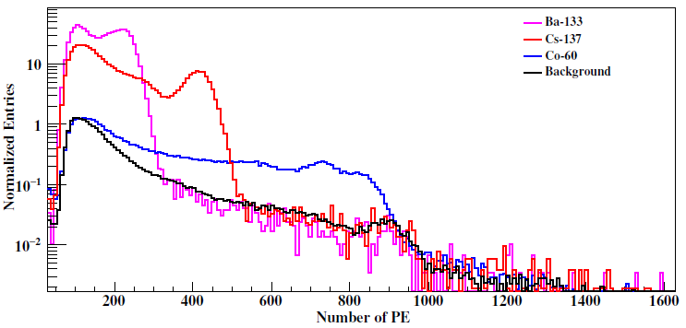
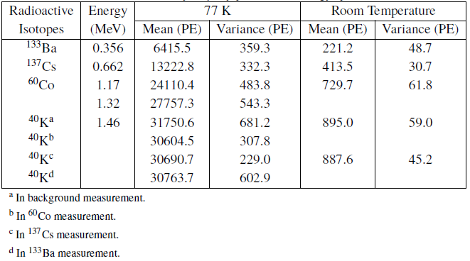
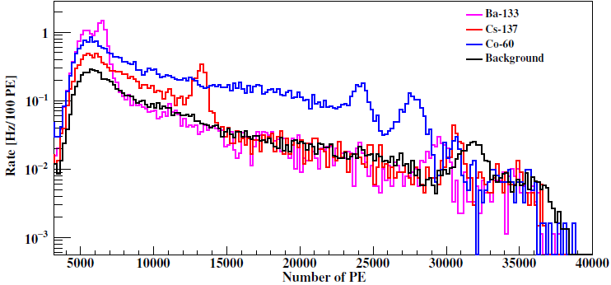
Energy calibration of a pure CsI crystal
Room temperature
77 K

Slide 10

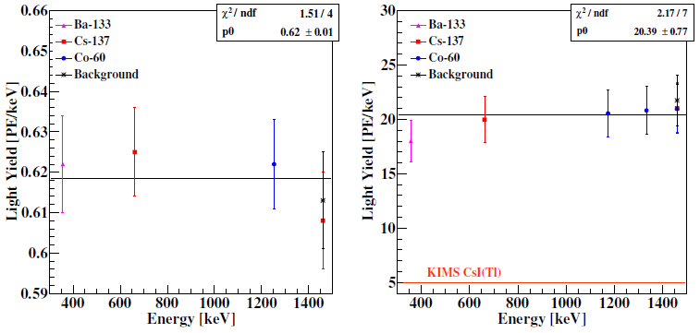
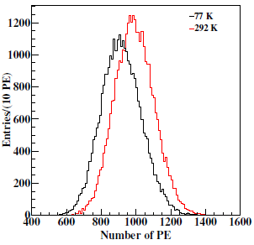
Light yields
Light collection efficiency
QE of the PMT quoted by Hamamatsu at room temperature is 29.5% at 300 nm
Measurement of QE change from room temperature to 77 K using an LED with fixed light intensity:
77 K
Room temperature
(A rough estimation)

Slide 11
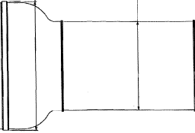
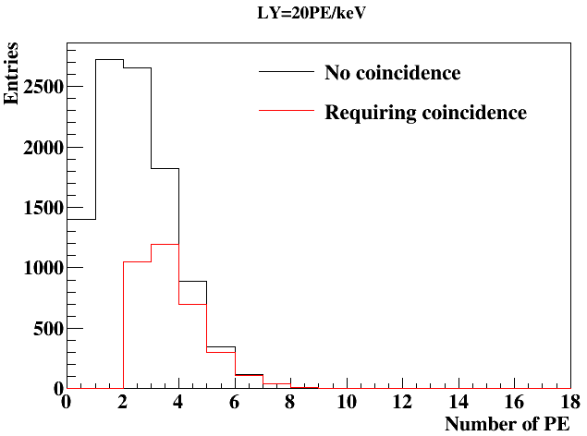
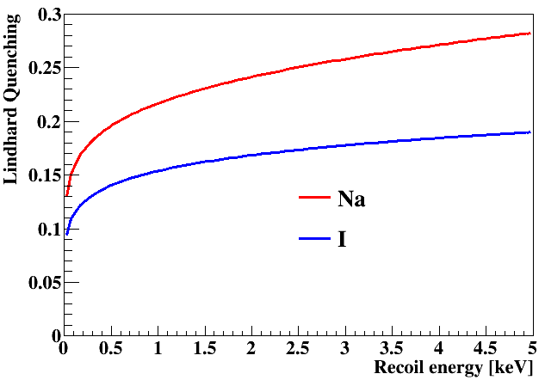
Trigger efficiency
50%
PMT
photon
PMT
LY = 20 PE/keV, @ 0.1 keV

Slide 12
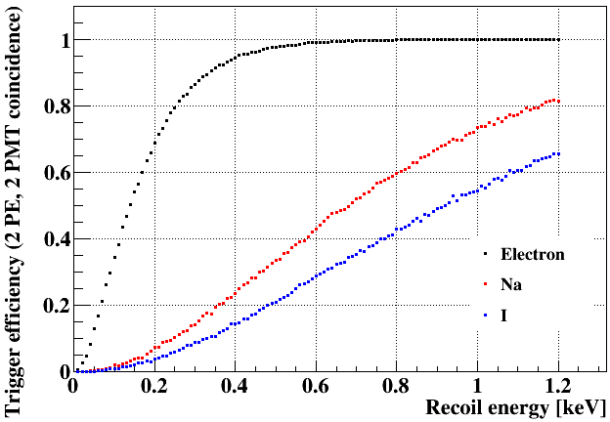
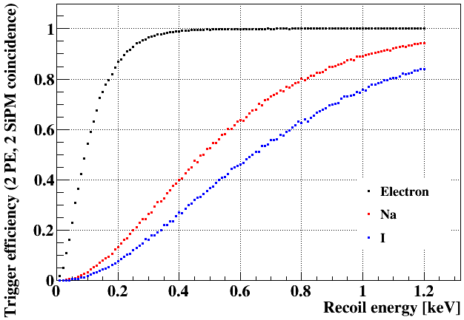
Trigger efficiency
20 PE/keVee
30 PE/keVee

Slide 13
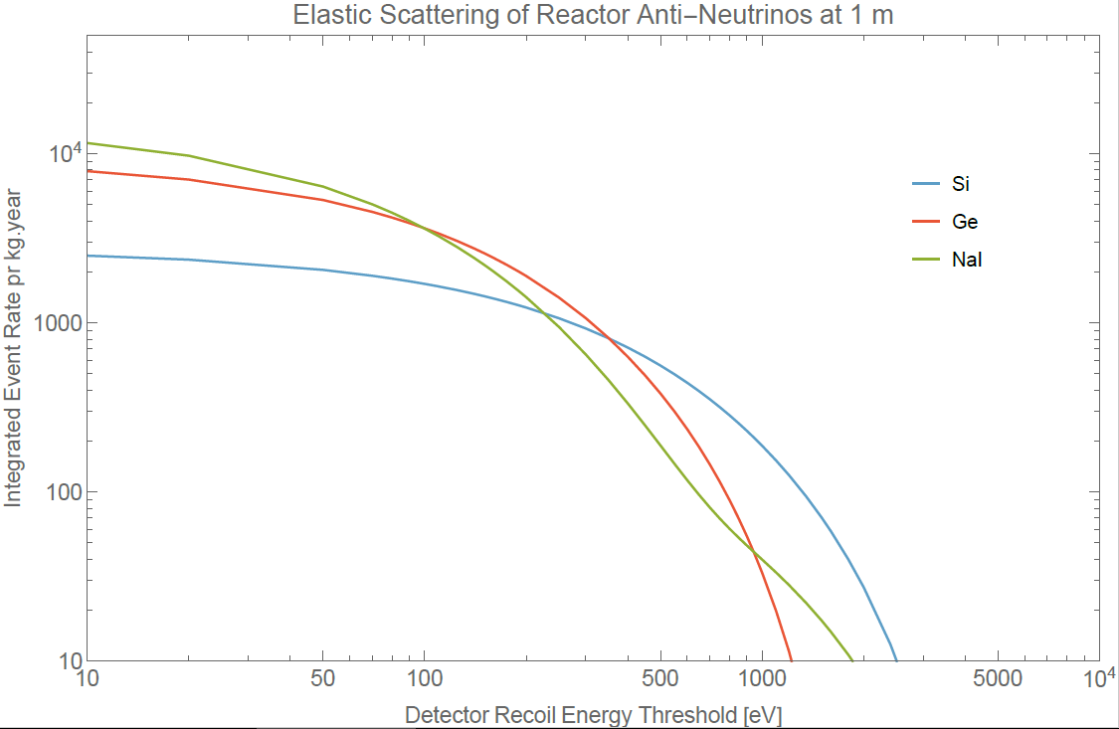
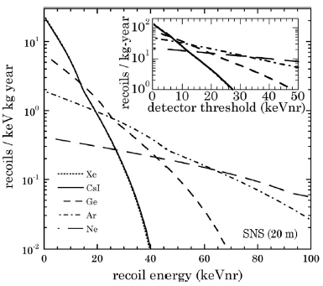
CEvNS event rate VS nuclear recoil energy
J. Collar et al. NIM A773 (2015) 56–65

Slide 14
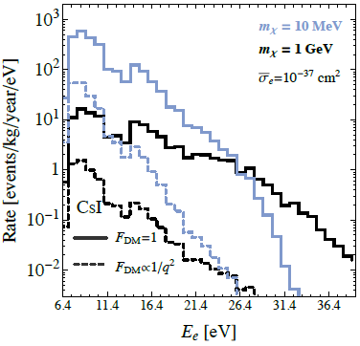
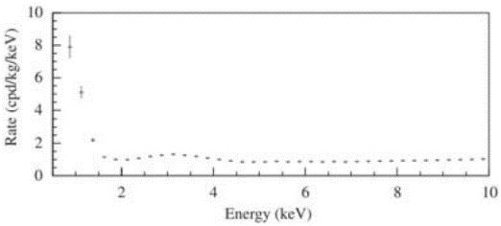
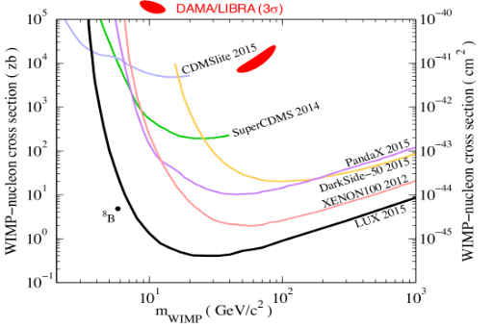
Dark matter sensitivity at 77 K
arXiv:1607.01009
COSINE achieved 15 PE/keV with NaI(Tl) at RT
-> There is still room for us to improve!
LY of DAMA: ~ 8 PE/keV
Good chance to verify DAMA ☺
No chance for sub-GeV DM ☹
Have to use TES for
100% QE
Zero dark count → no coincident requirement
arXiv:1512.03506

Slide 15
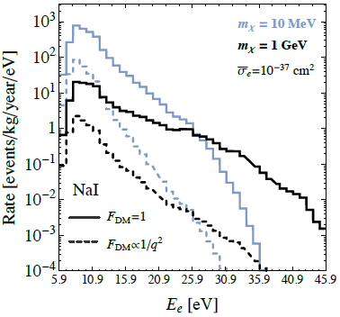
Sensitivity with TES
TES for
100% QE → ~ 60 PE/keV @ mK
Zero dark count → no coincident requirement → 100% trigger eff.
arXiv:1607.01009
Assume 10% DAMA background: 0.1 cnt/kg/day/keV → ~ 0.3 cnt/kg/year/eV

Slide 16
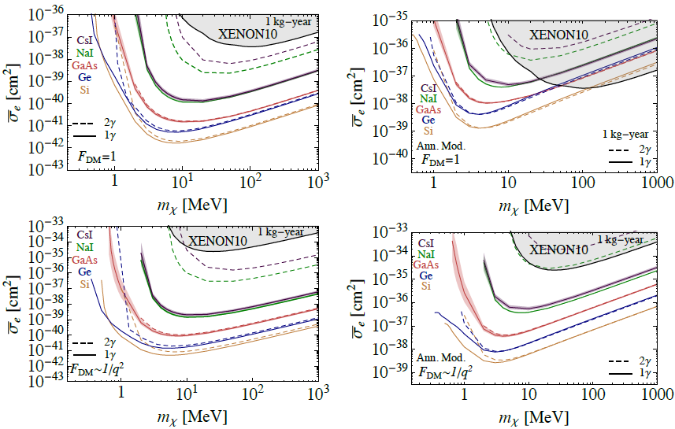
Ideal case
arXiv:1607.01009
Assuming TES + SuperCDMS cavity:
Photon + phonon
Multiple targets

Slide 17
Phased approach
Phase I, physics focus: CEvNS, technical focus: light yield
  CsI + PMT for MINER background
  Quenching factor measurement @ TUNL
  NaI/CsI + PMT/SiPM for CEvNS with MINER/COHERENT
  NaI/CsI + TES for CEvNS with MINER
Phase II, physics focus: DAMA, technical focus: low background
  CsI/NaI + PMT/SiPM + liquid argon/neon active veto
  Collaborating with COSINE/SABRE for radio-pure crystals
Phase III, physics focus: sub-GeV DM, technical focus: integration
  CsI/NaI + TES for photon only or photon + phonon
  Collaborating with SuperCDMS
$20k (new crystals, photon sensors)
$30k, 3 kg radio-pure crystals
$24k, 3 pairs of PMTs/SiPM
$100k, cryostat
$100k, shielding
$100k (new crystals, TES, integration)

Slide 18
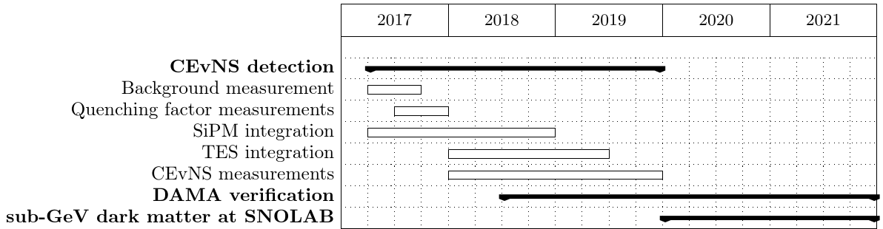
Time table

Slide 19
Summary
A rather conventional approach with guaranteed physics results
A bit novelty each step forward with great physics potential
NaI/CsI(pure) with light sensors at cryogenic temperatures
Low threshold experiment for rare event search
Doubled intrinsic LY
TES

Slide 20
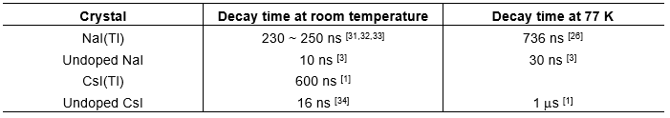
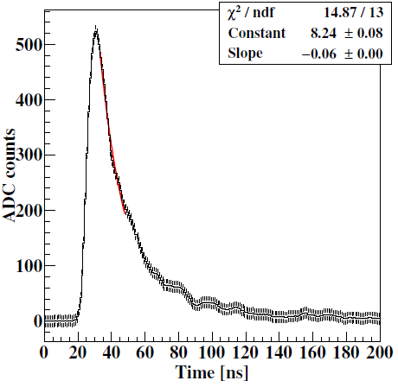
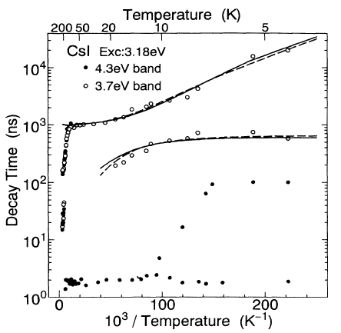

Slide 21
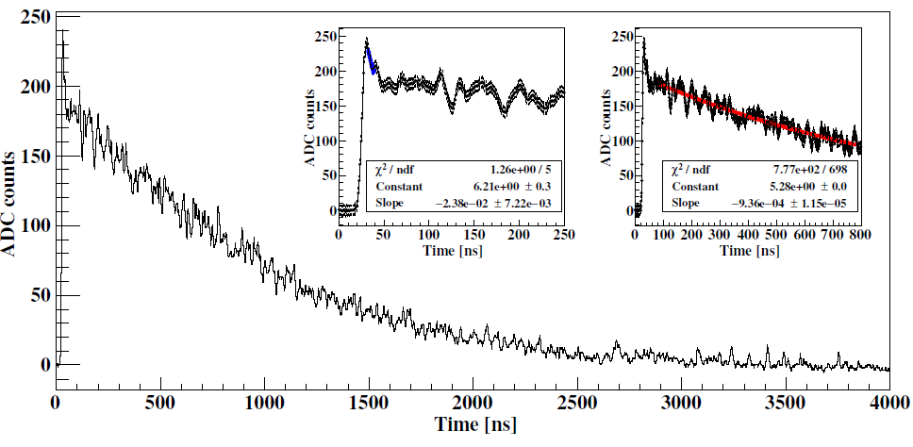
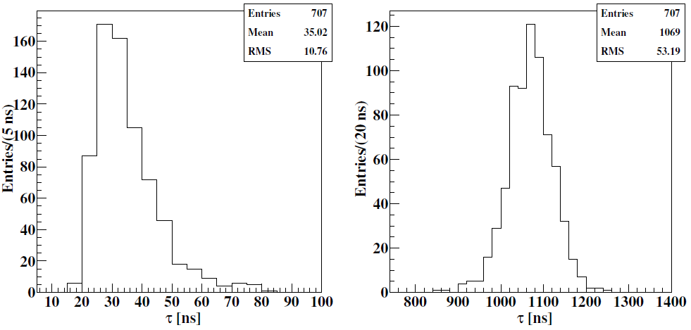

Slide 22
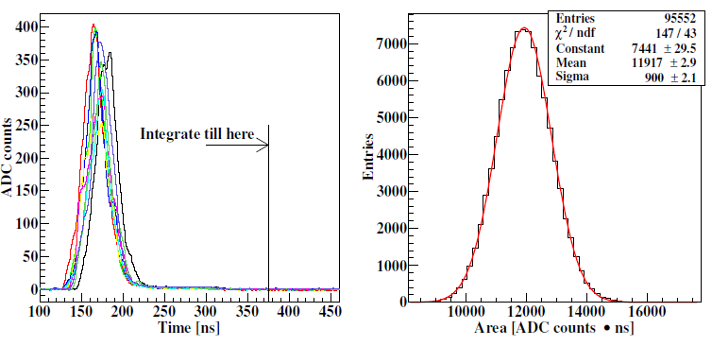

Slide 23
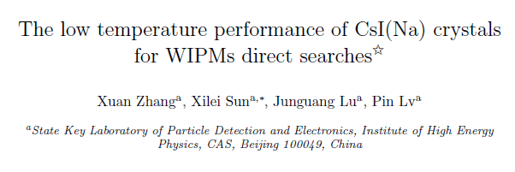
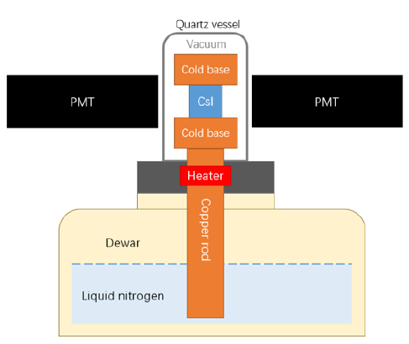
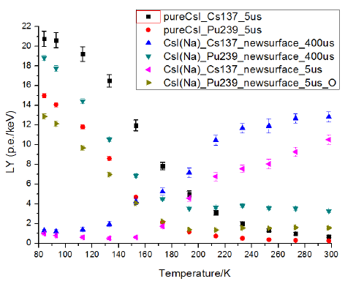
arXiv:1612.06071

