Slide 1
Q1 Status Report and Forecast – HTS-2
Joseph Ozelis
PIP-II Quarterly Progress and Forecast Review
27, January, 2017

Slide 2
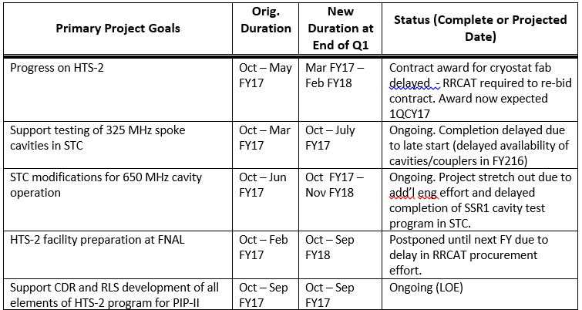
HTS-2 Schedule Status
Are there any risk for IIFC deliverables, either by FNAL or DAE, to impact your schedule?
Possibility exists that HTS-2 delivery to FNAL could be delayed due to
choice of inexperienced vendor in India running into problems with fabrication or testing/QA of cryostat before shipment to RRCAT
delays/problems in commissioning of cryostat in India (issues with sub-systems)
Delay in SSR1 cavity test program impacts start of STC modifications for 650MHz

Slide 3
HTS-2 Financial Status Discussion
FTE and SWF is forecasted to overrun budget, what is the driver for the increase?
Labor overrun primarily due to additional mechanical engineering and drafting effort for STC modifications
Drafting forecast for remainder of FY17 may be a bit pessimistic (high)
Also some additional labor due to responding to IIFC needs re: HTS-2
M&S if forecasted to underrun, what is the driver for the decrease?
HTS-2 #2 procurements coming in below estimate
STC additional relief valve not needed
Lower cryo costs (SSR1 test program slower)
Will use some of this overrun to cover un-budgeted M&S (RF distr. line, shipping HTS-2 #2 parts to RRCAT) and potentially higher M&S for STC modifications

Slide 4
Other Questions, Comments for HTS-2
If applicable, is your EPDM up to date? If no, provide brief explanation on why.
All required Engineering Documentation (FRS, TRS, RA, Dwgs/Models, Review Materials) is in EPDM
Additional (“supporting”) documentation is being added ASAP
Documents/communications shared with RRCAT on Sharepoint
Materials outside of original scope of EPDM (Feedcan/Cryostat)

