Slide 1
Q1 Status Report and Forecast – HWR
Allan Rowe – FNAL, Zack Conway - ANL
PIP-II Quarterly Progress and Forecast Review
27, January, 2017

Slide 2
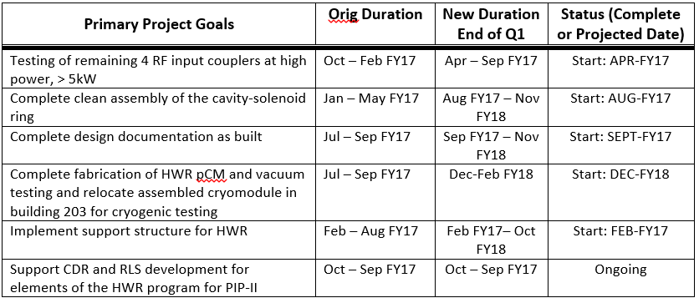
HWR Schedule Status – Zack Conway
Multiple primary goals have shifted into FY18, what is the driver and will that result in a lower cost in FY17?
  Delays in the HWR processing and coupler development are driving the schedule into FY2018.
  The FY2017 cost will not change due to the added expense of these tasks while we expect to be within ~$100,000 of our target for FY2018 to finish the HWR cryomodule.
    HWR hydrogen degassing no longer occurring at FNAL.
    HWR coupler modifications and bias tee costs deferred FY2018.
The delivery target for the HWR cryomodule is still Q2FY2018.

Slide 3
HWR Financial Status Discussion – Allan Rowe
SWF is forecasted to overrun $10K, what is the driver?
  SWF consists of FNAL RF engineers participating at a low level to serve as HWR project liaison as well as discussions associated with RF components. FNAL also participates in the conductively cooled lead procurement which has taken more effort than expected.

Slide 4
Other Questions, Comments for HWR – Zack Conway and Allan Rowe
If applicable, is your EPDM up to date? If no, provide brief explanation on why.
  The EPDM information supplied in the last round is up to date. For the HWR cryomodule work our focus is on:
    Finishing the processing/testing of the HWRs.
    Finishing the power coupler development.
    Beginning the clean assembly of the HWR components.
  ANL expects to begin the 3-4 month clean assembly process in August 2017. This includes the cleaning and then assembly of all parts.
  Once the clean assembly is finished the final cryomodule assembly will take 2-3 months due to man-power availability at ANL.
    We are hiring 1 new employee to work on this in addition to existing manpower.

Slide 5
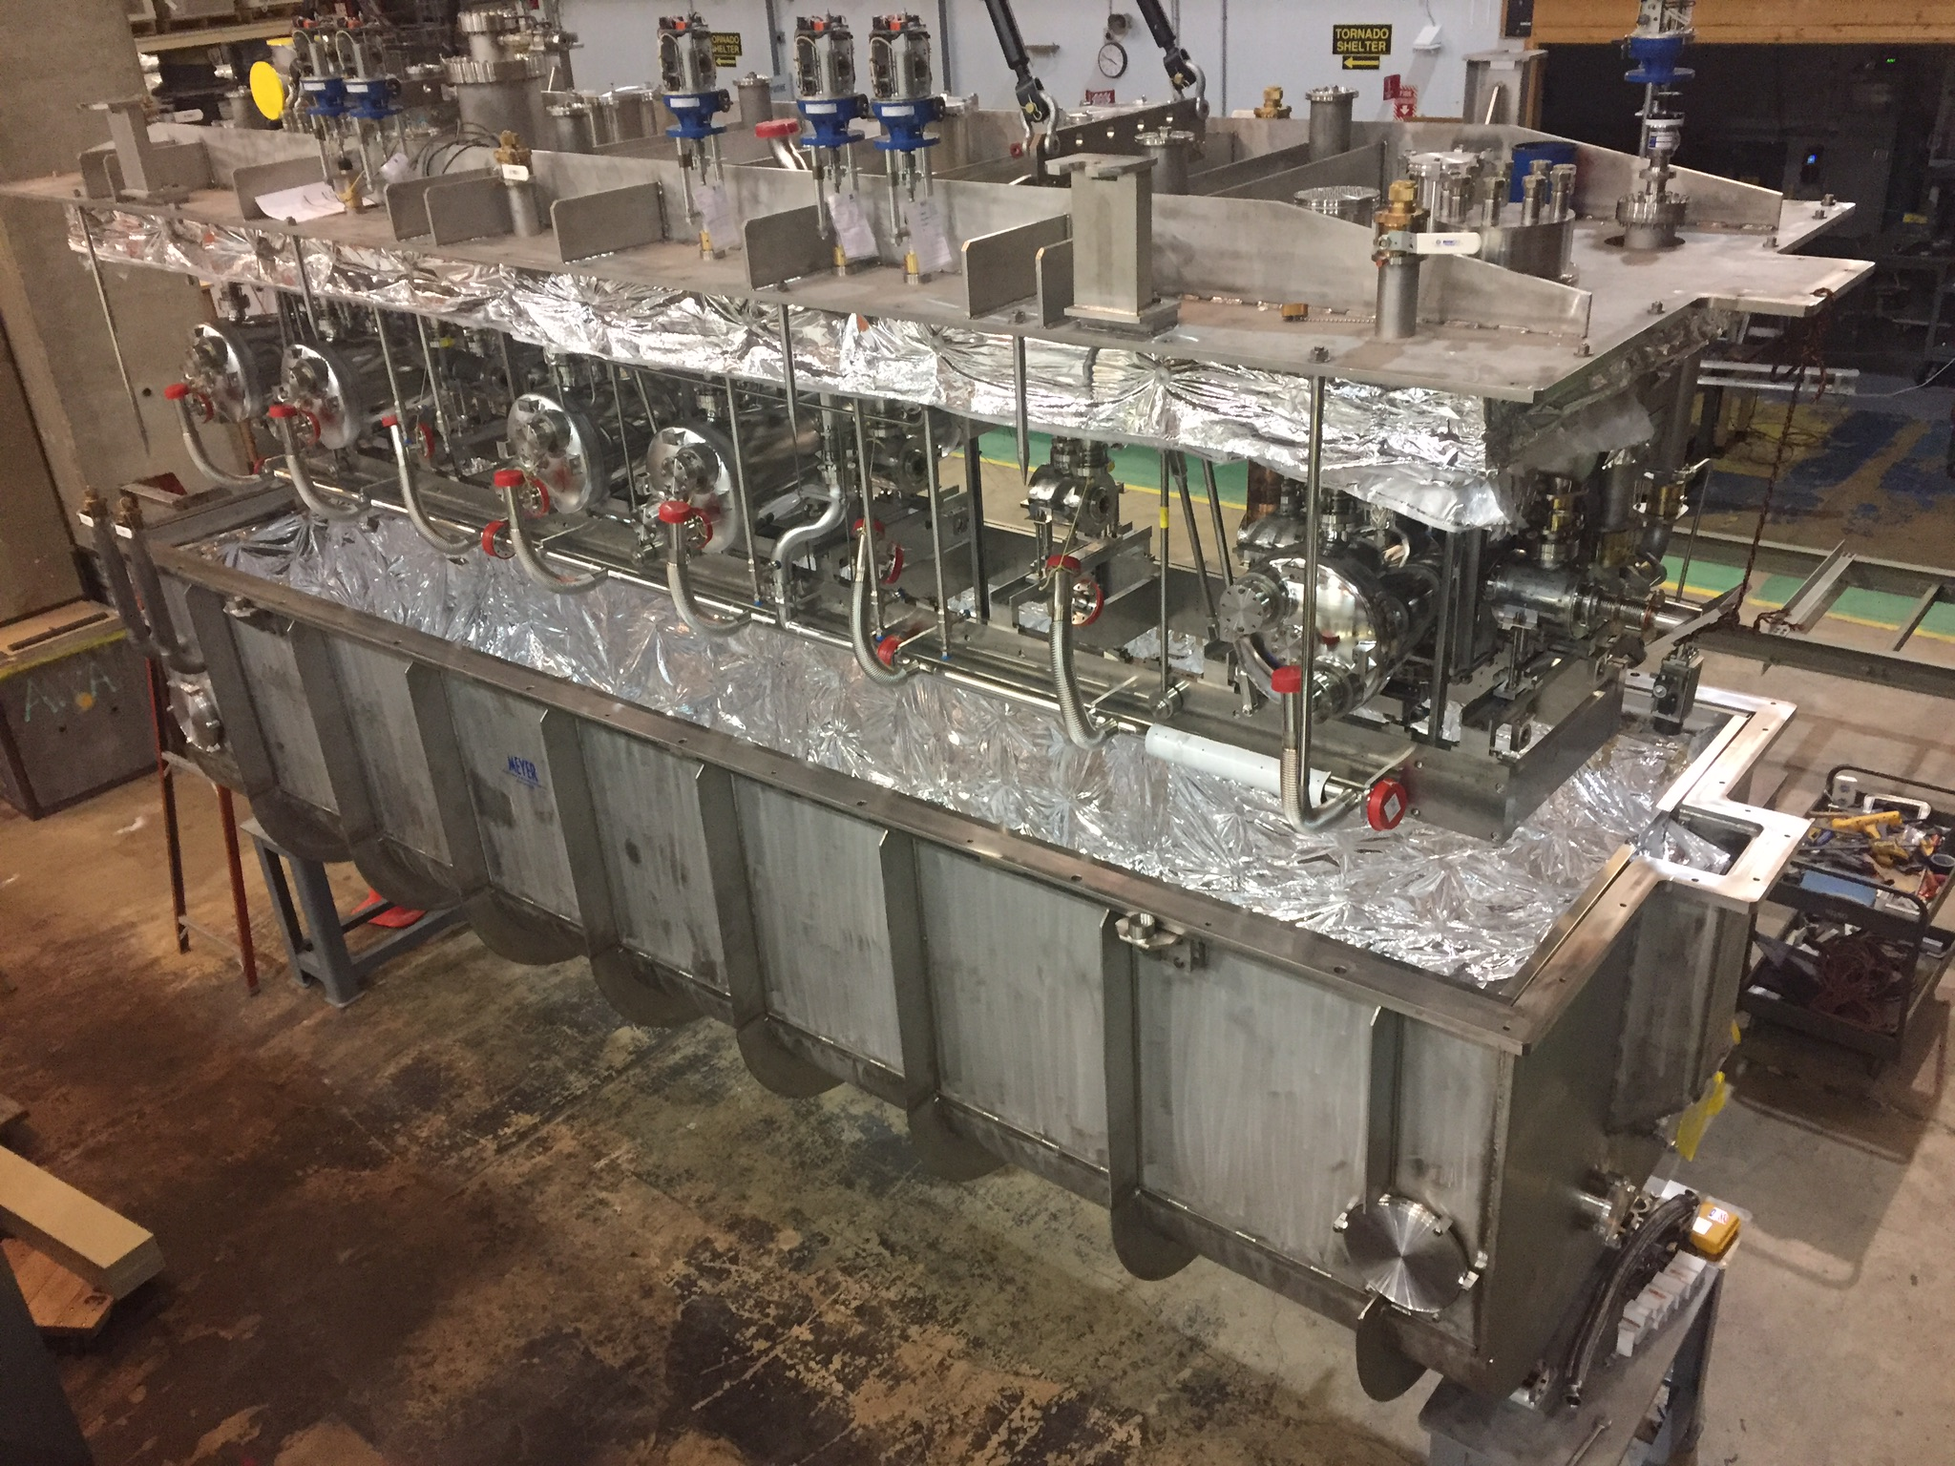
HWR Engineering Assembly - Finished

Slide 6
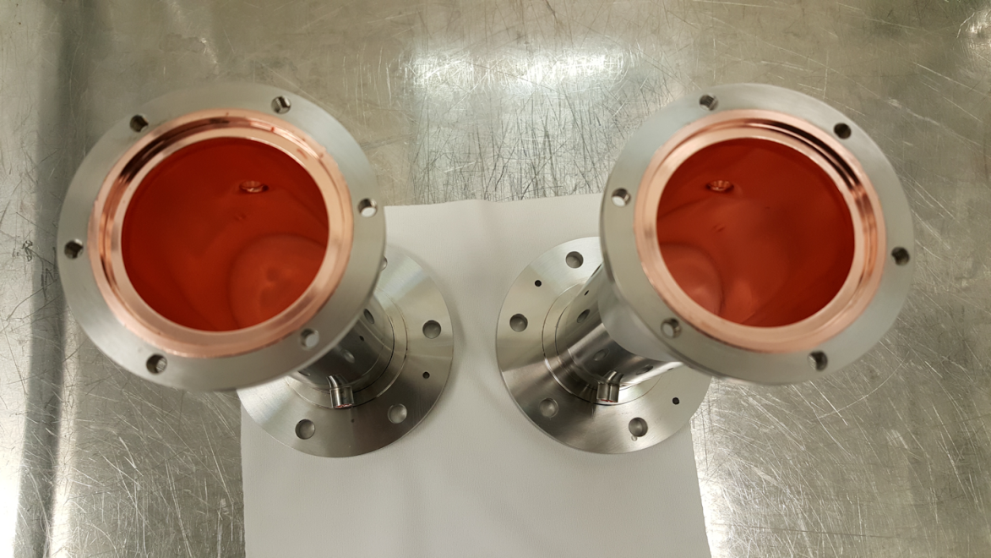
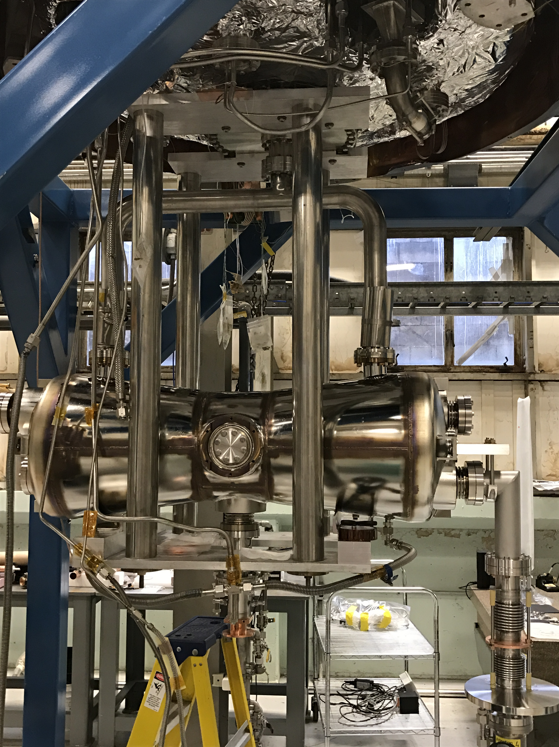
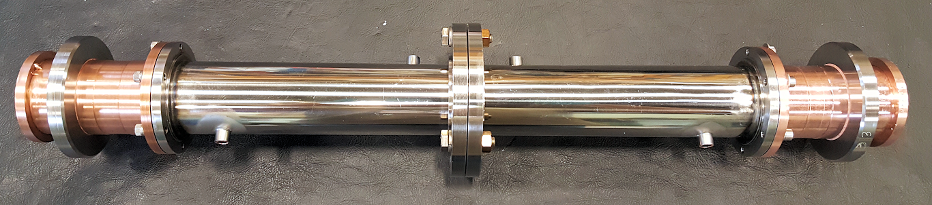
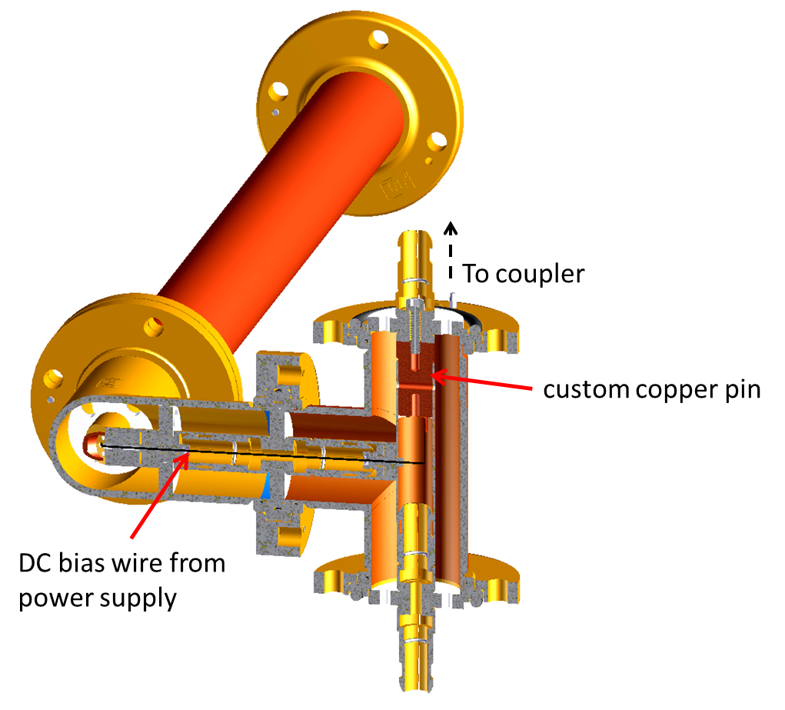
HWR Cavity Processing and Couplers
1st of the Final 3 HWRs
Being Prepared for Testing
70K to R.T. Coupler Transitions: Final coupler parts.
Bias Tee preliminary testing = finished. Building prototype now.

