Slide 1
72 Hour Weekend Summary
Michael Wesley
Monday 09:00 Meeting
January 23, 2016

Slide 2
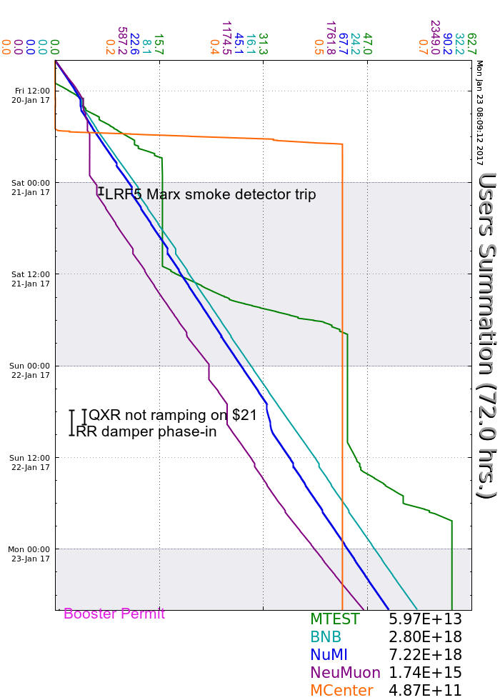
Friday
LRF5 Marx modulator smoke detector
$E9/$E3 RR LLRF errors
Beam to MCenter
Saturday
MI20 LCW temp regulation issues
MKS06 LL fan faults
Sunday
RR LLRF slipstacking failure
Issues w/ new damper
QXR is missing events
$39 doesn’t go out with $21
Misc. proton source nuisance trips
BRF sparking

Slide 3
Current Conditions
Beam to NuMI, BNB, & SeaQuest
~ 620 kW on NuMI target
2.5 Hz to BNB
1E12 to SeaQuest
Booster permit issues
Flaky input, fix should be transparent

