Slide 1
CMTF ICW Pipe Loop : - CMTF Cryomodule ceases running on Feb. 17 - CMTF Campus ICW service off line on Feb. 23
Delivered CMTF Pump Station
Dec. 29 – Start up scheduled for Feb. 23
Communication Line to be completed early Feb.
ICW Intake & Discharge Piping Tie in Completed
Pump Station power Connection to switch at NML To be completed early In Feb.

Slide 2
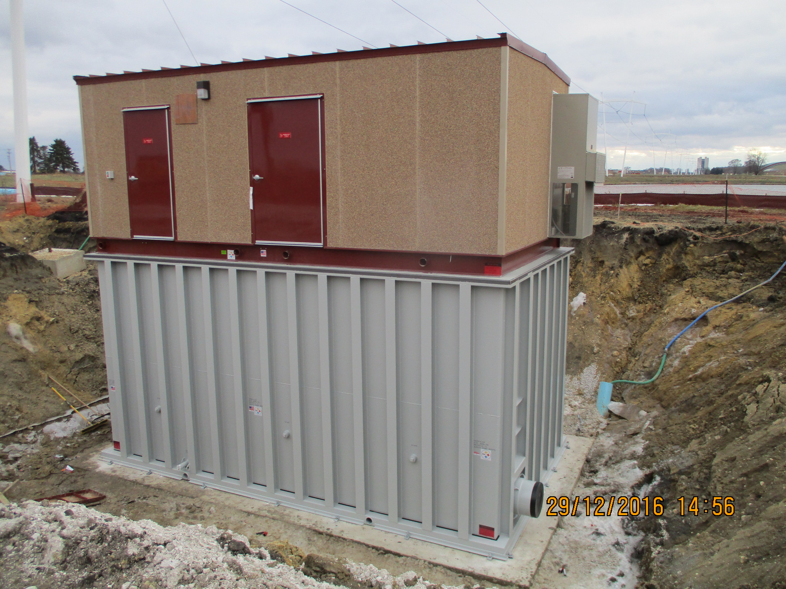
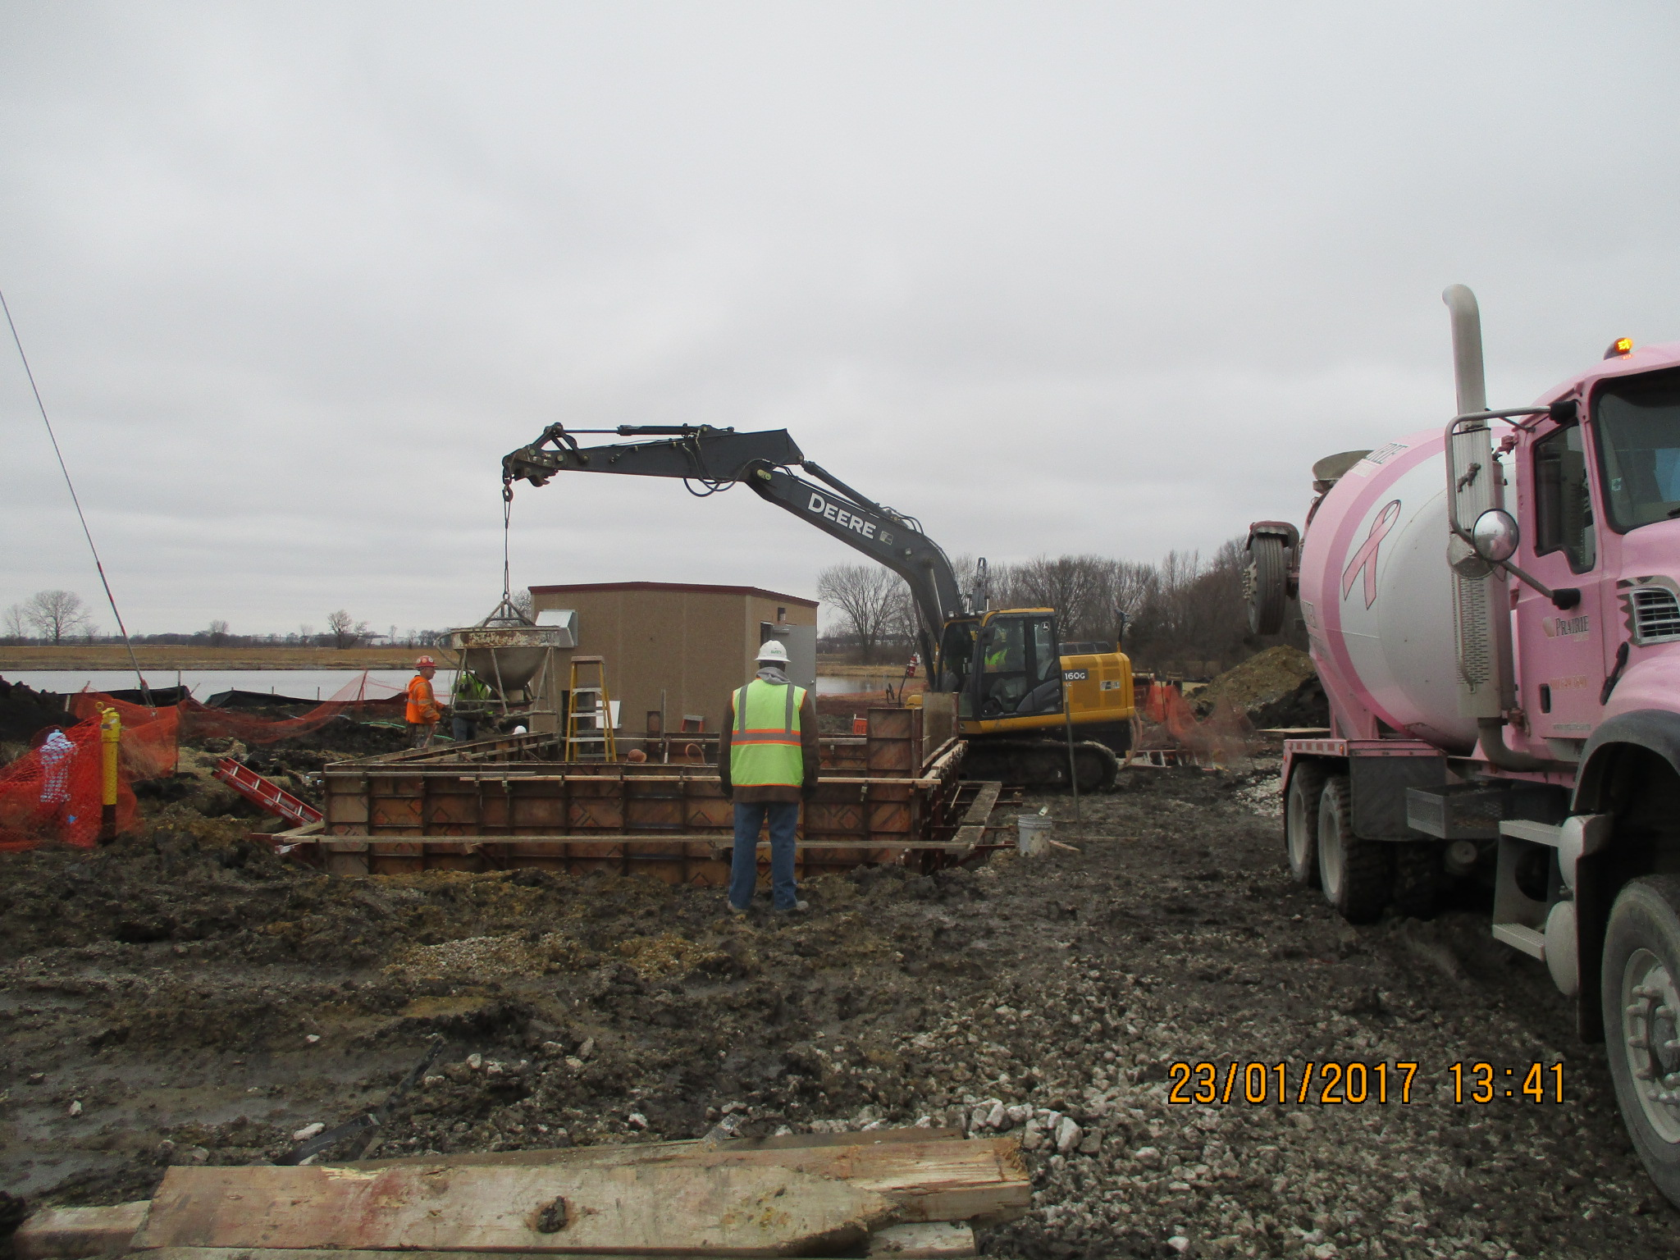
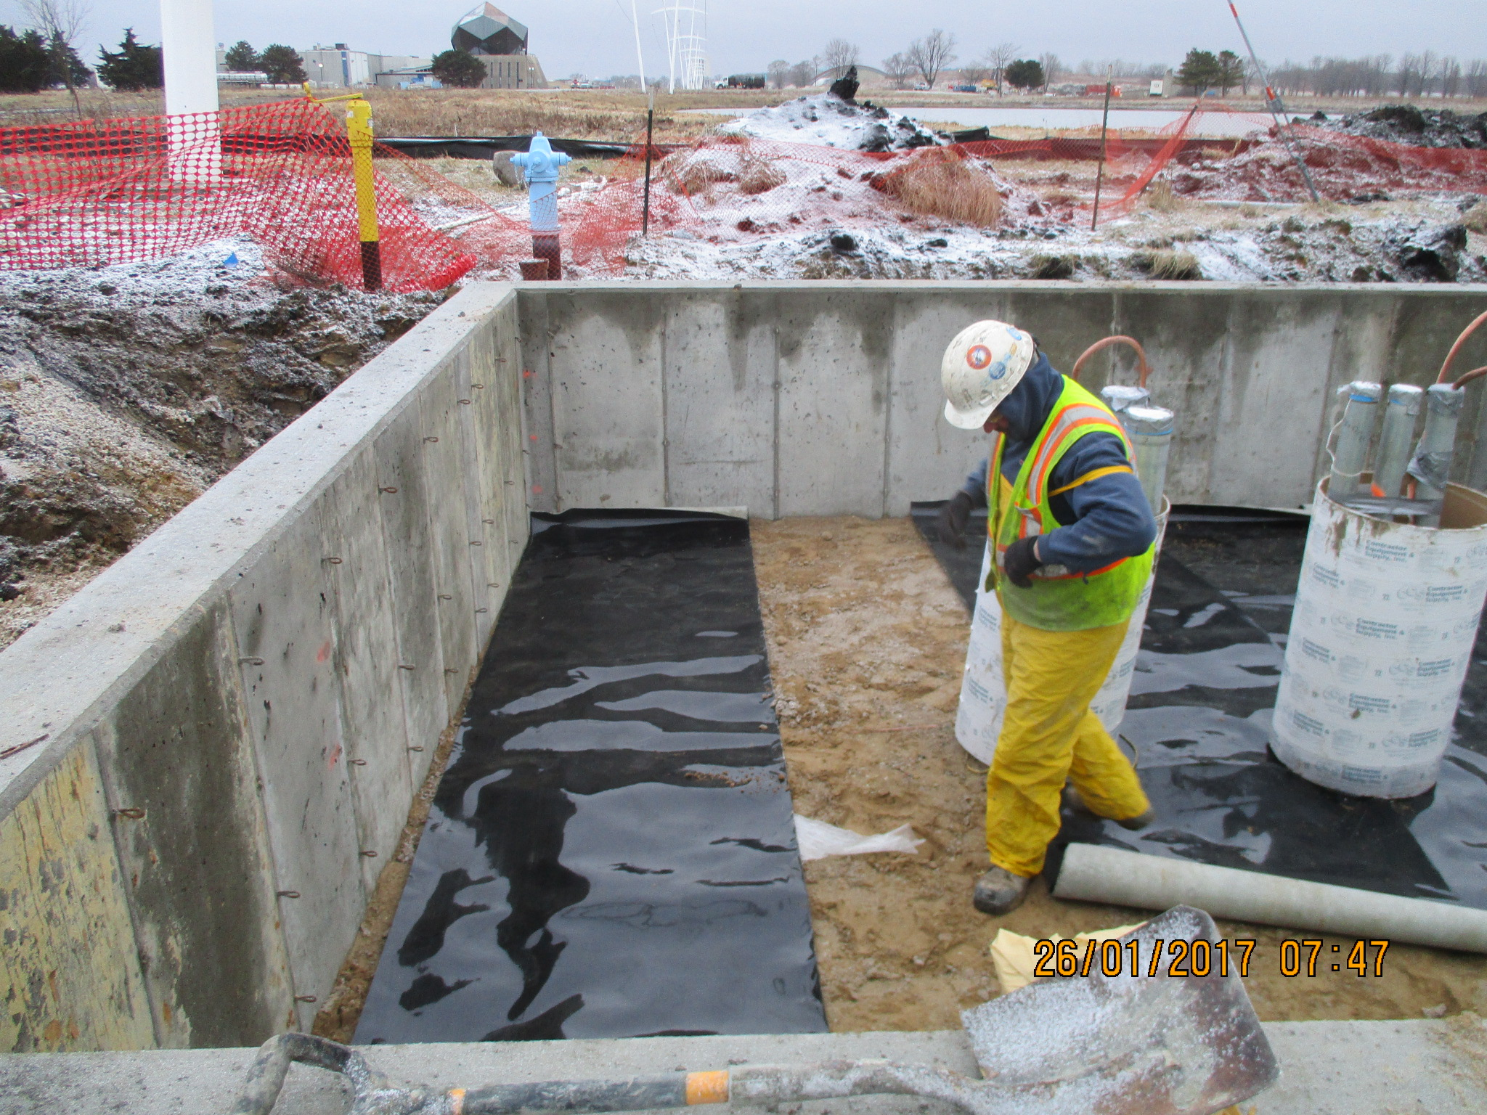
CMTF Pump House Installation

Slide 3
Swan Lake Construction Activities
Swan Lake Pump House vault complete : Pump house delivery March 2017
Pine St.
Pine St
Road A-2
Road D
Outbound Pine St Closing - March 2017
Road D

Slide 4
ICW Reduction and Demolition Work at Casey’s Pond

Slide 5
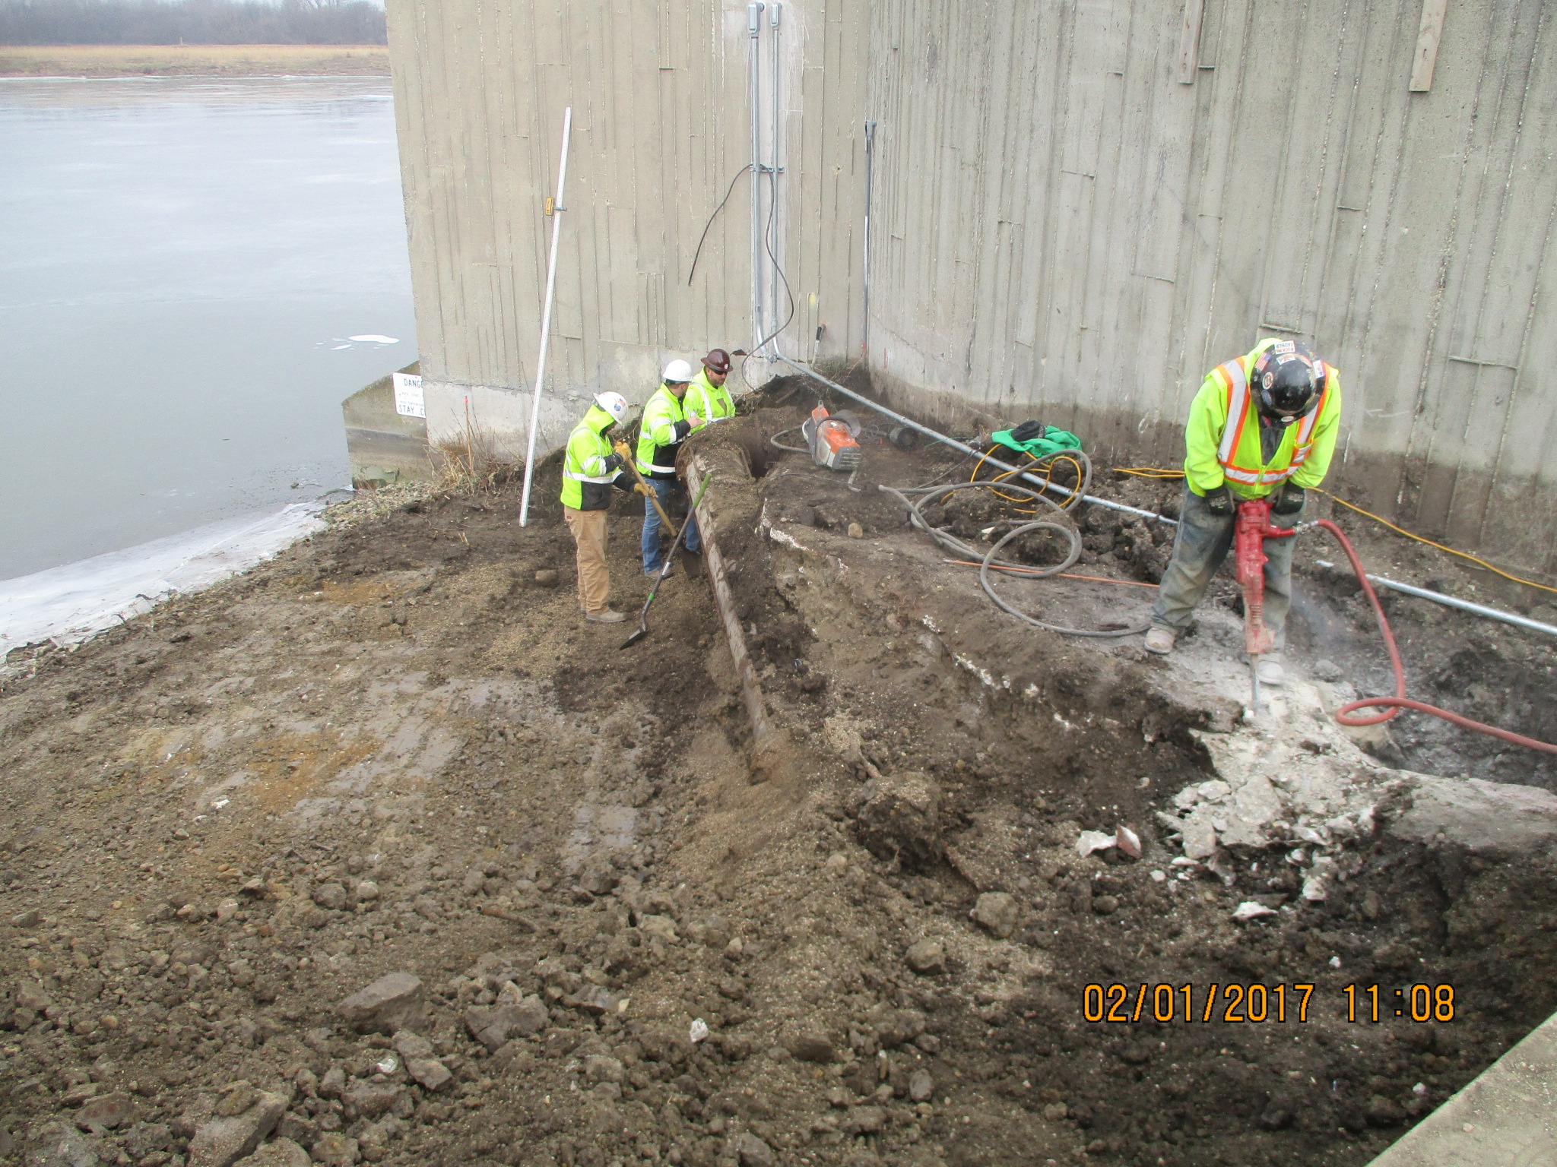
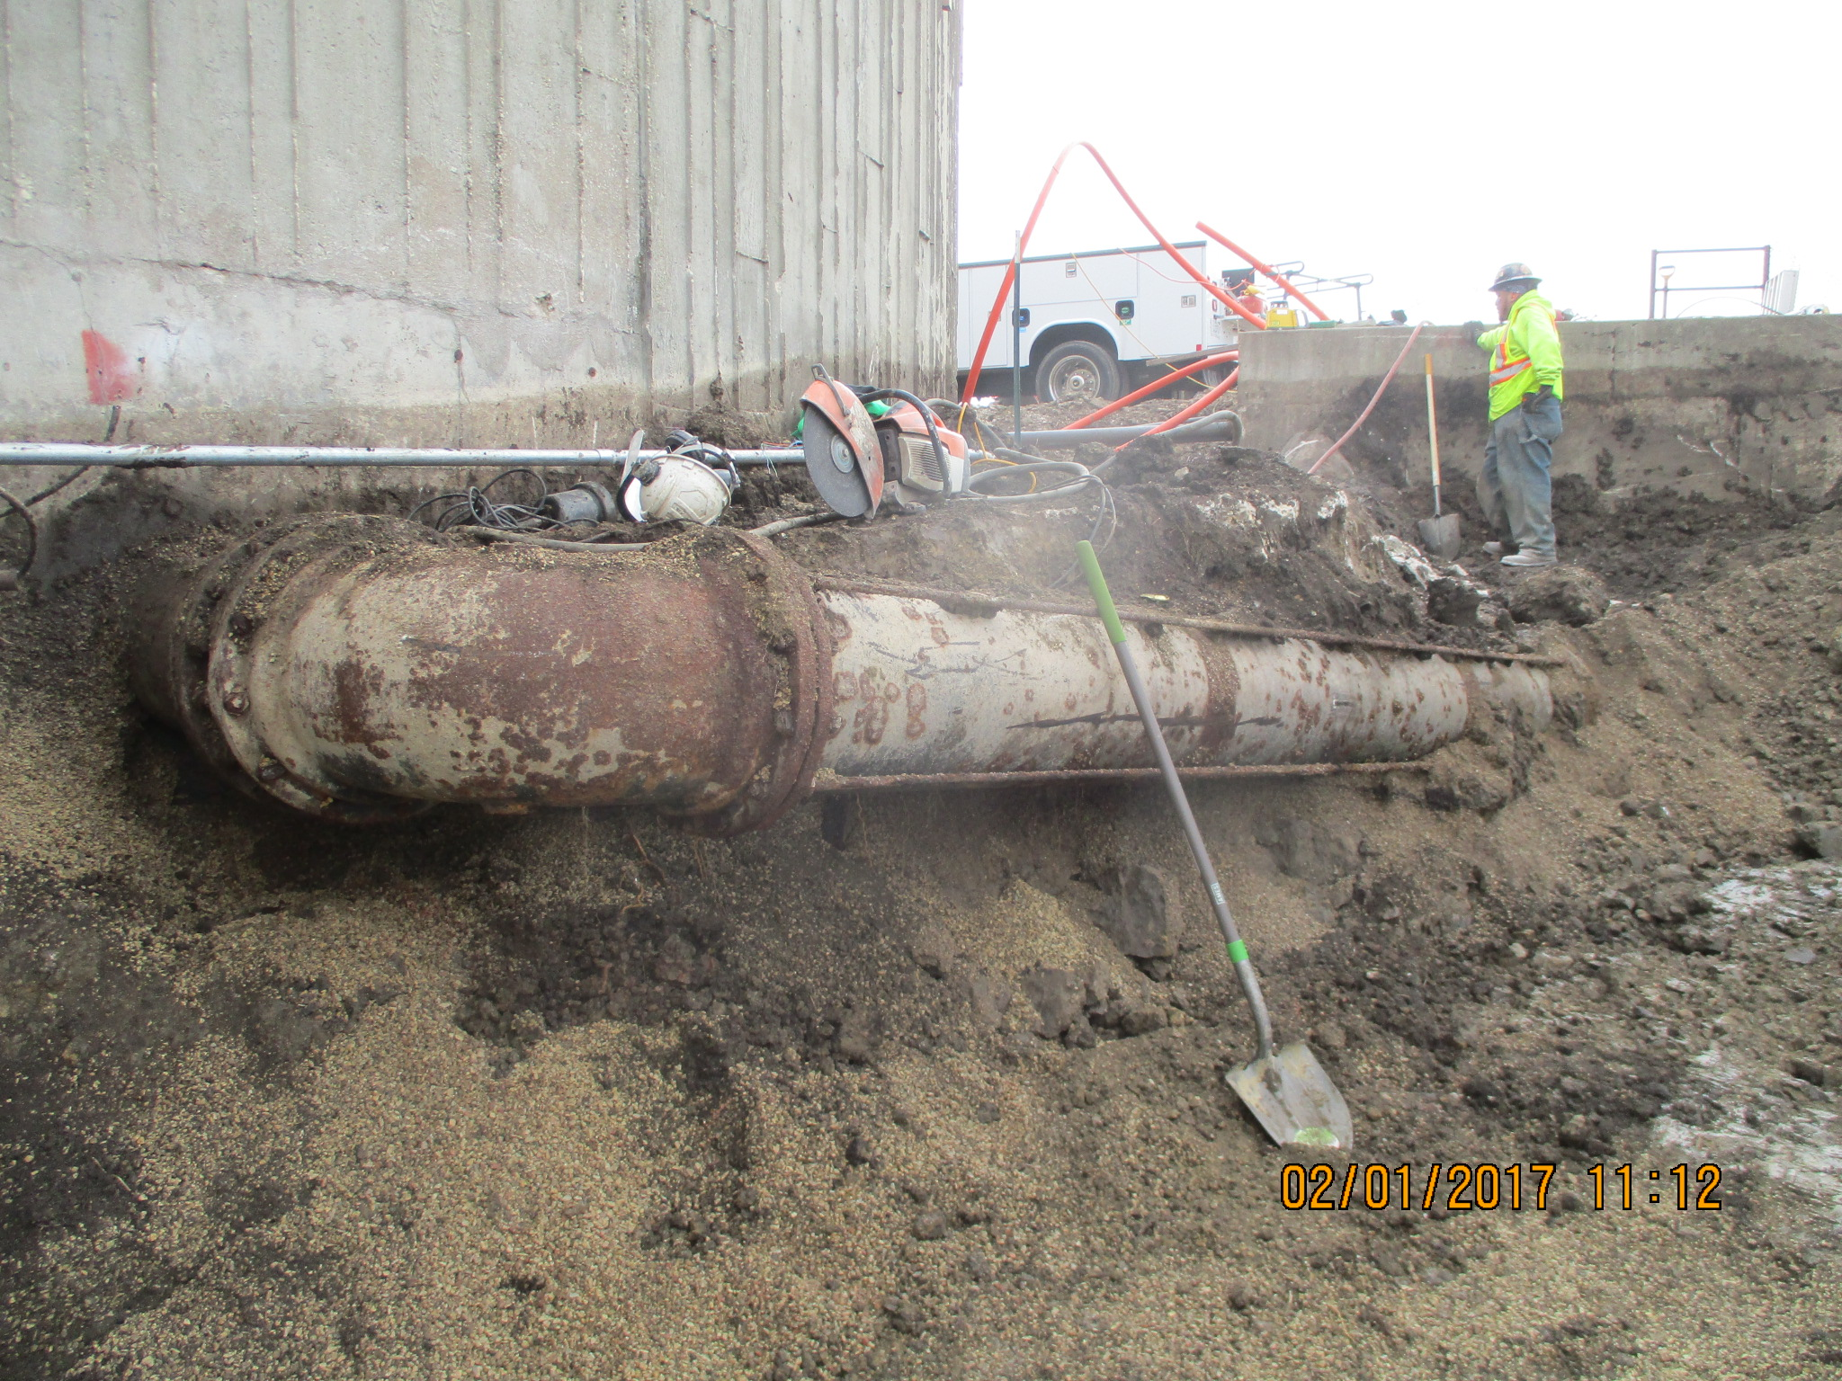
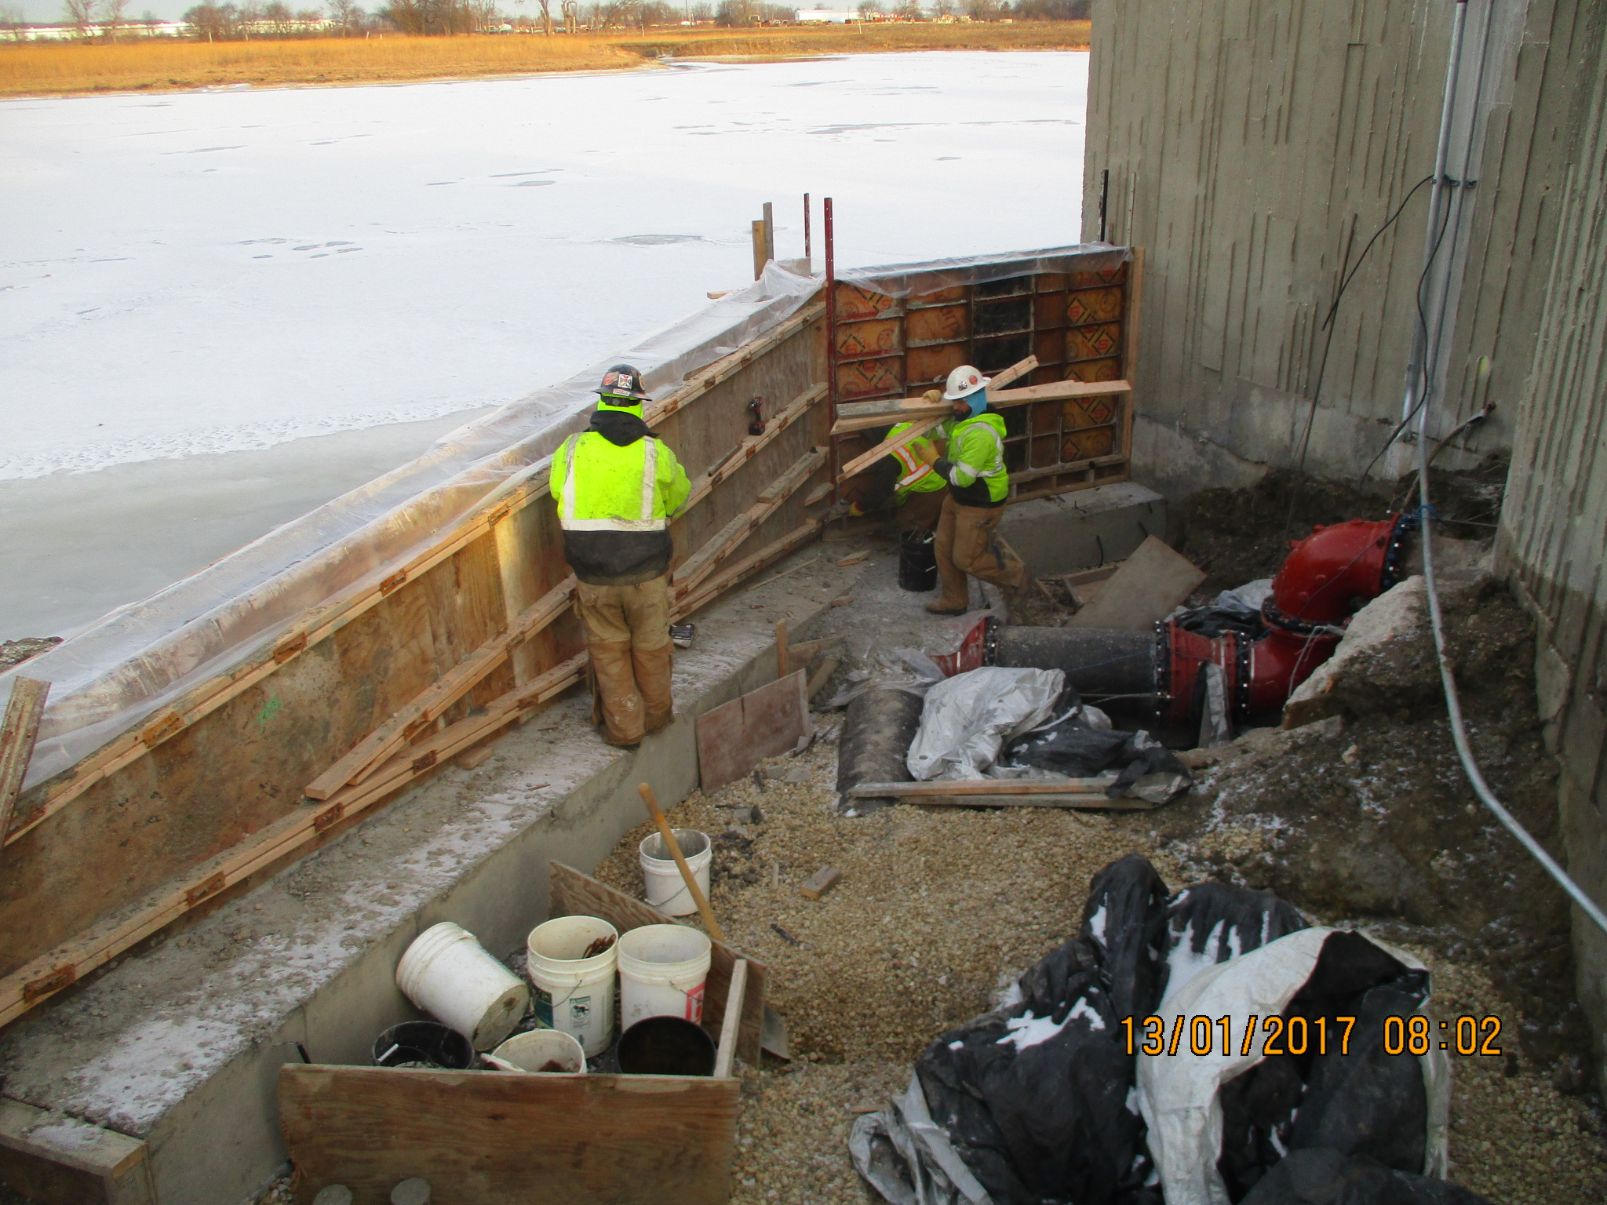
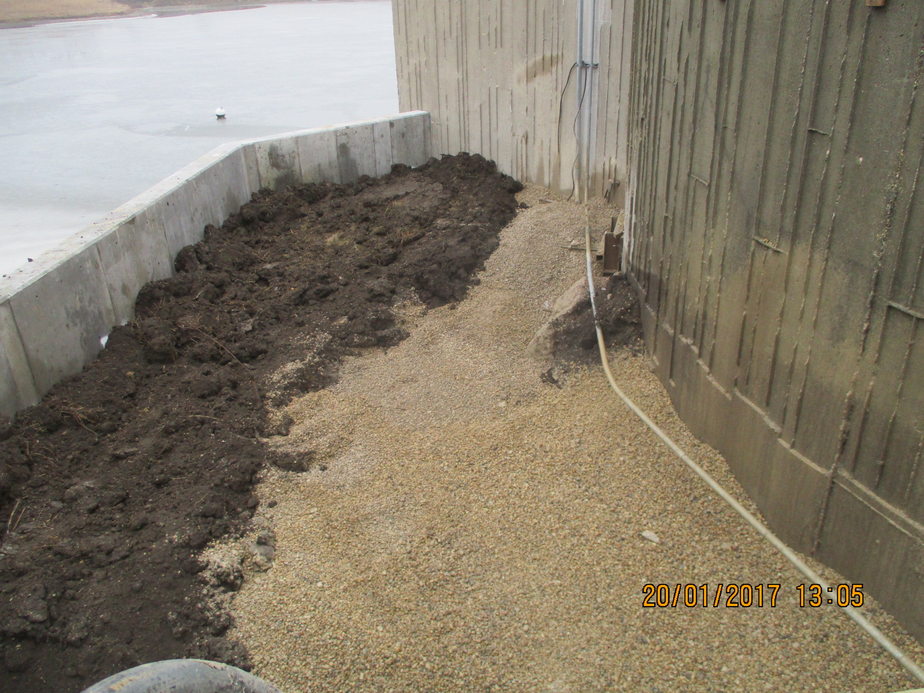
ICW Reduction – Demolition & Installation of new Discharge Piping at Casey’s Pond – Completed Jan. 3 - Jan. 20
Demoliton of Discharge Piping / Com. & Power Duct Bank
Installation of New Discharge Piping & Retaining Wall
ICW Backbone Piping Project – Completion Date: Sept. 2017

Slide 6
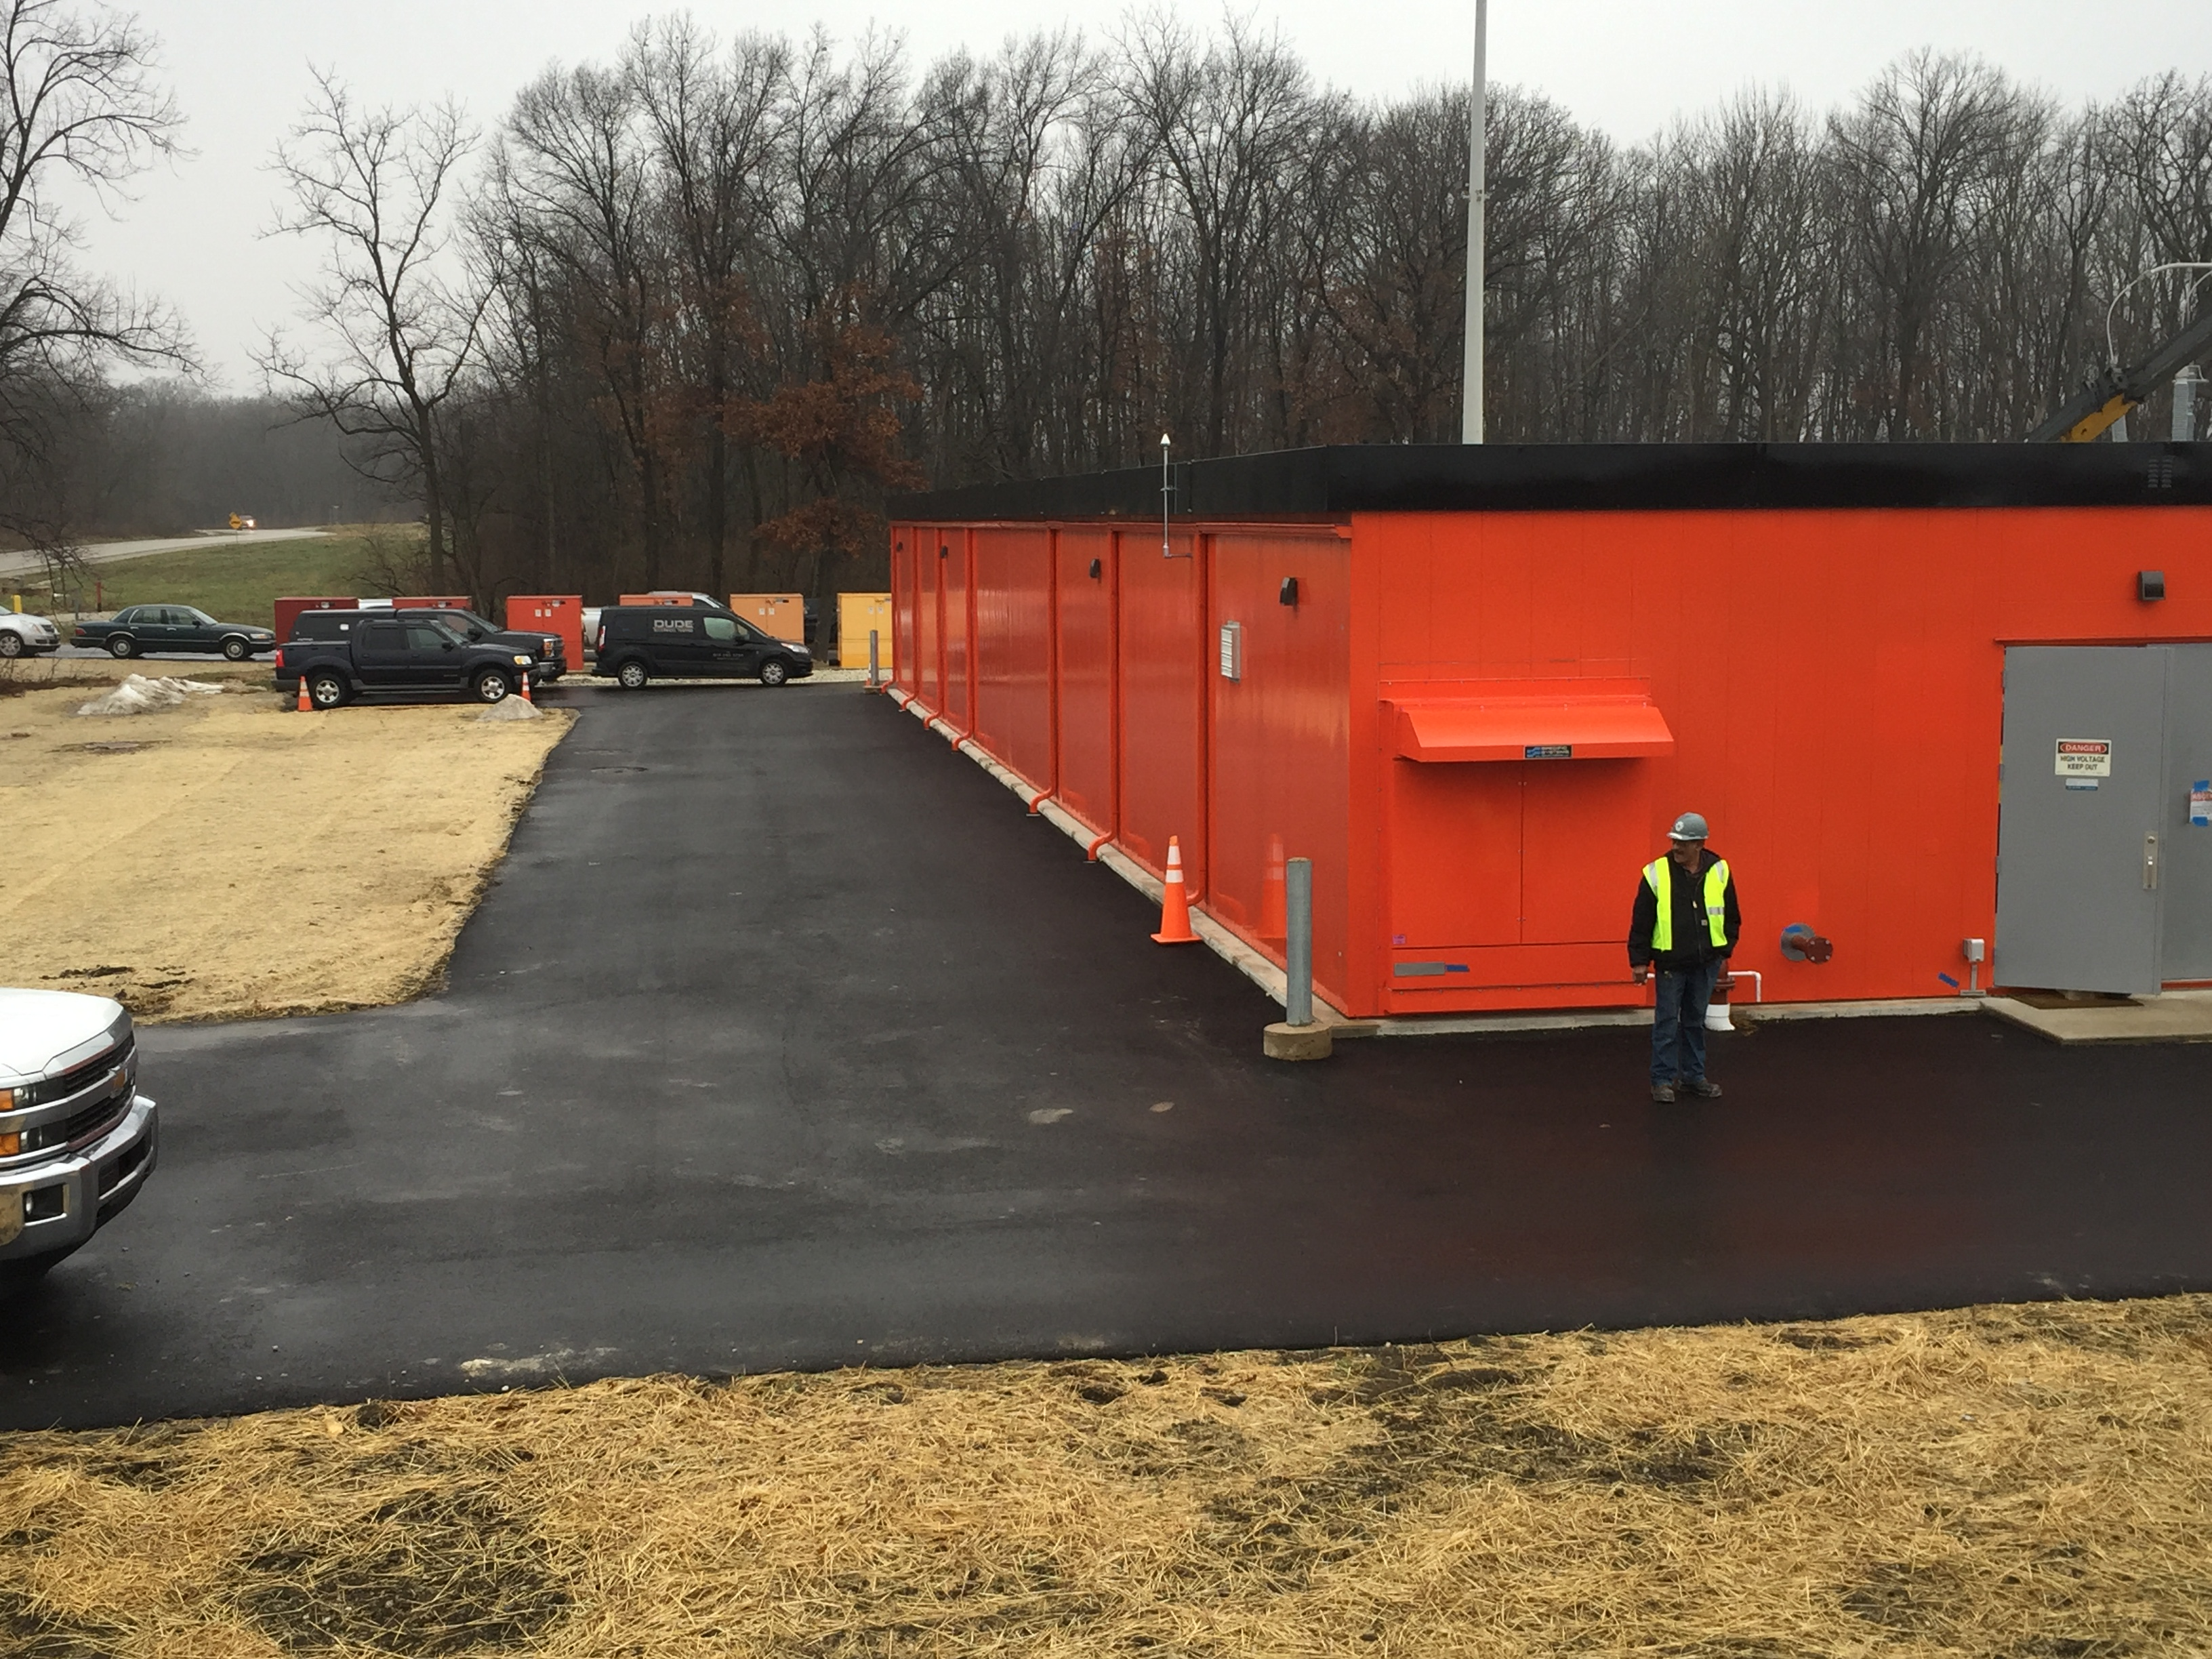
Master Substation Construction Progress

Slide 7
Master Substation – Meade / ABB / Com Ed - Installation
Energization with Com Ed Completed – Jan. 13, 2017
Energized to 345 KV End of Line Breaker: CB 120
HV Testing in progress
Troubleshooting Controls
Switchgear inside Control Bldg.
Transformers
Switchyard Equipment
Overhead 345 KV lines scheduled to be energized : Week of Feb. 13.
Facilities Management coordinating Feeder in-service dates
Meade - MSS Project Completion Date: March 2017

